Slide 1
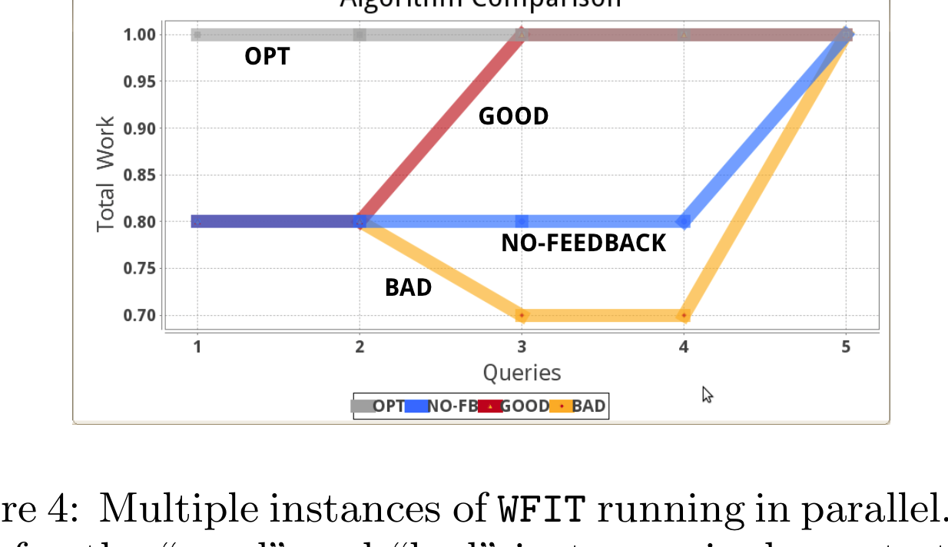
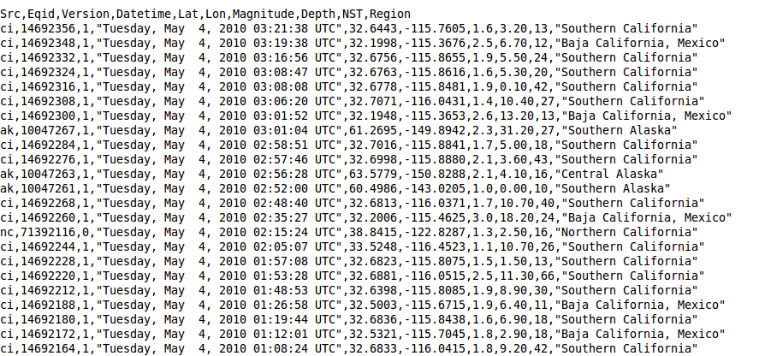
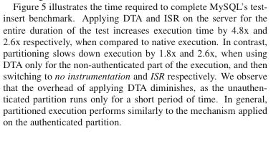
Experiment Goal: Show that my
algorithm/system/etc. is better than
the state-of-the-art.
Figure
Raw data
Means of Experiment
Observations

