Slide 1
Tackling the Reproducibility Problem in Systems Research with Declarative Experiment Specifications
Ivo Jimenez, Carlos Maltzahn (UCSC)
Adam Moody, Kathryn Mohror (LLNL)
Jay Lofstead (Sandia)
Andrea Arpaci-Dusseau, Remzi Arpaci-Dusseau (UW)

Slide 2
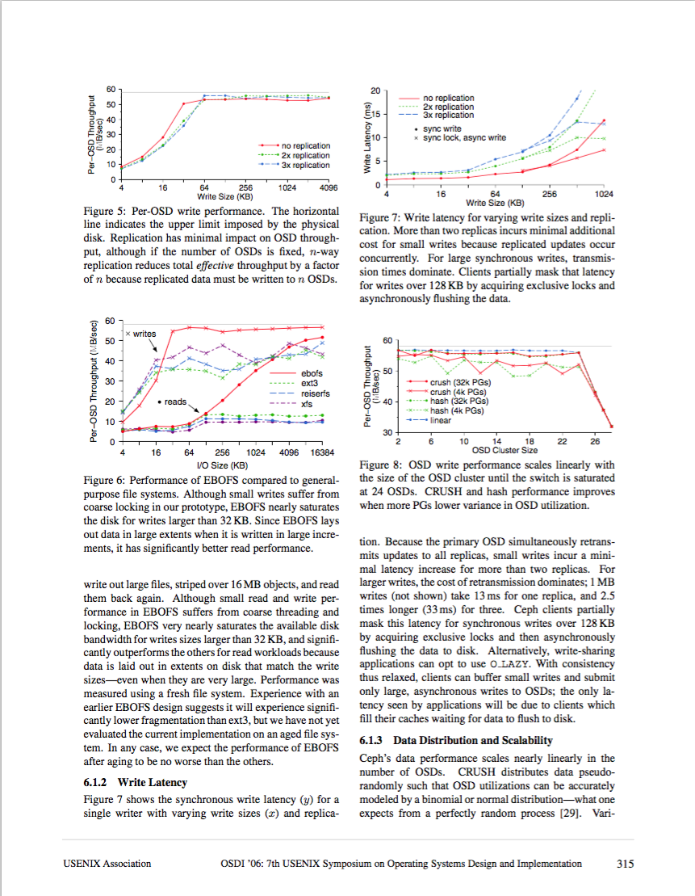
The Reproducibility Problem
Network
Disks
BIOS
OS conf.
Magic numbers
Workload
Jitter
etc...
140
Reproduced?
120
Original
100
Throughput (MB/s)
80
60
40
20
1 2 3 4 5 6 7 8 9 10 11 12 13
Cluster size
Notes:
We can try to deal with the issues of finding the root cause of irreproducibility
But that is a rabbit hole, it quickly becomes infeasable
Just think about the combinatorial explosion in all the possible ways in which the experiment might have failed
Instead, we take a step back and try to define a methodology that can be used by researchers in order to facilitate the validation of experimental results

Slide 3
Outline
Re-execution vs. validation
Declarative Experiment Specification (ESF)
Case Studies
Benefits & Challenges

Slide 4
Outline
Re-execution vs. validation
Declarative Experiment Specification (ESF)
Case Studies
Benefits & Challenges

Slide 5
Reproducibility Workflow
Re-execute experiment
Recreate original setup, re-execute experiments
Technical task
Validation of results
Compare against original
A subjective task
How do we express the validation criteria?
Can we provide contextual information?
Notes:
The main point we try to address in our work is that we don’t have ways of automating the validation of results.
While the re-execution can be automated.
In fact, a lot of the cloud computing world is focused in making this as easy as posible.
“push-button” deployment and execution of data/sienctific workflows
So in our work, we try to address #2
Our goal is to come up with ways to remove the subjectiveness of experimental result validation
In order to do so, we take a step back and look at what are the common tasks that a researcher goes through.

Slide 6
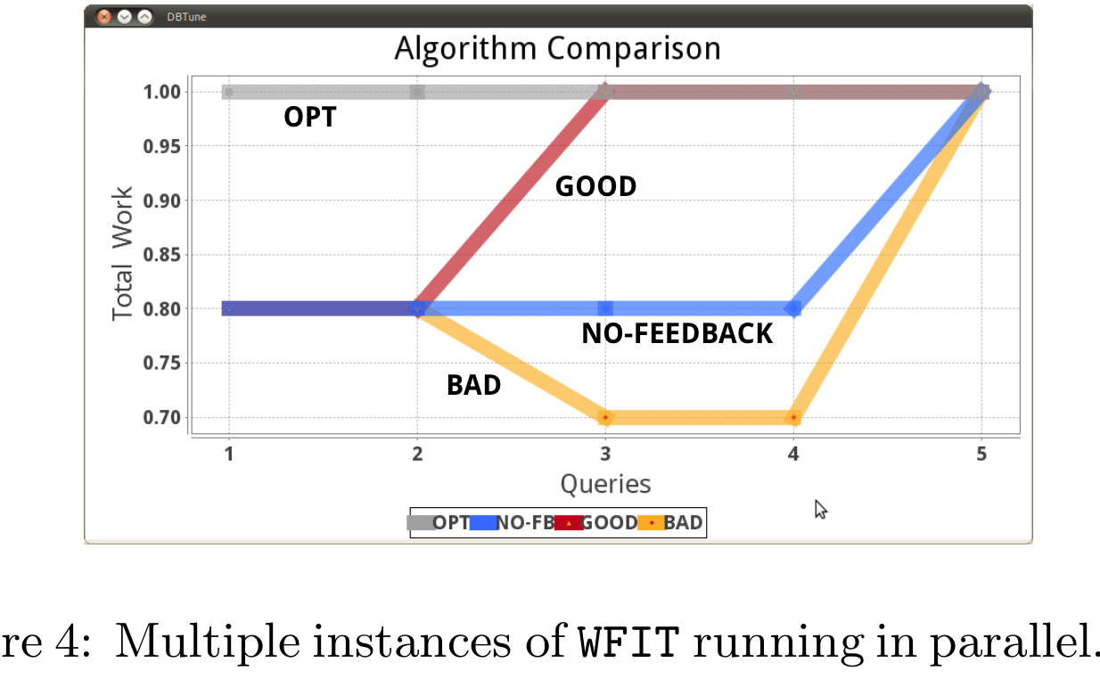
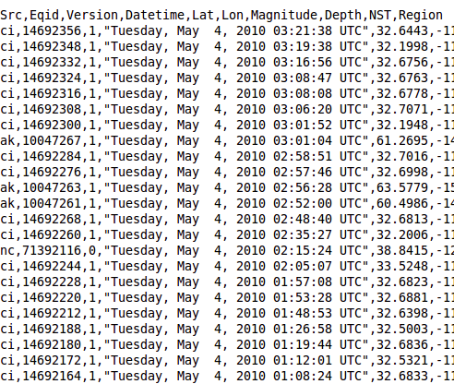
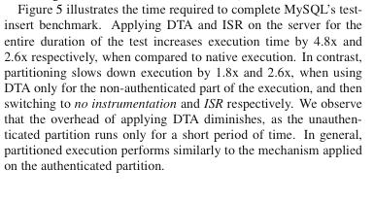
Need a piece of information
that describes the relationship between these
Figure
Experiment Goal: Show that my
algorithm/system/etc. is better than
the state-of-the-art.
Raw data
Means of Experiment
libs
data
code,
workload
OS
Observations
hardware
Notes:
So we would like to define a methodology that embodies this high-level steps.

Slide 7
Outline
Re-execution vs. validation
Declarative Experiment Specification (ESF)
Case Studies
Benefits & Challenges

Slide 8
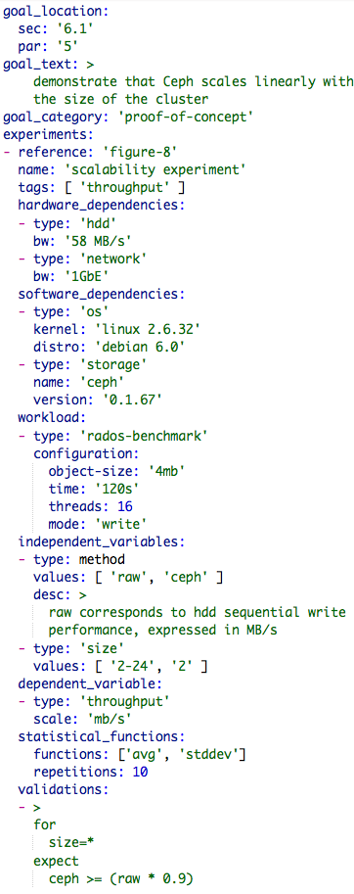
Experiment Goal: Show that my
algorithm/system/etc. is better than the state-of-the-art.
Means of Experiment
Notes:
Specifies the goal of the experiment and optionally points to where this is addressed in an article.
Describes the means of the experiments (OS, Hardware, Software, Workload, Configuration)
Defines the schema of the raw output data and any post-processing done to it
Describes the relationship between independent and dependent variables. In other words, a declarative description of the observations that validate the claims

Slide 9
Validation Language Syntax
validation
: 'for' condition ('and' condition)* 'expect' result ('and' result)*
;
condition
: vars ('in' range | ('=' | '<' | '>' | '!=') value)
;
result
: condition
;
vars
: var (',' var)*
;
range
: '[' range_num (',' range_num)* ']'
;
range_num
: NUMBER '-' NUMBER | '*'
;
value
: '*' | 'NUMBER (',' NUMBER)*
;
Notes:
Missing the grammar specification for ‘between’ and ‘?’... And many others that I might find while analyzing more papers

Slide 10
Outline
Re-execution vs. validation
Declarative Experiment Specification (ESF)
Case Studies
Benefits & Challenges

Slide 11
Ceph OSDI ‘06
Select scalability experiment.
Distributed; makes use of all resources.
Scaled-down version of original.
1 client node instead of 20
Experiment goal: system scales linearly.
This is the reproducibility criteria.
Notes:
We took an empirical approach....
Ceph distributed storage system. Object-storage system.
Why this experiment? We have the ideal conditions to reproduce it: same hardware, contextual information, access to original author.

Slide 12
Ceph OSDI ’06 Scalability Experiment
Schema of Experiment Output Data
Validation Statement
"independent_variables": [{
"type": “cluster_size”,
"values": “2-28”
}],
"dependent_variable": {
"type": "throughput",
"scale": "mb/s"
},
"independent_variables": [{
"type": “cluster_size”,
"values": “2-28”
},{
"type": "method",
"values": ["raw", "ceph"]
}],
"dependent_variable": {
"type": "throughput",
"scale": "mb/s"
},
"independent_variables": [{
"type": “cluster_size”,
"values": “2-28”
},{
"type": "method",
"values": ["raw", "ceph"]
}],
"dependent_variable": {
"type": "throughput",
"scale": "mb/s"
},
"independent_variables": [{
"type": “cluster_size”,
"values": “2-28”
}, {
"type": "method",
"values": ["raw", "ceph"]
},{
"type": ”net_saturated",
"values": [”true", ”false"]
}],
"dependent_variable": {
"type": "throughput",
"scale": "mb/s"
},
for
cluster_size <= 24
expect
ceph >= 55 mb/s
for
cluster_size <= 24
expect
ceph >= (raw * .90)
for
cluster_size <= 24
expect
ceph >= (raw * .90)
for
cluster_size <= 24
expect
ceph >= 55 mb/s
for
cluster_size <= 24
expect
ceph >= (raw * .90)
for
cluster_size = * and
not net_saturated
expect
ceph >= (raw * .90)
60
50
Per-OSD Average
Throughput (MB/s)
40
30
2 6 10 14 18 22 26
Cluster size
Notes:
trans: would a description like this work? We actually re-executed the experiments on a different experimental setup

Slide 13
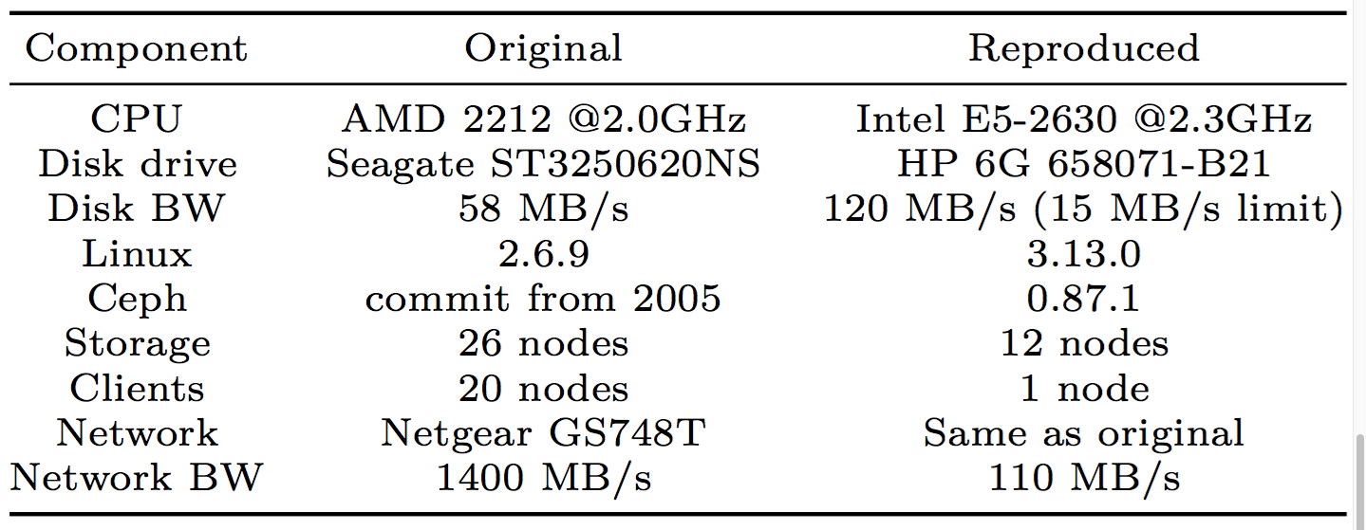

Slide 14
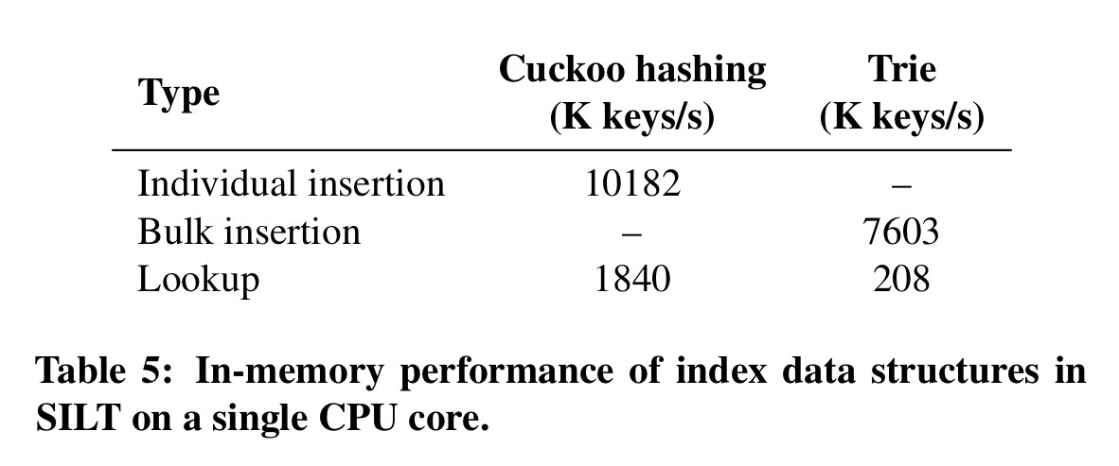
Experiment Goal
SILT SOSP ‘11
Schema
Validations
{
"type": ”method”,
"values": [“raw”, "cuckoo", "trie"]
},
{
"type": "workload",
"values": [
"individual", "bulk", "lookup”
]
},
"dependent_variable": {
"type": "throughput",
"scale": ”bytes/second"
}
The high random read speed of flash drives means that the CPU budget available for each index operation is relatively limited. This microbenchmark demonstrates that SILT’s indexes meet their design goal of computation-efficient indexing.
for
workload=*
expect
cuckoo > raw and trie > raw
for
lookup
expect
cuckoo > trie
and
for
individual and bulk
expect
cuckoo > trie

Slide 15
Benefits & Challenges

Slide 16
Why care about Reproducibility?
Good enough is not an excuse
We can always improve the state of our practice
How do we compare hardware/software in a scientific way?
Experimental Cloud Infrastructure
PRObE / CloudLab / Chameleon
Having reproducible / validated experiments would represent a significant step toward embodying the scientific method as a core component of these infrastructures

Slide 17
Benefits of ESF-based methodology
Brings falsibiability to our field
Statements can be proven false
Automate validation
Validation becomes an objective task

Slide 18
Validation Workflow
Obtain/recreate
means of experiment.
Re-run and check validation clauses against output. Any validation failed?
Original work findings are corroborated
no
Any significant differences between original and recreated means?
yes
yes
Update means of experiment
Cannot validate original claims
no

Slide 19
Benefits of ESF-based methodology
Brings falsibiability to our field
Statements can be proven false
Automate validation
Validation becomes an objective task
Usability
We all do this anyway, albeit in an ad-hoc way
Integrate into existing infrastructure
Notes:
Link usability with the scientific method. Mention that it would be ideal if you write your hypothesis first

Slide 20









Integration with Existing Infrastructure
pull
push code
and
ESF
push code
Test:
- Unit
- Integration
- Validations
Test:
- Unit
- Integration

Slide 21
Challenges
Bottlenecks “move”
Include sanity checks as part of experiment
Example: corroborate that network/disk observes expected behavior
Binary reproducibility
Example: GCC’s flags, 10⁸⁰⁶ combinations
Solution: provide image of complete software stack (e.g. linux containers)

Slide 22
Early Feedback
Creating an ESF helps to:
Find meaningful/reproducible baselines
Create a feedback loop in author’s mind
Specify exactly what author means
Make temporal context explicit

Slide 23
Conclusion
ESFs:
Embody all components of an experiment
Enable automation of result validation
Brings us closer to the scientific method
Our ideal future:
Don’t write the experimental section of an article
Write ESFs instead to express your hypothesis
Let a tool write it by consuming ESFs
https://github.com/systemslab/esf

Slide 24
Thanks!
Notes:
Peter:
Talk less about falsibiability, add more examples.
Can we write experimental sections in a very high level
I’m describing a methodology for specifying experiments, which has the following implications:
Reproducibility
Validation
Falsifiability
The methodology is the main contribution, that has all of the above.
-------------
Shel:
Reproducibility
Falsibiability
Testability
Causality
Cleanup which ones we are talking about. Reproducibility or validation.
-----------
Ike:
If you really want to get people’s attention, list famous, unambigous cases:
Cold fusion
Systems experiments (can we have some?)
Carlos:
For storage to work, its correctness has to be perfect
You can survive a crash, but not if you lose data

Slide 25
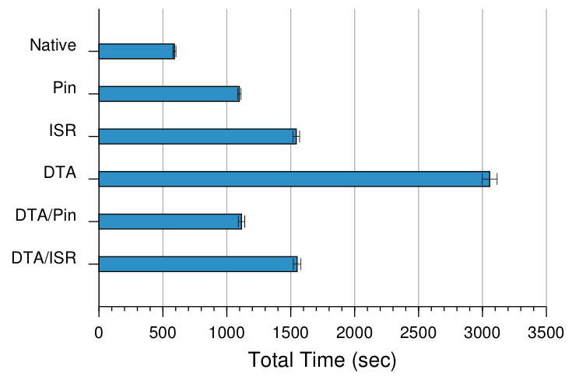
Geneiatakis et. al. CCS ‘12

Slide 26
Experiment Goal
In this section, our goal is to evaluate the performance benefits that can be reaped, by utilizing virtual partitioning to apply otherwise expensive protection mechanisms on the most exposed part of applications. This allows us to strike a balance between the overhead imposed on the application and its exposure to attacks.

Slide 27
Experiment Goal
In this section, our goal is to evaluate the performance benefits that can be reaped, by utilizing virtual partitioning to apply otherwise expensive protection mechanisms on the most exposed part of applications. This allows us to strike a balance between the overhead imposed on the application and its exposure to attacks.
Notes:
In other words, to show that when partitioning operations in 2 and applying distinct protection mechanisms for each, there is a benefit to be gained.

Slide 28
Schema
Notes:
By schema we mean the description of the dependent and independent variables that are being used in the experiment.

Slide 29
Schema
"independent_variables": [
{
"type": ”method",
"alias": [”technique”],
"values": [
“native", “pin", “isr”, “dta”,
“dta_pin”, “dta_isr”
]
}
],
"dependent_variable": {
"type": ”runtime",
"scale": “s"
},

Slide 30
Validations
"independent_variables": [
{
"type": ”method",
"alias": [”technique”],
"values": [
“native", “pin", “isr”, “dta”,
“dta_pin”, “dta_isr”
]
}
],
"dependent_variable": {
"type": ”runtime",
"scale": “s"
},

Slide 31
Validations
"independent_variables": [
{
"type": ”method",
"alias": [”technique”],
"values": [
“native", “pin", “isr”, “dta”,
“dta_pin”, “dta_isr”
]
}
],
"dependent_variable": {
"type": ”runtime",
"scale": “s"
},
expect
native < any

Slide 32
Validations
"independent_variables": [
{
"type": ”method",
"alias": [”technique”],
"values": [
“native", “pin", “isr”, “dta”,
“dta_pin”, “dta_isr”
]
}
],
"dependent_variable": {
"type": ”runtime",
"scale": “s"
},
expect
native < any and

Slide 33
Validations
"independent_variables": [
{
"type": ”method",
"alias": [”technique”],
"values": [
“native", “pin", “isr”, “dta”,
“dta_pin”, “dta_isr”
]
}
],
"dependent_variable": {
"type": ”runtime",
"scale": “s"
},
expect
native < any and
dta_pin between pin and isr

Slide 34
Validations
"independent_variables": [
{
"type": ”method",
"alias": [”technique”],
"values": [
“native", “pin", “isr”, “dta”,
“dta_pin”, “dta_isr”
]
}
],
"dependent_variable": {
"type": ”runtime",
"scale": “s"
},
expect
native < any and
dta_pin between pin and isr and

Slide 35
Validations
"independent_variables": [
{
"type": ”method",
"alias": [”technique”],
"values": [
“native", “pin", “isr”, “dta”,
“dta_pin”, “dta_isr”
]
}
],
"dependent_variable": {
"type": ”runtime",
"scale": “s"
},
expect
native < any and
dta_pin between pin and isr and
dta_isr between isr and dta

Slide 36
Example 2

Slide 37
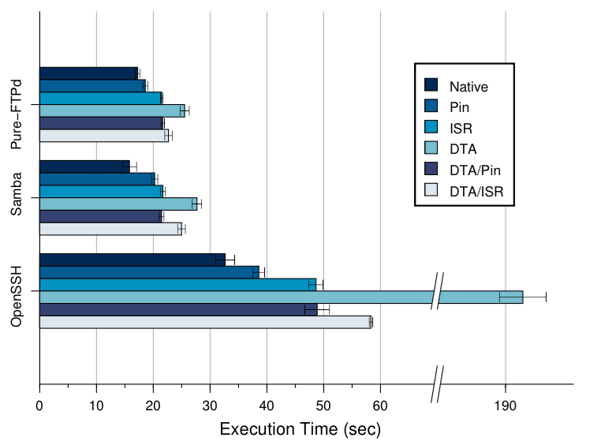
Example 2
Notes:
Similar goals as previous

Slide 38
Schema
"independent_variables": [
{
"type": ”method",
"values": [
“native", “pin", “isr”, “dta”,
“dta_pin”, “dta_isr”
]
}
],
"dependent_variable": {
"type": ”runtime",
"scale": “s"
},

Slide 39
Schema
"independent_variables": [
{
"type": ”method”,
"values": [
“native", “pin", “isr”, “dta”,
“dta_pin”, “dta_isr”
]
},
{
"type": ”workload”,
"values": [“ftp", “samba", “ssh”]
}
],
"dependent_variable": {
"type": ”runtime",
"scale": “s"
},
Notes:
We can have more than one independent variable

Slide 40
Validations
"independent_variables": [
{
"type": ”method”,
"values": [
“native", “pin", “isr”, “dta”,
“dta_pin”, “dta_isr”
]
},
{
"type": ”workload”,
"values": [“ftp", “samba", “ssh”]
}
],
"dependent_variable": {
"type": ”runtime",
"scale": “s"
},
for
workload=*
expect
native < any and
dta_pin between pin and isr and
dta_isr between isr and dta

Slide 41
Example 3

Slide 42
SILT SOSP ‘11

Slide 43
SILT SOSP ‘11

Slide 44
Experiment Goal
The high random read speed of flash drives means that the CPU budget available for each index operation is relatively limited. This microbenchmark demonstrates that SILT’s indexes meet their design goal of computation-efficient indexing.

Slide 45
Schema
{
"type": ”method”,
"values": [“raw”, "cuckoo", "trie"]
},
{
"type": "workload",
"values": [
"individual", "bulk", "lookup”
]
},
"dependent_variable": {
"type": "throughput",
"scale": ”bytes/second"
}

Slide 46
Validations
{
"type": ”method”,
"values": [“raw”, "cuckoo", "trie"]
},
{
"type": "workload",
"values": [
"individual", "bulk", "lookup”
]
},
"dependent_variable": {
"type": "throughput",
"scale": ”bytes/second"
}
for
workload=*
expect
cuckoo > raw and trie > raw
for
lookup
expect
cuckoo > trie
and
for
individual and bulk
expect
cuckoo > trie

Slide 47
Falsifiability in Science
Falsibiability of a statement, hypothesis, or theory is an inherent possibility to prove it to be false.
In other words, the ability to specify the conditions under which a statement is false
Synonymous to Testability
Example:
Statement: All swans are white
Falsifiable: Observe one black swan
source: en.wikipedia.org/wiki/Falsifiability
Notes:
If it is possible to conceive an observation or an argument which proves the statement in question to be false, then it is falsifiable.
Notice what we mean; being able to not "to commit fraud" but "show to be false".

Slide 48
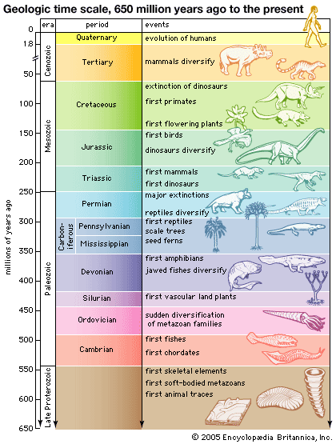
Notes:
For example, the Theory of evolution is falsibiable
As you all know, we can map the geological timeline to the geological layers of the earth
We can prove that the theory is false by finding the fosil record of an advanced species in a layer that doesn’t correspond to it
For example, if we can find the fosil record of a rabbit in the precambrian era

Slide 49
Falsifiability in Systems
Figure
Experiment Goal: Show that my
algorithm/system/etc. is better than
the state-of-the-art.
Raw data
Means of Experiment
libs
data
code,
workload
OS
Observations
hardware

Slide 50
Falsifiability in Systems
To falsify a claim:
Describe the means of the experiments
Provide validation statements over the output data
Conditional statement:
if means are properly recreated
then validation statements should hold
Go from inert observations to falsifiable statements
From:
We observe that our system outperforms the alternatives
To:
Expect 25-30% performance improvement on hardware platform X, on workload Y, when configured like Z
Notes:
trans: so this is our goal for an experiment specification, we want to capture statements and falsify them

Slide 51
Usability
Creating ESFs represents little overhead
Researchers do this anyway
Provides useful template template/checklist
Makes it easier to follow the scientific method
Notes:
Point out that this is the scientific method casted to the way we do systems research

