Slide 1



























Code
Package
Execute
Data and
Metrics
Analyze/
Visualize
Manuscript
Input Data

Slide 2







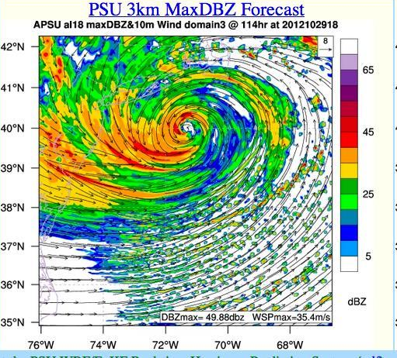
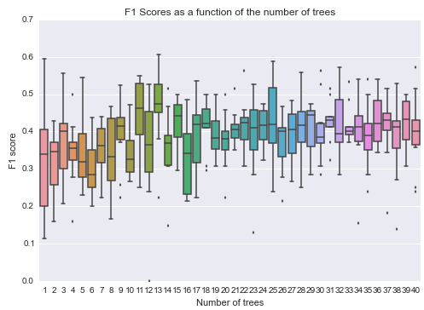
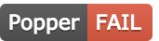


3
Run multi-node experiment on one of supported backends
2
Trigger execution
1
Commit change to experiment
Validate experiment results by testing codified assertions on output
PopperCI
5
Experiment generates output datasets or runtime metrics
4
6
Keep track of execution and associated status to the corresponding commit

