Slide 1
Characterizing and Reducing Cross-Platform Performance Variability Using OS-level Virtualization
Ivo Jimenez, Carlos Maltzahn (UCSC)
Adam Moody, Kathryn Mohror (LLNL)
Jay Lofstead (Sandia)
Andrea Arpaci-Dusseau, Remzi Arpaci-Dusseau (UW Madison)

Slide 2



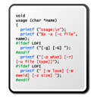
Performance Variability
…
benchmark
2500 op/s
2750 op/s
?
So many factors that influence performance: CPU, motherboard, RAM, network, wear level, etc..
Characterize, quantify and reduce variability
Notes:
It’s difficult to predict the performance of an application

Slide 3
Outline
Problem Definition.
Characterize performance of a machine.
Quantify variability across machines.
Reduce variability using containers.
Next steps.

Slide 4
The Problem
benchmark
2500 op/s
???? op/s
CPU-bound programs (ignore network and I/O).
single-node, single-threaded applications.
Uncontended scenarios.

Slide 5
Outline
Problem Definition.
Characterize performance of a machine.
Quantify variability across machines.
Reduce variability using containers.
Next steps.

Slide 6
Characterize a Machine’s Performance
CPU-bound benchmarks
benchmark A
benchmark B
2500 op/s
1300 op/s
benchmark C
590 op/s
…

Slide 7
Characterize a Machine’s Performance
Given a particular machine, opcode mix determines performance of an application.
Alternatives:
Generate all possible programs that exercise all possible combinations of the instruction set of a machine (e.g. 50/50 flops/ints vs 25/75 vs …).
Use an array of programs that exercise multiple CPU subsystems.

Slide 8

stress-ng
130 stressors that test multiple subsystems of a computer.
CPU, CPU cache, memory, network, disk and OS.
CPU stressor.
Loop a function for n seconds and report op/s.
More than 80 functions (called methods).
Idea: use this “spectrum” of CPU microbenchmarks to characterize the performance of a machine.

Slide 9
Performance Fingerprint of a Machine
CPU-bound stress-ng benchmarks
stressor 1
stressor 2
stressor | op/s
-----------------
ackerman | 530
matrix | 1343
int32 | 433
int64 | 333
int128 | 233
…
…
stressor 3
stressor 80
The profile of stress-ng on a machine constitutes its “performance identity”

Slide 10
Outline
Problem Definition.
Characterize performance of a machine.
Quantify variability across machines.
Reduce variability using containers.
Next steps.

Slide 11
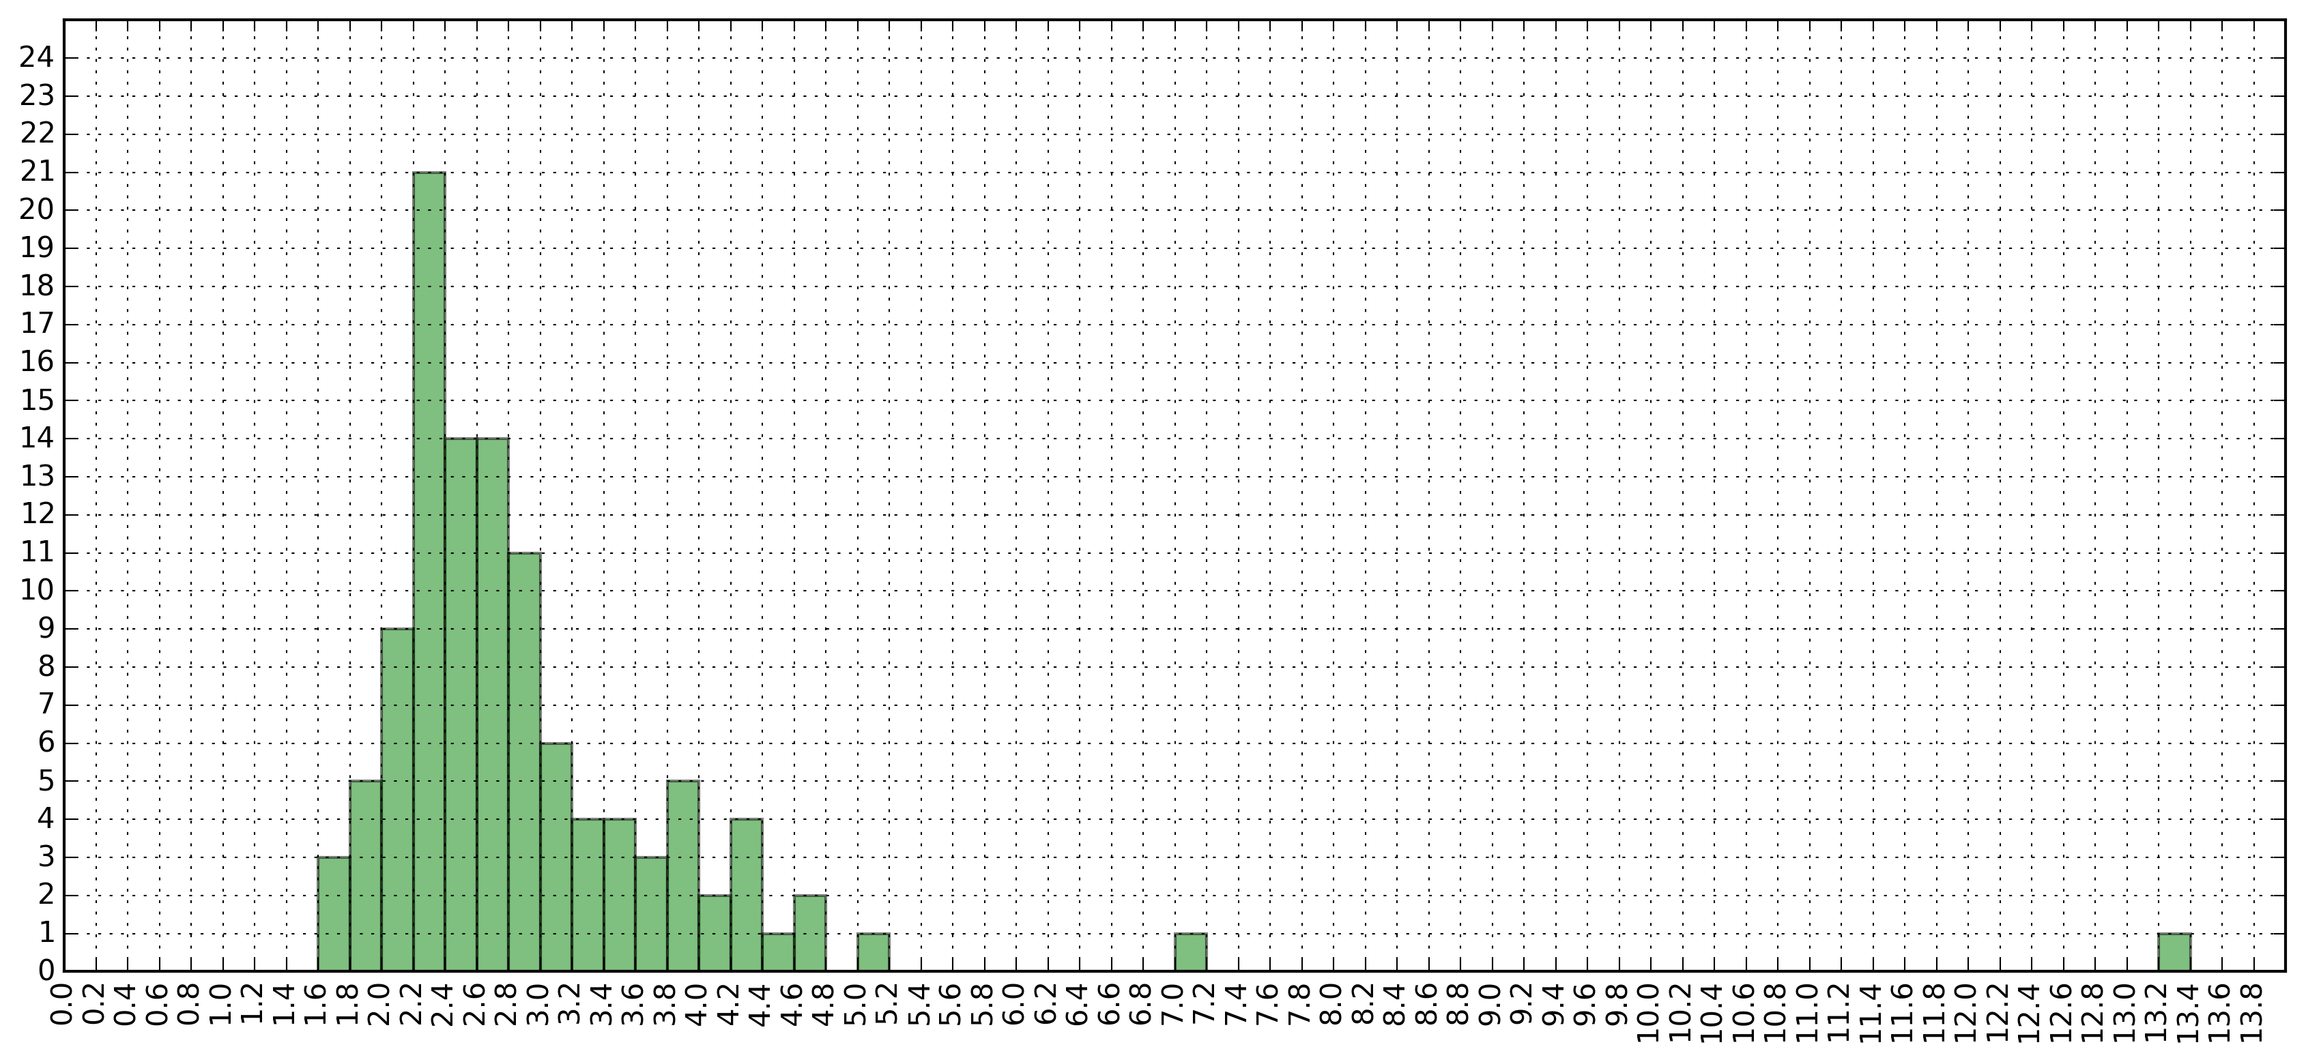
Machine A
Machine B
Faster
stressor | op/s
-----------------
ackerman | 530
matrix | 1343
int32 | 433
int64 | 333
int128 | 233
…
stressor | op/s
-----------------
ackerman | 750
matrix | 2403
int32 | 684
int64 | 892
int128 | 1302
…
Slower
Notes:
Check op/s overall

Slide 12
Outline
Problem Definition.
Characterize performance of a machine.
Quantify variability across machines.
Reduce variability using containers.
Next steps.

Slide 13
Environmental Variables
Variables in our scenario:
Time spent on a CPU subsystem (e.g. FPU).
Memory bandwidth.
Compiler flags.
Can’t control: 2
Can control: 3
Partially control: 1
Time spent on CPU (overall).

Slide 14
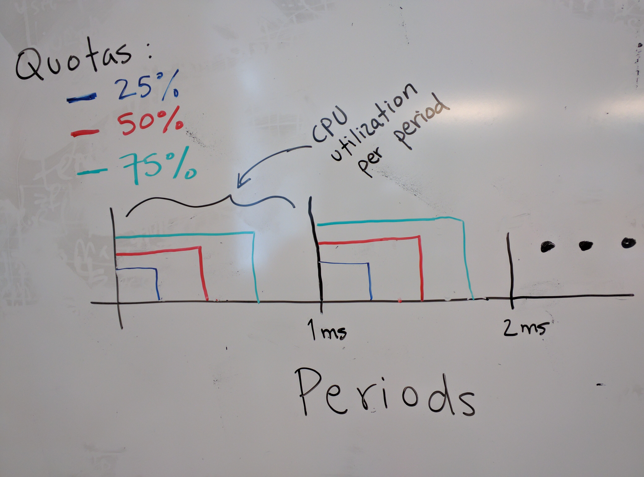
Period-based CPU bandwidth control

Slide 15
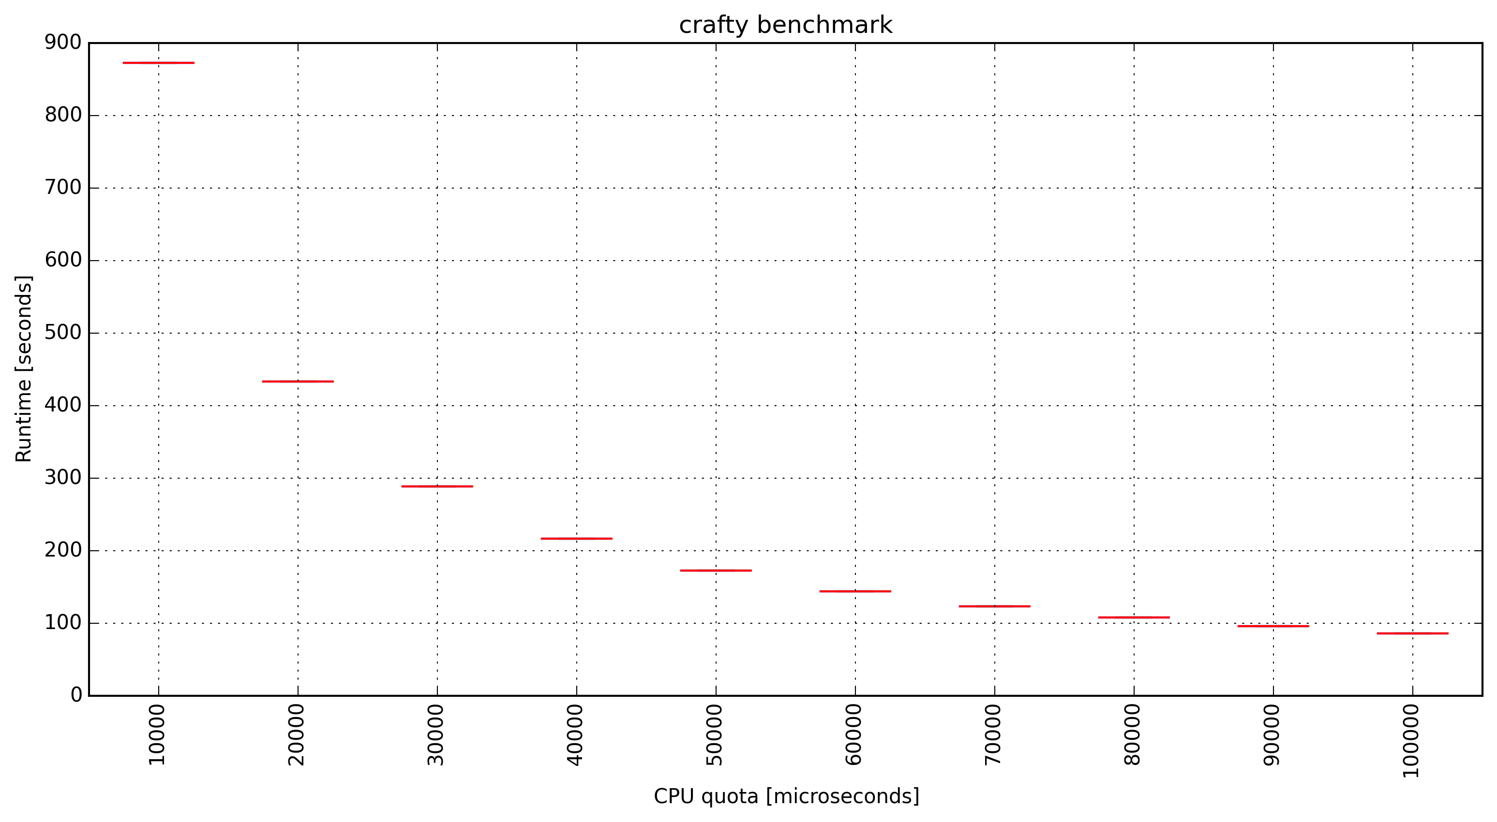
Controlling CPU bandwidth
Docker (cgroups) exposes some parameters of Linux’s CFS scheduler.
Can specify quota/period for a container.
docker run --cpu-quota=X --cpu-period=100000 ivotron/crafty

Slide 16
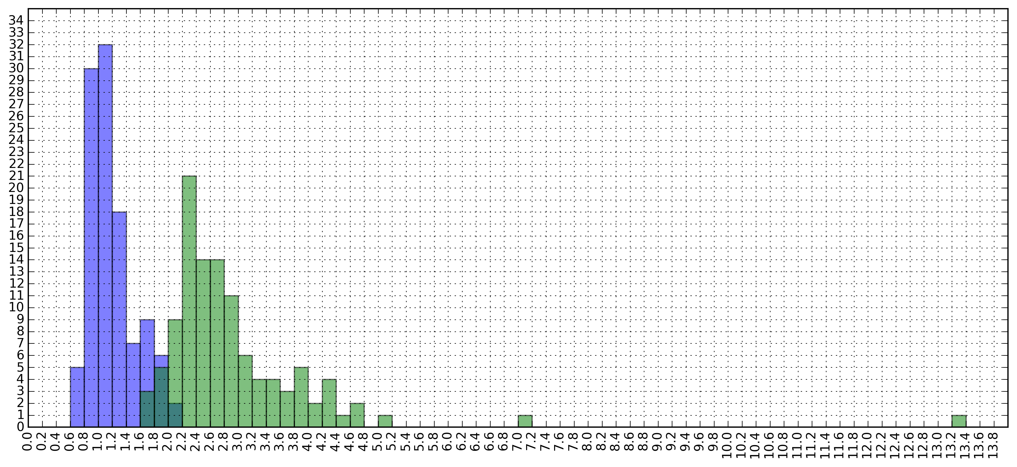
Effects of Limiting CPU Bandwidth
Faster
Faster
Slower
Slower

Slide 17
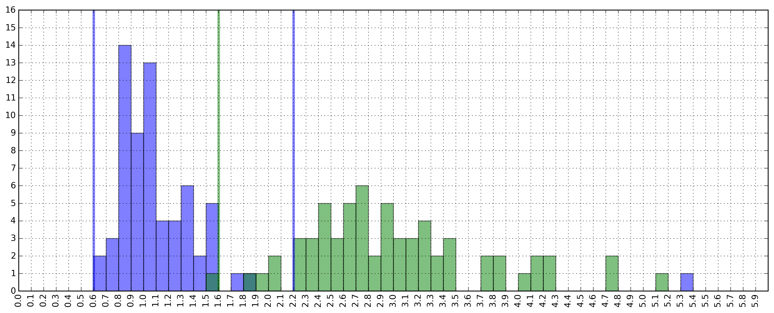
Does the Range Hold for Other Apps?
Test on 30 benchmarks:
cloverleaf, comd, sequoia, c-ray, crafty, unixbench, stress-ng (string, matrix, memory and cpu-cache).

Slide 18
Outline
Problem Definition.
Characterize performance of a machine.
Quantify variability across machines.
Reduce variability using containers.
Next steps.

Slide 19
“I got a vaccine that cures ebola.”
“Tested 2 patients: 1 with disease, 1 without”
“My in-memory KV store is faster than XX.”
“Tested on my machine for YCSB”
How can we improve the validation of systems?

Slide 20
Statistical Study
More samples (n=100, 1000?)
Test on more scenarios:
More machines (e.g. run at each CloudLab site)
Workload characteristics
Degree of parallelism/contention
Claim in statistical terms
“With 95% confidence, my KV beats XX.”

Slide 21
Controlled Experiments
Exhaustively list all the environmental variables that affect performance.
Create a deterministic environment
Control each of the variables and “fix” them to specific values.
Study the effects of our work.
Claim with respect to the synthetic scenario:
“Under this specific conditions, my KV beats XX.”
Impractical!
how impractical
is it, if we use containers?

Slide 22
Conclusion
OS-level virtualization let’s us have control over environmental variables that affect application performance.
Limiting CPU bandwidth results in having predictable variability between machines.
Initial steps towards having new category of “Controlled Experiments”.
Slow and predictable vs. fast and noisy

Slide 23
Next Steps
What’s the impact of controlling memory bandwidth?
Can we narrow the variability around x=1.0
Consider other types of applications:
Multi-threaded applications, IO- and net-bound.
Notes:
----- Meeting Notes (1/29/16 15:05) -----
memory bandwidth (latency on a bus vs. aggregate bandwidth). servers have multiple sockets.

