Slide 1
Predicting Cross-Platform Performance Variability Using OS-level Virtualization
Ivo Jimenez, Carlos Maltzahn (UCSC)
Adam Moody, Kathryn Mohror (LLNL)
Jay Lofstead (Sandia)
Andrea Arpaci-Dusseau, Remzi Arpaci-Dusseau (UW)

Slide 2
“I got a vaccine that cures ebola.”
“Tested 2 patients: 1 with disease, 1 without”
“My in-memory KV store is faster than XX.”
“Tested on my machine for YCSB”
How can we improve the validation of systems?

Slide 3
Statistical Study
More samples (n=100, 1000?)
Test on more scenarios:
More machines (e.g. run at each CloudLab site)
Workload characteristics
Degree of parallelism/contention
Claim in statistical terms
“With 95% confidence, my KV beats XX.”

Slide 4
Controlled Experiments
Exhaustively list all the environmental variables that affect performance.
Create a deterministic environment
Control each of the variables and “fix” them to specific values.
Study the effects of our work.
Claim with respect to the synthetic scenario:
“Under this specific conditions, my KV beats XX.”
Impractical!
Is it?

Slide 5
Outline
Problem Definition
Characterize performance of a machine
Quantify variability across machines
Reduce variability using containers
Next steps

Slide 6


The Problem
2500 ops
???? ops
Discard network and I/O (for now).
single-node
single-threaded applications.

Slide 7
Characterize a Machine’s Performance
What determines performance of an app?
opcode mix.
Our goal is to characterize a machine.
Instead of an application.
An alternative: use an array of mini-apps.

Slide 8

stress-ng
120 stressors that test multiple subsystems of a computer.
CPU, CPU cache, memory, network, disk, OS.
CPU stressor.
Loop a function for n seconds and report ops.
More than 80 functions (called methods).
Idea: use this “spectrum” of microbenchmarks to characterize the performance of a machine.

Slide 9
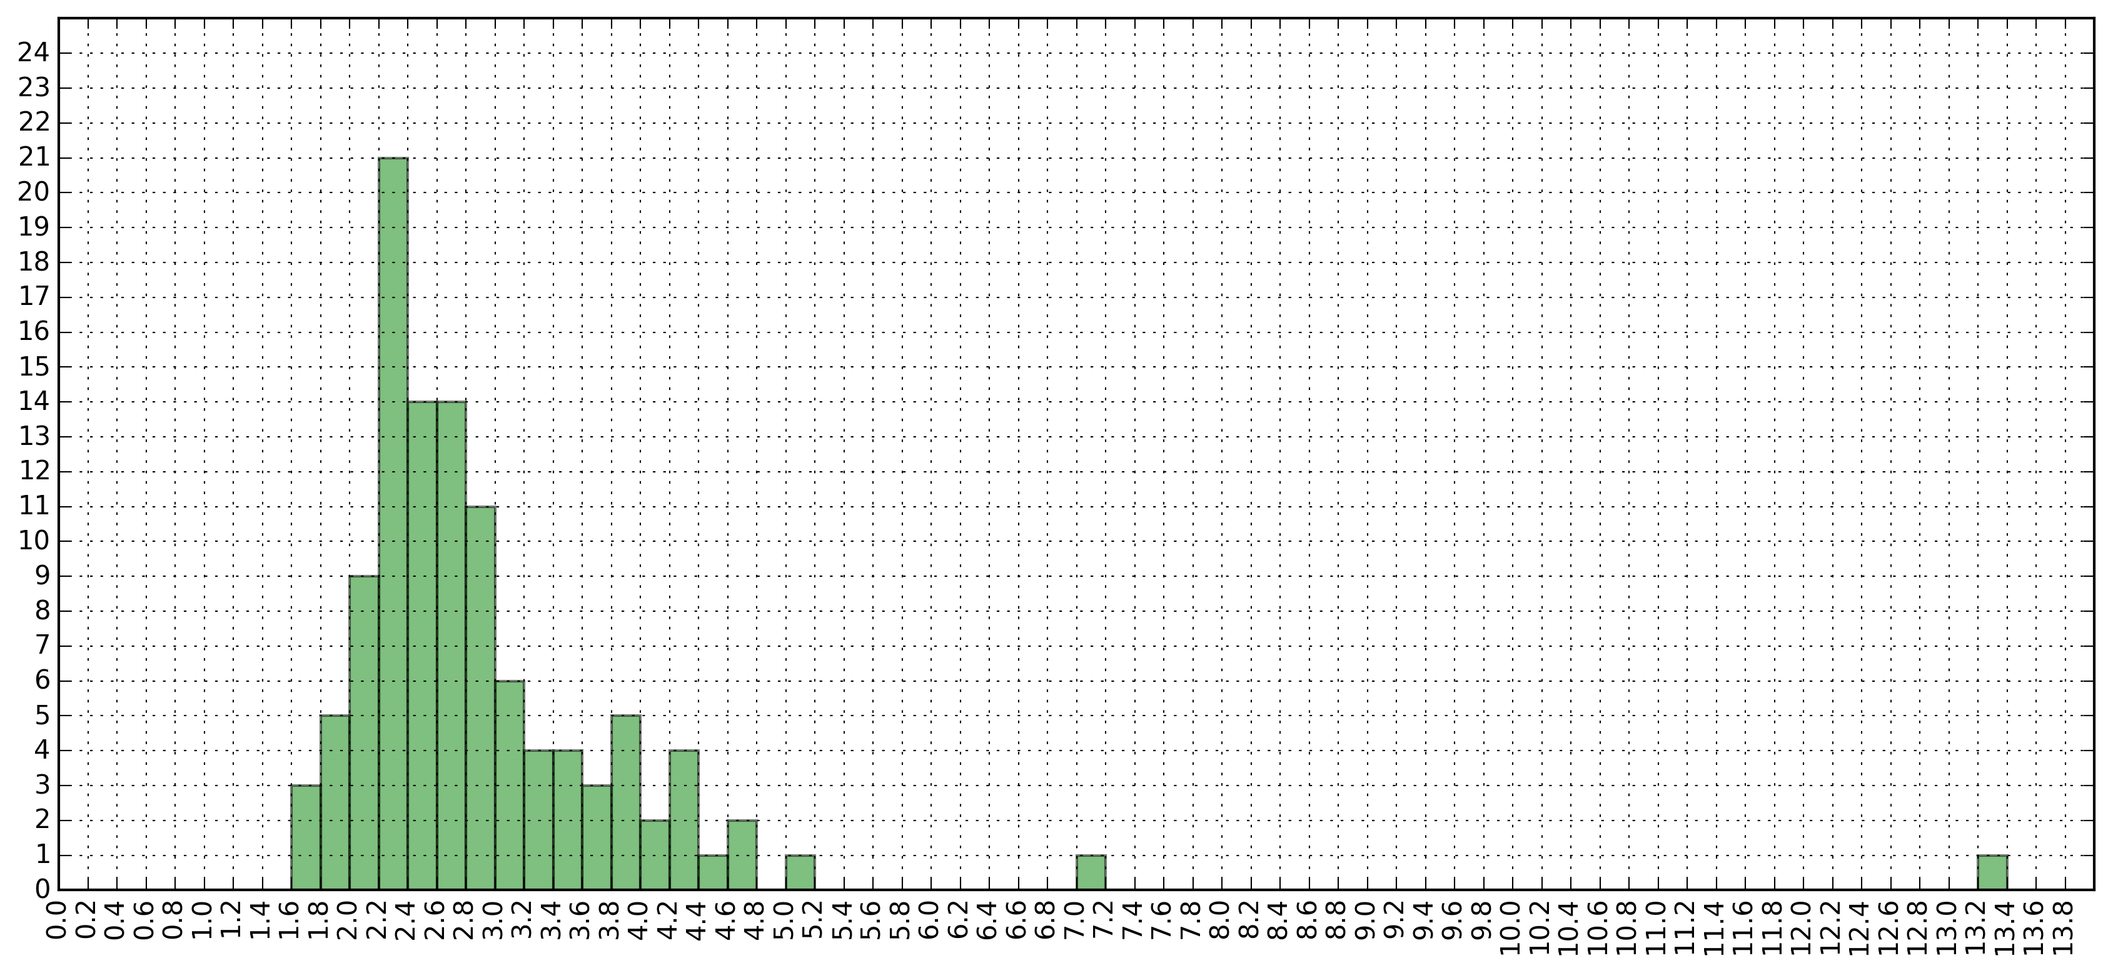
Machine A
Machine B
Faster
ackerman - 530 ops
matrix - 1343 ops
int32 - 433 ops
int64 - 333 ops
int128 - 233 ops
…
ackerman - 330 ops
matrix - 1643 ops
int32 - 967 ops
int64 - 852 ops
int128 - 436 ops
…
Slower

Slide 10
Environmental Variables
Variables in our scenario:
CPU physical subsystems.
Memory bandwidth.
Compiler flags.
Can’t control:
CPU physical subsystems nor RAM bandwidth.
Can control:
Compiler flags.
CPU bandwidth (with containers).

Slide 11
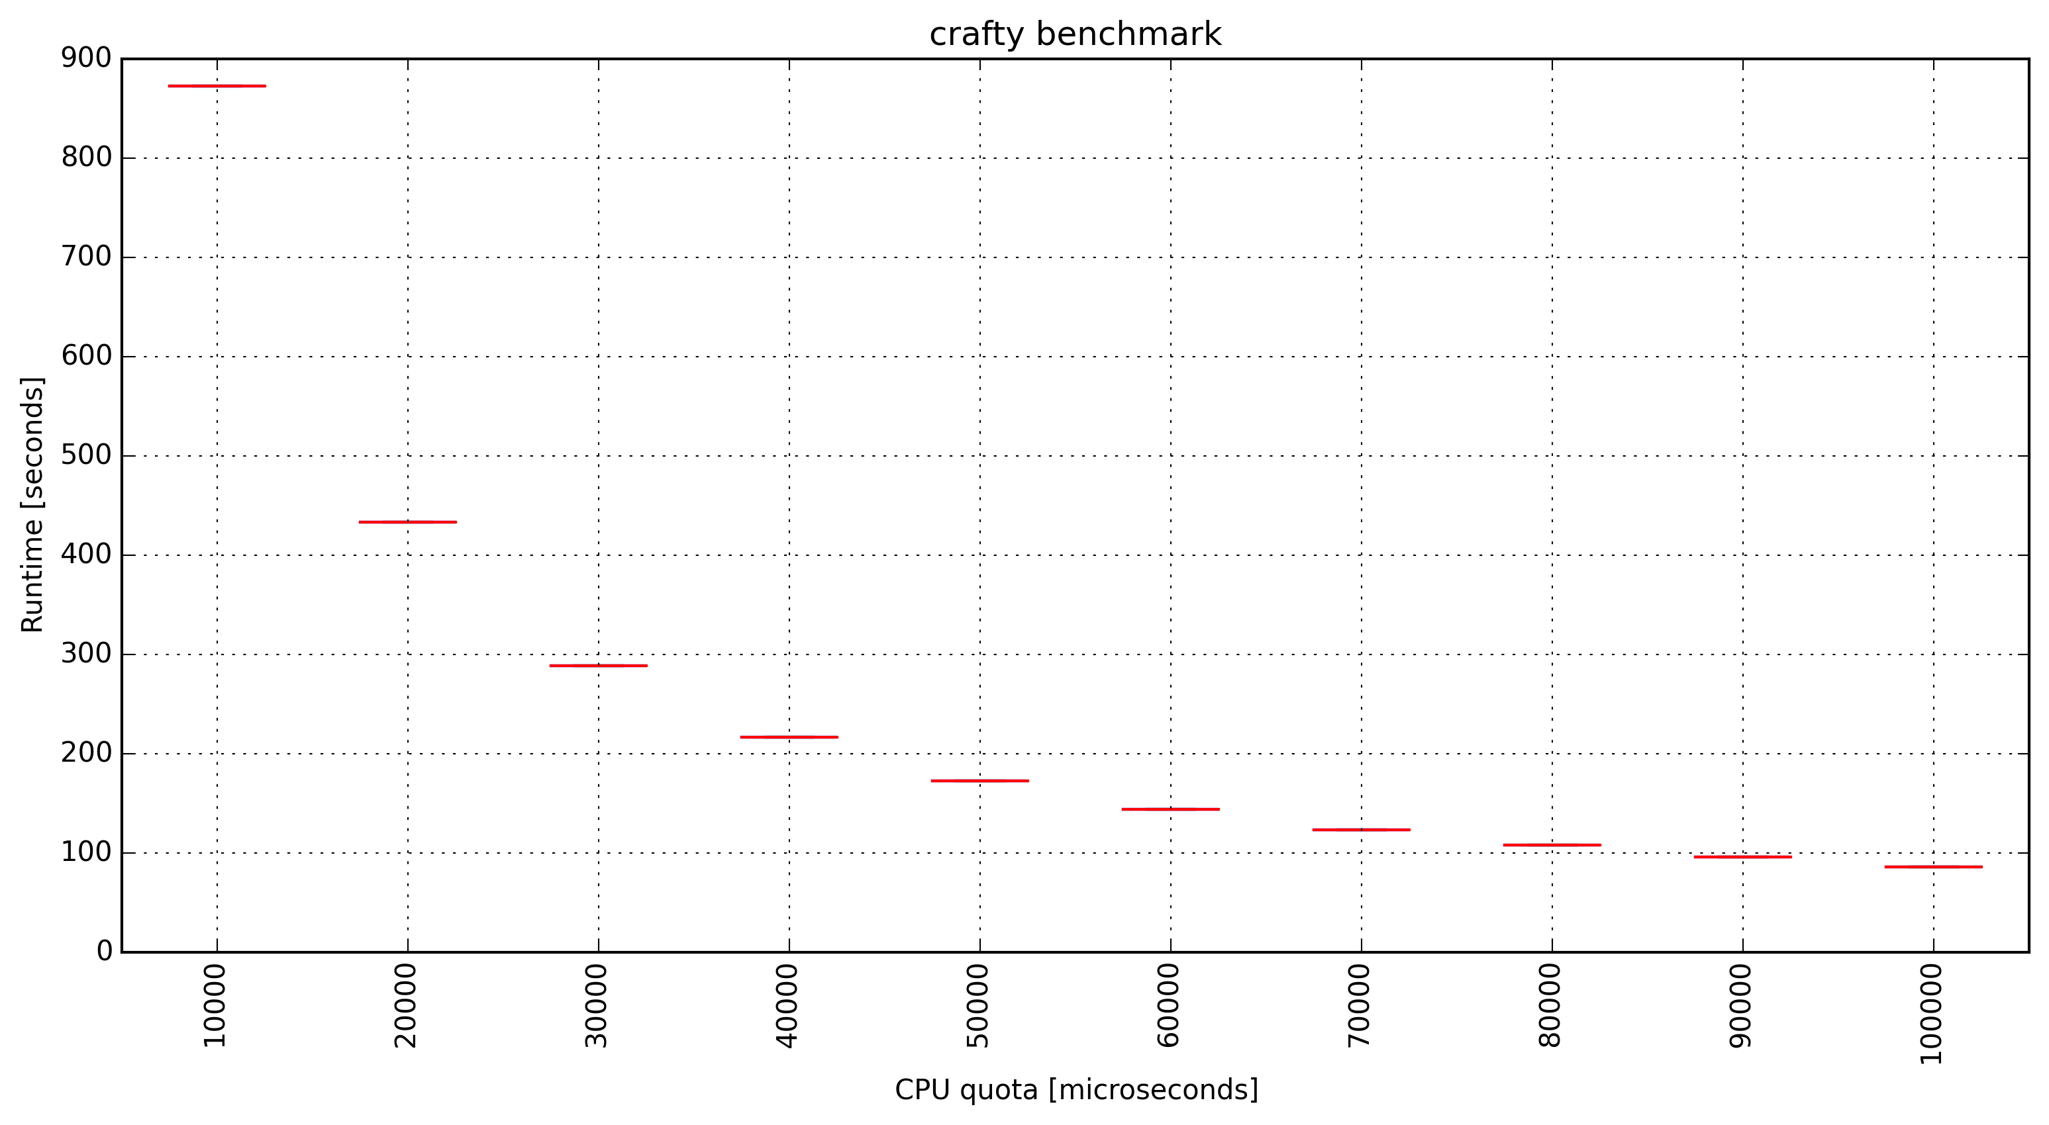
Controlling CPU bandwidth
Docker (cgroups) exposes some parameters of Linux’s CFS scheduler.
Can specify quota/period for a container.

Slide 12
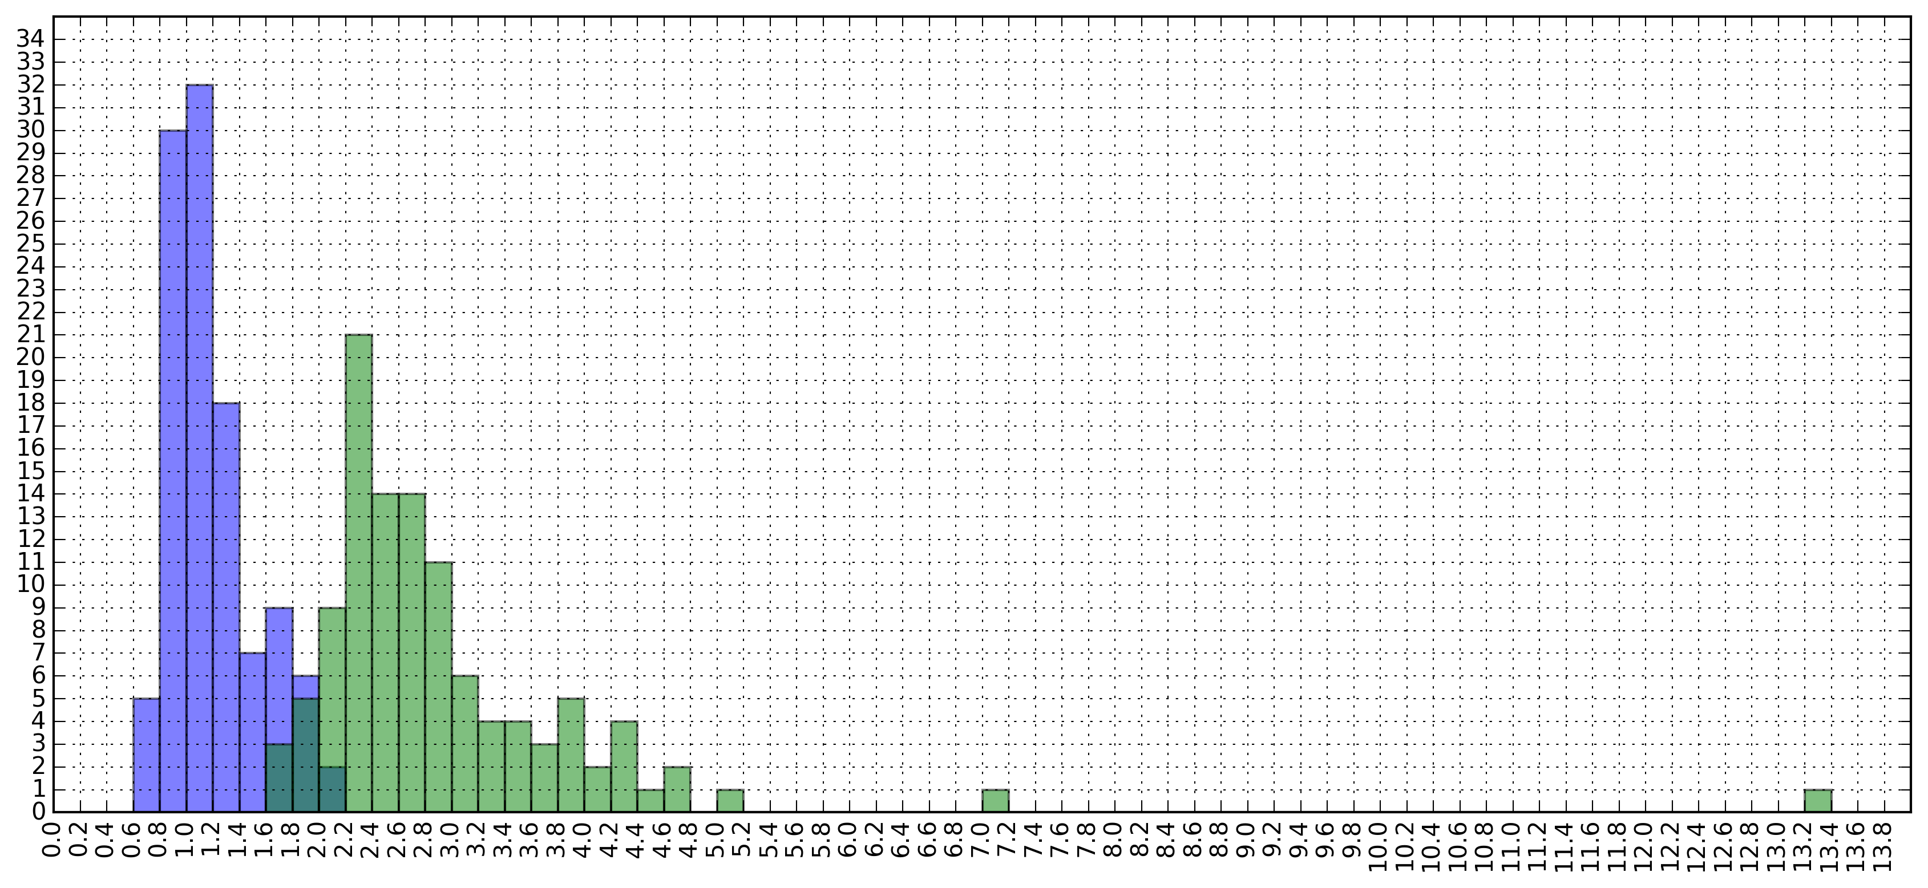
Effects of Limiting CPU Bandwidth
Faster
Faster
Slower
Slower

Slide 13
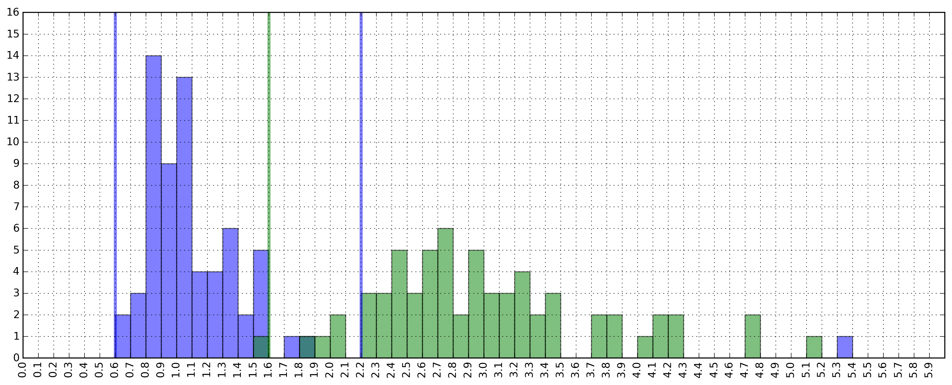
Does the Range Hold for Other Apps?
Test on 30 benchmarks:
cloverleaf, comd, sequoia, c-ray, crafty, unixbench, stress-ng (string, matrix, memory and cpu-cache).

Slide 14
Conclusion
OS-level virtualization let’s us have control over environmental variables that affect application performance.
Limiting CPU bandwidth results in having predictable variability between machines.
Initial steps towards having new category of “Controlled Experiments”.
Slow and predictable vs. fast and noisy

Slide 15
Next Steps
What’s the impact of controlling memory bandwidth?
Can we narrow the variability around x=1.0
Consider other types of applications:
Multi-threaded applications, IO- and net-bound.
What is the impact
Notes:
----- Meeting Notes (1/29/16 15:05) -----
memory bandwidth (latency on a bus vs. aggregate bandwidth). servers have multiple sockets.

