Slide 1
Characterizing and Reducing Cross-Platform Performance Variability Using OS-level Virtualization
Ivo Jimenez, Carlos Maltzahn (UCSC)
Adam Moody, Kathryn Mohror (LLNL)
Jay Lofstead (Sandia)
Andrea Arpaci-Dusseau, Remzi Arpaci-Dusseau (UW Madison)

Slide 2

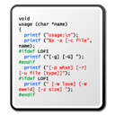
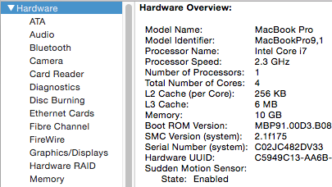
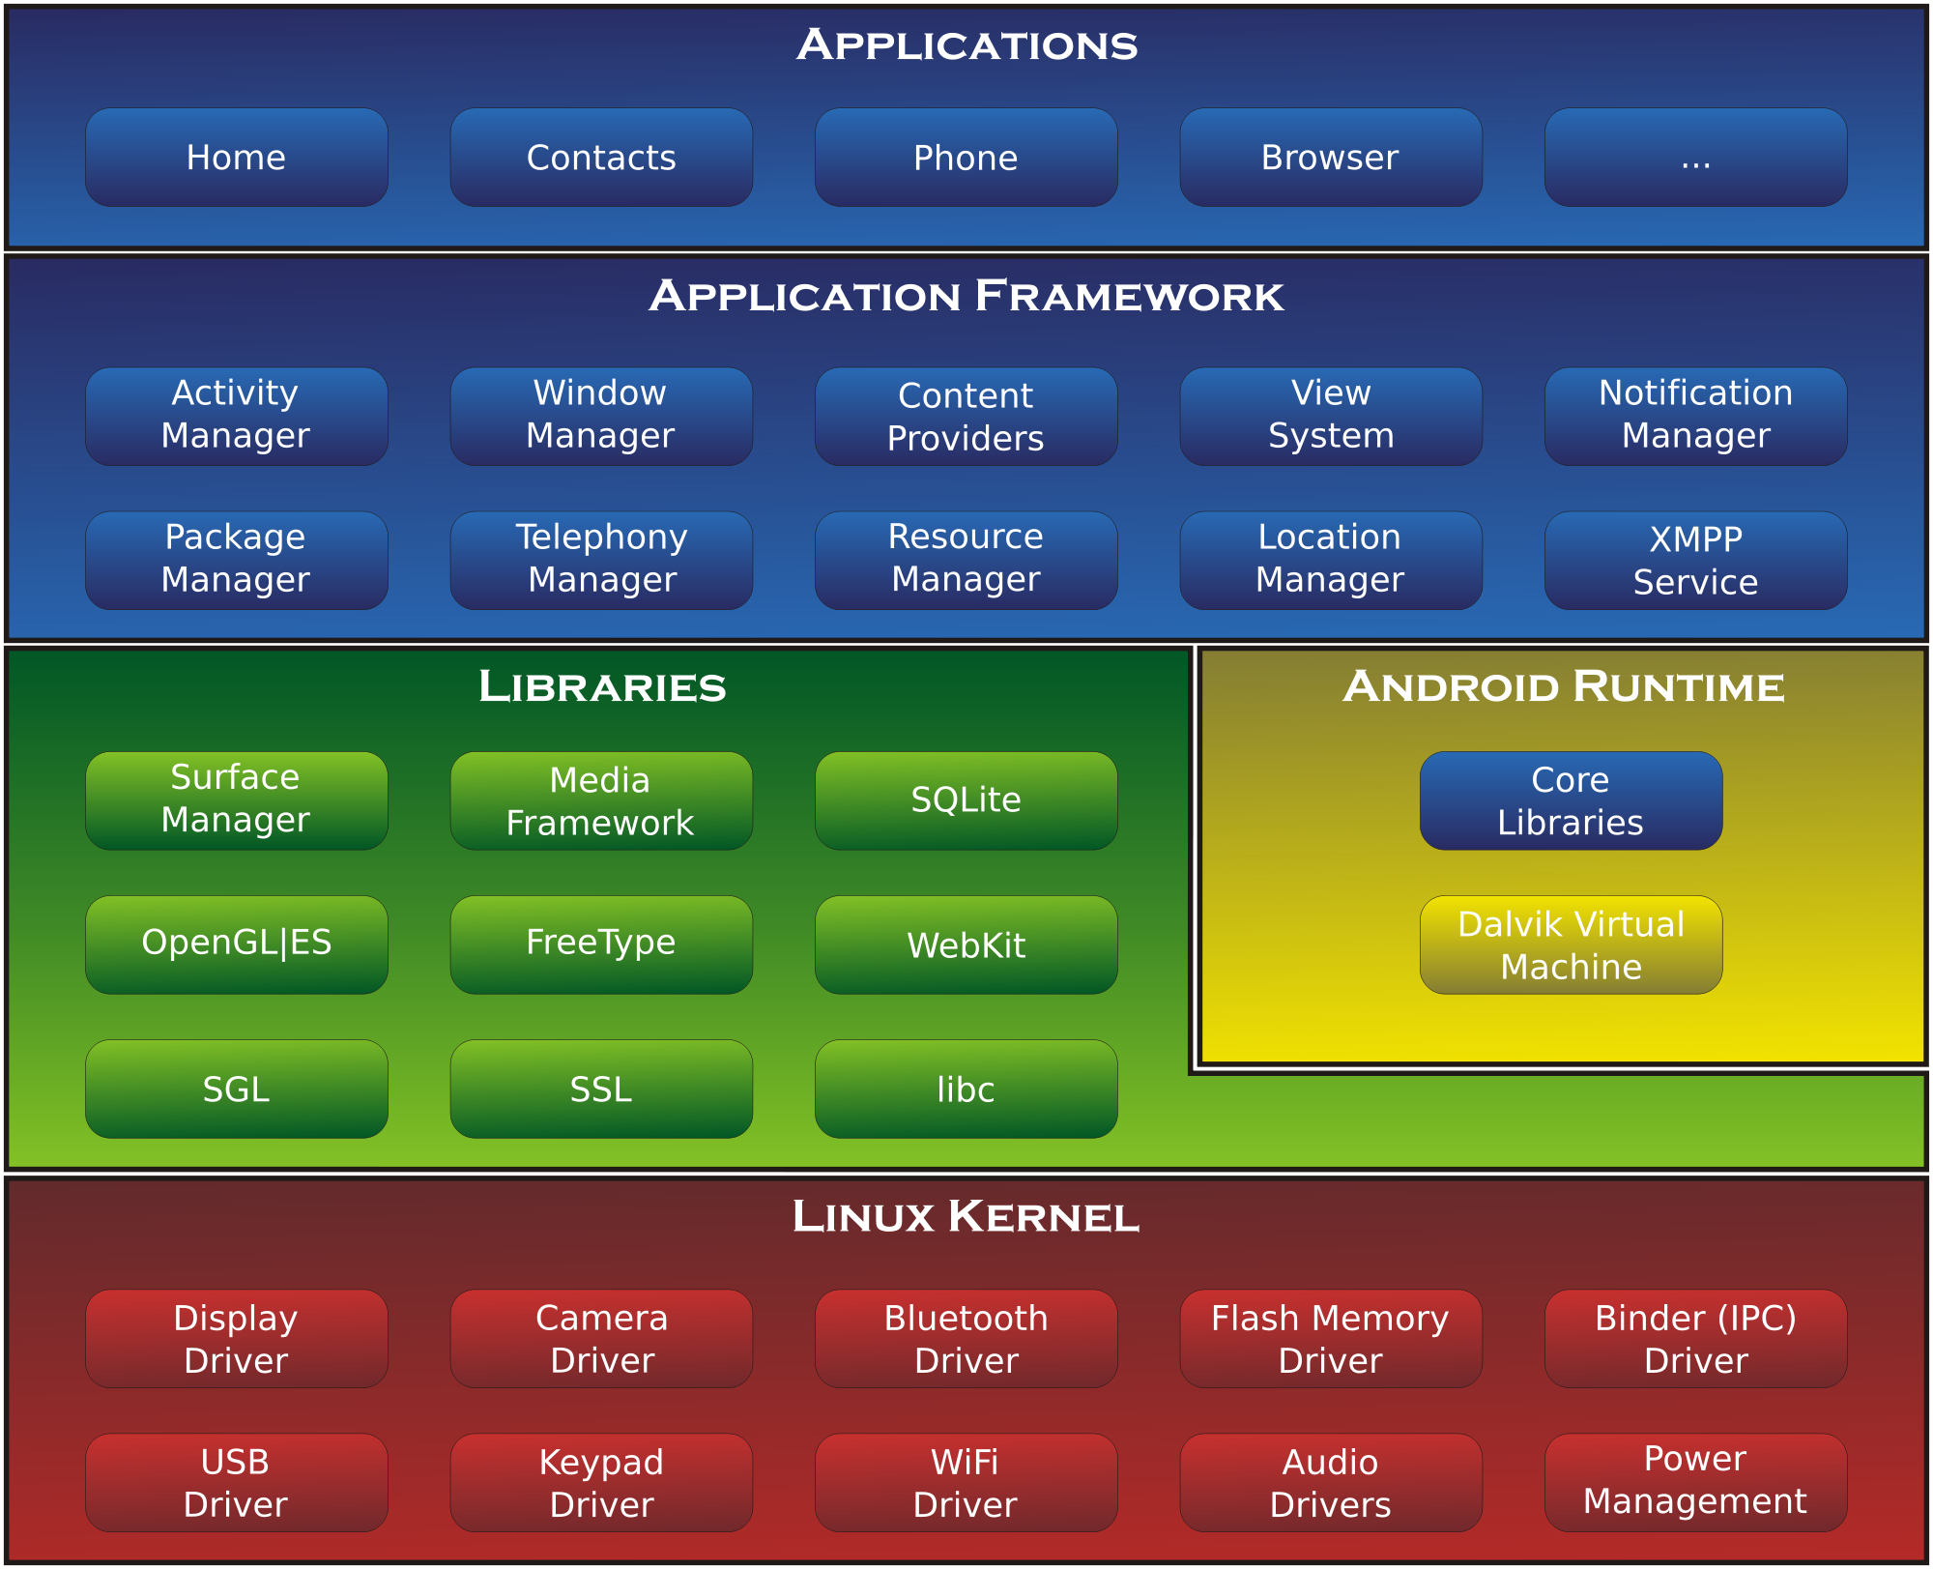


Overview
2013:
2015:
Comparison
“Given the same workload,
B is 2.5x faster than A”
Platform A
Platform B
Key ideas:
A performance profile of a platform is more meaningful and comprehensive than HW/SW specs
Automatically calibrate Platform B based on performance profile of Platform A in order to reduce variability
HW spec A:
SW stack A:
HW spec B:
SW stack B:
Performance profile A:
Performance profile B:
Notes:
We validate a system by executing tests/experiments and recording performance metrics
When we re-execute the same system/app on another platform we get a number. This number is meaningless without a context
We usually try to address this by describing the hardware/software specs where the original number was generated
In our work we make the case for also having a performance profile of the platform associated to the number in order to facilitate the validation
With this profile, we can obtain a variability descriptor (a histogram of speedups/slowdowns of a target machine w.r.t. the original one). This variability descriptor allows us to:
Put a performance metric in context. For example, we are now able to say things like “the speedup could be larger/smaller”.
Quantify a new _performance variability_ metric by associating the range of the histogram to it (this is a number=(max-min) speedup).
Assuming that the profiling is accurate (covers all possible performance scenarios), we can treat the performance variability range as strict bounds (no app will land outside the range). This is good for predictability
By using OS-level virtualization features (cgroups), we can reduce the performance variability
In this talk, I’ll describe how to create the perf profile in such a way that is representative, show how we quantify variability using the profiles, and how we can reduce it using containers

Slide 3
Outline
Scope of Work
Performance Profile of a Machine
Quantify Cross-platform Variability
Reduce Variability Using Containers
Future Work

Slide 4
Scope of Work
Many factors influence performance:
CPU architecture, RAM bandwidth, network speed, storage media, wear-level, etc..
Breaking it down into pieces
CPU-bound programs
Ignore network and I/O for now
Single-node applications
Distributed/parallel apps coming soon
Uncontended scenarios
Ignore noisy neighborhood phenomena
Our approach is generic
We are currently working on relaxing the above
Notes:
We are currently working on removing these constrains

Slide 5
Outline
Scope of Work
Performance Profile of a Machine
Quantify Cross-platform Variability
Reduce Variability Using Containers
Future Work

Slide 6

Characterize a Machine’s Performance
Benchmarks
benchmark A
benchmark B
2500 ops/s
1300 ops/s
benchmark C
590 ops/s
…
?
Notes:
What we want to do is to find a set of microbenchmarks that characterize the performance of a machine, so that we can record this and make this part of tests resutls
The question is, which benchmarks do we pick?

Slide 7
Characterize a Machine’s Performance
Given a particular machine, opcode mix determines performance of an application
Alternatives:
Generate all possible programs that exercise all possible combinations of the machine’s ISA
e.g. 50/25/25 FLOPs/INT/MEMORY vs 25/15/70 vs …
Use an array of programs that exercise multiple subsystems
CPU, memory, network, OS, FS
Notes:
Alternative #1 is not practical. Alternative #2 is more realistic

Slide 8


stress-ng github.com/ColinIanKing/stress-ng
220 microbenchmarks that test multiple subsystems of a computer
CPU, CPU cache, memory, network, I/O and OS
85 CPU microbenchmarks
Loop for n seconds and report ops/s
Idea: use this “spectrum” of microbenchmarks as the performance profile of a machine
Notes:
We can use stress-ng to profile the machine.
In the case of the work we present here at VarSys, since we’re only focusing on CPU, we’ll look at the CPU microbenchmarks

Slide 9
CPU Performance Profile of a Machine
CPU-bound stress-ng micrbenchmarks
1
2
benchmark | ops/s
-----------------
ackerman | 530
matrix | 1343
int32 | 433
int64 | 333
int128 | 233
…
…
3
85
The performance of stress-ng CPU microbenchmarks on a machine constitutes its “performance fingerprint”

Slide 10
Outline
Scope of Work
Performance Profile of a Machine
Quantify Cross-platform Variability
Reduce Variability Using Containers
Future Work

Slide 11

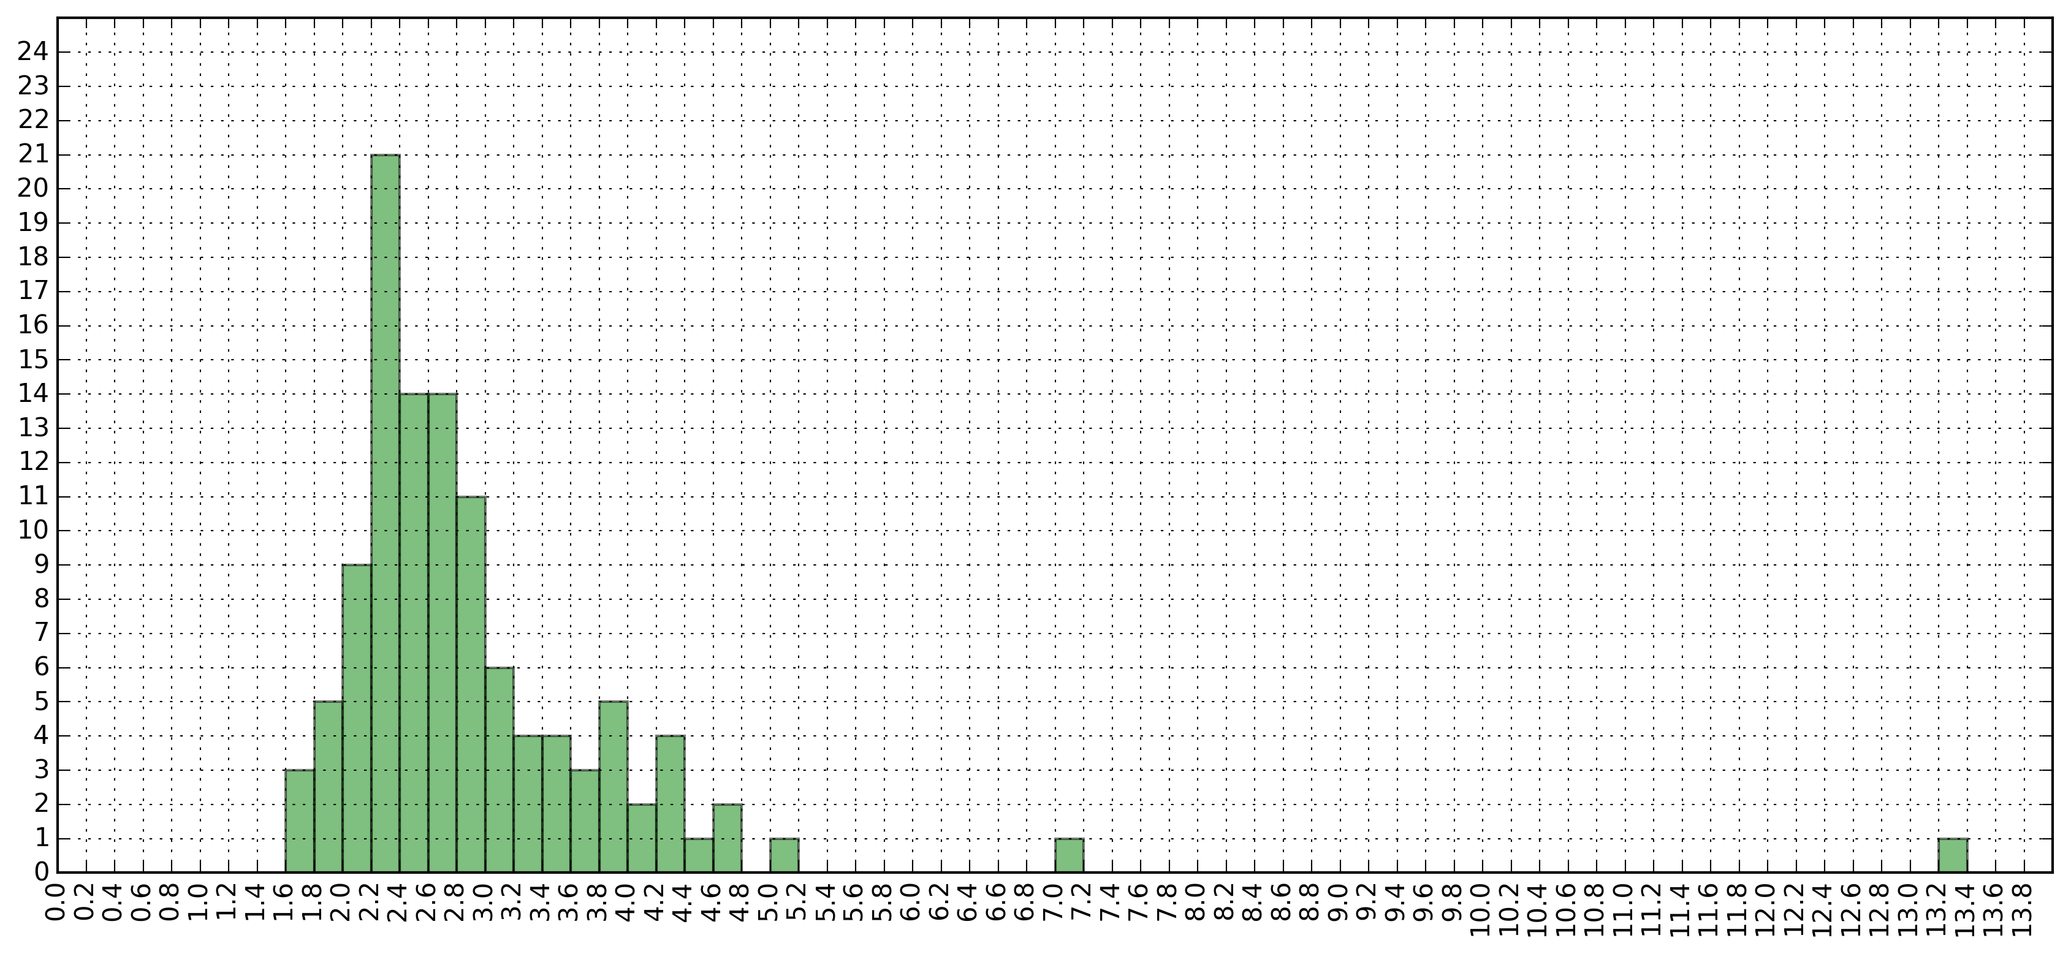
Machine A
Machine B
Faster
benchmark | ops/s
-----------------
ackerman | 530
matrix | 1343
int32 | 433
int64 | 333
int128 | 233
…
benchmark | ops/s
-----------------
ackerman | 750
matrix | 2403
int32 | 684
int64 | 892
int128 | 1302
…
speedup
Performance Variability = (min – max) = (13.4 - 1.6) = 11.8
Slower
= 1.41
= 1.78
= 1.57
= 2.67
= 5.58
Frequency
Speedup (B/A)

Slide 12
Outline
Scope of Work
Performance Profile of a Machine
Quantify Cross-platform Variability
Reduce Variability Using Containers
Future Work

Slide 13
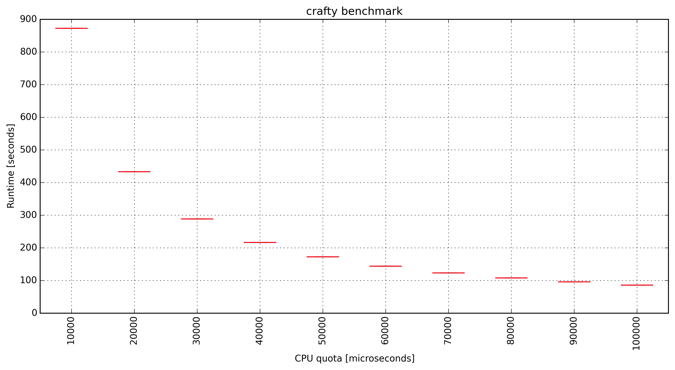
Controlling CPU Bandwidth
Docker (via cgroups) exposes some parameters of Linux’s CFS scheduler
Can specify quota/period for a container
Utilization per period
Quota:
25%
50%
75%
100ms
200ms
300ms
….
Periods
docker run --cpu-quota=X --cpu-period=100000 crafty
Notes:
* Period and quota can have arbitrary values with 1ms min and 1s max
* This is a boxplot of 10 executions (tight boxes)

Slide 14
Autotuning CPU Quota for a Machine
Given profiles for A,B:
Pick maximum CPU quota
Execute microbenchmarks on B
Check if B/A speedup gets closer to 1
Select smaller quota based on result of 3
Go to 2
Stop conditions:
iterate n times
if no progress in last m iterations
Machine A
Machine B
benchmark | ops/s
-----------------
ackerman | 530
matrix | 1343
int32 | 433
int64 | 333
int128 | 233
…
benchmark | ops/s
-----------------
ackerman | 750
matrix | 2403
int32 | 684
int64 | 892
int128 | 1302
…
Notes:
Microbenchmarks can come from:
Pick min, median, max benchmarks from unconstrained scenario
Choose int- and float- intensive benchmarks

Slide 15
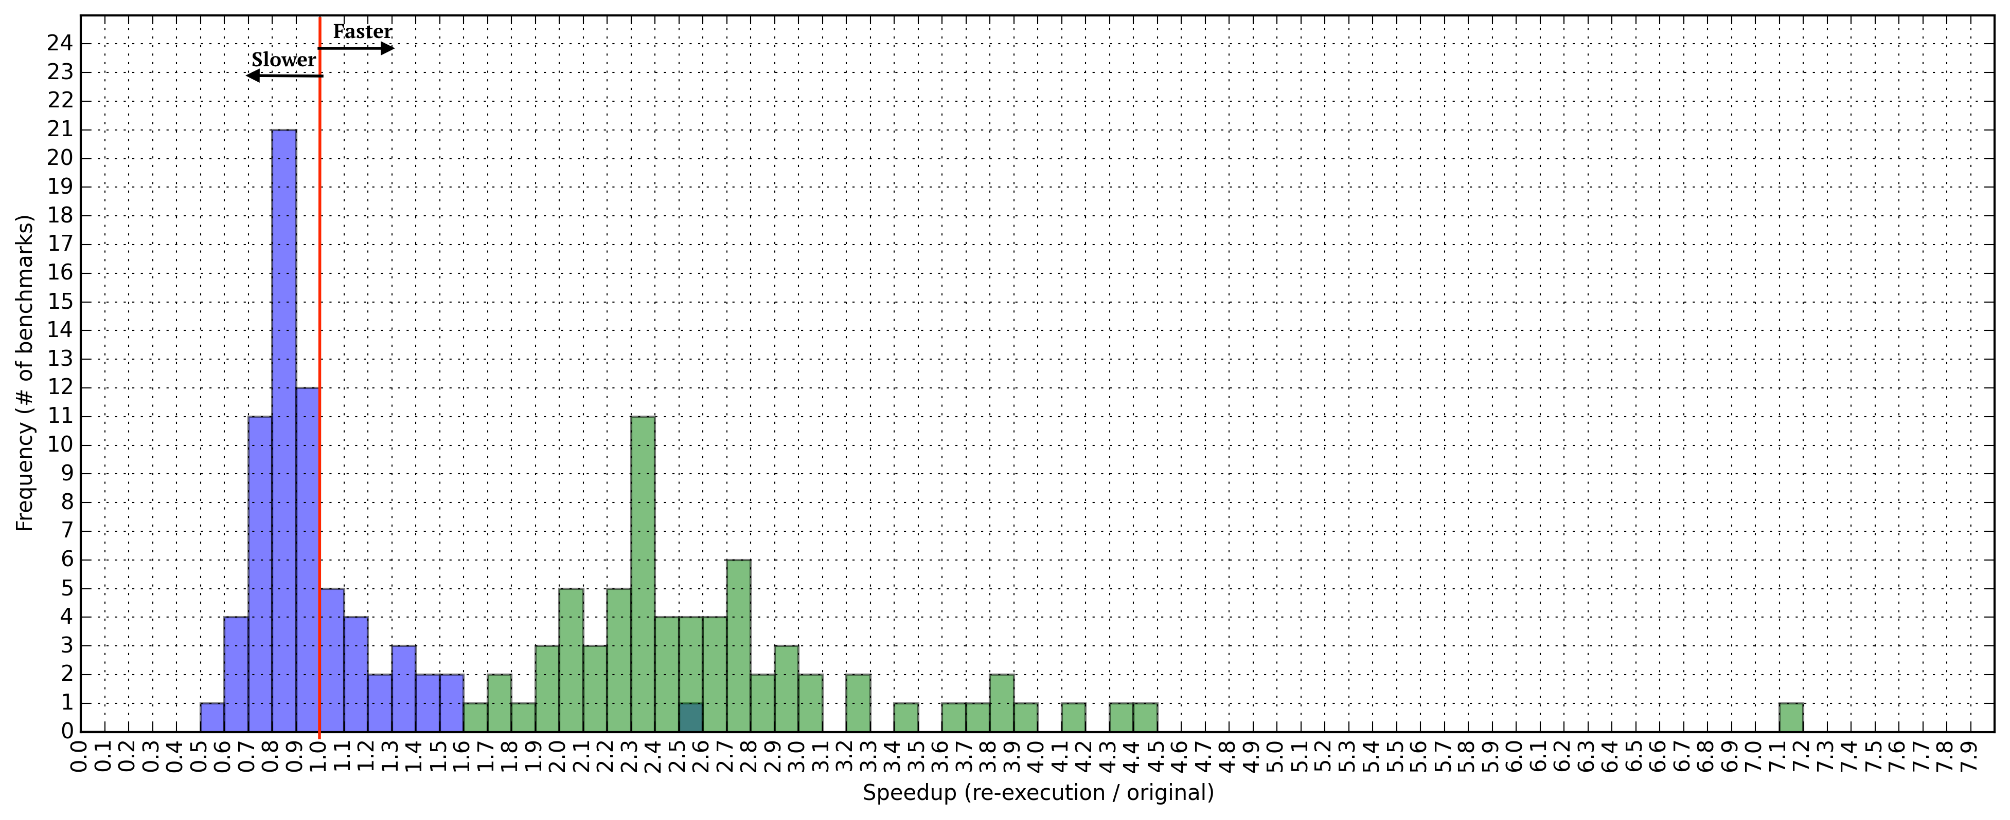
Effects of Limiting CPU Bandwidth
Setup:
Original: 2006 Xeon E5-310
Re-execution: 2012 Xeon E5-2630
Linux 3.13
Docker 1.8
Performance Variability = 5.6
(without CPU limits)
Performance Variability = 2.1
(with CPU bandwidth limits)

Slide 16
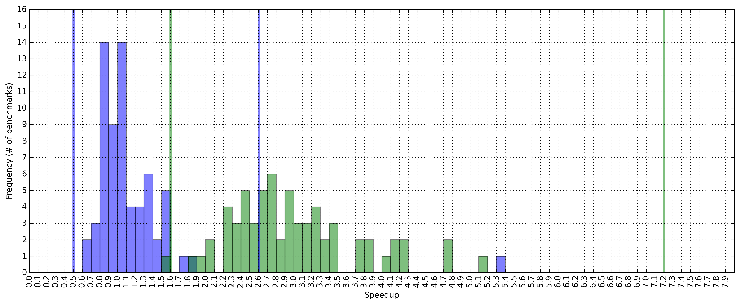
Does the Range Hold for Other Apps?
Test on 30 benchmarks:
cloverleaf, comd, sequoia, c-ray, crafty, unixbench, stress-ng (string, matrix, memory and cpu-cache).
stress-ng’s STREAM
Notes:
Why these benchmarks?

Slide 17
Outline
Scope of Work
Performance Profile of a Machine
Quantify Cross-platform Variability
Reduce Variability Using Containers
Future Work

Slide 18
Future Work
What’s the impact of controlling memory bandwidth?
Can we narrow the variability around x=1.0
Consider other types of applications:
Multi-threaded applications, IO- and net-bound

Slide 19
Conclusion
Fingerprinting performance puts results in perspective
We can quantify performance variability
Container technology allows us to mitigate variability
Tuning CPU bandwidth reduces cross-platform variability
Ivo Jimenez <ivo@cs.ucsc.edu>
Experiments: github.com/ivotron/varsys16
Tuning Framework: github.com/ivotron/torpor

Slide 20
Thanks!

Slide 21
Discussion
“I got a vaccine that cures ebola.”
“Tested 2 patients: 1 with disease, 1 without”
“My in-memory KVS is faster than XX.”
“Tested on my machine on random data”
How can we improve the validation of systems?
Notes:
KVS - key-value store

Slide 22
Statistical Study
More samples (n=100, 1000?)
Test on more scenarios, varying:
Machines (e.g. run at each CloudLab site)
Workload characteristics
Degree of parallelism/contention
Claim in statistical terms
“With 95% confidence, my KVS beats XX.”

Slide 23
Controlled Experiments
Exhaustively list all the environmental variables that affect performance.
Create a deterministic environment
Control each of the variables and “fix” them to specific values.
Study the effects of our work.
Claim with respect to the synthetic scenario:
“Under this specific conditions, my KVS beats XX.”
Impractical!
how impractical
is it, if we use containers?

