Slide 1



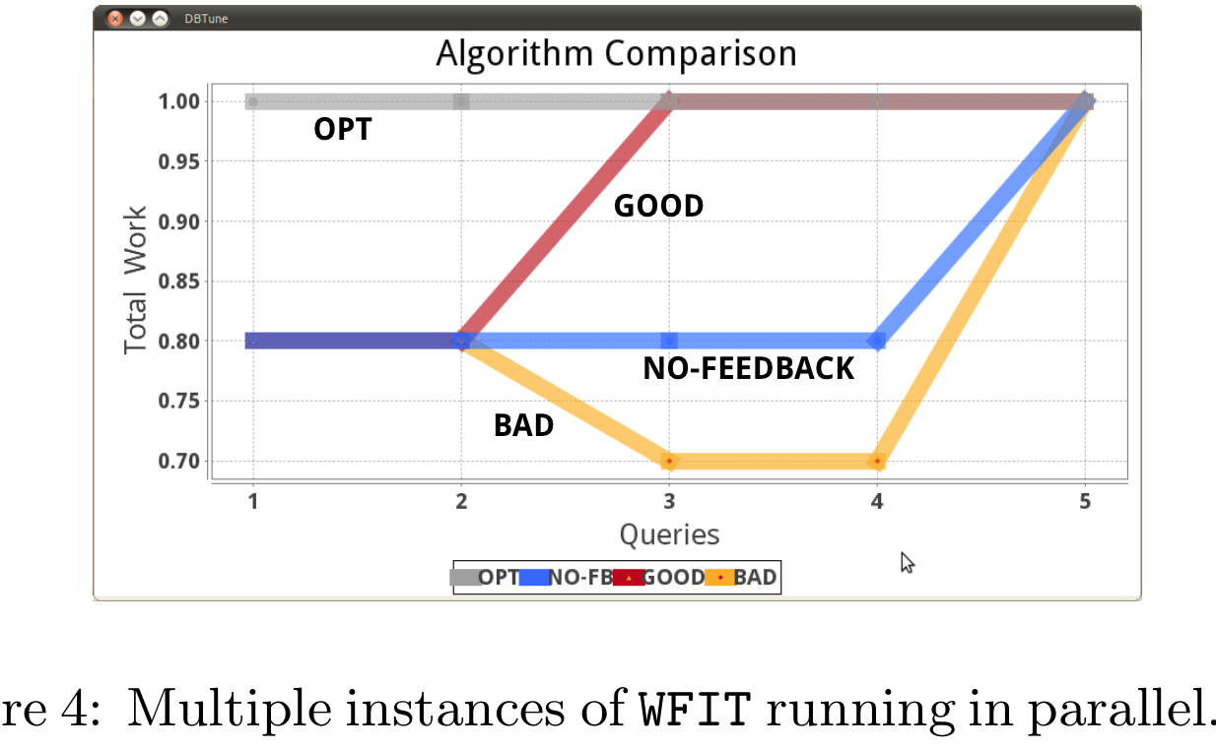
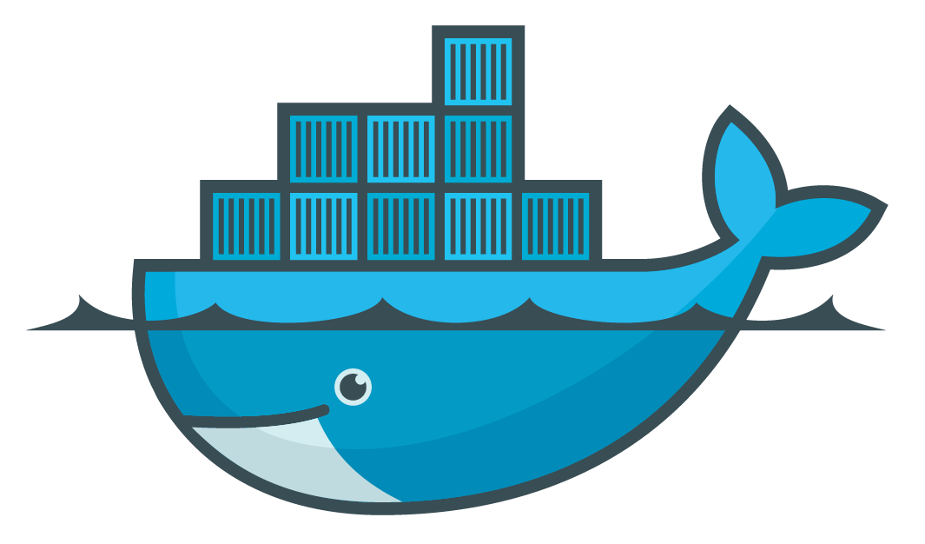
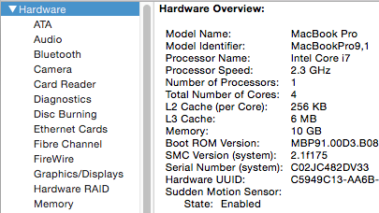
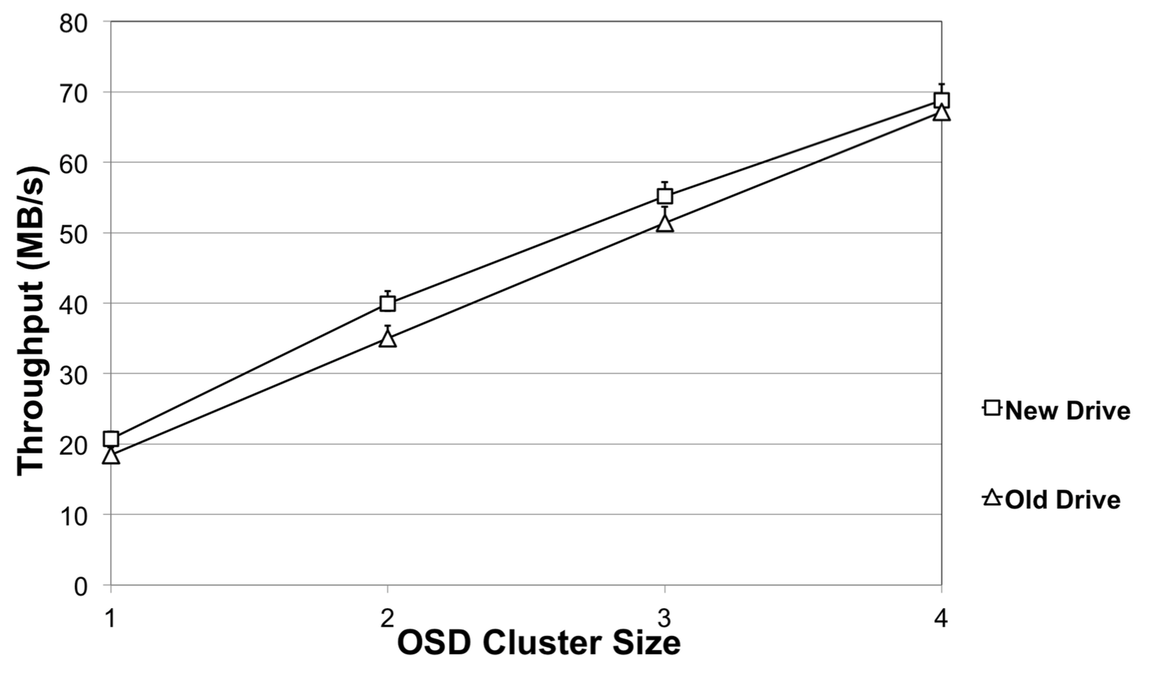
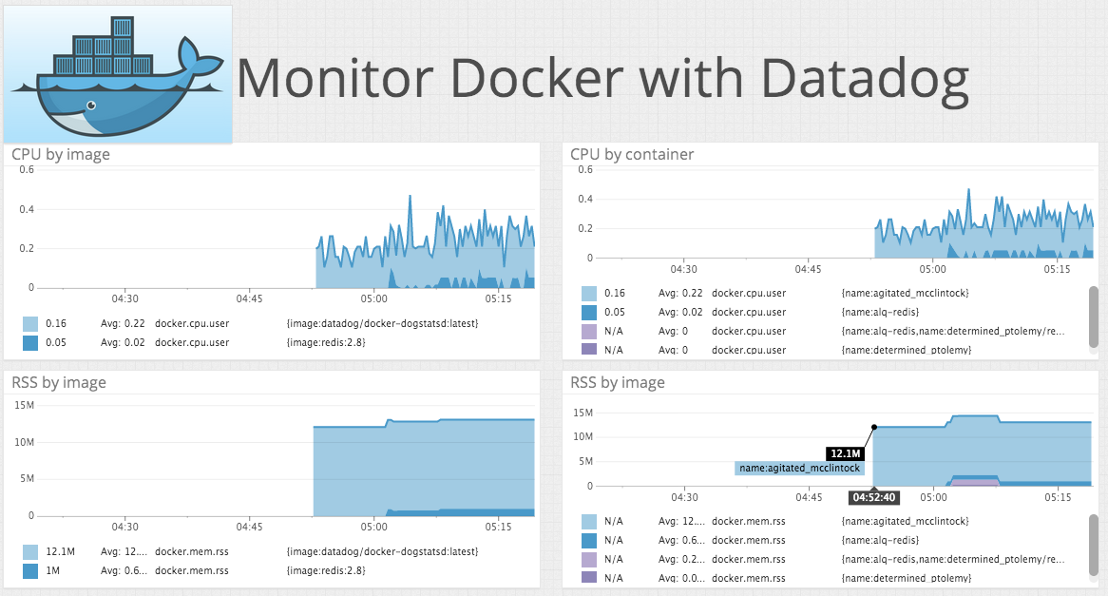
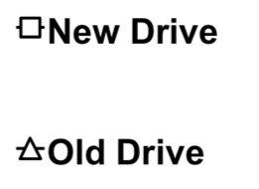
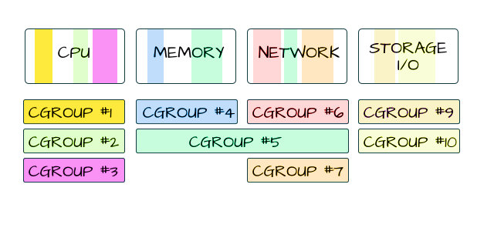
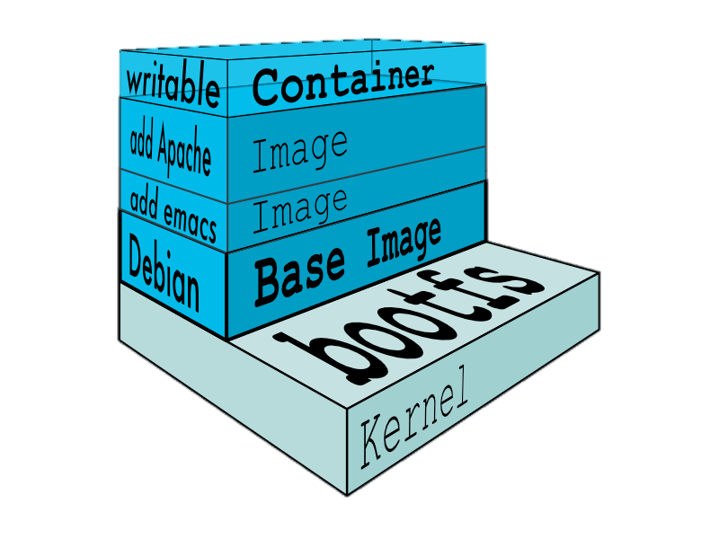
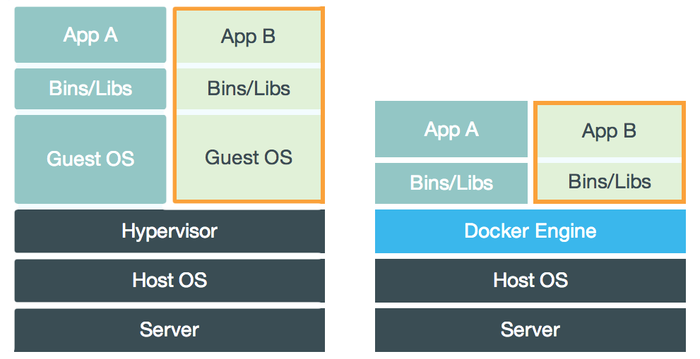
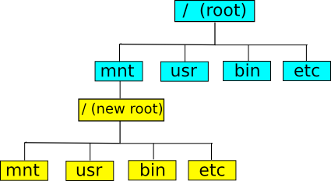
The Role of Container Technology in Reproducible CS Research Ivo Jimenez, Carlos Maltzahn (UCSC) | Adam Moody, Kathryn Mohror (LLNL) | Jay Lofstead (Sandia) | Andrea Arpaci-Dusseau, Remzi Arpaci-Dusseau (UW)
SRL
UCSC Systems Research Lab
Reproducibility in CS
Case Study: Ceph OSDI ‘06
140
Reproduced
140
Reproduced
Study goal: Empirically test the reproducibility features of containers by picking an already-published experiment.
Scalability experiment from Ceph OSDI ’06 original paper.
Implemented a scaled-down version in docker containers with only one client (as opposed to 20 clients in original article).
Original experiment goal: show that Ceph scales linearly with the size of the object storage device (OSD) cluster size.
Lessons Learned:
Resource management feature of containers makes it easier to control environmental noise.
Information not explicitly included in an article but important for reproducibility cannot be captured in container images.
120
Original
120
Original
libs
100
100
Throughput (MB/s)
80
code
80
60
Restoration of scalable
behavior by reducing noise through block I/O limiting capabilities of cgroups configuration
data
OS
60
40
40
Non-scalable
behavior
20
hardware
20
1 2 3 4 5 6 7 8 9 10 11 12 13
1 2 3 4 5 6 7 8 9 10 11 12 13
Container technology is a potential solution to many reproducibility problems
OSD cluster size
OSD cluster size
Figure 1: The y-axis represents average throughput, as seen by the client. The x-axis corresponds to the size of the cluster. We observe non-scalable behavior at 5. The underlying hard drives are unable to provide their advertised peak performance (60 MB/s) due to their age. This causes the cluster to be unbalanced.
Figure 2: In order to reduce the high variability of the environment we make use of the cgroups feature that allows to throttle I/O. The common lowest denominator among the hard disks being 30 MB/s. This makes the cluster behave in a predictable manner thanks to the uniformity of the underlying hard drives.
libs
Types of experiments:
Analyze properties of output data.
Evaluate analytic models.
Handle small amounts of data.
Depend on special hardware.
Observe performance metrics.
data
code
OS
container
Experiment Profile
Porting Experiments Between Systems
Our Approach
An experiment profile is composed by four items:
Name of image that experiment container is instantiated from.
Hardware profile.
Container configuration.
Execution profile.
To reproduce on host B an experiment E that originally ran on host A, we make use of the experiment profile for E and the hardware profile for B to configure the containers launched on host B, in such a way that the system resembles the original host A. Does it work?
Goal: complement container execution engine in order to extend its reproucibility capabilities
Experiment
Required functionality:
Capture contextual information
Create experiment profiles
Maintain repository of executions
Make info accessible to reviewers/readers
70
Figure 3: Using the limiting capabilities of cgroups, we recreate the behavior of old and slower disks on newer ones. Old hard drives are the same used in Figures 1 and 2 (above) and correspond to a set of 10 year old 250GB Seagate Barracuda ES (ST3250620NS). New hard drives correspond to 500GB Western Digital Re (WD5003ABYZ) hard disk drives. Every data point corresponds to the average (and standard error) of 10 executions.
Docker
(container engine)
Container configuration corresponds to the allocation of the base host system’s resources that are assigned to the container.
60
Host OS
CPU
Memory
Network
Block IO
2
50
40
Server
Experiment Container
Throughput (MB/s)
3
30
Experiment
All this information is invaluable when validating an experimental result and is usually not found in an academic article.
20
Ease validation of results
Monitor
(profiling engine)
Docker
(container engine)
10
?
Host OS
=
Profile
Repository
Server
4
OSD cluster size
Original
Re-execution
Docker Quick Start
Status and Future Work
App A (G3)
App B (G4)
Host
On-going: Characterize experiments for which the accounting/limiting capabilities don’t apply. For example: asynchronous I/O, memory bandwitdth.
Future: Given an isolation level guarantee, can we automate the process of checking for repeatability by looking at low-level container metrics?
Docker Client
- run, stop, kill
- build image
- commit, tag
- inspect, diff
Docker Daemon
pull/push image
Namespaces
- setup namespace
- configure, launch
...
Container 1
Docker Registry
CGroups
Container 2
...
VM Container
Components
Docker Image
Client/server architecture

