Slide 1
The Role of Container Technology in Reproducible CS Research
Ivo Jimenez
Computer Science Department
Co-authors:
Carlos Maltzahn (UCSC),
Adam Moody, Kathryn Mohror (LLNL)
Jay Lofstead (Sandia)
Andrea Arpaci-Dusseau, Remzi Arpaci-Dusseau (UW)

Slide 2
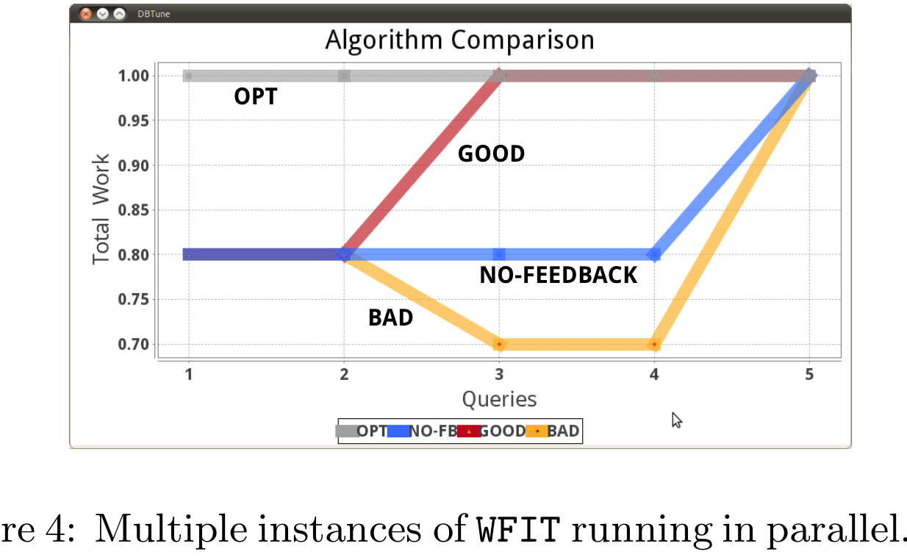
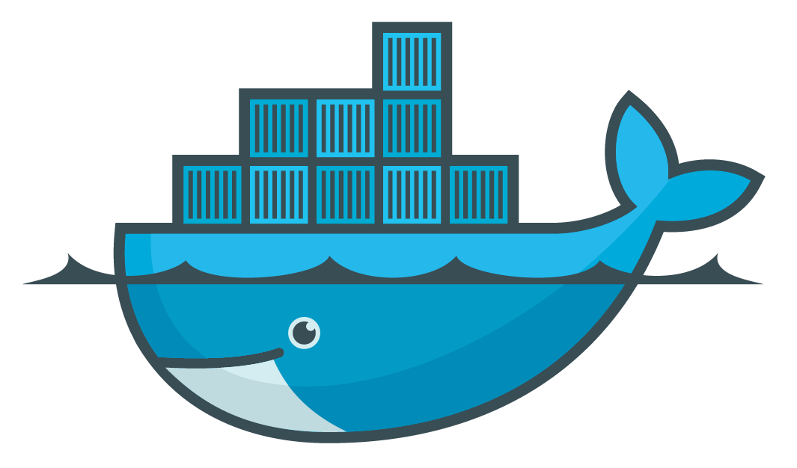
Reproducibility in Computer Science
libs
code
data
OS
hardware
A Potential Solution
Types of experiments:
Analyze properties of output data.
Evaluate analytic models.
Handle small amounts of data.
Depend on special hardware.
Observe performance metrics.
libs
data
code
OS
container
Notes:
Runtime, speedup, throughput, latency, etc.

Slide 3
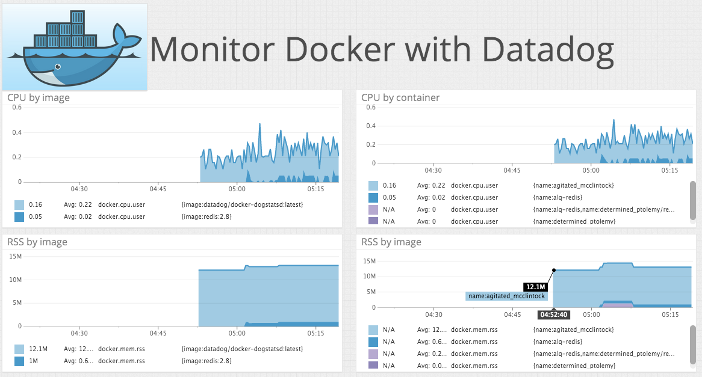
Our Goal: Complement Container Technology to Enhance Reproucibility Capabilities
Experiment
Required functionality:
Capture contextual information
Create experiment profiles
Maintain repository of executions
Make info accessible to reviewers/readers
Docker
(container engine)
Host OS
Server
Experiment
Ease validation of results
Monitor
(profiling engine)
Docker
(container engine)
?
=
Host OS
Profile
Repository
Server
Original
Re-execution
Notes:
2 minute talk. One minute per slide.

