Slide 1
The Role of Container Technology in Reproducible Computer Systems Research
Ivo Jimenez, Carlos Maltzahn (UCSC)
Adam Moody, Kathryn Mohror (LLNL)
Jay Lofstead (Sandia)
Andrea Arpaci-Dusseau, Remzi Arpaci-Dusseau (UW)

Slide 2
Why Care About Reproducibility
Theoretical, Experimental, Computational, Data-intensive research.
Reproducibility well established for the first two, but impracticably hard for the last two.
Negative impact on science, engineering, and education.
Notes:
Why is it impracticably hard? Continual stream of changes, etc.

Slide 3
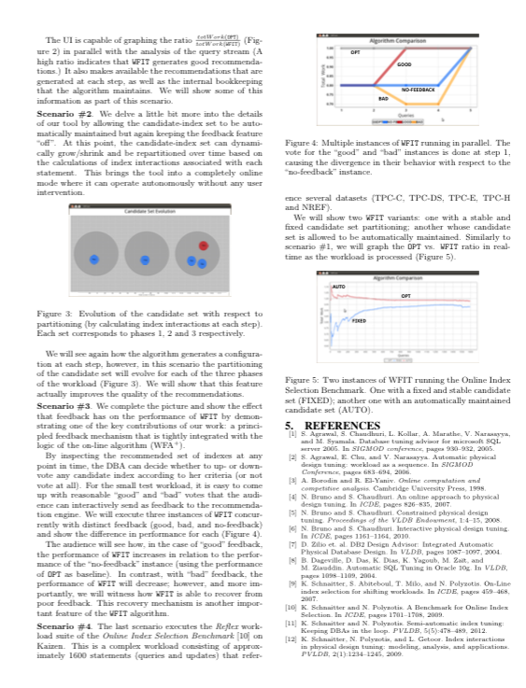
Status Quo of Reproducibility

Slide 4
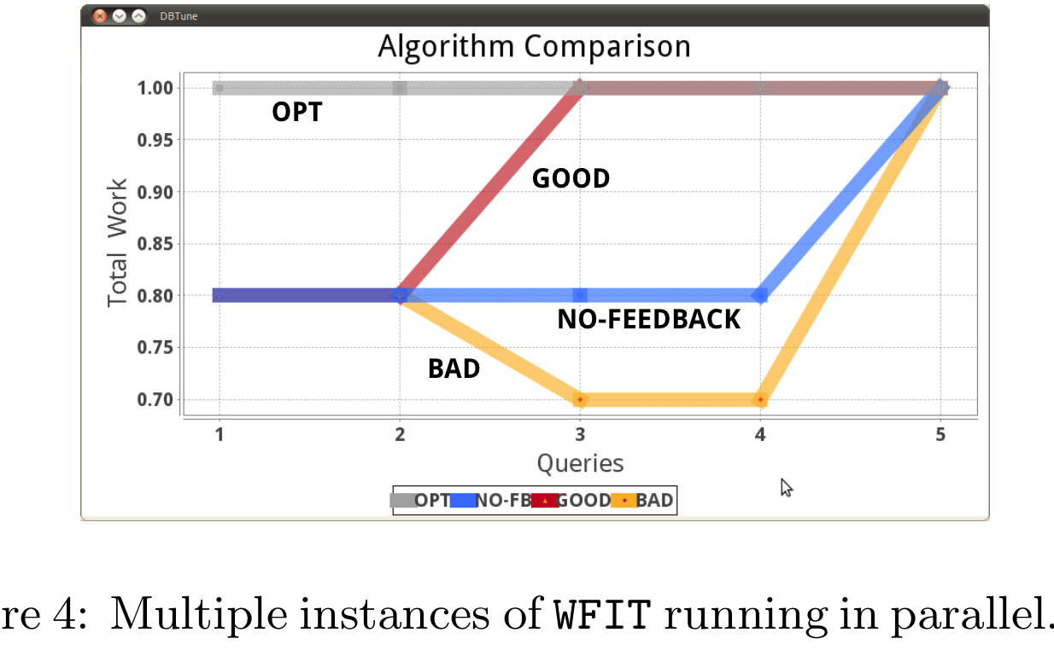
Status Quo of Reproducibility
Notes:
For the purposes of this talk, the content of the figure is irrelevant. So please ignore the graph and think of it as the graphical representation of an experiment

Slide 5
Status Quo of Reproducibility

Slide 6
Status Quo of Reproducibility
libs
data
code
OS
hardware

Slide 7
Status Quo of Reproducibility
libs
data
code
OS
hardware

Slide 8
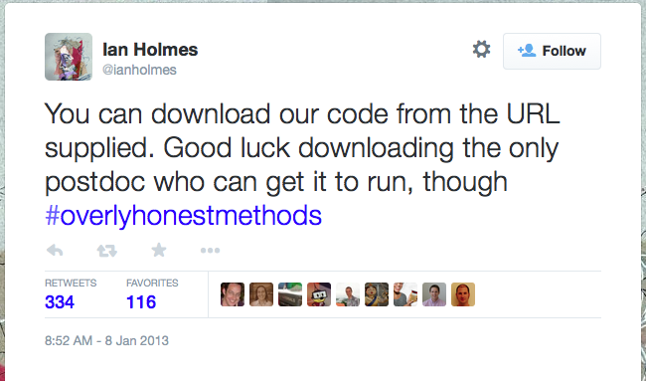

Slide 9
Sharing Code Is Not Enough
libs
data
code
OS
hardware

Slide 10
Results Rely on Complete Context
libs
data
code
OS
hardware
Notes:
So if you are aware of this problem in CS, and have experience user containers, you kind of naturally ask. Why don’t we use containers to solve this problem?
This begs the question...

Slide 11
Potential Solution: Containers

Slide 12
Potential Solution: Containers
Can containers reproduce any experiment?
Taxonomize CS experiments.
Determine challenging ones.
What is container technology missing?
Answer empirically by reproducing an already-published experiment.
Delineate missing components.
Based on learned lessons, define characteristics that enhance reproucibility capabilities.
Notes:
This is the outline of the talk.
So now, let’s look at each in this order.
Time: 5 minutes

Slide 13
libs
data
code
OS
hardware

Slide 14

Effects of Containerizing Experiments
libs
libs
data
code
OS
data
code
OS
hardware
container

Slide 15
Does it work for any experiment?
libs
Analyze output data.
Evaluate analytic models.
Handle small amounts of data.
Depend on special hardware.
Observe performance metrics.
data
code
OS
container

Slide 16
Does it work for any experiment?
libs
Analyze output data.
Evaluate analytic models.
Handle small amounts of data.
Depend on special hardware.
Observe performance metrics.
data
code
OS
container

Slide 17
Experiments in systems research
Runtime.
Throughput.
Latency.
Caching effects.
Performance model.
etc.

Slide 18
Experiments in systems research
Runtime.
Throughput.
Latency.
Caching effects.
Performance model.
etc.
Sample of 100 papers from 10 distinct venues spanning 5 years: ~80% have one or more experiments measuring runtime.

Slide 19
Experiments in systems research
Runtime.
Throughput.
Latency.
Caching effects.
Performance model.
etc.
libs
data
code
OS
hardware

Slide 20
Experiments in systems research
Runtime.
Throughput.
Latency.
Caching effects.
Performance model.
etc.
libs
data
code
OS
hardware
Notes:
Many (if not all) of this metrics depend heavily on the hardware that they are running on.
It also depends on the kernel version, but I will assume that you have the ability to pin the kernel to a particular version and leave it like that. Or alternatively, I only consider experiments for which the kernel doesn’t influence results.

Slide 21
Experiments in systems research
Runtime.
Throughput.
Latency.
Caching effects.
Performance model.
etc.
libs
data
code
OS
container
Notes:
And of course, the hardware cannot be captured in a container. Thus:
We won’t be able to reproduce experiments right out of the box.
So there will be challenges in trying to repeat system research experiments.
And we also expect to need to complement container technology.
The question is: what is container technology missing? W.r.t. reproducibility in systems research
Time: around 10-12 mins.

Slide 22
Ceph OSDI ‘06
Select scalability experiment.
Distrubuted; makes use of all resources.
Scaled-down version of original.
1 client instead of 20
Implement experiment in containers.
Docker 1.3 and LXC 1.0.6
Experiment goal: system scales linearly.
This is the reproducibility criteria.
Notes:
We took an empirical approach....
Ceph distributed storage system. Object-storage system.
Why this experiment? We have the ideal conditions to reproduce it: same hardware, contextual information, access to original author.

Slide 23
Ceph OSDI ‘06
140
120
100
Throughput (MB/s)
80
60
40
20
1 2 3 4 5 6 7 8 9 10 11 12 13
OSD cluster size

Slide 24
Ceph OSDI ‘06
140
120
Original
100
Throughput (MB/s)
80
60
40
20
1 2 3 4 5 6 7 8 9 10 11 12 13
OSD cluster size

Slide 25
Ceph OSDI ‘06
140
Reproduced
120
Original
100
Throughput (MB/s)
80
60
40
20
1 2 3 4 5 6 7 8 9 10 11 12 13
OSD cluster size

Slide 26
Ceph OSDI ‘06
140
Reproduced
120
Original
100
Throughput (MB/s)
80
60
Non-scalable
behavior
40
20
1 2 3 4 5 6 7 8 9 10 11 12 13
OSD cluster size

Slide 27
Repeatability Problems
High variability in old disk drives.
Causes cluster to be unbalanced.
Paper assumes uniform behavior.
Original author (Sage Weil) had to filter disks out in order to get stable behavior.

Slide 28
Repeatability Problems
High variability in old disk drives.
Causes cluster to be unbalanced.
Paper assumes uniform behavior.
Original author (Sage Weil) had to filter disks out in order to get stable behavior.
Solution: throttle I/O to get uniform raw-disk
performance. 30 MB/s as the lowest
common denominator.

Slide 29
Ceph OSDI ’06 (throttled I/O)
140
120
100
Throughput (MB/s)
80
60
40
20
1 2 3 4 5 6 7 8 9 10 11 12 13
OSD cluster size
Notes:
Solid line represents throttled I/O

Slide 30
Ceph OSDI ’06 (throttled I/O)
140
120
100
Throughput (MB/s)
80
60
40
20
1 2 3 4 5 6 7 8 9 10 11 12 13
OSD cluster size
Notes:
Solid line represents throttled I/O

Slide 31
Lessons
Resource management feature of containers makes it easier to control sources of noise.
I/O and network bandwidth, CPU allocation, amount of available memory, etc.
Stuff that is not in the original paper but it’s important for reproducibility cannot be captured in container images.
Details about the context matter.
Notes:
So the Ceph experiments gave us some insights. In general, that the accounting/limiting capabilities are a powerful mechanism to tweak the environment w.r.t. reproducing original results.
That there is info that it’s not captured in a container image.
“Stuff not in paper” what paper.

Slide 32
Container Execution Engine
Linux Kernel
Host

Slide 33
Container Execution Engine
Container Execution
Engine
Linux Kernel
Host

Slide 34
Container Execution Engine
Application
Container Execution
Engine
Linux Kernel
Host

Slide 35
Container Execution Engine (LXC)
Application
LXC
cgroups
namespace
Linux Kernel
Host

Slide 36
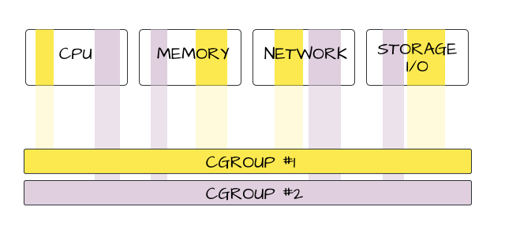
cgroups
Notes:
Images taken from Mairin Duffy’s blog https://mairin.wordpress.com/2011/05/13/ideas-for-a-cgroups-ui/

Slide 37
cgroups

Slide 38
Container “Virtual Machine”
host’s raw performance
+
cgroups configuration
=
“virtual machine”
Notes:
In order to understand the differences that we observe when re-executing experiments that are implemented in containers, we’re going to need to have access to the hosts’s hardware specification
If we are running multiple containers in the same host, then we need access to the ACTUAL resources that the experiment container observes. E.g. if the host is giving 200/400

Slide 39
Experiment Execution Engine
LXC
cgroups
namespace
Linux Kernel
Host

Slide 40
Experiment Execution Engine
LXC
cgroups
namespace
Linux Kernel
Host

Slide 41
Experiment Execution Engine
Monitor
LXC
cgroups
namespace
Linux Kernel
Host

Slide 42
Experiment Execution Engine
Experiment
Monitor
LXC
cgroups
namespace
Linux Kernel
Host

Slide 43
Experiment Execution Engine
Experiment
Monitor
LXC
cgroups
namespace
Linux Kernel
Host
Profile
Repository

Slide 44
Experiment Execution Engine
Experiment
Monitor
LXC
cgroups
namespace
Linux Kernel
Host
Profile
Repository

Slide 45
Experiment Profile
Container image
Platform profile
Container configuration
Execution profile

Slide 46
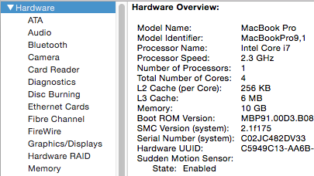
Platform Profile
Host characteristics
Hardware specs
Age of system
OS/BIOS conf.
etc.
Baseline behavior
Microbenchmarks
Raw performance characterization
Notes:
Static is usually the output of `lshw` or `/proc/cpuinfo`.
But sometimes this is not enough, as we saw with the Ceph experiments, the fact that a hard disk or switch specifies 100 MB/s doesn’t mean it will actually be that what it’s observed in practice.
hyperthreading

Slide 47
Container Configuration
cgroups configuration
CPU
Memory
Network
Block IO
Experiment Container

Slide 48
Execution Profile
Container metrics
Usage statistics (overall)

Slide 49
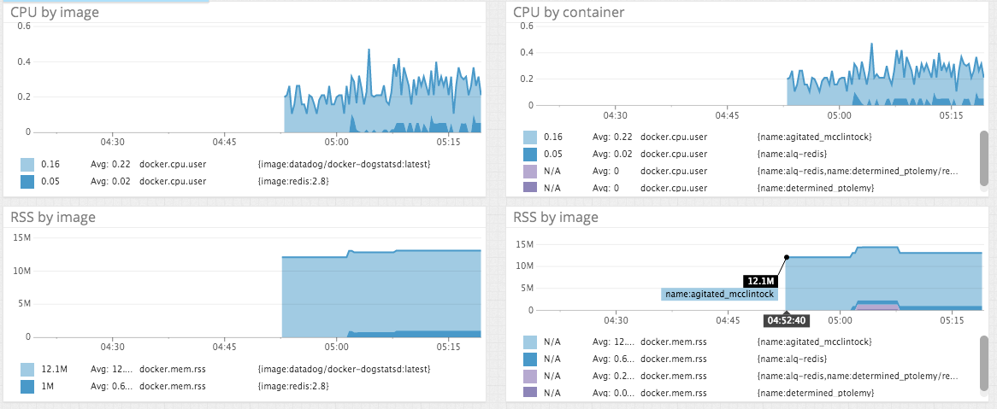
Execution Profile
Container metrics
Usage statistics (overall)
Over time
Notes:
Image taken from DataDog blog https://www.datadoghq.com/2014/06/monitor-docker-datadog/

Slide 50
Experiment Profile
Container image
Platform profile
Container configuration
Execution profile
CPU
Memory
Network
Block IO
Experiment Container

Slide 51
Experiment Profile
Container image
Platform profile
Container configuration
Execution profile
Having all this information at hand is invaluable when validating an experimental result and is usually not found in an academic article.
CPU
Memory
Network
Block IO
Experiment Container
Notes:
We make a pause and mention how we can make use of this information to try to recreate a system on another

Slide 52
Mapping Between Hosts
Reproduce on host B (original ran on host A):
Obtain the platform profile of A.
Obtain the container configuration on A.
Obtain the platform profile of B.
Using 1-3, generate configuration for B.
Example: emulate memory/io/network on B so that characteristics of A are reflected.

Slide 53
Mapping Between Hosts
System A
CPU
Memory
Network
Block IO

Slide 54
Mapping Between Hosts
System A
CPU
Memory
Network
Block IO
Experiment Container

Slide 55
Mapping Between Hosts
System A
CPU
Memory
Network
Block IO
Experiment Container
System B
CPU
Memory
Network
Block IO

Slide 56
Mapping Between Hosts
System A
CPU
Memory
Network
Block IO
Experiment Container
System B
CPU
Memory
Network
Block IO

Slide 57
Does it work?

Slide 58
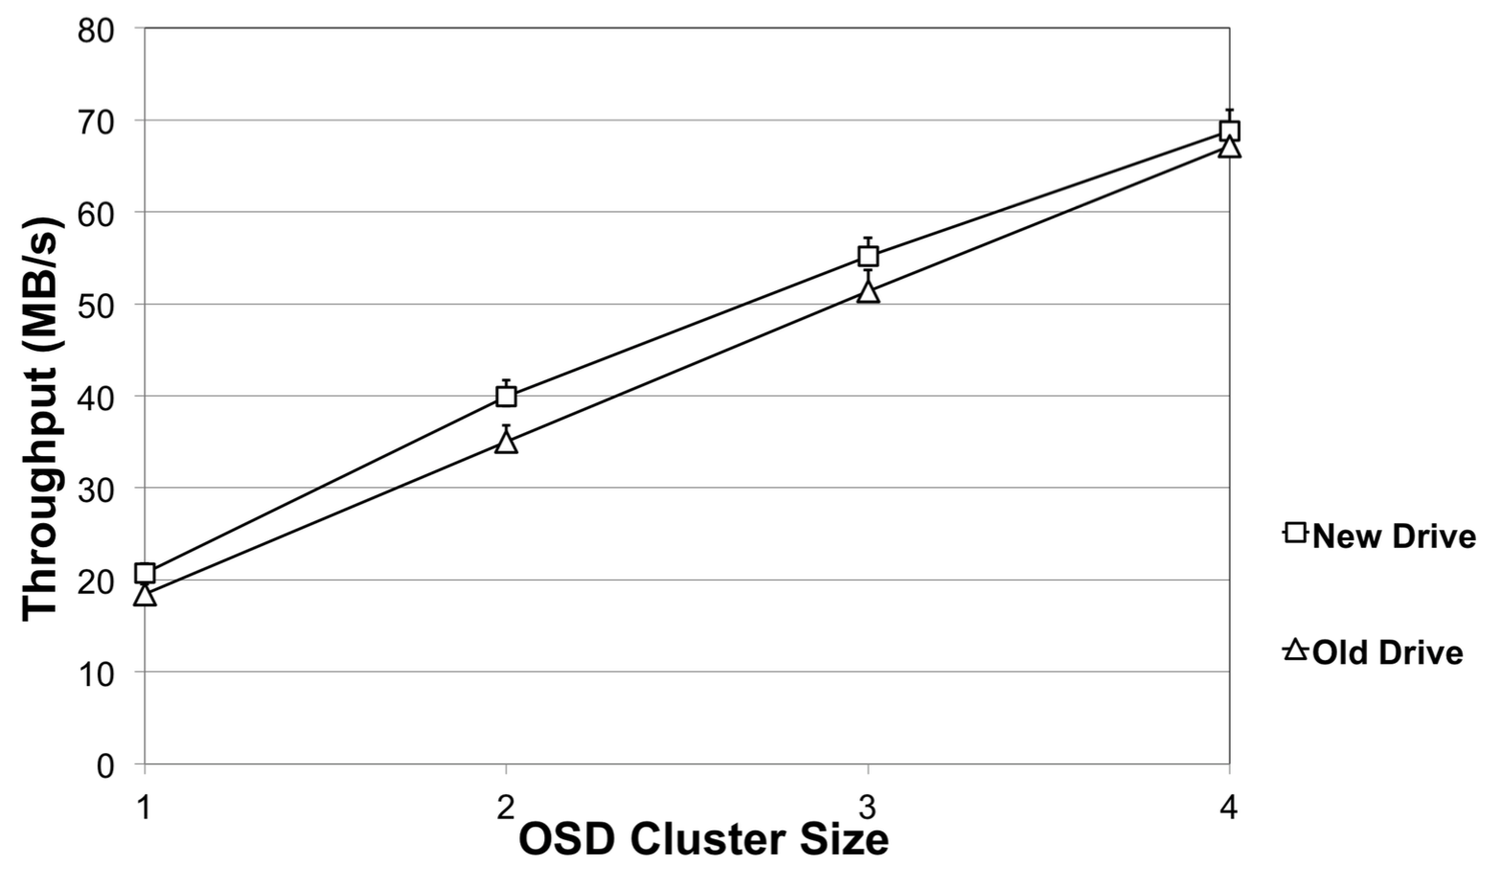
Does it work?

Slide 59
Mapping doesn’t always work
Experiments that rely on unmanaged operations and resources.
Asynchronous I/O, memory bandwidth, L3 cache, etc.
Enhancing isolation guarantees of container execution engine results in supporting more of these cases.
E.g. if cgroups now isolate asynchronous I/O for every distinct group.
Notes:
This won’t work in general for resources for which the isolation guarantees of containers aren’t strong.
We showed how the mapping works for synchronous block I/O.
Can this also work for other things like CPU, memory, network?
Environments with high degree of sharing will be sensible to this.

Slide 60
Open Question
Given strong isolation guarantees, can we automatically check for repeatability by looking at low-level metrics?

Slide 61
Open Question
Given strong isolation guarantees, can we automatically check for repeatability by looking at low-level metrics?

Slide 62
Open Question
Given strong isolation guarantees, can we automatically check for repeatability by looking at low-level metrics?
System A

Slide 63
Open Question
Given strong isolation guarantees, can we automatically check for repeatability by looking at low-level metrics?
System A

Slide 64
Open Question
Given strong isolation guarantees, can we automatically check for repeatability by looking at low-level metrics?
System A
System B

Slide 65
Open Question
Given strong isolation guarantees, can we automatically check for repeatability by looking at low-level metrics?
?
=
System A
System B

Slide 66
On-going and Future Work
Taking more already-published experiments to test robustness of our approach.
Integrate our profiling mechanism into container orchestration tools.

Slide 67
Thanks!

