Slide 1

Detecting Single Point Attacks in Electricity Markets using Decision Trees
Ioannis Vourkas, EE PhD Candidate, CUNY City College, SP 2025
Class: Applied Machine Learning and Data Mining
Instructor: Sadegh Farhang

Slide 2

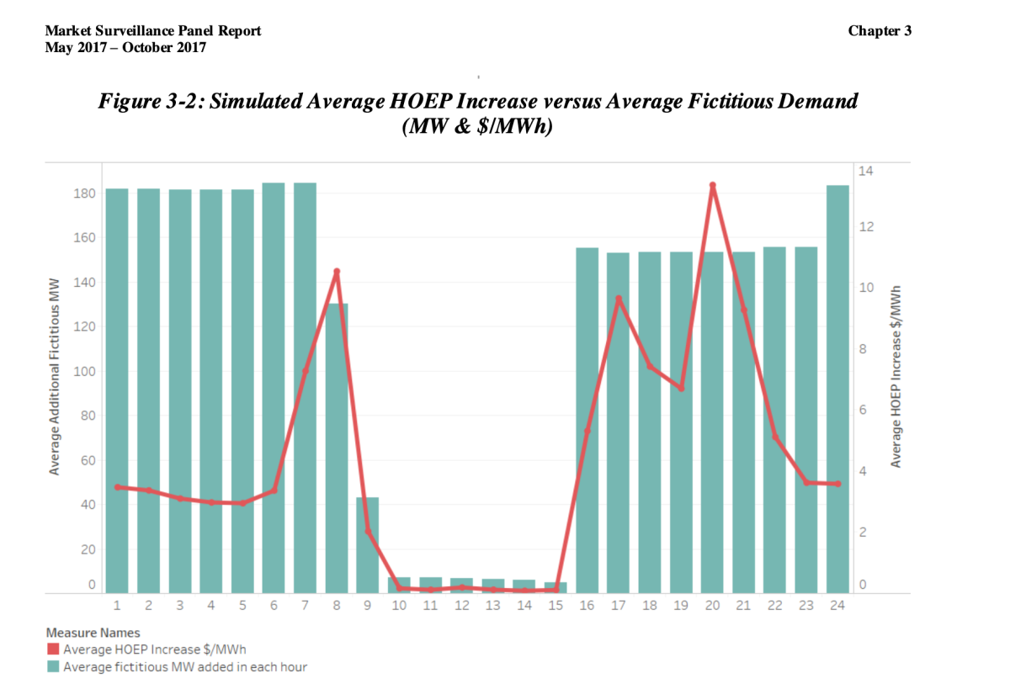

When $500 Million Disappeared
Ontario electricity operator made a mistake in 2016-2017 by counting "phantom" electricity demand that didn't exist
Instead of subtracting the embedded (behind-the-meter) solar generation from demand, the system operator (IESO) added it, effectively double-counting electricity use
Nobody noticed for almost a year!
Monitoring Report on the IESO-Administered Electricity Markets, ONTARIO ENERGY BOARD

Slide 3
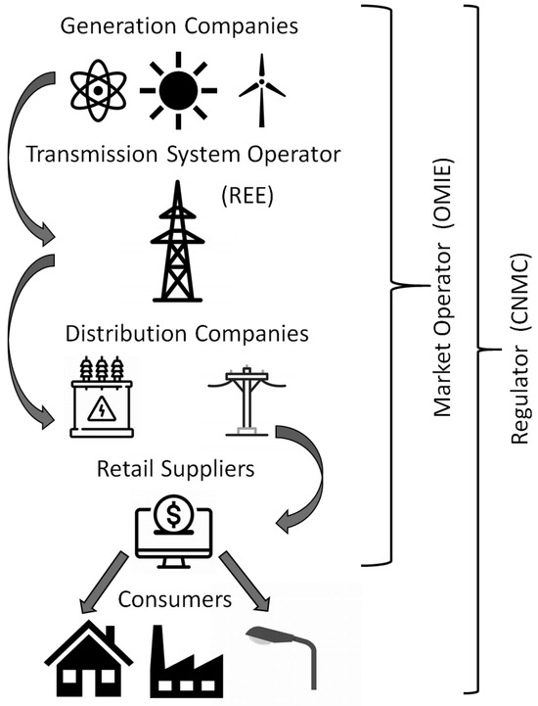


The Electricity Market Puzzle
Multiple power plants compete to sell electricity by bidding in the local electricity market
Market operator solves a complex math problem called "Optimal Power Flow" (OPF)
What is OPF? Think of it like planning delivery routes:
Goal: Meet all electricity demand at lowest total cost
Constraints: Respect physical limits (like speed limits on highways)
Consider: How much each plant can produce and at what price
Prediction of Matching Prices in Electricity Markets through Curve Representation,
Section C: Energy Economics and Policy

Slide 4
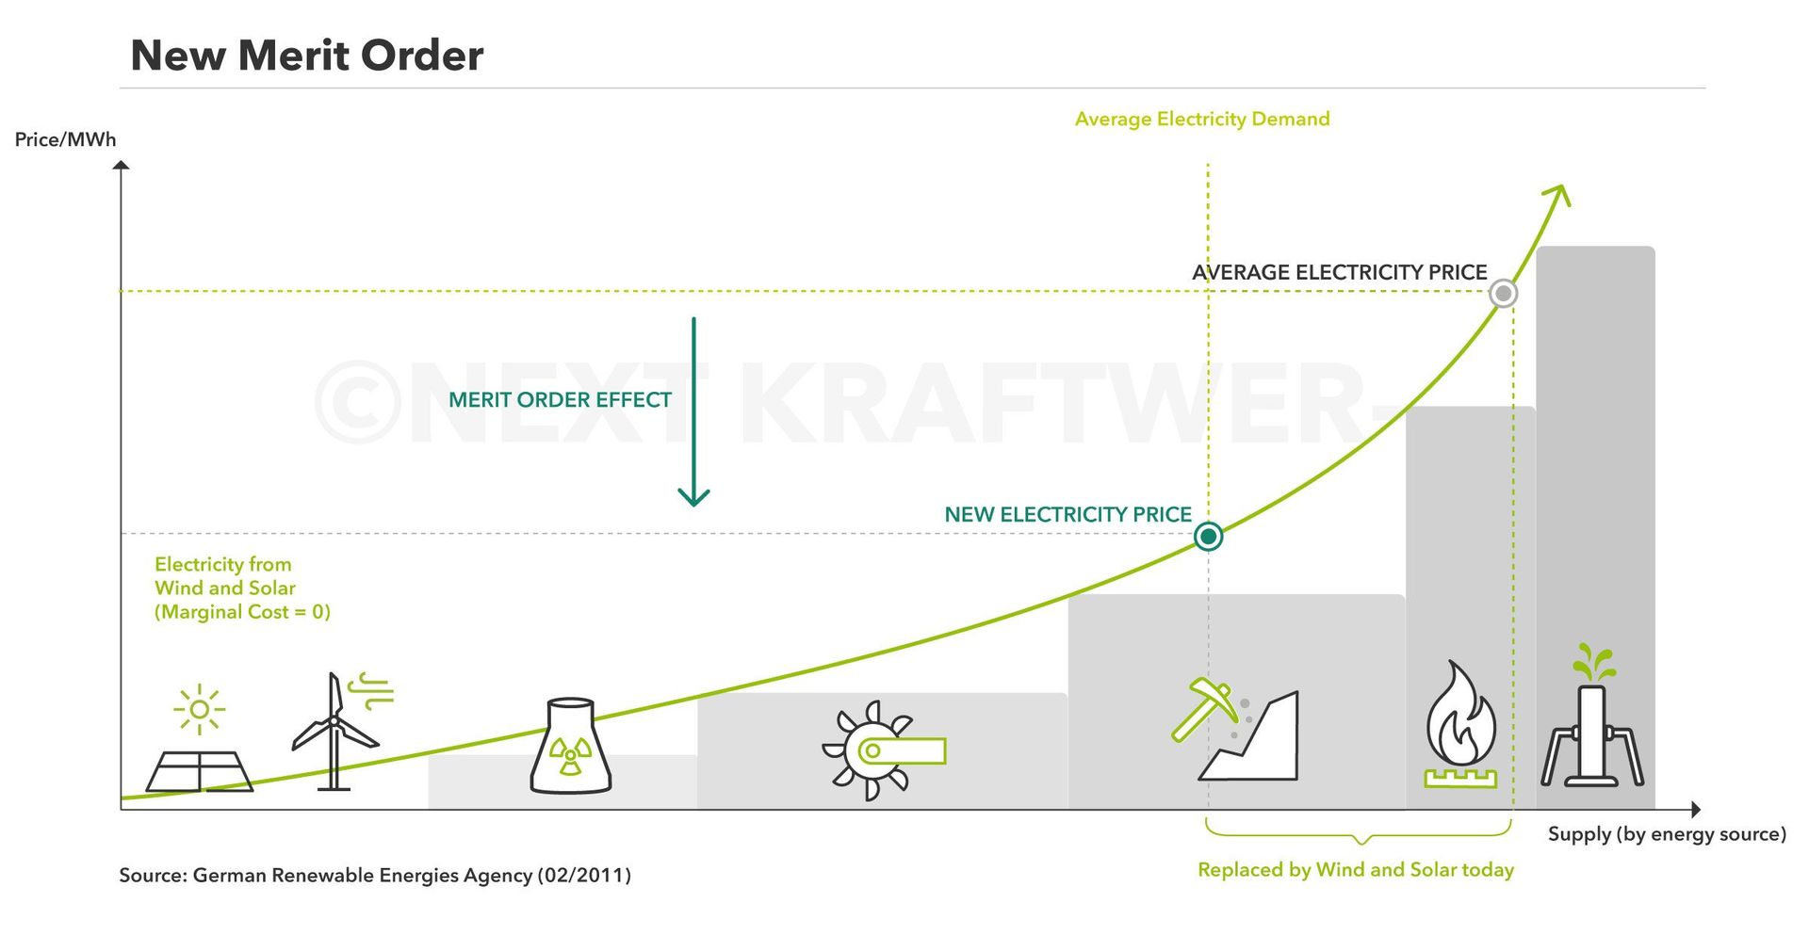
Merit Order

Slide 5
What Can Go Wrong?
Small errors in this calculation can cost millions of dollars
Attack types (100% realistic!):
Ramp Rate Attack: Changing how fast generators can adjust output => Forces the system to use more expensive alternatives
Upper Limit Attack: Reduces the maximum power a plant can produce => Creates artificial scarcity, drives up prices
Lower Limit Attack: Forces a plant to produce more than economically optimal => Wastes resources and increases system costs
Generation Cost Attack: Changes the reported cost of generating electricity => Misleads the market operator into making inefficient choices

Slide 6

Data Creation
Used IEEE 300-bus system (like a small city grid)
DC-OPF solved and creation of synthetic data simulating both normal and attack scenarios
Generated 1,920 examples across 4 seasons
50% normal operations, 50% with attacks

Slide 7



What Our Data Contains
Black Box Elements: Complex power system variables (voltages, power flows, etc.)
- I let the AI figure these out
fval: The total cost of running the system for each day - this is what we're trying to minimize with the OPF
Attack Information:
Type of attack (1-4, or 0 for normal)
Which generator was attacked
Which season it occurred in

Slide 8
Model pipeline
Create Binary Labels
Extensive feature Engineering for the fval (30 new features added)
80-20 split without stratified sampling (realistic scenario)
From 34069 to 100
Hyperparameter optimization with RandomizedSearchCV
Scaling with RobustScaler
Dimensionality Reduction with VarianceThreshold & SelectKBest
5+1 Models: Extra Trees, GradientBoosting, RandomForest, Xgboost, Logistic Regresion & Voting Classifier for the top 3 of them

Slide 9
Models Results
Model | Accuracy | F1 Score
Voting Classifier | 0.9245 | 0.9258
Gradient Boosting | 0.9219 | 0.9227
Random Forest | 0.9193 | 0.9215
XGBoost | 0.9193 | 0.9211
Extra Trees | 0.8646 | 0.8738
Logistic Regression | 0.6823 | 0.7550

Slide 10
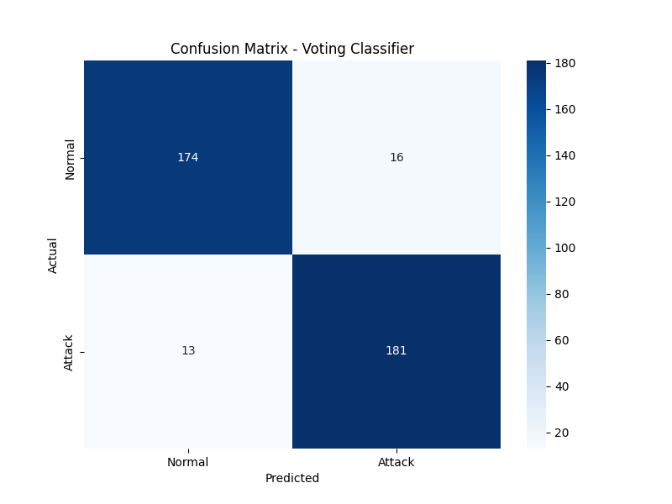
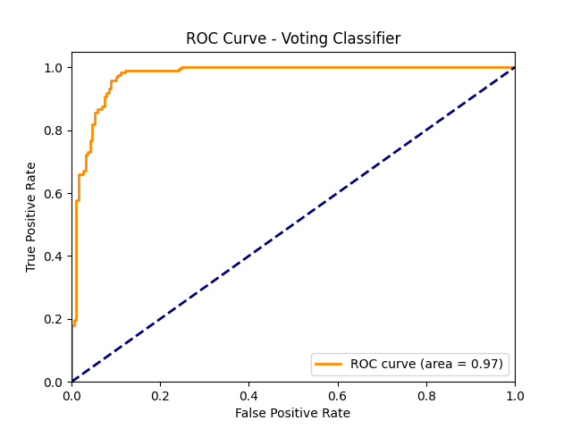

Slide 11

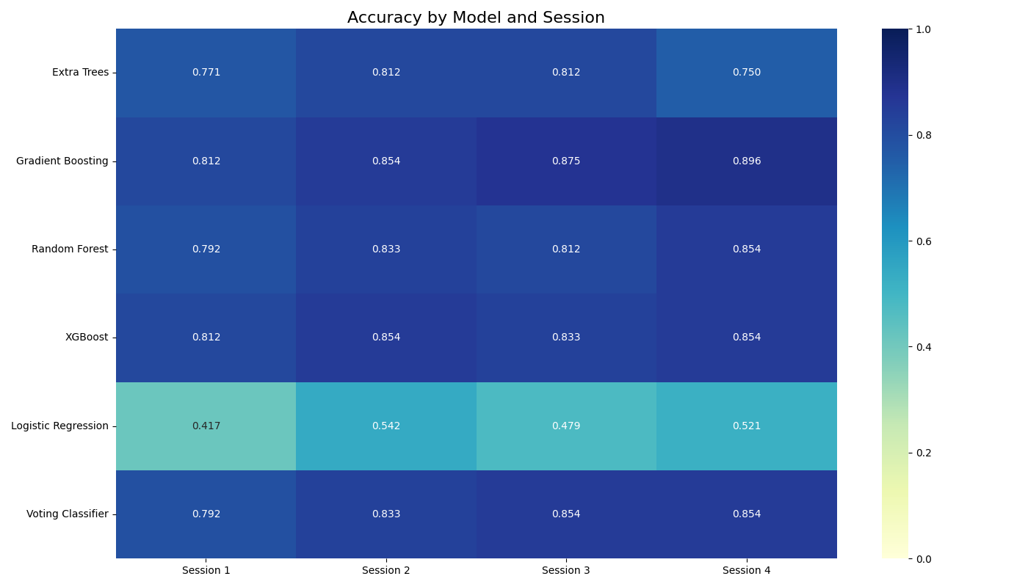
Seasonal Modeling
Exact same approach for each individual season (90-10 split that time)

Slide 12
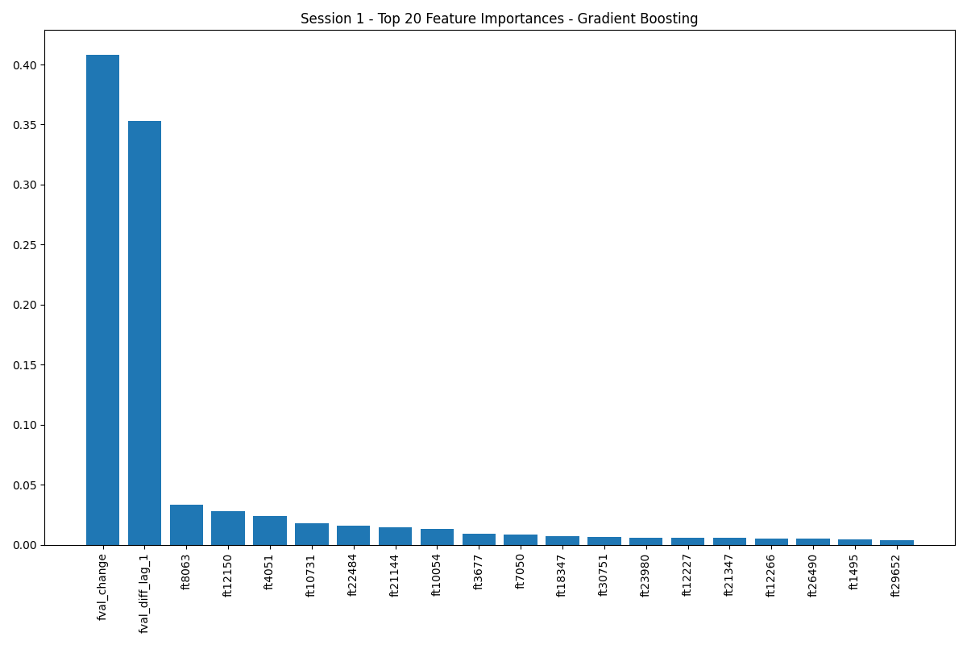
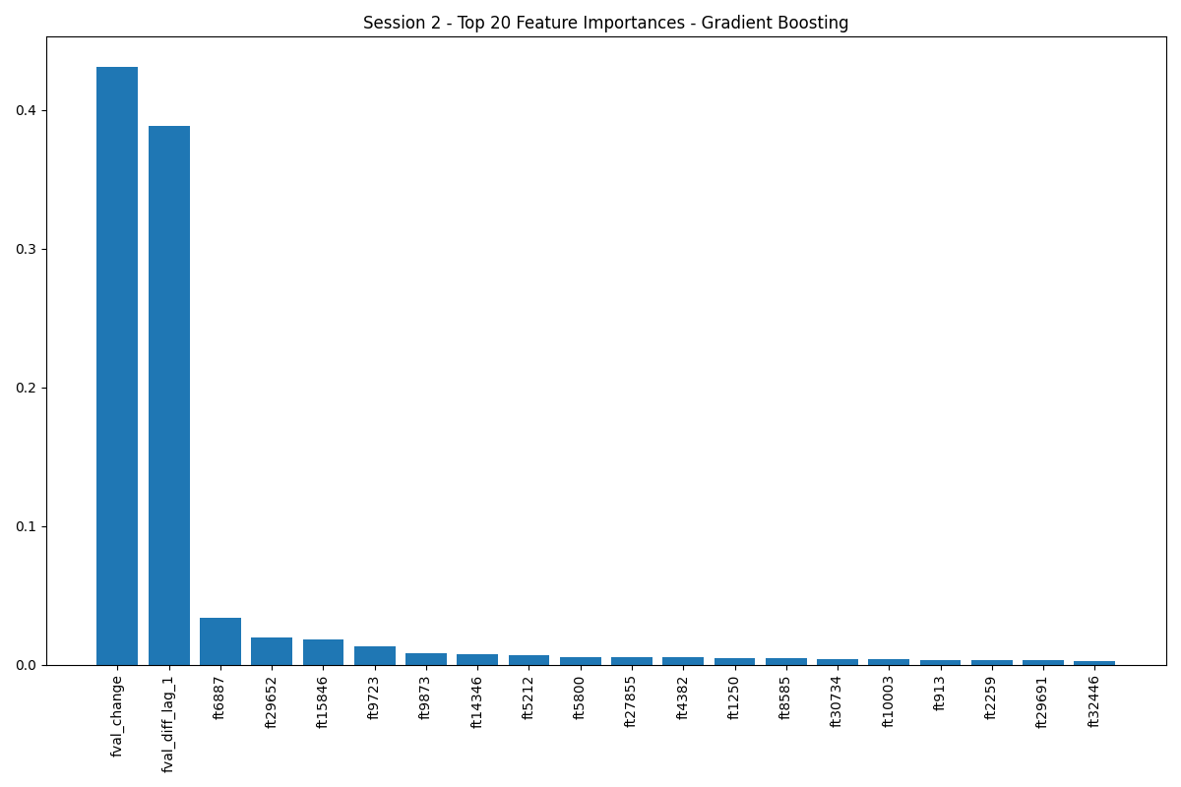
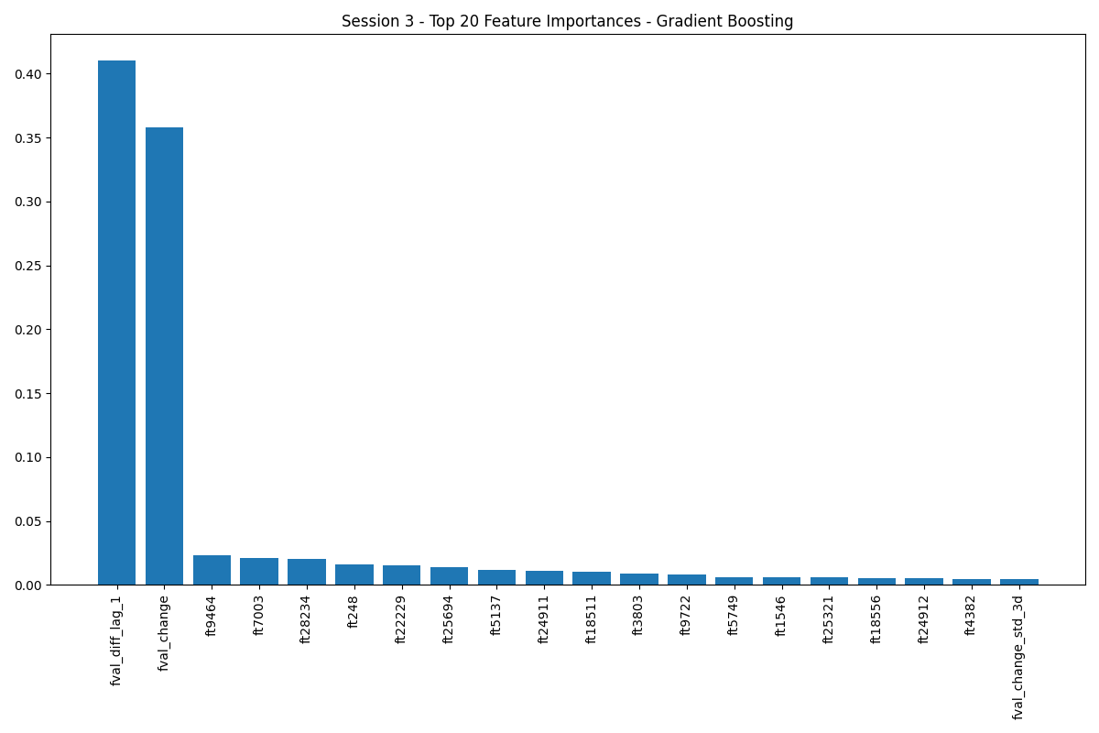
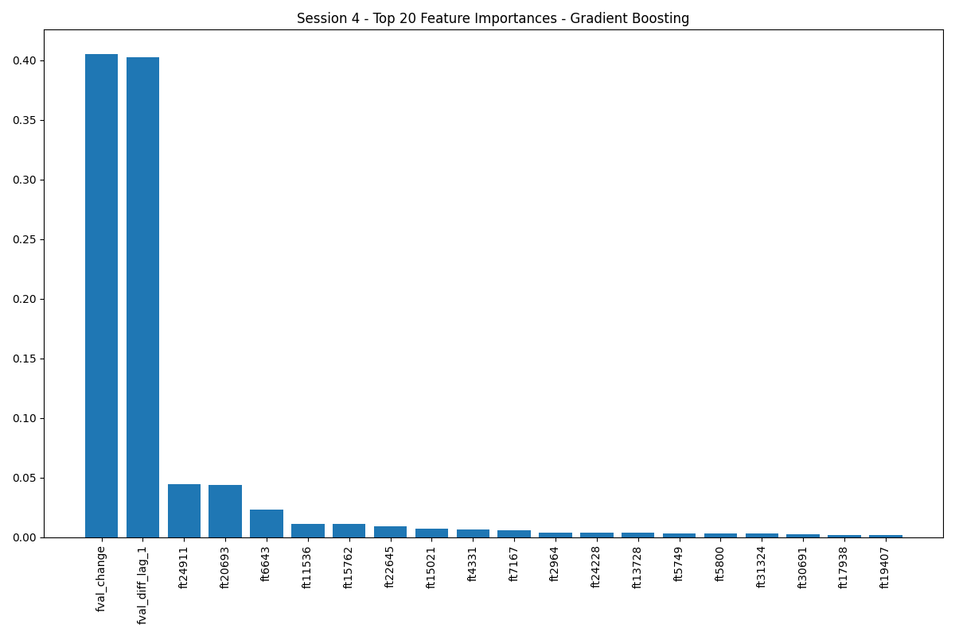

Slide 13

Some Key Findings
Surprisingly, any individual model can outperform Voting Classifier on seasonal subsets, proving more effective with limited data (480 vs 1,920 samples).
The AI system successfully detected 92% of market manipulations for the full dataset and 81-90% for the seasonal datasets by identifying cost changes(fval) as the primary warning signs.
This technology could have prevented Ontario's $500M phantom demand incident and serves as an early warning system that protects consumers from inflated electricity bills.
Future work includes testing on different grid sizes, analyzing whether undetected attacks occurred on low-impact generators that don't significantly affect system costs (fval), improving detection of subtle attacks, and developing unsupervised detection methods.
Bottom Line: AI can be a powerful watchdog for electricity markets, potentially saving millions of dollars and ensuring fair prices for everyone.

Slide 14

Thank you!

