Slide 1
SHOUTING PINWALL (By CENTRAL PERK)
Ivo Maag 정대영
양경 유언우

Slide 2
Introduction
We are making an Online Bulletin Board for friends. It displays a pin wall where everyone can post a text in CAPITAL LETTERS.

Slide 3
Features(Initially Planned)

Slide 4
Features
Login, Logout
View Post made by You and Others
Add / Delete / Edit Post
Refresh the Post List
Aligned in Chronological Order
Choose the COLOUR of your Post!
Set a Time Limit of your Post can be shown
ALL CAPS!

Slide 5

Desired Backend Environment
Several Options were discussed
Given $100 Credit for AWS, we initially decided to utilize AWS server as our backend environment.
But there were problems...

Slide 6
Final Product(What we have achieved so far)

Slide 7
Features
View Posts made by Others
Add Post
Refresh the Post List
Aligned in Chronological Order
Utilized Google Firebase instead of AWS

Slide 8
Overall System Architecture

Slide 9
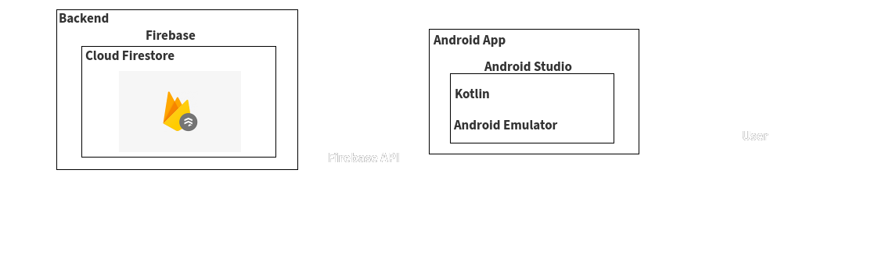
Overall System Architecture
Retrieve Data
Output
Save Data
Input

Slide 10
Use Cases

Slide 11
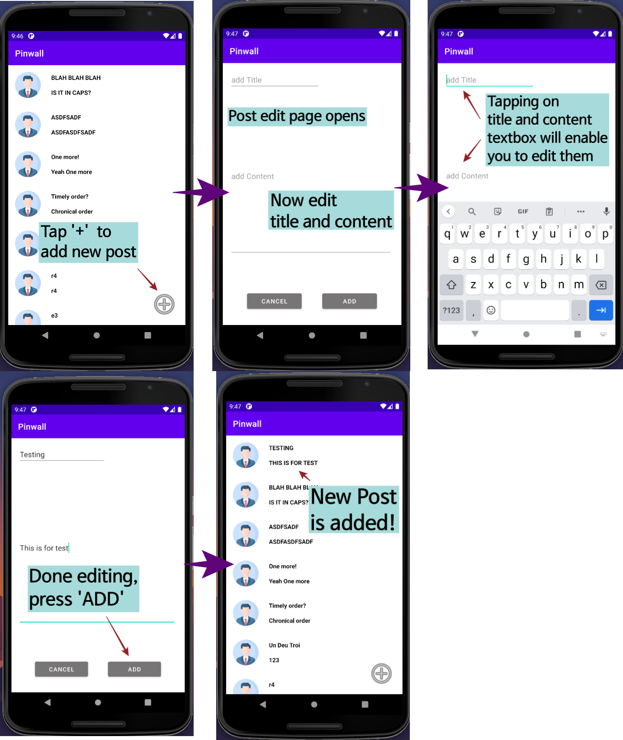
Use Cases — Adding Post

Slide 12
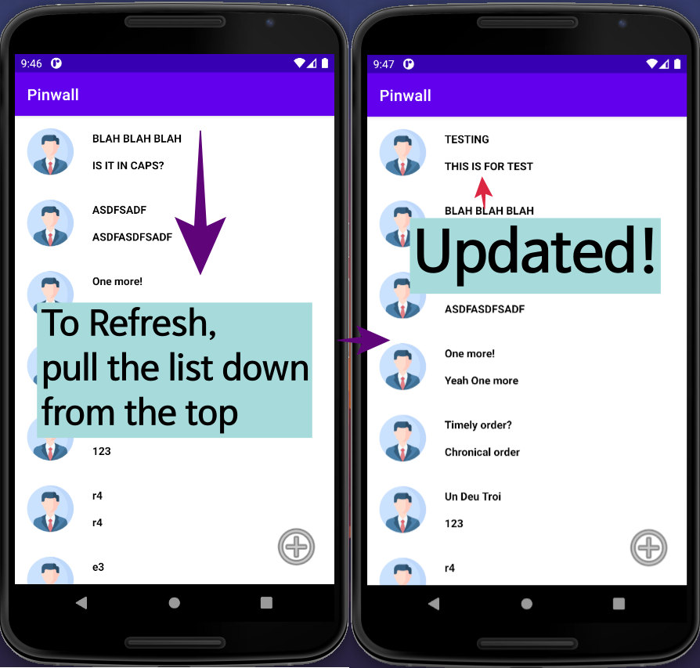
Use Cases — Updating Post List

Slide 13
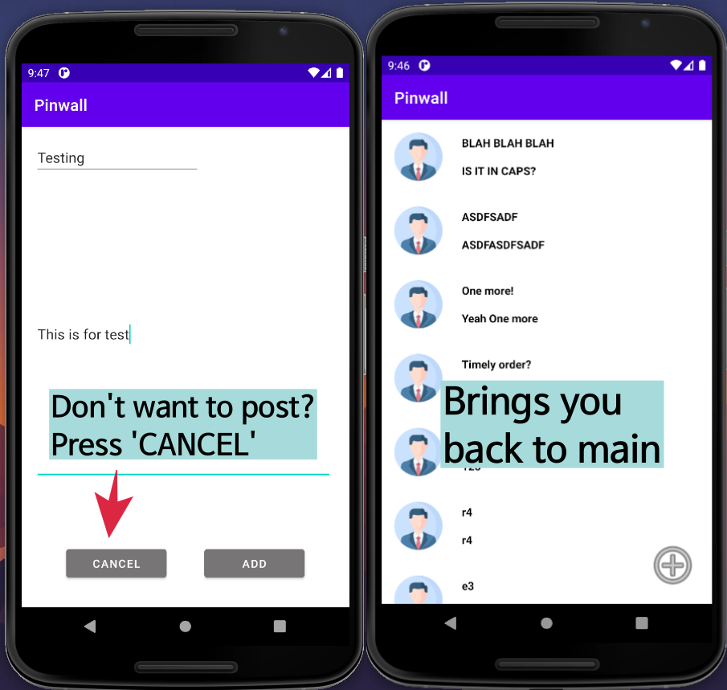
Use Cases — Discard New Post

Slide 14
Evaluation
Application is about 50% feature complete
Some features are still required to be added.
We learned how to construct a DB using online services and integrate into an application.

Slide 15

Demo in Action
https://youtu.be/XEz0Xrby4vg

Slide 16
Thank you!

