Slide 1
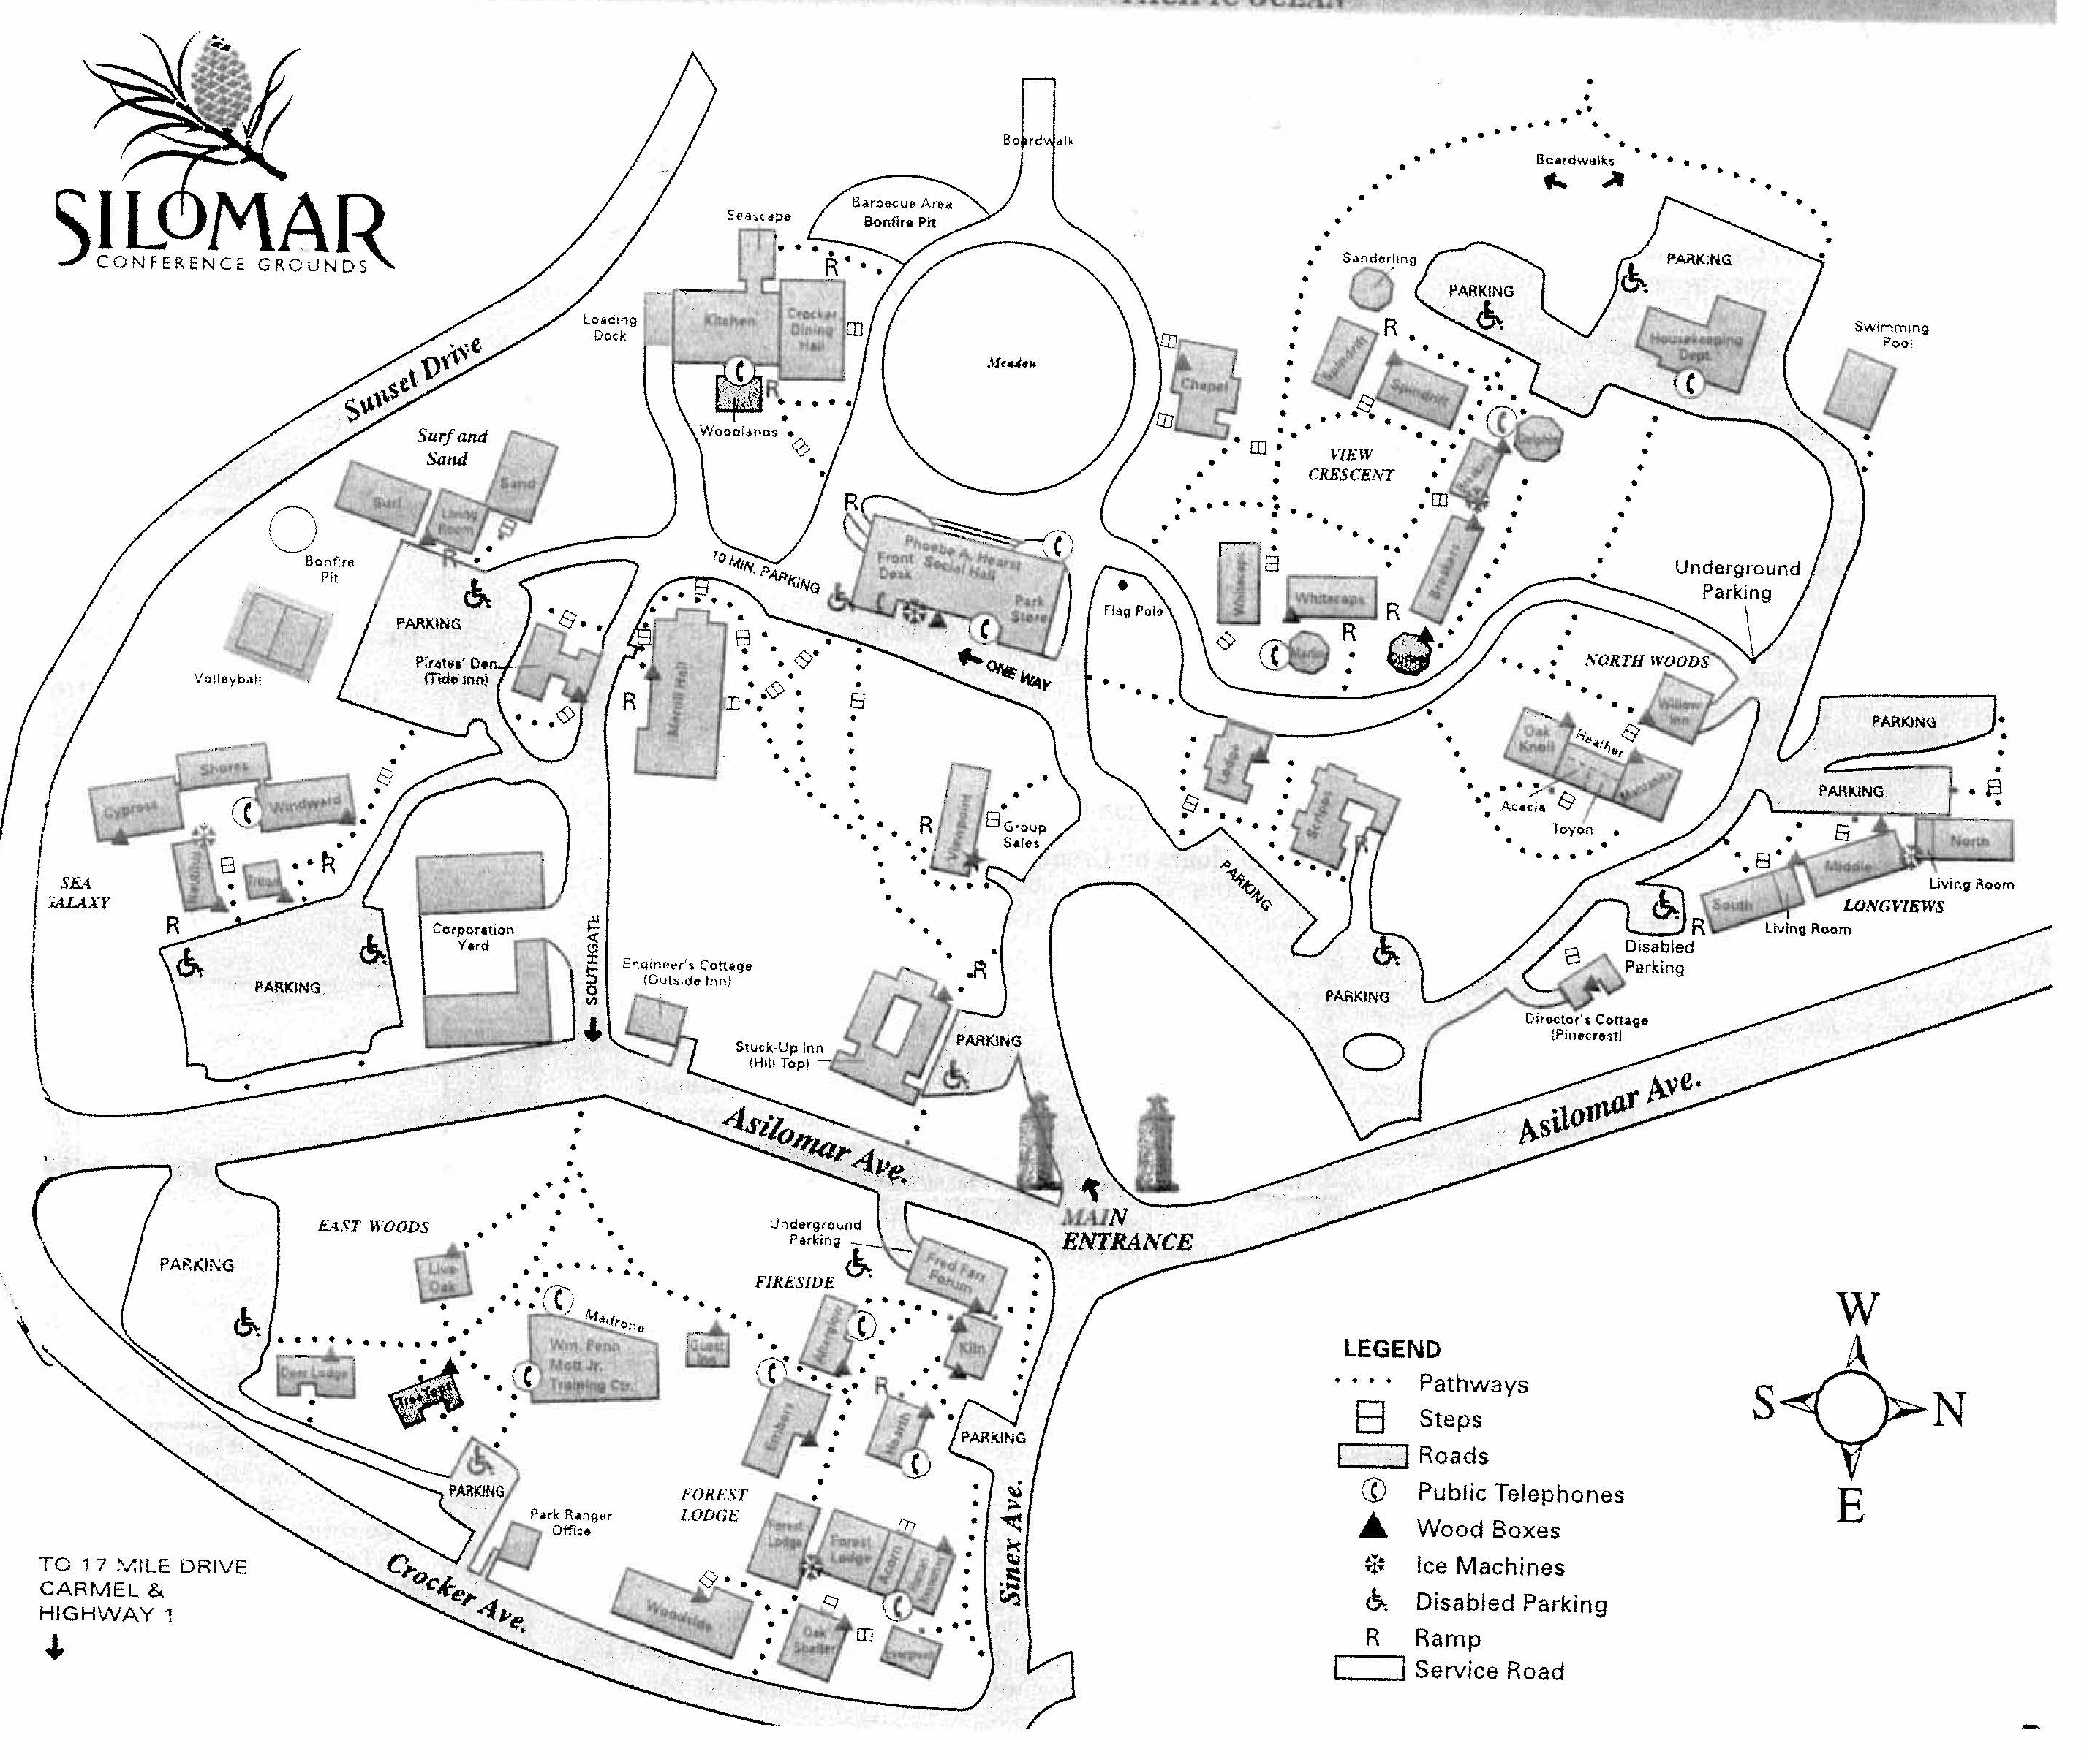
Hotel registration
Technical conference
Registration
Merrill Hall

