Slide 1
域适应 domain adaption & 图卷积 GCN
杨光磊
2019.10.19

Slide 2
内容概要
域适应介绍
DBG工作介绍
GCN学习
GCN在域适应中的应用

Slide 3
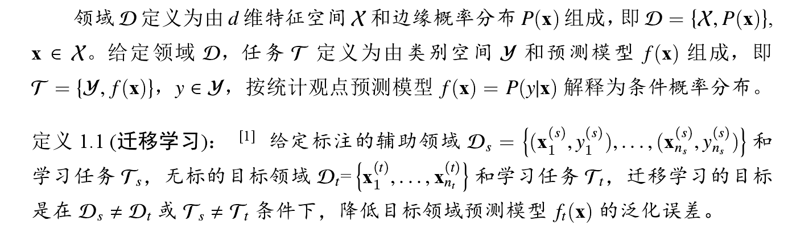
1.域适应
迁移学习

Slide 4
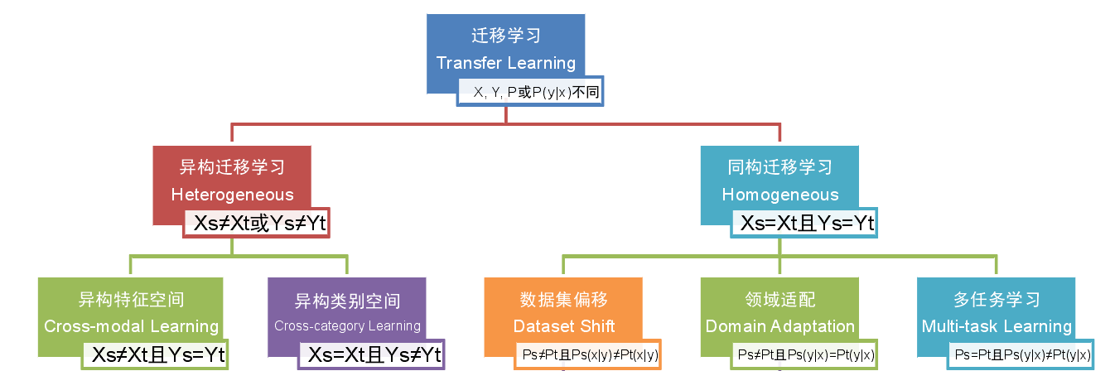
1.域适应
迁移学习与域适应的关系

Slide 5
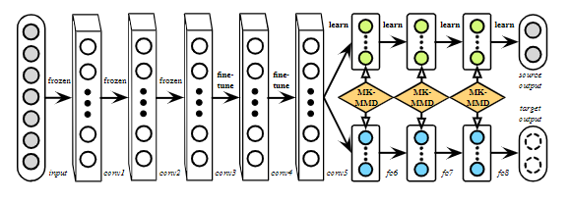
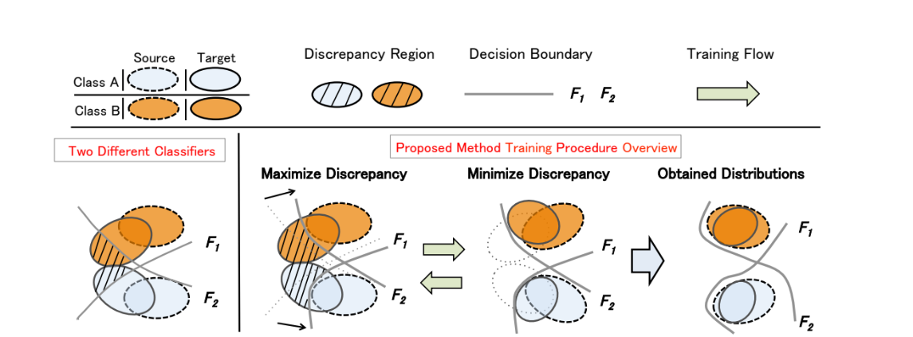
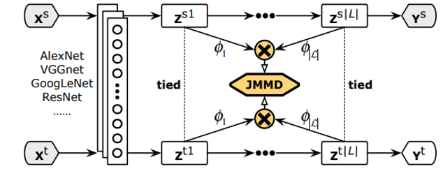
1.域适应
域适应算法
特征匹配
生成对抗网络

Slide 6
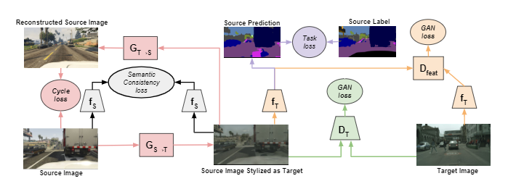
1.域适应
域适应典型应用
语义分割

Slide 7
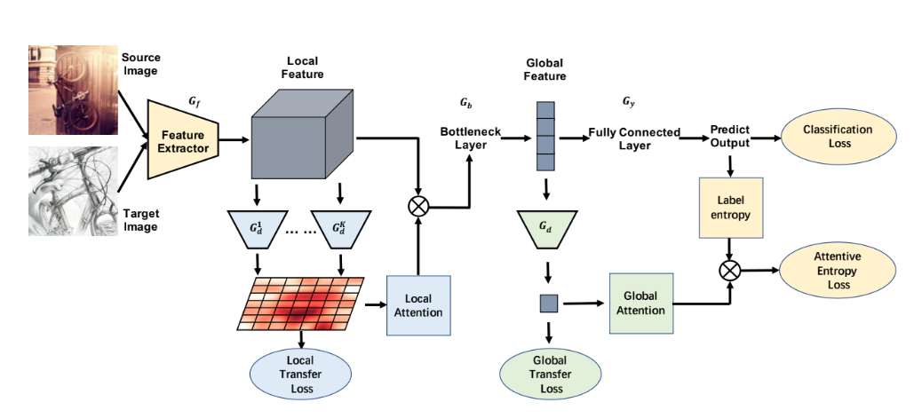
1.域适应
域适应典型应用
分类

Slide 8
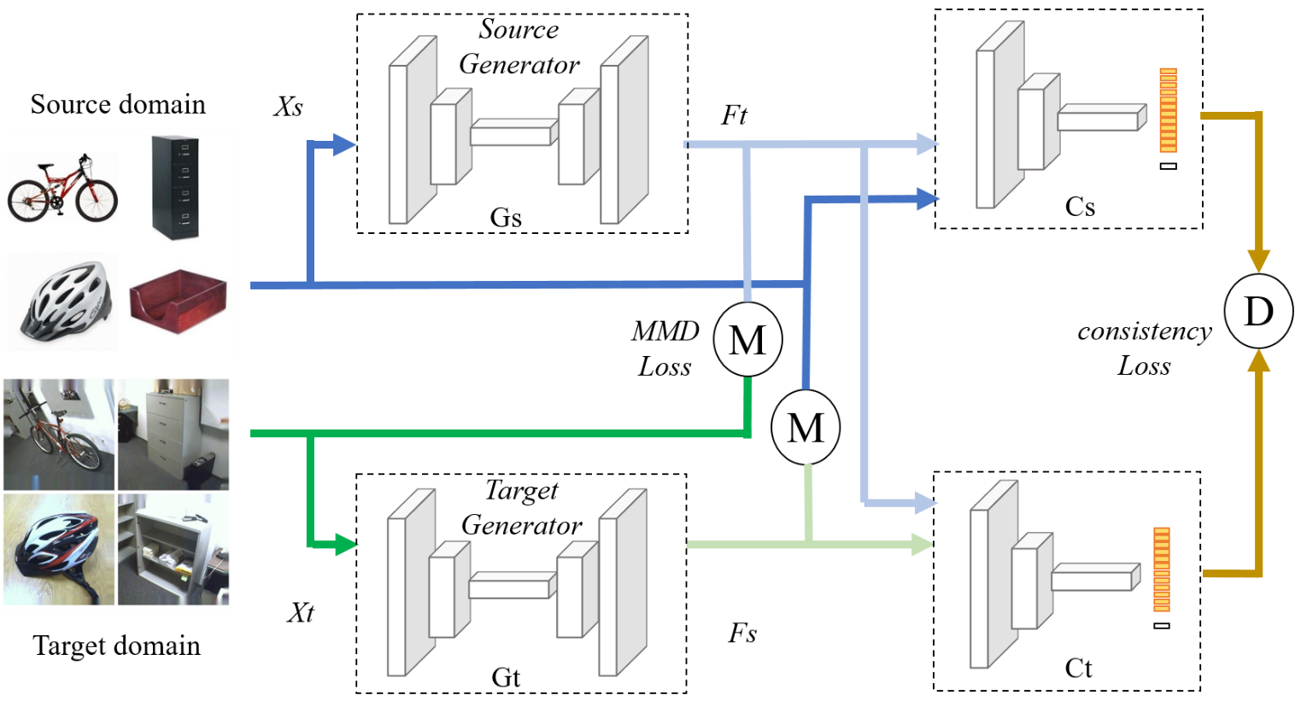
2.BDG介绍

Slide 9
3.GCN学习
 | from | work | dataset | method | code
Semi-sup GCN | ICLR 2017 | classification | citation network datasets | semi-superviewed | https://github.com/tkipf/gcn.
VGAE |  | classification | citation network datasets | unsuperviewed
CNN_graph | NIPS 2016 | classification | MNIST/20NEWS | superviewed | https://github.com/mdeff/cnn_graph
Spectral Networks and Deep Locally Connected Networks on Graphs |  | classification | MNIST | superviewed
Deep Convolutional Networks on Graph-Structured Data |  | classification | DPP4 | superviewed
GC-MC |  | Matrix completion | collaborative filtering benchmark | semi-superviewed | https://github.com/fmonti/mgcnn
R-GCN |  | Link prediction/entity classification |  | semi-superviewed | https://github.com/tkipf/relational-gcn;https://github.com/MichSchli/RelationPrediction

Slide 10
3.GCN学习
PyGCN 分析
From：https://github.com/tkipf/pygcn
引用：
@article{kipf2016semi,
title={Semi-Supervised Classification with Graph Convolutional Networks},
author={Kipf, Thomas N and Welling, Max},
journal={arXiv preprint arXiv:1609.02907},
year={2016}
}

Slide 11
3.GCN学习
Data 分析
The .content file contains descriptions of the papers in the following format:
<paper_id> <word_attributes>+ <class_label>
paper_id 1 word_attributes 1433 class_label 1
The .cites file contains the citation graph of the corpus. Each line describes a link in the following format:
<ID of cited paper> <ID of citing paper>
5429 items

Slide 12
3.GCN学习
Data 分析
The .content file contains descriptions of the papers in the following format:
<paper_id> <word_attributes>+ <class_label>
paper_id 1 word_attributes 1433 class_label 1
The .cites file contains the citation graph of the corpus. Each line describes a link in the following format:
<ID of cited paper> <ID of citing paper>
5429 items

Slide 13
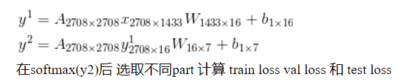
3.GCN学习

Slide 14
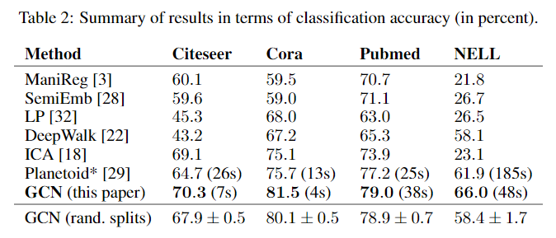
3.GCN学习

Slide 15
3.GCN学习
总结
GCN 基本上是特征提取—图生产—GCN
特征提取主要是通过 ResNet VGG
图生成的方式关键在于如何定义两者之间的关系
GCN网络则是存在是一般的GCN和normalize GCN两种区分

Slide 16
4.GCN在域适应中的实验
L1+exp
L2+exp
Full connection
L1+exp+normal
L2+exp+normal
Inner product
cosimilarity
Related connection

Slide 17

4.GCN在域适应中的实验
L1+exp
L2+exp
正则化

Slide 18
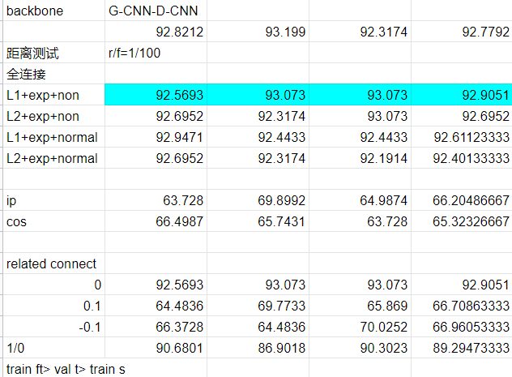
4.GCN在域适应中的实验

Slide 19
参考文献
Semi-Supervised Classification with Graph Convolutional Networks,ICLR 2017
Convolutional Neural Networks on Graphswith Fast Localized Spectral Filtering, NIPs2016.
GCAN: Graph Convolutional Adversarial Network for Unsupervised Domain Adaptation,CVPR 2019

Slide 20
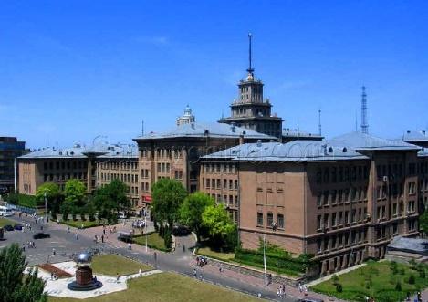
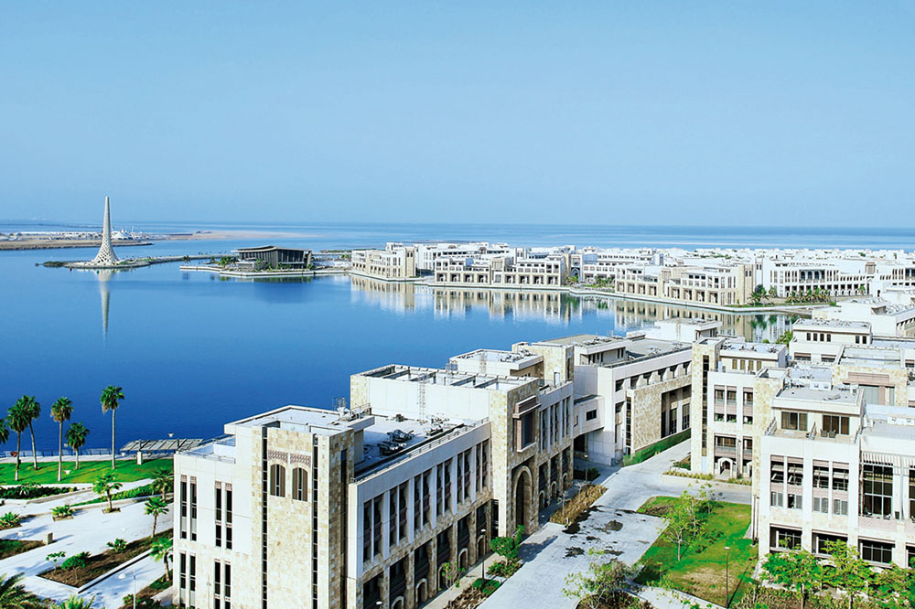
THANK YOU !

