Slide 1

Operating Systems
(操作系统 2026秋冬）
教四-306（周2第9-10节，周4第7-8节）
实验课：曹西-503（周3第11-12节）
Lecture 1: Overview
Shou Lidan
should @ zju.edu.cn

Slide 2
Operating Systems: Course Overview
How computers run programs and manage resources,
with hands-on practice in system design.
Program execution
Software and hardware
How do programs share processors?
How do threads coordinate safely?
How does virtual memory work?
How are files stored?
How do systems recover from crashes?
System calls, kernels and interrupts.
Context switches and page tables.
How apps obtain OS services.
How the OS controls hardware.
System design and explanation
Prerequisites
Build correct software, write clear code,
and explain the reasons for your design.
C programming, data structures,
basic RISC-V assembly and Linux tools.
Enjoy hacking around!
Operating Systems
1.2
@ZJU

Slide 3
Main Contents
Overview
  Intro
  OS structure
Process Management
  Processes
  Threads
  CPU scheduling
  Process Synchronization
  Deadlocks
Memory Management
  Main memory
  Virtual memory
Storage Management
  File-system interface
  File-system implementation
  Mass-storage structure
  I/O systems

Slide 4
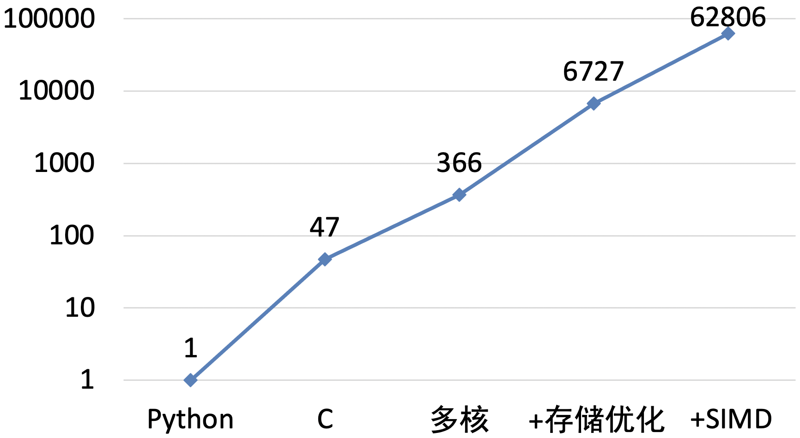
Why is OS still important in ChatGPT-era?
There’s plenty of room at the Top: What will drive computer performance after Moore’s law? https://www.science.org/doi/10.1126/science.aam9744
  Performance improved 63000x
  C program can be optimized 1300x
multiplying two 4096-by-4096 matrices
for i in xrange(4096):
for j in xrange(4096):
for k in xrange(4096):
C[i][j] += A[i][k] * B[k][j]
Software performance engineering, development of algorithms, and hardware streamlining at the Top can continue to make computer applications faster in the post-Moore era.

Slide 5
Why To Learn Operating Systems?
Building blocks of modern computer software
Applications
Algorithm
Data Structure
System Software

Slide 6
OS Ideas in AI and Cloud Computing
vLLM
Llumnix
Dirigent
SOSP 2023
OSDI 2024
SOSP 2024
Virtual memory and paging
Scheduling and migration
Sandboxes and scheduling
Stores GPU KV-cache in
noncontiguous blocks.
Shares blocks with
copy-on-write.
Reschedules requests
across model instances.
Migrates request states
to rebalance the load.
Runs cloud functions in
containerd or Firecracker
sandboxes. Simplifies
scheduling and scaling.
2–4× throughput
Lower tail latency
2,500 starts/s
At similar latency versus
FasterTransformer / Orca
in evaluated workloads.
Balances load and honors
request priorities and
latency requirements.
Sandbox startup rate
in evaluated workloads.
Lower scheduling latency.
Notes:
[1] Kwon et al., Efficient Memory Management for Large Language Model Serving with PagedAttention, SOSP 2023. https://arxiv.org/abs/2309.06180 and https://doi.org/10.1145/3600006.3613165 . Paging and copy-on-write are OS ideas applied to GPU KV-cache management, rather than a claim that this is kernel virtual-memory paging. Throughput comparison is against FasterTransformer and Orca at similar latency in the evaluated workloads.
[2] Sun et al., Llumnix: Dynamic Scheduling for Large Language Model Serving, OSDI 2024. https://www.usenix.org/conference/osdi24/presentation/sun-biao . Runtime request rescheduling and live migration balance load and differentiate priorities/SLOs.
[3] Cvetković et al., Dirigent: Lightweight Serverless Orchestration, SOSP 2024. https://anakli.inf.ethz.ch/papers/dirigent_sosp24.pdf . Supports containerd and Firecracker sandboxes. Reported rate: 2,500 sandbox starts per second. Simplifying state management and removing persistence from the latency-critical path reduce orchestration overhead.
The reported results use different metrics and are not directly comparable.

Slide 7
OS Ideas in AI and Cloud: 2026 Studies
Prism
Libra
RamRyder
OSDI 2026
NSDI 2026
OSDI 2026
GPU memory ballooning
Fine-grained scheduling
Elastic VM memory
Reclaims memory across
models. Combines space
and time sharing for
bursty LLM workloads.
Splits requests into
small cooperating units.
Schedules units globally
and locally on GPUs.
Remaps guest OS pages
to memory channels.
Adjusts memory capacity
and bandwidth per VM.
Memory reuse
Up to 1.91×
Higher utilization
Adapts model co-serving
to changing demand
with elastic allocation.
Goodput versus colocated
baselines on real-world
workload traces.
Capacity use: +28.6%
Bandwidth use: +43.2%
in the evaluated cluster.
Notes:
[1] Shan Yu et al. Prism: Cost-Efficient Multi-LLM Serving via GPU Memory Ballooning. OSDI 2026, July, pp. 75–93. https://www.usenix.org/conference/osdi26/presentation/yu-shan . Applies memory ballooning to reclaim memory across models and unify spatial and temporal sharing for bursty demand. The kvcached balloon driver is open source and reported as deployed on 10K+ GPUs. The slide describes its mechanism without claiming a quantitative speedup.
[2] Chaoyi Ruan et al. Libra: Flexible Request Partitioning and Scheduling for Serving Unbalanced and Dynamic LLM Workloads. NSDI 2026, May, pp. 1243–1258. https://www.usenix.org/conference/nsdi26/presentation/ruan-libra . Splits requests at token boundaries into micro-requests. Global scheduling chooses partition points; local GPU scheduling creates SLO-aware batches. Chunked KV-cache transfers support cross-instance execution. The abstract reports up to 1.91× and 1.61× goodput versus colocated and disaggregated baselines on real-world traces with A100/H100 GPUs. Goodput means useful throughput meeting service-level latency targets, rather than raw throughput.
[3] Yanbo Zhou et al. Break On Through to the Other Side: Pooling Memory Elastically with RamRyder. OSDI 2026, July, pp. 95–113. https://www.usenix.org/conference/osdi26/presentation/zhou-yanbo . Controls guest OS page-to-memory-channel mapping to allocate memory capacity and bandwidth mostly independently and isolate VM performance. Reports improvements in average cluster capacity and bandwidth utilization by 28.6% and 43.2%, respectively, while delivering performance comparable to exclusive access.

Slide 8
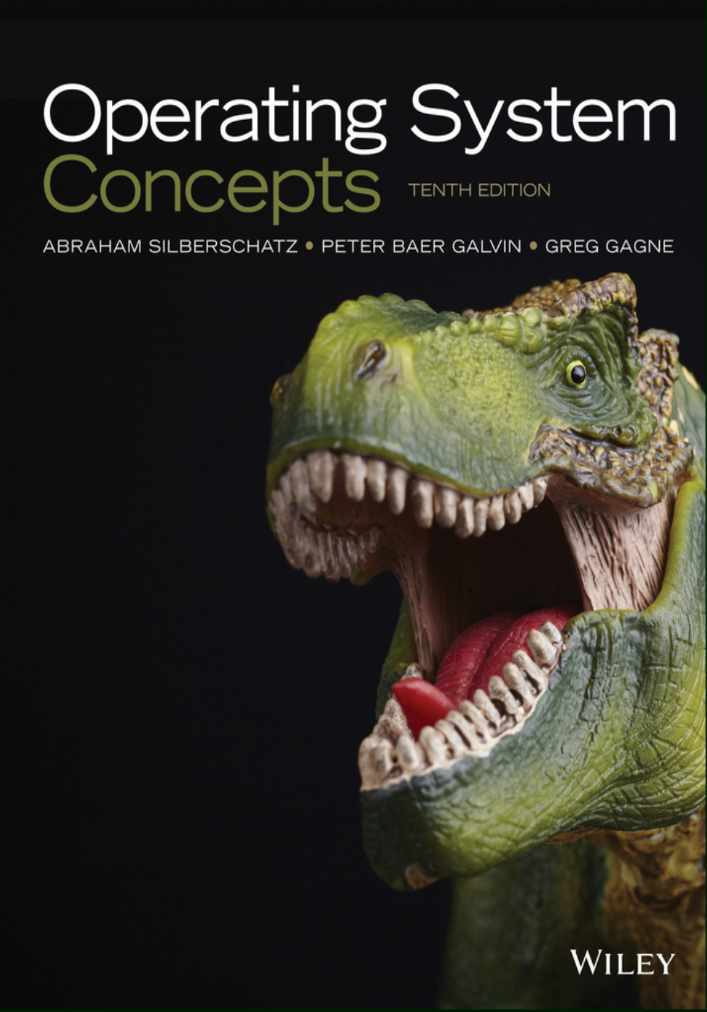
Textbook and Learning Resources
Operating System Concepts
10th edition
Abraham Silberschatz, Peter Baer Galvin
and Greg Gagne
Official companion resources
Chapter slides, exercises and study guide
Review questions, C/Java examples and errata
os-book.com/OS10/
Supplementary reading: OSTEP
Free online chapters, simulators and projects
Course website and lecture slides: courses.zju.edu.cn

Slide 9
xv6: Courses and Resources
A small kernel
you can read
MIT 6.1810
Operating System Engineering
Lectures and labs: page tables, traps, locking,
network drivers, file systems and mmap.
A Unix-like teaching OS
for multicore RISC-V.
Read the book alongside
its C and assembly code.
pdos.csail.mit.edu/6.1810/2026/
xv6 book: online text and source
mit-pdos.github.io/xv6-riscv-book/
Russ Cox
Frans Kaashoek
Robert Morris
github.com/mit-pdos/xv6-riscv-book
xv6 kernel source
Useful starting points:
kernel/proc.c and kernel/vm.c
github.com/mit-pdos/xv6-riscv
Notes:
MIT 6.1810 Operating System Engineering, Fall 2026: https://pdos.csail.mit.edu/6.1810/2026/ and https://pdos.csail.mit.edu/6.S081/2026/schedule.html .
Official xv6 resource index: https://pdos.csail.mit.edu/6.1810/2026/xv6.html .
Online book: https://mit-pdos.github.io/xv6-riscv-book/ . Authors: Russ Cox, Frans Kaashoek, Robert Morris. Describes a multicore RISC-V teaching kernel and recommends reading with code.
Book source: https://github.com/mit-pdos/xv6-riscv-book .
Kernel source: https://github.com/mit-pdos/xv6-riscv .
Replaced the outdated 2020 text date and 2022 resource link with live resource links.

Slide 10
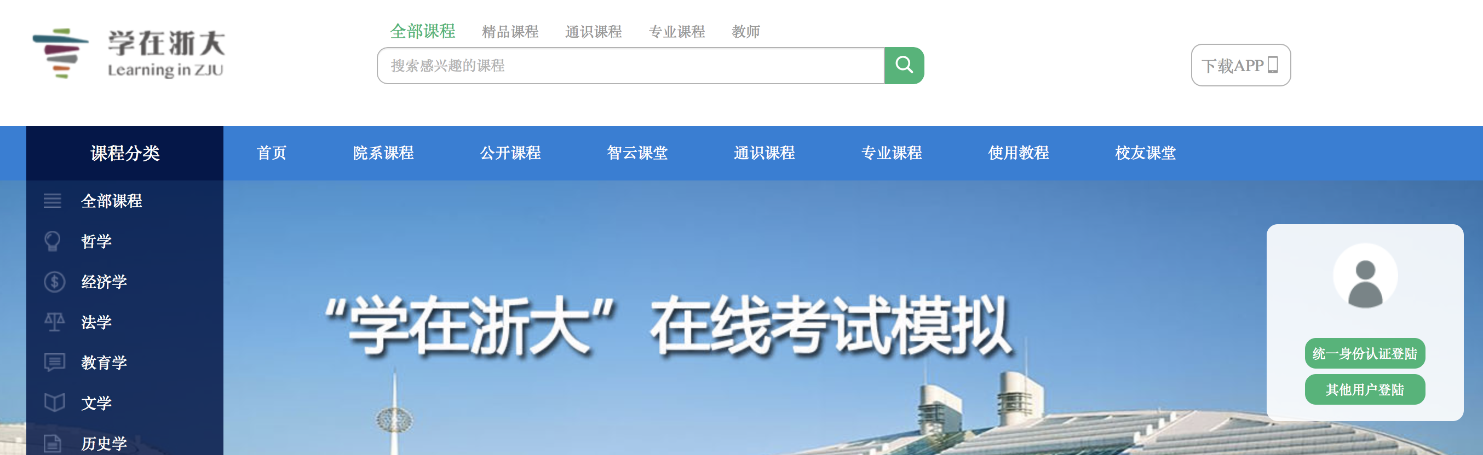
Online Assignments
http://courses.zju.edu.cn/
Teaching Assistants: 谭昭阳、张宇、桑晟, 课程钉群可联系到
Please submit your assignment IN TIME!

Slide 11
Lab Projects
每位同学独立完成，不得复制同年级、高年级同学的实验代码。代码抄袭行为和协助抄袭如被确认，后果自负。
  实验Lab0 RISC-V 64 Kernel Debug 5%
  实验Lab1 Kernel Booting & Timer 15%
  实验Lab2 Scheduling, Context Switching 15%
  实验Lab3 Virtual Memory 15%
  实验Lab4 User Mode (shell) 20%
  实验Lab5 Page fault and Fork 30%
  实验Lab6 File System 10%

Slide 12
Lab Projects
Lab0：To submit a Project Report, NO Demo；
Lab1-6：To submit a Project Report, To Demo with TA
  代码必须有详细的注释，每5行代码有注释
  每个实验写“讨论心得” (实验过程中遇到的问题及解决方法)这部分内容占本实验报告20%分数
  每个实验完成后，向老师/助教演示，以完成验收。
Project Docs https://os.pages.zjusct.io/fa26/doc-shoulidan
Project Code Repo https://git.zju.edu.cn/os/fa26/shoulidan/os-<ID>

Slide 13
Final Grade
Final exam (50%)
Lab Exam上机考试 (10%+Bonus)
Assignments/homework (5%)
In-class Quiz (5%)
Lab Reports 实验报告 (10%)
Lab Demos 实验验收 (20%)

Slide 14
Suggestions for Learning OS
Read before and after class
Trace an execution path
Read the English textbook before
and after class. Note mechanisms
and questions to discuss.
Trace a system call or page fault
from user code into the kernel
and back.
Implement and test incrementally
Debug with evidence
Make small changes. Test edge cases,
correctness invariants and
concurrent execution.
Reproduce bugs. Inspect registers,
stack traces and memory with
GDB/QEMU.
Explain your design
Reason independently
Explain correctness and tradeoffs.
Ask questions and participate
actively in lectures.
Unverified answers may be wrong.
Copied incorrect answers may incur
penalties. Keep a bug-and-fix log.

Slide 15
Lab0: GDB + QEMU, LINUX Debug
Code Repo
  https://git.zju.edu.cn/os/fa26/shoulidan/os-<学号>
Project Instructions 实验说明文档在
  https://os.pages.zjusct.io/fa26/doc-shoulidan 可浏览器阅读文档
实验重点：掌握实验环境、尝试简单调试
gdb有一个text UI可以尝试使用，按 Ctrl-x Ctrl-a 进入

Slide 16
Chapter 1 Introduction

Slide 17
Outlines for Chapter ONE
What Operating Systems Do
Computer-System Organization
Computer-System Architecture
Operating-System Structure
Operating-System Operations
Process Management
Memory Management
Storage Management
Protection and Security
Distributed Systems
Special-Purpose Systems
Computing Environments
Overview
Structure
Main parts

Slide 18
Objectives
To provide a grand tour of the major operating systems components
To provide coverage of basic computer system organization

Slide 19
What is an Operating System?
A program that acts as an intermediary between a user of a computer and the computer hardware.
Operating system goals:
  Execute user programs and make solving user problems easier.
  Make the computer system convenient to use.
Use the computer hardware in an efficient manner.

Slide 20
Computer System Structure
Computer system can be divided into four components
  Hardware – provides basic computing resources
    CPU, memory, I/O devices
  Operating system
    Controls and coordinates use of hardware among various applications and users
  System & application programs – define the ways in which the system resources are used to solve the computing problems of the users
    Word processors, compilers, web browsers, database systems, video games
  Users
    People, machines, other computers

Slide 21
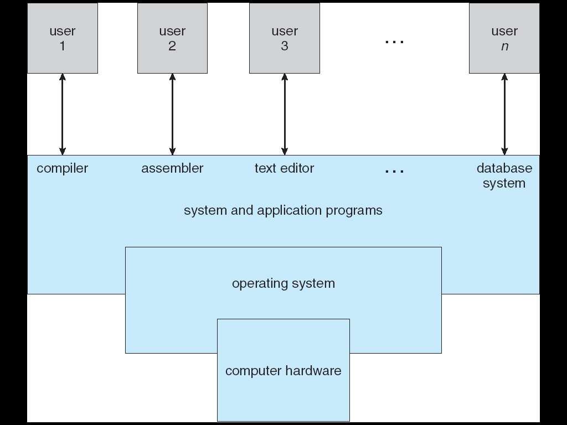
Four Components of a Computer System

Slide 22
Operating System Definition
OS is a resource allocator
  Manages all resources
  Decides between conflicting requests for efficient and fair resource use
OS is a control program
  Controls execution of programs to prevent errors and improper use of the computer
Notes:
OS is programmed constructs of software tools and services that comprise the Abstraction of a computer!
Let’s talk about Abstraction…

Slide 23
Operating System Definition (Cont.)
No universally accepted definition
“Everything a vendor ships when you order an operating system” is good approximation
  But varies wildly
“The one program running at all times on the computer” is the kernel. Everything else is either a system program (ships with the operating system) or an application program

Slide 24

Computer Startup
bootstrap program is loaded at power-up or reboot
  Typically stored in ROM or EPROM, generally known as firmware
  Initializes all aspects of system
  Loads operating system kernel and starts execution

Slide 25
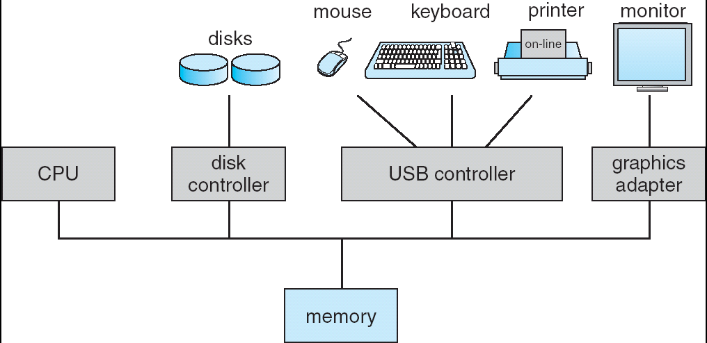
Computer System Organization
Computer-system operation
  One or more CPUs, device controllers connect through common bus providing access to shared memory
  Concurrent execution of CPUs and devices competing for memory cycles

Slide 26
Computer-System Operation
I/O devices and the CPU can execute concurrently.
Each device controller is in charge of a particular device type.
Each device controller has a local buffer.
CPU moves data from/to main memory to/from local buffers
I/O is from the device to local buffer of controller.
Device controller informs CPU that it has finished its operation by causing an interrupt (via system bus).
Notes:
Interrupt ahead

Slide 28
Common Functions of Interrupts
Interrupt transfers control to the interrupt service routine generally, through the interrupt vector, which contains the addresses of all the service routines.
Interrupt architecture must save the address of the interrupted instruction.
Incoming interrupts are disabled while another interrupt is being processed to prevent a lost interrupt.
A trap is a software-generated interrupt caused either by an error or a user request (the latter is often referred to as a system call). Note: names may vary across different architectures.
An operating system is interrupt driven.
Note: RISC-V terms
traps
exceptions & ecalls
interrupts
Notes:
注意区分术语上区别!

Slide 29
Interrupt Handling
The operating system preserves the state of the CPU by storing registers and the program counter.
Determines which type of interrupt has occurred:
  a generic routine examines the interrupt info
  vectored interrupt system, indexed by a unique number
Separate segments of code determine what action should be taken for each type of interrupt

Slide 30
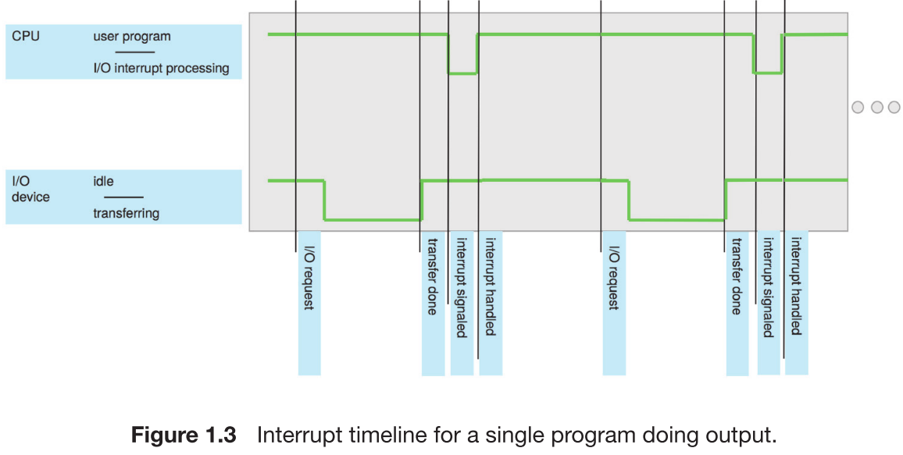
Interrupt Timeline

Slide 31
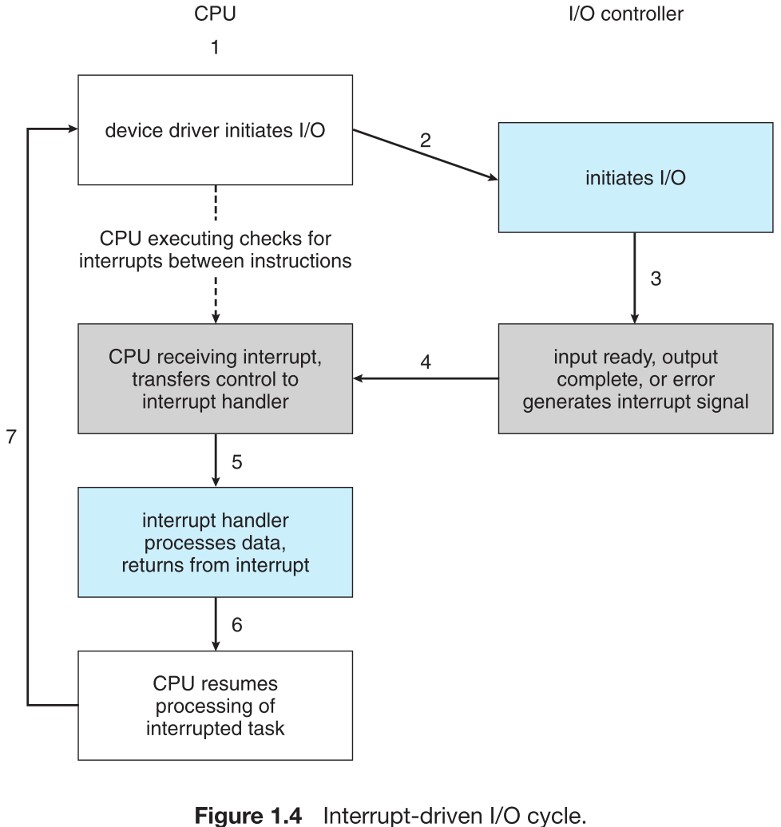
Interrupt-Driven I/O Cycle

Slide 32
I/O Structure – Two I/O Methods
After I/O starts, control returns to user program only upon I/O completion.
  Wait instruction idles the CPU until the next interrupt
  Wait loop (contention for memory access).
  At most one I/O request is outstanding at a time, no simultaneous I/O processing.
After I/O starts, control returns to user program without waiting for I/O completion.
  System call – request to the operating system to allow user to wait for I/O completion.
  Device-status table contains entry for each I/O device indicating its type, address, and state.
Notes:
Last sentence: modify table entry to include interrupt.

Slide 33
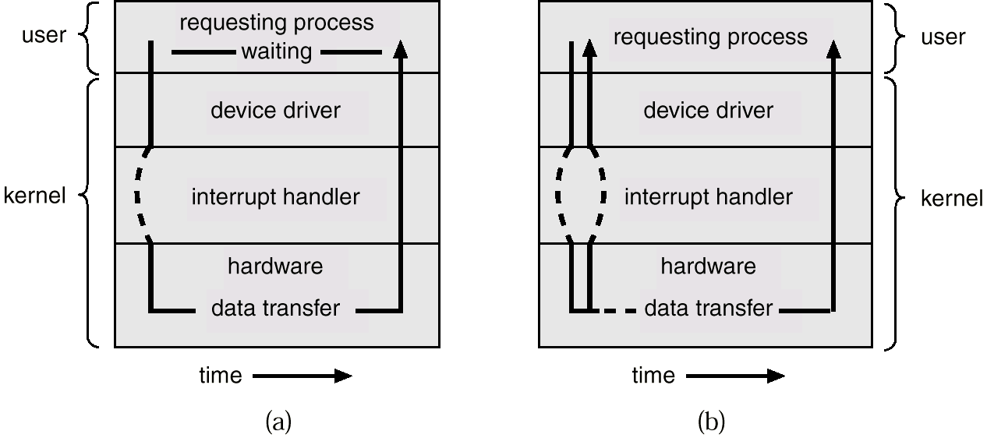
Two I/O Methods
Synchronous
Asynchronous

Slide 34
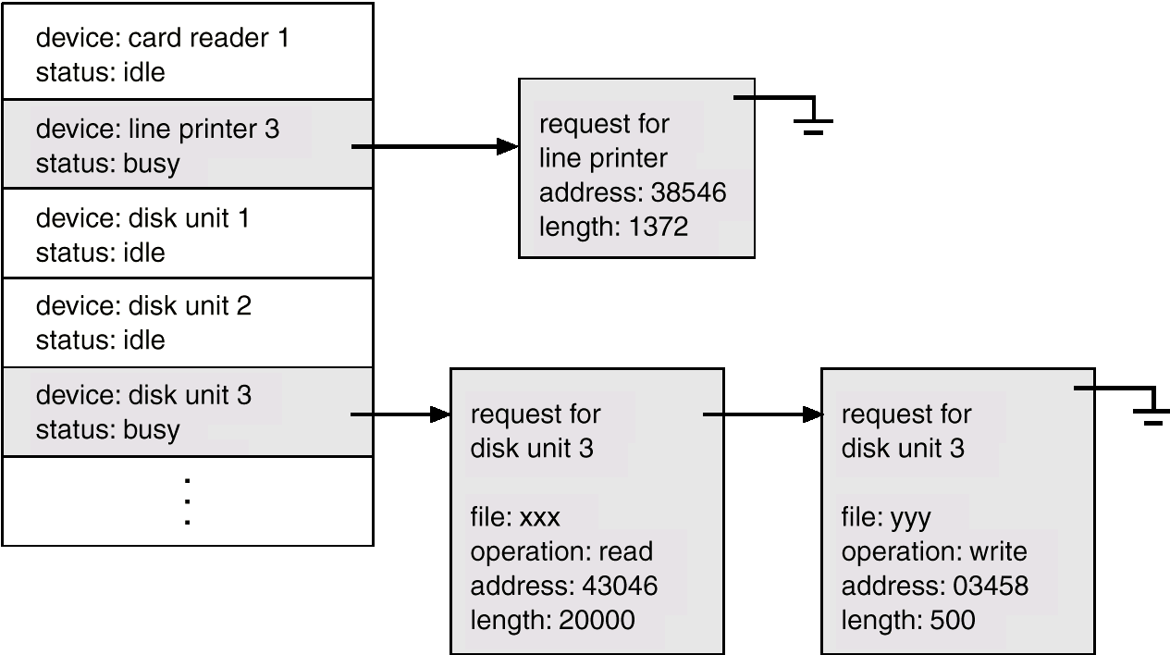
Device-Status Table

Slide 35
Direct Memory Access Structure
Used for high-speed I/O devices able to transmit information at close to memory speeds.
Device controller transfers blocks of data from buffer storage directly to main memory without CPU intervention.
Only one interrupt is generated per block, rather than the one interrupt per byte.

Slide 36
Storage Structure
Main memory – only large storage media that the CPU can access directly.
Secondary storage – extension of main memory that provides large nonvolatile storage capacity.
Magnetic disks – rigid metal or glass platters covered with magnetic recording material
  Disk surface is logically divided into tracks, which are subdivided into sectors.
  The disk controller determines the logical interaction between the device and the computer.

Slide 37
Storage Hierarchy
Storage systems organized in hierarchy.
  Speed
  Cost
  Volatility
Caching – copying information into faster storage system; main memory can be viewed as a last cache for secondary storage.

Slide 38
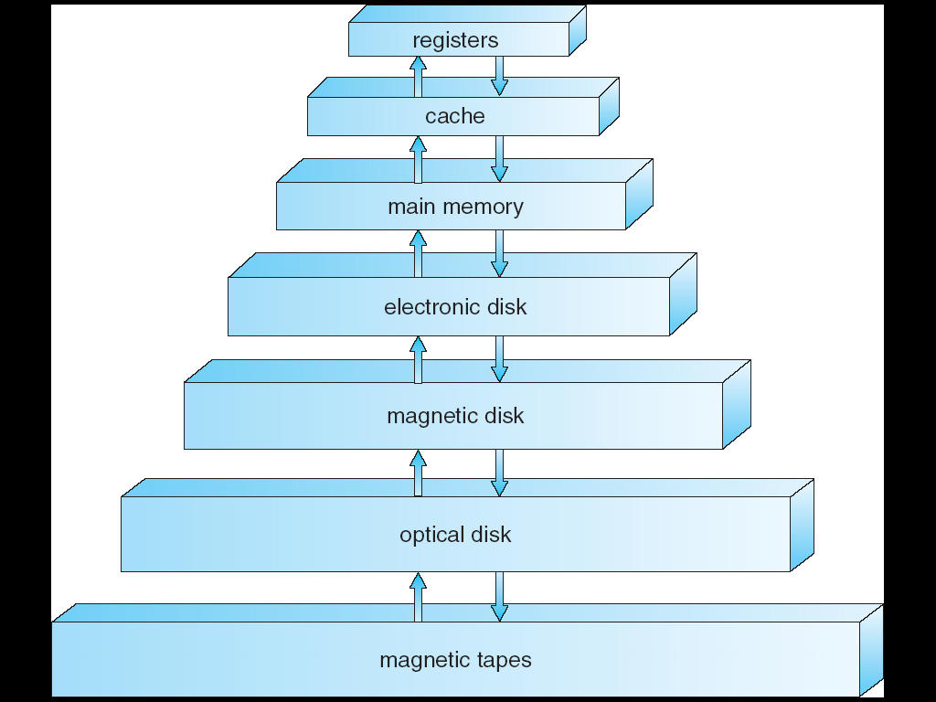
Storage-Device Hierarchy

Slide 39
Caching
Important principle, performed at many levels in a computer (in hardware, operating system, software)
Information in use copied from slower to faster storage temporarily – Speed mismatch
Faster storage (cache) checked first to determine if information is there
  If it is, information used directly from the cache (fast)
  If not, data copied to cache and used there
Cache smaller than storage being cached
  Cache management important design problem
  Cache size and replacement policy

Slide 40
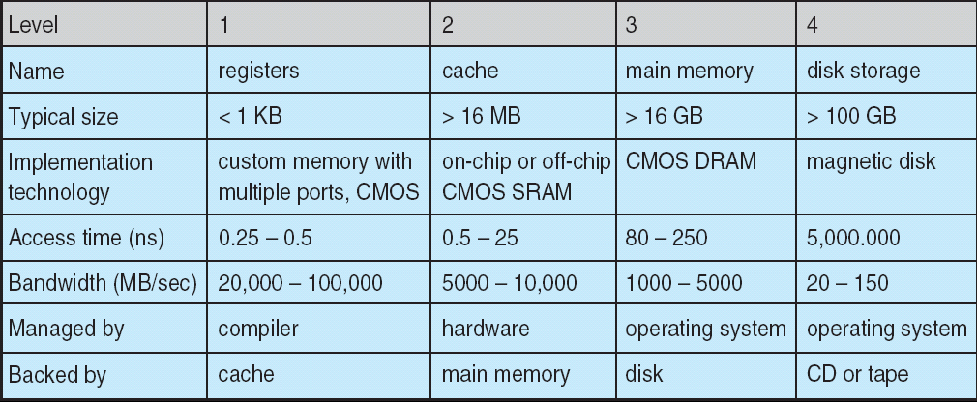
Performance of Various Levels of Storage
Movement between levels of storage hierarchy can be explicit or implicit

Slide 41
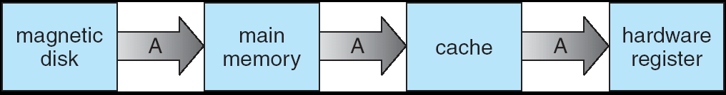
Migration of Integer A from Disk to Register
Multitasking environments must be careful to use most recent value, no matter where it is stored in the storage hierarchy
Multiprocessor environment must provide cache coherency in hardware such that all CPUs have the most recent value in their cache

Slide 42
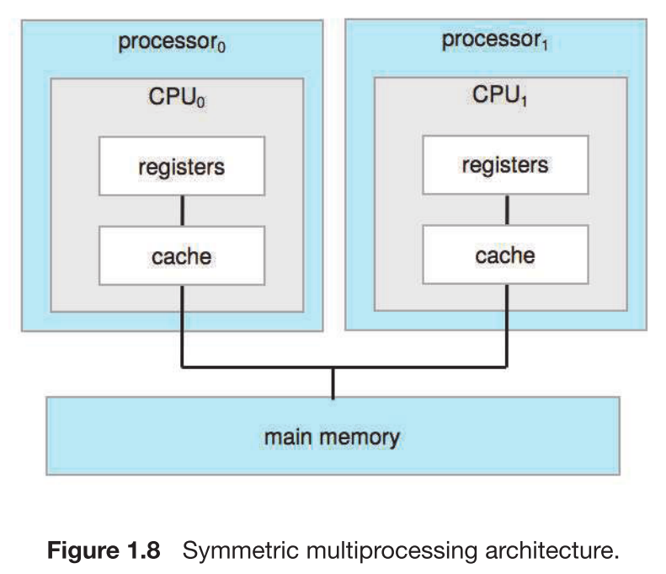
Multiprocessor Systems
SMP architecture
  Each CPU processor has its own set of registers
  All processors share physical memory over the system bus
Notes:
Intel Core CPUs are multicore, and thus support SMP.
Some processors can support both SMP and AMP operating modes.
Some processors allow you to have two cores running an SMP and the other two cores running an AMP.

Slide 43
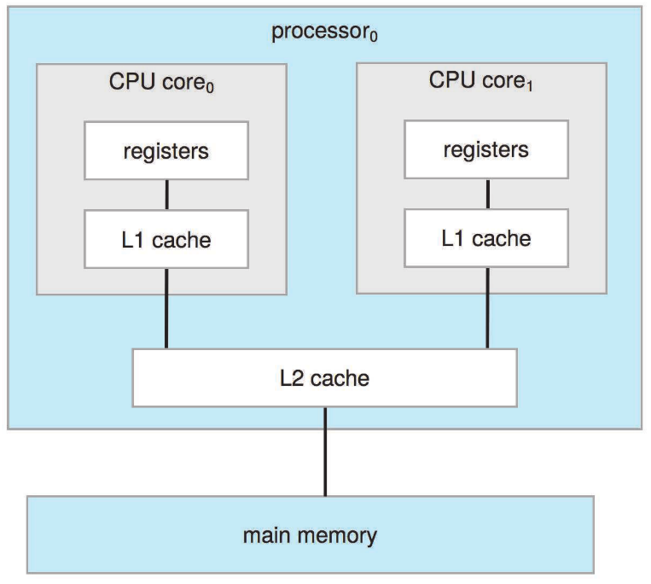
Multicore Systems
On-chip communication is faster than between-chip communication
Less power (good for mobile devices)

Slide 44
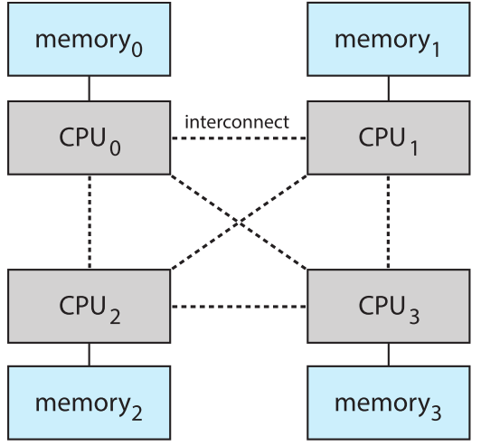
The NUMA Architecture
The CPUs are connected by a shared system interconnect
Scales more effectively as more processors are added
Remote memory across the interconnect is slow
Operating systems need careful CPU scheduling and memory management
Notes:
NUMA is something different with SMP.
Q: NUMA的内存为什么non-uniform?
Example: Intel Xeon (至强) Scalable Processors (such as the Intel Xeon Gold or Platinum series). These processors are used in multi-socket configurations, typically 2-socket, 4-socket, or even 8-socket systems. Different sockets are connected to different processors.

Slide 45
Operating System Structure
Multiprogramming needed for efficiency (CPU utilization)
  Single user cannot keep CPU and I/O devices busy at all times
  Multiprogramming organizes jobs (code and data) so CPU always has one to execute
  A subset of total jobs in system is kept in memory
  One job selected and run via job scheduling
  When it has to wait (for I/O for example), OS switches to another job
Timesharing (multitasking) is logical extension in which CPU switches jobs so frequently that users can interact with each job while it is running, creating interactive computing (interactivity)
  Response time should be < 1 second
  Each user has at least one program executing in memory process
  If several jobs ready to run at the same time  CPU scheduling
  If processes don’t fit in memory, swapping moves them in and out to run
  Virtual memory allows execution of processes not completely in memory

Slide 46
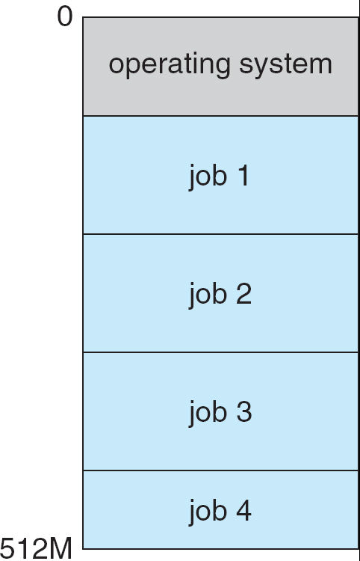
Memory Layout for Multiprogrammed System
Notes:
Introduce “Isolation”

Slide 47
Operating-System Operations
Interrupt driven by hardware
Software error or request creates exception or trap
  Division by zero, request for operating system service
Other process problems include infinite loop, processes modifying each other or the operating system
Thus we need protection:
Dual-mode operation allows OS to protect itself and other system components
  User mode and kernel mode
  Mode bit provided by hardware
    Provides ability to distinguish when system is running user code or kernel code
    Some instructions designated as privileged, only executable in kernel mode
    System call changes mode to kernel, return from call resets it to user
Notes:
Trap: A software interrupt. The interrupt can be caused either by an error (e.g., division by zero or invalid memory access) or by a specific request from a user program that an operating-system service be performed.
Q: can interrupt run in user mode?

Slide 48
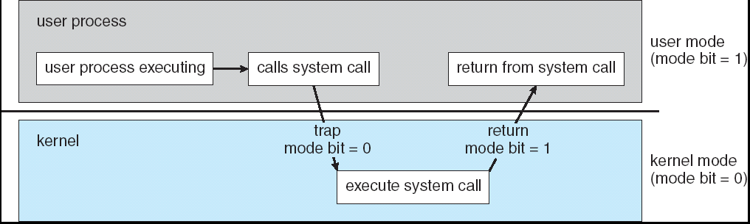
Transition from User to Kernel Mode
Timer to prevent infinite loop / process hogging resources
  Set interrupt after specific period
  Operating system decrements counter
  When counter zero generate an interrupt
  Set up before scheduling process to regain control or terminate program that exceeds allotted time

Slide 49
Process Management
A process is a program in execution. It is a unit of work within the system. Program is a passive entity, process is an active entity.
Process needs resources to accomplish its task
  CPU, memory, I/O, files
  Initialization data
Process termination requires reclaim of any reusable resources
Single-threaded process has one program counter specifying location of next instruction to execute
  Process executes instructions sequentially, one at a time, until completion
Multi-threaded process has one program counter per thread
Typically system has many processes, some user, some operating system running concurrently on one or more CPUs
  Concurrency by multiplexing the CPUs among the processes / threads

Slide 50
Process Management Activities
The operating system is responsible for the following activities in connection with process management:
Creating and deleting both user and system processes
Suspending and resuming processes
Providing mechanisms for process synchronization
Providing mechanisms for process communication
Providing mechanisms for deadlock handling

Slide 51
Memory Management
All data must be in memory before and after processing
All instructions must be in memory in order to execute
Memory management determines what is in memory when
  Optimizing CPU utilization and computer response to users
Memory management activities
  Keeping track of which parts of memory are currently being used and by whom
  Deciding which processes (or parts thereof) and data to move into and out of memory
  Allocating and deallocating memory space as needed

Slide 52
Storage Management
OS provides uniform, logical view of information storage
  Abstracts physical properties to logical storage unit - file
  Each medium is controlled by device (i.e., disk drive, tape drive)
    Varying properties include access speed, capacity, data-transfer rate, access method (sequential or random)
File-System management
  Files usually organized into directories
  Access control on most systems to determine who can access what
  OS activities include
    Creating and deleting files and directories
    Primitives to manipulate files and dirs
    Mapping files onto secondary storage
    Backup files onto stable (non-volatile) storage media

Slide 53
Mass-Storage Management
Usually disks used to store data that does not fit in main memory or data that must be kept for a “long” period of time.
Proper management is of central importance
Entire speed of computer operation hinges on disk subsystem and its algorithms
OS activities
  Free-space management
  Storage allocation
  Disk scheduling
Some storage needs not be fast
  Tertiary storage includes optical storage, magnetic tape
  Still must be managed
  Varies between WORM (write-once, read-many-times) and RW (read-write)

Slide 54
I/O Subsystem
One purpose of OS is to hide peculiarities of hardware devices from the user – ease of usage & programming
I/O subsystem responsible for
  Memory management of I/O including buffering (storing data temporarily while it is being transferred), caching (storing parts of data in faster storage for performance), spooling (the overlapping of output of one job with input of other jobs)
  General device-driver interface
  Drivers for specific hardware devices

Slide 55
OS Purposes
Basic requirements for OS
  Sharing/multiplexing
  Isolation
  Interaction
Abstraction
Security
Performance
Range of uses
Notes:
Abstraction -> Great programmer convenience and strong isolation
Q: How about syscalls implemented as libraries? Each APP may even have
its own library implementation.
APPs must be cooperative! But if APPs don’t trust each other, STRONGER ISOLATION needed.
Abstraction: Open, Read/Write, Close syscalls vs. disk read/write directly
Save and restore registers transparently.
Exec syscall builds memory image of a process. If memory is lacking, store to disk!

Slide 56
End of Chapter 1

Slide 57
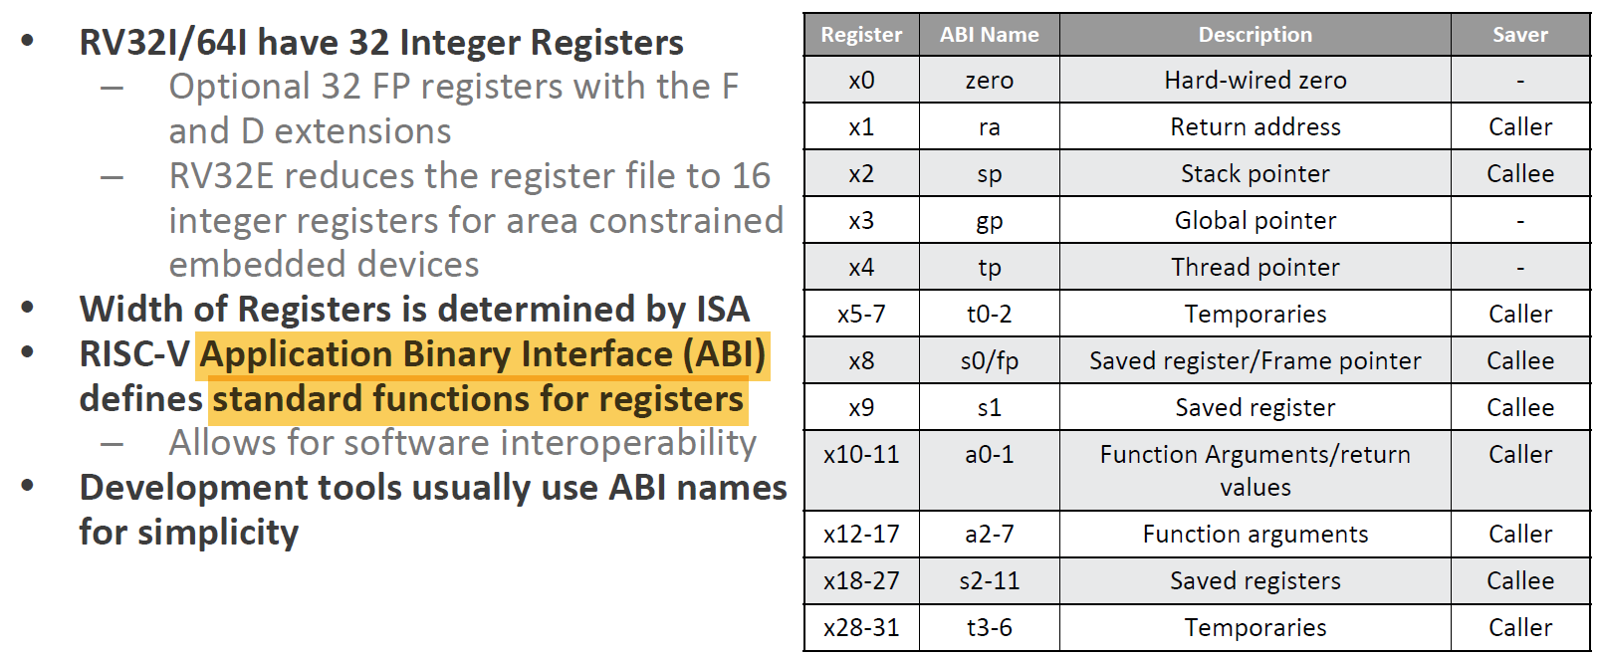
RISC-V Registers
Register file as follows:
In addition, RISC-V has a set of Control & Status Registers (CSRs)
Notes:
In summary, caller-saved registers are volatile across function calls, meaning the caller is responsible for saving their values, while callee-saved registers are preserved across function calls, with the callee ensuring their values are restored.

