Slide 1
Automotive Vehicle Dynamics
Driver-Vehicle Interaction
Sean Brennan
Modified from presentations from Andrew Alleyne, used with permission
All Rights Reserved

Slide 2
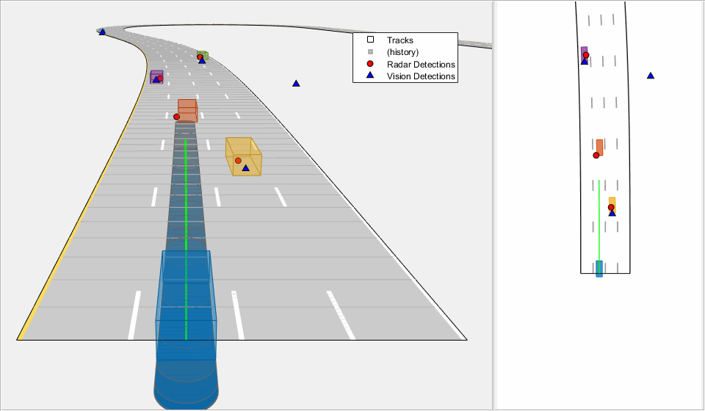
Path following is a difficult challenge. Most tools for autonomous driving focus on this.
https://www.mathworks.com/help/nav/ug/object-tracking-and-motion-planning-using-frenet-reference-path.html

Slide 3
So far we have examined the dynamics of the vehicle as a stand-alone system.
However, the driver is an important part of the overall system that will keep the vehicle following the proper direction on the road
….or not.

Slide 4
The driver-vehicle system is actually a feedback loop with the driver providing the feedback using visual, inertial, haptic, and auditory cues
Disturbances: wind/road
vehicle
Vehicle states:
road
conditions
driver
steering
road path
accelerator
& brakes
speed, relative position, relative orientation

Slide 5
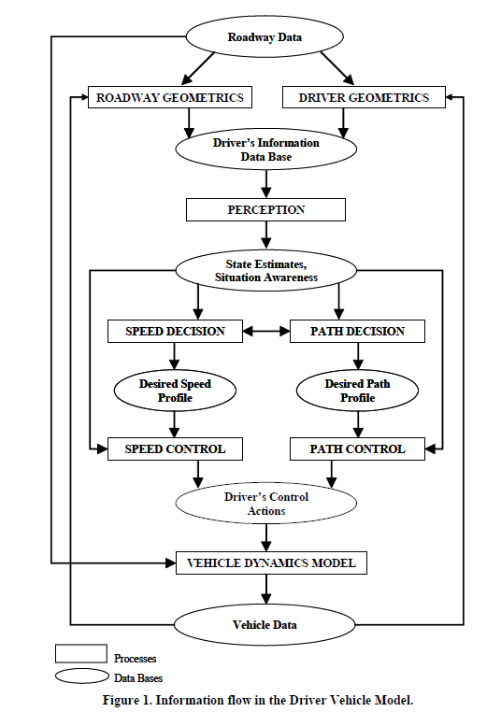
One could argue that most of the behavior on the road is actually human-human interaction mediated by a vehicle
See “Development of a Driver Vehicle Module for the Interactive Highway Safety Design Model” Publication No. FHWA-HRT-08-019

Slide 6
How do we model this feedback loop? We know that drivers respond to the road ahead of them mostly using visual cues…
lateral distance
preview distance

Slide 7
We seek to isolate input/output relationships, so usually model one input to one output
Driver inputs
Driver outputs
road
conditions
steering
road path
accelerator
& brakes

Slide 8
In this lecture, we consider only very simple models of the driver to be used in conjunction with our vehicle models
Accurate modeling of human behavior is an extremely difficult task.
But even analyzing gross behavior, we obtain some very good insights into how to drive better ourselves!

Slide 9
For our modeling purposes, the driver consists of several individual components
limbs and muscles
component:
eye
brain
function:
sensing
actuation
processing and command generation

Slide 10
There’s usually a (big) delay between sensing any signal and having it processed.
This includes perception delay (paying attention), plus the delay between developing a command (planning) and that command reaching the limbs (actuation)
Total delay is often referred to as the reaction time (0.1 sec to 2 seconds… or more)
time delay
time delay

Slide 11
This pure-delay method generates the simplest driver feedback model
In simplest terms, the driver can be represented by a transfer function.
K_{d} is the driver gain and τ is the lumped delay of the driver including sensor processing and command delay
Driver output
Driver input

Slide 12
There’s also a limit to how fast you can move! (actuator dynamics)
Even after commands arrive at the limbs, there’s a delay before the actual task is performed by the muscle
In other words, there’s a maximum frequency signal that can be tracked by the limb!
  Dependent on limb size (i.e. inertia) & musculature
mag
Limbs have a bandwidth
ω

Slide 13
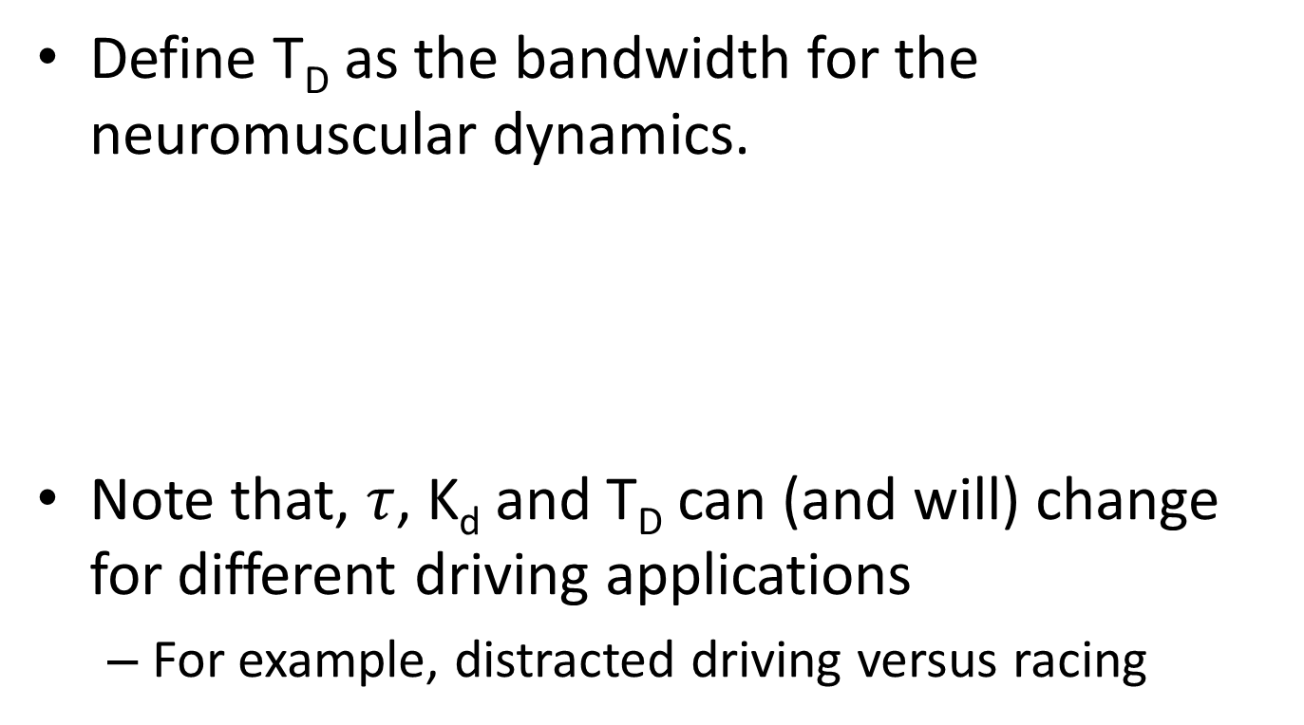
We can include the limb actuation dynamics into a driver feedback model
Define T_{D} as the bandwidth for the neuromuscular dynamics.
Note that, $τ$, K_{d} and T_{D} can (and will) change for different driving applications
  For example, distracted driving versus racing
Time delay
Driver lag

Slide 14
The driver feedback depends on lateral or longitudinal positioning
The units for driver gain and driver lag are different for speed following (m/s) versus lane regulation (m) so K_{d} should be different for longitudinal vs. lateral tasks.
Similarly, the gain and the lag will be different between the arms/steering wheel actuation and foot/pedal actuation

Slide 15
Problems with modeling: humans anticipate events (and have memory)
Often, humans are very good at anticipating events.
  Particularly if they’ve been in similar situations before.
    (It’s called learning and remembering)
The driver action can actually react a bit sooner than the events actually occur!
  In System Dynamics terms, humans can ‘add phase’ to the feedback system.

Slide 16
One way to add phase is to use a simple lead controller model
Defining T_{L} to be the driver ‘lead time,’
Question: What is y(s) and u(s)?
  y(s) is simpler; it’s the steer wheel angle or the throttle/brake pedal position.
  U(s) is harder; it’s often a combo of many things.
Driver output (steering)
Driver lead
Driver’s input (eyes)

Slide 17
Why not just use PID control on position?
Let’s pretend we have a simple line-following idea… goal is to keep the vehicle along a prescribed path.
desired path
lateral error
heading error

Slide 18
If use only lateral error, we cannot correct yaw angle errors
These three all have zero lateral error but only one is correct.
Remember, yaw motion is lightly damped…!

Slide 19
It is difficult to control the vehicle using only c.g. lateral position information
For example, it is very hard to keep your car parallel to the center line while looking out the bottom of an open driver door.
What do they teach in high school Driver’s Ed?
  Look ahead of the vehicle and try to control this point.

Slide 20
To track a geometry, we define two core types of error
These errors are defined relative to the target path geometry rather than in global coordinates
  Cross-Track Error (ey): The perpendicular distance from the vehicle's center of gravity (CG) or control axle to the closest point on the path trajectory.
  Heading Error (eψ): The angular deviation between the current vehicle yaw angle and the structural tangent of the path reference frame.

Slide 21
Preview: how a driver’s control is really done!
From inside the vehicle:
Desired look-ahead point
Vehicle longitudinal axis
error
Road path

Slide 22

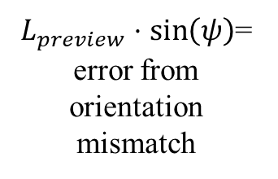
A view from above the vehicle shows that using preview is like using both yaw and lateral control
preview length = $L_{preview}$
$L_{preview}⋅\sin\left(ψ\right)$= error from orientation mismatch
ψ
lateral error
desired path
total error

Slide 23
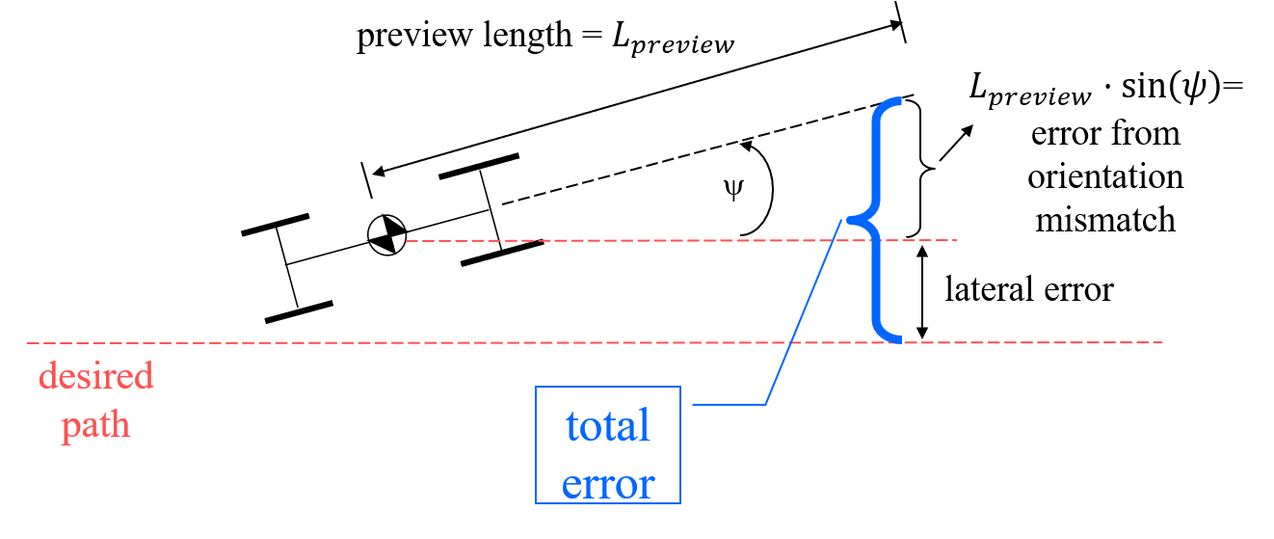
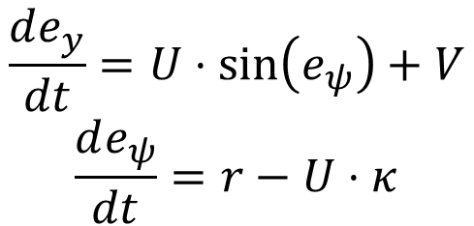
Let’s put this into equation form:
The static relationship tells us where we are.
The derivatives tell us how things get worse.
$$e_{total}=L_{preview}⋅\sin\left(e_{ψ}\right)+e_{y}+(curvature)$$
$$\frac{de_{y}}{dt}=U⋅\sin\left(e_{ψ}\right)+V$$
$$\frac{de_{ψ}}{dt}=r−U⋅κ$$

Slide 24

For normal, “look-ahead” driving, we see that the driver acts like a state-feedback controller
$$L_{preview}⋅\sin\left(e_{ψ}\right)+e_{y}$$
Steer angle or steer angle command (if you include limb dynamics)
G_{driver}(s)
preview distance*heading angle error
L*ψ for small heading angle errors

Slide 25
The look-ahead or preview distance is a critical factor
For pure lateral control (no preview), the input to the driver would be the lateral error.
The lateral error is given in Earth fixed coordinates for our purposes.
lateral error
G_{driver}(s)
Steer angle or steer angle command (if you include limb dynamics)

Slide 26
We need to reconcile body-fixed to earth-fixed tracking
In a general case, the earth fixed coordinates would have to move along with the road.
X_{earth}
Y_{earth}

Slide 27
There is such thing as too much look-ahead, or too little
The larger the look-ahead distance L is, the greater the relative contribution of yaw angle orientation to the driver feedback.
Yaw feedback has a tendency to stabilize the Driver-Vehicle system.
    It adds damping
More L=>more damped response which is beneficial…to a point.
  You can’t be looking a mile ahead to control the vehicle.

Slide 28
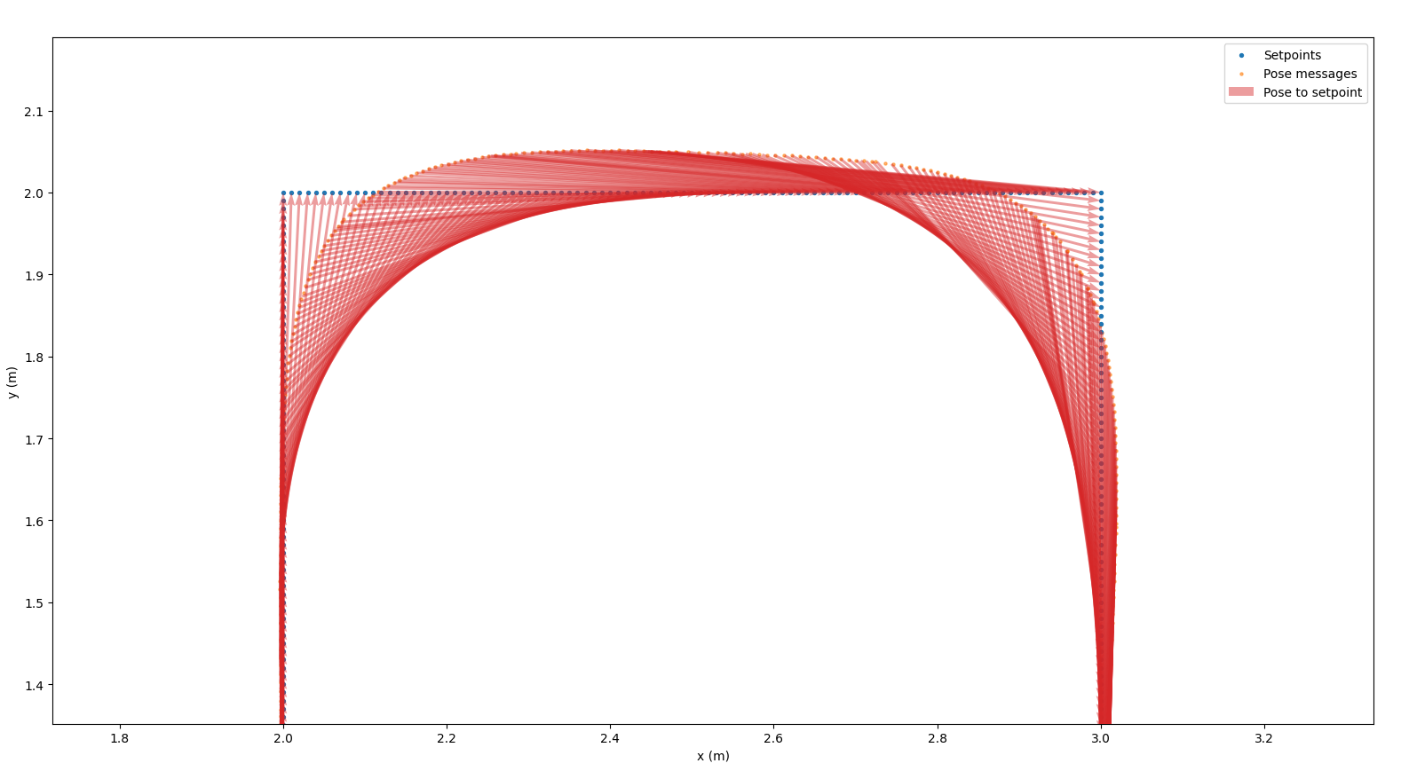
Look-ahead can also cause corner-cutting
Here’s a plot from an ongoing research project into quadcopter guidance that shows, clearly, that corner-cutting is occurring.

Slide 29
Now, let’s compare common strategies
PID
Pure-pursuit methods
  Preview control with Fixed Distance
  Preview control with Fixed Time
Preview control with Breadcrumbs
Fixed-distance model-based preview
Model predictive control

Slide 30
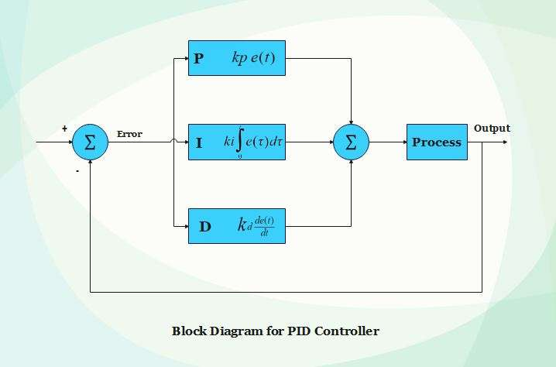
Method 1: Proportional-Integral-Derivative (PID)
Model-Free Classical Feedback Control Architecture
  Computes steering actuation entirely using present and historical tracking errors without predictive modeling or structural plant dynamics.
  In other words: it is VERY easy to implement
Technical Evaluation & Performance Insights:
  Pros: Negligible real-time computational footprint; trivial execution configuration for low-velocity structured domains.
  Cons: Inherent phase lag at elevated forward velocities because actions are purely reactive. Prone to severe integral windup during sustained steady-state cornering profiles. Very high-speed driving (above about 50 mph) is provably not possible with PID.
  Stability Constraints: Highly non-linear sensitivity to forward velocity (U). Multi-variable gain scheduling is strictly required to prevent catastrophic high-speed divergence.

Slide 31
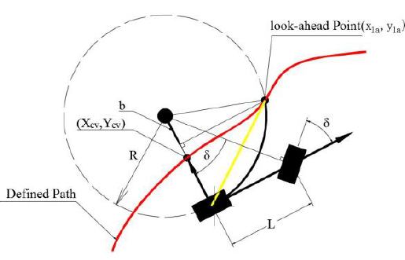
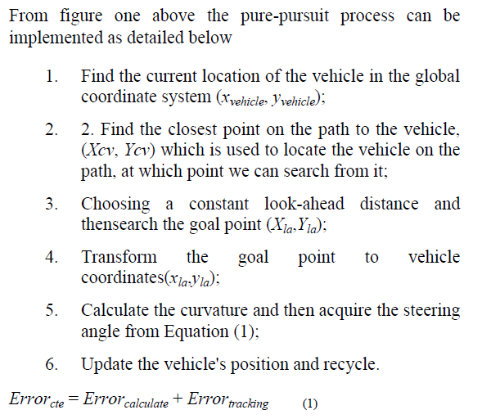
The “pure pursuit” strategies look ahead of the current location
Here’s an example from online:
https://www.researchgate.net/figure/Geometric-explanation-of-pure-pursuit-From-figure-one-above-the-pure-pursuit-process-can_fig2_295257868

Slide 32
Method 2a: Preview Control with Fixed Distance
Geometric Look-Ahead Path Tracking
  Projects a localized look-ahead vector of static length (L_preview) directly along the longitudinal chassis coordinate center to determine a tracking goal target.
Technical Evaluation & Performance Insights:
  Pros: Effectively attenuates high-frequency sensor noise and minor local pathway irregularities via spatial low-pass filtering.
  Cons: A static distance forces a severe trade-off. Large look-ahead values induce significant corner-cutting at tight turns; small look-ahead values generate severe lateral oscillations at speed. Can be unstable at very high speeds if not tuned correctly.
  Structural Limitation: Lacks any physics-based or tire-force state projection to counteract vehicle slide or tire saturation.

Slide 33
Method 2b: Preview Control with Fixed Time
Velocity-Adaptive Spreading Look-Ahead
  Dynamically scales the look-ahead horizon distance as a direct function of current vehicle longitudinal velocity: L_preview(U) = t_preview * U.
Technical Evaluation & Performance Insights:
  Pros: Resolves the fundamental high-speed instability of fixed-distance tracking. Damps out aggressive wheel inputs naturally as velocity increases.
  Cons: The tracking loop remains geometric. At near-zero velocities (vx → 0), the preview envelope mathematically collapses.
  Implementation Note: Demands an artificial minimum distance threshold ceiling to avoid mathematical singularities or jittery low-speed docking maneuvers.

Slide 34
Method 3: Preview Control Using Breadcrumbs
Discretized Relative Path Tracking Profiles
  Tracks a historical queue or discrete matrix of coordinates ('breadcrumbs') instead of a continuous analytical path function.
Technical Evaluation & Performance Insights:
  Pros: Outstanding operational resilience for vehicle-following platoons or GPS-denied environments where reference states are updated sequentially.
  Cons: Demands significant search and sorting compute overhead to ensure the tracking loop does not anchor to incorrect adjacent track paths during complex loops or switchbacks.
  Dynamic Behavior: Tracking outputs are inherently stepped or jerky due to localized discontinuities in curvature step calculations (Δκ). Controller behavior changes significantly comparing near vs far breadcrumbs.
  Note: breadcrumbs, with large numbers of “crumbs” is the same as fixed-distance preview control! (same pros/cons)

Slide 35
Method 4: Model-Based Preview (Fixed Distance)
Physics-Driven Kinematic/Dynamic Feedforward Injection
  Combines look-ahead tracking mechanics with an explicit multi-degree-of-freedom vehicle model. Uses target curvature (κ) at the preview horizon to actively compute feedforward steering.
Technical Evaluation & Performance Insights:
  Pros: Anticipates physical geometry transitions before the chassis physical frame encounters them. Drastically minimizes steady-state cross-track errors at speed.
  Cons: Intensely reliant on precise identification of internal parameters including the understeer gradient (Kv) and real-time tire cornering stiffness (Cα).
  Operational Risk: Parameter estimation and modeling error easily translates to premature steering entry or delayed turn-in overshoot behavior. In other words, if the vehicle model is bad, the tracking will be bad also.

Slide 36
Method 5: Model Predictive Control (MPC)
Constrained Optimal Multi-Horizon Control Architecture
  Formulates and continuously solves a state-space optimization algorithm online over an explicit multi-step predictive time horizon (Hp).
Technical Evaluation & Performance Insights:
  Pros: Natively respects real-world engineering constraints (e.g., maximum steering angles, steering rate limits, and lateral acceleration safe zones).
  Cons: Substantial real-time computational overhead. Requires deterministic execution of iterative Quadratic Programming (QP) solvers within small, fixed time steps.
  Performance Index: Represents the state-of-the-art framework for maximizing track fidelity alongside vehicle body stability margins.

Slide 37
Technical Evaluation & Trade-Off Matrix
Control Architecture | Compute Latency | Velocity Sensitivity | Constraint Management
PID Control | O(1) - Negligible | Poor (Requires scheduling) | None (Blind saturation)
Fixed Distance Preview | Low | High (Unstable at speed) | None
Fixed Time Preview | Low | Medium (Robustly scales) | None
Breadcrumb Preview | Medium (Sorting) | Medium | None
Model-Based Preview | Medium | Low (Model compensated) | None
Model Predictive (MPC) | High (Iterative QP) | Minimal (Dynamic updates) | Excellent (Explicit bounds)

Slide 38
Engineering Architecture Recommendations
Selection Protocol for Targeted Implementations
1. Low-Speed / Low-Cost AGVs & Logistics Robotics:
  • Deploy Fixed Time Preview. Offers the ideal performance-to-overhead ratio, managing dynamic velocity scaling without heavy processors.
2. High-Speed Production Autonomous Vehicles (Highway / Track):
  • Leverage Model-Based Preview or full Linear/Non-linear MPC. Pre-loading steering loops for tire-slip dynamics and bounding cornering forces is safety-critical.
3. Off-Road / Heavy Machinery / Variable Grip Trajectories:
  • Implement Model-Based Preview with adaptive parameter estimation. Provides necessary physical compensation without the computational brittle risks of real-time optimization.

Slide 39
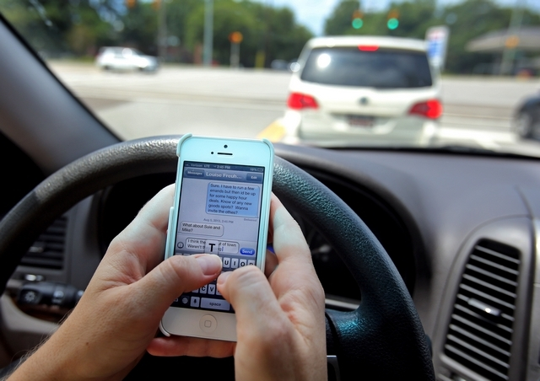
There’s a joke that, the more technology we develop to make cars safer, the more technology makes us behave unsafe
In 2011, Blackberry had an outage for 3 days. In Dubai and Abu Dhabi (strong Blackberry usage base then), accidents fell by 20 to 40 percent nationwide over those 3 days.

Slide 40
The problem with developing models of humans… we don’t like to conform!
Risk homeostasis: proposed by Gerald J.S. Wilde to explain why crash rates do not seem to be declining with ABS
  The basic idea: if you make the vehicle safer to drive (by improving the human/vehicle system), humans will drive in more risky manner to compensate
  For example, if you have 4WD, you are more likely to drive in snow storms than if you didn’t!

Slide 41
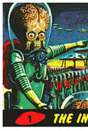
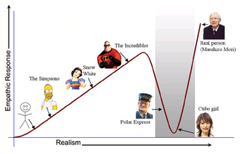
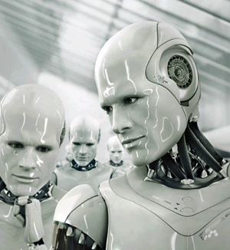
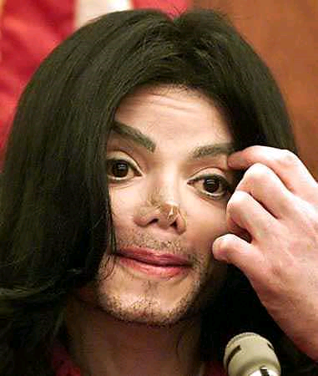
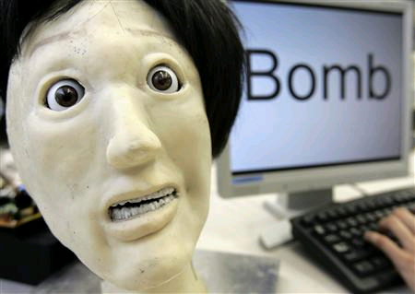
The other problem is that we don’t like vehicles making human-like decisions
This is called the “canny valley”
http://www.youtube.com/watch?v=1js5bD68Nw8&feature=player_embedded

Slide 42
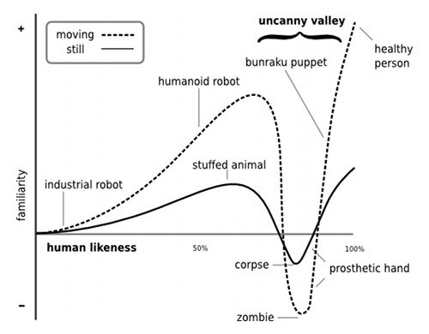
The canny valley gets deeper if things move… like vehicles
http://en.wikipedia.org/wiki/File:Mori_Uncanny_Valley.svg

Slide 43
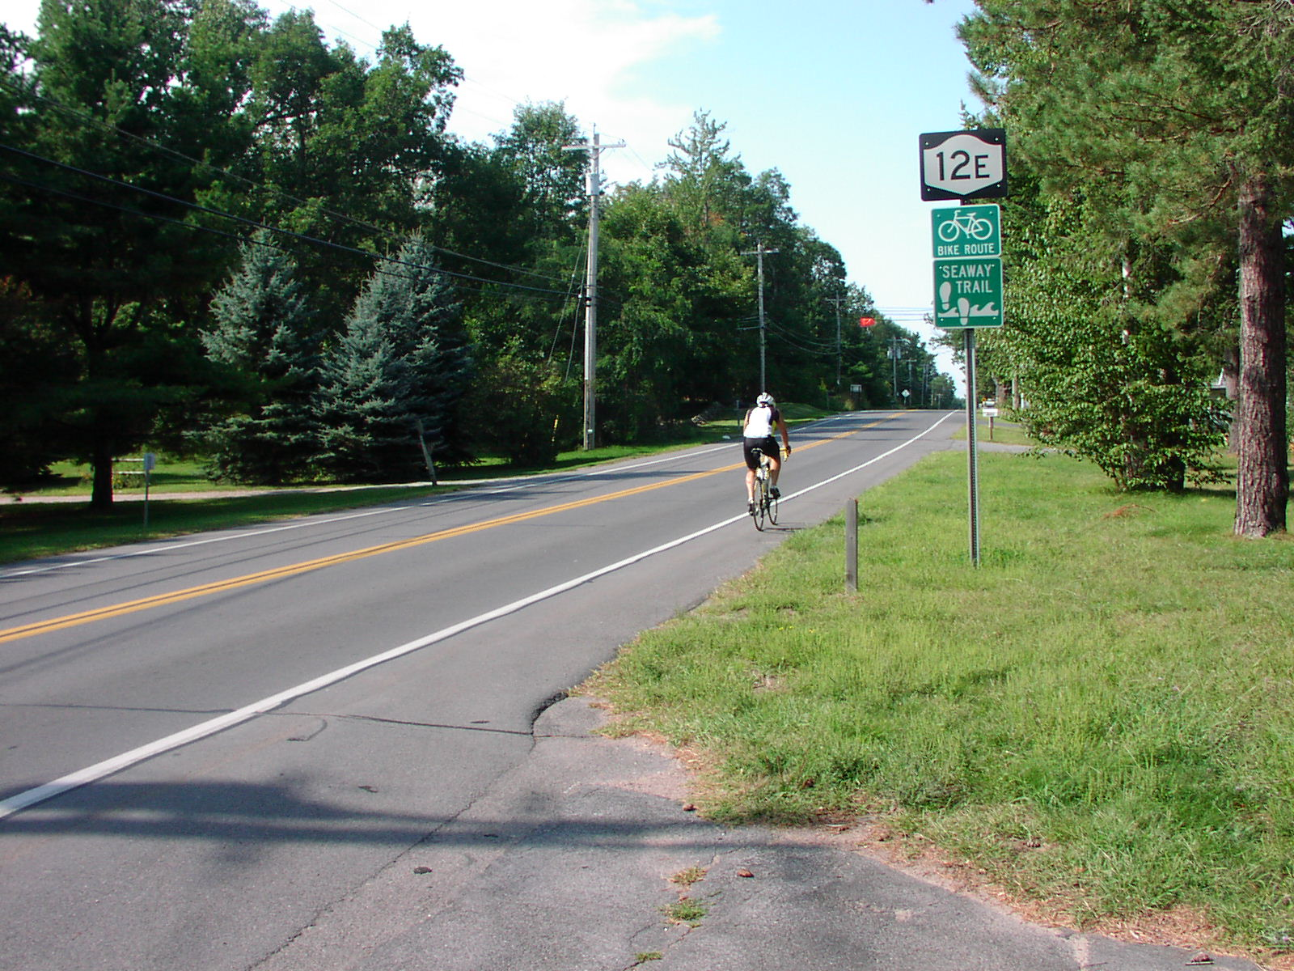
A key challenge with driving is that it is a giant psychology experiment
For example, are you more likely to get hurt by a car with a helmet or without when riding a bicycle near the road?

Slide 44
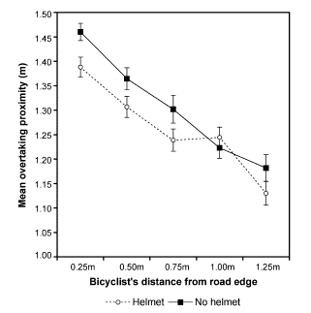
Turns out: drivers give bikes less room if wearing a helmet!

Slide 45
ME 452
Automotive Vehicle Dynamics
Produced by the
College of Engineering, UIUC
© 2000 UIUC BOT,
Modifications by S. Brennan, PSU
© 2011 PSU
All Rights Reserved

Slide 46
Confounding Factors
Amount of sleep
Doesn’t just affect driving.
    Obesity, Feb 2008 reports that sleep loss leads to excessive weight gain.
    If more than 2 hours a night missed, 92% more likely to be overweight.
Modified 2008/03

Slide 47
Suggested Sleep?
Younger than 5 years: 11 hours
5 to 10 years: 10 hours
Older than 10 years: 9 hours
Modified 2008/03

Slide 48
Driving Strategies
So, how should one drive in snow?

