Slide 1
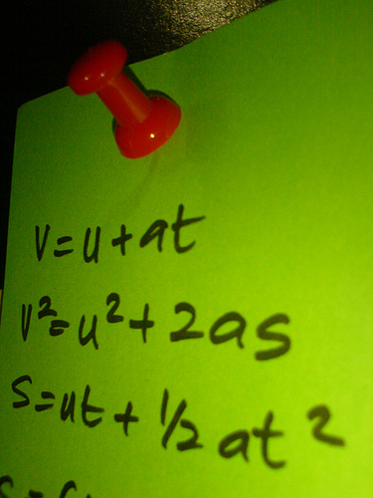
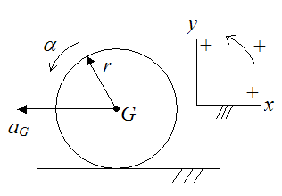
Automotive Vehicle Dynamics
Transient Response 2 – Equations of Motion
Sean Brennan
Department of Mechanical and Nuclear Engineering
Penn State University
sbrennan@psu.edu

Slide 2

Today we’ll discuss a variety of strange beasts!
A bicycle model that doesn’t work for bicycles
State space that has nothing to do with outer space, and
How complex numbers bring simplicity

Slide 3
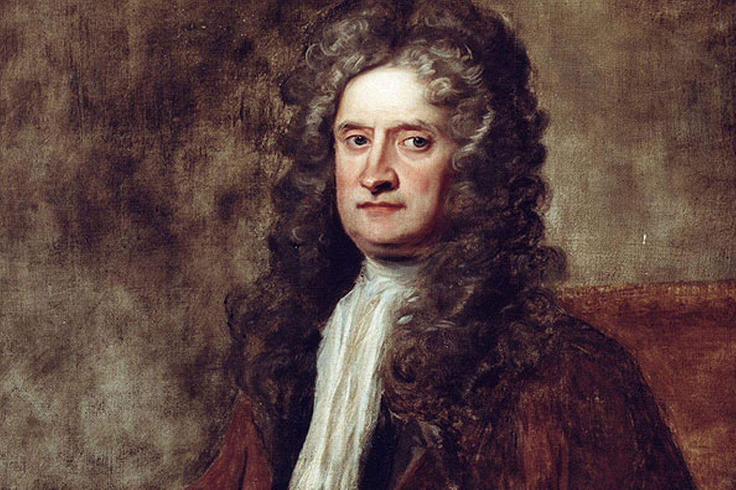
We start with our friend Newton

Slide 4
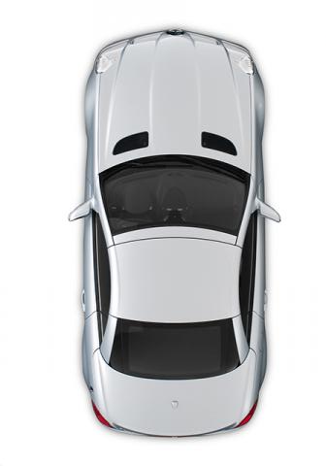








The equations of motion for the planar bicycle model follow from the acceleration components derived previously:
$$δ_{f}$$
$$α_{f}$$
$$F_{yf}$$
$$a$$
$$α_{r}$$
$$b$$
$$F_{yr}$$

Slide 5



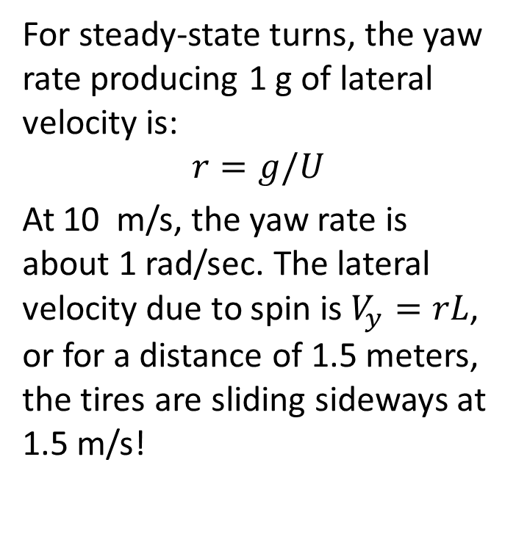
Rotation causes each tire to experience different velocities. The front/rear rotation-induced side velocities are large.
For steady-state turns, the yaw rate producing 1 g of lateral velocity is:
$$r=g/U$$
At 10 m/s, the yaw rate is about 1 rad/sec. The lateral velocity due to spin is $V_{y}=rL$, or for a distance of 1.5 meters, the tires are sliding sideways at 1.5 m/s!
$$V_{yf}$$
$$r$$
$$a$$
$$b$$
$$V_{yr}$$

Slide 6
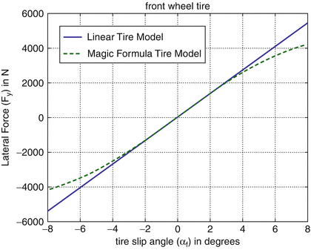
We can simplify these equations assuming the linear tire model, as we did earlier

Slide 7
We can rearrange to obtain an equation for lateral velocity:

Slide 8
And another for yaw:
Yaw:

Slide 9
The so-called bicycle model can now be defined in “state space”!
We choose r and V as the system states. This is the standard, linear 2-DOF transient bicycle model given in matrix differential equation form

Slide 10
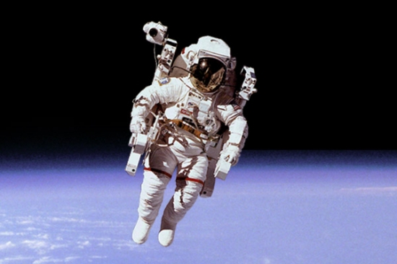
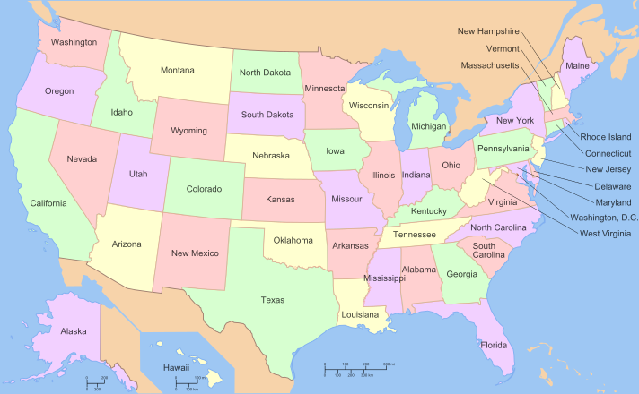
Just a reminder… state-space has nothing really to do with space, or states in the US

Slide 11
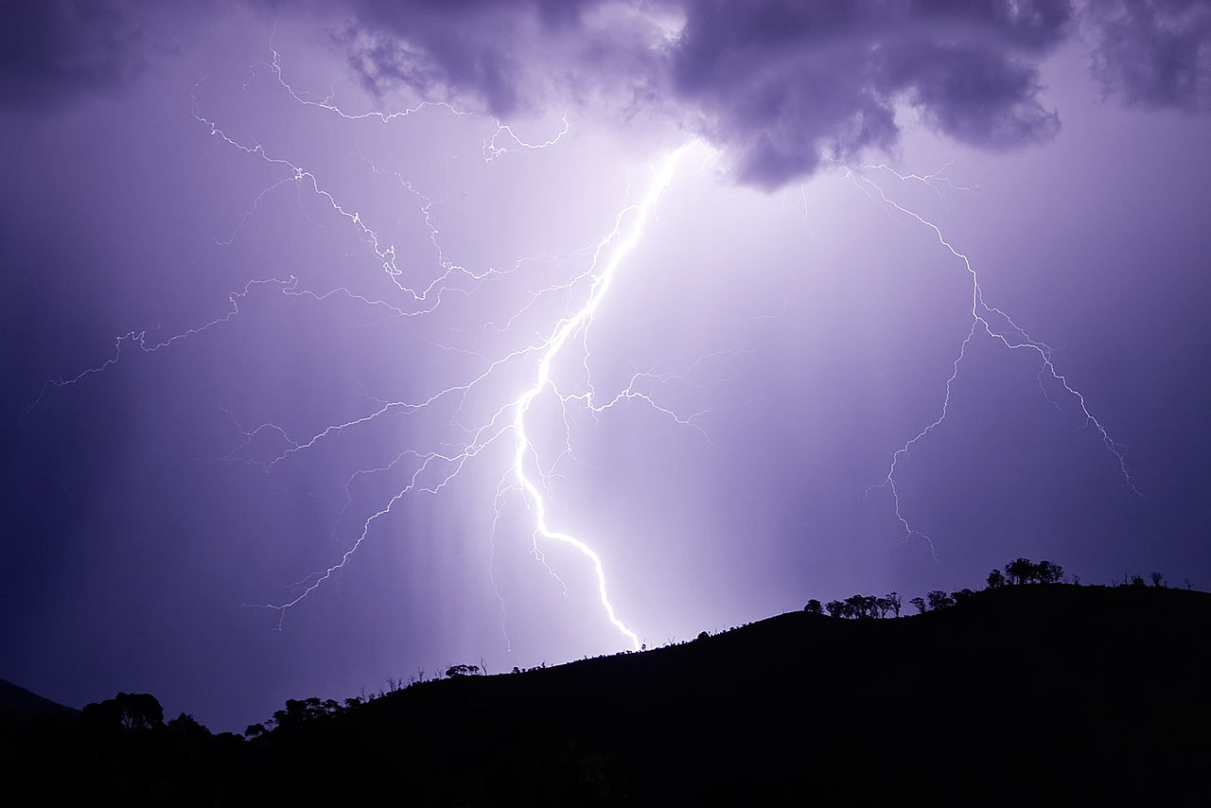
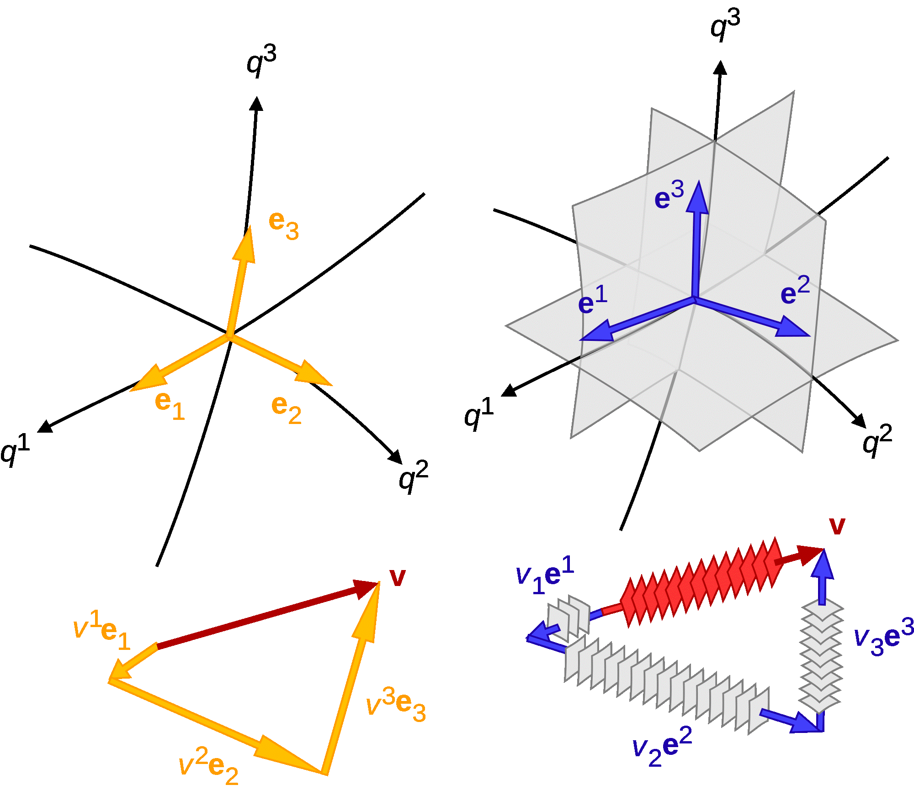
States refer to measurements that convey how energy is transferred, and space refers to the fact that we order the states into vectors
https://en.wikipedia.org/wiki/File:Lightning_strike_jan_2007.jpg
https://commons.wikimedia.org/wiki/File:Vector_1-form.svg

Slide 12
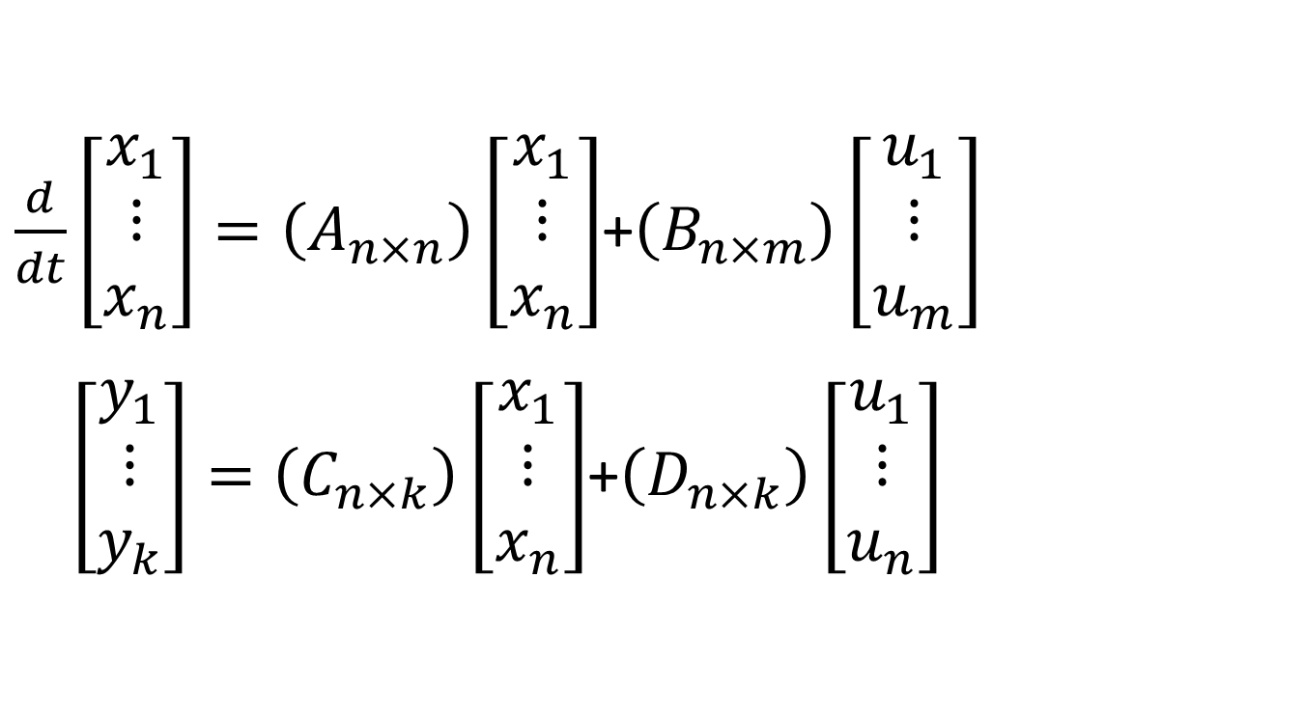
State space is really just a template for writing differential equations…
$\frac{d}{dt}\left[\begin{matrix}x_{1} \\ ⋮ \\ x_{n}\end{matrix}\right]=\left(A_{n×n}\right)\left[\begin{matrix}x_{1} \\ ⋮ \\ x_{n}\end{matrix}\right]$+$\left(B_{n×m}\right)\left[\begin{matrix}u_{1} \\ ⋮ \\ u_{m}\end{matrix}\right]$
$\left[\begin{matrix}y_{1} \\ ⋮ \\ y_{k}\end{matrix}\right]=\left(C_{n×k}\right)\left[\begin{matrix}x_{1} \\ ⋮ \\ x_{n}\end{matrix}\right]$+$\left(D_{n×k}\right)\left[\begin{matrix}u_{1} \\ ⋮ \\ u_{n}\end{matrix}\right]$

Slide 13
State-space equations are very handy for feedback control…
Easy to implement on a computer
Easy to expand to use on high-dimensional systems
Easy to transform between coordinate systems
Easy to analyze for stability
(but.. HARD for human understanding, sadly!)

Slide 14
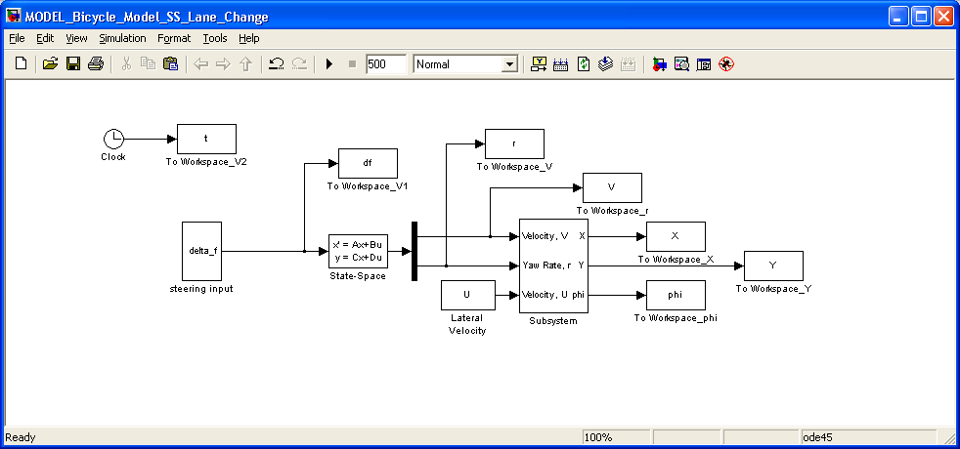
Our resulting simulation is now very compact…

Slide 15


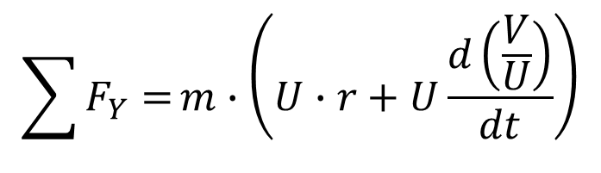
How does state-space compare to other methods, for example Milliken’s Derivative Notation?
$$\sum{F_{Y}=}m∙\left(U∙r+U\frac{dβ}{dt}\right)$$
$$\sum{M_{z}=}I_{z}∙\frac{dr}{dt}$$
Milliken writes:
Since
since U = constant.
This is the same as our derivation!
.
lateral vel.
long. Vel.
$$\sum{F_{Y}=}m∙\left(U∙r+U\frac{d\left(\frac{V}{U}\right)}{dt}\right)$$
$$=m∙\left(U∙r+\frac{dV}{dt}\right)$$

Slide 16
Milliken’s Derivative Notation is based on sensitivity functions
Using Milliken & Milliken’s notation
Y_{β}
Y_{δ}
Y_{r}
stability & control derivatives

Slide 17
And the sensitivity functions give us the same result as state-space
damping-in-sideslip lateral force/yaw coupling control force derivative

Slide 18
One can do the same analysis in yaw moments
M_{β}
M_{r}
M_{δ}

Slide 19
Many of these terms were named through the years prior to state-space… 1960’s
over/understeer derivative or static directional stability slope
yaw damping derivative
control moment derivative
M_{β} = the directional stability or under/oversteer gradient. If M_{β} > O then the vehicle tends to want to align with the relative velocity vector.

Slide 20
Milliken’s Derivative Notation does give some insight …
M_{β} is the difference between the moment around the vehicle C.G. produced per unit β (sideslip angle) by the front and rear wheels.
E.g. for a given sideslip angle, if the rear wheels produce a greater moment than the front wheels then the vehicle is stable and wants to reduce the sideslip angle β. M_{β} > 0

Slide 21
As an analogy, this is like a spring connected to a velocity vector pulling the vehicle along
understeer
V
M_{β} > O
moment
V
M_{β} < O
oversteer
moment

Slide 22
Nature of the derivatives does help
M_{δ}, Y_{δ} control M_{r}, Y_{β} damping M_{β}, Y_{r} coupling between yaw and sideslip.
This may be okay for describing the qualitative nature of the dynamics. However, these derivatives are not independent. They are functions of C_{f}, C_{r}, a, b…

Slide 23

Since 1960, we’ve slowly abandoned the term-by-term analysis
Today, we tend to look at the overall dynamics of the system. i.e. eigenvalues/poles frequency response
stability analysis
sine wave
in
sine wave
out
Linear System

Slide 24

State space really became popular around 1970’s due to our space program
(some things never change)

Slide 25
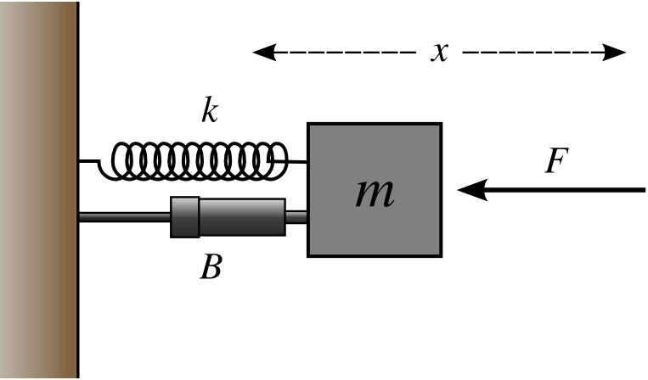
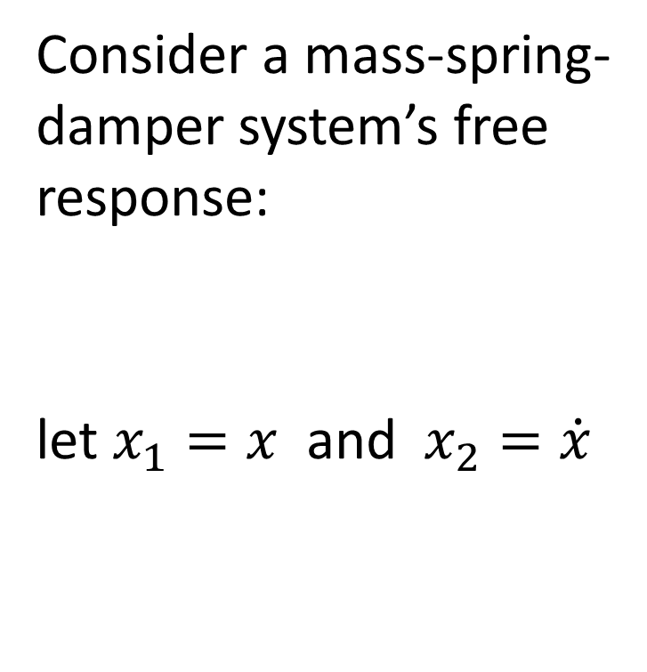
The most basic state-space analysis is that of stability
Consider a mass-spring-damper system’s free response:
let $x_{1}=x$ and $x_{2}=\dot{x}$
A

Slide 26
The eigenvalues of the A-matrix determine the stability of the system
Denote these as (λ₁, λ₂)
characteristic equation

Slide 27
The eigenvalues also show what behavior to expect
If critical damping over damped under damped complex numbers
x
x
remember
x
x
x
x

Slide 28
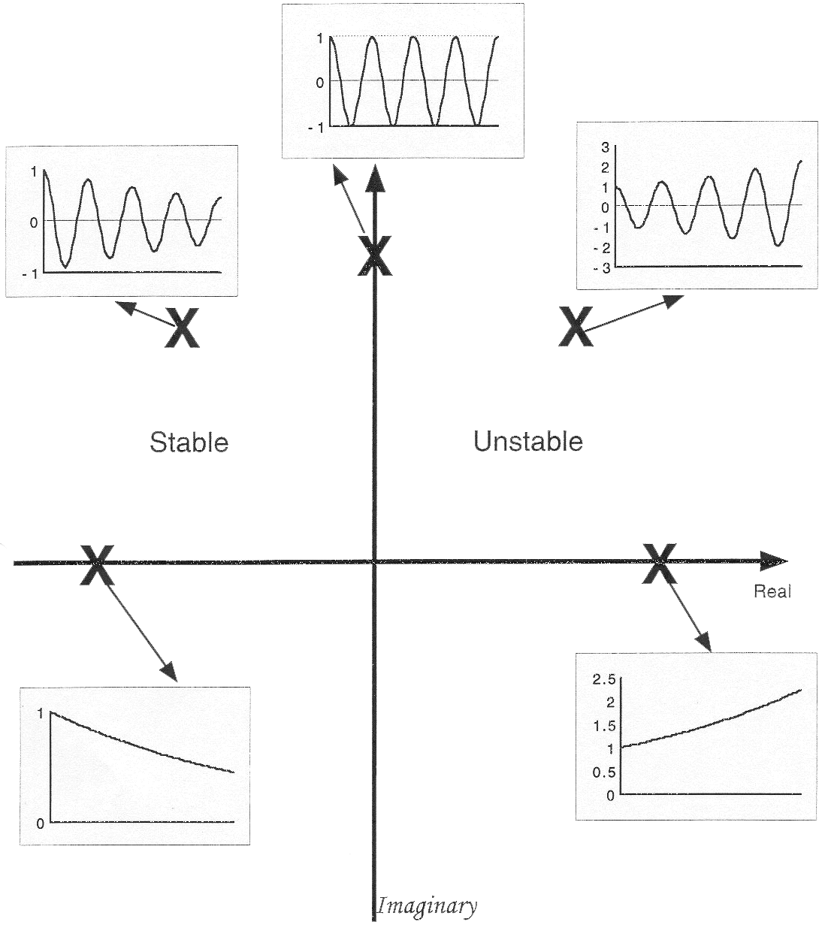
The pole locations predict system response

Slide 29
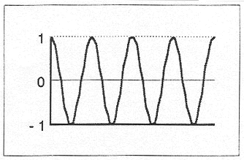
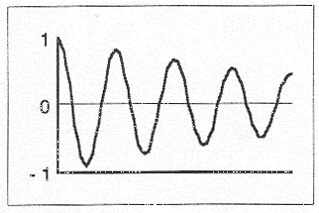
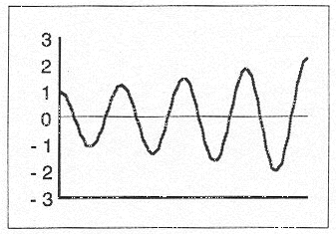
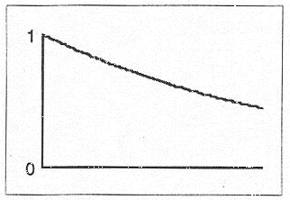
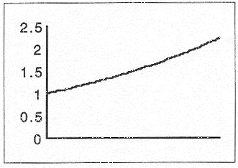
Since system responses depend on eigenvalues, let’s study these directly from here on…
stable
unstable

Slide 30
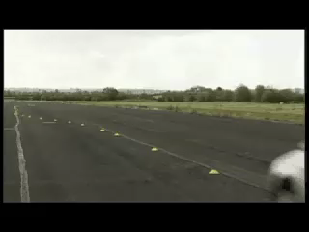
The analysis of transient behavior is critical for vehicles, particularly at high speeds

