Slide 1
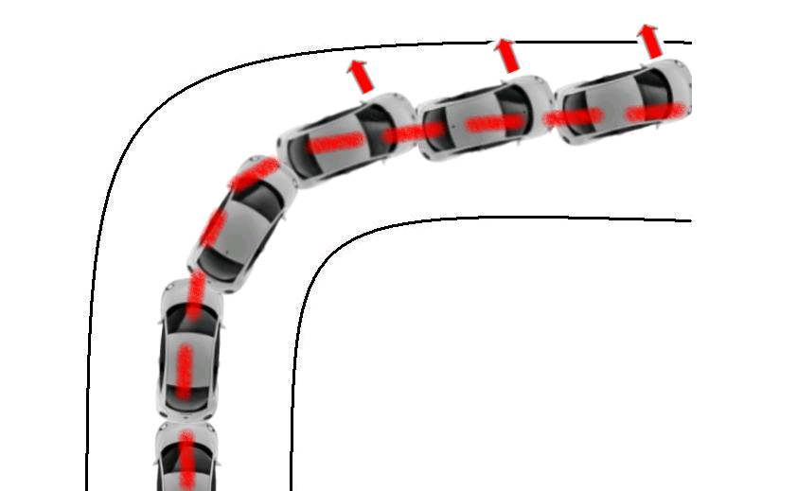
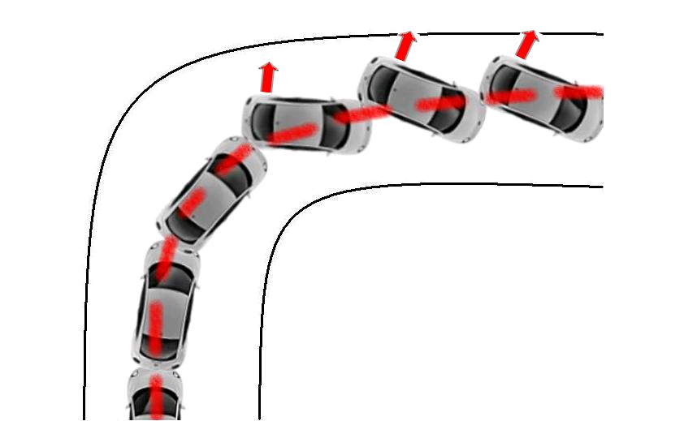
Automotive Vehicle Dynamics
Transient Response – Model Analysis
Sean Brennan
Department of Mechanical and Nuclear Engineering
Penn State University
sbrennan@psu.edu

Slide 2
The Bicycle Model represents 2 degree of freedom vehicle dynamics in the plane
Unlike previous steady-state formulations, it works with changing steering inputs.
B
A

Slide 3
The stability of the transient system is dependent on the eigenvalues of the system A matrix
For a 2x2 system (like the bicycle model) the eigenvalues are easy to calculate. Set

Slide 4
Plugging in the entries of the bicycle model “A-matrix” gives the characteristic equation
This turns out to be the same as the denominator of the transfer function from input to any measured output.

Slide 5
The eigenvalues are obtained by finding the roots to the characteristic equation…
Let C₁ = C_{α f} + C_{α r} C₂ = (aC_{α f} - bC_{α r}) C₃ = a²C_{α f} + b²C_{α r}
Then

Slide 6
For 2nd or 1st order systems, stability can be seen by inspection
For a 2nd order polynomial to have roots with negative real parts, all the coefficients must have the same sign. (Routh – Hurwitz) ⇒ mC₃ + I_{z}C₁ < O
This is always satisfied if C_{α f} + C_{α r} are negative (remember SAE convention).
See any controls course textbook

Slide 7
We can use this stability criteria to find conditions under which a vehicle is stable
Also
Simplify to get.

Slide 8
So, stability is guaranteed if a vehicle is understeer, but not so with oversteer
Positive coefficients will always be true if
or (i.e. understeer)
If not, then
will be the speed above which one eigenvalue moves into the RHP ⇒ unstable.
(critical speed)

Slide 9
The characteristic equation also tells us how the natural frequency and damping changes with speed
Looking back at the characteristic equation we can see that it looks like a standard 2nd order system:
We see that the natural frequency is
So, as U increases, the effective damping of the system decreases.

Slide 10
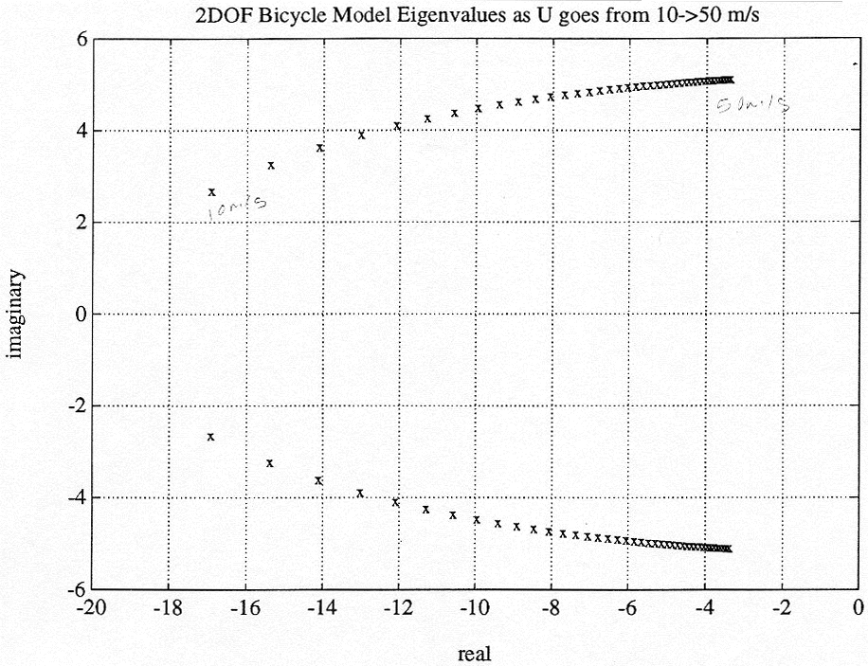
Understeer vehicle eigenvalues approach the jw-axis, but NEVER cross…
50 m/s
10 m/s
cos⁻¹ζ

Slide 11
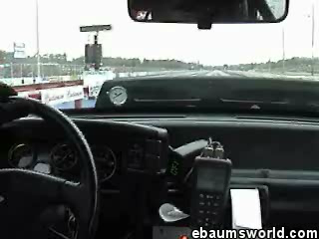
We can see the decreasing damping of an understeer vehicle at high speeds. This can become so oscillatory that the vehicle is effectively undrivable. Lesson: a system that is stable BUT poorly damped is still BAD.

Slide 12
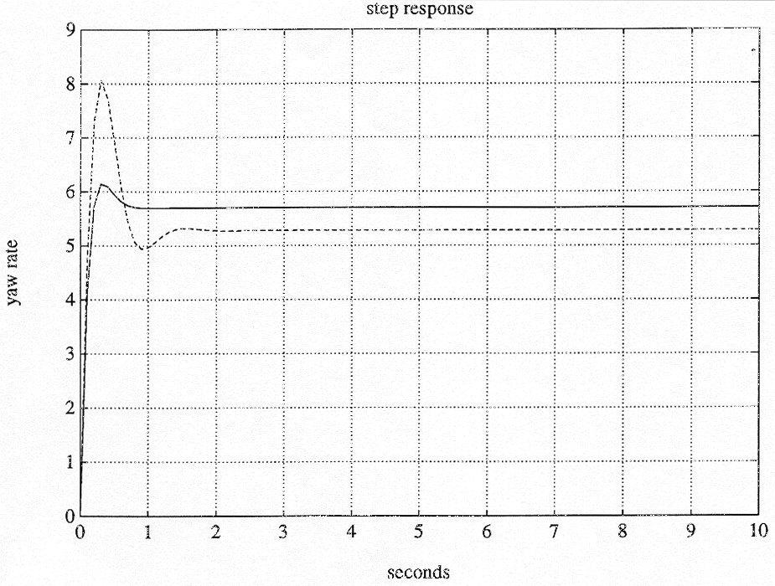
Time response verify that damping DECREASES with increasing speed
25 m/s
50 m/s

Slide 13
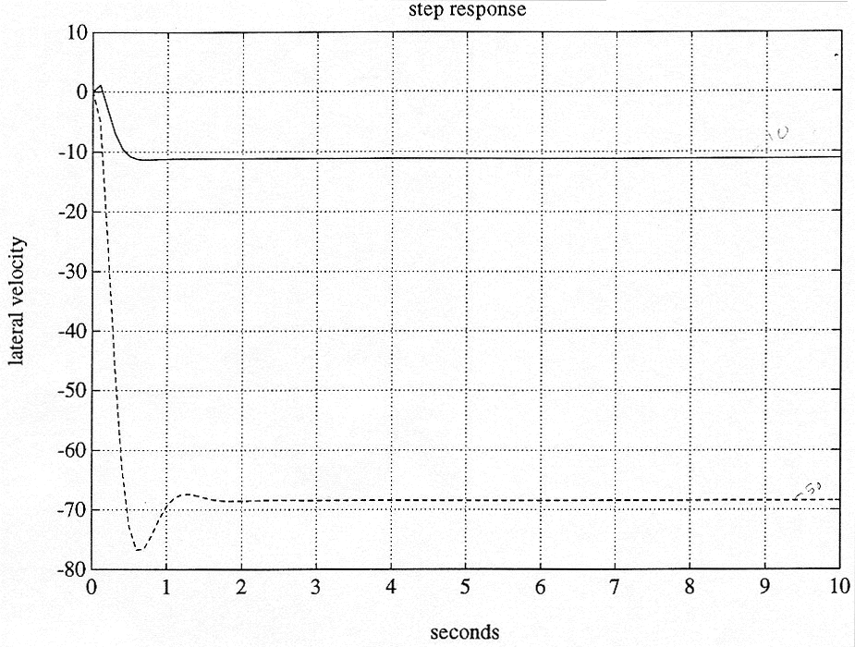
Similar behavior is seen in lateral velocity (or ANY state we look at)
25 m/s
50 m/s

Slide 14
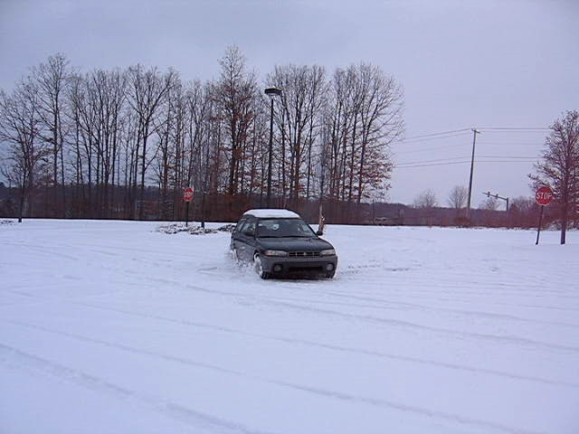
For oversteer vehicles, instability manifests itself by yaw and slip angles that increase in magnitude to infinity

Slide 15
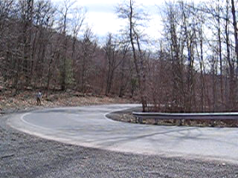
This oversteer-like instability can be seen regularly under RWD throttle-on situations

Slide 16
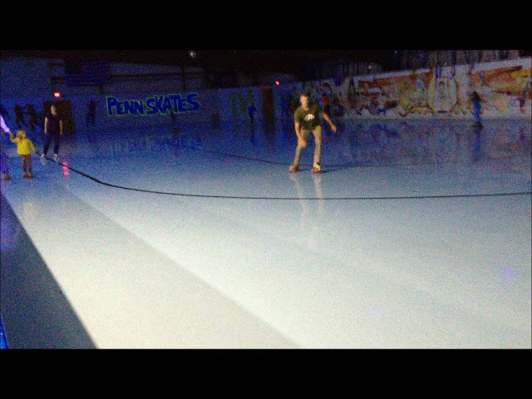
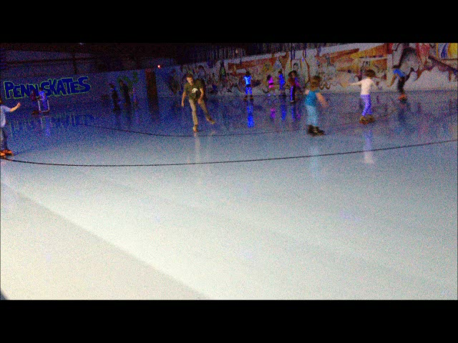
You can do this experiment of stability even without a vehicle

Slide 17
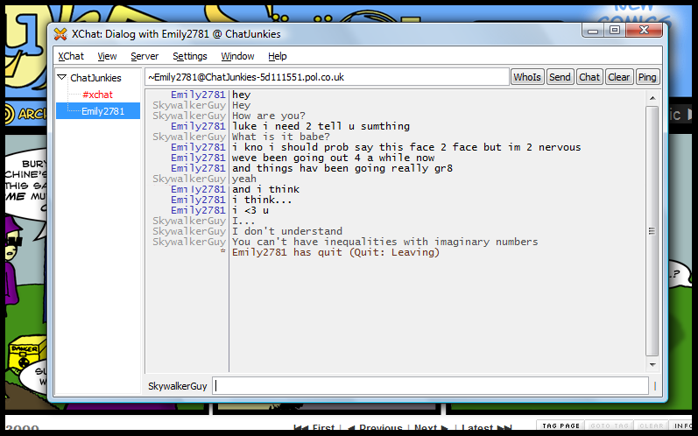
Stability analysis depends on complex numbers, but isn’t complex as relationships…

