Slide 1
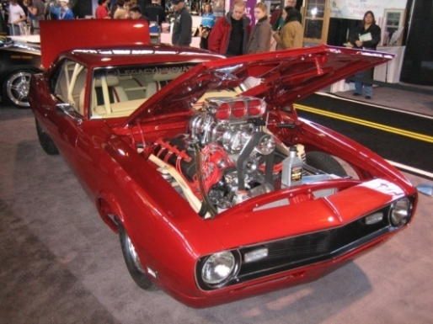
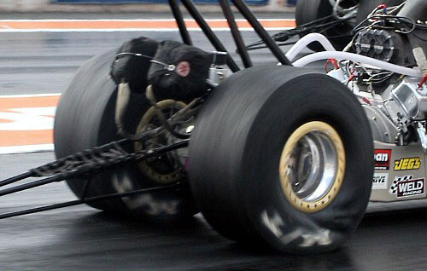
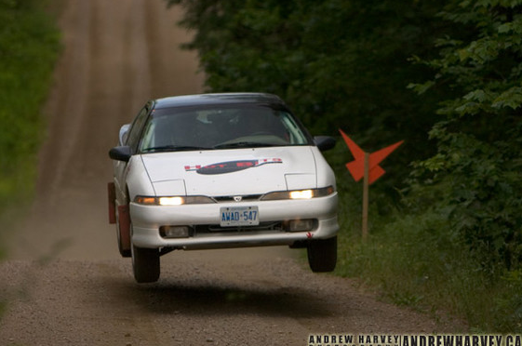
Automotive Vehicle Dynamics
Acceleration 1
Sean Brennan
Department of Mechanical and Nuclear Engineering
Penn State University
sbrennan@psu.edu

Slide 2
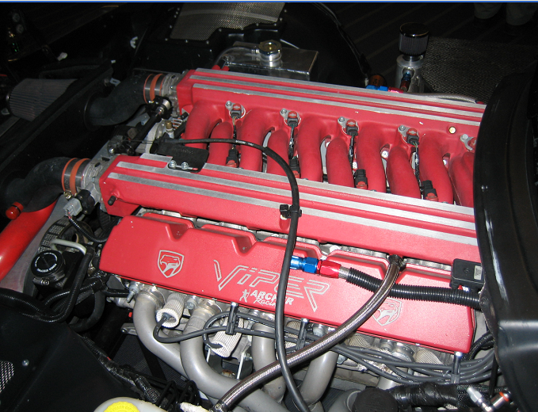
This is an engine. It’s basically an air pump that happens to use explosions to keep the pump going. It produces so much extra power beyond that needed to keep running that we can siphon some power off to make a vehicle move.

Slide 3
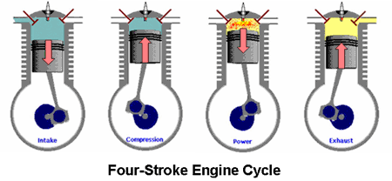
There are 2 types of engines in common use (with others in development)
Spark Ignition (SI)
Compression Ignition (CI)
Both use the 4-Stroke Engine Cycle
Intake → Compression → Expansion → Exhaust
[1]
Can anyone think of any other types of engines?

Slide 4
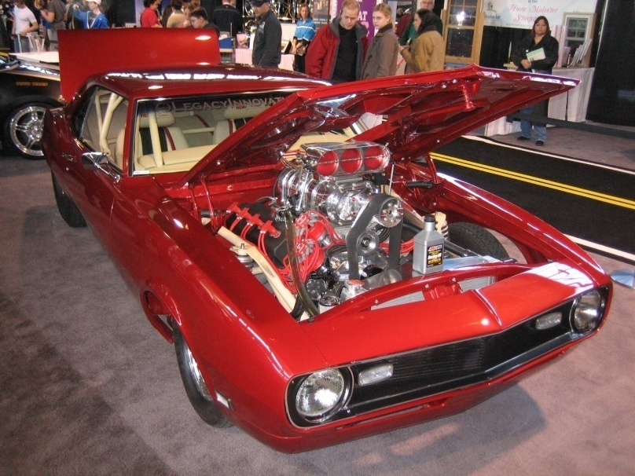
Spark ignition engines are the most common now in the US fleet…
Patented in 1876 by Nicolaus August Otto
Fuel: Typically Gasoline (Ethanol ~10-15%)
Ignition Type: Spark gap
Fired just before piston
reaches “Top Dead Center”
Compression Ratio is around 11 to 13
Throttle control amount of Fuel-Air Mixture allowed to enter
Flat power curve enables applications with changing speeds

Slide 5
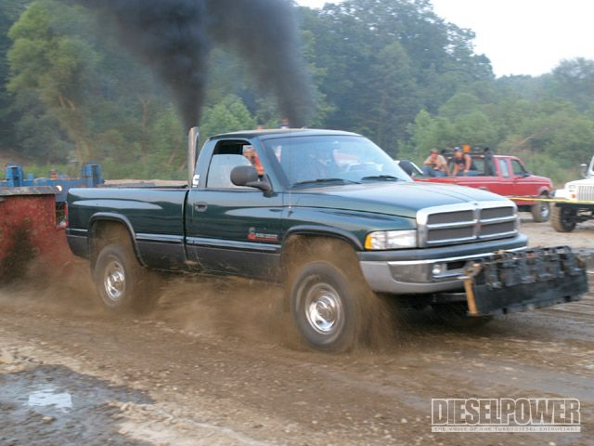
In contrast, compression ignition are popular in Europe and on large trucks…
Patented in 1894 by Rudolf Diesel
Fuel: Diesel
Ignition Type: Auto-ignition
No spark plugs
High Temperature & Pressure
Direct-fuel Injection
High Compression Ratio
CR >= 15
Throttle: affects fuel (only) injected into cylinder
Good for low speed variation applications
[2]

Slide 6
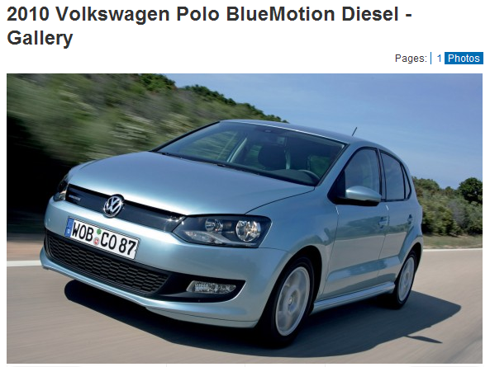
Engine efficiencies favor CI over SI
Ideally: The Otto Cycle (SI) is more thermodynamically efficient for same CR
Practically: The Diesel Cycle (CI) is more efficient due to higher compression ratios (CR) and popular turbocharger applications
Real World Efficiencies:
Spark Ignition: ~30%
Compression Ignition: ~40%
Direct-injected SI: ~35%
[4]
[3]

Slide 7
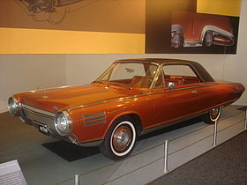
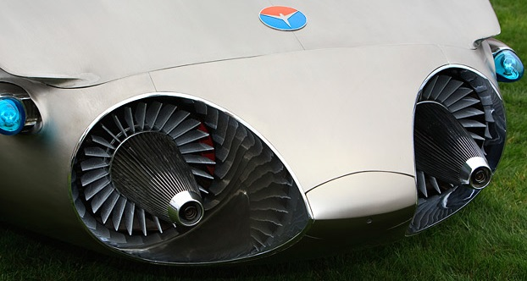
There are other engine types. For example, turbine engines have been implemented for use in cars before…
Sam B. Williams made turbine engines possible for cars
Fuel: multiple types
High power to weight ratio
Turbine cars are not on the market today because they are more expensive, very noisy, and have bad fuel economy
Does not work well in cities with stop and go traffic conditions

Slide 8
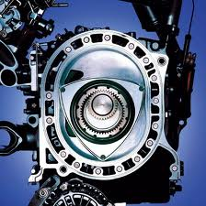
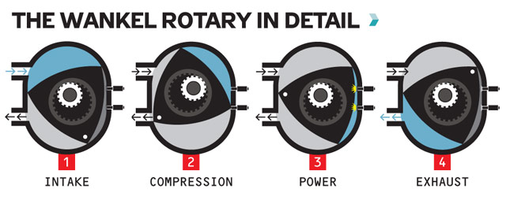
Rotary engines are also in use today, but are not as common…
Also known as a Wankel engine
Most commonly found in Mazda’s
Fuel: Gasoline
Compression Ratio:9-10
Smoother ride, higher power to weight ratio, less moving parts
Problems with sealing, high emissions

Slide 9
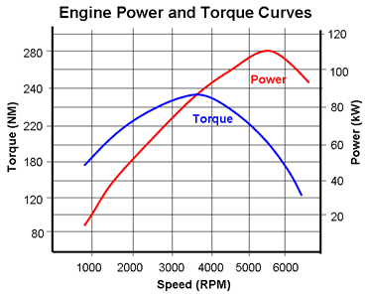
Acceleration performance is usually what people want…
The acceleration of the vehicle is governed by the performance of the engine.
The engine can be characterized by torque and power curves which vary as a function of engine speed.
Electrical Energy Supply Overview. "Piston Engine Power Plants." Electropaedia, Energy Sources and Energy Storage, Battery and Energy Encyclopaedia and History of Technology. Web. 25 Apr. 2010. <http://www.mpoweruk.com/piston_engines.htm>.

Slide 10
To determine acceleration, have to recognize that torque/speed are interrelated
Power = torque ⋅ angular velocity
(ft – lbs/sec) = (ft – lbs) ⋅ (rad/sec)
Also Power (KW) = 0.746 x Hp
Notes:
9

Slide 11
It’s simple to show that the primary predictor of a vehicle’s acceleration performance is its power-to-weight ratio
Usually reported in goofy units as Weight (lb) / Power (hp)
Taking a very simple analysis M a_{x} = F_{x} M = vehicle mass a_{x} = acceleration in the forward direction F_{x} = tractive force @ drive wheels
Newton’s law
Notes:
10

Slide 12
You can easily calculate acceleration limits from HP and weight
Since power = force × velocity
And V_{x} = velocity in the forward direction
Putting in the power to weight ratio and converting to British units
Notes:
11

Slide 13
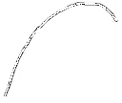
Predicting Engine Power? Need a “map”!
Engine data is often given as a plot
It is possible to come up with a curve fit to predict a torque-speed relationship
Popular ones are polynomial fits.
Power
ω

Slide 14
IC Engine Characteristics say a LOT about power and speed…
For example, Genta uses general fits determined by Artamonov.
Engine power
all engines
engine speed
P_{max} = max power
ω_{max} = speed @
which max power
occurs
Ref. G. Genta, Motor Vehicle Dynamics, Modeling and Simulation, World Scientific Press, 1997

Slide 15
The Aratamonov method is also called the VT-CPFM1 model
See K. Ahn, H. Rakha, and K. Moran, “ECO-cruise control: Feasibility and initial testing,” In Transportation Research Board 90th Annual Meeting (No. 11-1031), Washington, DC, USA, 2011.
B. Saerens, H. A. Rakha, M. Diehl, and E. Van den Bulck, “A methodology for assessing eco-cruise control for passenger vehicles,” Transp. Res. part D, Transp. Environ., vol. 19, pp. 20-27, 2013.

Slide 16
IC Engine characteristics can be approximated generically
For spark ignition engines:
We can also fine tune depending on engine type, e.g. direct injection diesel engines:
Ref: See Appendix, page 145, Motor Vehicle Dynamics, Modeling and Simulation , Genta

Slide 17
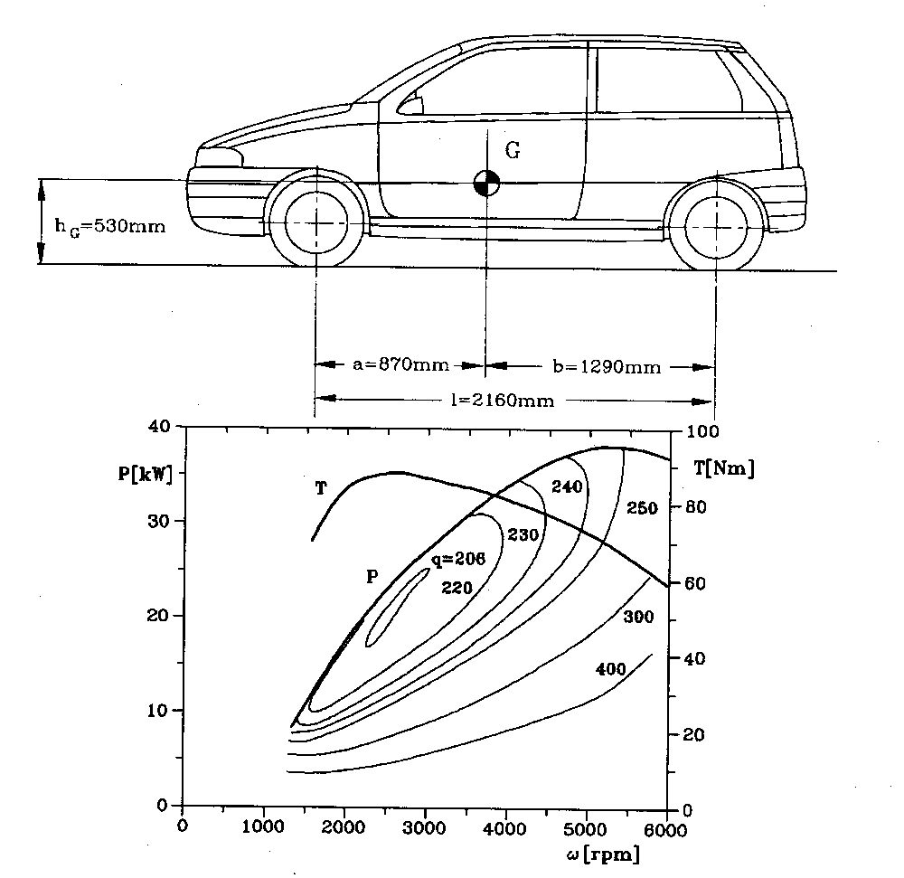
Torque, Power, and Efficiency peak at different locations
For example, consider a small front wheel drive car with a 1 liter spark ignition engine.
Engine map
Ref. G. Genta, Motor Vehicle Dynamics, Modeling and Simulation, World Scientific Press, 1997, page 524.

Slide 18
For this engine…
Using Artamonov’s fitting method:
Using a least squares regression on the 3rd order polynomial gives:

Slide 19
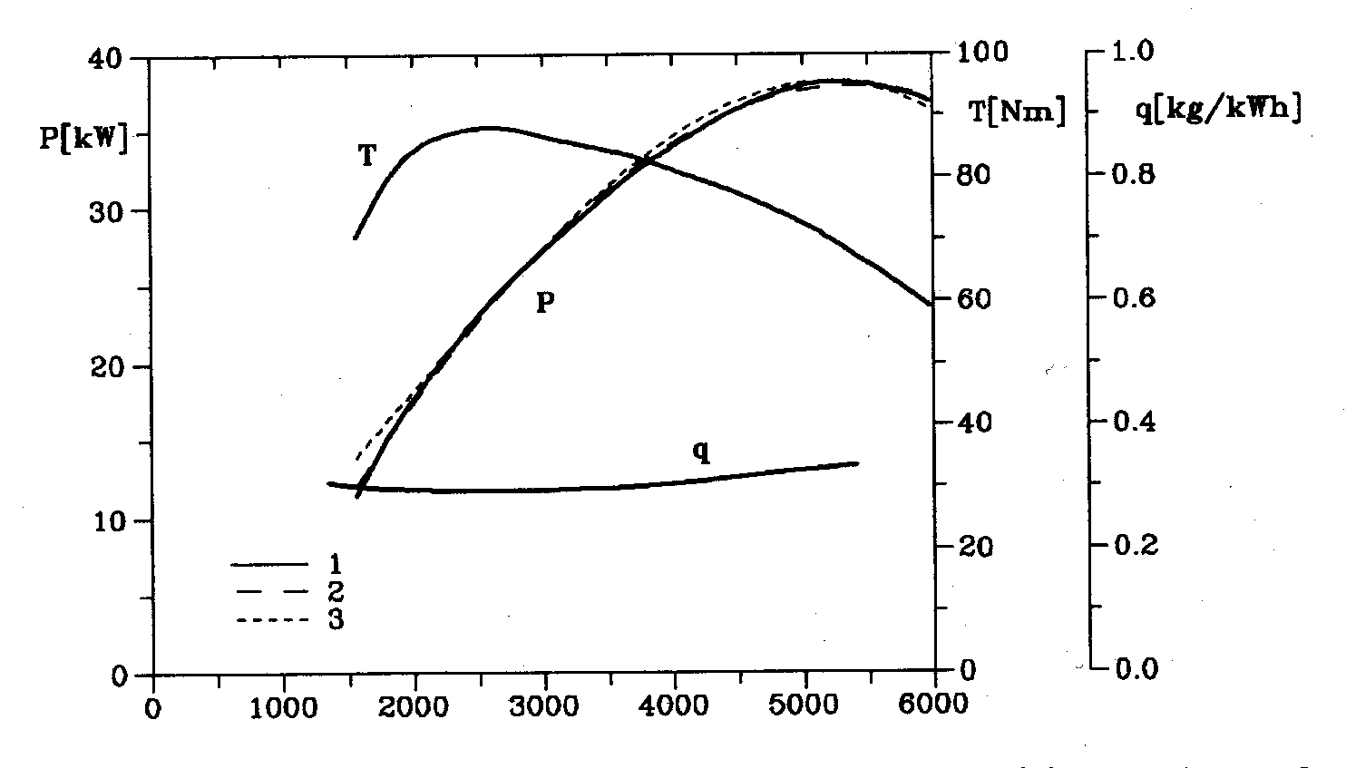
IC Engine Characteristics
Resulting fits are pretty close.
Ref. G. Genta, Motor Vehicle Dynamics, Modeling and Simulation, World Scientific Press, 1997, page 155.

Slide 20
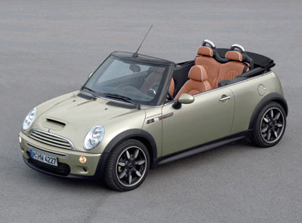
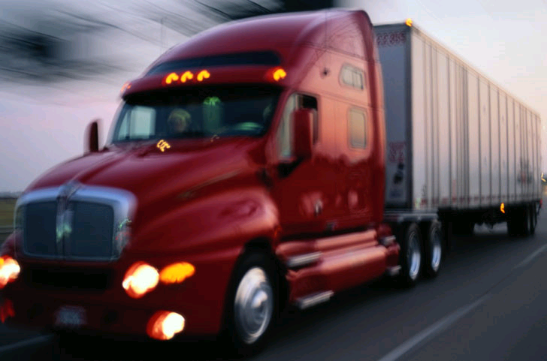
But power isn’t everything…
Heavy vehicles have lower fuel economy than a regular vehicle, so how to compare?
Suggestion from US National Academy of Sciences/National Research Council report “Technologies and Approaches to Reducing the Fuel Consumption of Medium- and Heavy-Duty Vehicles“, is to calculate fuel used per weight of the vehicle

Slide 21
LSFC = Load Specific Fuel Consumption
Tractor weighs 7 metric tons
Trailer weights 8 tons
Maximum capacity with load is 25 tons (Europe)
Cargo volume is 13.6 x 2.5 x 2.65 = 90 meters (L x W x H)
Fuel consumption is 3.0 L per 10 km at max load.
Energy content of diesel is 38.6 MJ/L (10.7 kWh/L)
C02 is 2.67 kg per L of diesel (or 3.1 kg CO2 per kg fuel) –
Note: 3 kg CO2 per kg fuel holds for any fuel of CxHy type, except methane which is 2.75)

Slide 22
What LSFC does this predict?
From this follows the load specific values.
“Massed out”
Grams of fuel per ton-km of goods: 10
Grams of CO2 per ton-km of goods: 31
kWh of fuel energy per ton-km of goods: 0.13
“Cubed out”
Grams of fuel per m3-km of goods: 2.5
Grams of CO2 per m3-km of goods: 7.7
kWh of fuel energy per m3-km of goods: 0.032

Slide 23
Fuel economy is usually seen as a tradeoff with power… and there’s some truth to that

Slide 24
But the truth is that poor fuel economy is most associated with excess mass

Slide 25
Do engines have dynamics (like the chassis)? Yes…
[6]

Slide 26
Engine dynamics are quite complex but can be conveniently modeled with a combination of physical and empirical relationships
The model can be broken down into six different subsystems, namely:
throttle
intake manifold
fuel injection (mass flow rate)
compression stroke
combustion and torque production
crankshaft rotation

Slide 27
Dynamic Engine Model
Taking this generalized form of the engine model and implementing it into Simulink

Slide 28
Dynamic Engine Model
Each subsystem represents a governing or empirical equation for the model.

Slide 29
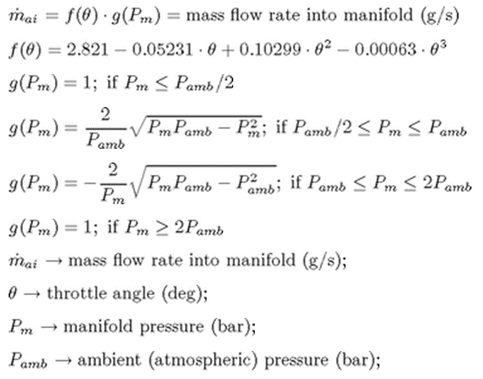
Dynamic Engine Model
1. Throttle – This models the mass flow rate of air that enters the intake manifold. It is modeled as a product of two functions: one dependent on throttle plate angle and one dependent on pressure.

Slide 30
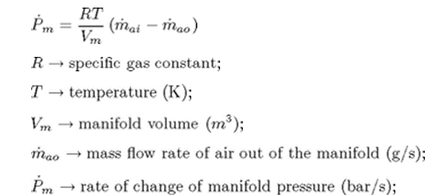
Dynamic Engine Model
2. Intake Manifold – This models the manifold pressure rate of change as an ideal gas relationship with the difference in mass flow rates through the manifold.

Slide 31
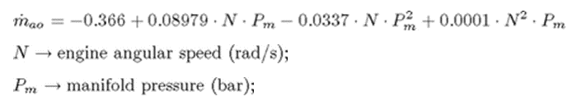
Dynamic Engine Model
3. Fuel Injection – This models the mass flow rate into the cylinders as an empirical relationship between engine angular speed and manifold pressure.

Slide 32
Dynamic Engine Model
4. Compression Stroke – A inline four-cylinder four-stoke engine compression stroke is modeled as a series of delays and triggers to perform the discrete time events of the compression cycle.

Slide 33
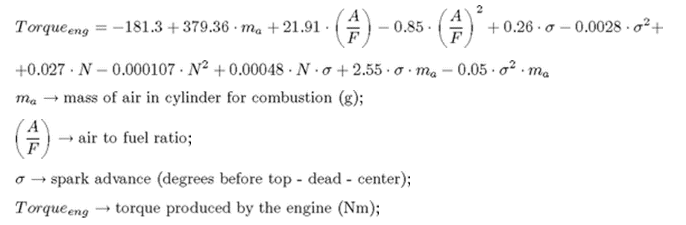
Dynamic Engine Model
5. Combustion and Torque Production – This models torque generated by the engine as an empirical relationship between the mass of air in the cylinder, the air to fuel ratio, and the spark advance.

Slide 34
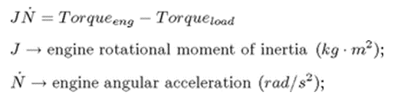
For a simple dynamic engine model, you can ignore almost everything except the engine inertia
Crankshaft Rotation – This uses a simple sum of torques to find the angular acceleration of the engine.

Slide 35
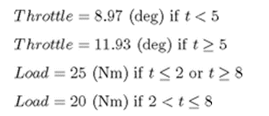
Running this model with the following inputs shows how the engine behaves under the influence of a load torque and a throttle angle displacement.
*Note: A version of this simulation can be found by typing “sldemo_engine” into the Matlab command prompt
[7]

Slide 36
There is another class that I teach (Powertrain modeling) that covers this in detail
In this class, I’ll give you a “starter” engine model that we’ll use to predict acceleration performance.
For questions on this, please ask the TA (who took the powertrain class too!)

Slide 37
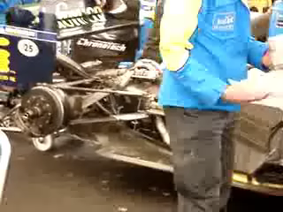
In closing, something fun

Slide 38
References
[1] Electrical Energy Supply Overview. "Piston Engine Power Plants." Electropaedia, Energy Sources and Energy Storage, Battery and Energy Encyclopaedia and History of Technology. Web. 25 Apr. 2010. <http://www.mpoweruk.com/piston_engines.htm>.
[2] "2008 Yankee Lake Ohio Truck Pull Green Dodge Ram Stacks Photo." Diesel Engines, Performance Parts, Biodiesel Trucks, & Cars - Diesel Power Magazine. Web. 24 Apr. 2010. <http://www.dieselpowermag.com/events/0811dp_2008_yankee_lake_ohio_truck_pull/photo_08.html>.
[3] Yetter, Richard. "ME431: Internal Combustion Engines." Spring 2010 Semester. PA, State College. 27 Jan. 2010.
[4] "2010 Volkswagen Polo BlueMotion Photo Car and Driver - (311727)." Car Reviews - 2010 Car Reviews at CARandDRIVER.com - Car Buying Resource. Web. 24 Apr. 2010. <http://www.caranddriver.com/reviews/car/09q4/2010_volkswagen_polo_bluemotion_diesel-quick_spin/gallery/2010_volkswagen_polo_bluemotion_photo_2>.
[5] Beard, Michael. "Competition Plus.com - Drag Racing's Internet Magazine." Competition Plus - Drag Racing Magazine. Web. 25 Apr. 2010. <http://www.competitionplus.com/2004_11_18/mt.html>.
[6] www.andrewharvey.ca - Andrew Harvey Photography. Web. 25 Apr. 2010. <http://andrewharvey.ca>.
[7] "Simulink - Modeling Engine Timing Using Triggered Subsystems Demo." MathWorks. Web. 27 Apr. 2010. <http://www.mathworks.com/products/simulink/demos.html?file=/products/demos/shipping/simulink/sldemo_engine.html>.

Slide 40
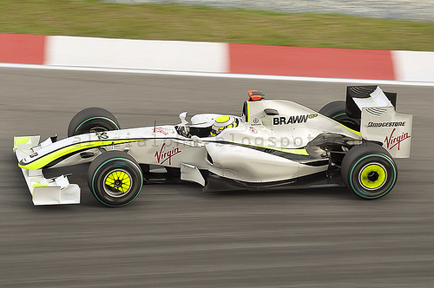

0-60 Times: Projected Vs. Tested
Final Project
Michael Beeney
4-21-2011
http://homepage.smc.edu/nestler_andrew/sums25eq.jpg
http://www.grandprixweekly.com/wp-content/uploads/brawn-sepang1.jpg

Slide 41
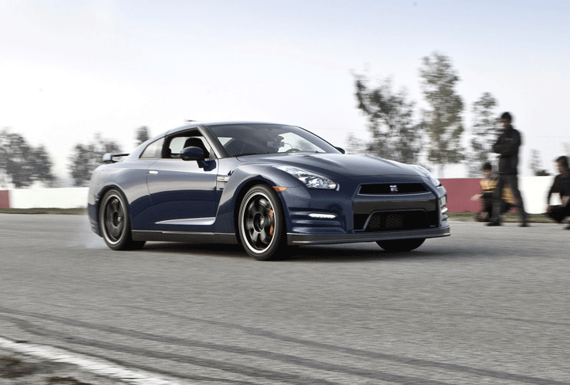
Premise
I wanted to test the equation given in class… (Lesson 26 - Longitudinal Dynamics - Engine Models and Accel. Limits)
And compare it to “real life” (Video game) values and see how close this equation truly was
http://test.factore.ca/system/images/images/492/original/Nissan-GT-R-launch.gif?1296585247
Note: Eqn take from class notes

Slide 42
Cars That Were Tested
Car | Engine Location | Engine Type | Wheels Powered
Lotus Elise 111R | Middle | Gas | Rear
Ford Mustang GT | Front | Gas | Rear
BMW 120i | Front | Gas | Rear
BMW 120d | Front | Diesel | Rear
Honda Insight | Front | Hybrid | Front
Subaru Impreza WRX Sti | Front | Gas | All
Caterham Fireblade | Front | Gas | Rear
Ruf RGT (Porsche 911) | Rear | Gas | Rear
Toyota Triathlon Race Car | ?? | Pure EV | ??
Ford RS200 | Middle | Gas | All
Mazda RX 8 | Front | Rotary | Rear
Nissan 240 ZG | Front | Gas | Rear
Honda Civic Type R | Front | Gas | Front
Dodge Ram Truck | Front | Gas | All

Slide 43
Data From Each Car
Car | Power (HP) | Mass (kg) | Weight (lbs) | Ratio (HP/lbs)
Lotus Elise 111R | 189 | 860 | 1895.98 | 0.1
Ford Mustang GT | 295 | 1568 | 3456.85 | 0.085
BMW 120i | 147 | 1335 | 2943.17 | 0.05
BMW 120d | 160 | 1415 | 3119.54 | 0.051
Honda Insight | 69 | 820 | 1807.79 | 0.038
Subaru Impreza WRX Sti | 276 | 1440 | 3174.66 | 0.087
Caterham Fireblade | 138 | 369 | 813.51 | 0.17
Ruf RGT (Porsche 911) | 379 | 1330 | 2932.15 | 0.129
Toyota Triathlon Race Car | 266 | 1200 | 2645.55 | 0.101
Ford RS200 | 250 | 1180 | 2601.45 | 0.096
Mazda RX 8 | 246 | 1310 | 2888.06 | 0.085
Nissan 240 ZG | 147 | 1010 | 2226.67 | 0.066
Honda Civic Type R | 212 | 1190 | 2623.5 | 0.081
Dodge Ram Truck | 345 | 2390 | 5269.05 | 0.065

Slide 44
Part 1: Mathematical Projection of 0-60 time

Slide 45
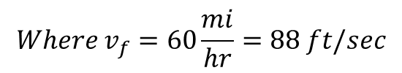
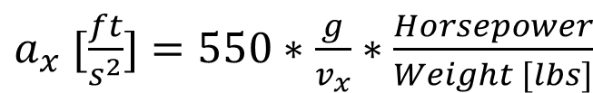
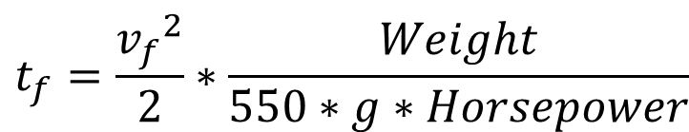
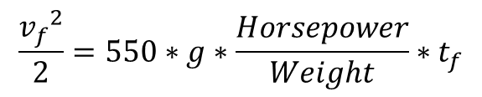
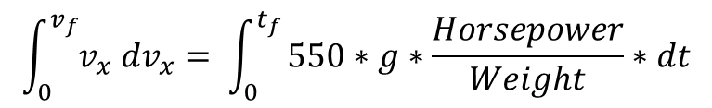
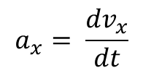
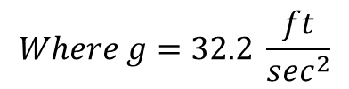
Derivation
Starting with the equations from class
$a_{x} [\frac{ft}{s^{2}}]=550∗\frac{g}{v_{x}}∗\frac{Horsepower}{Weight [lbs]}$
$$a_{x}= \frac{dv_{x}}{dt}$$
$$\int_{0}^{v_{f}}{v_{x} dv_{x}}= \int_{0}^{t_{f}}{550∗g∗\frac{Horsepower}{Weight}∗dt}$$
$$\frac{{v_{f}}^{2}}{2}=550∗g∗\frac{Horsepower}{Weight}∗t_{f}$$
$$Where v_{f}=60\frac{mi}{hr}=88 ft/sec$$
Finally…
$$t_{f}=\frac{{v_{f}}^{2}}{2}∗\frac{Weight}{550∗g∗Horsepower}$$
$$Where g=32.2 \frac{ft}{\sec^{2}}$$

Slide 46
Projections for Each Car
Car | Projected 0-60 Time (sec)
Lotus Elise 111R | 2.193
Ford Mustang GT | 2.562
BMW 120i | 4.377
BMW 120d | 4.263
Honda Insight | 5.728
Subaru Impreza WRX Sti | 2.515
Caterham Fireblade | 1.289
Ruf RGT (Porsche 911) | 1.691
Toyota Triathlon Race Car | 2.174
Ford RS200 | 2.275
Mazda RX 8 | 2.567
Nissan 240 ZG | 3.312
Honda Civic Type R | 2.706
Dodge Ram Truck | 3.339

Slide 47
Part 2: Testing
* Professional video game player – Closed virtual reality course

Slide 48

Assumptions
All Cars used the same Tire Compound
Same Track was used for all Testing
All Cars used Automatic Gearboxes, and shifted at Redline
All Cars tested were Stock
All Cars were Launched from Redline
http://www.videogameobsession.com/videogame/ps2/PS2-GranTurismo4-vgo.jpg

Slide 49
Results from “Testing”
Car | Actual 0-60 Time (sec) | Projected 0-60 Time (sec) | Percent Error
Lotus Elise 111R | 5.766 | 2.193 | 61.96%
Ford Mustang GT | 6.483 | 2.562 | 60.48%
BMW 120i | 9.766 | 4.377 | 55.18%
BMW 120d | 8.133 | 4.263 | 47.59%
Honda Insight | 13.116 | 5.728 | 56.33%
Subaru Impreza WRX Sti | 4.266 | 2.515 | 41.05%
Caterham Fireblade | 7.9 | 1.289 | 83.69%
Ruf RGT (Porsche 911) | 4.283 | 1.691 | 60.51%
Toyota Triathlon Race Car | 6.75 | 2.174 | 67.79%
Ford RS200 | 5.85 | 2.275 | 61.11%
Mazda RX 8 | 5.75 | 2.567 | 55.36%
Nissan 240 ZG | 7.783 | 3.312 | 57.45%
Honda Civic Type R | 8.183 | 2.706 | 66.94%
Dodge Ram Truck | 7.816 | 3.339 | 57.28%

Slide 50
Why So Off?
The power used was the peak power! Need to take into account that the car is not producing maximum amount of power at all RPM levels
To refine the values for the power, I used the Artamonov curve fits for engines.
Gas Engine
Diesel/Hybrid Engine

Slide 51
Part 3: Revised Estimations

Slide 52
Revised Values
Car | RPM at Max HP | Redline | Avg HP* | Ratio (avg HP/lbs) | Projected 0-60 Time (sec) | Actual 0-60 Time (sec) | Percent Error
Lotus Elise 111R | 7800 | 9000 | 110.275 | 0.058 | 3.759 | 5.766 | 34.81%
Ford Mustang GT | 5750 | 6000 | 158.477 | 0.046 | 4.769 | 6.483 | 26.44%
BMW 120i | 6200 | 6750 | 81.911 | 0.028 | 7.856 | 9.766 | 19.56%
BMW 120d | 4000 | 5000 | 103.056 | 0.033 | 6.618 | 8.133 | 18.63%
Honda Insight | 5700 | 6000 | 40.279 | 0.022 | 9.813 | 13.116 | 25.19%
Subaru Impreza WRX Sti | 6000 | 8000 | 175.838 | 0.055 | 3.947 | 4.266 | 7.47%
Caterham Fireblade | 10450 | 11500 | 77.57 | 0.095 | 2.293 | 7.9 | 70.98%
Ruf RGT (Porsche 911) | 7700 | 7750 | 197.026 | 0.067 | 3.254 | 4.283 | 24.03%
Toyota Triathlon Race Car | ?? | 7000 | ?? | ?? | ?? | 6.75 | ??
Ford RS200 | 6750 | 8500 | 154.658 | 0.059 | 3.678 | 5.85 | 37.14%
Mazda RX 8 | 8500 | 9000 | 133.854 | 0.046 | 4.717 | 5.75 | 17.96%
Nissan 240 ZG | 5600 | 7000 | 90.546 | 0.041 | 5.377 | 7.783 | 30.92%
Honda Civic Type R | 8000 | 8500 | 115.703 | 0.044 | 4.957 | 8.183 | 39.42%
Dodge Ram Truck | 5400 | 5750 | 188.654 | 0.036 | 6.106 | 7.816 | 21.87%
* Matlab Script to generate average HP at the end of the PowerPoint

Slide 53
Better But…
Still off!
Some other reasons for bad results
Weight Transfer
Inertia to move the wheels
Wheelspin – This was minimized using Traction Control
Gearchanges
Some cars needed 3 shifts to reach 60 mi/hr
A fast shift for a manual transmission car is 0.250 seconds (http://www.zeroshift.com/pdf/SPORT%20COMPACT%20CAR%20ARTICLE%2012-12-05.pdf)
Optimal Launch – Each car would benefit from testing different RPM levels to launch from

Slide 54
Conclusions
The equation used to calculate can be used as a rough estimate for 0-60 times
Correction factors for weight distribution, wheels that are powered, etc. could be developed to provide more accurate solutions.

Slide 55
MATLAB Code For Engine
%% Michael Beeney
% ME 452 Project
% 4-20-2011
close all
clear all
clc
% 0 -60 times, need average power
redline = 6000
omega_max = 5700
P_max = 69
%% constants for gas engine
% P_0 = 0;
% P_1 = .6*P_max/omega_max;
% P_2 = 1.4*P_max/(omega_max^2);
% P_3 = -1*P_max/(omega_max^3);
%% Constants for diesel and hybrid cars
P_0 = 0;
P_1 = .87*P_max/omega_max;
P_2 = 1.13*P_max/(omega_max^2);
P_3 = -1*P_max/(omega_max^3);
%% calcs
P_e = zeros(1,redline);
omega_x = zeros(1,redline);
for n = 1:redline
omega = n;
omega_x(n) = n;
P_e(n) = P_0 + P_1*omega + P_2*(omega^2) + P_3*(omega^3);
end
P_avg = mean(P_e)
%% plot
figure
plot(omega_x, P_e,'k')
title('Dyno Plot estimate')
xlabel('\omega_n, Engine speed, RPM')
ylabel('POWAHHH Horsepower')

Slide 56
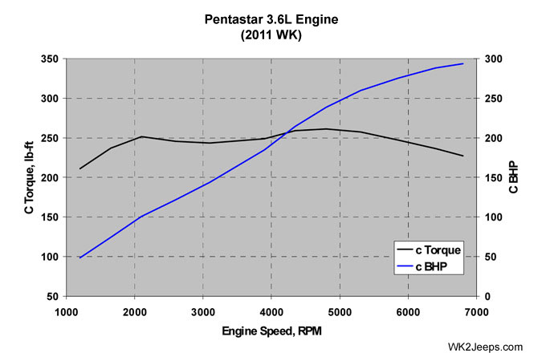
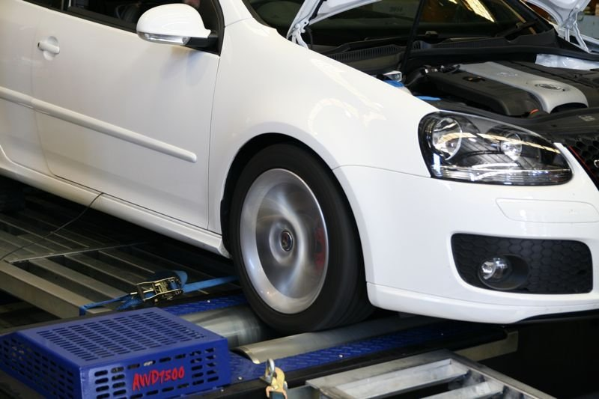
Automotive Vehicle Dynamics
Dynamometers
Sean Brennan
Department of Mechanical and Nuclear Engineering
Penn State University
sbrennan@psu.edu
Copyright © 2010 Sean Brennan
Created By Andrew Troutman, Spring 2011

Slide 57
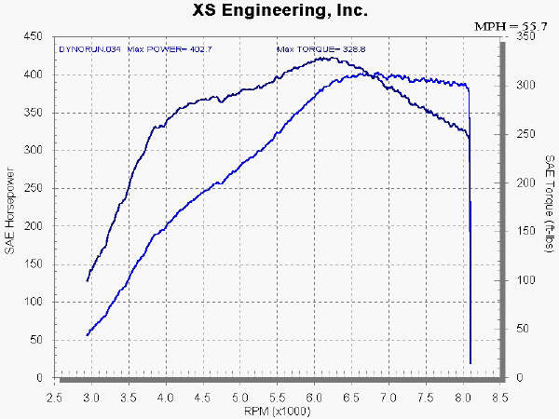
What’s a Dynamometer?
Definition: Any of several instruments used to measure mechanical power
In vehicle dynamics, we are interested in how much power and torque a vehicle can output and at what engine speed
HP and Torque plots are usually plotted together with RPM plotted on the x-axis

Slide 58
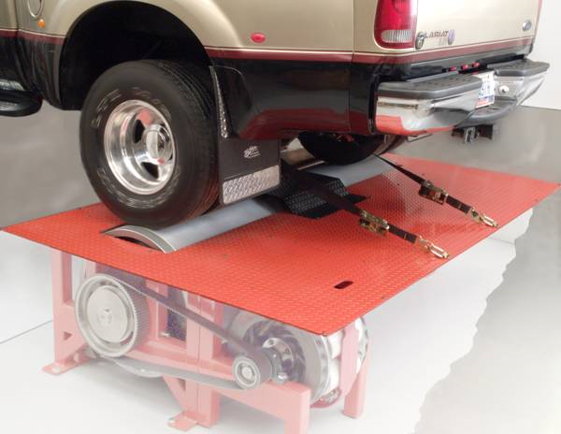
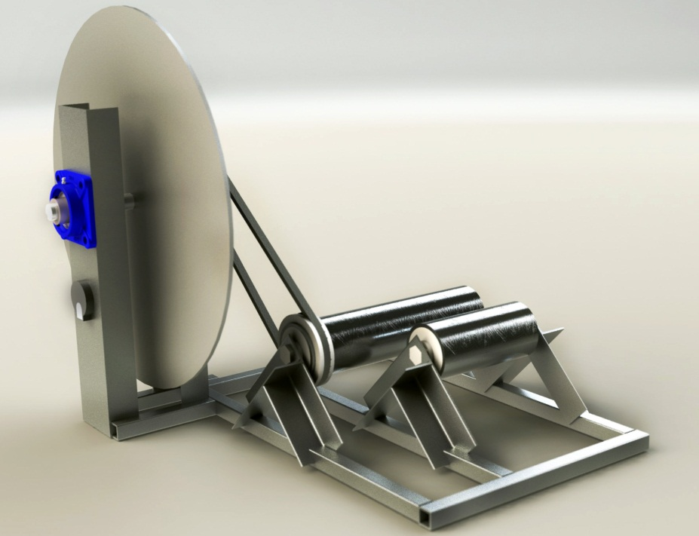
Dynamometer Types
Steady-State
Inertial

Slide 59
Steady State Dynamometer
Dissipates vehicle power through heat creation and/or electricity generation
Pros:
Power and torque data can be gathered at steady state speeds
Can handle large vehicles
Cons:
Expensive and Complex

Slide 60
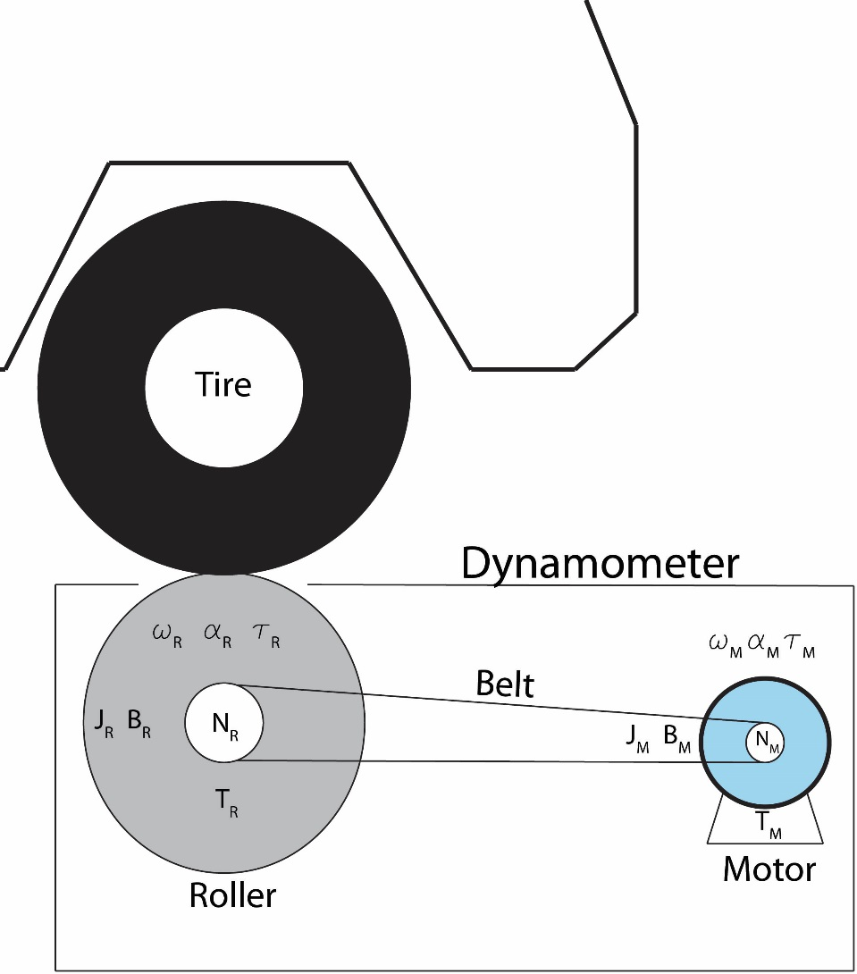
S.S. Dynamometer Dynamics
This is a steady state dynamometer that dissipates power by generating electricity and heat
ω_{R}, ω_{M} – Angular Velocities
α_{R}, α_{M} – Angular Accelerations
τ_{R}, τ_{M} – Torques
J_{R}, J_{M} – Rotational Inertias
B_{R}, B_{M} – Rotational Viscous Friction
T_{R}, T_{M} – Kinetic Friction Torques
N_{R}, N_{M} – # of Gear Teeth

Slide 61
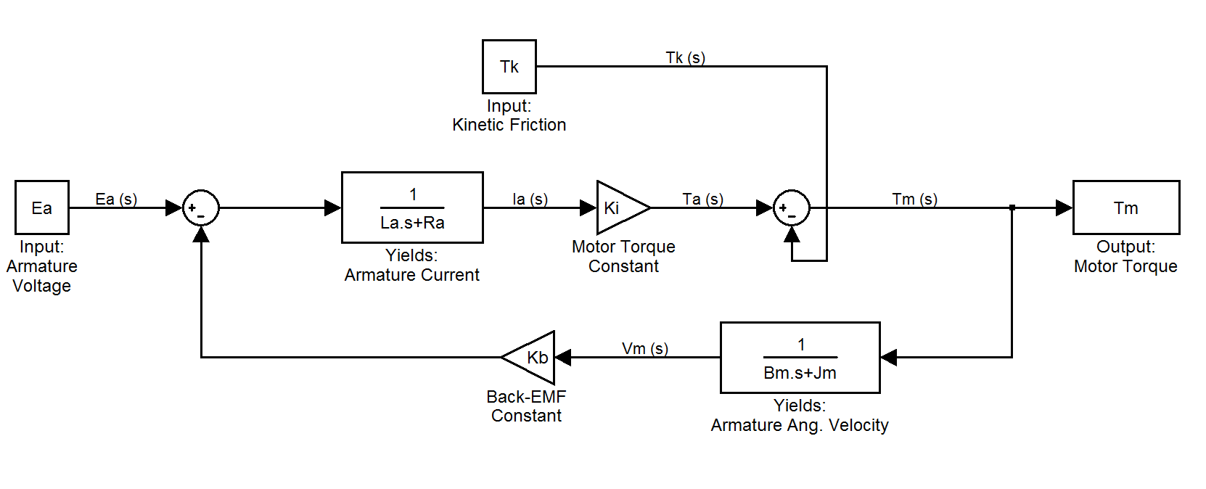
S.S. Dynamometer Dynamics
DC Motor Model:*
E_{a} – Armature Voltage
L_{a} – Armature Inductance
R_{a} – Armature Resistance
K_{i} – Torque Constant
T_{k} – Kinetic Friction Torque
V_{m} – Motor Angular Velocity
B_{m} – Viscous Motor Coefficient
J_{m} – Motor Rotational Inertia
K_{b} – Back EMF Constant
T_{m} – Motor Torque
[1]
*This model can be used in reverse to predict output voltage given the motor torque

Slide 62
Inertial Dynamometer
Vehicle’s power is used to accelerate an inertial mass
Pros:
Cheap and Simple
Cons:
Can only gather data while the vehicle is accelerating so vehicle must be run full throttle to test until maximum speed
Small Vehicles (Generally less than 20 HP)

Slide 63
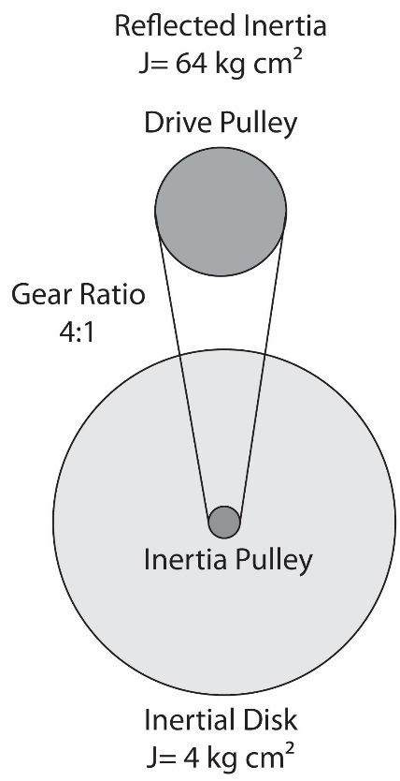
Inertial Dynamometer Equations
J α = τ : Inertia and Angular Acceleration are known. Finds Torque
τ ω= P : Torque and Angular Velocity are known. Finds Power
1 HP = 550 ft lb_{f} /s = 745.7 Watts
J = .5 m r ² : Inertia of Thin Disk
Useful Tip: Inertia is squared through gear ratios so this can be used to magnify the inertia seen by the drive roller

Slide 64
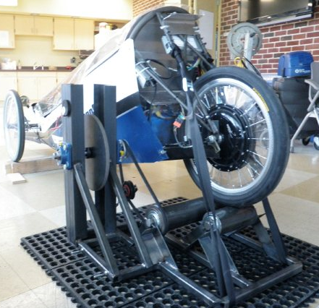
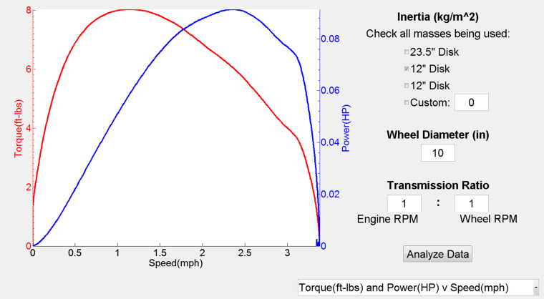
Inertial Dynamometer
Inertial Dynamometer created by for a PSU ME 440W project (sponsored by the PSU MNE Department) testing a .75 HP electric Eco Vehicle
This low HP dynamometer is capable of testing vehicles from .25 to 5HP and up to speeds of 25 mph; perfect for small, high efficiency and human powered vehicles
Entire system was produced for ~$750, while steady state commercial solutions exceeded ~$3000
Testing the GUI with a small DC motor. An optical encoder was used to capture angular velocity data, which was then converted to angular acceleration by taking the derivative. Using the equations in the previous slide allowed for the HP and torque to be found

Slide 65
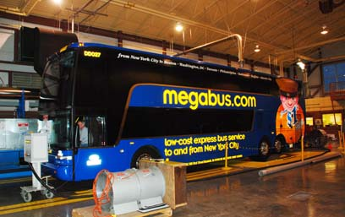
The Thomas D. Larson Pennsylvania Transportation Institute Dynamometer
One of the largest dynamometers in the county is located here at Penn State at the Transportation Institute and is used to test buses, semi-trucks, and large road repair vehicles

Slide 66
References
1. Carmen P. DiGiovine, MS; Rory A. Cooper, PhD; Michael L. Boninger, MD. 2001. Dynamic Calibration of a Wheelchair Dynamometer. Journal of Rehabilitation Research and Development, Vol. 38 No. 1, Pg. 41-55

Slide 68

Artamonov’s Engine Performance Predictions
Matt Geist
Akaash Raja
2012 FSAE Team

Slide 69
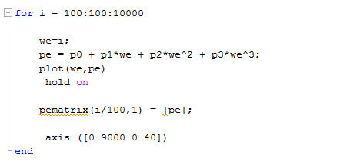
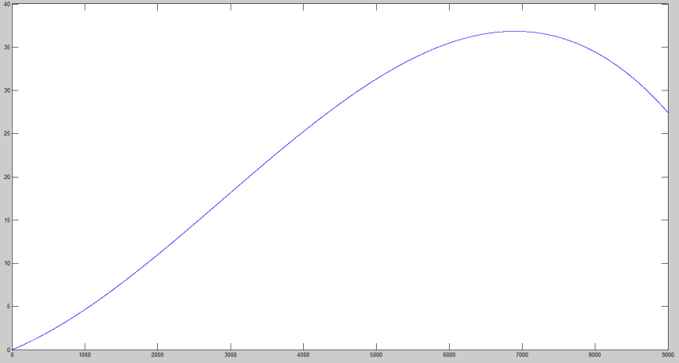



Artamonov’s Equations
Used equations to predict horsepower curve of vehicle
Input peak horsepower and ran looped simulation in MATLAB
$$P_{1}=.6∗\frac{P_{max}}{W_{max}}$$
$$P_{2}=1.4∗\frac{P_{max}}{{W_{max}}^{2}}$$
$$P_{0}=0$$
$$P_{3}=\frac{{−P}_{max}}{W^{3}}$$
$$Where P_{max}=36HP and W_{max}=7.2k$$

Slide 70
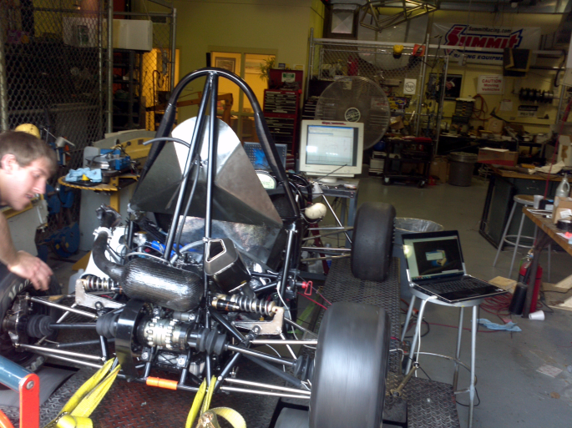
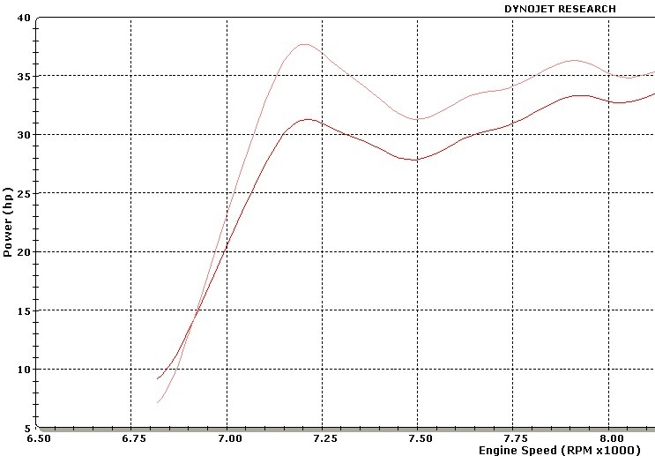
Dyno Runs with Real Formula Car
The 2012 car was run on the
dyno to measure real curves
Runs were made from 5000
RPM to 9000 at full throttle

Slide 71
Data Compared
Data imported to excel and compared
The slope is very similar in linear region of curves
However peak horsepower is offset
Model is fast and easy to implement, not most accurate

