Slide 1
Automotive Vehicle Dynamics
Driver-Vehicle Interaction
Sean Brennan
Modified from presentations from Andrew Alleyne, used with permission
All Rights Reserved

Slide 2
So far we have examined the dynamics of the vehicle as a stand-alone system.
However, the driver is an important part of the overall system that will keep the vehicle following the proper direction on the road
….or not.

Slide 3
The driver-vehicle system is actually a feedback loop with the driver providing the feedback using visual, inertial, haptic, and auditory cues
Disturbances: wind/road
vehicle
Vehicle states:
road
conditions
driver
steering
road path
accelerator
& brakes
speed, relative position, relative orientation

Slide 4
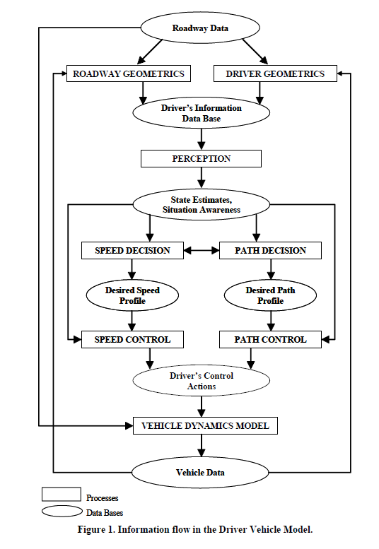
One could argue that most of the behavior on the road is actually human-human interaction mediated by a vehicle
See “Development of a Driver Vehicle Module for the Interactive Highway Safety Design Model” Publication No. FHWA-HRT-08-019

Slide 5
How do we model this feedback loop? We know that drivers respond to the road ahead of them mostly using visual cues…
lateral distance
preview distance

Slide 6
We seek to isolate input/output relationships, so usually model one input to one output
Driver inputs
Driver outputs
road
conditions
steering
road path
accelerator
& brakes

Slide 7
In this lecture, we consider only very simple models of the driver to be used in conjunction with our vehicle models
Accurate modeling of human behavior is an extremely difficult task.
But even analyzing gross behavior, we obtain some very good insights into how to drive better ourselves!

Slide 8
For our modeling purposes, the driver consists of several individual components
limbs and muscles
component:
eye
brain
function:
sensing
actuation
processing and command generation

Slide 9
There’s usually a (big) delay between sensing any signal and having it processed.
This includes perception delay (paying attention), plus the delay between developing a command (planning) and that command reaching the limbs (actuation)
Total delay is often referred to as the reaction time (0.1 sec to 2 seconds… or more)
time delay
time delay

Slide 10
This pure-delay method generates the simplest driver feedback model
In simplest terms, the driver can be represented by a transfer function.
K_{d} is the driver gain and τ is the lumped delay of the driver including sensor processing and command delay
Driver output
Driver input

Slide 11
There’s also a limit to how fast you can move! (actuator dynamics)
Even after commands arrive at the limbs, there’s a delay before the actual task is performed by the muscle
In other words, there’s a maximum frequency signal that can be tracked by the limb!
Dependent on limb size (i.e. inertia) & musculature
mag
Limbs have a bandwidth
ω

Slide 12
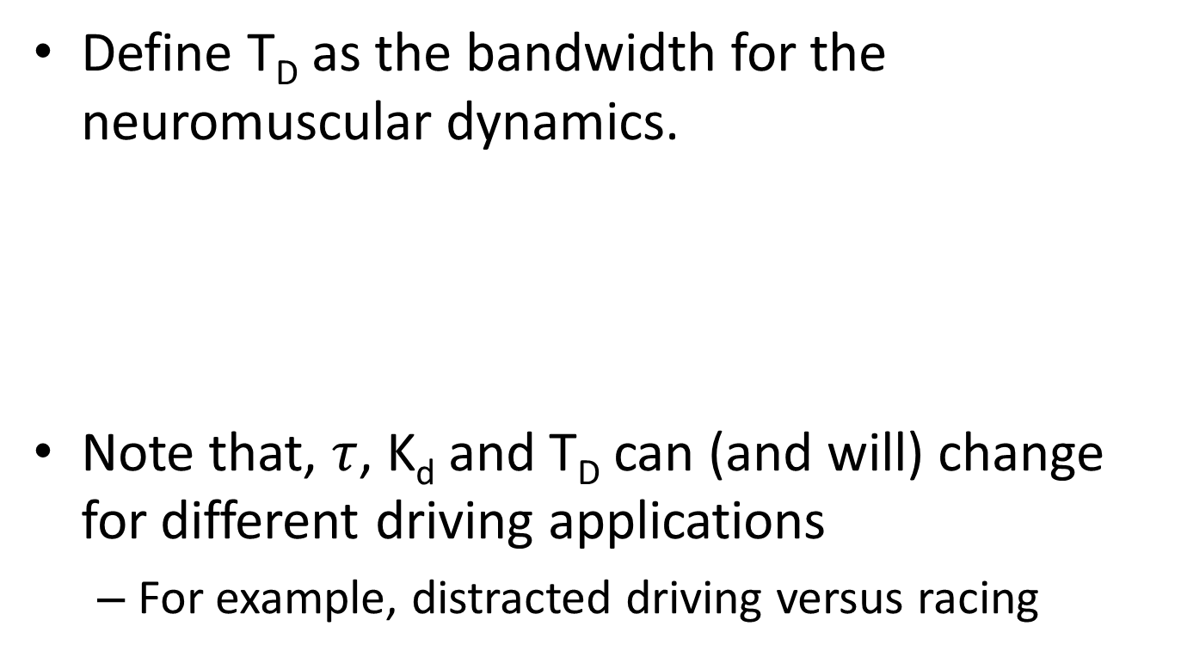
We can include the limb actuation dynamics into a driver feedback model
Define T_{D} as the bandwidth for the neuromuscular dynamics.
Note that, $τ$, K_{d} and T_{D} can (and will) change for different driving applications
For example, distracted driving versus racing
Time delay
Driver lag

Slide 13
The driver feedback depends on lateral or longitudinal positioning
The units for driver gain and driver lag are different for speed following (m/s) versus lane regulation (m) so K_{d} should be different for longitudinal vs. lateral tasks.
Similarly, the gain and the lag will be different between the arms/steering wheel actuation and foot/pedal actuation

Slide 14
Problems with modeling: humans anticipate events (and have memory)
Often, humans are very good at anticipating events.
Particularly if they’ve been in similar situations before.
(It’s called learning and remembering)
The driver action can actually react a bit sooner than the events actually occur!
In System Dynamics terms, humans can ‘add phase’ to the feedback system.

Slide 15
One way to add phase is to use a simple lead controller model
Defining T_{L} to be the driver ‘lead time,’
Question: What is y(s) and u(s)?
y(s) is simpler; it’s the steer wheel angle or the throttle/brake pedal position.
U(s) is harder; it’s often a combo of many things.
Driver output (steering)
Driver lead
Driver’s input (eyes)

Slide 16
Why not just use PID control on position?
Let’s pretend we have a simple line-following idea… goal is to keep the vehicle along a prescribed path.
desired path
lateral error
heading error

Slide 17
If use only lateral error, we cannot correct yaw angle errors
These three all have zero lateral error but only one is correct.
Remember, yaw motion is lightly damped…!

Slide 18
It is difficult to control the vehicle using only c.g. lateral position information
For example, it is very hard to keep your car parallel to the center line while looking out the bottom of an open driver door.
What do they teach in high school Driver’s Ed?
Look ahead of the vehicle and try to control this point.

Slide 19
Preview: how a driver’s control is really done!
From inside the vehicle:
Desired look-ahead point
Vehicle longitudinal axis
error
Road path

Slide 20
A view from above the vehicle shows that using preview is like using both yaw and lateral control
preview length = L
L*sin(ψ) = error from orientation mismatch
ψ
lateral error
desired path
total error

Slide 21
For normal, “look-ahead” driving, we see that the driver acts like a state-feedback controller
G_{driver}(s)
Steer angle or steer angle command (if you include limb dynamics)
lateral error + L*sin(ψ)
preview distance*heading angle error
L*ψ for small heading angle errors

Slide 22
The look-ahead or preview distance is a critical factor
For pure lateral control (no preview), the input to the driver would be the lateral error.
The lateral error is given in Earth fixed coordinates for our purposes.
lateral error
G_{driver}(s)
Steer angle or steer angle command (if you include limb dynamics)

Slide 23
We need to reconcile body-fixed to earth-fixed tracking
In a general case, the earth fixed coordinates would have to move along with the road.
X_{earth}
Y_{earth}

Slide 24
There is such thing as too much look-ahead, or too little
The larger the look-ahead distance L is, the greater the relative contribution of yaw angle orientation to the driver feedback.
Yaw feedback has a tendency to stabilize the Driver-Vehicle system.
It adds damping
More L=>more damped response which is beneficial…to a point.
You can’t be looking a mile ahead to control the vehicle.

Slide 25
The problem with developing models of humans… we don’t like to conform!
Risk homeostasis: proposed by Gerald J.S. Wilde to explain why crash rates do not seem to be declining with ABS
The basic idea: if you make the vehicle safer to drive (by improving the human/vehicle system), humans will drive in more risky manner to compensate
For example, if you have 4WD, you are more likely to drive in snow storms than if you didn’t!

Slide 26
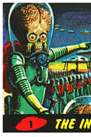
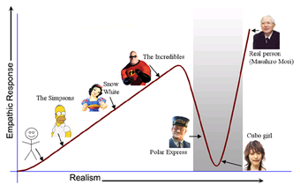
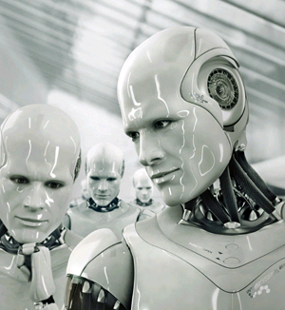
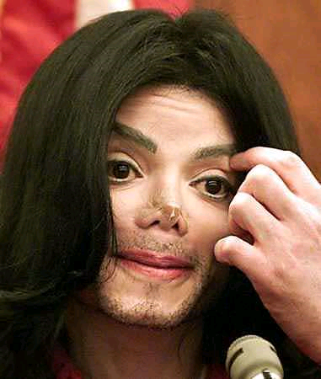
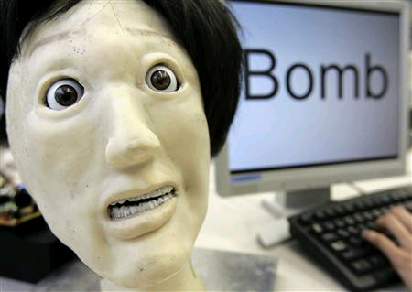
The other problem is that we don’t like vehicles making human-like decisions
This is called the “canny valley”
http://www.youtube.com/watch?v=1js5bD68Nw8&feature=player_embedded

Slide 27
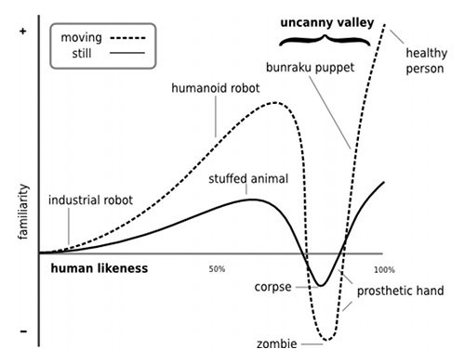
The canny valley gets deeper if things move… like vehicles
http://en.wikipedia.org/wiki/File:Mori_Uncanny_Valley.svg

Slide 28
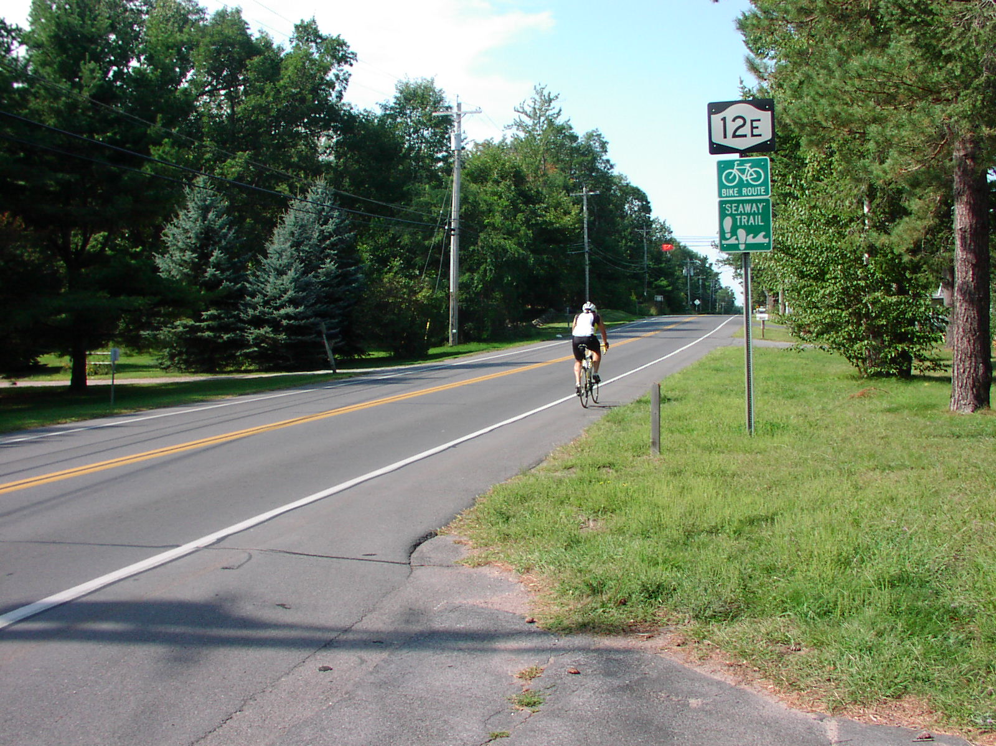
A key challenge with driving is that it is a giant psychology experiment
For example, are you more likely to get hurt by a car with a helmet or without when riding a bicycle near the road?

Slide 29
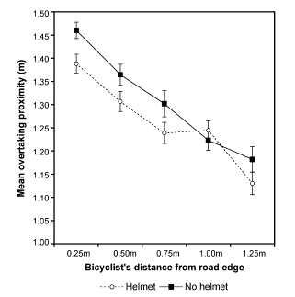
Turns out: drivers give you less room if wearing a helmet!

Slide 30
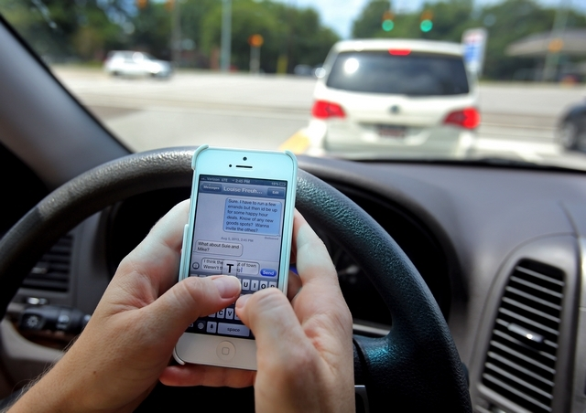
There’s a joke that, the more technology we develop to make cars safer, the more technology makes us behave unsafe
In 2011, Blackberry had an outage for 3 days. In Dubai and Abu Dhabi (strong Blackberry usage base then), accidents fell by 20 to 40 percent nationwide over those 3 days.

Slide 31
ME 452 Automotive Vehicle Dynamics
Produced by the
College of Engineering, UIUC
© 2000 UIUC BOT,
Modifications by S. Brennan, PSU
© 2011 PSU
All Rights Reserved

Slide 32
Confounding Factors
Amount of sleep
Doesn’t just affect driving.
Obesity, Feb 2008 reports that sleep loss leads to excessive weight gain.
If more than 2 hours a night missed, 92% more likely to be overweight.
Modified 2008/03

Slide 33
Suggested Sleep?
Younger than 5 years: 11 hours
5 to 10 years: 10 hours
Older than 10 years: 9 hours
Modified 2008/03

Slide 34
Driving Strategies
So, how should one drive in snow?

