Slide 1

Laps Library
Descriptions of the “Laps” class of functions
Photo by Anders J on Unsplash

Slide 2
The organization of this presentation is as follows:
Motivation and structure
Basic “getting started” functions
Filling Sample Laps
Identifying and Plotting Zone Definitions
Identification of Important Zone characteristics
Finding Lap Locations
Function that Breaks Data into Laps

Slide 3
Motivation and Definitions for the Laps library of functions
Updated 2022-07-21 by J. Kerr

Slide 4

When we collect data, it must be separated into “start” and “end” parts
The most common location is the Larson Test Track, and we regularly use “laps around the track” as replicates, hence the name of the library.

Slide 5
Definitions of terms are important so that we don’t get confused later
Lap
Laps
Zone

Slide 6
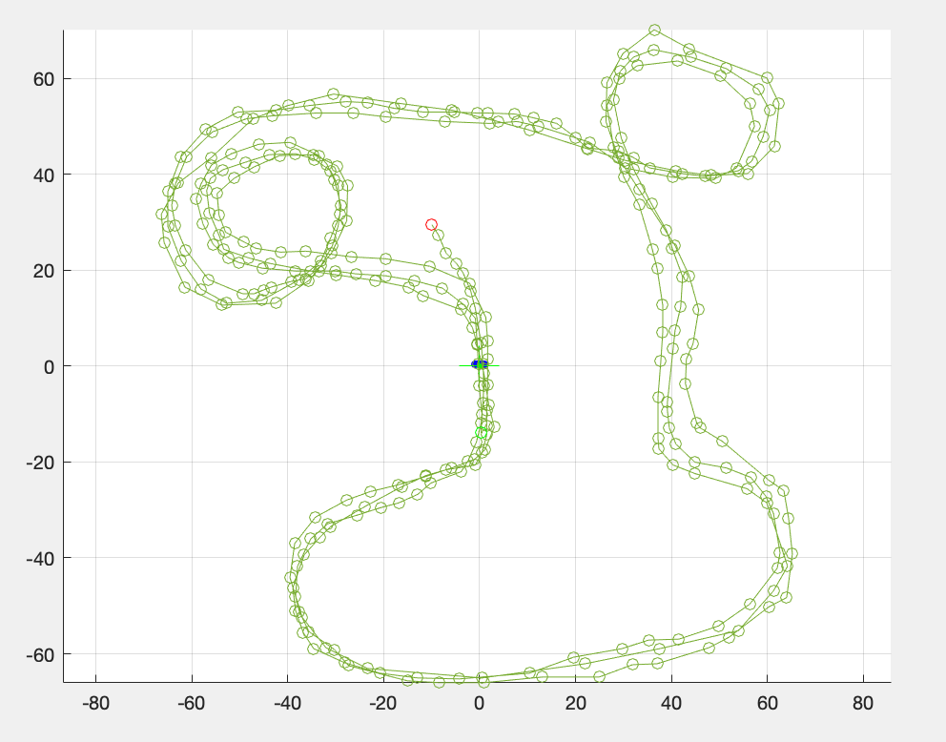
How do we ensure that individual laps are being generated for data collection without stopping code?
The vehicle will rarely have the same exact start and stop point on the track while a human operates the machine. This is where the difficulty in parsing laps arises.

Slide 7
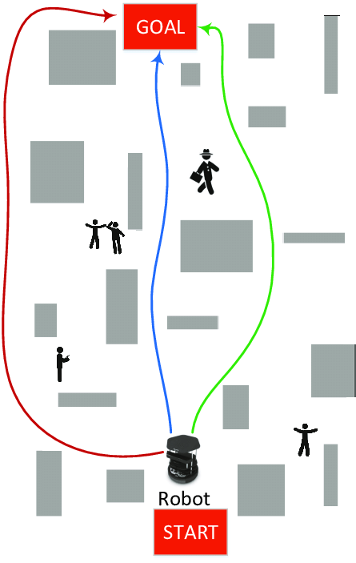
Starting and stopping zones are established as criteria to declare a new lap
Although the vehicle may take different paths each time it is driven and have unique start or stopping points, the zones dedicate specific areas to these characteristics. The driver will not have to worry about exact precision or stop the computer for every lap that is completed.

Slide 8
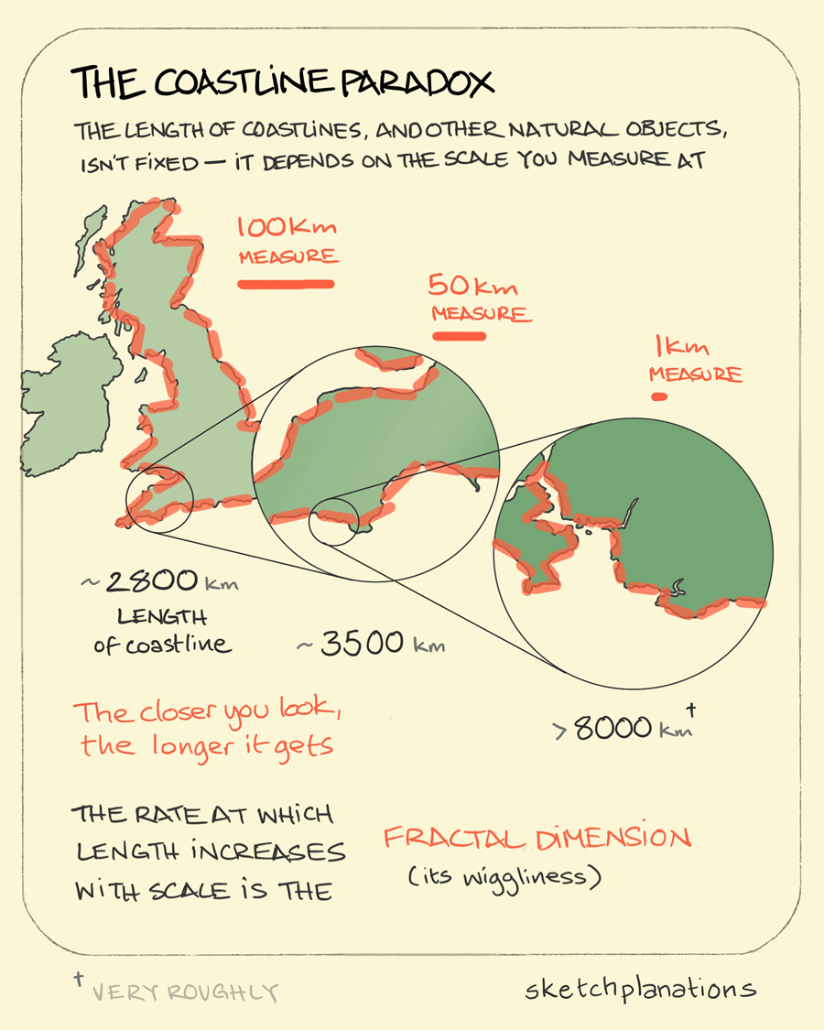
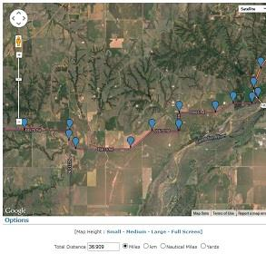
An important aspect of a lap is that is does not depend on distance traveled
Calculations are made purely on the specification of two types of zone definitions that will be identified later in the presentation.
As driving distance may change and to avoid the fractal problem, the functions in this library do not take distance traveled into account.

Slide 9

Calculations are also independent from the lap time
This independence from timing constraints allows the driver to take different paths or drive at varying speeds.

Slide 10
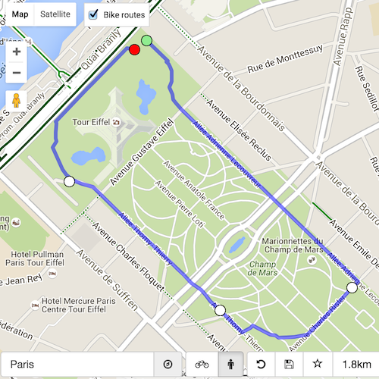
What is a lap?
A lap is an individual traversal with a start and end point that satisfies the zone definition established by the user. The vehicle would ideally return to its starting area and continue to collect data for multiple laps.

Slide 11
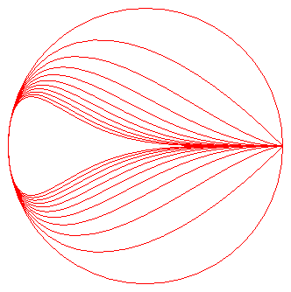
What are laps?
Given an input “traversal” type, data is broken into laps. Laps are a collection of individual lap data. Each lap has a place in a cell array to ensure that it can be accessed by the user and calculations can be performed.
See fcn_Laps_fillsampleLaps.m for examples of dummy laps test data created by users and mathematical inspiration (Left: Teardrop Curve).

Slide 12
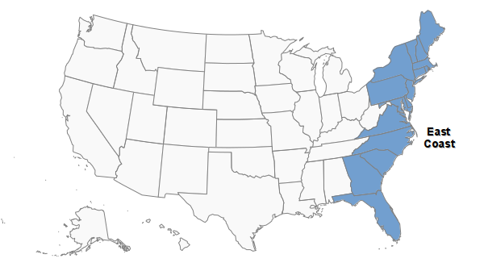
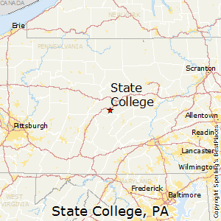
What is a zone definition?
This is a zone type
A zone definition is a region utilized to classify starting and stopping of a laps. They allow the parsing of laps without the need for the driver to be in the exact same position every lap.
Point constraints for lap parsing would not allow flexibility as for the location of the vehicle at the beginning and ends of laps.
This is a point type

Slide 13
Within the list of functions is a special function whose only purpose is to confirm that variables that are passed to it meet the requirements of each type
This is called “fcn_DebugTools_checkInputsToFunctions”
It is often called repeatedly at the top of other codes to check that the inputs are the correct type.
function fcn_Path_checkInputsToFunctions(...
variable,variable_type_string)
% fcn_Path_checkInputsToFunctions
% Checks the variable types commonly used in the Path class to ensure that
% they are correctly formed. This function is typically called at the top
% of most Path class functions. The input is a variable and a string
% defining the "type" of the variable. This function checks to see that
% they are compatible. For example, the 'path' type variables in the class
% function are N x 2 arrays of [x y] pairs; if someone had a path variable
% called "path_example", they could check that this fit the path type by
% calling fcn_Path_checkInputsToFunctions(path_example,'path'). This
% function would then check that the array was N x 2, and if it was not, it
% would send out an error warning.
%
% FORMAT:
%
% fcn_Path_checkInputsToFunctions(...
% variable,variable_type_string)
%
% INPUTS:
%
% variable: the variable to check
%
% variable_type_string: a string representing the variable type to
% check. The current strings include:
%
% 'station' - checks that the station type is N x 1 and is a
% number.
%
% 'stations' - checks that the station type is N x 1 and is a
% number, with N >= 2
%
% 'path' - checks that the path type is N x 2 with N>=2
%
% 'paths' - checks that the path type is N x 2 with N>=3
%
% 'traversal' - checks if a structure with X, Y, and Station,
% and that each has an N x 1 vector within all of same length.
% Further, the Station field must be strictly increasing.
%
% 'traversals' - checks if a structure containing a subfield
% that is a cell array of traveral{i}, e.g. "data.traversal{3}",
% with each traversal also meeting traversal requirements.
%
% Note that the variable_type_string is not case sensitive: for
% example, 'station' and 'Station' or 'STAtion' all give the same
% result.
%
% OUTPUTS:
%
% No explicit outputs, but produces MATLAB error outputs if conditions
% not met, with explanation within the error outputs of the problem.

Slide 14
Basic “getting started” functions in the library
Updated 2022-07-21 by J. Kerr

Slide 15
Basic getting started operations include
Checking the inputs to functions
Plotting laps
Padding Strings for uniform length
These basic functions are described below.

Slide 16
Checking the inputs to functions

Slide 17
Nearly all the functions use an input checking system,
As of July 2022, there is a working utility in the DebugTools repository.
% Check the zone_definition input that it has 2 columns, and exactly 2
% rows
fcn_DebugTools_checkInputsToFunctions(zone_definition, '2column_of_numbers',[2 2])

Slide 18
Defining starter laps

Slide 19
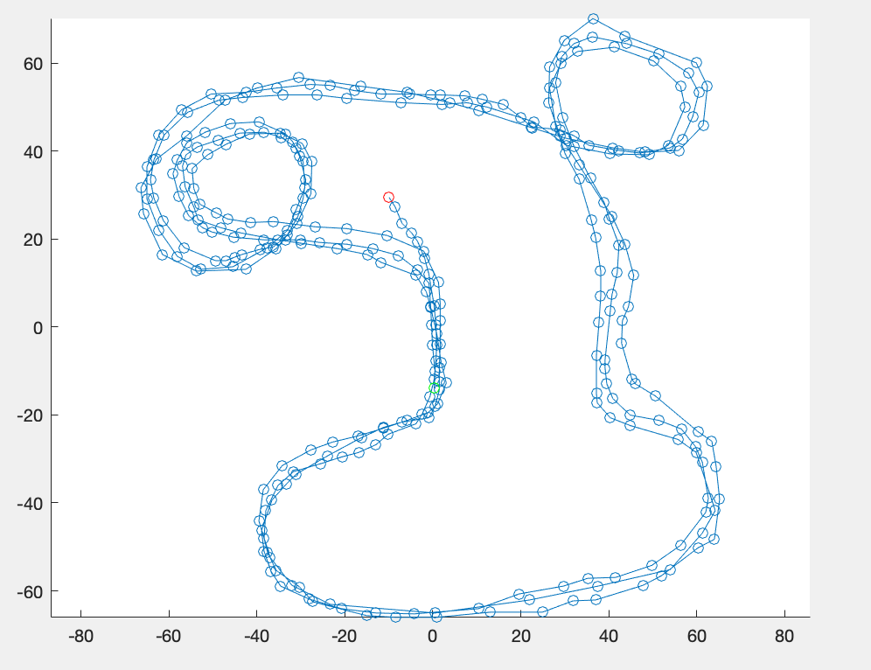
We’re often creating laps, but for dummy “starter” laps we have a function to create samples
It (currently) fills in three different laps in an array, which is easily converted into a “traversals” type.
% Fill in some dummy data
laps_array = fcn_Laps_fillSamplePaths;

Slide 20
Creating Lap Data

Slide 21
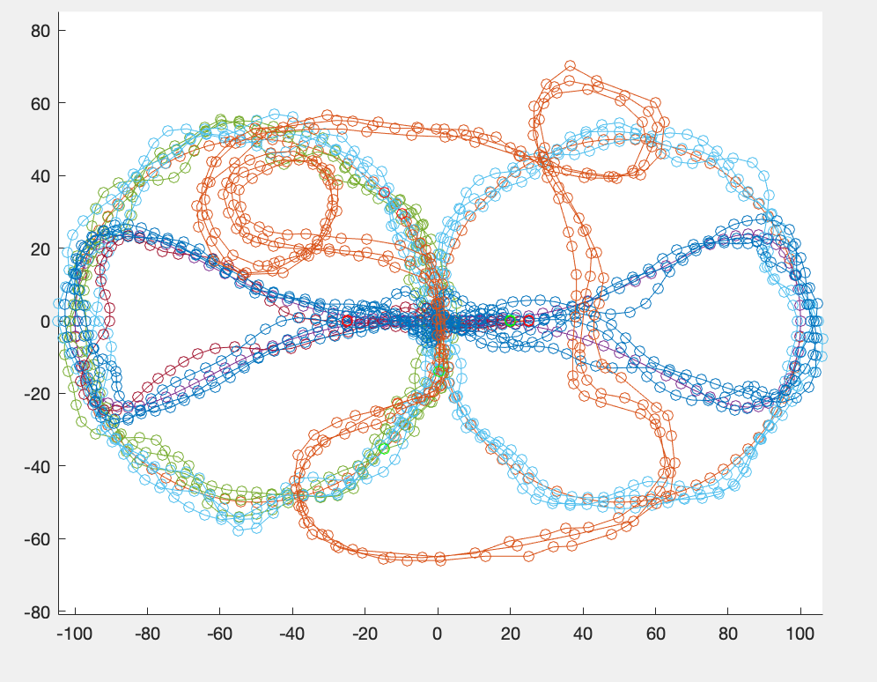
Artificial Data can be generated from user specifications
An important feature of the Laps Library is fcn_Laps_fillSampleLaps.m. This function allows users to use or draw their own dummy data to test lap functions. It ensures that the library can work on varying and complicated data sets before the collection of large amounts of data commences.

Slide 22

Real data will be collected by the IVSG mapping van
The mapping van will ultimately be deployed to collect large amounts of data which will be parsed into laps through the Laps Library functions. This area remains a work in progress and will be updated at a later point.

Slide 23
Differentiating between Point and Line Segment Zone Definitions

Slide 24

A Point Zone is when a start, stop, or excursion is defined by "passing by" a point
For example, if a journey is said to start at someone's house and go to someone's office, then the location of the house and office define the start and end of the journey.
The specification is given by an X,Y location and a radius in the form of [X Y radius], as a 3x1 matrix. Whenever the path passes within the radius with a specified number of points within that radius, the minimum distance point then "triggers" the zone.

Slide 25
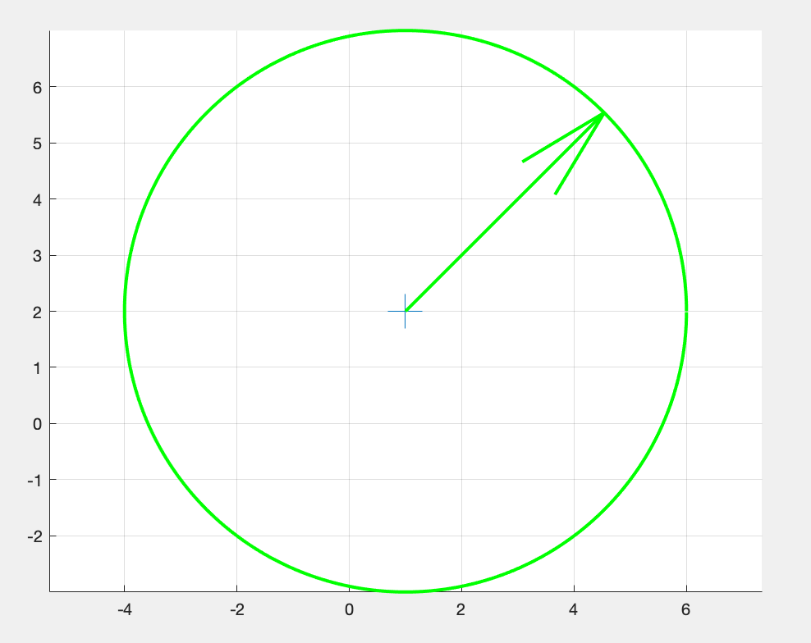
Plotting a Point Zone
Use fcn_Laps_findPointZoneStartStopAndMinimum.m for an interactive point zone plotting workplace.

Slide 26
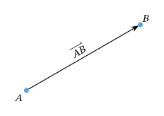
A Line Segment Zone is defined as a path between two points
For line segment conditions, the inputs are condition formatted as: [X_start Y_start; X_end Y_end] wherein start denotes the starting coordinate of the line segment, end denotes the ending coordinate of the line segment.

Slide 27
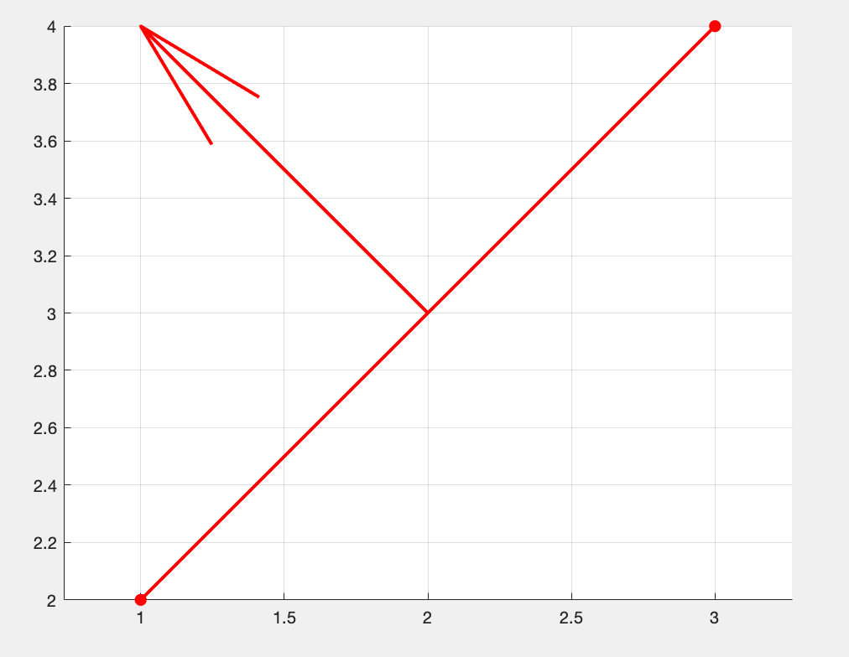
Plotting a line segment zone
Use fcn_Laps_findSegmentZoneStartStop.m for an interactive line segment zone plotting workplace.

Slide 28
The Importance of Start and Stop Zones

Slide 29
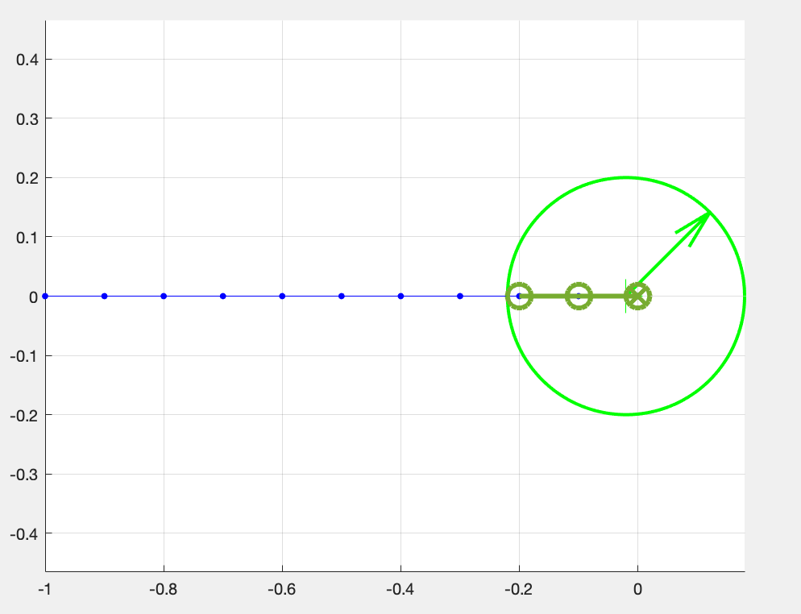
A zone condition is met if the path crosses within the zone with enough points
These points must be STRICTLY within the zone (e.g. not on the boundary, but within). The default number of points is 3 but can be altered by the user in the num_points variable.

Slide 30
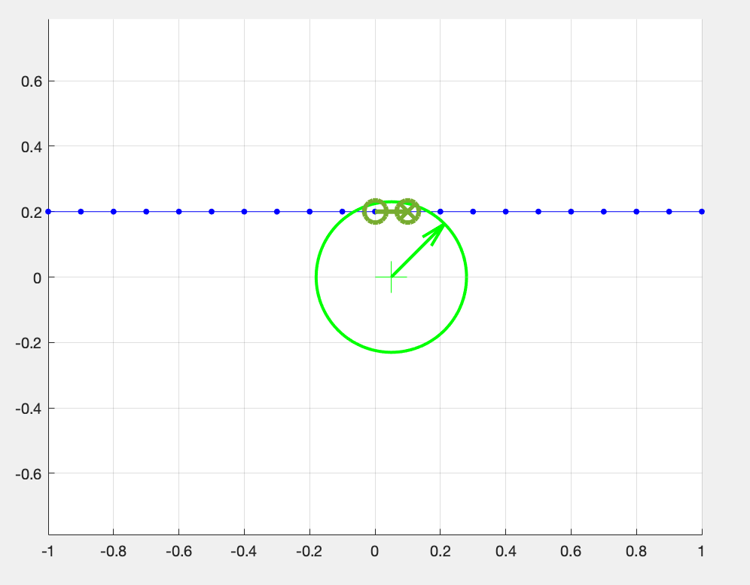
The number of points that satisfy a point zone can be changed by the user
The figure on the left shows a point zone definition that requires only two indices in the zone.
In addition to start and stop zones, the point zone utilizes a minimum distance to identify which indices have the closest distance to the point criteria. This is indicated by the index with an ‘x’ inside.
zone_num_points = 2

Slide 31
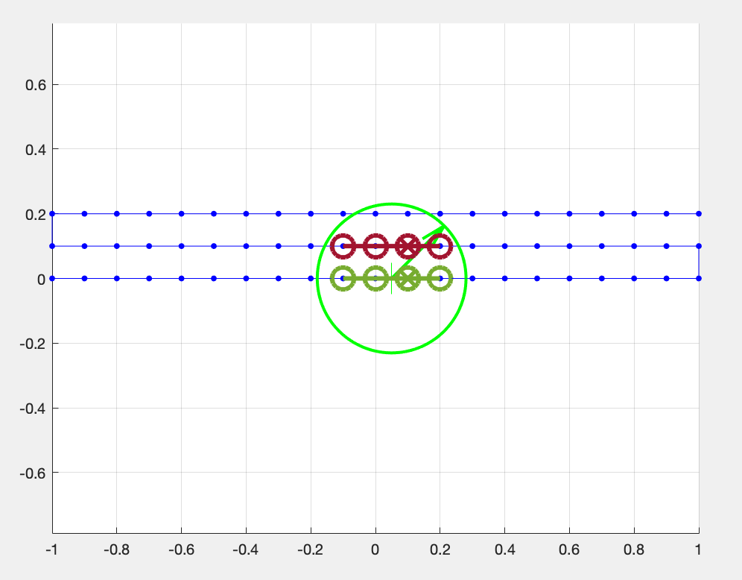
Point Zones can handle multiple laps at the same time
Since the point zones cover a certain radius and area, they can determine start/stop zones. This enables the parsing of traversals with multiple laps into an array with single laps.
zone_num_points = 3

Slide 32
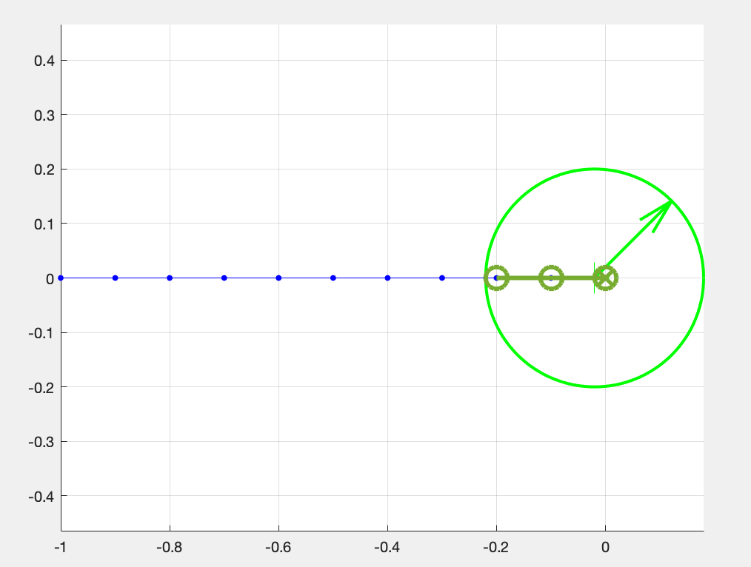
Three Important Aspects of Point Zones
The start of the zone is the index of the first point strictly within the zone.
The end of the zone is the index of the last point strictly still within the zone immediately after the previous start.
The minimum-distance is the index that, of the part of the path within the zone after the most previous start, is the minimum distance to the center point of the zone.

Slide 33
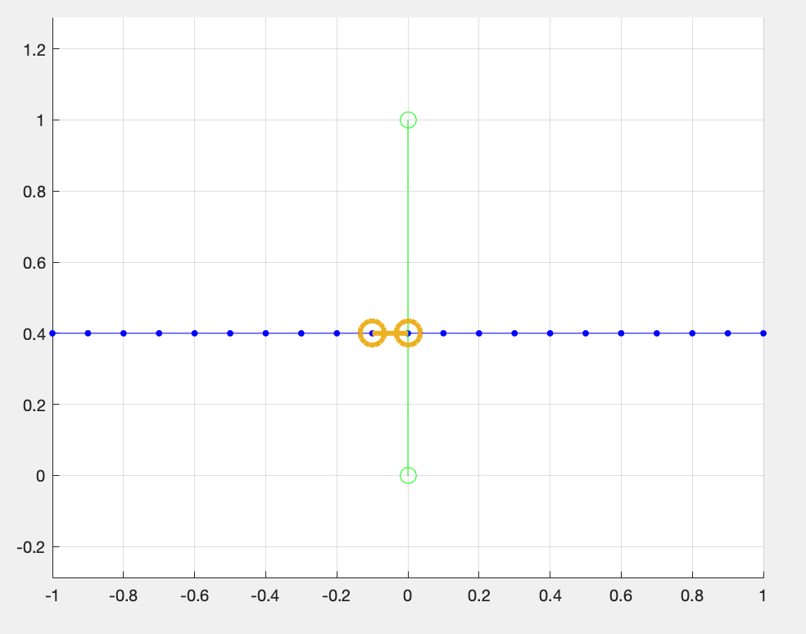
A line segment condition is met if the object fully crosses the specified line
Each time a path crosses the segment, the start and end of the path crossing are returned by the fcn_Laps_findSegmentZoneStartStop function.

Slide 34
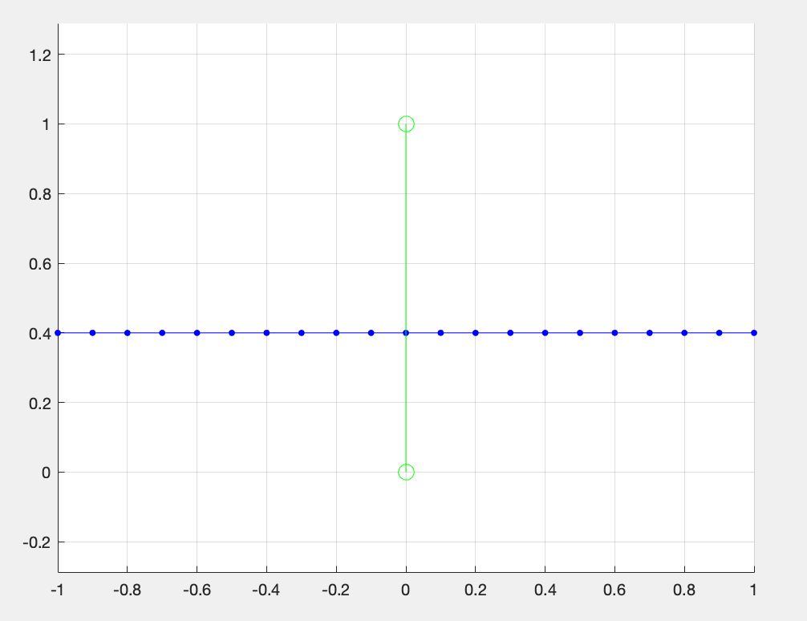
The line segment crossing must be in the positive cross-product direction from the path to the segment.
This means that the segment must start to the right of the path and end up on the left side after intersection otherwise it will not be counted.
The plotted figure shows no hits as the path crosses the segment line in the wrong direction.

Slide 35
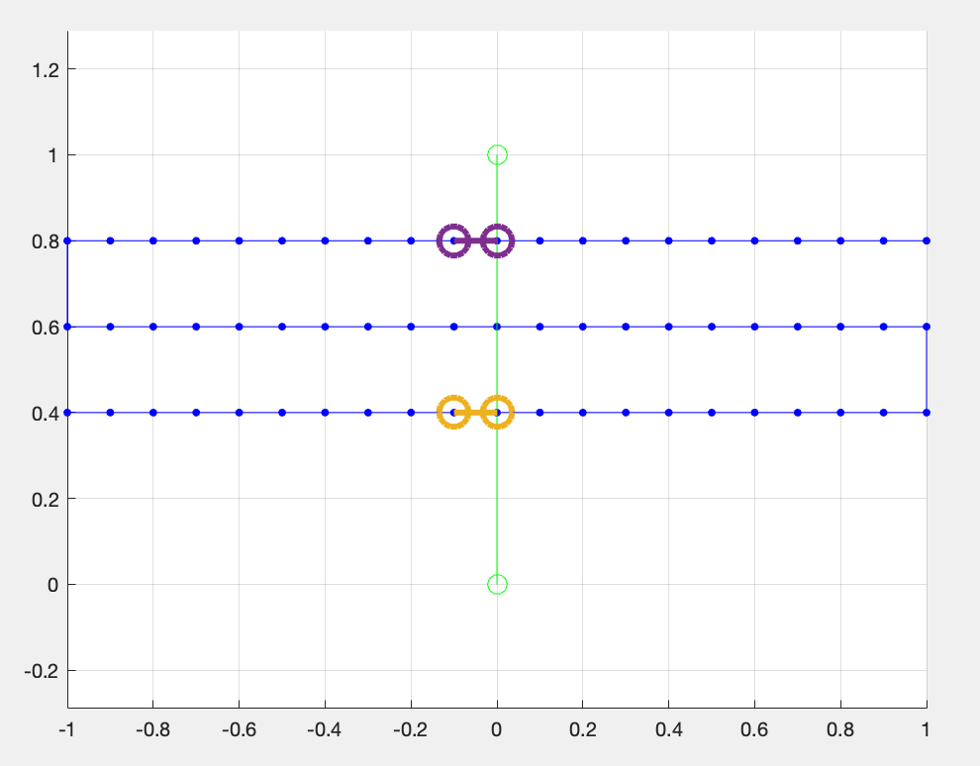
Two Important Aspects of Segment Zones
The start of the zone is the index of the first point strictly before the segment crossing
The end of the zone is the point after the crossing, immediately after the previous start.

Slide 36
Lap Positions

Slide 37
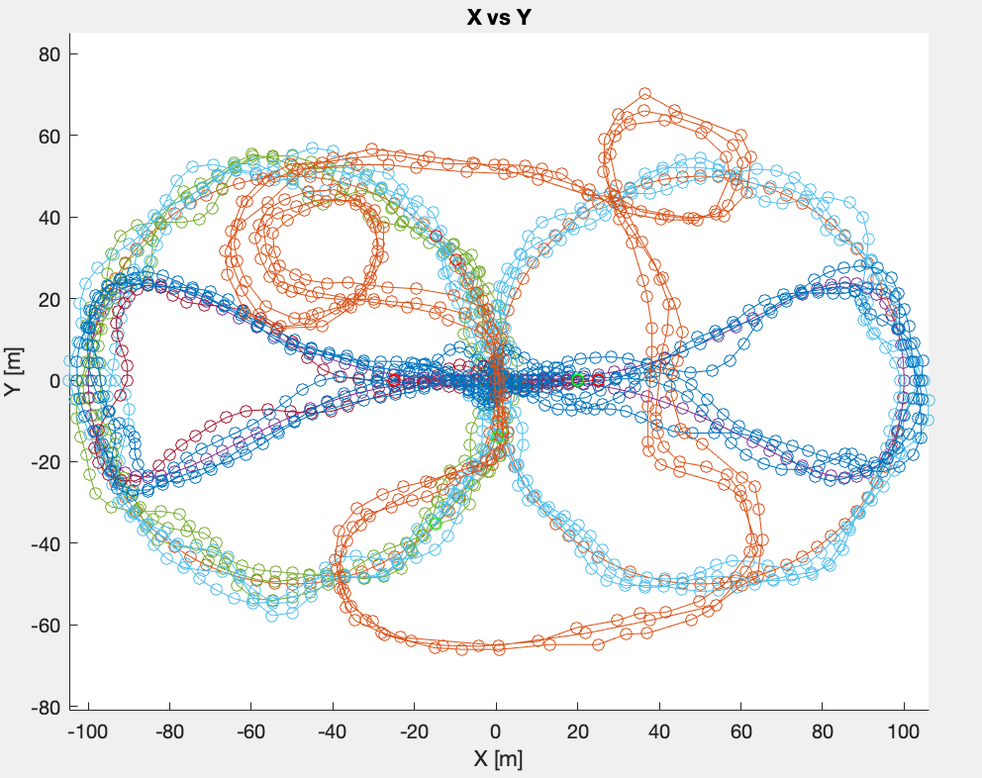
The Laps Library shares similar functions with the Path Library
The fcn_Laps_plotLapsXY function plots the XY positions of all laps existing in a data structure.
This is just a modified version of fcn_Path_plotTraversalsXY from the "Path" library of functions. The "laps" type and "traversals" type are the same type, for consistency.

Slide 38
Parsing Lap Data

Slide 39
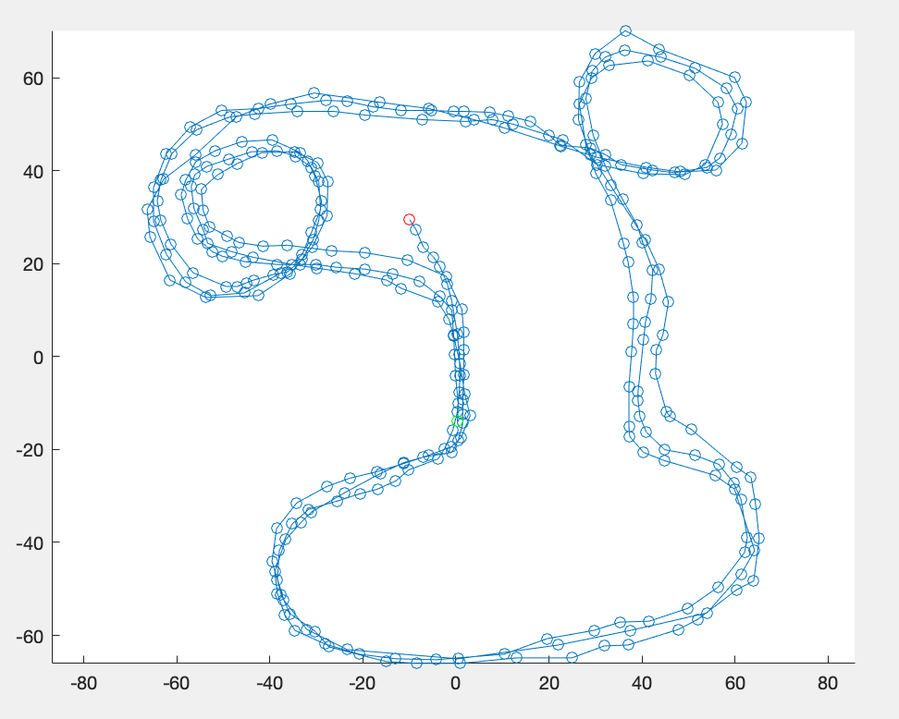
Required inputs are an input traversal and start definition
An input_traversal is the raw data created or collected that will be broken up into laps. Also, a start definition is required for point or line segment zone methods that we previously discussed.
Some optional inputs for the fcn_Laps_breakDataIntoLaps function include an end definition for breaking data into laps, an excursion definition if a condition needs to be met between the start and end zones, and a figure number if the data is to be plotted.

Slide 40
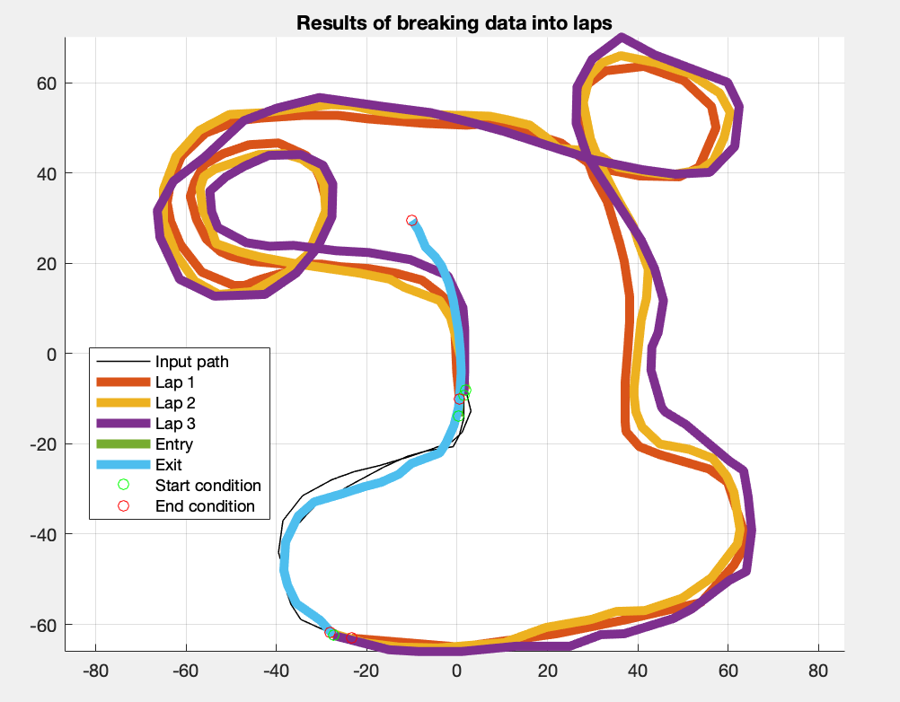
Outputs will vary depending on the number of conditions inputted
The fcn_Laps_breakDataIntoLaps function returns the laps as an array "traversals" type, with each traversal being one lap. If no laps are detected the lap_traversals array is empty. Entry and exit traversals that are not considered full laps are also returned.

