Slide 1
Coding and Git Practices
Steve Harnett

Slide 2
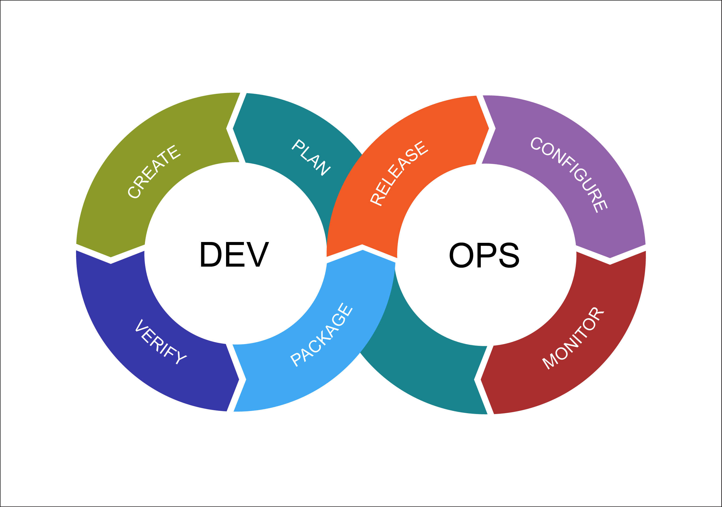
What is the purpose of this slide deck? To explain why practices are executed, not how to do them (Git and Github documentation already accomplishes the latter). Many companies have an entire DevOps team focusing on workflow practices and tools because it’s challenging and affects everything.
https://external-content.duckduckgo.com/iu/?u=https%3A%2F%2Fwww.cabotsolutions.com%2Fpublic%2FDevOps-Cycle.png&f=1&nofb=1

Slide 3

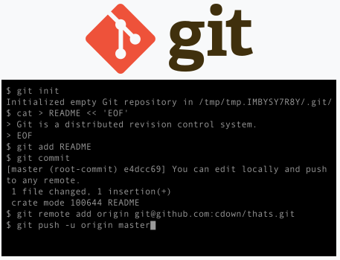
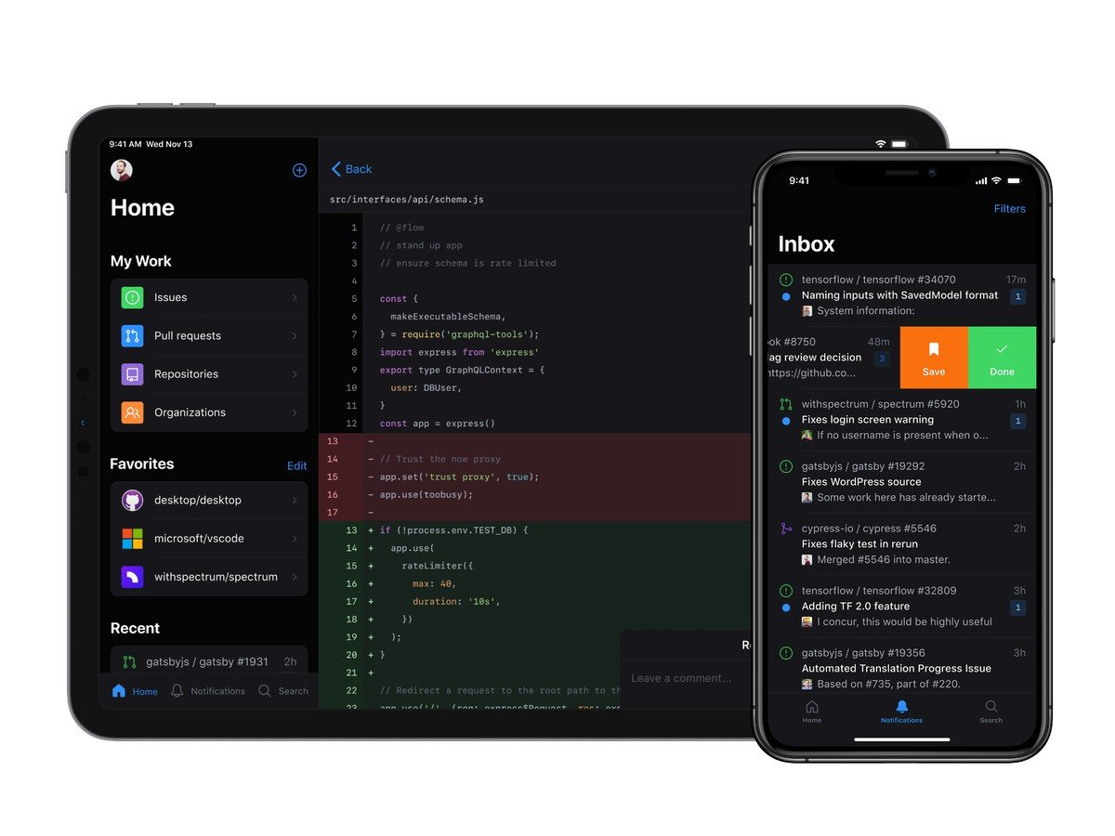
What are Git and Github? Are they the same? Git is a version control system written by Linus Torvalds (the creator of Linux). Github is a popular front end and hosting service for Git repositories.
Notes:
“git” is also a UK slang word for an obtuse person

Slide 4


When should I commit? When you reach a checkpoint such that code is functional and you may want to revert to this change or cherry-pick this change another branch.
https://www.mariowiki.com/Checkpoint_Flag#/media/File:SMG2_Activated_Checkpoint_Flag.png

Slide 5
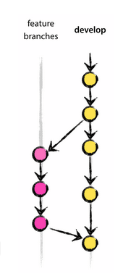
When should I branch? To make experimental changes, whether or not they are to be merged back into the trunk. Why? The health of main should be static. If your change could break main, it should go on a branch off main for development first.
I recommend this branching model for production/industrial use.
Notes:
Some companies play silly games such as making you wear a funny hat if you break main. So please use branches.

Slide 6
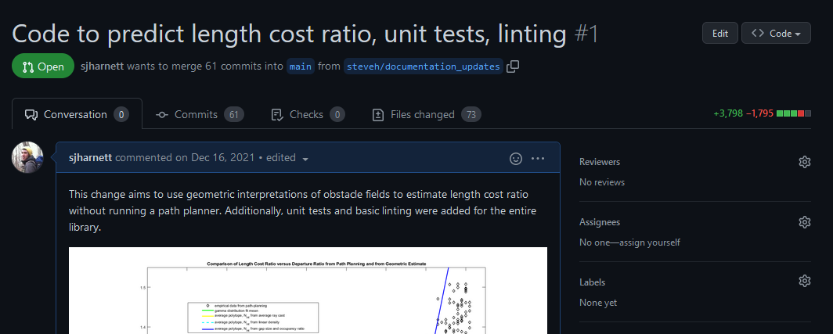
How do I merge back to the trunk? Conventionally on a pull-request (PR) with peer reviews with a squash merge to create a traceability chain. PRs are a great place to document and justify a change.

Slide 7
When do I merge back to the trunk? When you have a body of work large enough to stand on its own (so that reverting this merge doesn’t cause a large dependency break) but when it’s small enough to be manageable for a reviewer. Merges should be squashed for cleanliness of documentation.
Merging
Squash-merging
main
main
steve/really_good_feature
steve/really_good_feature
C1
C1
C2
C2
C3
C3
C4
C4
C3
C3
C5
C5
C4
C4

Slide 8
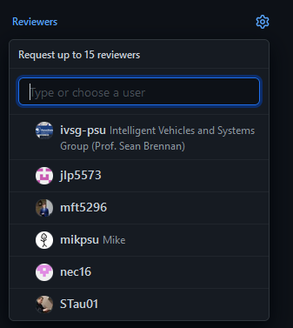
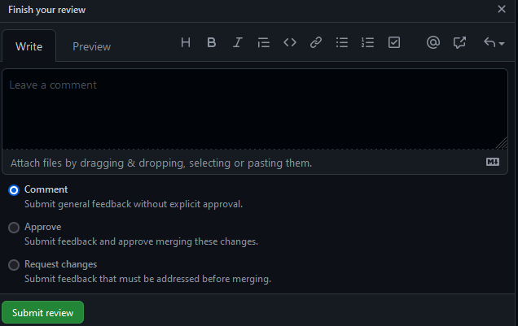
Who should review? What does the reviewer do? Someone familiar enough with the work to understand the function of the code, but not someone who worked on the change. Reviews should be for form and function and comments can be non-blocking or blocking, with respect to merging.

