Slide 1

The Debug Tools Class Library
Steve Harnett and Sean Brennan
Last updated: 2022_03_27
Photo by Zan on Unsplash

Slide 2
The goal of this presentation is to explain some core tools within the DebugTools class of functions, and how to debug code
Functions include:
fcn_DebugTools_addSubdirectoriesToPath
fcn_DebugTools_debugPrintStringToNCharacters

Slide 3
The function: fcn_DebugTools_addSubdirectoriesToPath adds the user-given subdirectories to the path, and pushes an error if the directory is not found
%% Demonstrate how to add subdirectories
if ~exist('flag_DebugTools_Folders_Initialized','var')
fcn_DebugTools_addSubdirectoriesToPath(top_folder,{'Functions','Data'});
% set a flag so we do not have to do this again
flag_DebugTools_Folders_Initialized = 1;
end

Slide 4
The function: fcn_DebugTools_debugPrintStringToNCharacters converts strings into fixed-length forms, so that they print cleanly
This lets us create clean prints to screen such as:
Data ID Location X Location Y s-coord 1 s-coord 2
1 0.351659507063 0.075854289563 0.162182308193 450.54159850249
2 0.830828627896 0.053950118667 0.794284540684 83.821377996933
3 0.585264091153 0.530797553009 0.311215042045 228.97696871681
4 0.549723608291 0.779167230102 0.528533135506 913.33736150167
5 0.917193663830 0.934010684229 0.165648729500 152.37801896922
6 0.285839018820 0.129906208474 0.601981941402 825.81697748954
7 0.757200229111 0.568823660872 0.262971284540 538.34243526005
8 0.753729094278 0.469390641058 0.654079098477 996.13471662688
9 0.380445846975 0.011902069501 0.689214503140 78.175528753184
10 0.567821640725 0.337122644399 0.748151592824 442.67826977544

Slide 5
The function: fcn_DebugTools_checkInputsToFunctions checks inputs to functions to ensure they conform to user specifications
For example, the following command checks that the input is 2 columns of integers, of length 5 or less:
% Maximum length is 5 or less
Twocolumn_of_integers_test = [4 1; 3 9; 2 7];
fcn_DebugTools_checkInputsToFunctions(Twocolumn_of_integers_test, '2column_of_integers',[5 4]);

Slide 6

Unit test: the most atomic type of test. It usually tests one small function or few lines of code. The test scope is something that can be logically isolated (generally no dependencies on other libraries, files, or functions).

Slide 7
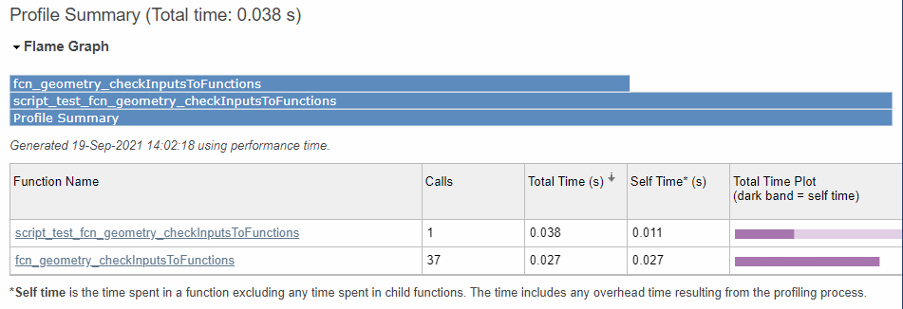
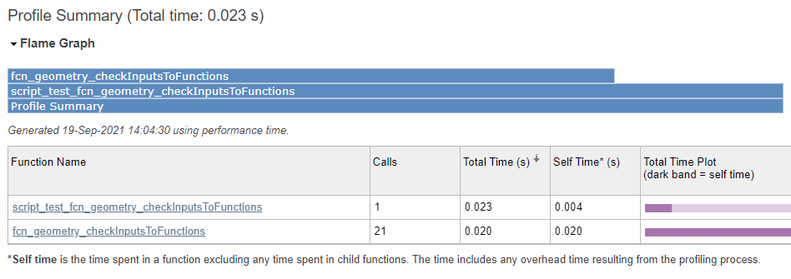
Advantages: a unit test’s small scope allows for quick testing and straightforward debugging. And the overhead to the script is usually minor.
Instrumented with 19 assertion tests:
The same function calls without instrumentation:

Slide 8


Disadvantages: unit tests do not protect from integration or performance regressions.
For example, if the arguments to a function change, the integration may be in error even if the function itself still works. Or if a modified function takes 10,000 times longer to run than previously, the performance will regress sometimes to the point of causing other things to fail.

Slide 9
Current implementation is based on binary assertions. This is typical for simplicity.
%% BASIC example 1
fig_num = 1;
points = [0 0; 1 4; 0.5 -1];
[centers,radii] = fcn_geometry_circleCenterFrom3Points(points,fig_num);
...
assert(isequal(round(centers,4), [3.6667,1.2083]))
assert(isequal(round(radii,4), 3.8606))

Slide 10
To assert that an error was not thrown, a true assertion can be placed after the point where execution would stop if an error was thrown.
% Maximum length is 3
Twocolumn_of_numbers_test = [4 1; 3 9; 2 7];
fcn_geometry_checkInputsToFunctions(Twocolumn_of_numbers_test, '2column_of_numbers',[3 3]);
assert(true); % pass the test defined by this section if no errors were thrown

Slide 11
To assert that an error is thrown, the error can be caught and verified to avoid breaking execution. The try-catch functionality works well for this.
%% Maximum length is 2
TwoOrThreeColumn_of_numbers_test = [4 1; 3 9; 2 7];
try
fcn_geometry_checkInputsToFunctions(TwoOrThreeColumn_of_numbers_test, '2or3column_of_numbers',[2 2]);
catch ME
assert(strcmp(ME.message,'The TwoOrThreeColumn_of_numbers_test input must be a 2or3column_of_numbers, namely (N x 2) or (N x 3) with N = 2'));
end

Slide 12
Tests are a way to force all the assertions within scripts to be tested.
This gives an AUTOMATED way to test if code still works after people change it.
Assertions run as tests will not break operation. In other words, the failure can be noted, but the code will continue running the other assertions to make sure they work. This lets one isolate failure points.
Assertions that fail outside of tests will break operation and are a great way to throw an exception (with an informative failure message) when a critical failure is detected. The code after this failure will NOT run, though.

Slide 13
Test suites can be made in several ways. One of the simplest ways, is to use the built-in “Testsuite” function in MATLAB to make a test suite from every assertion test in a given file.
suite_geometry_circleCenterFrom3Points = testsuite('script_test_fcn_geometry_circleCenterFrom3Points');
This avoids the wordiness of having to explicitly define test cases and explicitly add them to a test suite, which is useful for larger scope tests requiring fixtures.
geometry_circleCenterFrom3Points_case1 = matlab.unittest.TestCase.forInteractiveUse;

Slide 14
The run method on the runner object can be created and used to call the suite and report the output.
results = run('script_test_fcn_geometry_findIntersectionOfSegments/SimpleTest1_ASimpleIntersection')
Simple intersection result:
.
Done script_test_fcn_geometry_findIntersectionOfSegments
__________
results =
TestResult with properties:
Name: 'script_test_fcn_geometry_findIntersectionOfSegments/SimpleTest1_ASimpleIntersection'
Passed: 1
Failed: 0
Incomplete: 0
Duration: 0.5964
Details: [1×1 struct]
Totals:
1 Passed, 0 Failed, 0 Incomplete.
0.59645 seconds testing time.

Slide 15
Failure summaries indicate failed function and test case. Test case names are generated programmatically from the name of the section in which the assertions occur.
Simple intersection result:
================================================================================
Error occurred in script_test_fcn_geometry_findIntersectionOfSegments/SimpleTest1_ASimpleIntersection and it did not run to completion.
---------
Error ID:
---------
'MATLAB:assertion:failed'
--------------
Error Details:
--------------
Error using script_test_fcn_geometry_findIntersectionOfSegments (line 27)
Assertion failed.
================================================================================
.
Done script_test_fcn_geometry_findIntersectionOfSegments
__________
Failure Summary:
Name Failed Incomplete Reason(s)
====================================================================================================================
script_test_fcn_geometry_findIntersectionOfSegments/SimpleTest1_ASimpleIntersection X X Errored.
results =
TestResult with properties:
Name: 'script_test_fcn_geometry_findIntersectionOfSegments/SimpleTest1_ASimpleIntersection'
Passed: 0
Failed: 1
Incomplete: 1
Duration: 0.5584
Details: [1×1 struct]
Totals:
0 Passed, 1 Failed (rerun), 1 Incomplete.
0.55841 seconds testing time.

Slide 16
Wrappers are files that run “around” other files. Wrappers can be used to create test cases from assertions, test suites from files of assertions, and trigger all created test suites in a given repository, while logging the outputs.
% This is a wrapper script to run all the test scripts in the geometry
% class library for the purpose of evaluating every assertion test in these
% files
clear all; close all; clc;
all_scripts = dir('script_test_fcn_*');
suites = [];
diary ‘script_test_fcn_geometry_all_stdout.txt’; % this is git ignored
for i_script = 1:length(all_scripts)
file_name_extended = all_scripts(i_script).name;
file_name = erase(file_name_extended,'.m');
if ~strcmp(mfilename,file_name) && ~strcmp(file_name(end-3:end),'.asv')
file_name_trunc = erase(file_name,'script_');
suite = testsuite(file_name);
suites(end+1) = suite;
results = run(suites);
end
end

Slide 17

One practice for making unit tests is Test Driven Development (TDD).
In TDD, code is written as follows:
Requirements are defined as tests
Features are ONLY added to turn a test from failing to passing (commonly called red-light, green-lighting).
Every additional feature MUST have an additional test that requires that feature. Thus, there should be NO extraneous features.

Slide 18
This ensures only the functionality to meet the requirement is added.
For example, say we are writing a function to sum all the input arguments. The following definition of the “sum” function would seem to work. And indeed, this function is probably the best if there were ONLY one input argument.
% test cases
assert(sum(0) == 0)
% a function sums inputs
def sum(a):
return a

Slide 19
Additional requirements force additional functionality
% test cases
assert(sum(0) == 0)
assert(sum(0,1) == 1)
% a function sums inputs
def sum(a):
return a
def sum(a,b):
return a + b
This new definition of the “sum” function corrects the error if there are 2 arguments, and is indeed probably the best function for the case of 2 arguments.

Slide 20
If there are 3 arguments, then we impose additional functionality by an additional assertion.
% test cases
assert(sum(0) == 0)
assert(sum(0,1) == 1)
assert(sum(0,1,2)) = 3
% a function sums inputs
def sum(a):
return a
def sum(a,b):
return a + b
def sum(*args):
ans = 0
for arg in args:
ans = ans + arg
return ans

Slide 21
This can be a time-consuming way to develop, but it helps ensure that every part of a function has test coverage and serves some use case.

Slide 22
Environment variables can be used to flag large types of execution on or off (e.g. input sanitation, plotting, testing). This is done the same in Matlab regardless of OS so our code can be platform agnostic.
var = getenv('variable_name')

Slide 23
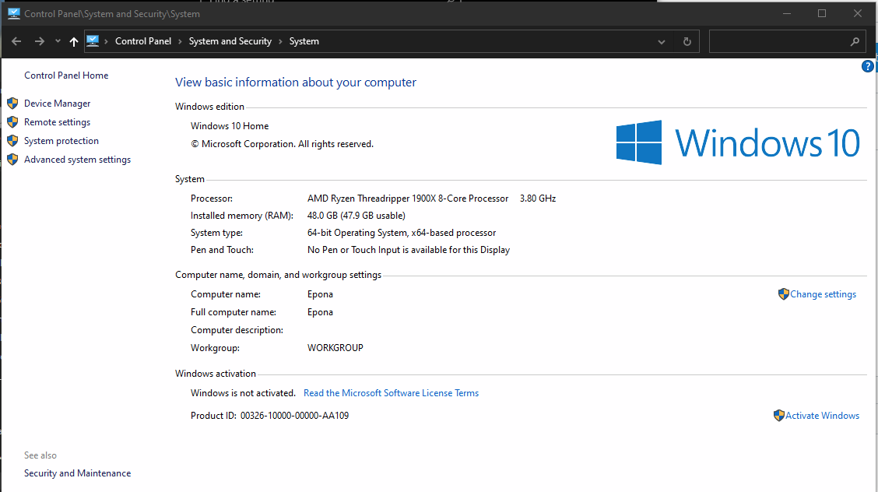
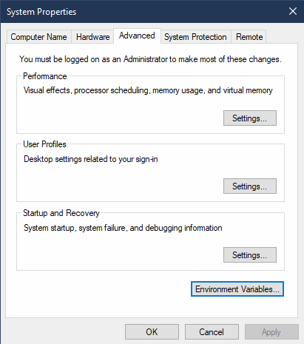
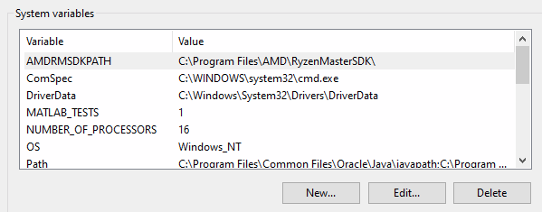
Environment variables in Windows (called "system variables" by Windows) can be set from the "Advanced system settings" pane in the System Control Panel.
1
2
4
3

Slide 24
Environment variables in Linux can be set in ~/.bashrc by adding a line to set the variable at each new terminal session.
export VAR_NAME=variable_value

Slide 25
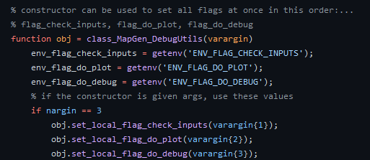
Environment variables are useful for setting “global” flags, which allow users to optionally run blocks of code. This is a more sustainable practice than commenting code on and off as it can have default behavior and associated warnings.
/* //
% #

Slide 26
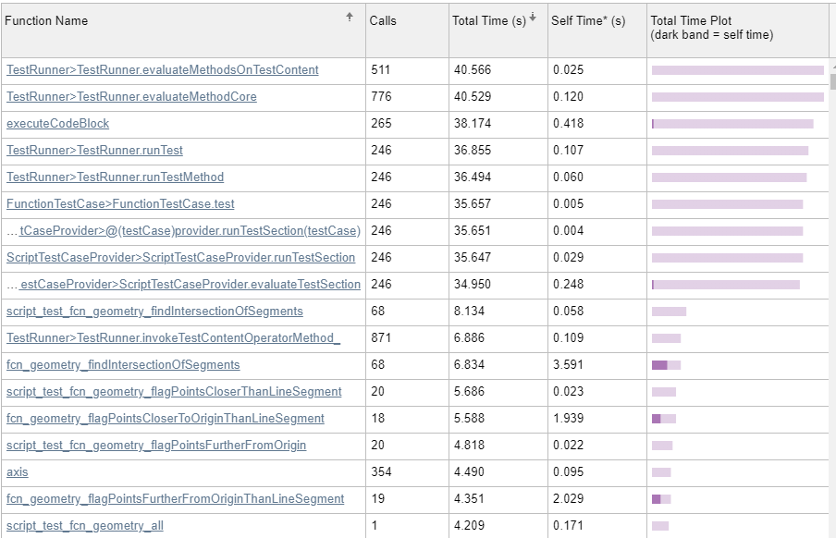
Performance profiling of the Geometry library.

Slide 27
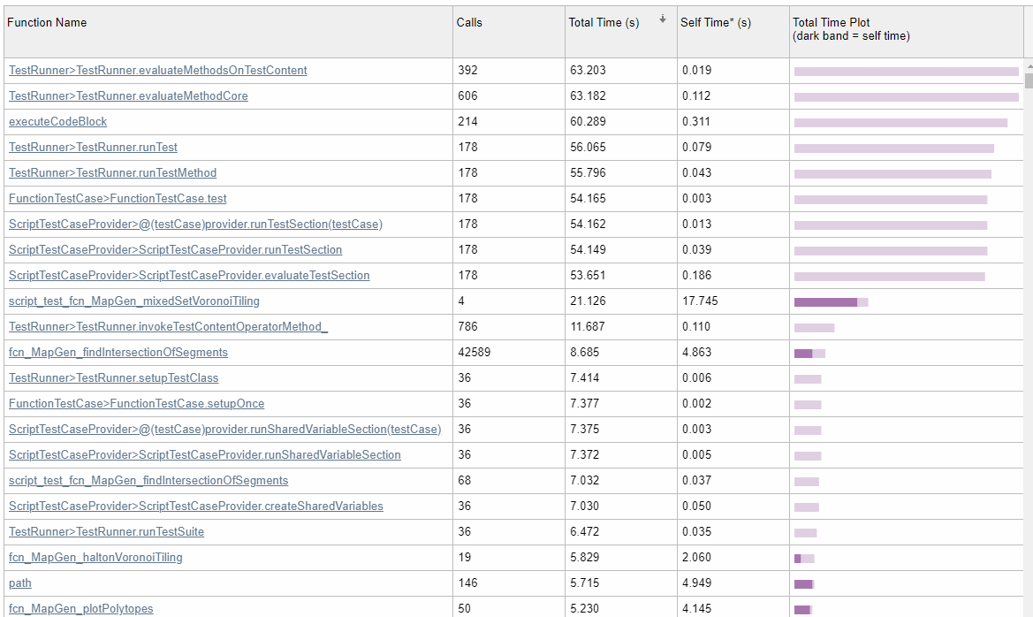
Performance profiling of the MapGen library.

