Slide 1
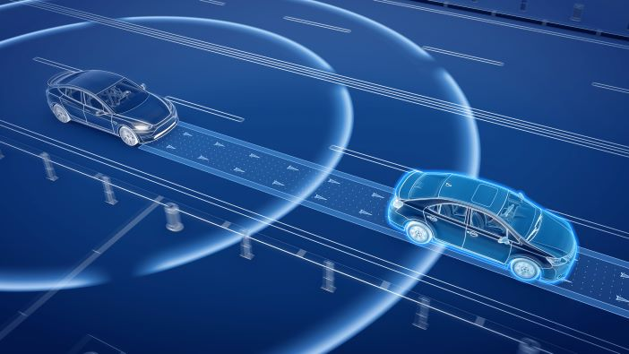
Detecting Collisions
By Shashank Garikipati on 6/28/2022

Slide 2
This presentation is organized as follows
Input checking and basic plotting
All about patches
Vehicle Collision detection
Basic definitions
Calculating circular trajectories
Straight line collision detection
Dataset XY point association

Slide 3
Checking inputs to function is a useful way to avoid input errors
%% Show how input arguments are checked, fcn_Points_checkInputsToFunctions
% TO-DO - move debug tools into utilities and remove the checkinputs capability out of Path class
path_test = [4 1; 2 1];
fcn_Points_checkInputsToFunctions(path_test, 'path');

Slide 4
A function in the Feature Extraction library allows users to plot paths
Function: fcn_Points_plotSetsXY.m
Script: No script yet

Slide 5
Users can create their own paths using a function in this library
User inputs
Paths created
Function: fcn_Points_fillPointSetViaUserInputs.m
Script: script_test_fcn_Path_fillPathViaUserInputs.m

Slide 6
Patches are used to represent objects that the vehicle can potentially collide into
Patches are represented as [1 x N] struct array in MATLAB
They are primarily defined by the x and y coordinates of their verticies inputted as two [M x 1] vectors for x and y, and a [1 x 3] RBG color vector.

Slide 7
Sample patches are used to illustrate how patched are implemented in the library
Function: fcn_Patch_fillSamplePatches.m
Script: No script yet

Slide 8
These patches can be easily visualized
Function: fcn_Patch_plotPatch.m
Script: script_test_fcn_Patch_plotPatch.m

Slide 9
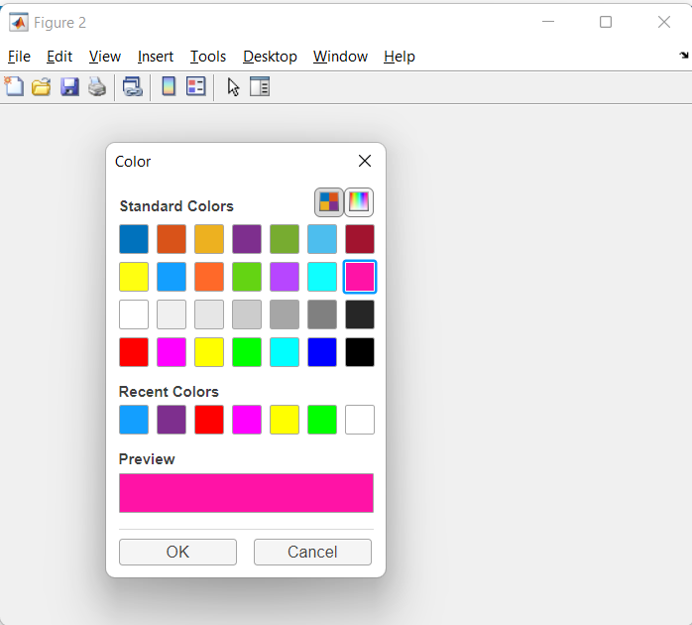
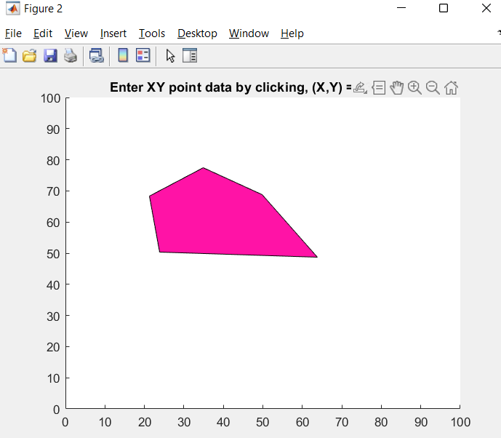
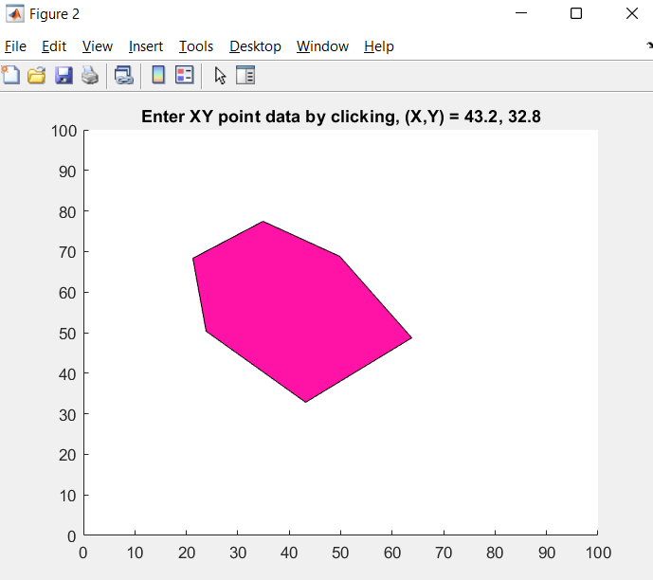
The library allows users to interactively create patches through color selection and mouse clicks
Function: fcn_Patch_fillPatchArrayViaUserInputs.m
Script: No script yet

Slide 10
Axis Aligned Bounding Boxes (AABB), which are useful when working with collision detection, can be determined for each of the patches
Function: fcn_Patch_determineAABB.m
Script: script_test_fcn_Patch_determineAABB.m

Slide 11
Basic definitions
Course over ground (COG) – Actual direction of progress of a vehicle between two points.
Heading angle -

Slide 12
We define the following vehicle properties
Longitudinal speed (vx)
CG-front bumper distance (df)
CG-rear bumper distance (dr)
Center of Gravity (CG)
Body width

Slide 13

The heading angle is defined as the angle between the positive x axis and vehicle’s direction of travel
$Heading angle:$h0

Slide 14
A function in the library enables the finding of the inner and outer radius of circular trajectory that the vehicle can clear without collision
Function: fcn_Patch_CalcCircularTrajectoryGeometry.m
Script: script_test_fcn_Patch_CalcCircularTrajectoryGeometry.m

Slide 15
Finding the collision points between obstacles and a vehicle travelling down a straight path
Function: fcn_Patch_checkStraightCollisions.m
Script: script_test_fcn_Patch_checkStraightCollisions.m

Slide 16
The strategy
Rotate (about CG) the vehicle and obstacles to point to the x-axis (to turn any situation into a standard problem) – use a rotation matrix
Use polyxpoly (matlab function to find intersection between two polylines) to find points of collision
We then check to see if there are any vertices of the object that lie on this rotated path
We then check to see if there have been any collisions by comparing the vertices and polyxpoly intersection points

Slide 17
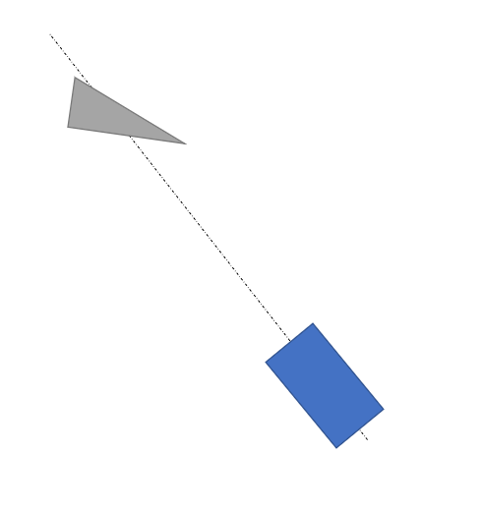
Rotate (about CG) the vehicle and obstacles to point to the x-axis (to turn any situation into a standard problem) – use a rotation matrix

Slide 18
Use polyxpoly (matlab function to find intersection between two polylines) to find points of collision
We determine any obstacles that lie within or across the vehicle path on the positive the x-axis between the back of the vehicle (-vehicle.dr) and some large distance (1e6) (this area is given by the red box)
Potential collision
Potential collision
Potential collision
Potential collision
Link to polyxpoly documentation: https://www.mathworks.com/help/map/ref/polyxpoly.html

Slide 19
We then check to see if there are any vertices of the object that lie on this rotated path
collVertexInds = find(abs(rotObst(:,2)) < 1*vehicle.w/2 & rotObst(:,1) > -vehicle.dr);
Checking between x-axis between back of vehicle and come large distance
Checking within the width of the vehicle

Slide 20
We then check to see if there have been any collisions
Closest point -> point of collision
If there is a collision, we compare whether the vertex was closer or polyxpoly point is closer. Which ever point is closer is the collision point.
If there is no collision, we try to find the minimum clearance and location of this on the obstacle.

Slide 21
Once this point is obtained, we rotate and translate it back to the original coordinate space
*
*

Slide 22
There are several test cases that the algorithm can encounter
Collision with right edge
Collision with left edge
Collision with multiple objects’ edges

Slide 23
Collision with vertex
Collision with multiple objects’ vertex

Slide 24
The algorithm displays the location of the minimum clearances on the figure as near misses

Slide 25
We can also have these different test cases plotted as a single scenario

Slide 26
X,Y points from two different datasets can be paired as an application of machine leaning (k-nearest neighbor algorithm)
Function: fcn_Points_pairXYdata.m
Script: script_test_fcn_Points_pairXYdata.m
Plot showing association of points
Zoomed in version of the plot on the left

Slide 27
In this problem, we want to associate X,Y data points in one data set (a map, for example) with X,Y data points in another data set
The data sets are not assumed to be sorted or have the same number of points.
A graphical depiction is given for two data sets here:
Data Set A
Data Set B

Slide 28
Association of XY points to XY points
Data Set A
Data Set B
The data sets are likely to have some points that are “mutual matches” where a pair of points in set A and set B are each the closest point to the point in the opposing data set.
The data sets are also likely to have points that do not have a close match once all of the mutual matches have been assigned.

Slide 29
Nearest-neighbor or k-nearest-neighbor (kNN) searches are well-researched machine learning algorithms that can help determine mutual matches
MATLAB implementation: [idx, dist] = knnsearch(datasetA, datasetB);
The kNN search will return a vector of indices that indicate the nearest neighbor in datasetA to each point in datasetB.
This can be modified to return a matrix of multiple (k) nearest neighbors for each point in datasetB.
https://www.mathworks.com/help/stats/knnsearch.html
Requires: Statistics and Machine Learning Toolbox

Slide 30
There may be points in set A that are the closest for multiple points in set B, or points that are never identified as a nearest neighbor.
Duplicate
neighbor
Not a
neighbor
Data Set A
Data Set B

Slide 31
How the algorithm works
Apply 1NN search to find the nearest neighbors in both directions
Compare returned indices to determine which points have mutual matches
Data Set A
Data Set A
Data Set B
Data Set B
Data Set A
Data Set A
Data Set B
Data Set B

Slide 32
How the algorithm works (continued)
Check each mutual match the distance is less than a radial limit
Reorganize (or copy) the matched points in Data Set A and Data Set B into a matrix where each row contains the X and Y coordinates of the two points
Optionally, append each of the unmatched points in Data Set A with padding in the last two columns since there aren’t matches in Data Set B
Optionally, append each of the unmatched points in Data Set B with padding in the first two columns since there aren’t matches in Data Set A
Data Set A
Data Set A
Data Set B
Data Set B

Slide 33
Association of XY points to XY points
Computational efficiency of the algorithm depends strongly on the complexity of the kNN searches
R*-trees can be used to do efficient searching over sets of points
Since databases can be organized this way, the algorithm can be fairly fast
Most of the remainder of the work is simply comparing sets of indices (relatively fast) and copying/moving the data (depends on implementation

Slide 34
It is useful to have some statistics for points in datasets that have been associated with each other
RMS Error: the RMS distances associated with the point-to-point match errors
Variance Error: the variance in the point-to-point match error distances
Mean Shift: the [X Y] shift that would cause the centroids of the two data sets to match
A function in the library helps us do this
Function: fcn_Points_calcPairStatistics.m
Script: script_test_fcn_Points_calcPairStatistics.m

Slide 35
Another function allows us to modify the statistics of datasets by adjusting XY points
Function: fcn_Points_adjustPointSetStatistics.m
Script: script_test_fcn_Points_adjustPointSetStatistics.m

