Slide 1
Combined Histograms and Boundary Error Plots
Aneesh Batchu
November 6th, 2024

Slide 2
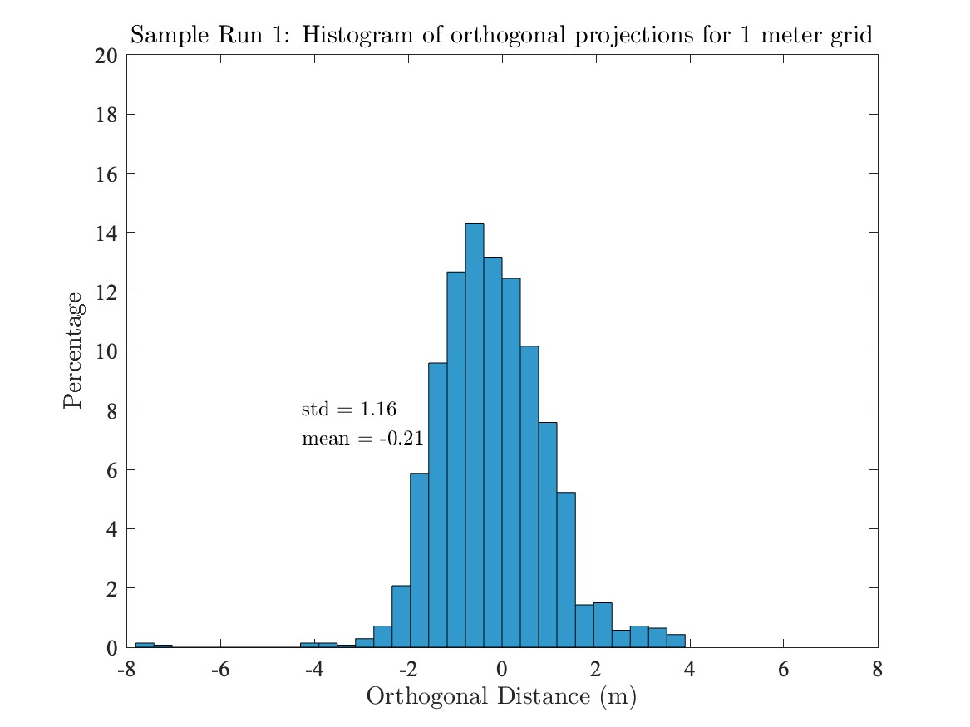
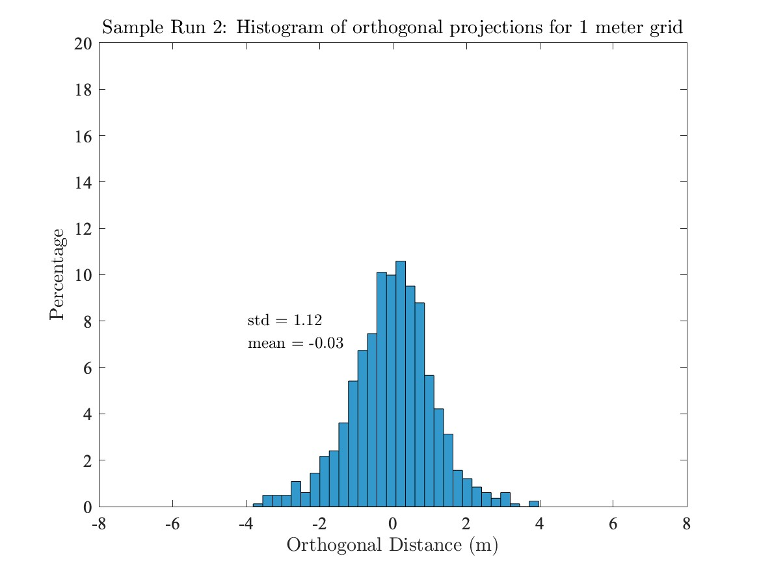
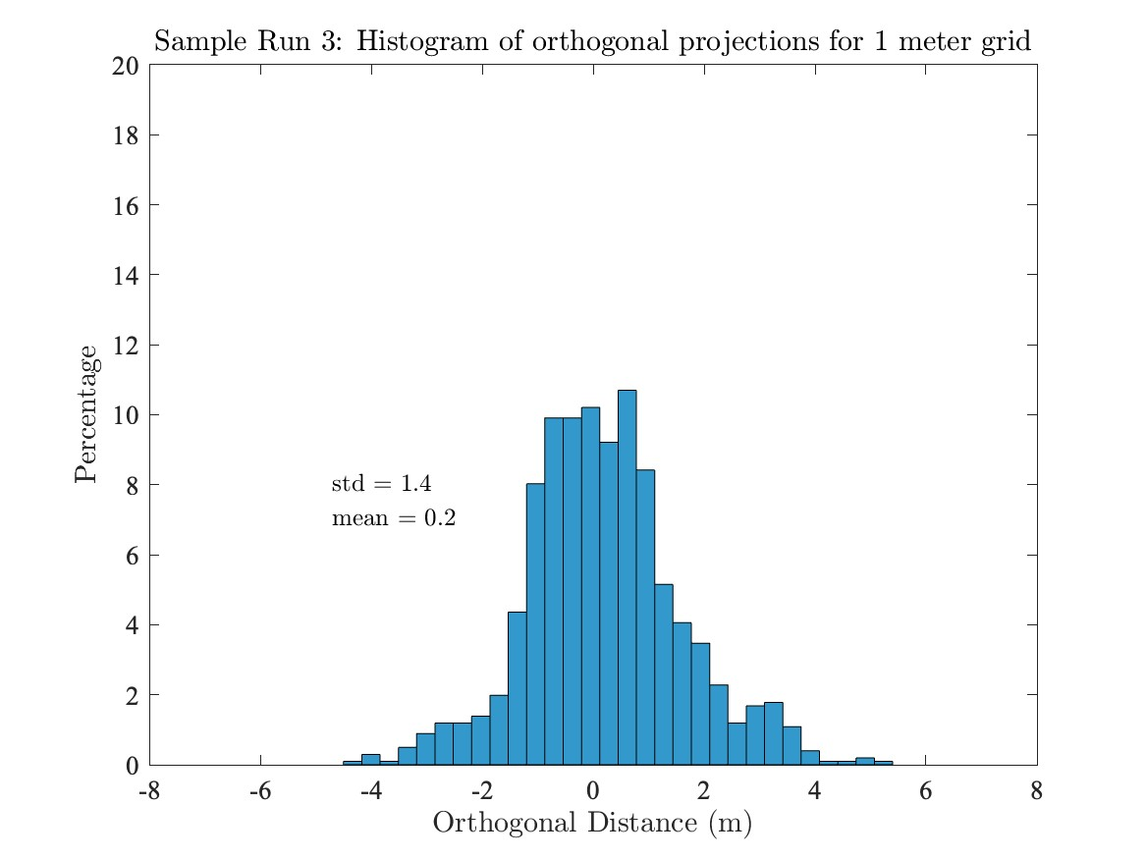
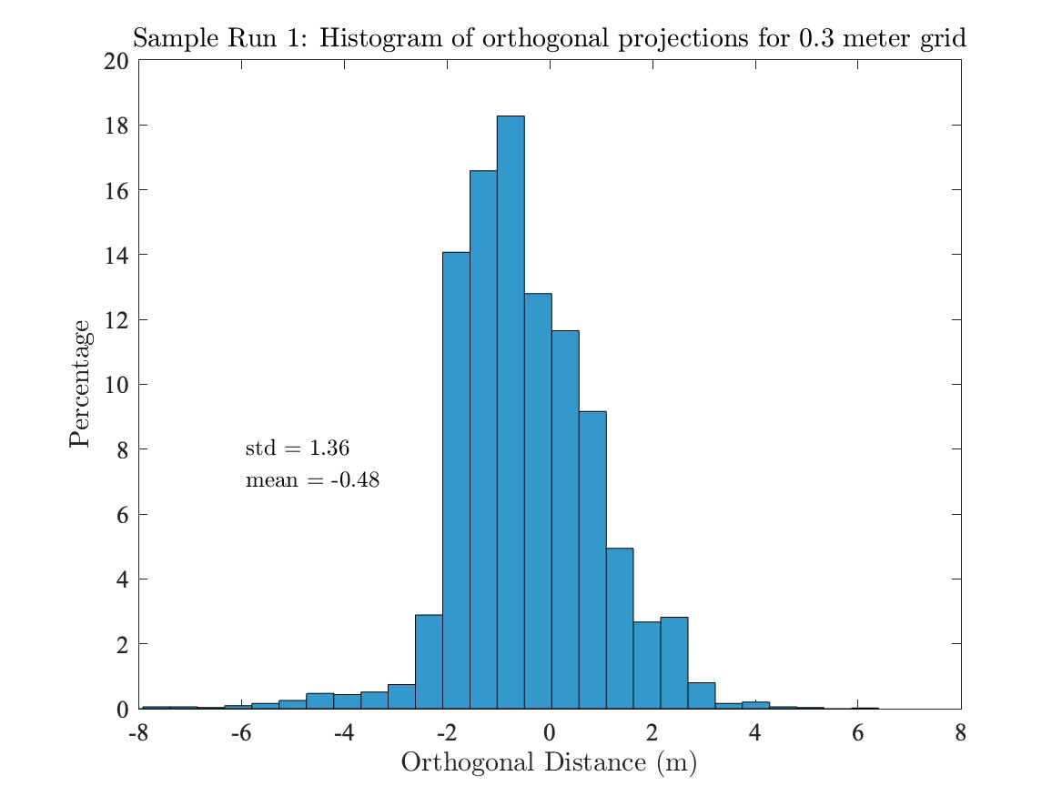
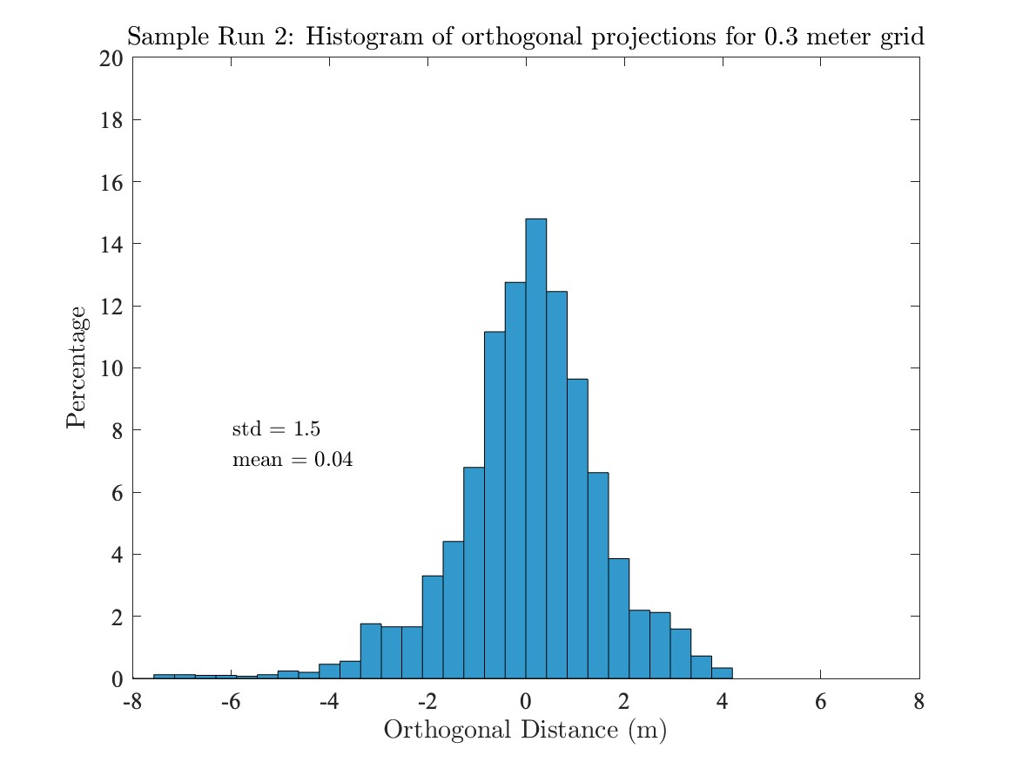
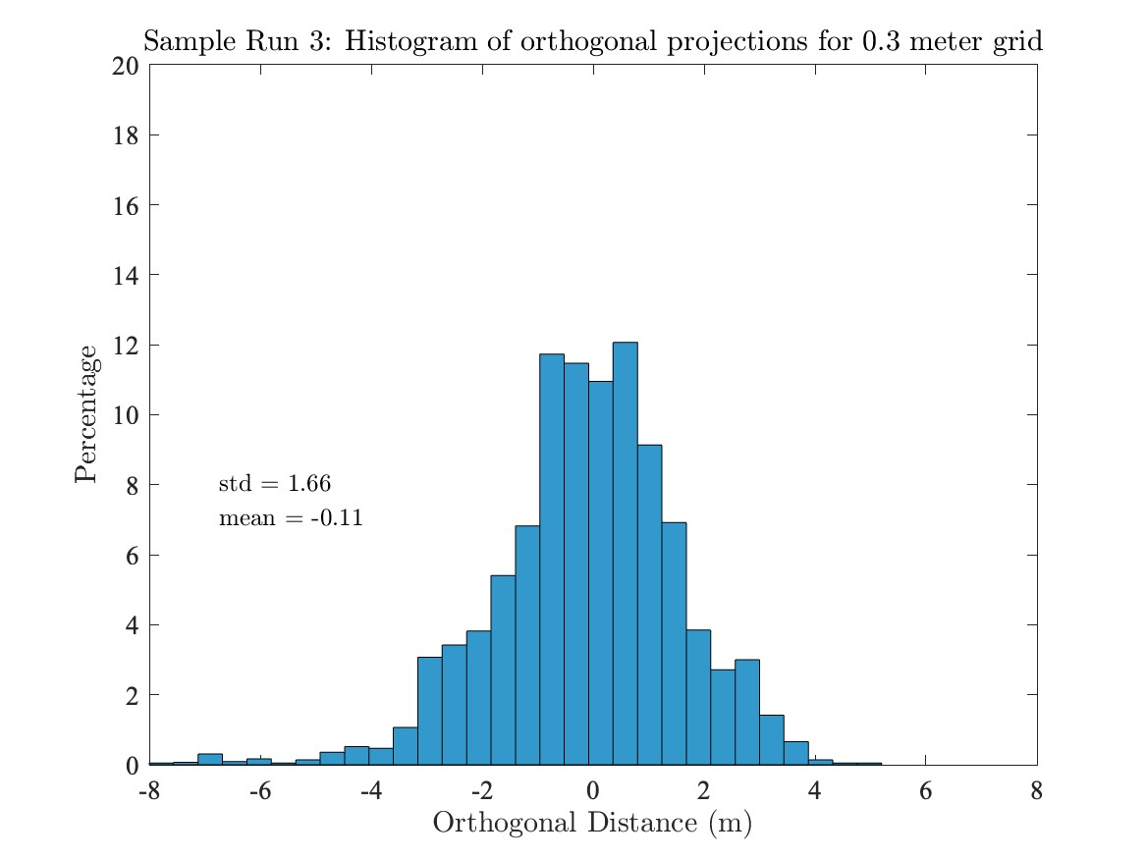
The mean values for both grid sizes are relatively close to zero, indicating that the computed boundary points are, on average, close to the hand-labeled boundary. The standard deviations are generally higher for the 0.3-meter grid compared to the 1-meter grid across most samples. This indicates more variability in the orthogonal distances for the finer grid.

Slide 3
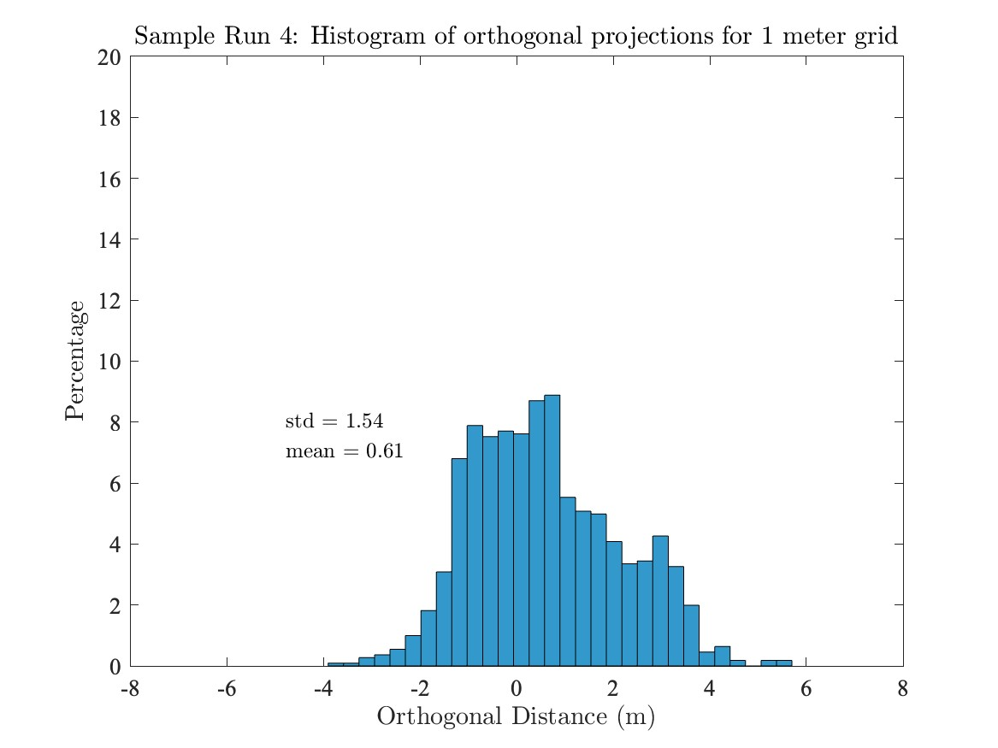
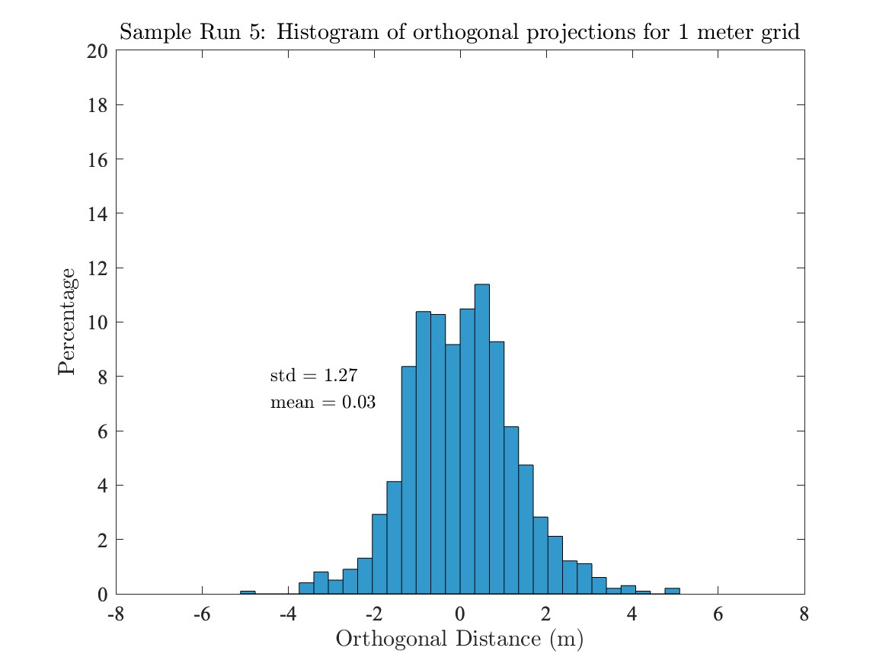
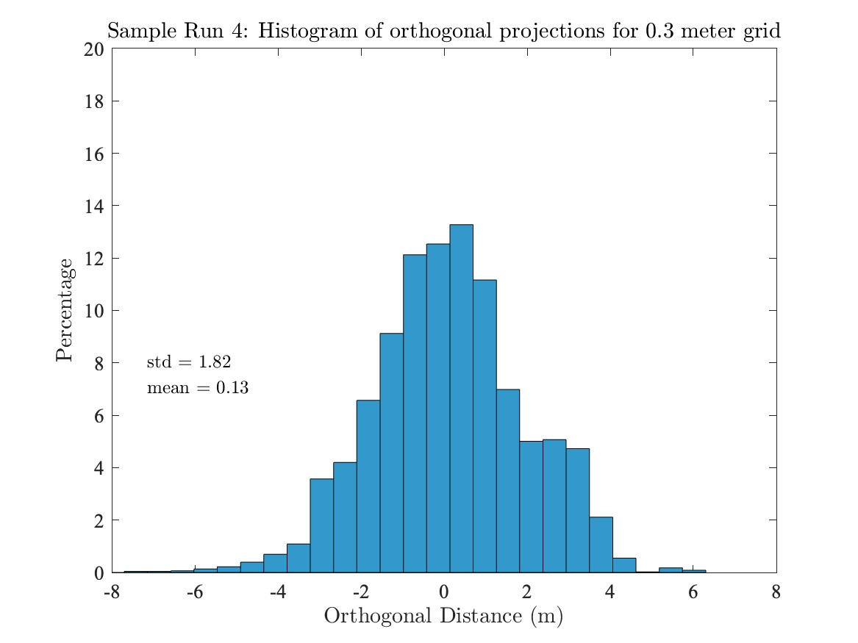
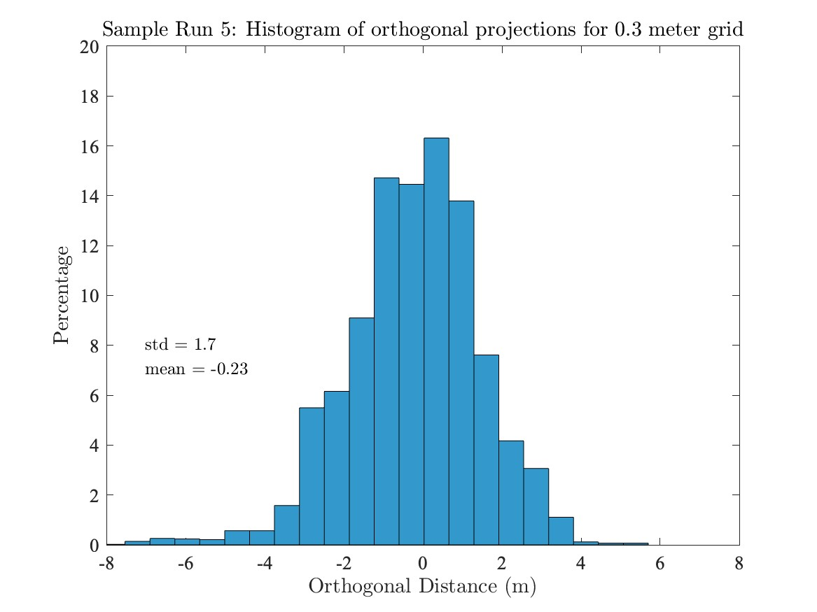
The 1-meter grid consistently shows a lower standard deviation, suggesting that using a larger grid size results in less variation in distances from hand-labeled points to computed boundaries.

Slide 4
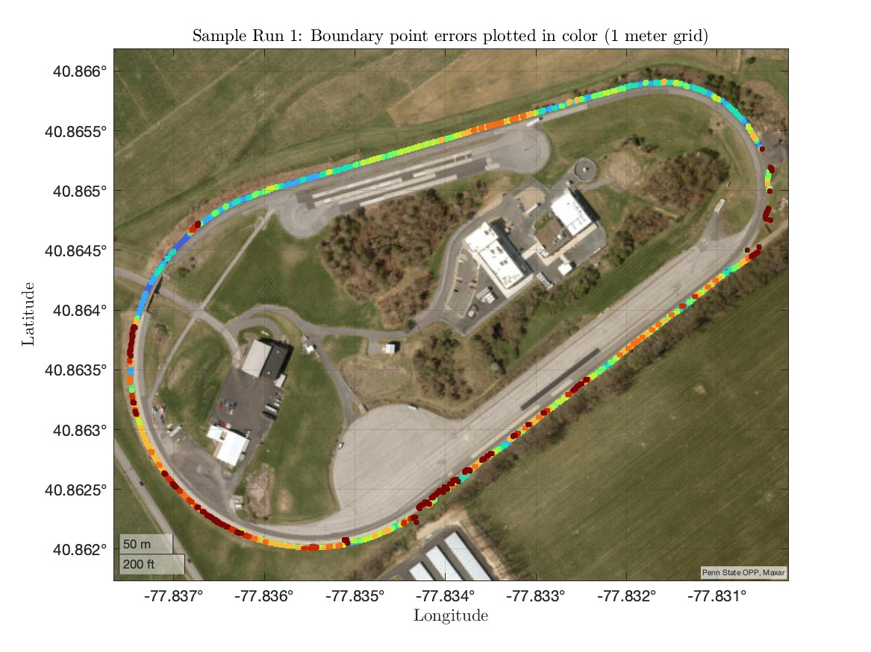
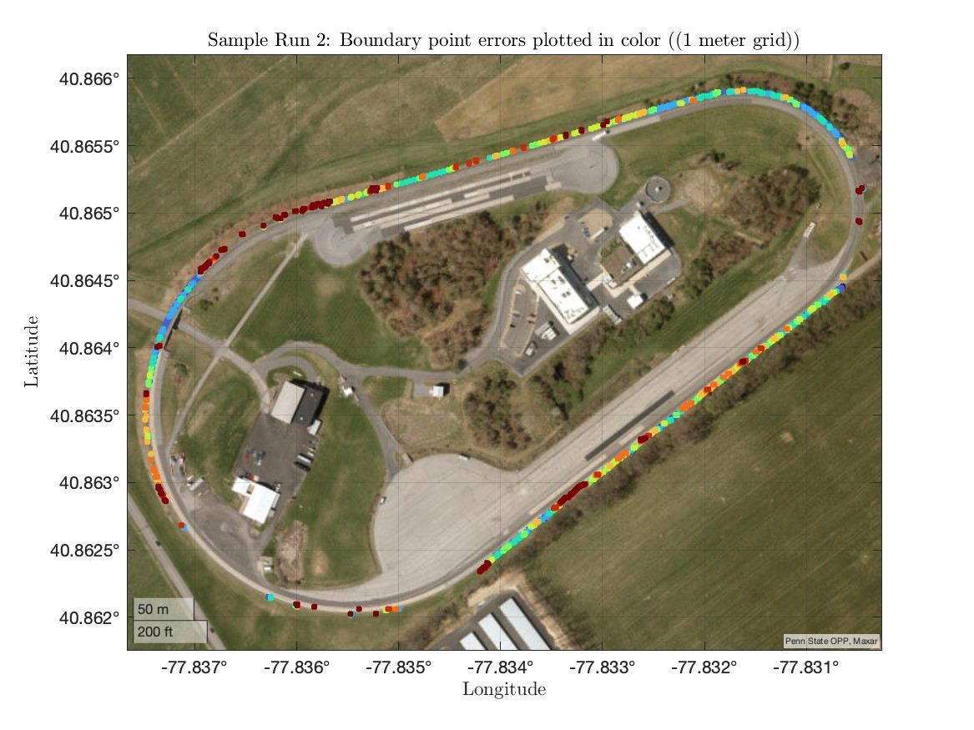
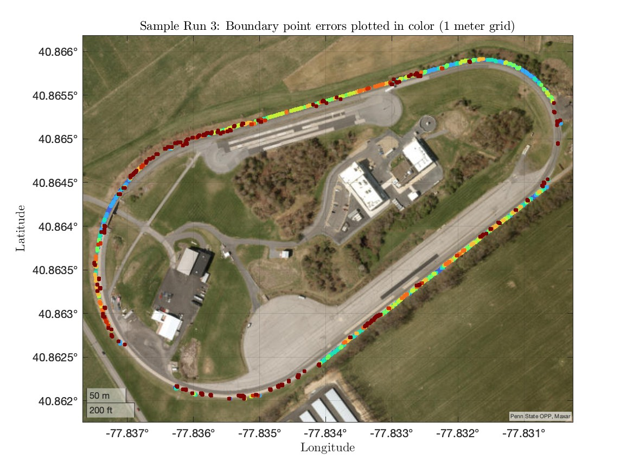
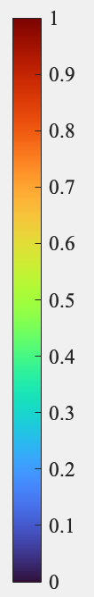
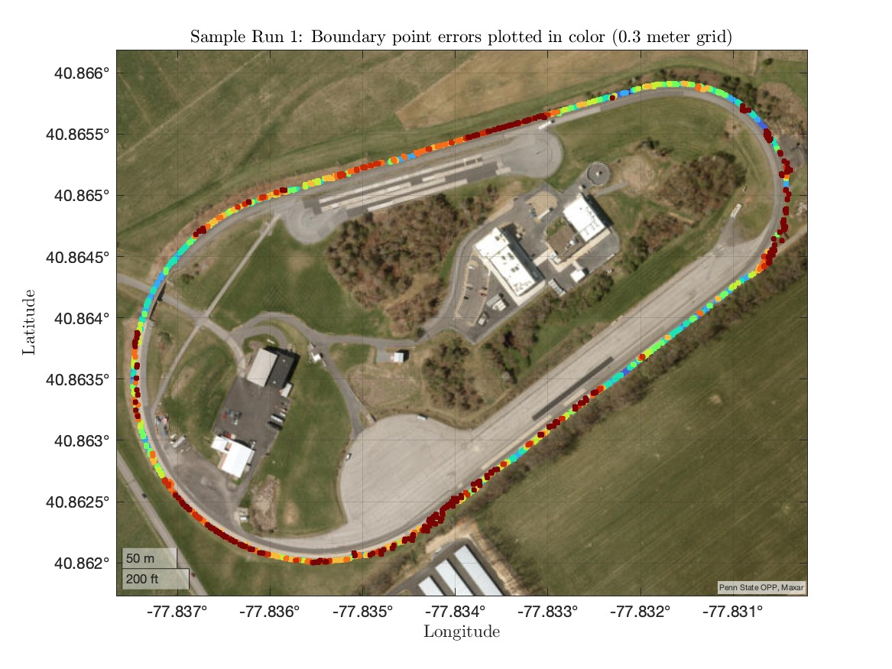
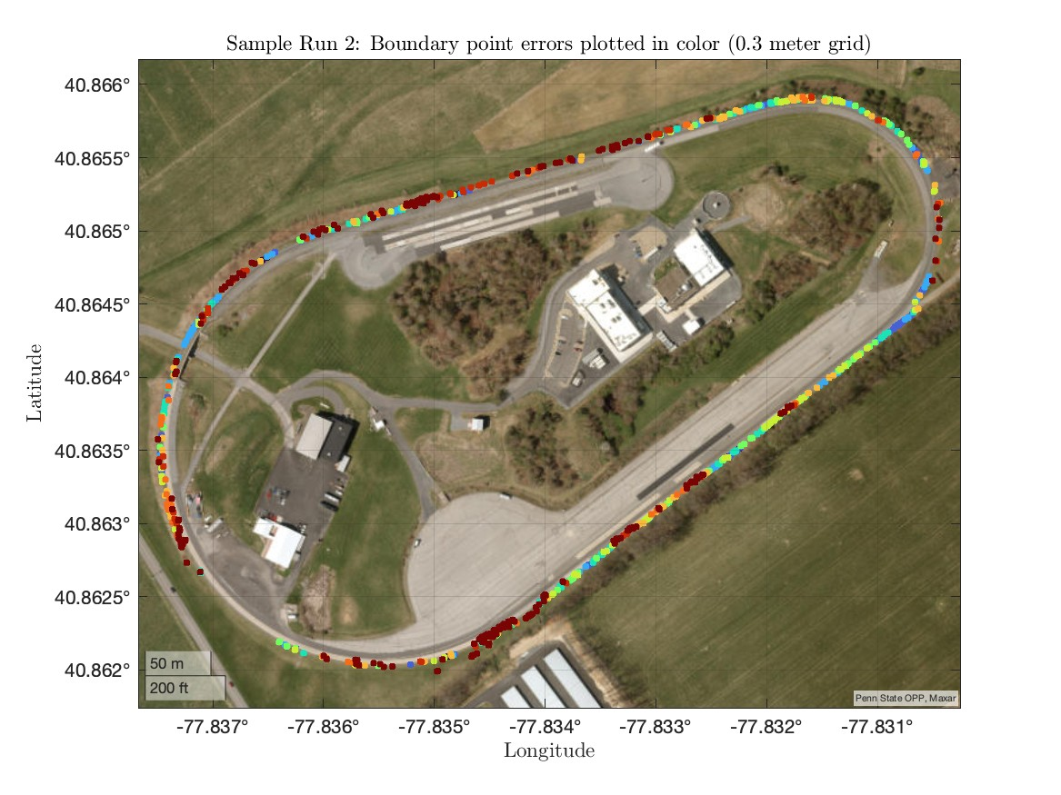
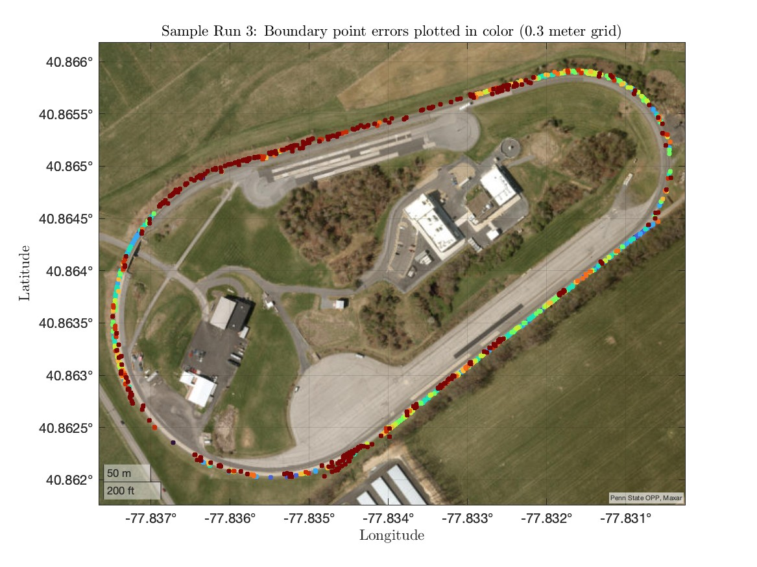
The color coding represents the normalized orthogonal distance (error) between computed boundary points and hand-labeled points. The 1-meter grid provides a smoother and more stable boundary representation by reducing the significance of localized errors. On the other hand, the 0.3-meter grid offers a higher level of detail but at the cost of increased variability and higher sensitivity to local deviations.

Slide 5
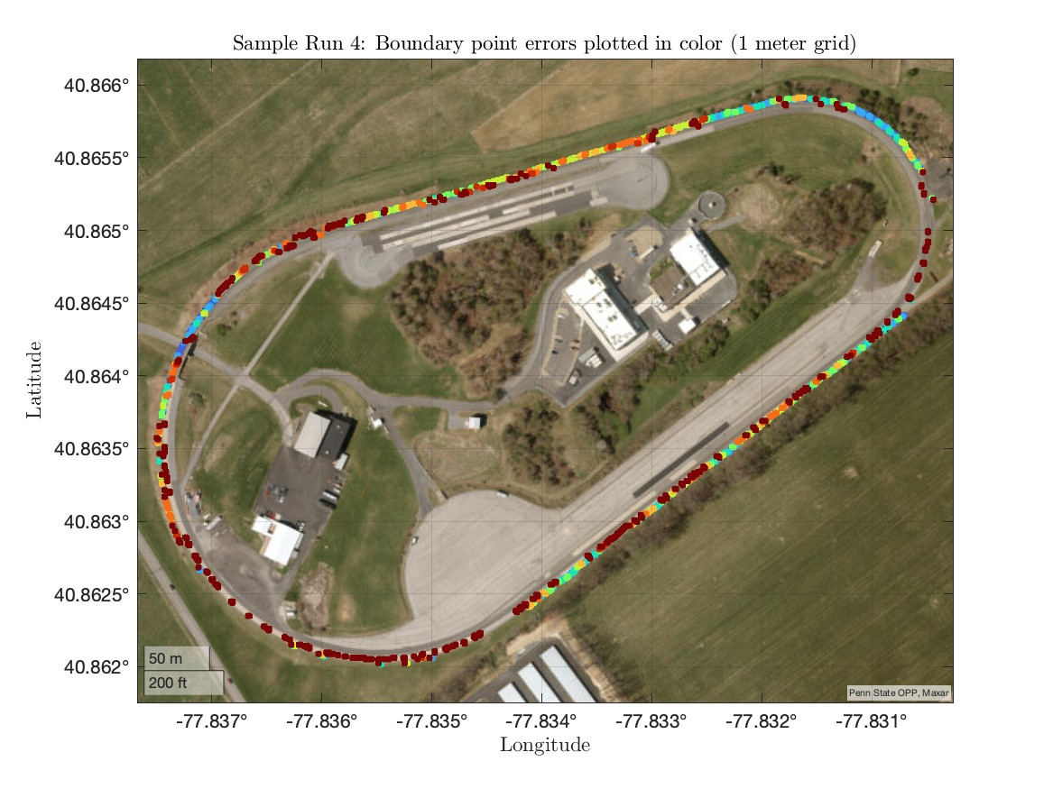
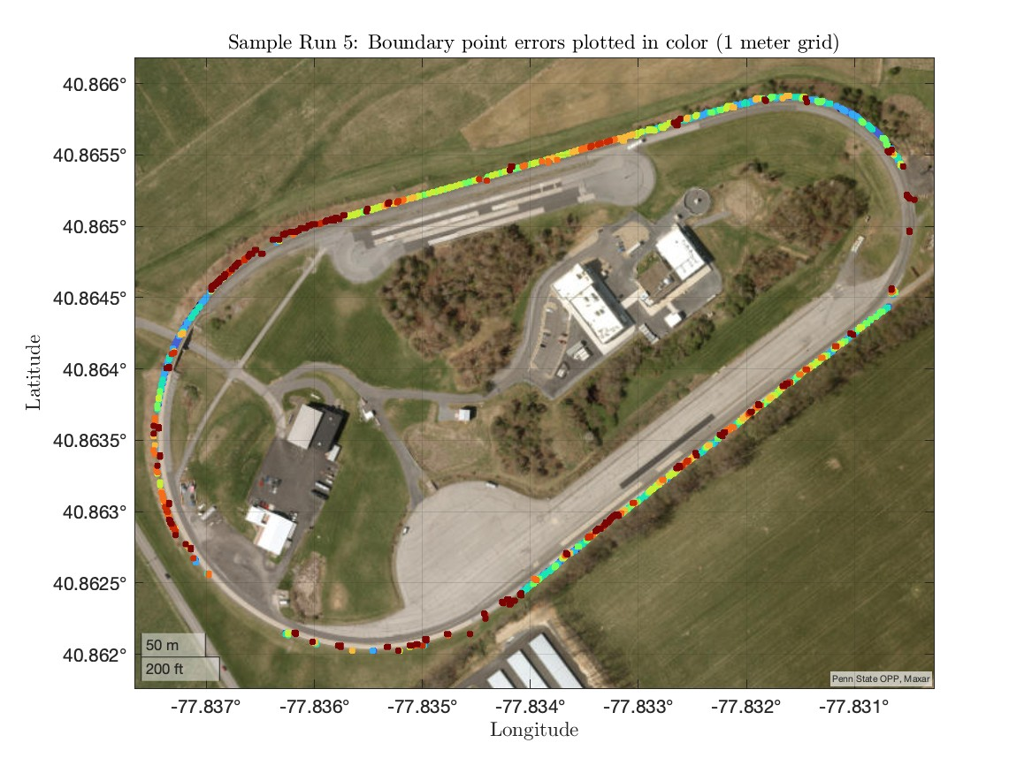
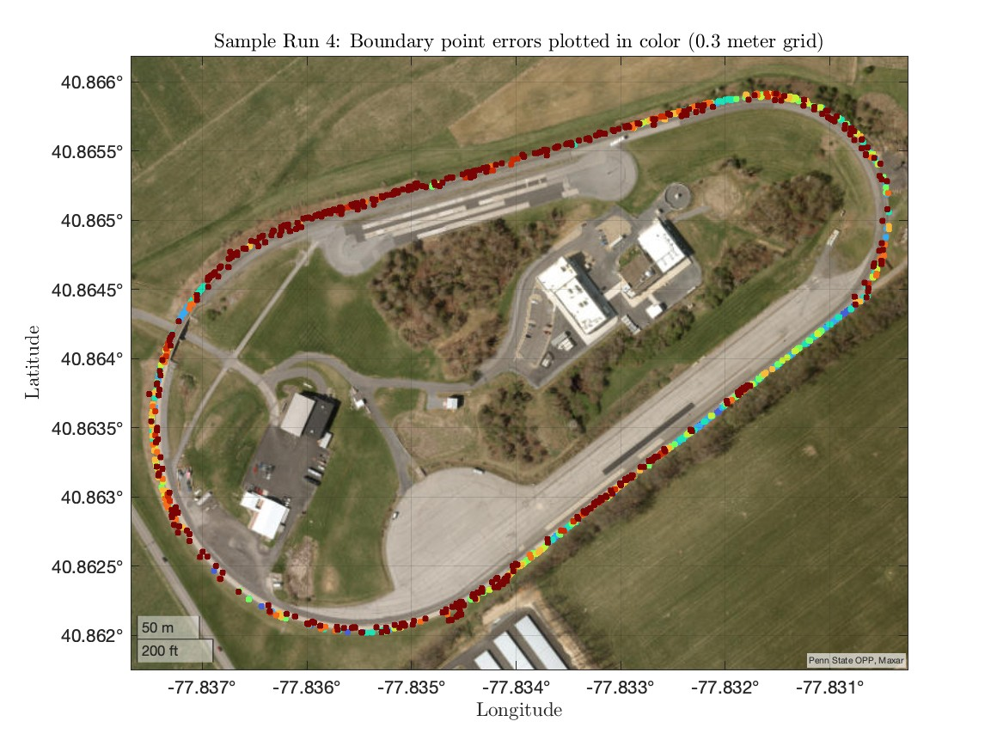
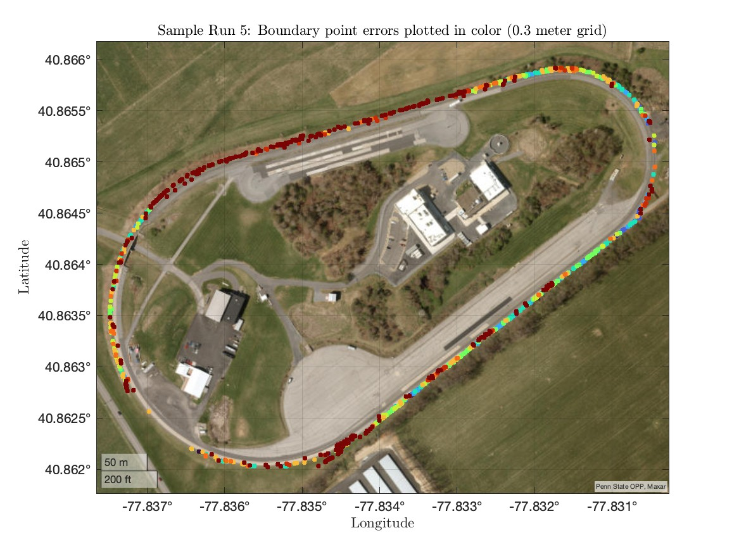
In both grid sizes, certain boundary segments consistently show higher errors (in red or orange), likely due to local topographic features or other variations. However, the 0.3-meter grid amplifies these high-error zones with more intense colors, while the 1-meter grid smooths them out with a softer gradient.

