Slide 1
Hand Trace Library
Descriptions and use of the “Handtrace” functions
Photo by Anders J on Unsplash

Slide 2
The organization of this presentation is as follows:
Motivation and structure of the repo
Basic “getting started” steps
Category organization suggestions – what order to fill them in
Examples from the test track on how to fill in details
Sections for each category that show examples of the items being labelled

Slide 3
Motivation and Structure of the Repo
Updated 2026-03-17 by S. Brennan and J. Rodriguez

Slide 4
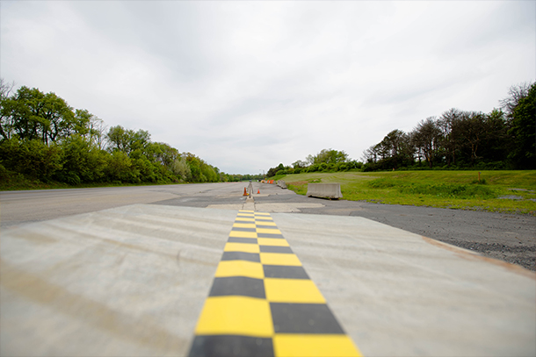
The goal if this repo is to allow humans to “tag” key features for autonomous or automated vehicles operating on roads
The most common location is the Larson Test Track, and so the examples that follow are largely motivated by tags that we have to add to the track.

Slide 5
Basic “getting started” Steps
Updated 2026-03-17 by S. Brennan and J. Rodriguez

Slide 6
Basic getting started operations include
Setting up the workspace
These basic functions are described below.

Slide 7
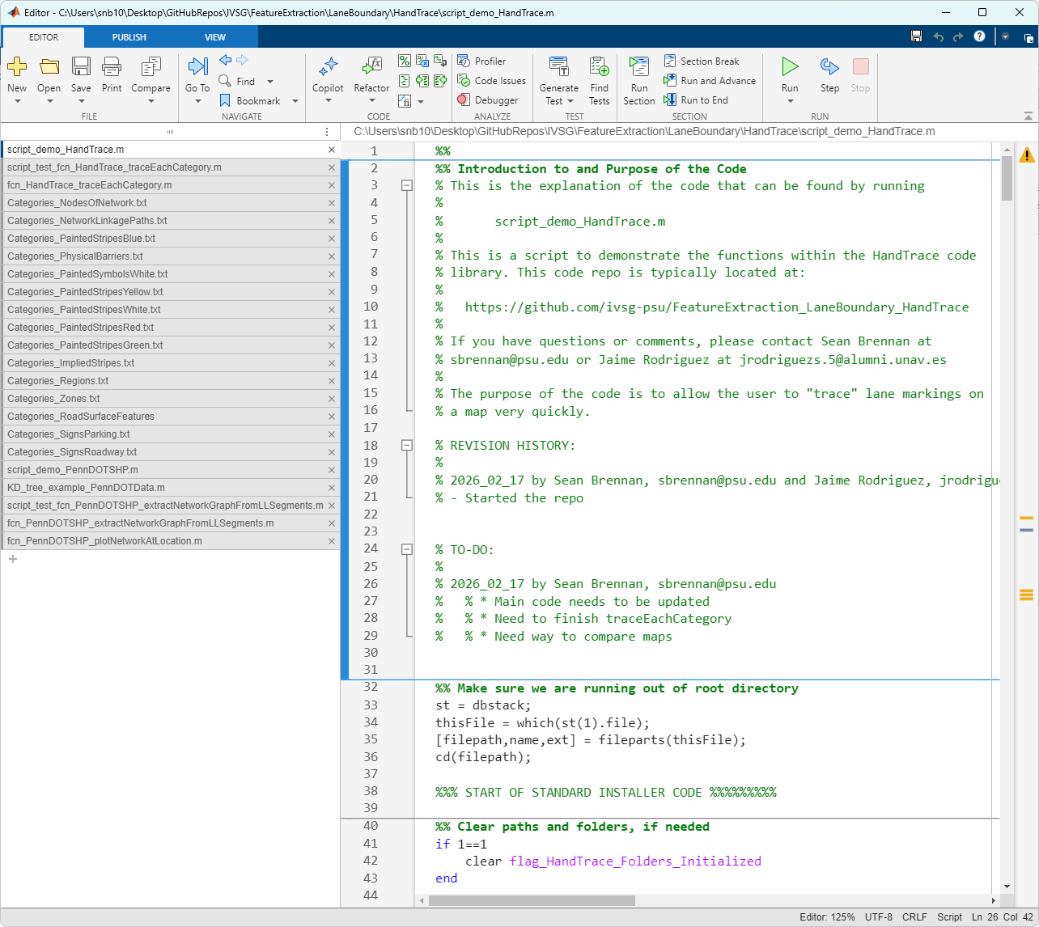
To set up the work space, run the main demo script in the repo
The file is:
Script_demo_HandTrace

Slide 8
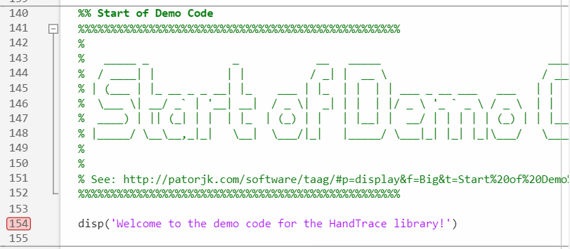
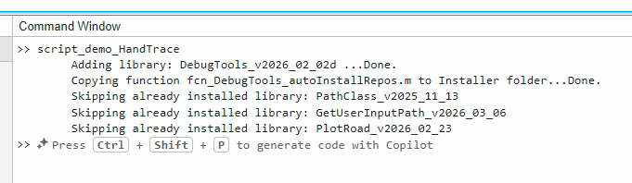
We only need to run the function up to the line AFTER the environment has been set up
The point at which the environment setup has been finished is usually indicated by a “Welcome to…” statement.
We can put a break-point there to stop the code at this point, so it doesn’t run all the functions, which we usually do not need.
When running up to this section, the code will install some libraries.

Slide 9
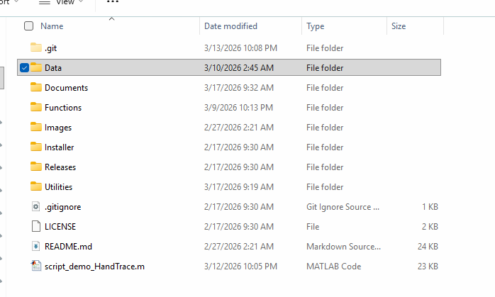
The core functions of the code depend on category definitions for items we want to label.
These definitions are stored in text files within the Data subfolder of the repository.

Slide 10
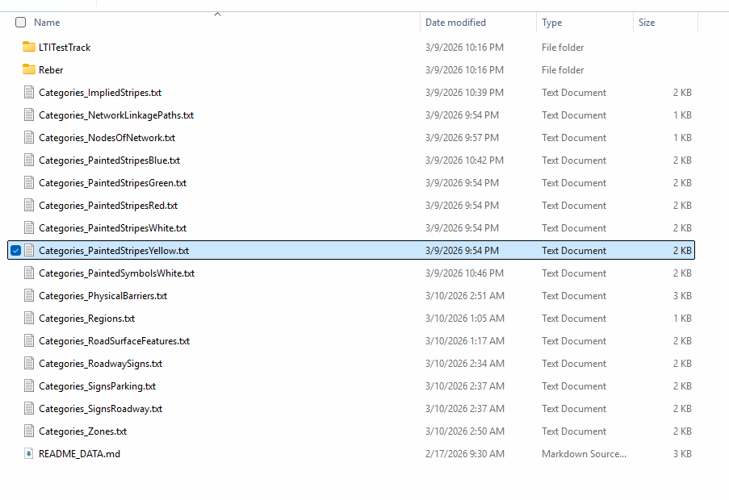
Inside each text file is a list of all the items that can be “tagged” as part of that category.
There are MANY different categories.
Examples of each item in each list can be found later in this tutorial.

Slide 11
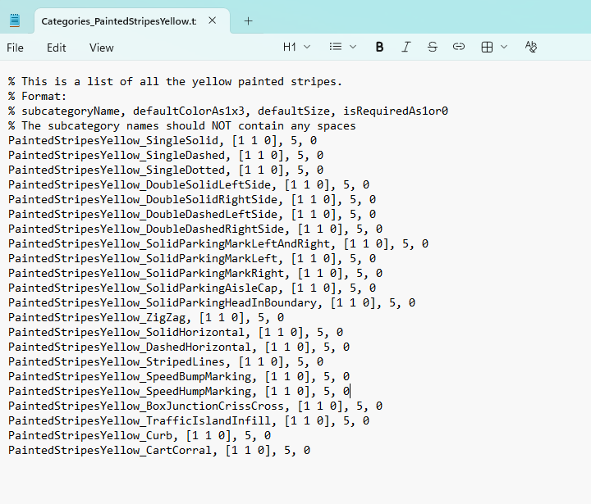
For example, the file “Categories_PaintedStripesYellow.txt” contains a list of all the painted yellow markings that are possible to find on the road.
The files are in text format so that it is easy for us to modify them and read them without loading them.
The text file comments are ignored. These start with “%” symbols.

Slide 12

The format of each line inside a category lists important items
Those items are:
The name
The color as [red green blue], with values of each between 0 and 1
The size it will be drawn on the screen.
Line sizes are typically 1 to 10
Marker sizes are typically 1 to 50
If the item MUST be drawn on the screen (isRequredAs1or0) flag
So the first item has the following values: Name: “PaintedStripesYellow_SingleSolid”
Color: [1 1 0] (yellow)
Size: 5
Required: No (0)

Slide 13
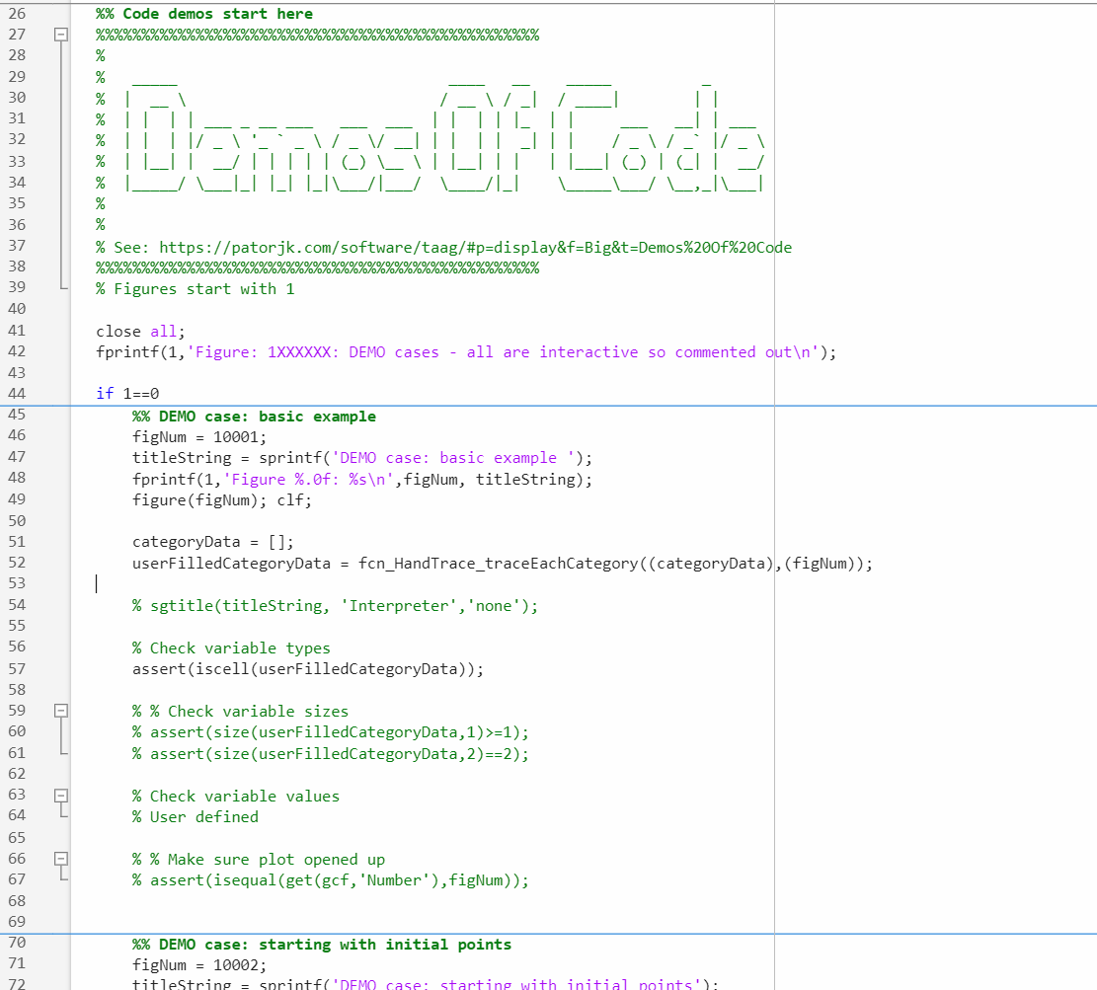
Each category appears when we run the core labelling function.
A demo of this can be seen by running the script in the Functions subfolder:
script_test_fcn_HandTrace_traceEachCategory
The first demo is shown here. We can just run this one section.

Slide 14
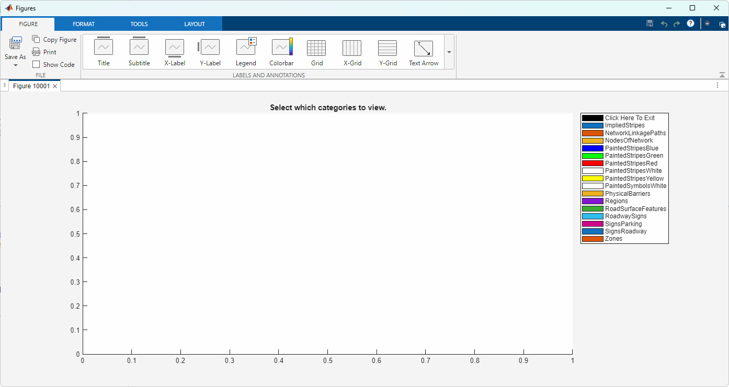
When running the demo, it opens the drawing interface tool
This shows all the categories that can be labelled.

Slide 15
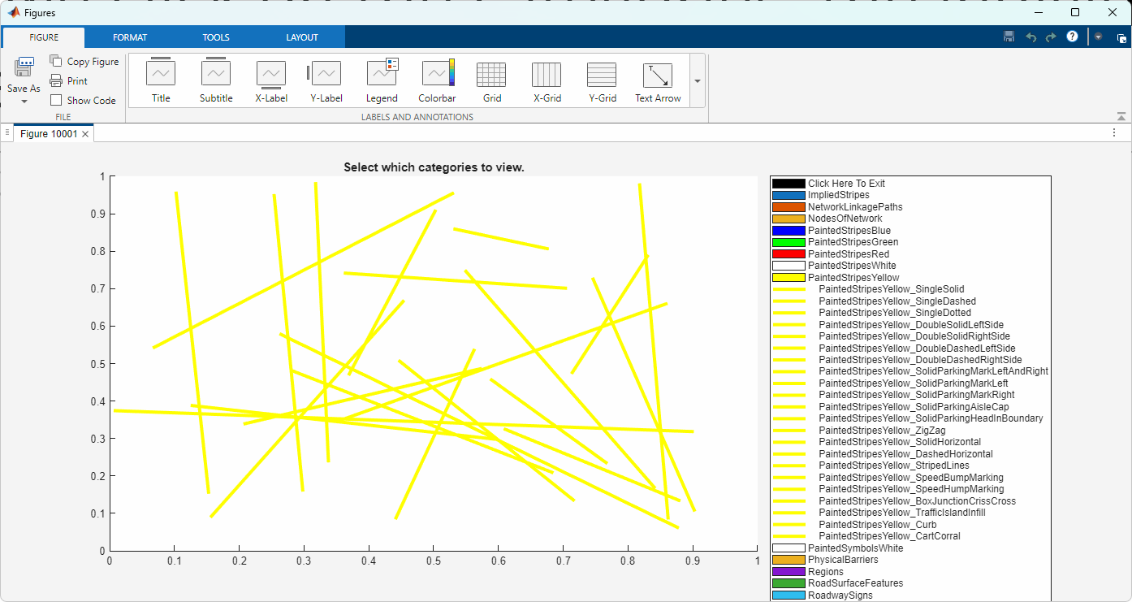
If we click on the categories, the individual items are shown.
For testing, only random points are filled in to represent a “map”

Slide 16
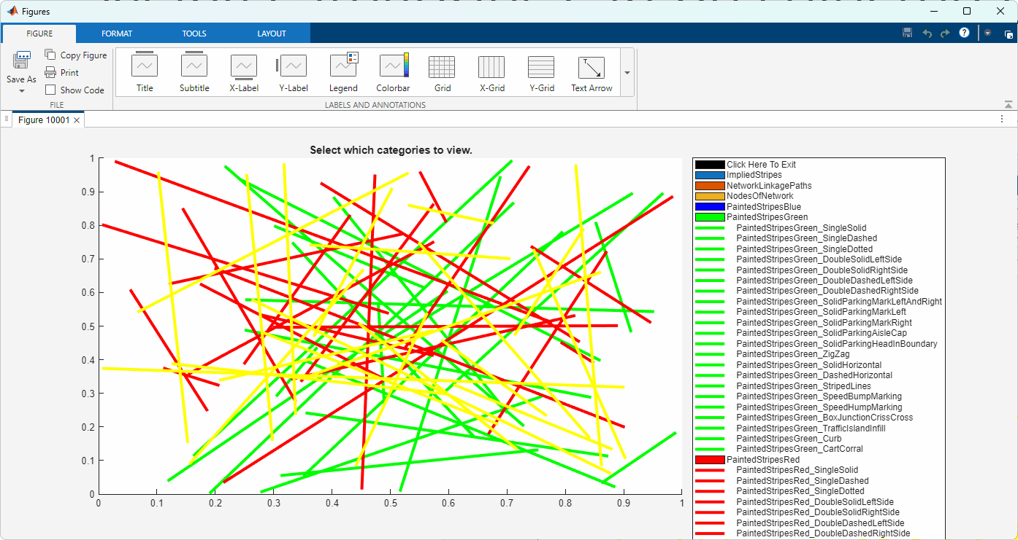
Many categories can be selected on/off by clicking on the legend.
Each category and each sub-item display can be toggled on/off by clicking on the legend

Slide 17
Category Organization Suggestions
Updated 2026-03-17 by S. Brennan and J. Rodriguez

Slide 18
Checking the inputs to functions

Slide 19
Examples from Test Track

Slide 20
Documentation of Items Within “ImpliedStripes”
Updated 2026-03-17 by S. Brennan and J. Rodriguez

Slide 21
Here are images that show all items within the ImpliedStripes category
ImpliedStripes_SingleSolid, 0.5*[1 1 1], 5, 0
ImpliedStripes_SingleDashed, 0.5*[1 1 1], 5, 0
ImpliedStripes_SingleDotted, 0.5*[1 1 1], 5, 0
ImpliedStripes_DoubleSolidLeftSide, 0.5*[1 1 1], 5, 0
ImpliedStripes_DoubleSolidRightSide, 0.5*[1 1 1], 5, 0
ImpliedStripes_DoubleDashedLeftSide, 0.5*[1 1 1], 5, 0
ImpliedStripes_DoubleDashedRightSide, 0.5*[1 1 1], 5, 0
ImpliedStripes_SolidParkingMarkLeftAndRight, 0.5*[1 1 1], 5, 0
ImpliedStripes_SolidParkingMarkLeft, 0.5*[1 1 1], 5, 0
ImpliedStripes_SolidParkingMarkRight, 0.5*[1 1 1], 5, 0
ImpliedStripes_SolidParkingAisleCap, 0.5*[1 1 1], 5, 0
ImpliedStripes_SolidParkingHeadInBoundary, 0.5*[1 1 1], 5, 0
ImpliedStripes_ZigZag, 0.5*[1 1 1], 5, 0
ImpliedStripes_SolidHorizontal, 0.5*[1 1 1], 5, 0
ImpliedStripes_DashedHorizontal, 0.5*[1 1 1], 5, 0
ImpliedStripes_StripedLines, 0.5*[1 1 1], 5, 0
ImpliedStripes_SpeedBumpMarking, 0.5*[1 1 1], 5, 0
ImpliedStripes_SpeedHumpMarking, 0.5*[1 1 1], 5, 0
ImpliedStripes_BoxJunctionCrissCross, 0.5*[1 1 1], 5, 0
ImpliedStripes_TrafficIslandInfill, 0.5*[1 1 1], 5, 0
ImpliedStripes_Curb, 0.5*[1 1 1], 5, 0
ImpliedStripes_CartCorral, 0.5*[1 1 1], 5, 0

Slide 22
Documentation of Items Within “PaintedStripesBlue”
Updated 2026-03-17 by S. Brennan and J. Rodriguez

Slide 23
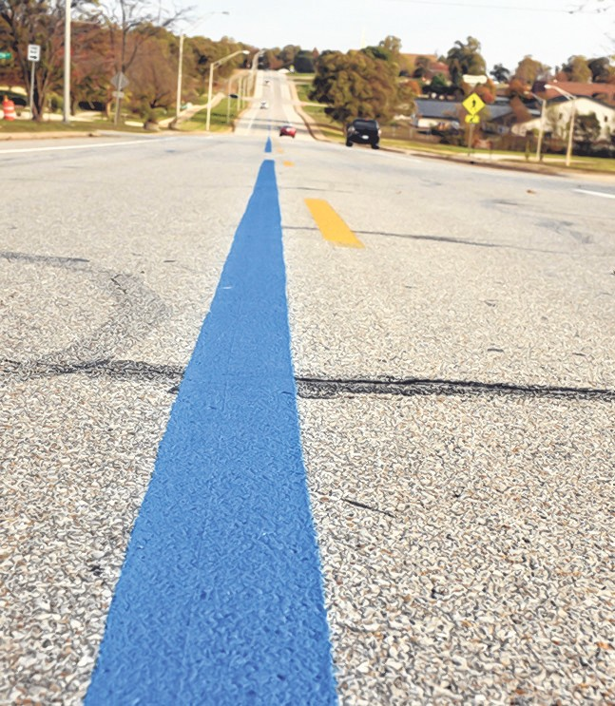
Here’s a visual example of blue painted stripes

Slide 24
Here are images that show all items within the PaintedStripesBlue category
PaintedStripesBlue_SingleSolid, [0 0 1], 5, 0
PaintedStripesBlue_SingleDashed, [0 0 1], 5, 0
PaintedStripesBlue_SingleDotted, [0 0 1], 5, 0

Slide 25
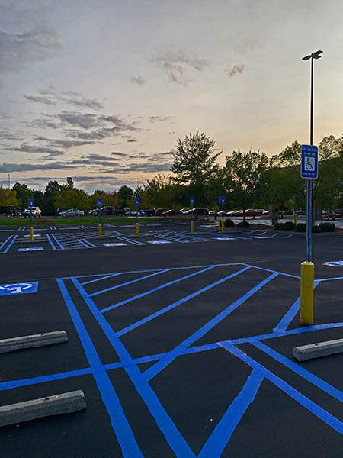
PaintedStripesBlue_SolidParkingMarkLeftAndRight, [0 0 1], 5, 0
PaintedStripesBlue_SolidParkingMarkLeft, [0 0 1], 5, 0
PaintedStripesBlue_SolidParkingMarkRight, [0 0 1], 5, 0
PaintedStripesBlue_SolidParkingAisleCap, [0 0 1], 5, 0
PaintedStripesBlue_SolidParkingHeadInBoundary, [0 0 1], 5, 0

Slide 26
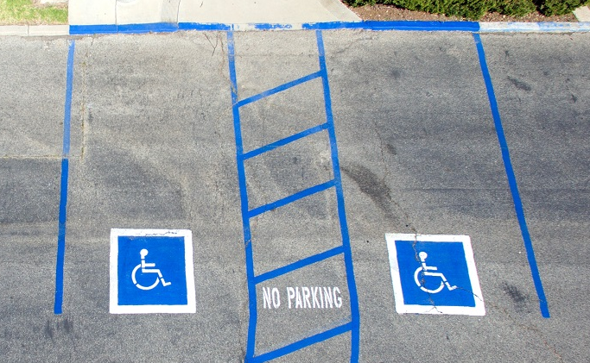
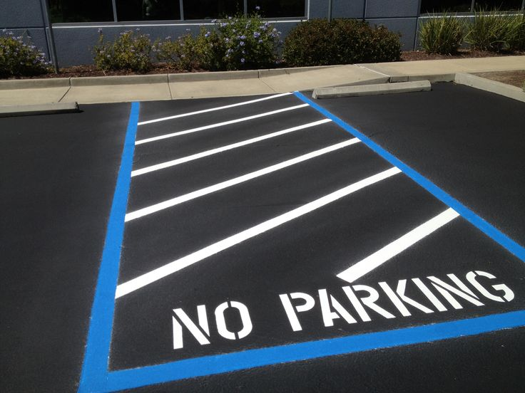
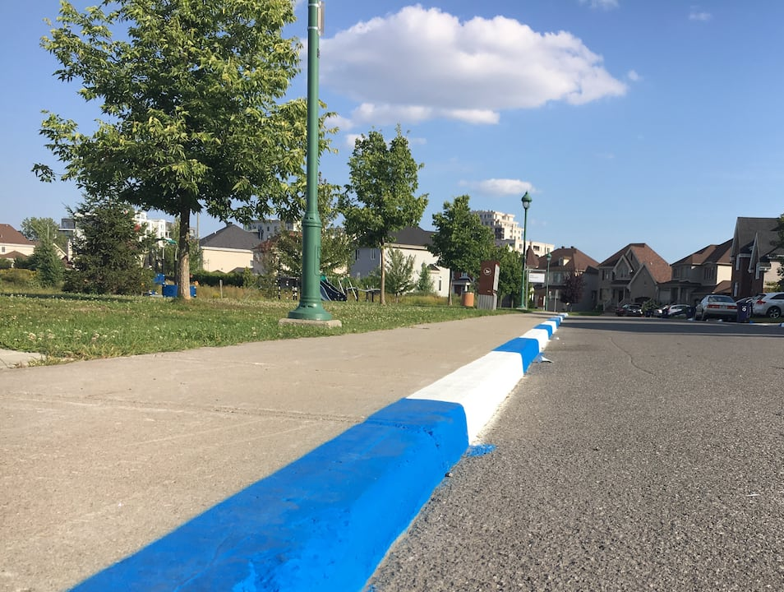
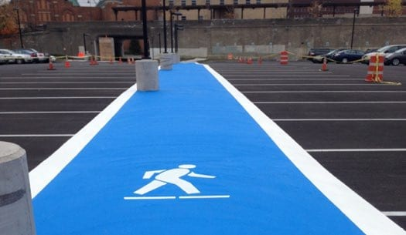
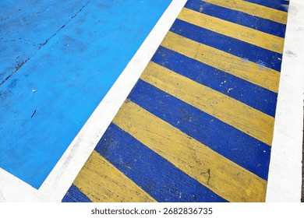
HandicappedParking
NoParking
Curb
PedestrianWalkway
PaintedStripesBlue_TrafficIslandInfill, [0 0 1], 5, 0
PaintedStripesBlue_CartCorral, [0 0 1], 5, 0
StripedLines

Slide 27
Documentation of Items Within “PaintedStripesGreen”
Updated 2026-03-17 by S. Brennan and J. Rodriguez

Slide 28
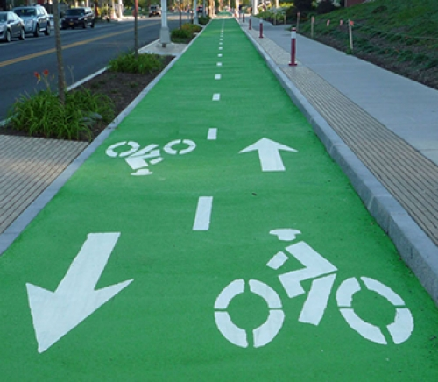
Here are images that show all items within the PaintedStripesGreen category
Cycling path

Slide 29
Documentation of Items Within “PaintedStripesRed”
Updated 2026-03-17 by S. Brennan and J. Rodriguez

Slide 30
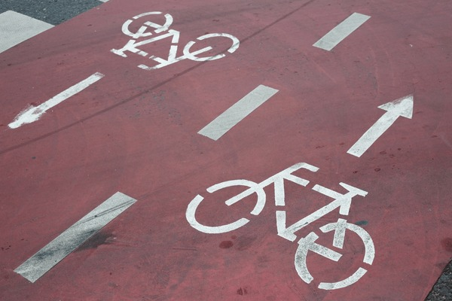

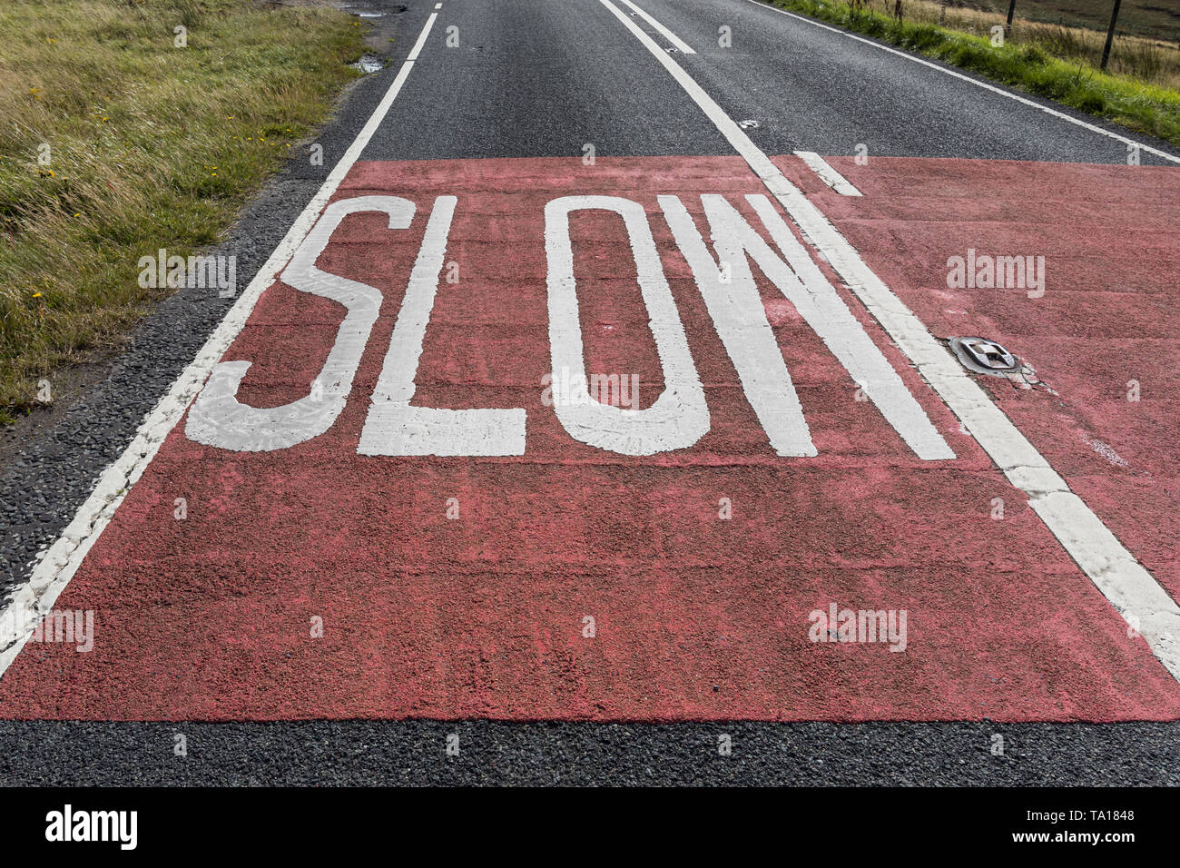
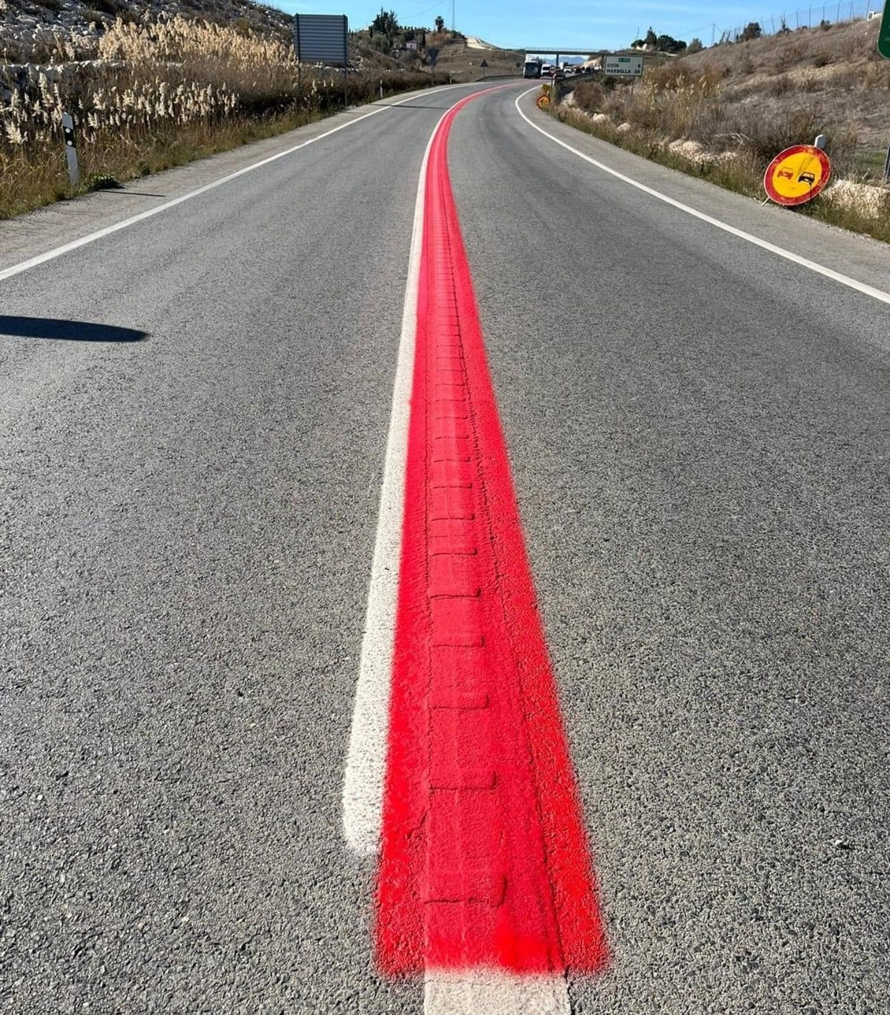
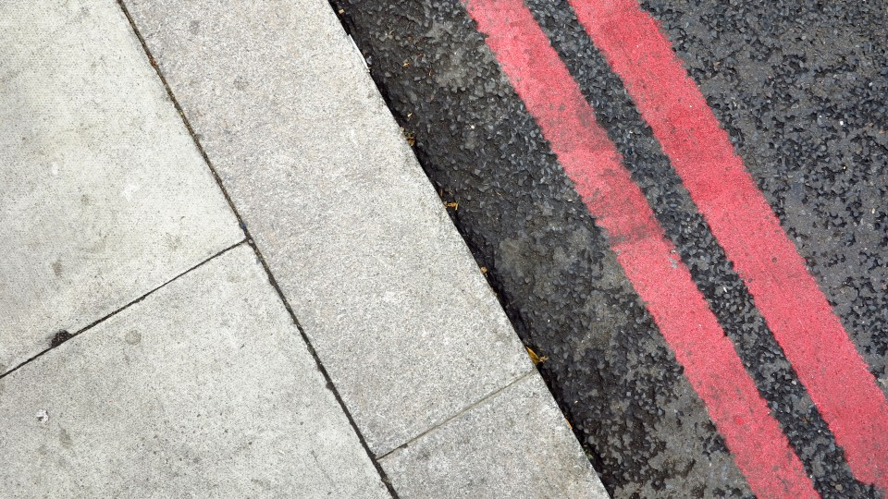
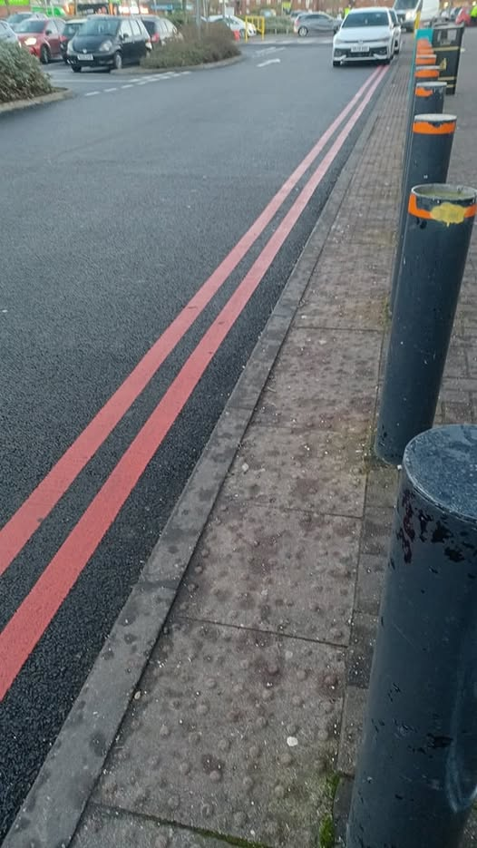
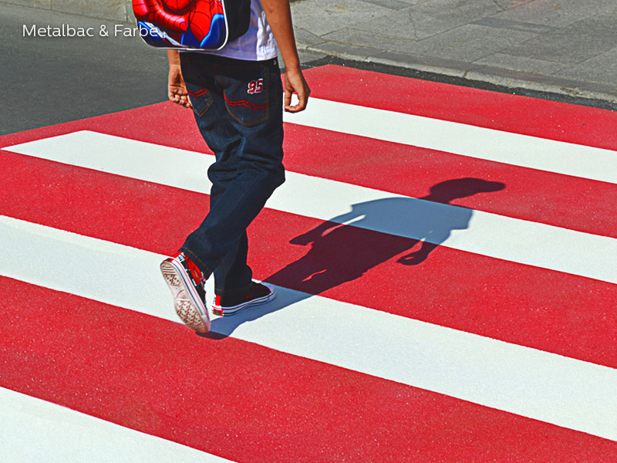
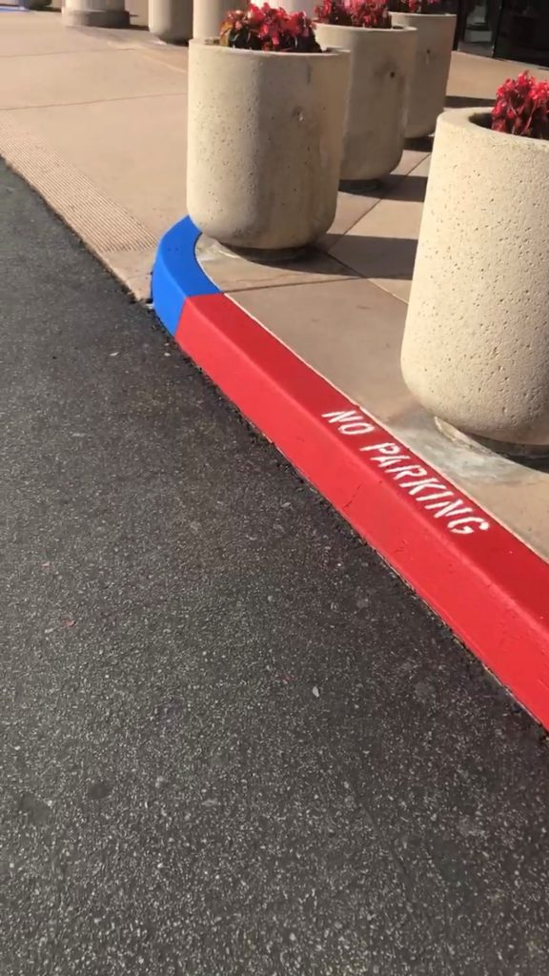
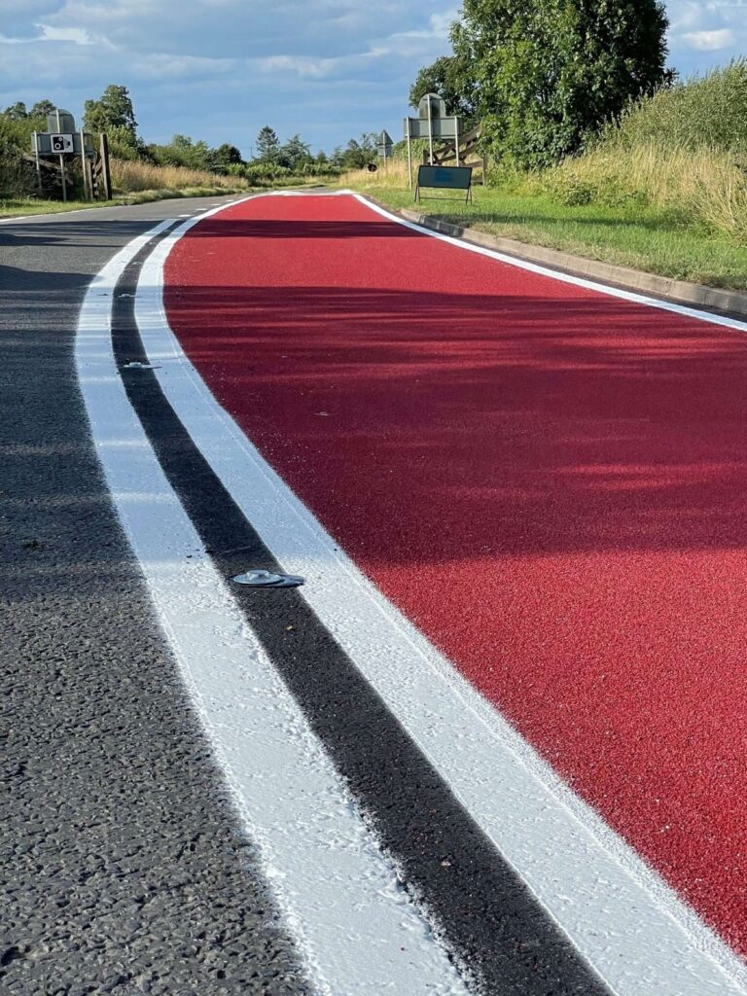
Here are images that show all items within the PaintedStripesRed category
Bike lane
Bus lane
Slow mark
Solid single line
Double Solid Left Side
Double Solid Right Side
Cross Walk
Curb
Driving lane

Slide 31
Documentation of Items Within “PaintedStripesWhite”
Updated 2026-03-17 by S. Brennan and J. Rodriguez

Slide 32

Here’s a visual example of white painted stripes

Slide 33


Here are images that show all items within the PaintedStripesYellow category
SingleSolid
SingleDashed
SingleDotted
PaintedStripesYellow_SingleSolid, [1 1 0], 5, 0
PaintedStripesYellow_SingleDashed, [1 1 0], 5, 0
PaintedStripesYellow_SingleDotted, [1 1 0], 5, 0

Slide 34

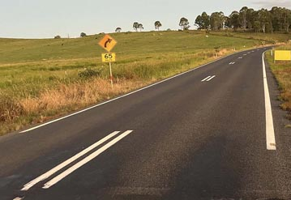


DoubleSolid
DoubleDashed
PaintedStripesYellow_DoubleSolidLeftSide, [1 1 0], 5, 0
PaintedStripesYellow_DoubleSolidRightSide, [1 1 0], 5, 0
PaintedStripesYellow_DoubleDashedLeftSide, [1 1 0], 5, 0
PaintedStripesYellow_DoubleDashedRightSide, [1 1 0], 5, 0
DoubleDashedRightSide
DoubleDashedLeftSide

Slide 35



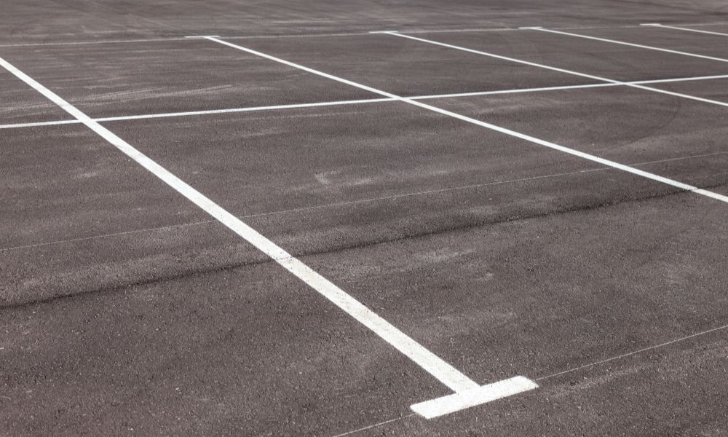
SolidParkingMarkLeftAndRight,
SolidParkingMarkLeft
SolidParkingMarkRight
PaintedStripesYellow_SolidParkingMarkLeftAndRight, [1 1 0], 5, 0
PaintedStripesYellow_SolidParkingMarkLeft, [1 1 0], 5, 0
PaintedStripesYellow_SolidParkingMarkRight, [1 1 0], 5, 0
PaintedStripesYellow_SolidParkingAisleCap, [1 1 0], 5, 0
PaintedStripesYellow_SolidParkingHeadInBoundary, [1 1 0], 5, 0
Parking lines

Slide 36

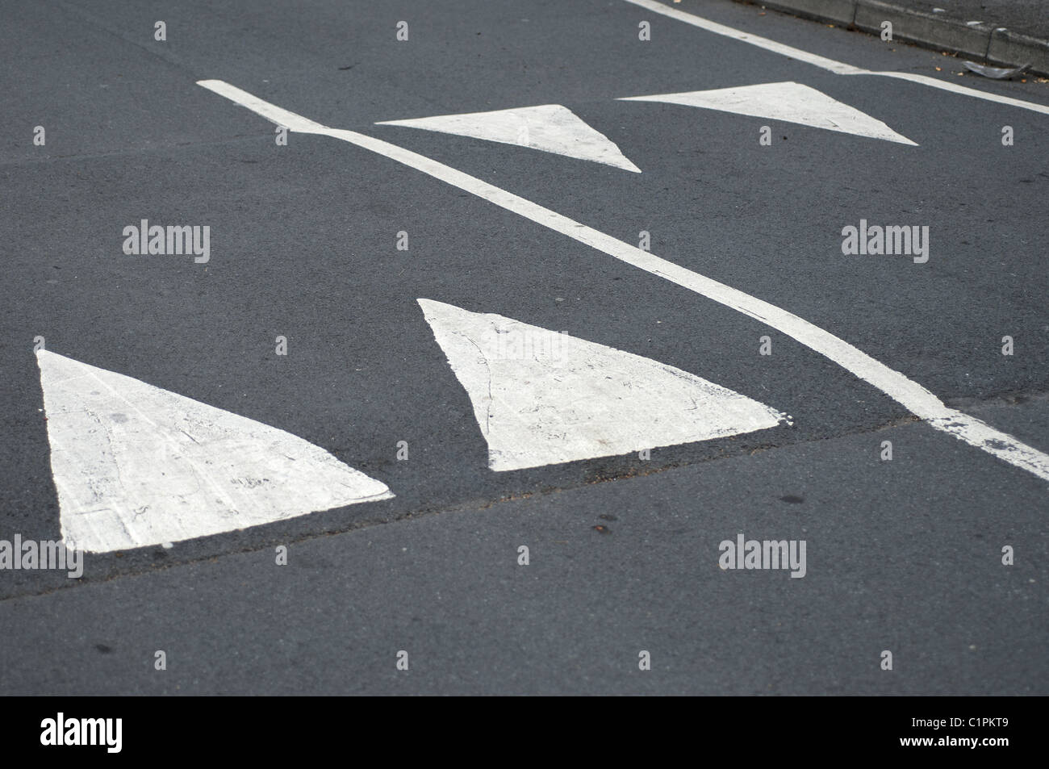
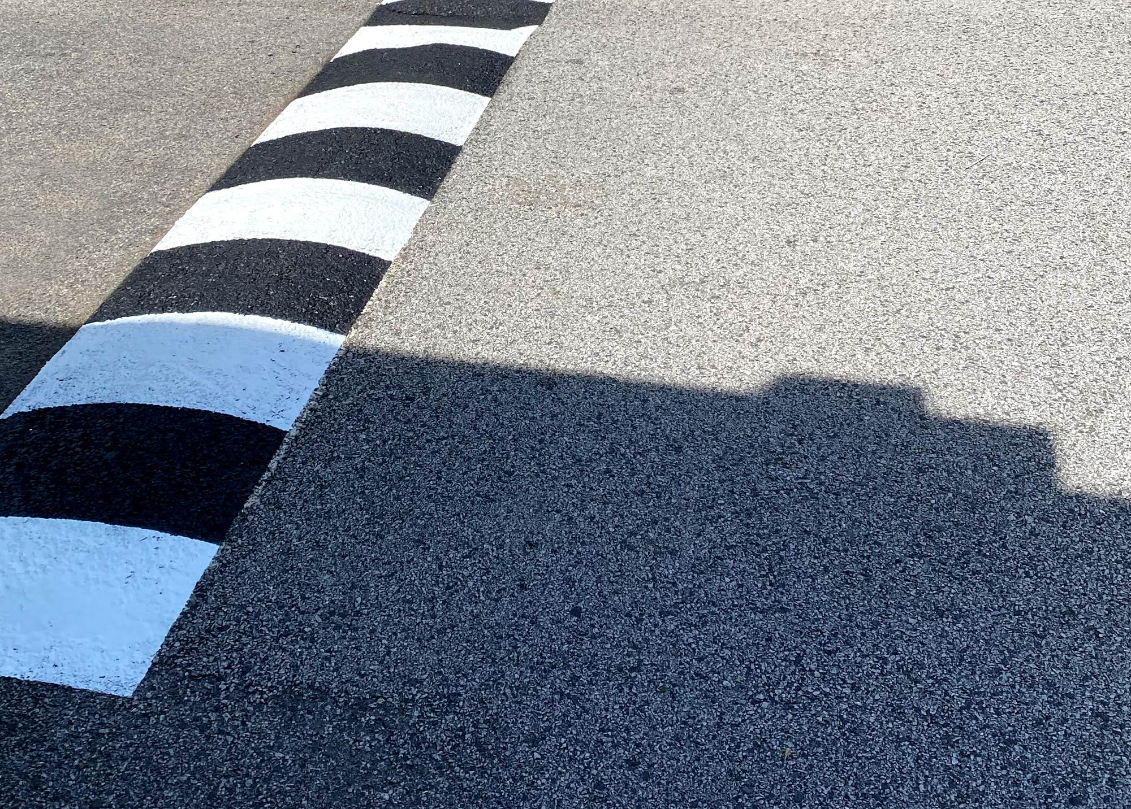

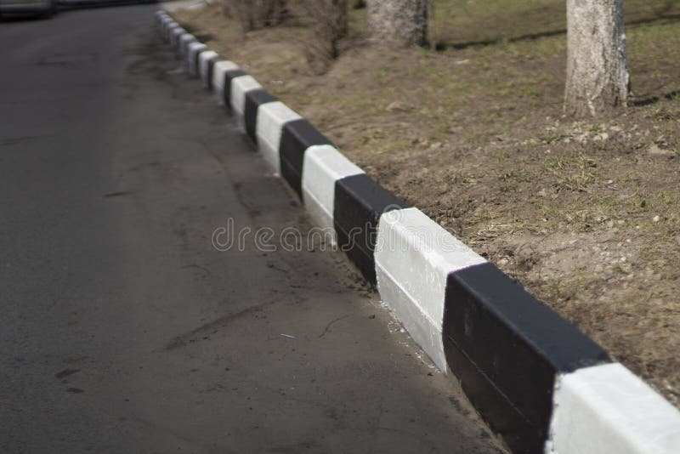

PaintedStripesYellow_ZigZag, [1 1 0], 5, 0
PaintedStripesYellow_SolidHorizontal, [1 1 0], 5, 0
PaintedStripesYellow_DashedHorizontal, [1 1 0], 5, 0
PaintedStripesYellow_StripedLines, [1 1 0], 5, 0
PaintedStripesYellow_SpeedBumpMarking, [1 1 0], 5, 0
PaintedStripesYellow_SpeedHumpMarking, [1 1 0], 5, 0
PaintedStripesYellow_BoxJunctionCrissCross, [1 1 0], 5, 0
PaintedStripesYellow_TrafficIslandInfill, [1 1 0], 5, 0
PaintedStripesYellow_Curb, [1 1 0], 5, 0
PaintedStripesYellow_CartCorral, [1 1 0], 5, 0
ZigZag
SpeedHumpMarking
SpeedBumpMarking
TrafficIslandInfill
Curb
Cross Walk

Slide 37
Documentation of Items Within “PaintedStripesYellow”
Updated 2026-03-17 by S. Brennan and J. Rodriguez

Slide 38

Here’s a visual example of yellow painted stripes

Slide 39


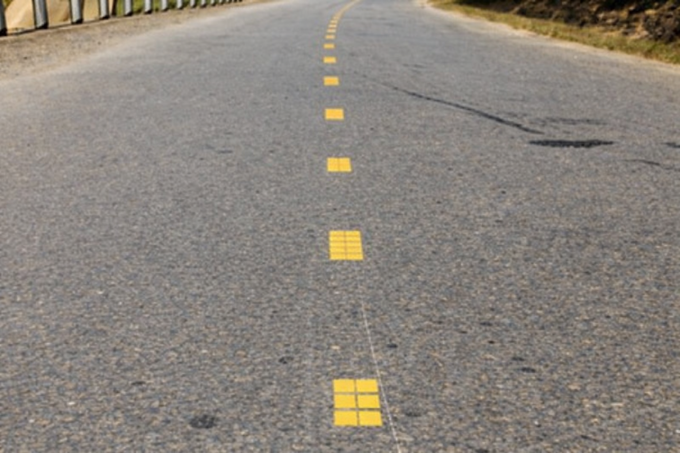
Here are images that show all items within the PaintedStripesYellow category
SingleSolid
SingleDashed
SingleDotted
PaintedStripesYellow_SingleSolid, [1 1 0], 5, 0
PaintedStripesYellow_SingleDashed, [1 1 0], 5, 0
PaintedStripesYellow_SingleDotted, [1 1 0], 5, 0

Slide 40
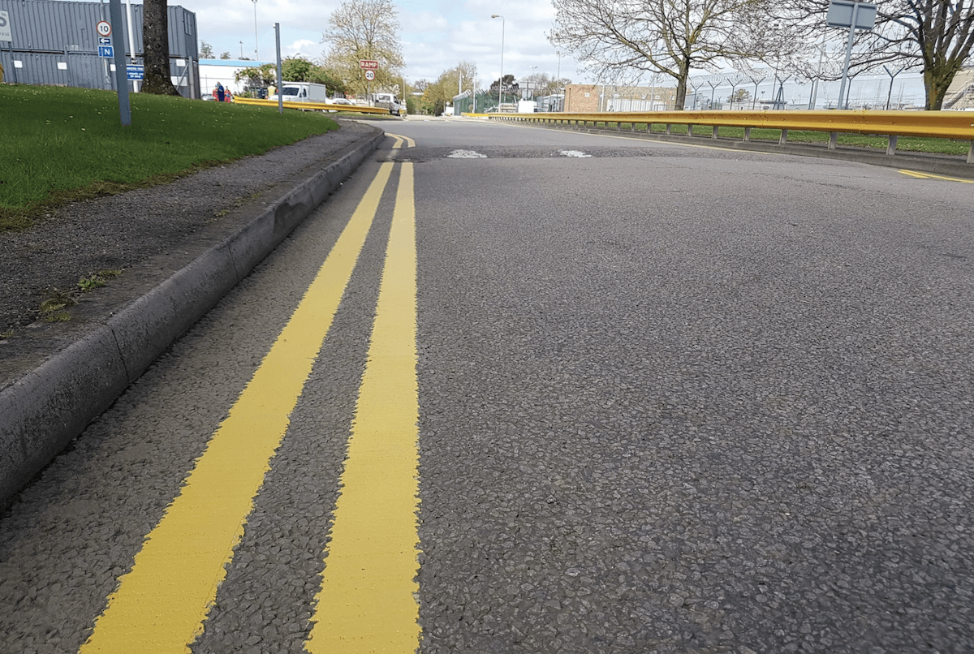
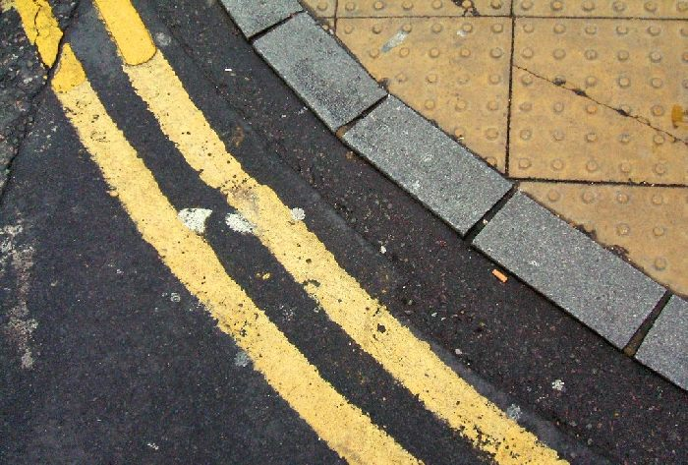
DoubleSolidLeftSide
DoubleSolidRightSide
PaintedStripesYellow_DoubleSolidLeftSide, [1 1 0], 5, 0
PaintedStripesYellow_DoubleSolidRightSide, [1 1 0], 5, 0
PaintedStripesYellow_DoubleDashedLeftSide, [1 1 0], 5, 0
PaintedStripesYellow_DoubleDashedRightSide, [1 1 0], 5, 0
DoubleDashedLeftSide

Slide 41



SolidParkingMarkLeftAndRight,
SolidParkingMarkLeft
SolidParkingMarkRight
PaintedStripesYellow_SolidParkingMarkLeftAndRight, [1 1 0], 5, 0
PaintedStripesYellow_SolidParkingMarkLeft, [1 1 0], 5, 0
PaintedStripesYellow_SolidParkingMarkRight, [1 1 0], 5, 0
PaintedStripesYellow_SolidParkingAisleCap, [1 1 0], 5, 0
PaintedStripesYellow_SolidParkingHeadInBoundary, [1 1 0], 5, 0

Slide 42
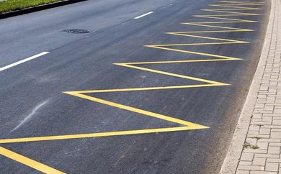
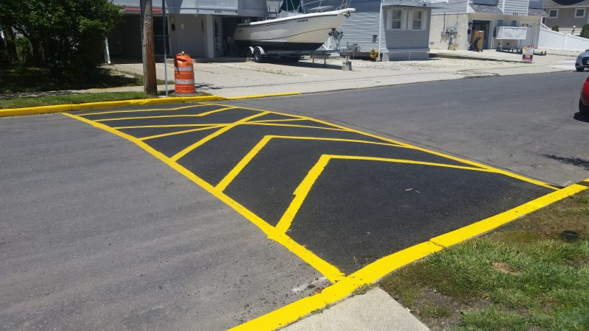

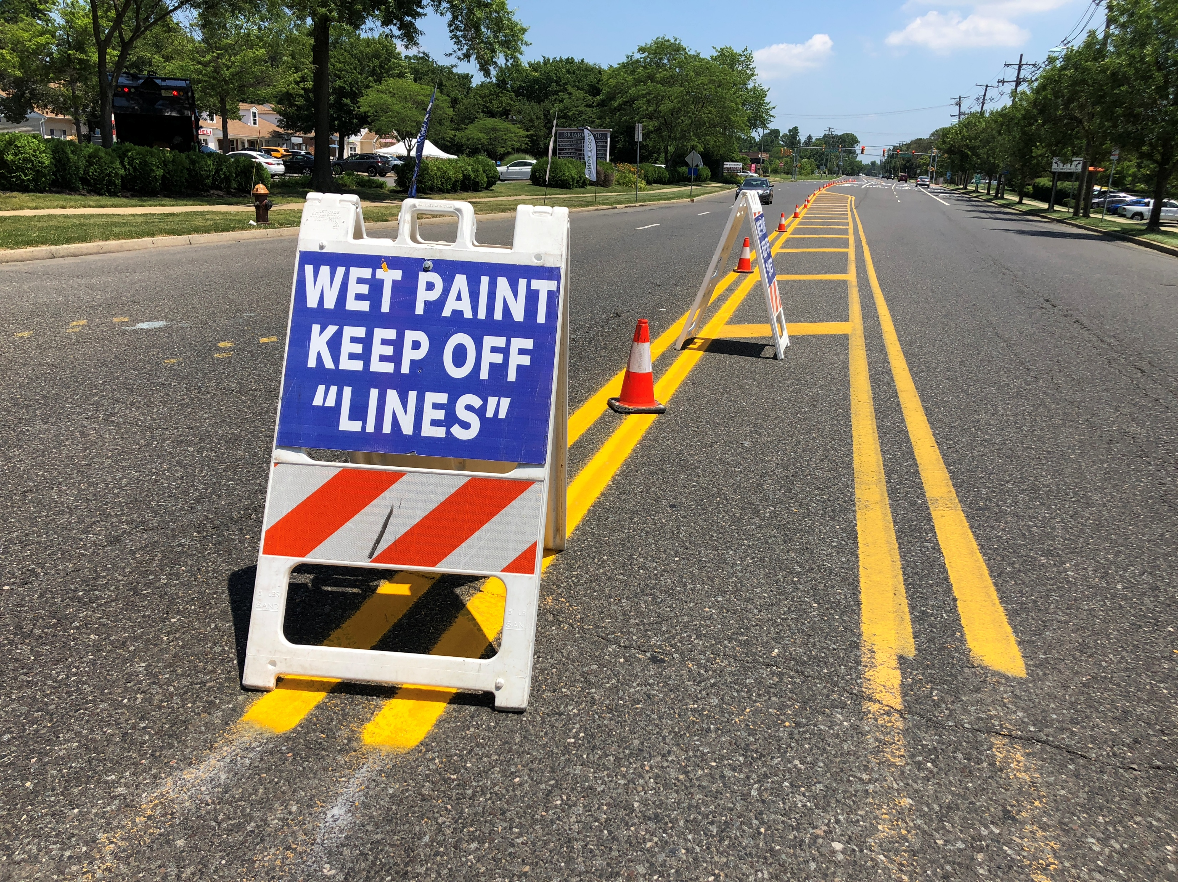
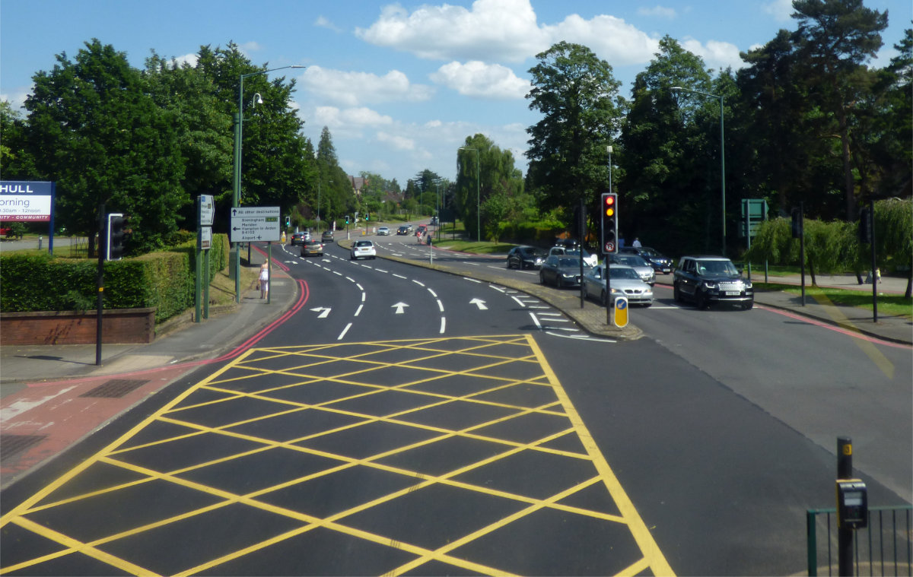
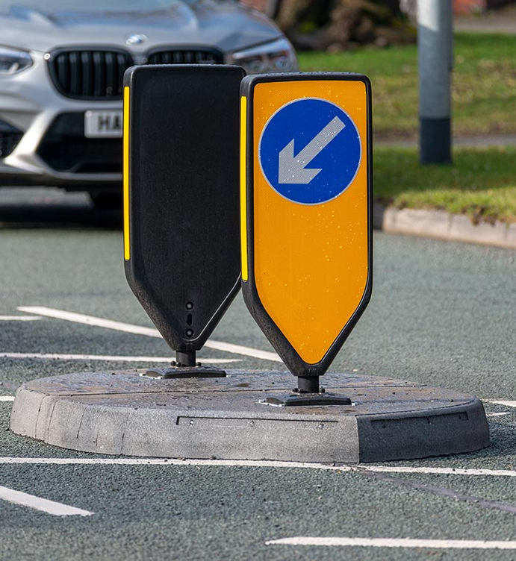
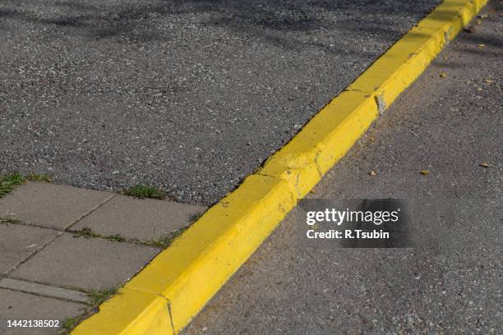
ZigZag
SpeedHumpMarking
SpeedBumpMarking
PaintedStripesYellow_ZigZag, [1 1 0], 5, 0
PaintedStripesYellow_SolidHorizontal, [1 1 0], 5, 0
PaintedStripesYellow_DashedHorizontal, [1 1 0], 5, 0
PaintedStripesYellow_StripedLines, [1 1 0], 5, 0
PaintedStripesYellow_SpeedBumpMarking, [1 1 0], 5, 0
PaintedStripesYellow_SpeedHumpMarking, [1 1 0], 5, 0
PaintedStripesYellow_BoxJunctionCrissCross, [1 1 0], 5, 0
PaintedStripesYellow_TrafficIslandInfill, [1 1 0], 5, 0
PaintedStripesYellow_Curb, [1 1 0], 5, 0
PaintedStripesYellow_CartCorral, [1 1 0], 5, 0
BoxJunctionCrissCross
TrafficIslandInfill
Curb

