Slide 1
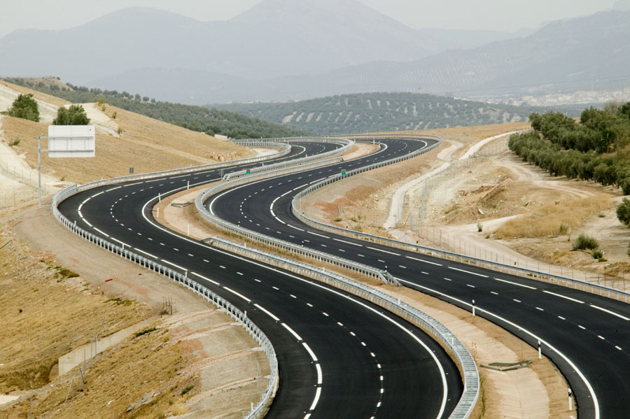
OpenDRIVE XODR Maps in MATLAB
Prof. Craig Beal
Bucknell University
Started: 3.25.22
Updated through: 5.13.22

Slide 2
OpenDRIVE XODR file basics
As applicable for import into MATLAB for plotting/analysis

Slide 3
OpenDRIVE XODR
Roads are defined in a hierarchical XML format
OpenDRIVE enclosing element
Header element → bounding box defined by west, east, south, north attributes
Road elements (multiple) → define the road reference line
Planview element (one per road)
Geometry elements (multiple within planview element)
Line → start point in E,N coords, start point in s coord, heading, length
Arc → start point in E,N coords, start point in s coord, initial heading, length, curvature
Spiral → start point in E,N coords, start point in s coord, initial heading, length, initial curvature, ending curvature
Parametric polynomial
Lanes
Lane Offset elements → shift the center lane away from the road reference line
Valid from the start station until the next lane offset element or the end of the road
A particular implication is that a constant lane offset is needed after a non-constant element to stop the lateral change
Lane Segment (multiple within lanes element) → break up the lanes along the s-coordinate into sections with uniform lane properties
Left, Center, Right → for convenience, encapsulate the multiple left and right lanes in a section into grouped elements
Lane (multiple) → define the width, type, etc. of the lanes
Width (multiple) → cubic polynomial form defining profile in s,t coordinates
RoadMark → gives the properties of the outer marking of the lane
Objects
Object elements (multiple)
Location of object origin in S,T coords
Bounding box (length, width or radius of circle in u,v coords)
Outline element (optional)
Corners in S,T coords or local u,v coords
Repeat element to repeat objects with linearly varying parameters
OpenDRIVE 2.0 will break almost everything that depends on these definitions!!!

Slide 4
Representing OpenDRIVE in MATLAB
Organizing OpenDRIVE data in MATLAB is fairly straightforward
There exist several xml2struct tools that can convert the XML into a MATLAB structure that preserves the hierarchy of the OpenDRIVE road structure.
Interpretation of the XML is so-so:
Fields are properly labeled according to the associated XML element
Multiple fields (e.g. roads, geometry elements of a road, objects) are listed in structure arrays, which make sense
All data values at the lowest level of the “tree” are represented in strings and must be converted with str2num() or str2double() for calculations in MATLAB
Every element has a separate “Attributes” structure rather than including the attributes in the element itself, leading to “deeper” addressing of the actual data

Slide 5
Good parts of OpenDRIVE structure in MATLAB
Cell arrays are used anywhere multiple elements exist at a level
Easy to iterate over the cell arrays (though requires loops)
Easy to compute (X,Y) coords from (S,T) representation
Each segment has initial pose (x0,y0), h0 and s0 plus the geometry descriptors and can thus be loaded/plotted separately from the others
Objects can be “indexed” by station to determine which segment to compute the geometry from
The initial pose of the segment allows for “local” computations using the segment initial values rather than referencing the road start

Slide 6
Bad parts of OpenDRIVE structure in MATLAB
The xml2struct function produces inconsistent structure hierarchies when layers contain only a single element
Cell arrays of structures for multiples, structure for singles
Can fix this easily, but has to be done at many different locations in the XODR structure tree
Addressed by fcn_RoadSeg_convertXODRtoMATLABStruct
Reliant on proper XODR formatting to ensure segment ordering is correct (in order of increasing station)
Addressed by fcn_RoadSeg_XODRSegmentChecks
Malformed segments or inconsistencies in XODR will transfer through to the MATLAB structure
May need to have a MATLAB routine to check that (xF,yF) as well as hF at sF matches with (x0,y0) as well as h0 at s0 of the next segment
Addressed by fcn_RoadSeg_XODRSegmentChecks
Need a separate lookup table to correlate objects with the road geometry segment they are located with respect to
Lanes are defined section-by-section and can “shift” identifier from one section to the next if a lane appears (begins with zero width and widens) or disappears (narrows to zero width) at the lane section boundary
Objects do not have any built-in attributes for appearance (e.g. color)
Can be stored in <userData> within the object elements

Slide 7
MATLAB Tools for OpenDRIVE Parsing/Plotting

Slide 8
Key Functionalities needed for MATLAB → XODR
Construction of XODR files given a particular MATLAB struct
Manual scripted construction of XODR MATLAB struct
Interactive construction of XODR MATLAB struct
Checking an XODR MATLAB struct for construction consistent with OpenDRIVE spec
Writing an XODR MATLAB struct to an OpenDRIVE XODR file
Conversion of recorded data to OpenDRIVE XODR files
Fitting of road reference line segments (line, arc, spiral) from data
Conversion of reference line segments into XODR MATLAB struct
Fitting of lane widths relative to center lane (assuming no lane offsets between reference line and center lane in data)
Classification of lane sections with uniform lane properties and writing to XODR MATLAB struct
Determination of bounding boxes (rectangular or cylindrical) and optionally vertices of objects
Coordinate transformation into road coordinates and writing to XODR MATLAB struct
Checking an XODR MATLAB struct for construction consistent with OpenDRIVE spec
Writing an XODR MATLAB struct to an OpenDRIVE XODR file

Slide 9
Construction of XODR MATLAB Structures (Complete)
script_RoadSeg_defineXODRStructManual - a script that demonstrates how to build the XODR MATLAB structure from scratch primarily using simple MATLAB syntax
Uses fcn_RoadSeg_findXYfromST to determine the end position and heading of one road geometry element in order to propagate as the start position and heading of the next element
Uses fcn_RoadSeg_XODRSegmentChecks to ensure that the manually-created structure is compliant with the OpenDRIVE standard
Uses fcn_RoadSeg_plotRealisticRoad to create a graphical representation of the road with realistic colors and accurate shape in (E,N) coordinates
Uses fcn_RoadSeg_extractXODRSegments to find the boundaries of the various geometry elements, lane offsets, and lane sections of the road for plotting purposes.
Uses fcn_RoadSeg_findXYfromSTandODRRoad to convert the section boundaries into X,Y positions that can be plotted over the roadway
Uses struct2xml (59411 from Mathworks File Exchange) to write the structure into XML/XODR format.

Slide 10
Construction of XODR MATLAB Structures (Complete)
script_RoadSeg_defineXODRStructPrompted - a script that aids a user in building the XODR MATLAB structure through a series of text and graphical prompts
Uses fcn_RoadSeg_findXYfromST to determine the end position and heading of one road geometry element in order to propagate as the start position and heading of the next element
Uses fcn_RoadSeg_XODRSegmentChecks to ensure that the manually-created structure is compliant with the OpenDRIVE standard
Uses fcn_RoadSeg_plotRealisticRoad to create a graphical representation of the road with realistic colors and accurate shape in (E,N) coordinates
Uses fcn_RoadSeg_extractXODRSegments to find the boundaries of the various geometry elements, lane offsets, and lane sections of the road for plotting purposes.
Uses fcn_RoadSeg_findXYfromSTandODRRoad to convert the section boundaries into X,Y positions that can be plotted over the roadway

Slide 11
Construction of XODR files

Slide 12
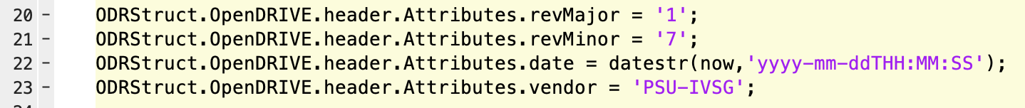
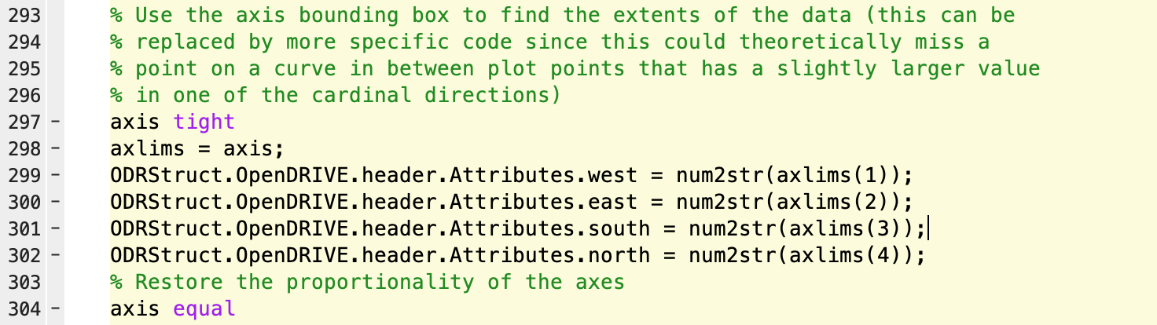
Filling the header

Slide 13
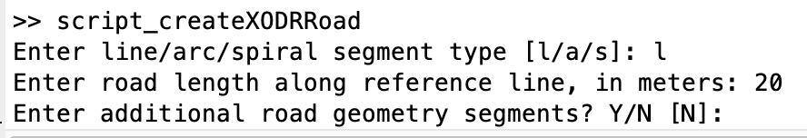
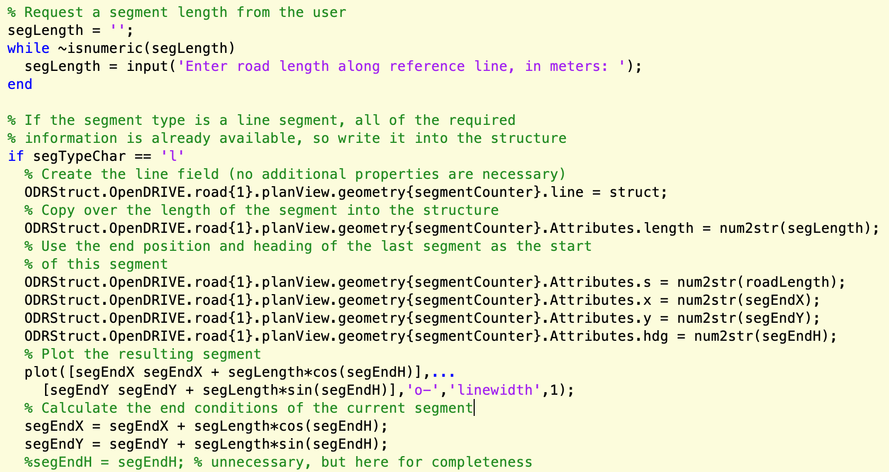
Describing the path (line)

Slide 14
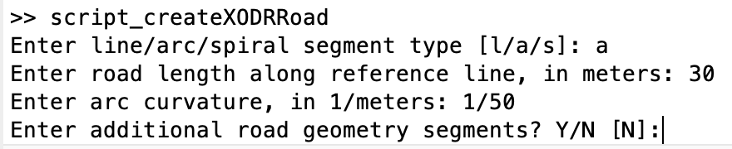
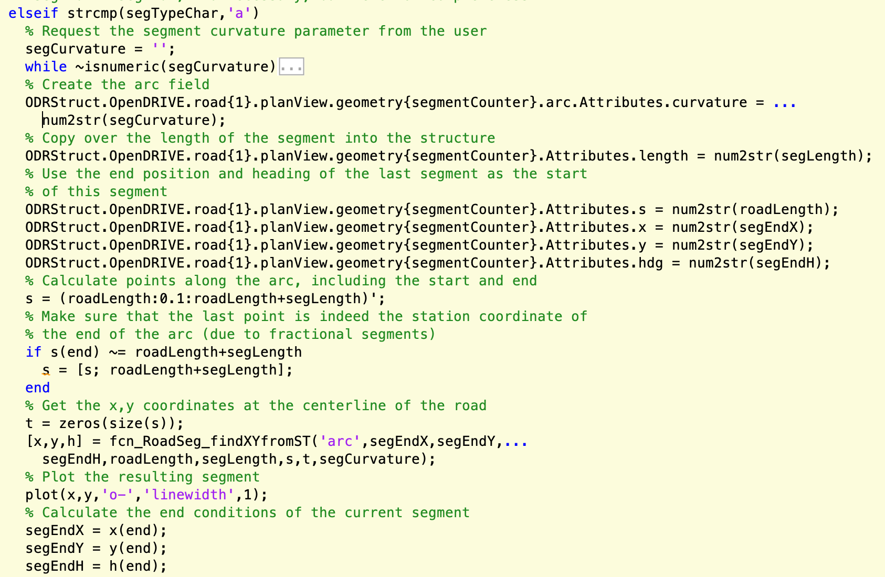
Describing the path (arc)

Slide 15
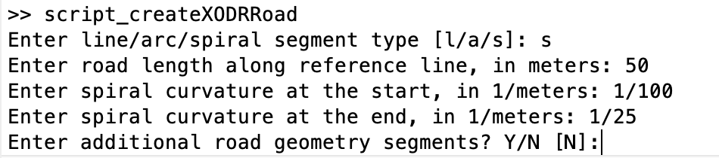
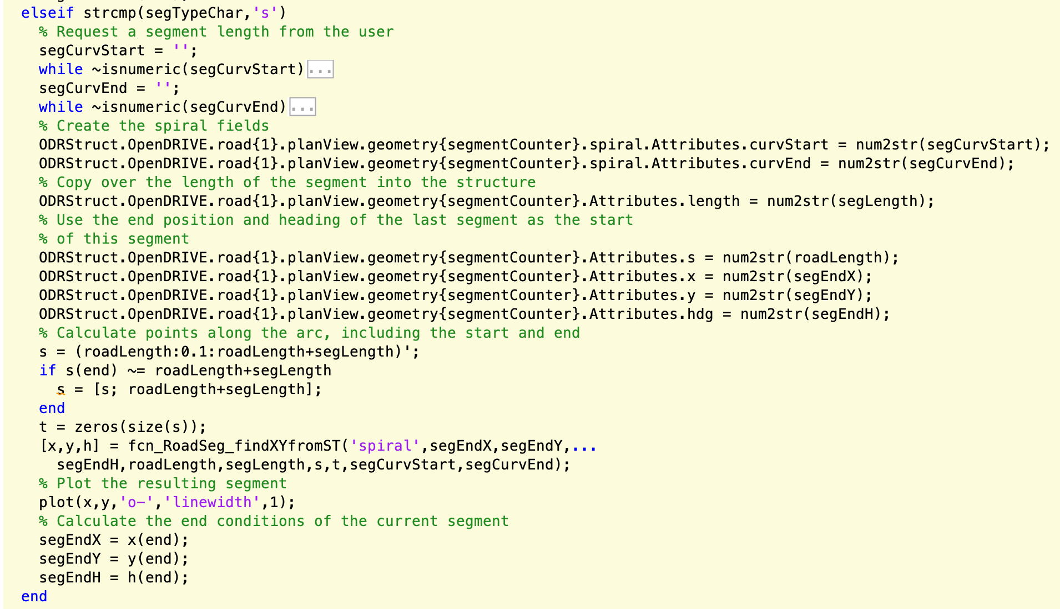
Describing the path (spiral)

Slide 16
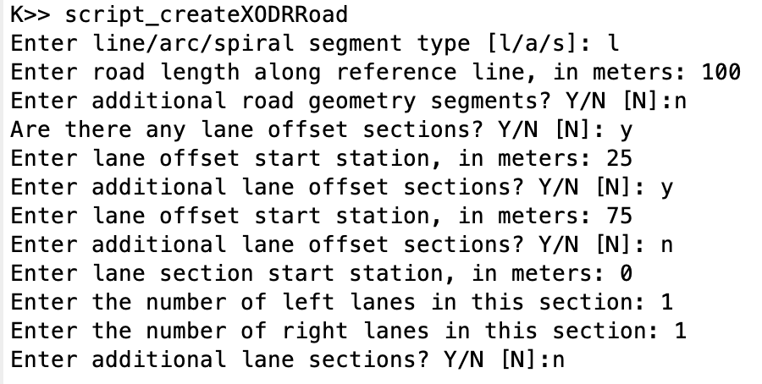
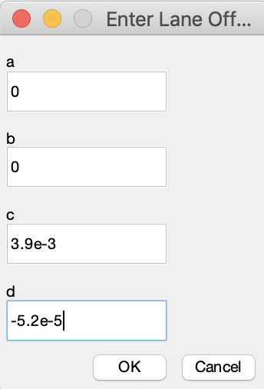
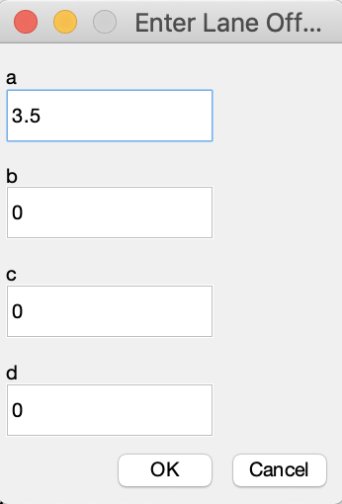
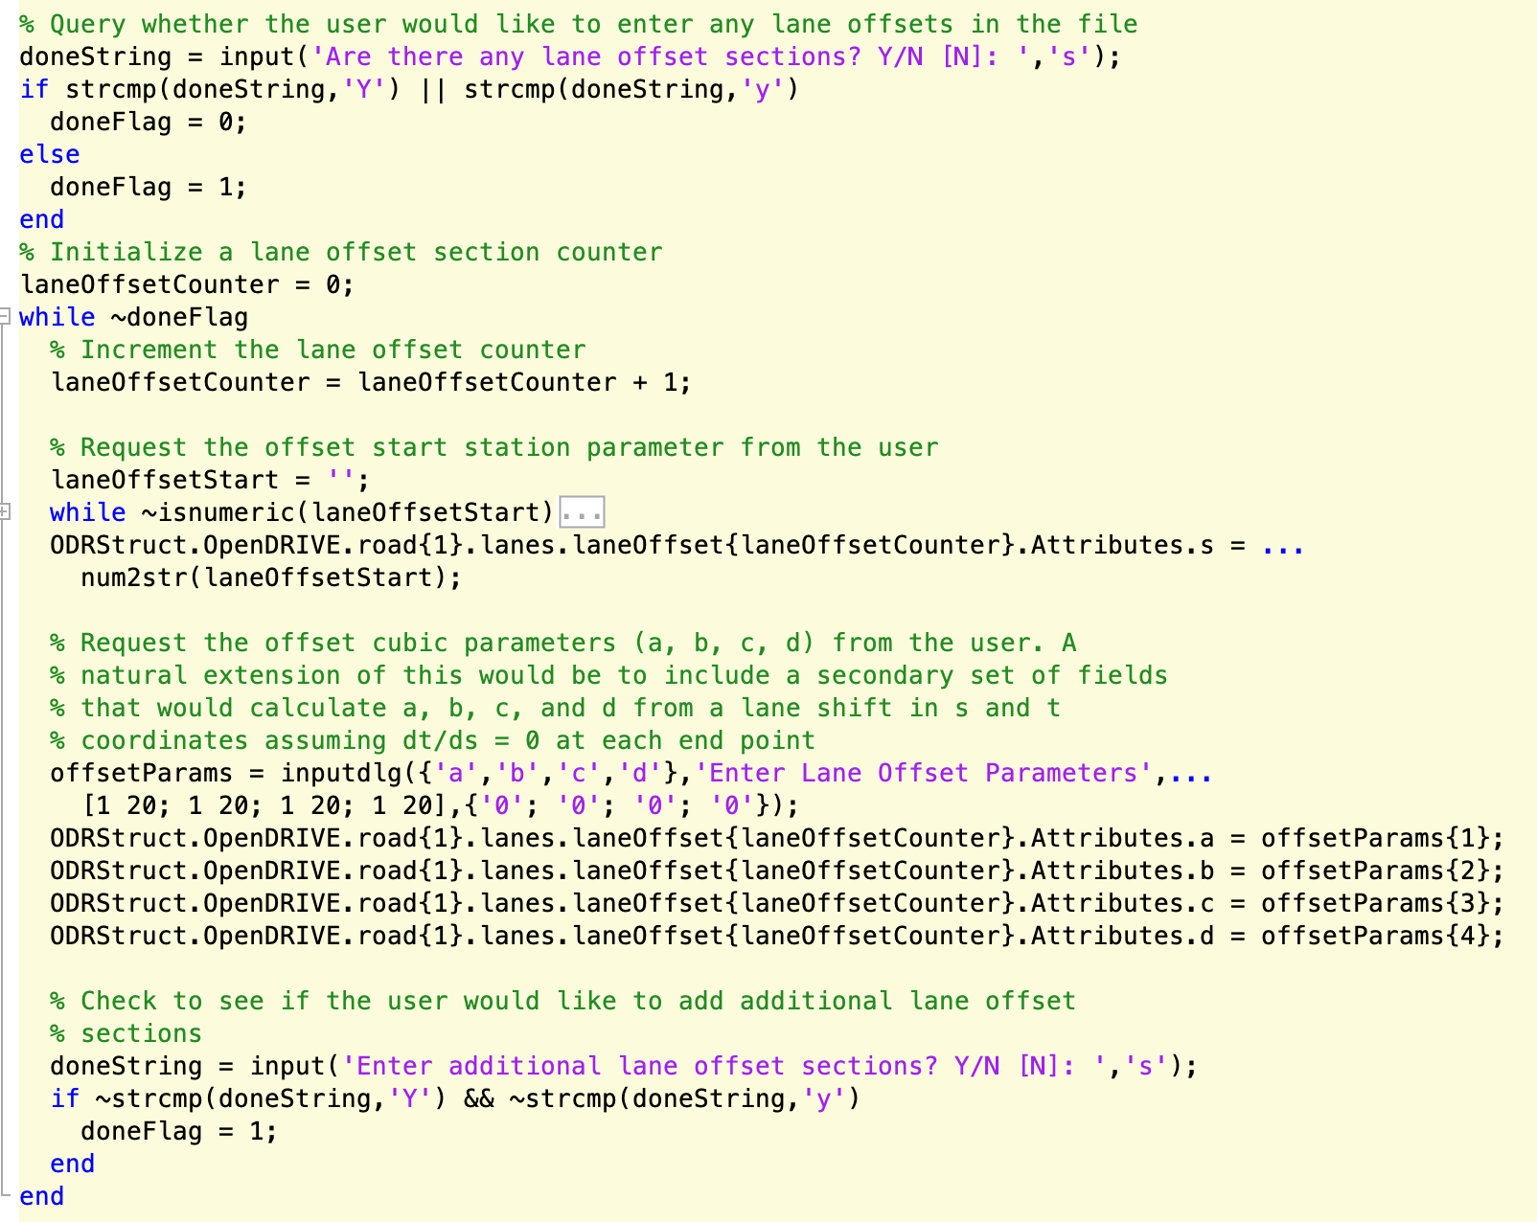
Setting lane offsets

Slide 17
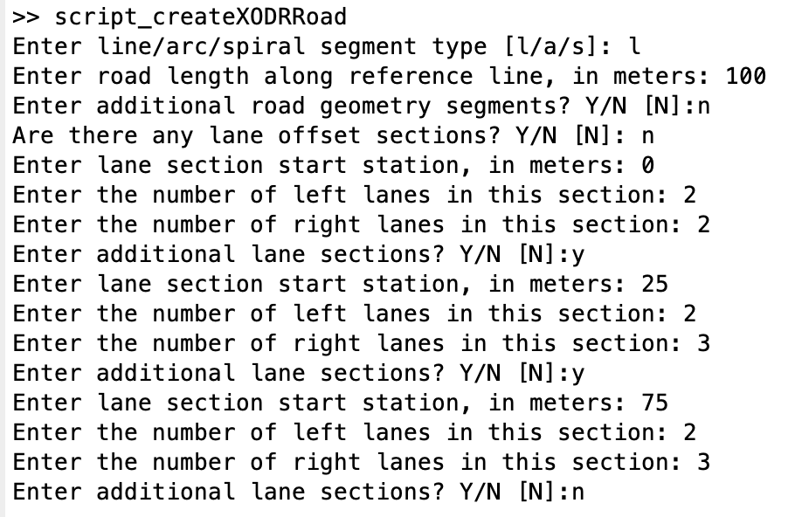
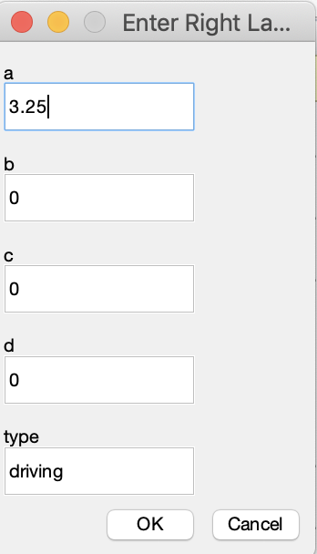
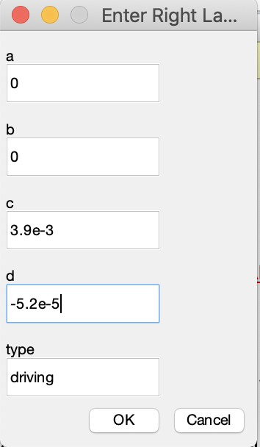
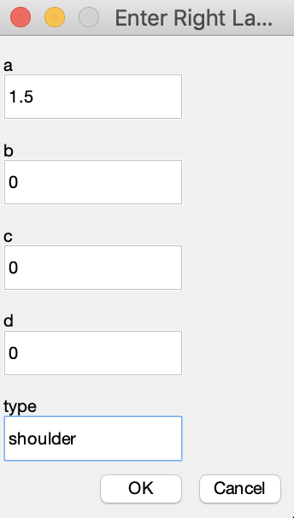
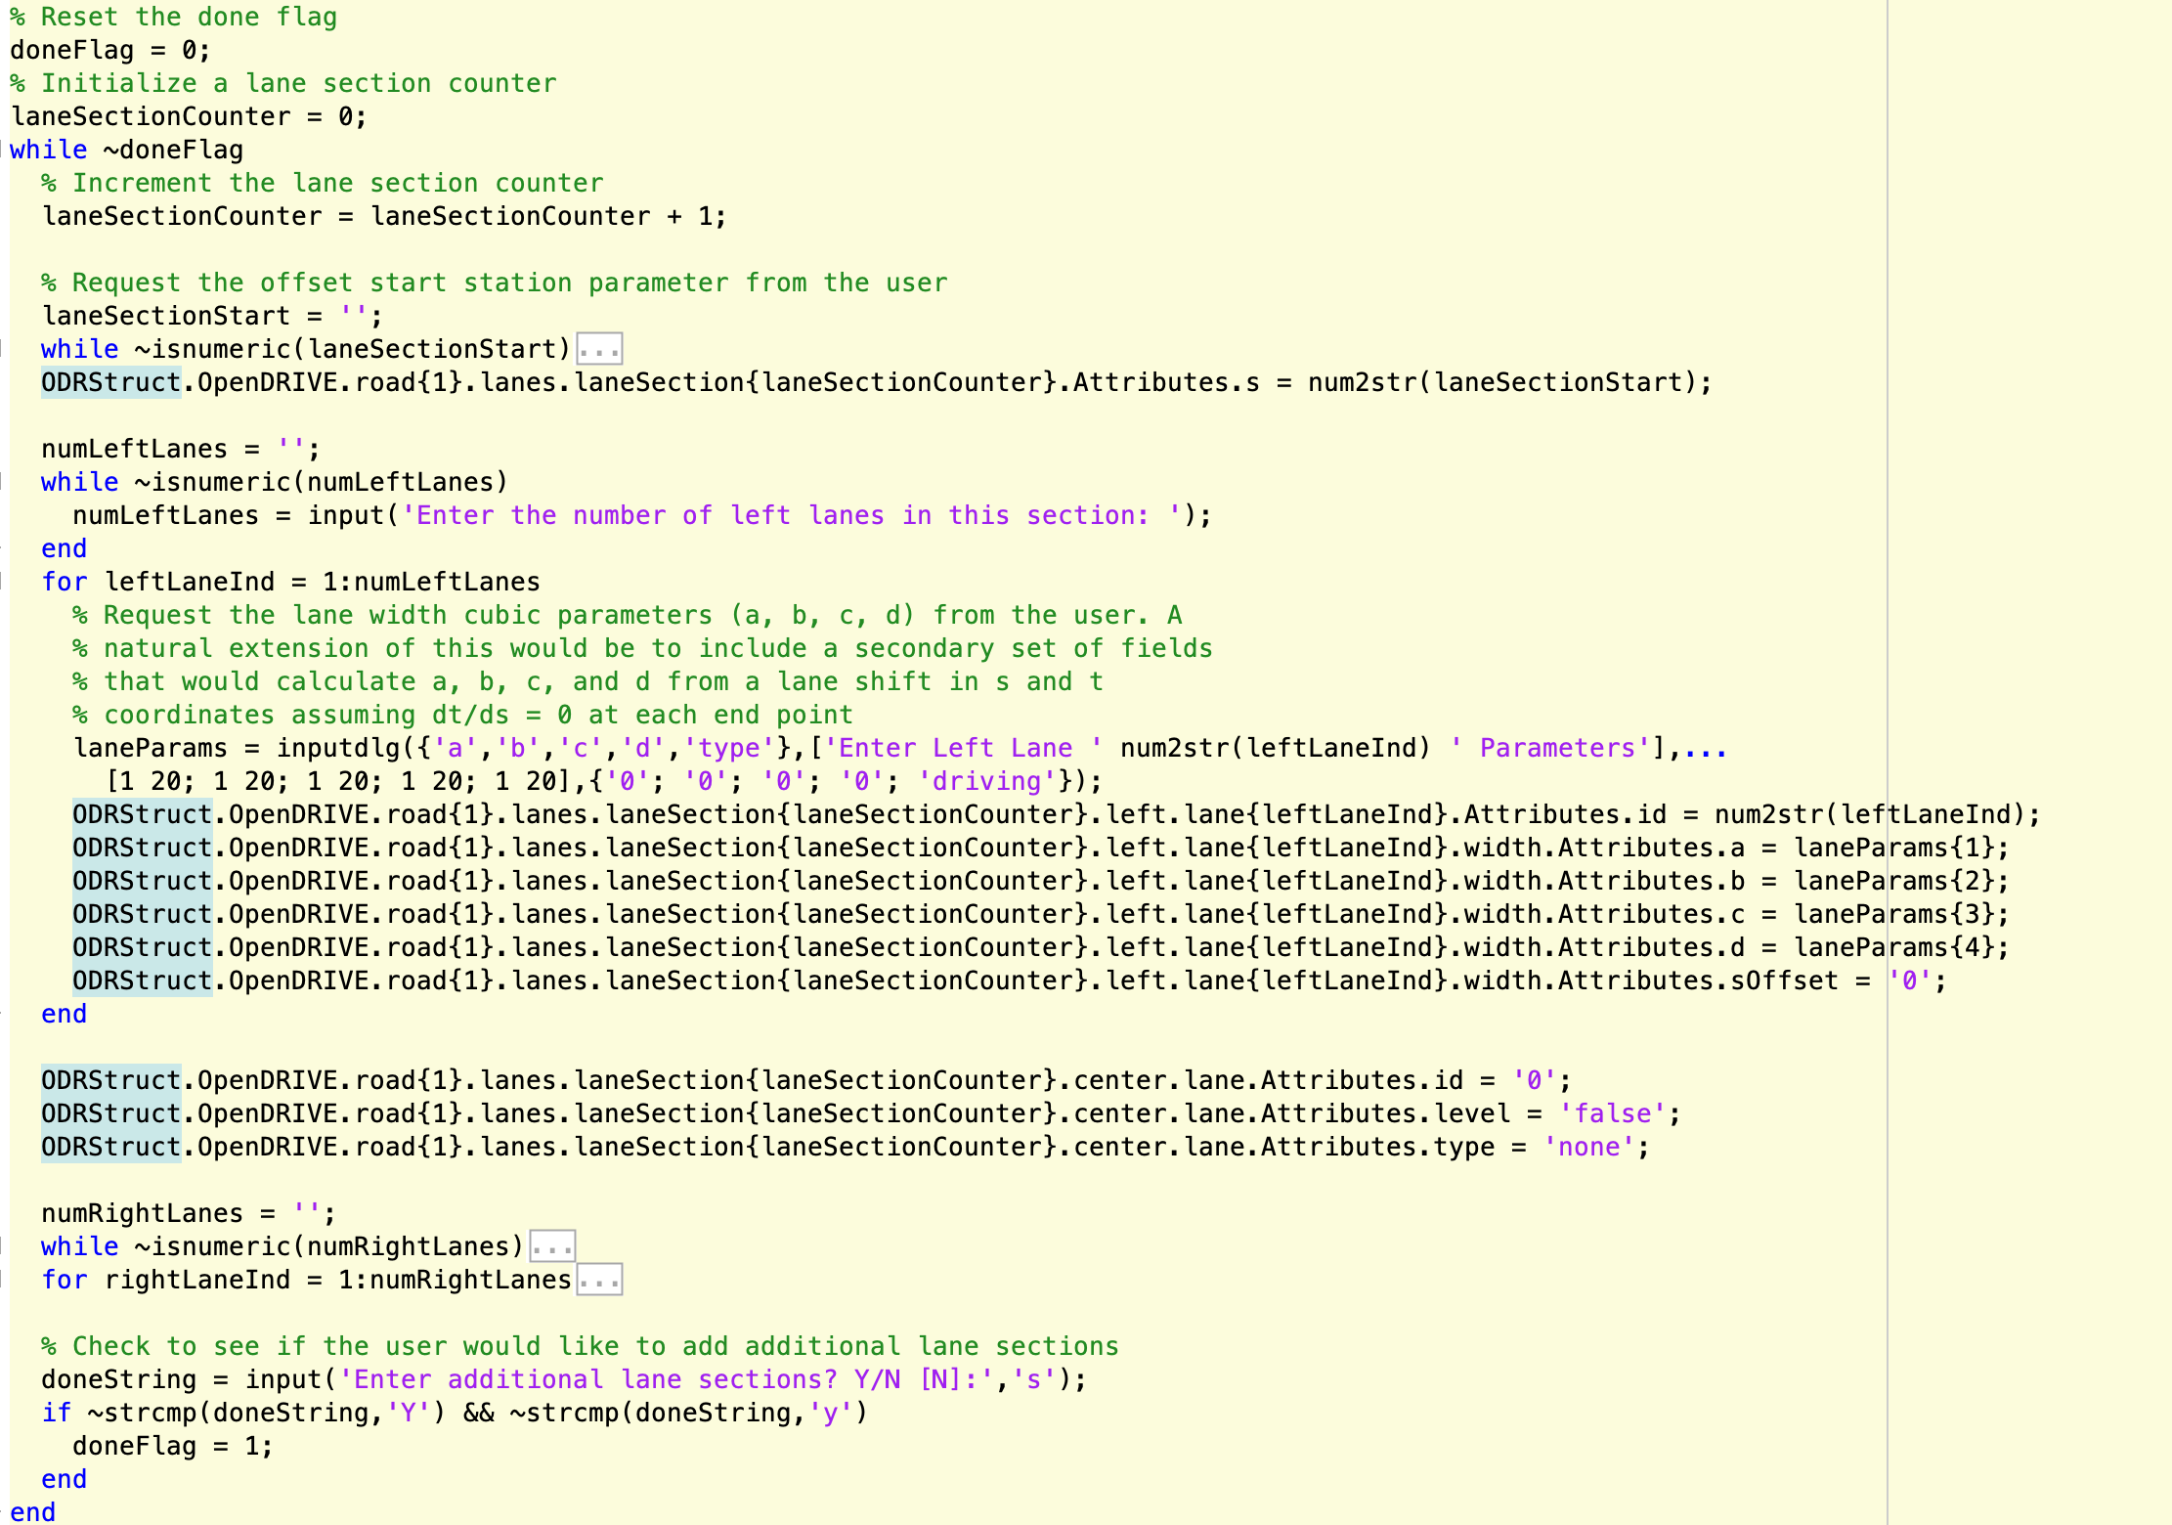
Setting lane sections

Slide 18
Lane Linkage
Need to determine which lanes “appear” or “vanish” as
the sections progress in order of increasing station. In the
example below, two right lanes in the first lane section become three right lanes in the second. The first lane
(closest to the center) continues, as does the third lane (the shoulder), so lane 2 in the second section is the “appearing” lane. This means is has no predecessor.
Similarly, lanes can disappear, in which case they simply
have no lane that refers to it as a predecessor. The MATLAB
code does not use successor elements, but they can be included for completeness. A table of the links for the example is provided below. These are entered into the
structure or XODR file manually.
None | None | None | None | None | None
-3 | None | -1 | 0 | 1 | 2
-3 | -2 | -1 | 0 | 1 | 2

Slide 19
Conversion of data into XODR Structures (Incomplete)
No top-level script or function yet exists for this purpose
script_RoadSeg_defineXODRStructManual provides a blueprint for how to create the XODR structure in MATLAB.
Some of the XODR elements will need to be defined manually, as in this script.
Other XODR elements will come from functions yet to be written.
Data-fitting code is needed that can convert paths (or traversals) into segments with uniform curvature properties for planView representation of the road
Line -> zero curvature from start to end station
Arc -> constant but non-zero curvature from start to end station (positive for left curves, negative for right curves)
Spiral -> linearly changing curvature from start to end station (positive for left curves, negative for right curves)
Other curves are possible, but not implemented
Other data fitting is needed to determine sectioning and cubic polynomial fits for road grade, lane offsets (could be zeroed by definition), and lane widths relative to center lane.

Slide 20
Key Functionalities for XODR → MATLAB
Loading an OpenDRIVE XODR file into a MATLAB XODR structure
Checking resulting MATLAB XODR struct for inconsistencies with OpenDRIVE standard
Converting objects from XODR structures into PSU patch format
Creation of point clouds (outlines) to represent objects in (E,N) space
Conversion of cornerRoad or cornerLocal definitions into (E,N) space
Conversion of (E,N) point clouds into PSU patch format for analysis/plotting
Converting road geometry information into PSU path traversals format
Creation of (E,N) point sequences to represent road centerlines in (E,N) space
Creation of (s,t) point sequences to represent continuous lane boundaries along the road path
Conversion of (s,t) point sequences into (E,N) space
Conversion of (E,N) point sequences into traversals
Plotting road/lane geometries and objects from XODR structures

Slide 21
Coordinate Conversion Functions (Complete)
fcn_RoadSeg_findXYfromSTandODRRoad – top-level conversion function, accepts vectors of (s,t) coordinates and a structure of one road element from the OpenDRIVE structure. Wrapper for fcn_RoadSeg_findXYfromSTandSegment.
fcn_RoadSeg_findXYfromSTandSegment – second-level conversion function, accepts vectors of (s,t) coordinates and a geometry element from the OpenDRIVE structure. Wrapper for fcn_RoadSeg_findXYfromST.
fcn_RoadSeg_findXYfromST – third-level conversion function, accepts vectors of (s,t) coordinates as well as all of the geometric parameters of a road segment in order to calculate the (X,Y) coordinates. Wrapper for fcn_RoadSeg_findXYfromXODRArc and fcn_RoadSeg_findXYfromXODRSpiral as well as handles calculations for lines internally.
fcn_RoadSeg_findXYfromXODRArc – conversion function that accepts a vector of station coordinates (no lateral offsets) and the parameters of an arc and returns the (X,Y) position of the points along the arc
fcn_RoadSeg_findXYfromXODRSpiral – conversion function that accepts a vector of station coordinates (no lateral offsets) and the parameters of an spiral and returns the (X,Y) position of the points along the spiral

Slide 22
Loading OpenDRIVE XODR files into MATLAB (Complete)
fcn_RoadSeg_convertXODRtoMATLABStruct – reads an OpenDRIVE XODR file and creates a MATLAB XODR structure suitable for use in analysis and plotting
Uses xml2struct_fex28518 to do the basic read of the XML file into a MATLAB structure, but leaves some inconsistencies in the structure, specifically when there are single elements in the structure where there can be multiple elements, depending on the road/lane geometries
The next step of the function converts singleton structure elements into single-element cell arrays for consistency of elements for which there can be multiple elements
The last step of the function handles expanding repeated objects into individual elements in the cell array.
The function returns a single structure representing the entire road system defined in the OpenDRIVE XODR file.

Slide 23
Loading OpenDRIVE objects into MATLAB (Complete)
fcn_RoadSeg_convertXODRObjectsToPatchObjects – pulls objects out of the XODR MATLAB structure and inserts them into a patch array
The first step of the function creates a segment table that identifies the types and start/end stations of each geometry element for locating objects in (E,N) coordinates relative to the road.
The biggest portion of the function iterates through each of the objects, filling out the parameters
Color is set to blaze orange for all
An ID is created for each object
The geometry of the object is represented with a point cloud created to represent the outline. If “corners” (there may be many) of the object are provided, these are converted to XY points. If only a bounding geometry is provided, points are created along the bounds to form an outline of the object.
(All geometries of the objects are converted to (E,N) coordinates by calling fcn_RoadSeg_findXYfromSTandSegment after cross referencing the (s,t) coordinates of the object with the segment table created at the start.)

Slide 24
Converting OpenDRIVE roads into MATLAB (Complete)
Since roads have multiple aspects of their geometry (reference line, lane offsets, lane widths, etc.) there is no individual function to convert an entire road into MATLAB. Instead, a series of functions pull out the individual geometries.
fcn_RoadSeg_findXYfromSTandODRRoad – converts the road geometry defined in (s,t) coordinates and segments into (E,N) coordinates. By providing a vector of station coordinates ranging from 0 to the end of the road and a t-coordinate vector of all zeros, this function returns the reference line of the road.
fcn_RoadSeg_extractLaneGeometry – extracts the lane borders from the XODR structure, outputting matrices of (s,t) coordinates for each of the left, center, and right lanes. The function fcn_RoadSeg_findXYfromSTandODRRoad can then be used to convert again to (E,N) coordinates.
fcn_Path_convertPathToTraversalStructure – not part of the XODR/MATLAB library, but can be used to convert reference lines and lane borders into PSU path library traversal structures

Slide 25
Plotting OpenDRIVE roads in MATLAB (Complete)
fcn_RoadSeg_plotRealisticRoad – uses the XODR MATLAB structure to plot a quasi-realistic view of the road geometry
Accepts a complete XODR MATLAB structure and creates the plot, returning a handle to the plot figure window
Assumes:
the center lane should be marked with double yellow
the extreme outer lane is the shoulder and the bounding line is the outer road (shoulder) edge
the boundary of the lane just to the inside of the shoulder defines the driving boundary of the road and should be marked with a solid white line
all lanes between the driving boundary and the center lane should be marked with dashed white lines
Uses fcn_RoadSeg_extractLaneGeometry to pull out the lane boundaries in (s,t) coordinates
Uses fcn_RoadSeg_findXYfromSTandODRRoad to convert the lane boundaries into (E,N) coordinates
The remainder of the function code creates the individual plotting elements.
Note: Before plotting any lane lines, the road surface is plotted with a MATLAB patch using the identified left and right extents of the road found from the extremes of the lane boundaries. This requires the lanes to be extracted from each of the road elements in sequence. The lane markings are then extracted a second time and plotted over the top of all of the road surface elements. This approach is not computationally efficient, but solves the problem of having road surface plotted on top of previously plotted lane markings and is simpler than keeping all of the lane boundaries in memory for plotting lane markers after previously reading them in to plot the road surface.

Slide 26
Project management notes

Slide 27
Next steps
There are numerous aspects of OpenDRIVE that are not currently included in the code. Some of these should probably be implemented:
Cubic polynomial road geometry (deprecated) or parametric polynomial geometry
Road markings -> reading from a file and plotting (harder) as well as writing (easy in manual construction)
Lane border elements (different than widths)
Road linkages and junctions
Plotting center lines with specified road markings will help with better realism in junctions
Function fcn_RoadSeg_XODRSegmentChecks is a bit limited. There are numerous additional checks that can (should?) be added or modified:
Lane linkage checks (predecessor tags present for all but first lane section)
Lane offset continuity check
Lane width continuity check
Degenerate object vertices (cornerLocal or cornerRoad) check
Ability to include lane widths in the bounding box check (this is technically a bug)
Testing, testing, testing!
No formalized testing of this code has been done.

