Slide 1
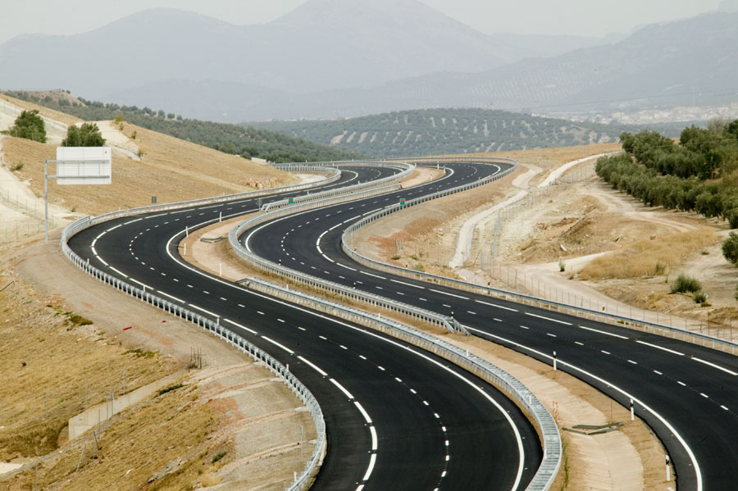
OpenDRIVE XODR Maps in MATLAB
Prof. Craig Beal
Bucknell University
Started: 3.25.22
Updated through: 5.13.22

Slide 2
OpenDRIVE XODR file basics
As applicable for import into MATLAB for plotting/analysis

Slide 3
OpenDRIVE XODR
Roads are defined in a hierarchical XML format
OpenDRIVE
Header → bounding box defined by west, east, south, north limit values
Roads (multiple)
Planview
Geometry (multiple)
Line → start point in E,N coords, start point in s coord, heading, length
Arc → start point in E,N coords, start point in s coord, initial heading, length, curvature
Spiral → start point in E,N coords, start point in s coord, initial heading, length, initial curvature, ending curvature
Parametric polynomial
Lanes
Lane Segment(multiple) -> start point in s coord
Left, Center, Right
Lane (multiple)
Width (multiple)-> cubic polynomial form defining profile in s,t coordinates
RoadMark ->
Objects
Object (multiple)
Location of object origin in S,T coords
Bounding box (length, width or radius of circle in u,v coords)
Outline
Corners in S,T coords or local u,v coords
Repeat element to repeat objects with linearly varying parameters
OpenDRIVE 2.0 will break almost everything that depends on these definitions!!!

Slide 4
OpenDRIVE -> MATLAB
Importing OpenDRIVE data to MATLAB is fairly straightforward
There exist several xml2struct tools that can convert the XML into a MATLAB structure that preserves the hierarchy of the OpenDRIVE road structure.
Interpretation of the XML is so-so:
Fields are properly labeled according to the associated XML element
Multiple fields (e.g. roads, geometry elements of a road, objects) are listed in structure arrays, which make sense
All data values at the lowest level of the “tree” are represented in strings and must be converted with str2num() or str2double() for calculations in MATLAB
Every element has a separate “Attributes” structure rather than including the attributes in the element itself, leading to “deeper” addressing of the actual data

Slide 5
Good parts of OpenDRIVE structure in MATLAB
Cell arrays are used anywhere multiple elements exist at a level
Easy to iterate over the cell arrays (though requires loops)
Easy to compute (X,Y) coords from (S,T) representation
Each segment has initial pose (x0,y0), h0 and s0 plus the geometry descriptors and can thus be loaded/plotted separately from the others
Objects can be “indexed” by station to determine which segment to compute the geometry from
The initial pose of the segment allows for “local” computations using the segment initial values rather than referencing the road start

Slide 6
Bad parts of OpenDRIVE structure in MATLAB
The xml2struct function produces inconsistent structure hierarchies when layers contain only a single element
Cell arrays of structures for multiples, structure for singles
Addressed by fcn_RoadSeg_convertXODRtoMATLABStruct()
Reliant on proper XODR formatting to ensure segment ordering is correct (in order of increasing station)
Addressed by fcn_RoadSeg_XODRSegmentChecks()
Malformed segments or inconsistencies in XODR will transfer through to the MATLAB structure
May need to have a MATLAB routine to check that (xF,yF) as well as hF at sF matches with (x0,y0) as well as h0 at s0 of the next segment
Addressed by fcn_RoadSeg_XODRSegmentChecks()
Need a separate lookup table to correlate objects with the road geometry segment they are located with respect to
Lanes are defined section-by-section and can “shift” identifier from one section to the next if a lane appears (begins with zero width and widens) or disappears (narrows to zero width) at the lane section boundary
Objects do not have any built-in attributes for appearance (e.g. color)
Can be stored in <userData> within the object elements

Slide 7
MATLAB Tools for OpenDRIVE Parsing/Plotting

Slide 8
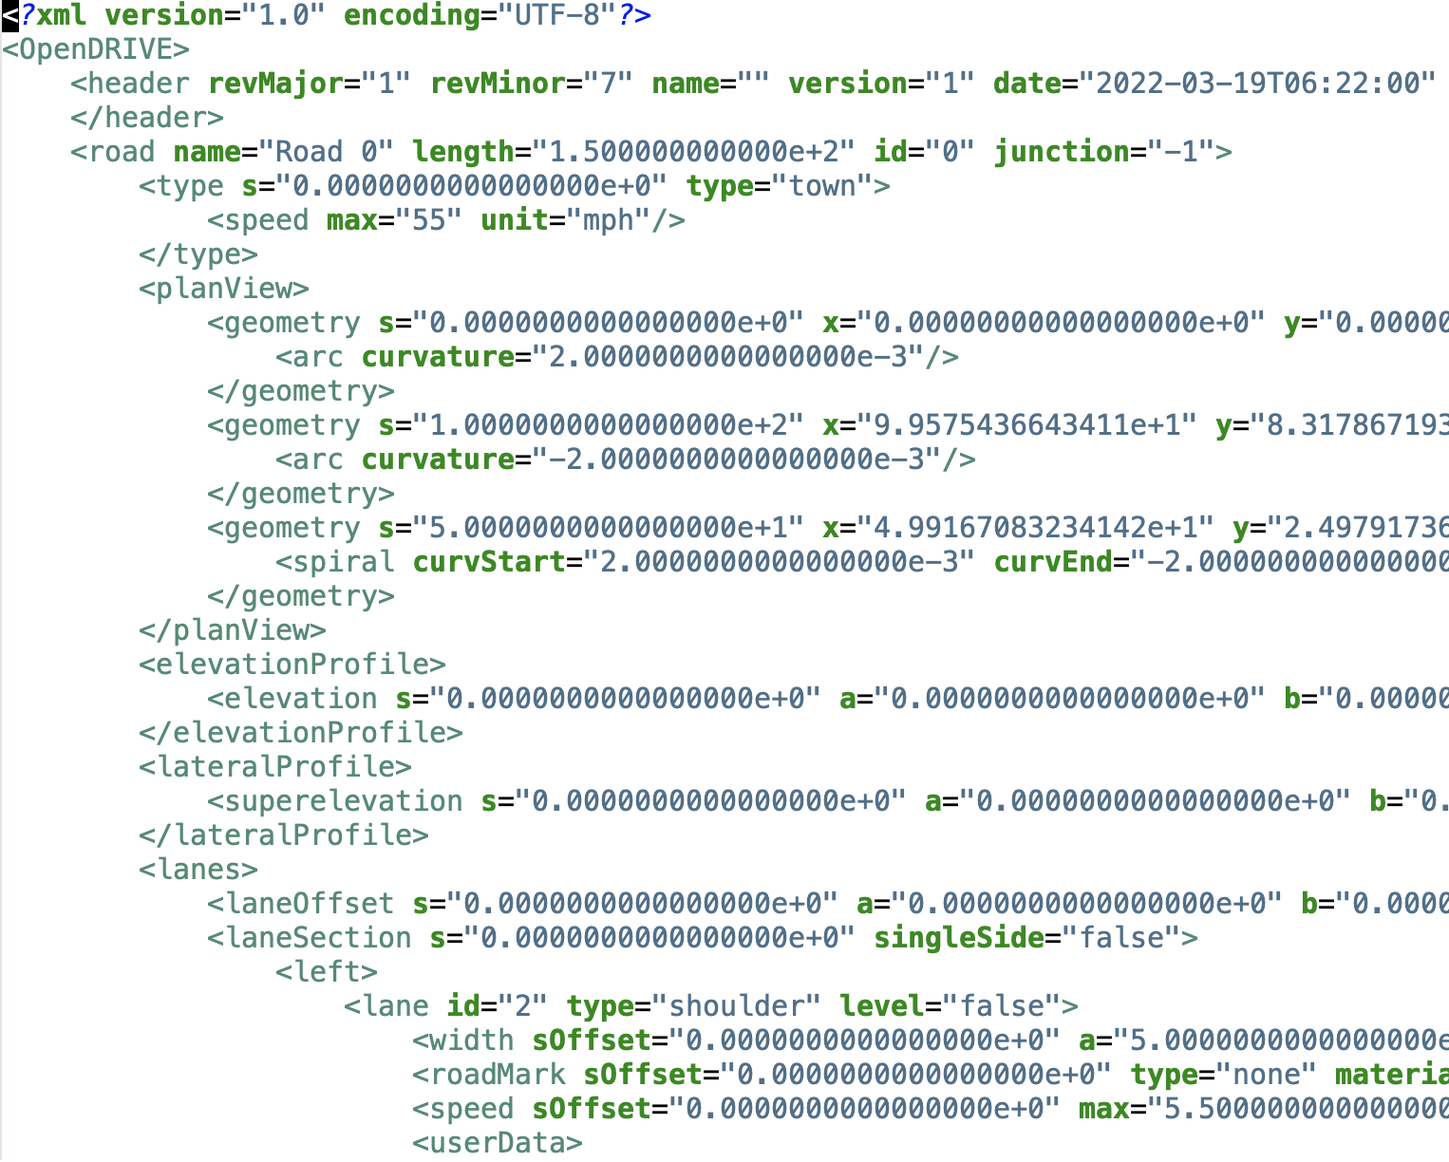
fcn_RoadSeg_convertXODRtoMATLABStruct()
Input: OpenDRIVE *.xodr file
Output: MATLAB structure, with nested hierarchical elements consistent with the OpenDRIVE specification

Slide 9
Key Functionalities for MATLAB -> XODR
Construction of XODR files
Scripted construction given a particular MATLAB struct
Interactive construction of XODR file
Dependencies:
Create road segment from given start station and parameters
Calculate (e,n,h) from segment and start
Conversion of recorded data to XODR files
Fitting of XODR parameterized segments from data
Conversion of XODR segments into XODR MATLAB structure
Check for proper XODR construction (consistency checks)
Writing to XODR file

Slide 10
Key Functionalities for XODR -> MATLAB
Parsing road centerlines from XODR files
Parsing lane boundaries from XODR files
Parsing objects from XODR files
How to represent signs?
UserData field option for storing “other” info
Color, smart/no, sign message
Plotting road/lane geometries and objects from XODR files

Slide 11
Key Functionalities
Interactive construction of XODR files
Status: geometry works, missing road/lane linkage and objects
Conversion of recorded data to XODR files
Status: not started, most of the tools needed in the chain exist
Parsing road centerlines from XODR files
Status: complete
Parsing lane boundaries from XODR files
Status: complete, may need upgrades for better handling of lane bounds
Parsing objects from XODR files
Status: complete
Plotting road/lane geometries and objects from XODR files
Status: mostly complete, does not handle junctions or non-driving lanes well

Slide 12
Construction of XODR files

Slide 13
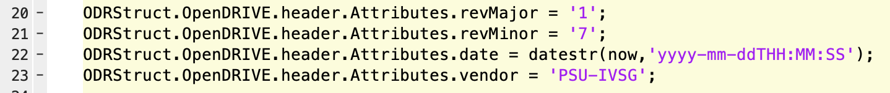
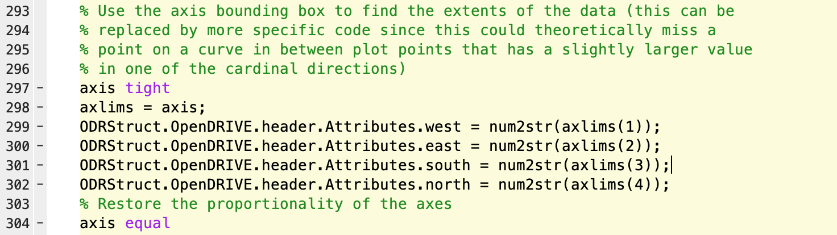
Filling the header

Slide 14
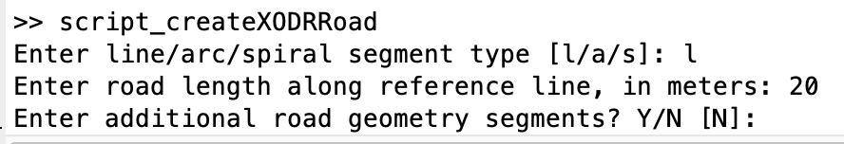
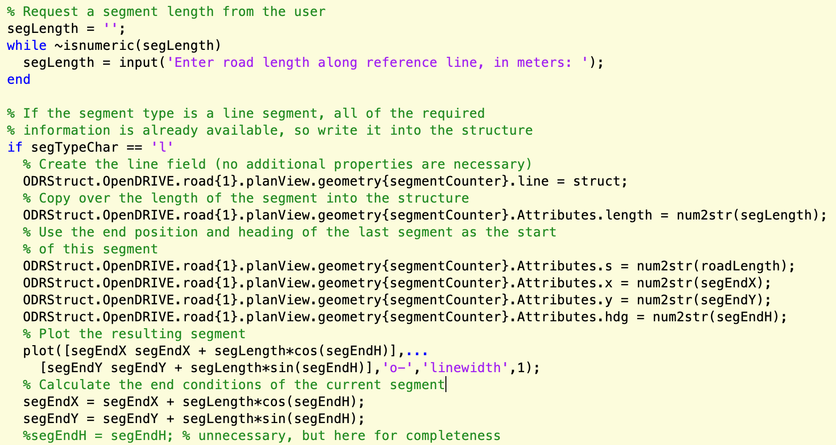
Describing the path (line)

Slide 15
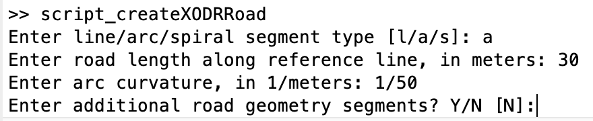
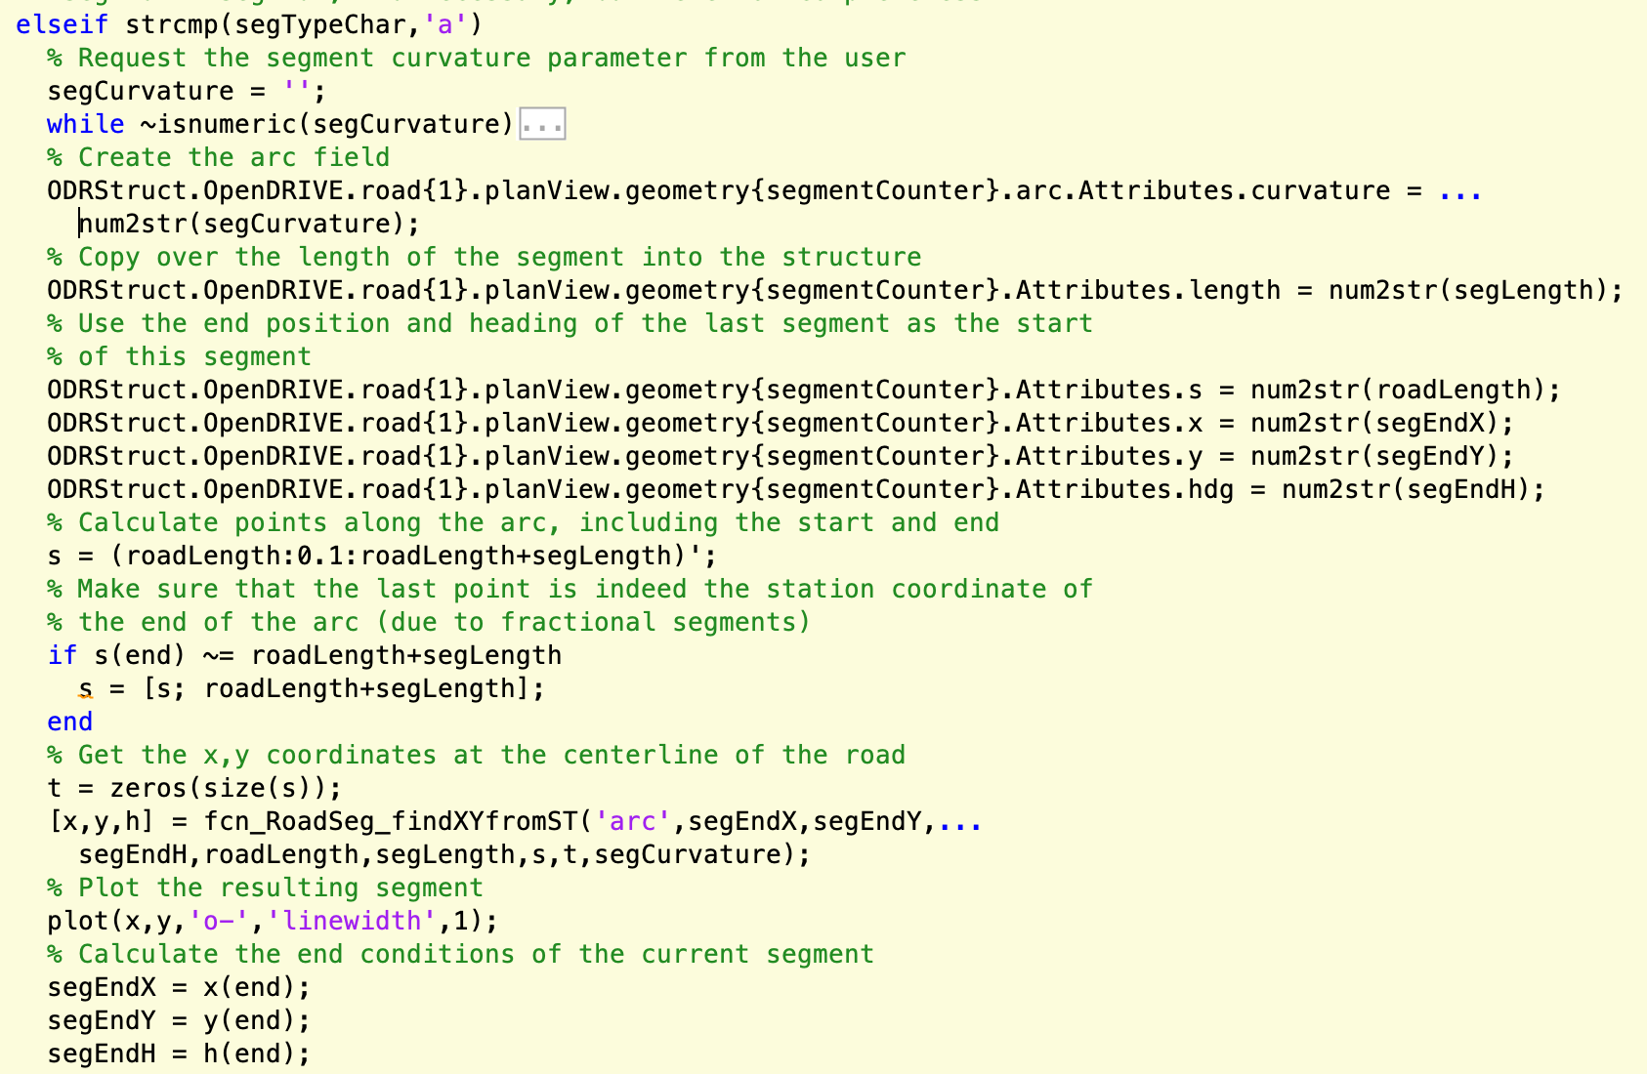
Describing the path (arc)

Slide 16
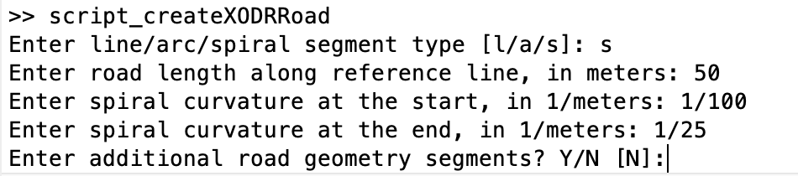
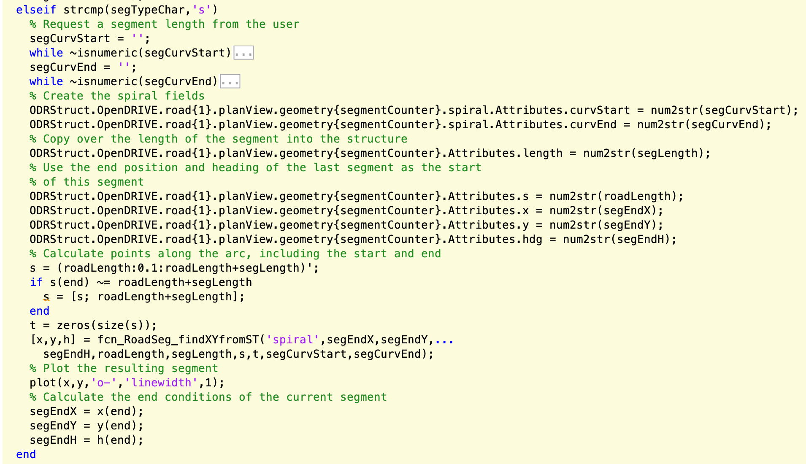
Describing the path (spiral)

Slide 17
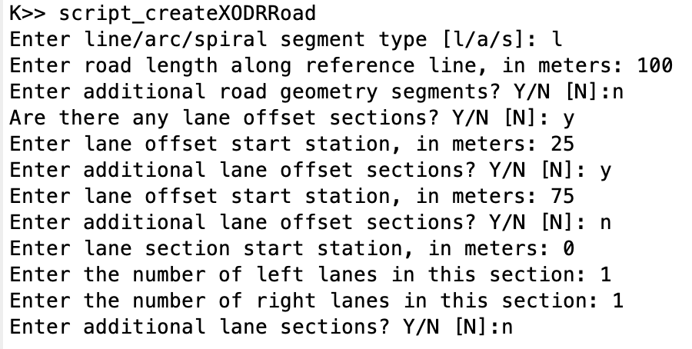
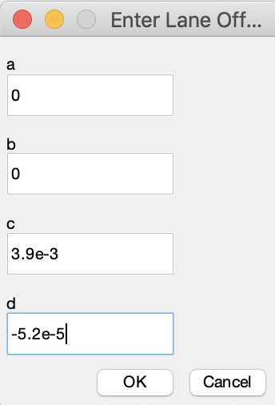
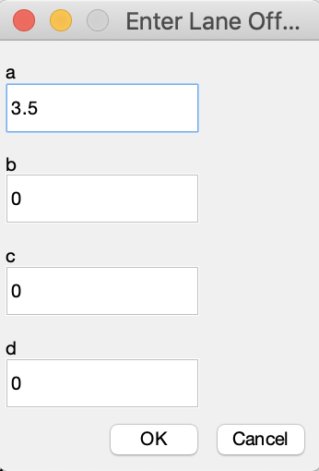
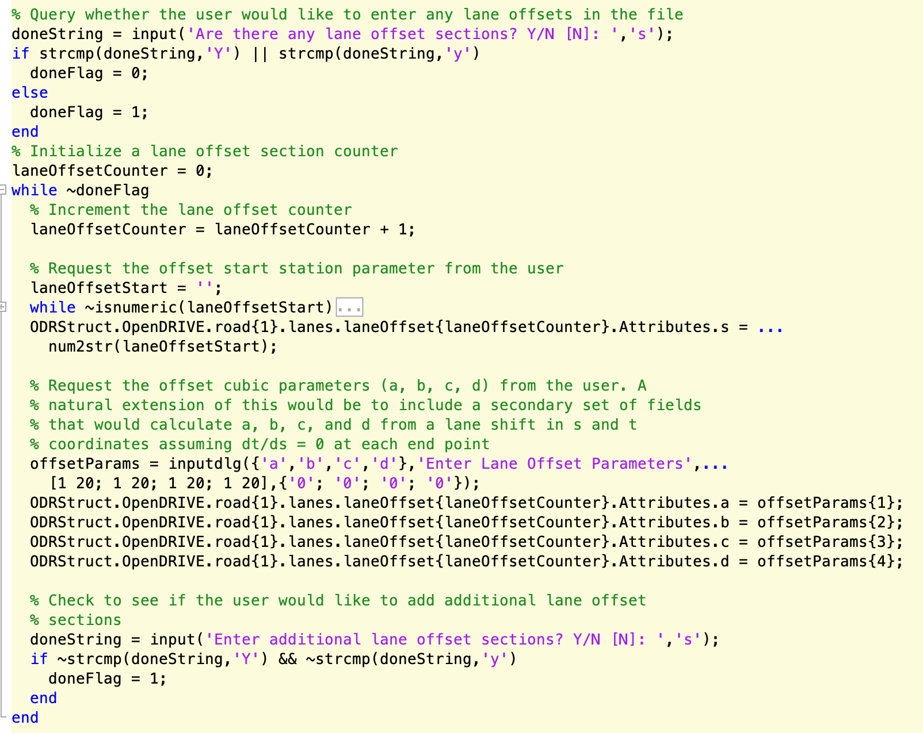
Setting lane offsets

Slide 18
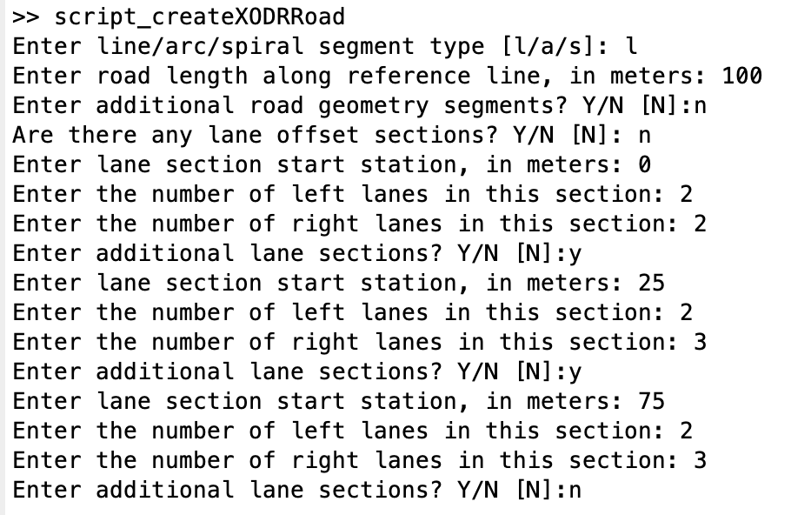
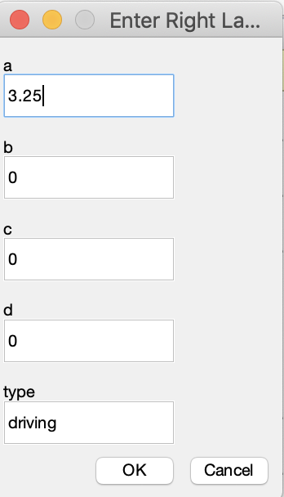
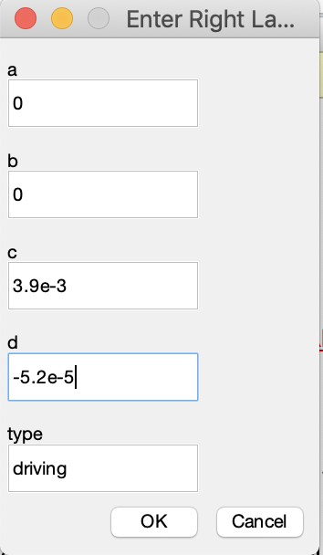
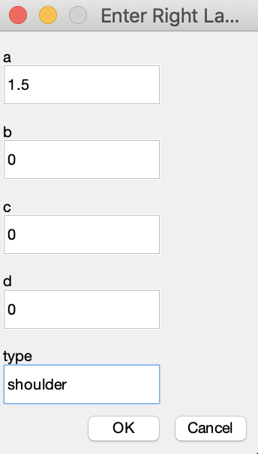
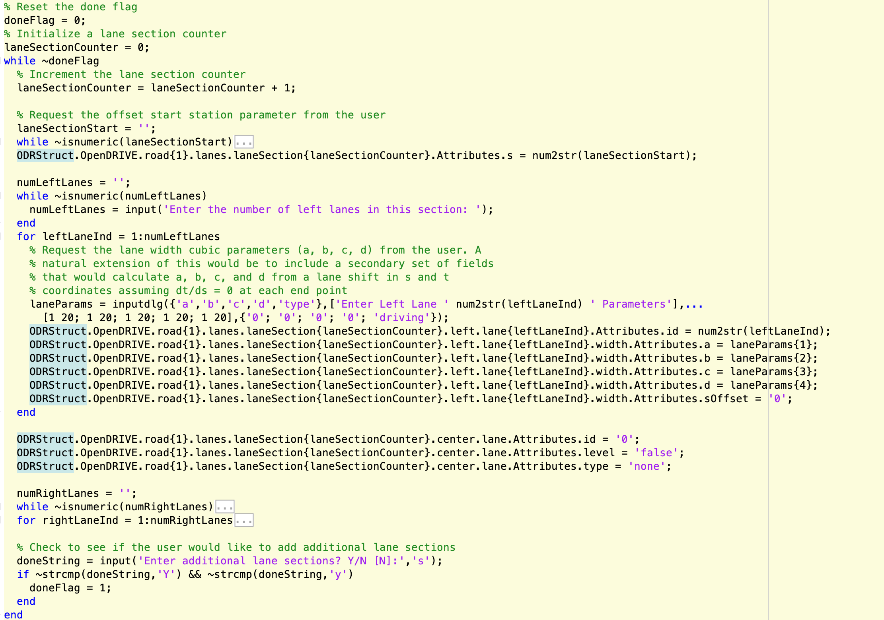
Setting lane sections

Slide 19
Lane Linkage
Need to determine which lanes “appear” or “vanish” as
the sections progress in order of increasing station. In the
example below, two right lanes in the first lane section become three right lanes in the second. The first lane
(closest to the center) continues, as does the third lane (the shoulder), so lane 2 in the second section is the “appearing” lane. This means is has no predecessor.
Similarly, lanes can disappear, in which case they simply
have no lane that refers to it as a predecessor. The MATLAB
code does not use successor elements, but they can be included for completeness. A table of the links for the example is provided below. These are entered into the
structure or XODR file manually.
None | None | None | None | None | None
-3 | None | -1 | 0 | 1 | 2
-3 | -2 | -1 | 0 | 1 | 2

Slide 20
Next steps
There are numerous aspects of OpenDRIVE that are not currently included in the code. Some of these should probably be implemented:
Cubic polynomial road geometry
Road markings -> reading from a file and plotting (harder) as well as writing (easy in manual construction)
Lane borders
Function fcn_RoadSeg_XODRSegmentChecks is a bit limited. There are numerous additional checks that can (should?) be added or modified:
Lane linkage checks (predecessor tags present for all but first lane section)
Lane offset continuity check
Lane width continuity check
Degenerate object vertices (cornerLocal or cornerRoad) check
Ability to include lane widths in the bounding box check (this is technically a bug)

