Slide 1
Differences between xodr file
Phakphum Artkaew

Slide 2
Comparing xodr exported from MATLAB to OpenDrive documentation and exported from RoadRunner
We compare OpenDrive version 1.6 which is the one that matches RR.
Official documentation from OpenDrive can be found here.

Slide 3
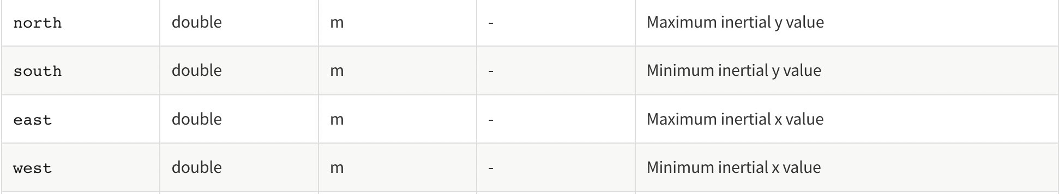
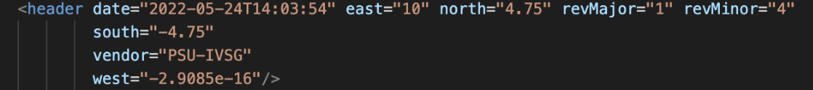
Header tag is in format of <header …/> but the preferred format is in <header …..> </header> (fixed)
North south east west should be in double type i.e. using decimal places (fixed)

Slide 4
<header revMajor="1" revMinor="4" name="" version="1" date="2022-05-24T13:50:32" north="2.4000000000000000e+1"
south="-2.4000000000000000e+1" east="3.0000000000000000e+1" west="-2.0000000000000000e+1" vendor="MathWorks">
<userData>
<vectorScene program="RoadRunner" version="R2022a Update 1 (1.4.1.c40ee10fc8)"/>
</userData>
</header>
<header date="2022-05-24T14:03:54" east="10" north="4.75" revMajor="1" revMinor="4"
south="-4.75"
vendor="PSU-IVSG"
west="-2.9085e-16"/>
Header tag is different format. <header … /> and <header …> </header> (fixed)
Roadrunner version has name element, userData tag which contains vectorScene (added)
The order of elements is different. The RR xodr is revMajor, revMinor, name, version, date, north, south, east, west, and vendor.
Orange = matlab xodr
Blue = roadrunner xodr

Slide 5
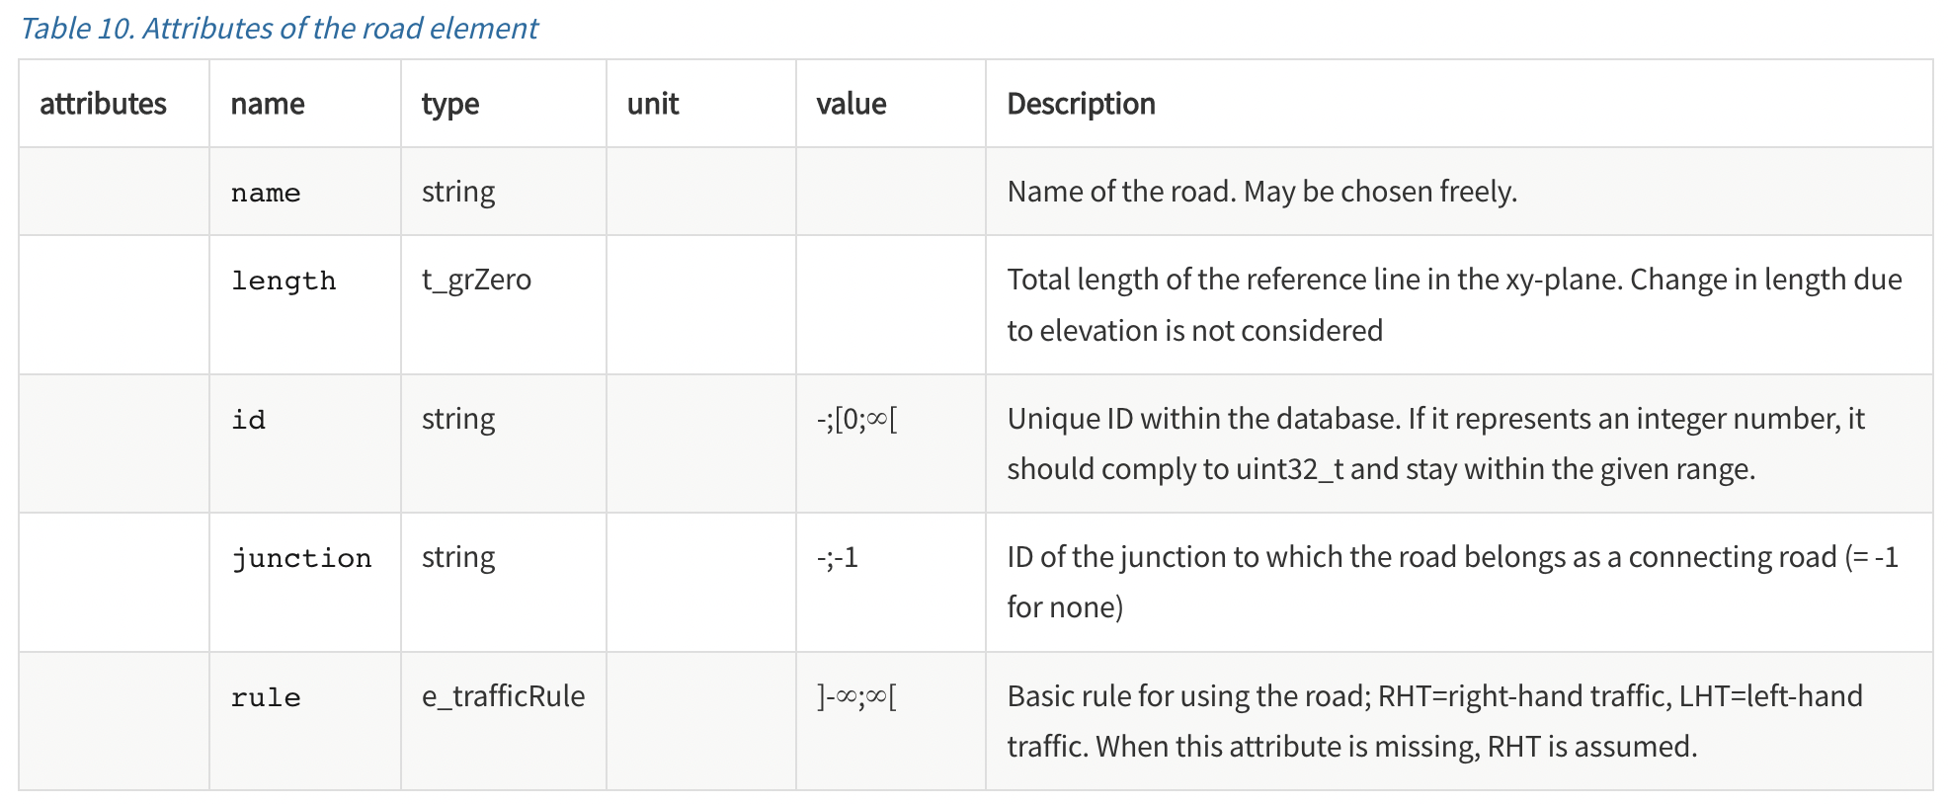
In road tag, there is no s elements. (fixed)

Slide 6
There is no s elements in roadrunner version (fixed)
MATLAB version has length elements in integer, but roadrunner version has it in double (fixed)
Id in matlab is 1, but in roadrunner is 0 (fixed)
Roadrunner has junction element while matlab version doesn’t have it (fixed)
Left: MATLAB xodr
Right: RoadRunner xodr

Slide 7
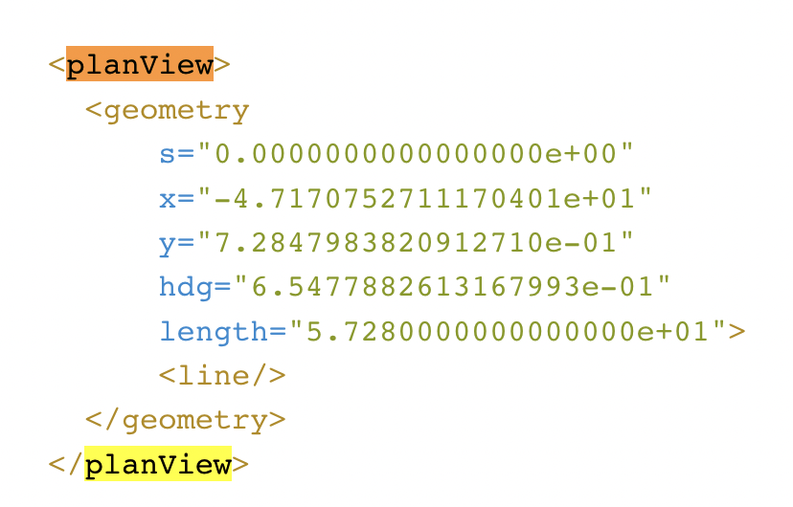
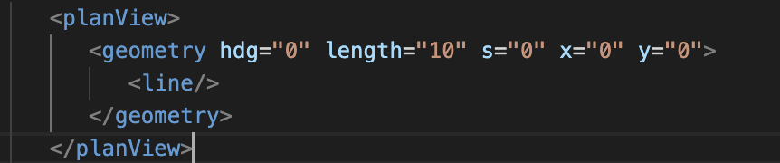
Left: format from documentation
Right: MATLAB xodr
- The order in geometry tag should be s, x, y, hdg, and length.

Slide 8
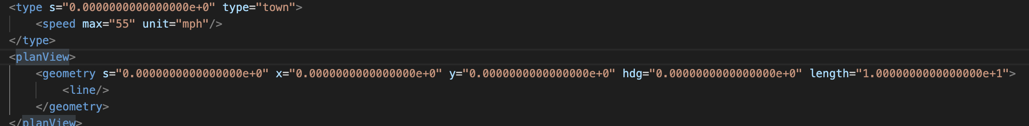
Left: MATLAB xodr
Right: Roadrunner xodr
Roadrunner xodr has type tag before geometry tag. (fixed)
The order of geometry elements in roadrunner go as follow s, x, y, hdg, length and the numbers are in decimal places (fixed)

Slide 9
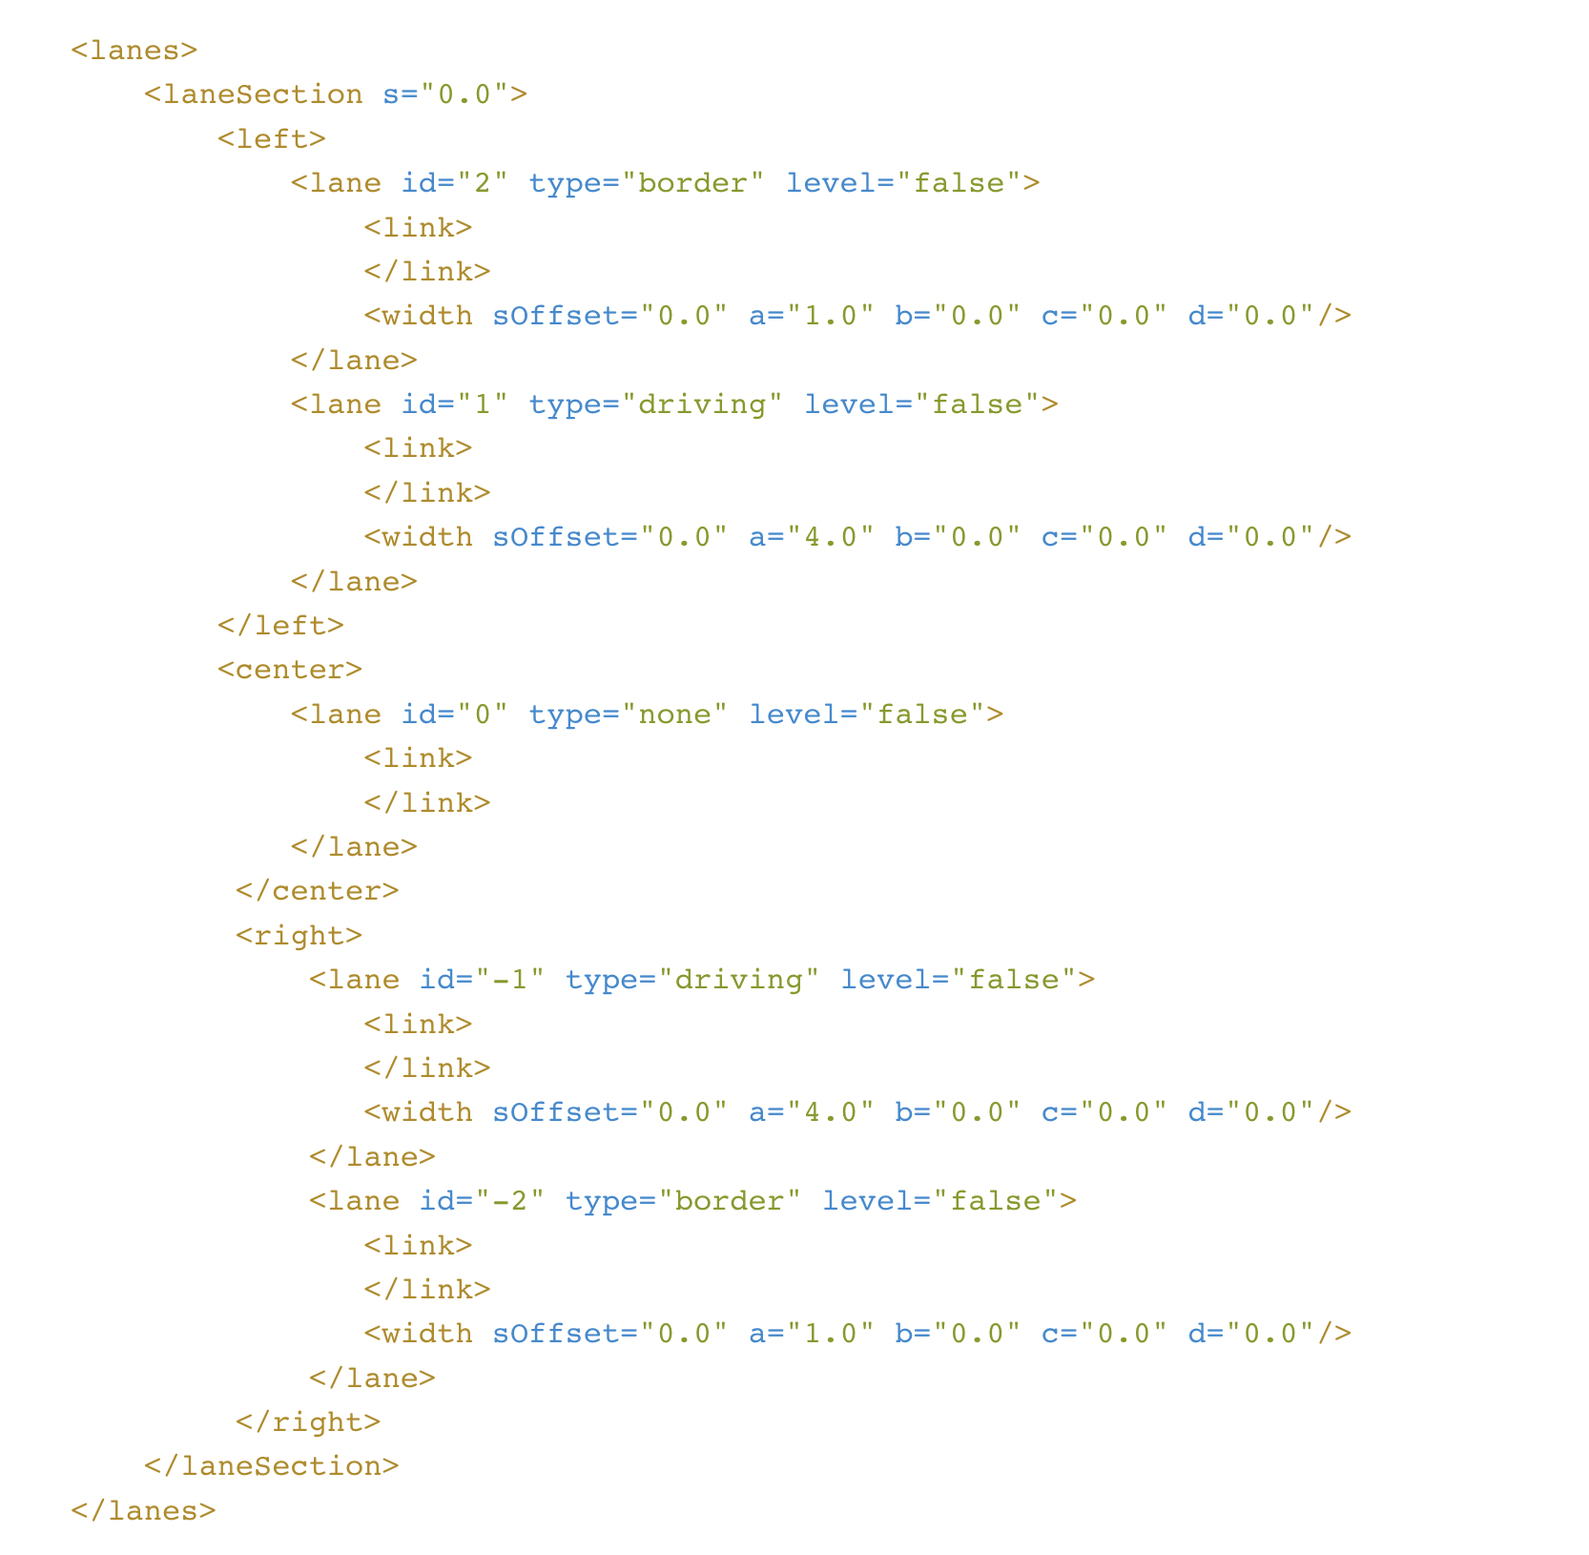
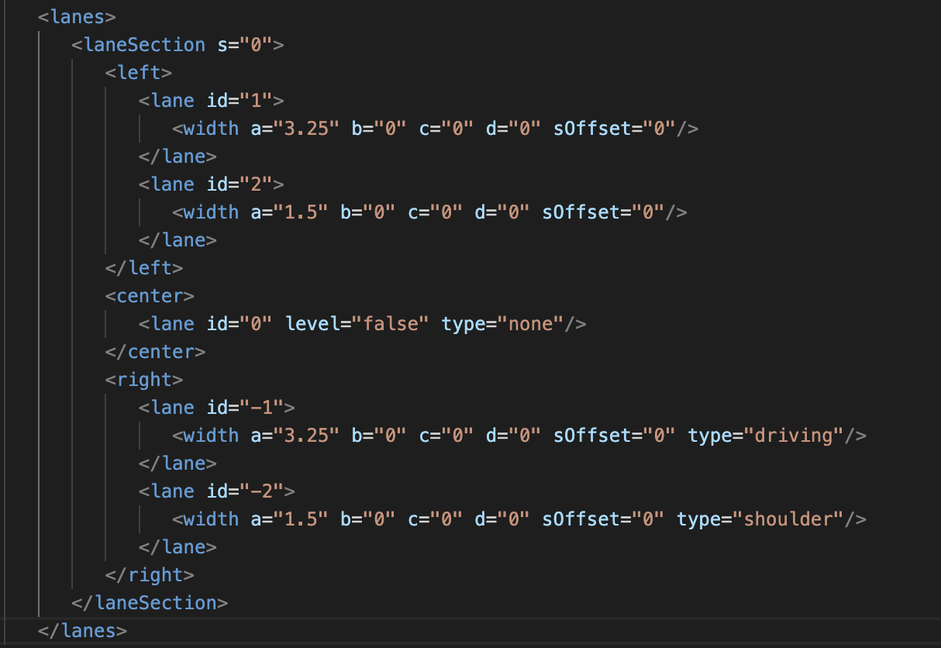
Left: documentation xodr
Right: matlab xodr
laneSection s element is in decimal places (fixed)
Lane numbering shall start with 1 next to the center lane, descend in negative t-direction and ascend in positive t-direction. (fixed)
Type elements and level elements should be in lane tag (fixed)
Width tag should be ordered as the following: sOffset, a, b, c, d
There is link element within lane tag

Slide 10
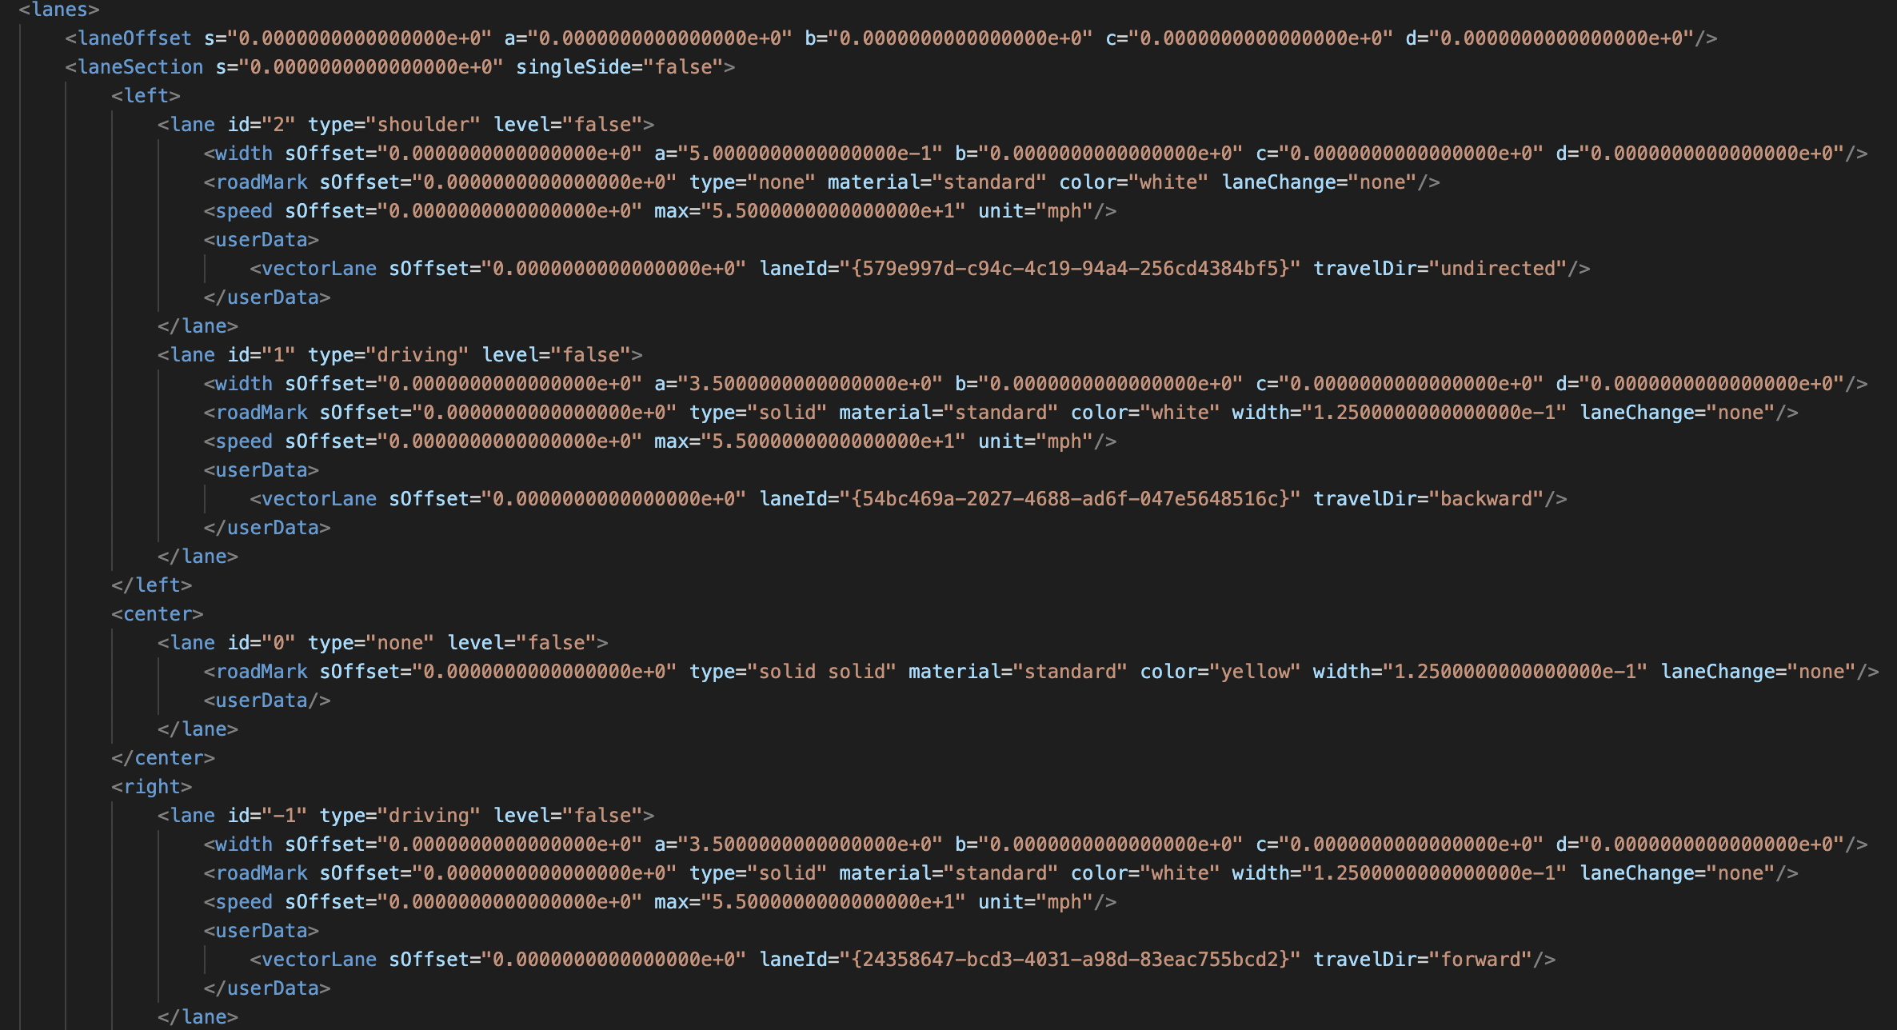
Right: matlab xodr
Left: Roadrunner xodr
There is laneOffset tag before laneSection tag (fixed)
S element in laneSection tag is in decimal places (fixed)
laneSection has singleSide element (fixed)
Lane numbering shall start with 1 next to the center lane, descend in negative t-direction and ascend in positive t-direction (fixed)
Lane tag contains type and level elements (fixed)

Slide 11
Right: matlab xodr
Left: Roadrunner xodr
Width tag should be ordered as the following: sOffset, a, b, c, d
Number in widtag tag should be in decimal places (fixed)
For lane tag, RR version has more elements which are roadMark, speed, and userData (fixed)

Slide 12
Other things
Before lane tag, RR xodr has elevationProfile and lateralProfile
After lane tag, RR xodr has userData tag which contains vectorLaneSection

