Slide 1
Lane storage algorithm
For each lane section in *.xodr file (separate for left and right lanes)
Initialize row in matrix with NaNs at same width as previous row
First row gets initialized to the number of lanes in first lane section
Iterate through each lane in the lane section
First lane section simply gets column values by self-ID of each lane
Get the predecessor ID of the current lane
Check to see if the predecessor ID exists
If exists:
place lane in matrix by looking up the column index of the predecessor lane ID in the previous row of the matrix
If does not exist:
append a column of NaNs to the lane matrix
place the current lane ID in the last row/column space

Slide 2
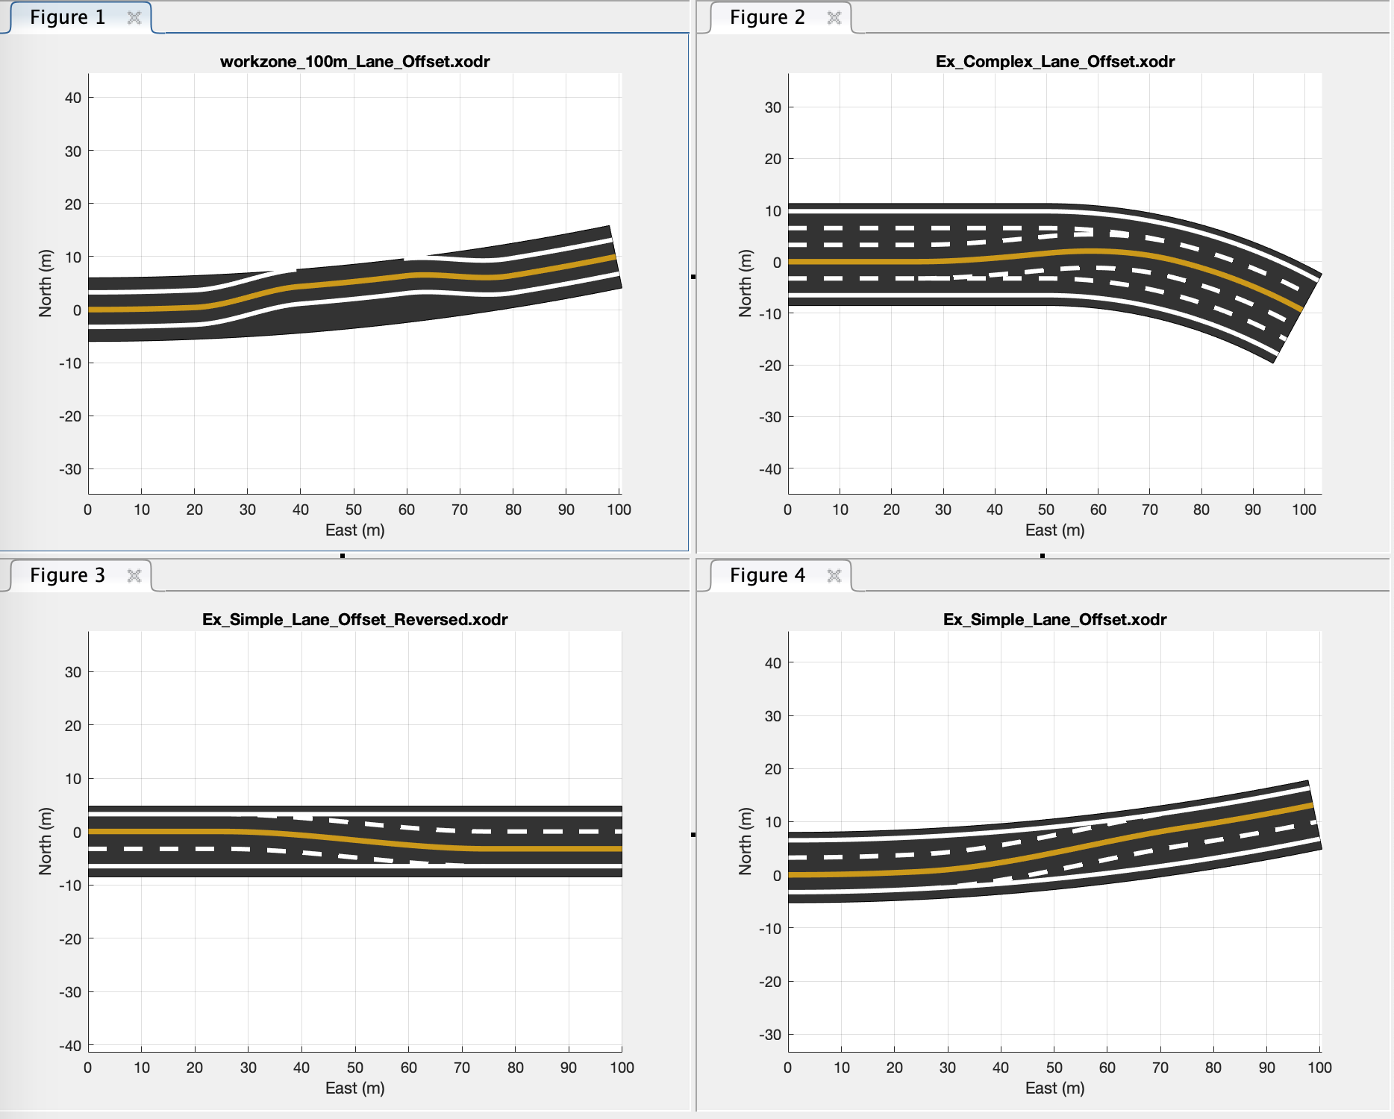

Slide 3
