Slide 1
Derivation notes for fcn_circleCenterFromThreePoints
By S. Brennan, sbrennan@psu.edu , 2020_05_22

Slide 2
Our goal is to find the circle that fits within three given points
Given: (x1, y1), (x2,y2), (x3,y3)
Find: (xc,yc) – the center of a circle passing through all 3 points, and r, the radius of that circle (not required, but helpful).

Slide 3

The solution approach is based on the equation for a circle
Since
$$(x−x_{c})^{2}+(y−y_{c})^{2}=r^{2}$$
So:
$$x^{2}−2⋅x⋅x_{c}+x_{c}^{2}+y^{2}−2⋅y⋅y_{c}+y_{c}^{2}+=r^{2}$$
Which, if x and y are known, is 1 equation with 3 unknowns (xc, yc, r)

Slide 4
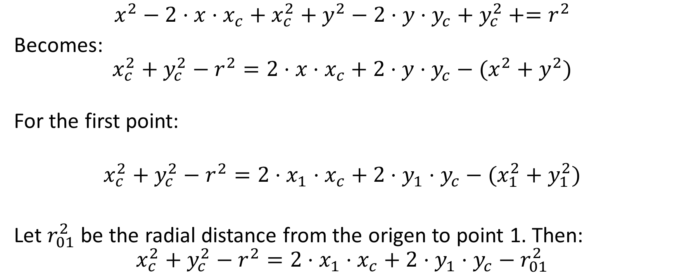
We rearrange this to try to get a linear form
$$x^{2}−2⋅x⋅x_{c}+x_{c}^{2}+y^{2}−2⋅y⋅y_{c}+y_{c}^{2}+=r^{2}$$
Becomes:
$$x_{c}^{2}+y_{c}^{2}−r^{2}=2⋅x⋅x_{c}+2⋅y⋅y_{c}−(x^{2}+y^{2})$$
For the first point:
$$x_{c}^{2}+y_{c}^{2}−r^{2}=2⋅x_{1}⋅x_{c}+2⋅y_{1}⋅y_{c}−(x_{1}^{2}+y_{1}^{2})$$
Let $r_{01}^{2}$ be the radial distance from the origen to point 1. Then:
$$x_{c}^{2}+y_{c}^{2}−r^{2}=2⋅x_{1}⋅x_{c}+2⋅y_{1}⋅y_{c}−r_{01}^{2}$$

Slide 5

So for points 2 and 3:
$$2⋅x_{2}⋅x_{c}+2⋅y_{2}⋅y_{c}−r_{02}^{2}=2⋅x_{1}⋅x_{c}+2⋅y_{1}⋅y_{c}−r_{01}^{2}$$
Or:
$$2⋅{(x}_{2}−x_{1})⋅x_{c}+2⋅(y_{2}−y_{1}) =r_{02}^{2}−r_{01}^{2}$$
And similarly:
$$2⋅{(x}_{3}−x_{2})⋅x_{c}+2⋅(y_{3}−y_{2}) =r_{03}^{2}−r_{01}^{2}$$

Slide 6
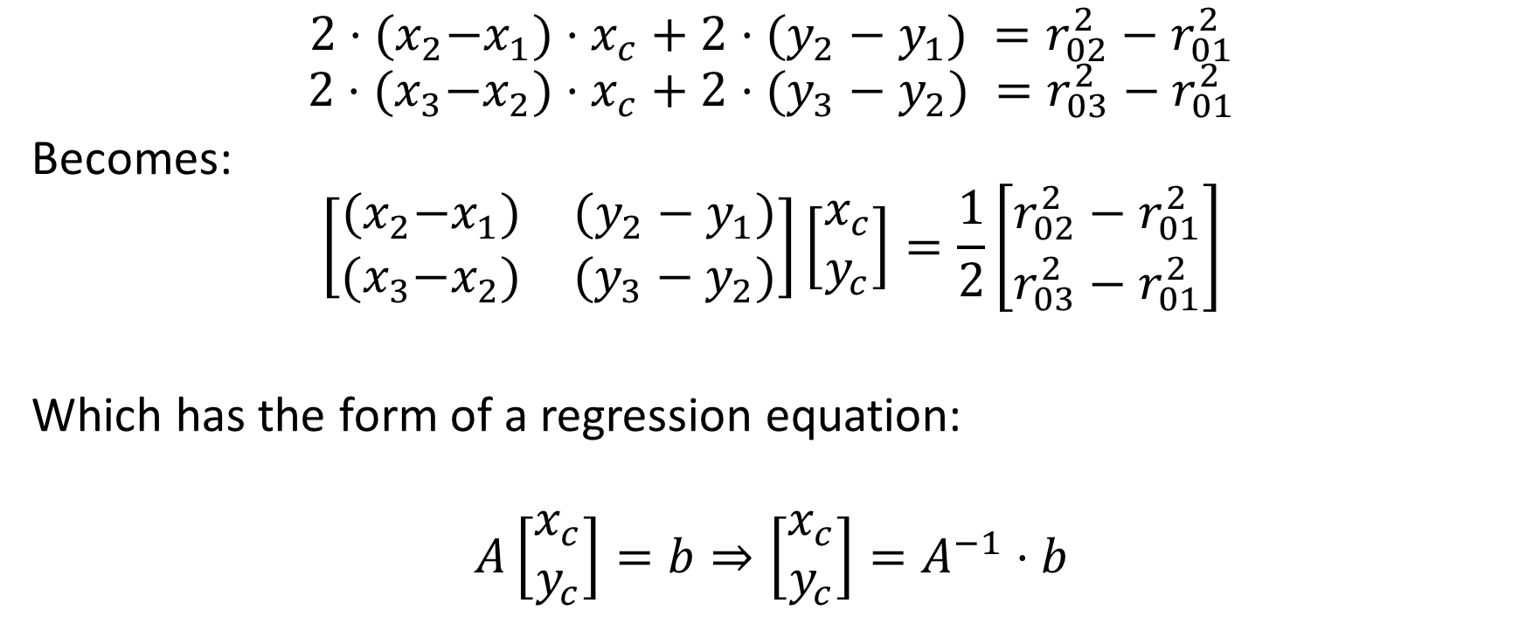
This admits a matrix form:
$$2⋅{(x}_{2}−x_{1})⋅x_{c}+2⋅(y_{2}−y_{1}) =r_{02}^{2}−r_{01}^{2}$$
$$2⋅{(x}_{3}−x_{2})⋅x_{c}+2⋅(y_{3}−y_{2}) =r_{03}^{2}−r_{01}^{2}$$
Becomes:
$$\left[\begin{matrix}{(x}_{2}−x_{1}) & (y_{2}−y_{1}) \\ {(x}_{3}−x_{2}) & (y_{3}−y_{2})\end{matrix}\right]\left[\begin{matrix}x_{c} \\ y_{c}\end{matrix}\right]=\frac{1}{2}\left[\begin{matrix}r_{02}^{2}−r_{01}^{2} \\ r_{03}^{2}−r_{01}^{2}\end{matrix}\right]$$
Which has the form of a regression equation:
$$A\left[\begin{matrix}x_{c} \\ y_{c}\end{matrix}\right]=b⇒\left[\begin{matrix}x_{c} \\ y_{c}\end{matrix}\right]=A^{−1}⋅b$$

Slide 7
The solution to this is solved via the MATLAB code:
Set up vectors:
Solve the problem:
r_squared = (x.^2 + y.^2); % These are the radii of points from origin
diff_x = diff(x);
diff_y = diff(y);
diff_rsquared = diff(r_squared);
A = [diff_x diff_y];
b = 1/2*diff_rsquared;
% Solve the center points
centers = A\b;
centers = reshape(centers,2,length(centers(:,1))/2);
xc = centers(1,:)';
yc = centers(2,:)';
% NOTE: the following line is the slowest in the code. It can be sped
% up if we do not take the square root
radii = ((xc - x(1:num_solutions,1)).^2 + ...
(yc - y(1:num_solutions,1)).^2).^0.5;

Slide 8
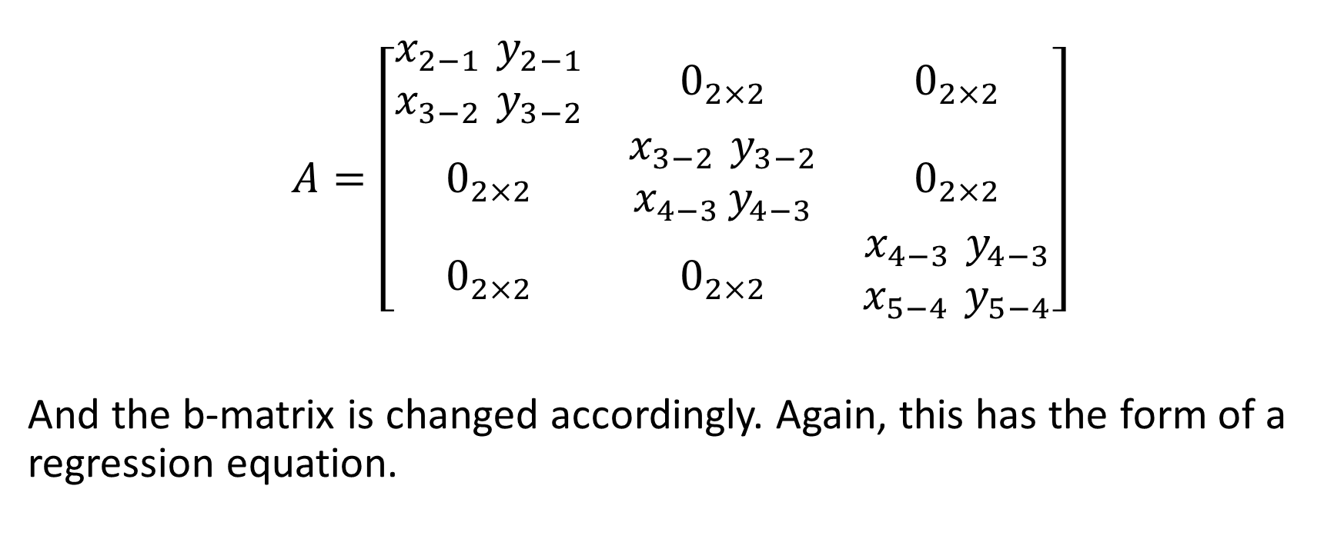
If there are more than one circle to be solved, we can write the A matrix in block form as:
$$A=\left[\begin{matrix}\begin{aligned}x_{2−1 }y_{2−1} \\ x_{3−2 }y_{3−2}\end{aligned} & 0_{2×2} & 0_{2×2} \\ 0_{2×2} & \begin{aligned}x_{3−2 }y_{3−2} \\ x_{4−3 }y_{4−3}\end{aligned} & 0_{2×2} \\ 0_{2×2} & 0_{2×2} & \begin{aligned}x_{4−3 }y_{4−3} \\ x_{5−4 }y_{5−4}\end{aligned}\end{matrix}\right]$$
And the b-matrix is changed accordingly. Again, this has the form of a regression equation.

Slide 9
The MATLAB code is quite similar if there are multiple solutions, but the A-and b-matrices are formed differently
% Do some pre-calculations
num_solutions = length(x(:,1))-2; % This is the number of solutions to expect
r_squared = (x.^2 + y.^2); % These are the radii of points from origin
diff_x = diff(x);
diff_y = diff(y);
diff_rsquared = diff(r_squared);
if 1 == num_solutions % Expecting just one solution. No need for big A, b matrices
% solve for the center point
A = [diff_x diff_y];
b = 1/2*diff_rsquared;
else % Simultaneous solutions to be calculated - create big A and b matrices
% Construct the A-matrix and b matrix that will create the regressor.
% Start by filling A and b matrices up with zeros (see notes for
% explanation of iputs)
A = zeros(2*num_solutions,2*num_solutions);
b = zeros(2*num_solutions,1);
% Fill in the non-zero portions of the matrix, which will be 1 per each
% of the N solutions
for i_solution = 1:num_solutions
A(1+2*(i_solution-1):2+2*(i_solution-1),1+2*(i_solution-1)) = ...
diff_x(i_solution:i_solution+1);
A(1+2*(i_solution-1):2+2*(i_solution-1),2+2*(i_solution-1)) = ...
diff_y(i_solution:i_solution+1);
b(1+2*(i_solution-1):2+2*(i_solution-1),1) = ...
1/2*diff_rsquared(i_solution:i_solution+1);
end
end
% Solve the center points
centers = A\b;
centers = reshape(centers,2,length(centers(:,1))/2);
xc = centers(1,:)';
yc = centers(2,:)';
% NOTE: the following line is the slowest in the code. It can be sped
% up if we do not take the square root
radii = ((xc - x(1:num_solutions,1)).^2 + ...
(yc - y(1:num_solutions,1)).^2).^0.5;

Slide 10
Here are some sample results
x = [0; 0.5; 1; 4; 6; 7; 9; 11; 15];
y = [0; 4; -1;-3; 2; -1;3; 3; -0.5];
fcn_circleCenterFromThreePoints(x,y,1);
plot(x,y,'r-');
figure(1); clf;
for i=1:length(x)-2
fcn_circleCenterFromThreePoints(x(i:i+2),y(i:i+2),1);
plot(x,y,'r-');
pause;
end
Type: “help fcn_circleCenterFromThreePoints” for more examples, or see:
script_test_fcn_circleCenterFromThreePoints.m

