Slide 1
Documentation for function: fcn_geometry_find_slope_intercept_from_N_points
a MATLAB function to find a line from points

Slide 2
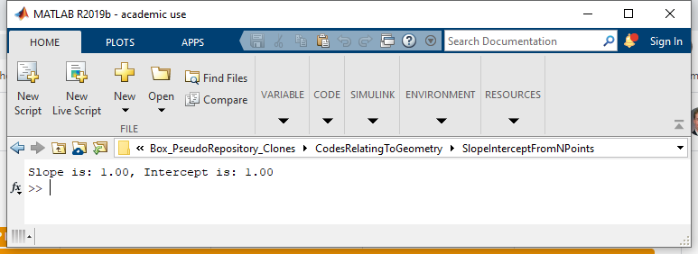
This function seeks to fit a line to user-defined points.
The basic usage is to pass in points in the format [X Y] where X and Y are columns. The column must be at least of length 2, representing the end-points of the line.
%% Simplest example
points = [2 3; 4 5];
[slope,intercept] = fcn_geometry_find_slope_intercept_from_N_points(points);
fprintf(1,'Slope is: %.2f, Intercept is: %.2f\n',slope,intercept);

Slide 3
If a figure number is passed as an argument, it produces a plot of the result with 100 equally-spaced points between the max and minimum x values
%% Test 1: a basic test
fig_num = 1;
points = [2 3; 4 5];
[slope,intercept] = fcn_geometry_find_slope_intercept_from_N_points(points,fig_num);
fprintf(1,'Slope is: %.2f, Intercept is: %.2f\n',slope,intercept);

Slide 4
If more than two points are specified, the code performs a regression fit of the points
%% Test 2: many points randomly determined
fig_num = 2;
slope = 3;
intercept = 4;
Npoints = 1000;
x_data = linspace(-2,5,Npoints)';
y_data = x_data*slope + intercept + intercept*0.2*randn(Npoints,1);
points = [x_data,y_data];
[slope,intercept] = fcn_geometry_find_slope_intercept_from_N_points(points,fig_num);
fprintf(1,'Slope is: %.2f, Intercept is: %.2f\n',slope,intercept);

Slide 5
Vertical lines produce a singularity, so these are handled via a special case in the code
%% Example 3: a vertical line
fig_num = 3;
points = [2 0; 2 2];
[slope,intercept] = fcn_geometry_find_slope_intercept_from_N_points(points,fig_num);
fprintf(1,'Slope is: %.2f, Intercept is: %.2f\n',slope,intercept);

Slide 6
The solution in the code is set up in matrix form
The code sets up the problem as a regression form. Since the
equation of a line is:
y = m*x + b
then:
y1 = m*x1 + b
y2 = m*x2 + b
(etc)

Slide 7
The use of vectors for X and Y enables matrix forms
Y = m*X+b
or:
Y = [X 1]*[m b]';
Where X and Y are column vectors. This allows one to solve for [m b] via matrix multiplication via matrix algebra and pseudo-inversion:
result = ([X 1]'*[X 1])\([X 1]*Y)
where the result variable contains the slope and intercept of the best-fit line through the points:
result = [m b].

Slide 8
There are a few special cases to consider
If the matrix is singular, e.g. if the x-coordinates are all the same,
the line is vertical and the slope is infinite, as is the intercept.
If the X matrix is 2x2, there's no need for the transpose. Each of these
conditions is handled separately in the code for speed.

