Slide 1

PathPlanning_GridFreePathPlanners_BoundedAStar
Library Documentation
Notes:
https://www.goodtherapy.org/blog/Labyrinth-as-Integration-Tool

Slide 2
Repo Purpose
This repo contains the bounded A* grid free path planner, variations of this path planner, and supporting infrastructure such as visibility graph (vgraph) creation tools

Slide 3
General Architecture
fcn_algorithm_bound_Astar.m – core planning algorithm
fcn_algorithm_straight_planner.m – alternative planner that only plans a straight path without diverting around obstacles
fcn_algorithm_setup_bound_Astar_for_tiled_polytopes.m – wraps and calls planning algorithms. This is generally the entry point for calling the planner stack. One purpose of this code is to find the search space boundary which will be explained later.
fcn_visibility_clear_and_blocked_points.m – creates the visibility graph for the polytope field from the given location
fcn_visibility_self_blocked_pts.m – determines points blocked by the current obstacle (i.e. points that would be visible if the current obstacle was transparent)

Slide 4
The argument “planner_mode” for fcn_algorithm_bound_Astar and fcn_algorithm_setup_bound_Astar_for_tiled_polytopes can be used to modify the planner modality to one of the following:
% PLANNER_MODE: string containing option for planner behavior
% indicates the planner mode
% "legacy" only goes around obstacles
% "through at vertices" allows the planner to go through or around each obstacle
% but only entering or exiting at vertices
% "straight through" the planner only goes straight from the start to the goal, calculating the cost
% "through or around" allows the planner to go through all obstacles or around all

Slide 5
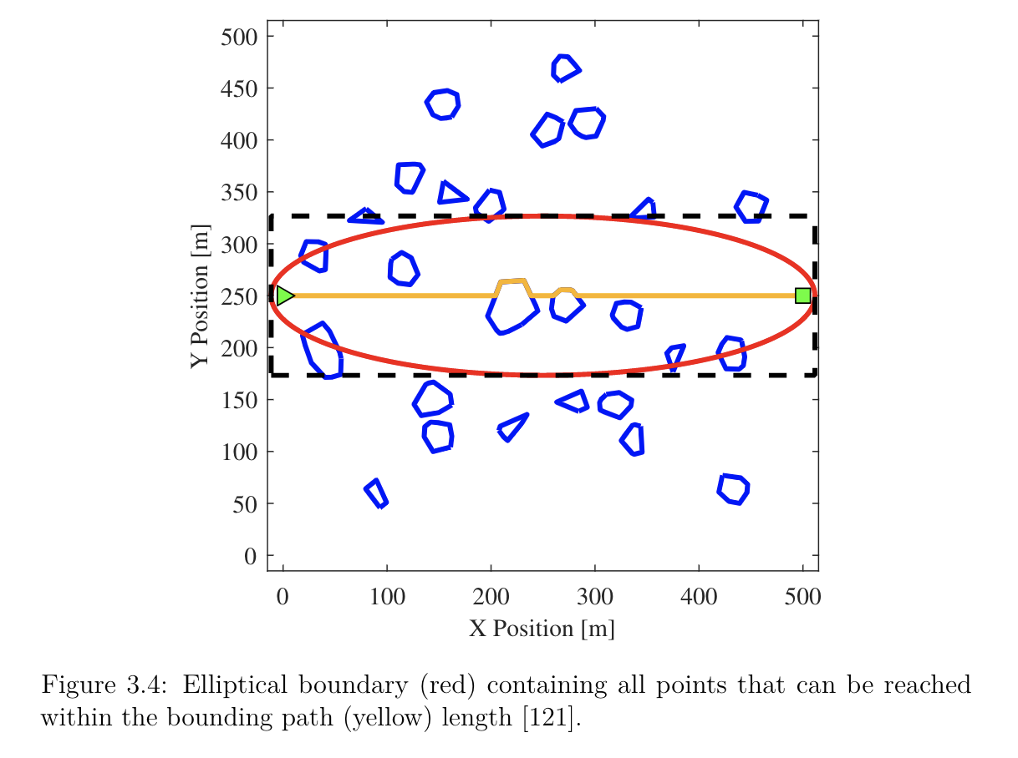
Legacy, i.e. the original bounded A*, is an A* algorithm which improves efficiency over A* by limiting the search space to paths navigable in less distance than the path that the Bug2 algorithm would plan. This is visualized as a bounding ellipse below. For more on this, see § 3.2 of Seth Tau’s thesis: THE EFFECTS OF PATH-PLANNING UNCERTAINTY ONINTELLIGENT VEHICLE PERFORMANCE. This is the main planner that all subsequent planners are variations of.

Slide 6
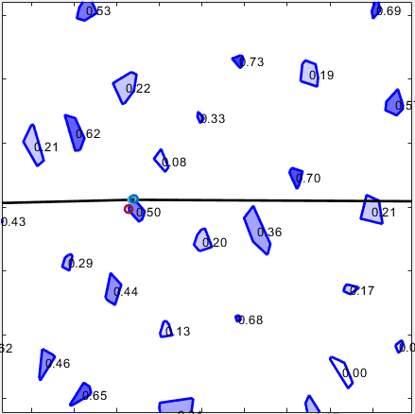
A note on polytope “cost”:
In the legacy mode, all obstacles are treated as impassable (infinite traversal cost).
In the following planner modes, obstacles may be traversed and have a cost field in the polytope struct which represents the increase in percent difficulty over free space traversal. In other words, a polytope with a cost of 0.2 is 20% harder to traverse than free space. So traveling 1 km through the polytope costs as much as travelling 1.2 km through free space.

Slide 7
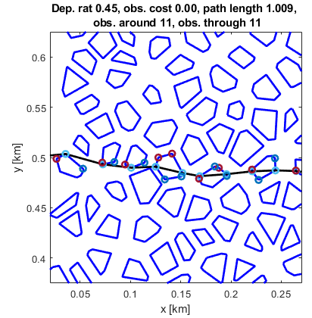
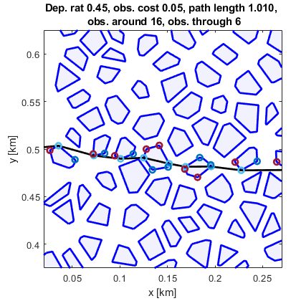
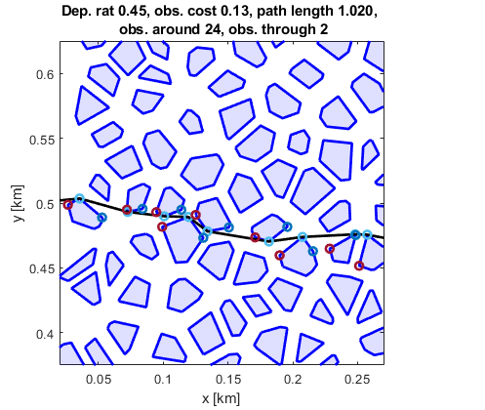
Through at Vertices – this planner mode allows for routing through obstacles or around them on a per obstacle basis, but only allows obstacles to be entered and exited at vertices rather than at arbitrary points along sides. This is achieved by looking through each obstacle that is arrived at using fcn_visibility_self_blocked_pts.m and adding self-blocked points back to the visibility graph to make them reachable through the current obstacle at a penalty of the distance to the point, scaled up by the polytope traversal cost.

Slide 8
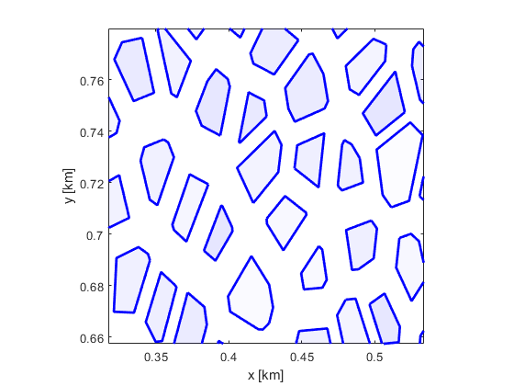
Bounded A* uses a vgraph constructed by considering all visible vertices as possible goals, with distance to them used as the cost of reaching them.

Slide 9
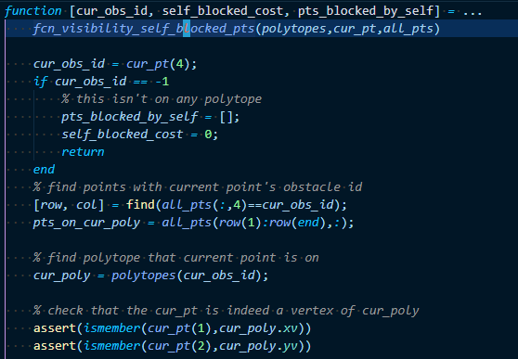
Using our knowledge the current point, we can query for other vertices on the same polytope and the cost associated with traversing that polytope.
+20% traversal cost

Slide 10
Then we can add these points to the vgraph, scaling their distance costs up by the factor associated with the polytope.

Slide 11
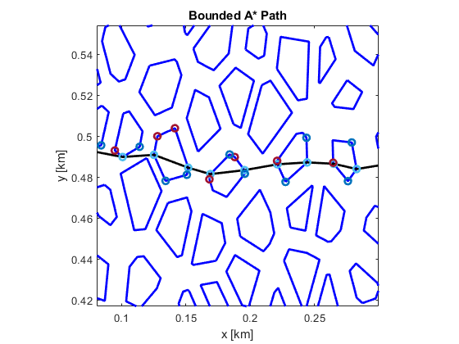
When polytopes have the same resistance or traversal cost as free space, the often planner routes through them, as expected.

Slide 12
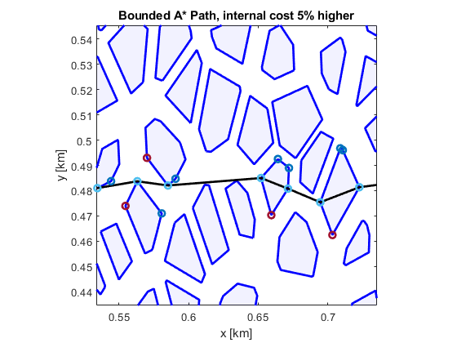
When polytopes are 5% more difficult to traverse than free space, spot checking shows the planner sometimes routes through them, but sometimes does not.

Slide 13
As expected, less obstructing polytopes are routed around.

Slide 14
And more obstructing polytopes (where the path passes through closer to the centroid) are routed through.

Slide 15
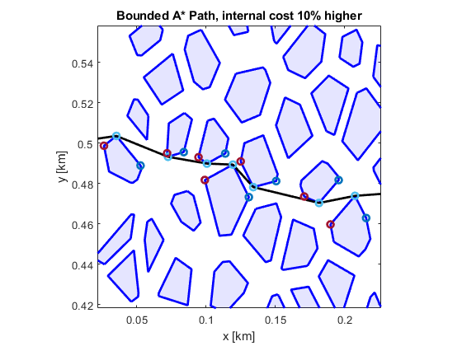
When polytopes are 10% more difficult to traverse than free space, spot checking shows the planner very rarely routes through them, for this particular obstacle field (point density 1000, average maximum radius of 0.0015 km).

Slide 16
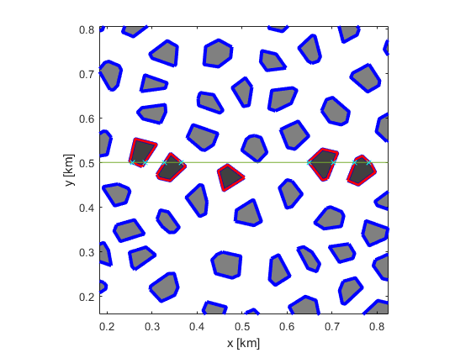
Straight Through – this planner uses fcn_algorithm_straight_planner.m to plan a path straight through the entire obstacle field, traversing all encountered polytopes, without being restricted to entering and exiting the polytope at its vertices. This process requires finding the intersections between a straight line and polytope sides (the cyan x-marks below). As this is very slow (O(NxM) for fields with N-polytopes having M-sides each), only polytopes near the line (the red polytopes below) are checked for collision.

Slide 17
Through or Around – this planner calls the Legacy planner and compares the result to the result from Straight Through, returning the lower cost option. In this way it chooses to either go through every encountered obstacle in the field or around every encountered obstacle in the field. It does not choose to go through or around each obstacle encountered on a per obstacle basis.

Slide 18
Pseudo code for this bimodal planner Through or Around planner as well as the optimization for the straight through planner is as follows:
plan the around path
call the legacy planner
plan the through path
total_cost = 0
distance_in_shapes = 0
obtain equation for line from a (start) to b (finish)
for each poly:
if poly is close to the line a-b:
note poly as possibly straddling the line
for each noted poly:
for each side on the poly:
if the line a-b intersects the side
note where intersection occurs
if this is the second intersection, break
assert there are two intersections for this poly
note the distance between intersection points
add to distance_in_shapes
scale by poly.cost, add to total_cost
subtract distance_in_shapes from dist between a-b % this is outside of polytope distance
add unscaled outside distance to total_cost
fcn_algorithm_straight_planner.m

Slide 19
We have developed a way to quickly estimate the free space around each edge in the visibility graph (i.e., each possible path segment), using only the visibility graph, which we need to compute for planning in all cases.

Slide 20
To get a geometric cost, we will estimate the corridor width around each visibility graph edge. This will be called the dilation robustness matrix and it can be derived from the visibility graph is approximately linear time, $ℴ(b⋅n)$, where b is the branching factor or average number of edges leaving each node and n is the number of nodes. Generally n>>b so this scales as $ℴ\left(n\right)$. E.g. for one of our floodplain maps with n = 221, b = 11.1.
Corridor width

Slide 21
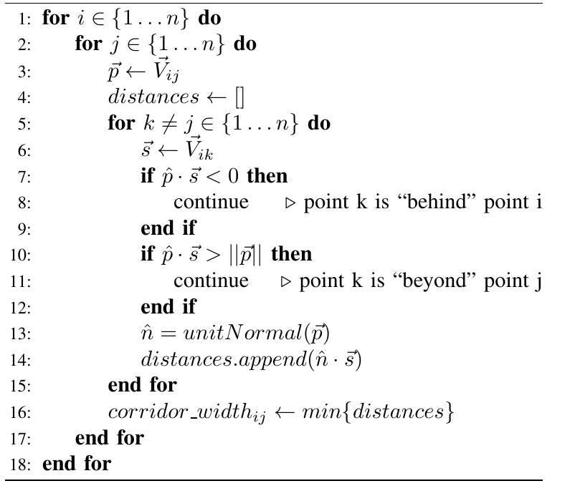

The algorithm seeks to come up with a cost matrix based on the expected lateral free space the vehicle would have when routing along a vgraph edge. For some edge, the primary edge, $\overset{⃑}{V_{ij}}$, we look at each visibility graph edges extending from the same start (all possible secondary edges) , $\overset{⃑}{{\{V}_{ik}}|k=\{1,…,n\}\}$.

Slide 22
We only consider secondary edges that are (1) are not behind the primary edge, i.e., they don’t have a negative dot product with the primary edge and (2) they do not end beyond the end of the primary edge, i.e., their component in the direction of the primary vector that is less than or equal to the magnitude of the primary vector.
Violates condition (1)
Violates condition (2)

Slide 23
Finally the unit normal of the primary edge is dotted with the secondary edges to get the lateral distance from the primary edge to the secondary edge. The minimum across all possible secondary edges is how far the destination of the secondary edge would have to move to cut off the primary edge. I.e., an approximation of corridor width.

Slide 24
Two special cases are handled. One is where there are no points to the side of a vgraph edge. This indicates the edge of the map and thus an infinite corridor width.

Slide 25
The other is if the polytope is adjacent to the edge, in which case there is 0 corridor width.

Slide 26
The cost distance cost of each edge is added to the inverse of the max of the left and right corridor widths to incentivize wider corridors.
$$Ctot=Cdist+\left(\max\left\{widthij,left , widthij,right\right\}\right)−1$$

Slide 27
Adding or removing an obstacle from the visibility graph could be performed without rebuilding the entire visibility graph using a two step process:
Modify edges starting or ending on the obstacle that was added/removed
Modify edges that pass through the area occupied by the obstacle that was added or removed
Edge is neither near new obstacle nor on new obstacle and can be ignored.
Edge connects to new obstacle and should be modified
Edge passes through region of new obstacle and should be modified
New obstacle

Slide 28
Determining which edges pass near an obstacle can be accomplished with an axis-aligned bounding box (AABB) check. This makes sense when only adding or modifying a single obstacle as many edges won’t be near the obstacle of interest.
Edge AABB does not collide with obstacle AABB – no check required
Edge AABB does collide with obstacle AABB – fine checking would reveal no collision
Edge AABB does collide with obstacle AABB – fine checking would reveal collision
Y-axis
X-axis

Slide 29
Combining this AABB check and a visibility check, obstacles can be removed from the vgraph without recalculating the entire visibility graph.
This requires about half as many edge intersection checks (from ~3000 down to ~1500)

Slide 30
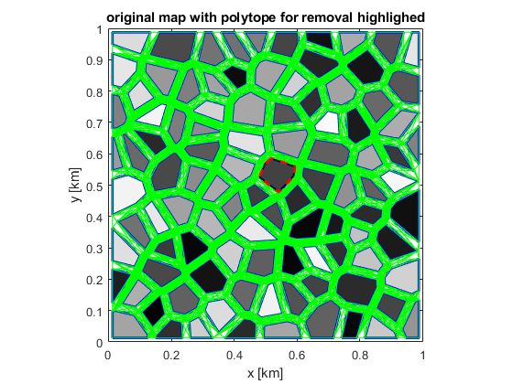
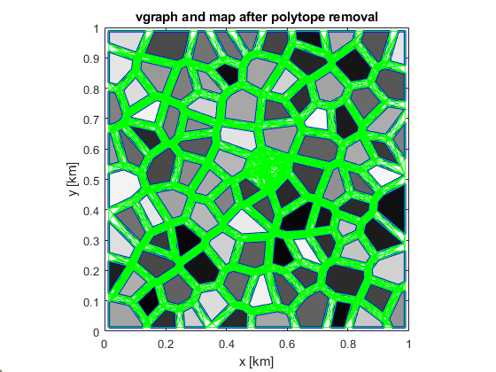
Combining this AABB check and a visibility check, obstacles can be removed from the vgraph without recalculating the entire visibility graph.
This requires about half as many edge intersection checks (from ~270k down to ~93k)

Slide 31
A similar method can be applied to add obstacles from the visibility graph.
This requires approximately 10% of edges to be checked (down from ~3000 down to ~300)

Slide 32
A similar method can be applied to add obstacles from the visibility graph.
This requires approximately 10% of edges to be checked (down from ~3000 down to ~300)

Slide 33
A similar method can be applied to add obstacles from the visibility graph.
This requires less than10% of edges to be checked (down from ~3000 down to ~200)

Slide 34
A similar method can be applied to add obstacles from the visibility graph.
This requires less than10% of edges to be checked (down from ~3000 down to ~200)

Slide 35
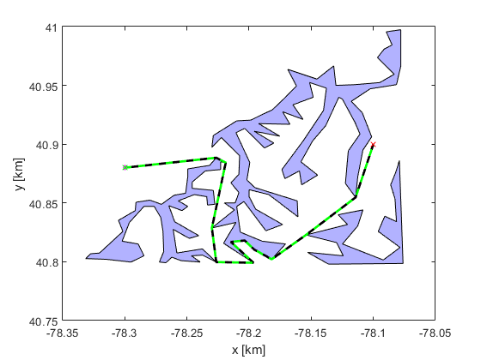
The legacy behavior of the visibility graph code contains an assumption that does not hold for concave obstacles.

Slide 36
There is an assumption in the visibility graph points on the same polytope are never visible to each other unless they are direct neighbors (i.e., adjacent in the vertex list).
Point of interest
Assumed visible to point of interest
Assumed blocked to point of interest

Slide 37
There is an assumption in the visibility graph points on the same polytope are never visible to each other unless they are direct neighbors (i.e., adjacent in the vertex list).
Point of interest
Assumed visible to point of interest
Assumed blocked to point of interest
This was added because internal rays don’t have a “collision” but they are blocked.

Slide 38
This assumption is fine for convex geometry but not concave geometry.
Point of interest
Assumed visible to point of interest
Assumed blocked to point of interest
Assumed to be blocked but actually visible

Slide 39
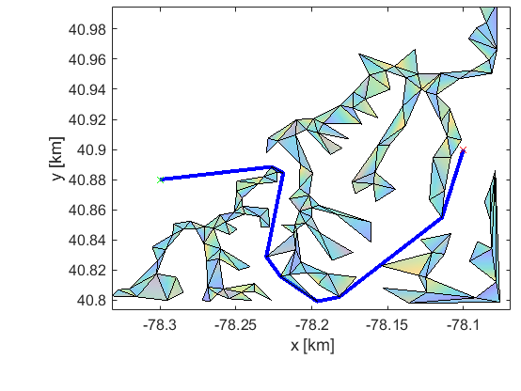
The 3D visibility graph is formed differently, without this assumption. Planning through the same flood plain in the 3D planner shows a result more consistent with intuitive expectation.
2D planner and vgraph
3D planner and vgraph

Slide 40
The 3D vgraph calculation does not have this assumption because rays without collision are checked to see if they are inside or outside of polytopes.
1. Ray does not cross a side
2. Point on ray is checked for containment by polytopes

Slide 41
Setting the is_concave flag optional arg to 1 in the visibility graph function enables this internal edge check in the 2d vgraph function, fcn_visibility_clear_and_blocked_points_global
New state (internal edges are checked for polytope containment)
Point of interest
Assumed visible to point of interest
Assumed blocked to point of interest
1. Ray does not cross a side
2. Point on ray is checked for containment by polytopes
Old state (assumes internal edge are blocked)

Slide 42
This has the effect of opening up more routes for nonconvex polytope maps.
Old state (assumes internal edge are blocked)
New state (internal edges are checked for polytope containment)
Valid edge
Blocked edge
Valid edge
Blocked edge

