Slide 1
3D Planning

Slide 2
Intro

Slide 3
Task 1: Global Path Planning in a Dynamic and/or 3D Environment
Extend graph-based mission planning from a static 2D environment to dynamic situations to represent time-varying obstacles (XYT or XYZT), environmental conditions, and threats
Key research question is whether the path planning process can be solved sufficiently quickly
Static 2D Planning
Dynamic 3D (XYT) Planning
Y [distance]
time
X [distance]

Slide 4
Where will we go? Today we will explain a method for planning towards a moving goal while avoiding moving obstacles with known trajectories.

Slide 5
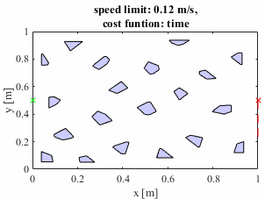
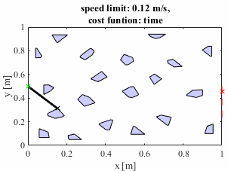
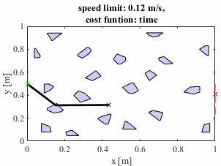
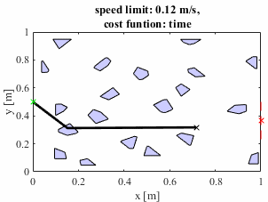
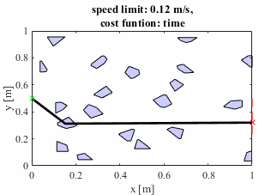
Gif frames from previous slide

Slide 6
Outline
Planning through moving 2D obstacles is a 3D planning problem!
Introduction to 3D planning
Literature on 3D planning
Process for 3D planning
Examples of 3D planning

Slide 7
Prior work has used path planners such as A* to route around polytopes in a grid-free map.
Y [distance]
X [distance]

Slide 8
Nodes of a graph are placed at starts, goals, and vertices of obstacles.
Y [distance]
X [distance]

Slide 9
Nodes are then connected by edges in the visibility graph. This graph connects edges between nodes that are not blocked by obstacles. This graph can be searched with A* for a path.
Y [distance]
X [distance]

Slide 10
To accommodate objects that change position in time, time-space can be employed.
time
X-Y plane
Polytope at time t_{k}

Slide 11
In time space, obstacles are 3D, with their position in time changing along the vertical axis.
time
Polytope at time t_{k+1}
X-Y plane
Polytope at time t_{k}
Note: polytope positions are labelled at discrete times to show progression but the 3D polytopes are continuous.

Slide 12
A 3D visibility graph can be constructed…
time

Slide 13
A 3D visibility graph can be constructed and searched for a path, as in 2D.
time

Slide 14
Outline
Introduction to 3D planning
Literature on 3D planning
Process for 3D planning
Examples of 3D planning

Slide 15
Some 3D planning concepts from the literature
Silver, 2005
“Cooperative A* (CA*) searches space-time for a non-colliding route. Hierarchical Cooperative A* (HCA*) uses an abstract heuristic to boost performance. Finally, Windowed Hierarchical Cooperative A* (WHCA*) limits the space-time search depth to a dynamic window, spreading computation over the duration of the route.”
Local repair A* (LRA*) plans around immediate neighbors as if stationary, then reads in the new positions and repairs the path.
Pros: These methods are advantageous when the path of the obstacles is not known as they are reactive.
Cons: Can lead to cycles unless random noise is injected into the path.
Blasi, 2022
project the 3D obstacles to a flat 2D x-y plane and plan through this
Pros: simple, 2D
Cons: extremely conservative, may incorrectly show missions as impossible
Find the vertical plane that goes through the start and goal and plan through this
Pros: simple, 2D
Cons: Assumes the goal can be reached by only driving “straight” along the line from A to B with variations in z only
Create a layered visibility graph (essentially gridded in time but grid free in space) and find optimal path from t_{k} to t_{k+1}
Pros: still grid free in space, reduced complexity of visibility computation as vgraph only needs to be calculated from one layer to the next
Cons: gridded in time, system may be sensitive to time step choice
Jiang, 1993
Proposes an efficient vgraph calculation for 3D
Pros: timely enough for real time use
Cons: assumes convex obstalces, with time as the vertical dimension obstacles can easily not be convex if they change direction over time

Slide 16
Some 3D planning concepts from the literature (cont.)
Lu, 2019
Connectivity metrics are presented for 3D visibility graphs with lots of verticality
Pros: this result may indicate that in the presence of many high speed obstacles, most connectivity will be x-y planar indicating the layered visibility approach of Blasi et al. is potentially more viable
Hunang, 2019
Another method where the 3D planning is composed of discrete 2D planning tasks. In this method a plane is formed from the current position to the goal and this plane is planned through.
Pros: this could be applied by finding a plane that goes through the start at t=0 and the goal at some t>0, planning through the 2D plane, and seeing if the velocity condition was violated. If so, try a plane with a greater angle from horizontal, if not, this is the lowest total time way to get to the destination
Cons: finding the intersection of the planes and polytopes at each elevation angle attempted is not trivial
Bygi, 2007
Claim because the analogue of a line segment in 2D is a plane segment in 3D, thus a 3D visibility graph is not line segments connecting points but rather plane segments connecting objects
Pros: gives a plane the planner can route on for each pair of visible objects
Cons: graphs can be searched with A* but sets of planes cannot

Slide 17
Some 3D planning concepts from the literature (cont.)
You, 2019
Describe a method similar to what will be shown in the following slides where nodes are added on sides of facets, and nodes are visible to others if the line segment connecting them does not cross a facet
Pros: very analogous to what we do in 2D
Cons: sensitive to node resolution when discretizing facet edges
Li, 2019
Run a space and time optimizer after RRT explores the configuration space, rather than planning an optimal path from the start
Pros: does not require optimality of planner or vgraph
Cons: RTT can be slow, resulting path likely will not be globally optimal
Fujimura, 1989
The problem is framed similar to what is proposed in the following slides. Vgraphs are not used as they change over time. Timespace is recursively broken into cells of non-constant size.
Pros: method allows for velocity and acceleration constraints
Cons: use constant velocity so convex obstacles create convex volumes, discretize environment as cells

Slide 18
Some 2D planning concepts also exist. These plan through moving 2D obstacles rather than timespace.
Nasrollahy, 2009
Particle swarm optimization is used to locally plan in the presence of moving obstacles and goal
Pros: goal can move as well as obstacles, obstacle trajectories do not need to be known in advance
Cons: assumes obstacles relocate, then stop so the robot can advance through a changed field of static obstacles
Schouwenaars, 2001
Problem is formulated as a mixed integer linear program so that path is out of all obstacles at all time steps
Pros: many MILP solvers exist that could be leveraged
Cons: this has the time step issue of potentially having a collision between time steps that is not captured

Slide 19
Several methods involve converting the 3D planning problem to a 2D problem for simplicity.

Slide 20
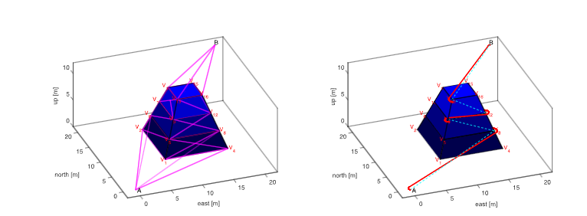
The Blasi Layered Visibility approach showing vgraph in pink and path from Dijkstras in green (smoothed path in red).
Blasi, Luciano, et al. "UAV Path Planning in 3D Constrained Environments Based on Layered Essential Visibility Graphs." IEEE Transactions on Aerospace and Electronic Systems (2022).

Slide 21
Notice visibility only goes to the next time stamp. E.g. the two highlighted points are visible from each other but do not get connected as they are two time steps apart.
Blasi, Luciano, et al. "UAV Path Planning in 3D Constrained Environments Based on Layered Essential Visibility Graphs." IEEE Transactions on Aerospace and Electronic Systems (2022).

Slide 22
One method is to project obstacles onto one plane. This obviously is conservative and can lead to unroutable maps as all possible obstacle positions are avoided. However, it may be possible for relatively sparse fields with obstacles whose speeds are low relative to their size.
time
time
Notes:
Intersection checking from ray to triangle

Slide 23
Obstacles that have large size relative to low speed can conservatively be treated as static. E.g. a construction vehicle moving back and forth in one area. Obstacles with high speed and small size, however, would take up an unreasonably large footprint when projected to one plane, e.g. a high speed vehicle on an interstate would appear to take an entire lane.
slow, large obstacle: projection is not significantly larger
time
time
fast, small obstacle: projection is significant larger than obstacle
time
time

Slide 24
Elevated plane method: a plane containing the start and goal is created. Where the 3D obstacles intersect the plane, a 2D obstacle is placed. The 2D path planning problem is then solved.
Pros: removes the time degree of freedom as for each plane there is now only one time a point can be arrived at thus creating a 2D problem
Cons: finding the intersection of a plane and each obstacle can be costly, this may need to be repeated for several planes.
time
If it is not possible due to velocity constraints, the plane is tilted up. The lowest angle plane is the shortest total time to reach the goal found by this search.

Slide 25
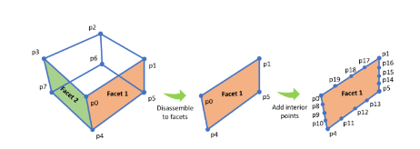
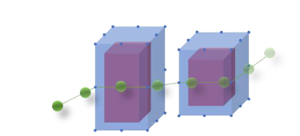
The You et al. method is close to what will be implemented in the following slides for true 3D planning here.
You, Yangwei, Caixia Cai, and Yan Wu. "3D visibility graph based motion planning and control." Proceedings of the 2019 5th International Conference on Robotics and Artificial Intelligence. 2019.

Slide 26
Outline
Introduction to 3D planning
Literature on 3D planning
Process for 3D planning
Examples of 3D planning

Slide 27
Specific next steps for possible method:
Continuous obstalces, brute force visibility check
Make Map
Need to be able to make 3D polytopes (polyhedra) as vertices now have (x,y,t) instead of (x,y)
Need to be able to plot them
Make vgraph – this can still be 2D, as it is still one point to one point, OR it may be 3D
Draw line from point to point
Check if face collision
Convex obstacle method given by Prof. Sommer, involves using outward surface normal
Ray casting method given by Prof. Sommer, similar to Seth’s method that is currently used
If not, it’s visible
Make cgraph & hgraph
Cost and heuristic cost can still be calculated as distance or time (z-distance only)
Plan path
A* will work in 3D
Critical planning substep: discarding vgraph edges based on time constraints (can’t go too fast, can’t go backwards in time)
Conic section approach: cone in timespace represents constraints, only keep edges in cone
Slope approach: discard edges that have too shallow of a slope when gathering successors to a node

Slide 28
As an example, let’s focus on a simple moving wall with 2-points that translates between the start and goal.
Y [distance]
X [distance]

Slide 29
In timespace, this translating line segment becomes a plane segment.
time

Slide 30
Polytope obstacles will be convex facets in the x-y plane. The sides form parallelograms if they have constant translational velocity.
time

Slide 31
Polytope obstacles will be convex facets in the x-y plane. The sides form parallelograms if they have constant translational velocity.
time

Slide 32
Next, nodes are added to the geometry.
time

Slide 33
This may require triangulating the facet, depending on the collision detection method used.
time

Slide 34
Pairs of nodes are connected with possible visibility graph edges.
time

Slide 35
Edges that collide with a facet are discarded as these are blocked.
time

Slide 36
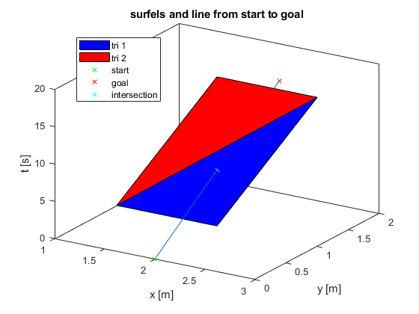
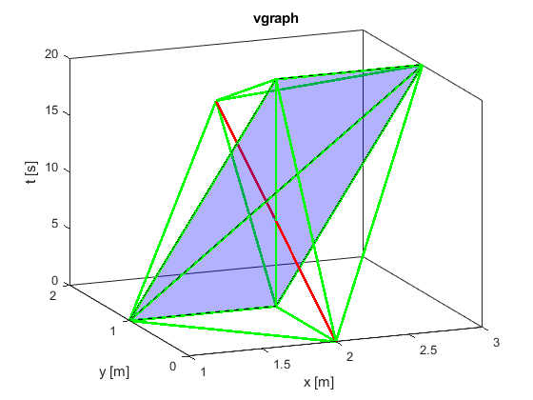
The following is a basic visibility graph formed from checking collision between rays connecting nodes in the graph and facets representing the obstacle in timespace.
All rays that were checked are shown. Green has no collisions while red do.

Slide 37
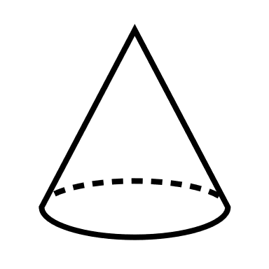
Edges that fall outside of a cone representing the speed limit are also discarded.
time

Slide 38
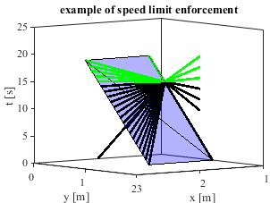
Recall that rays violating a speed limit have to be removed. Here, rays originating from a single point are plotted. Green rays are valid while black rays have been removed for going backwards in time or having infinite speed.

Slide 39
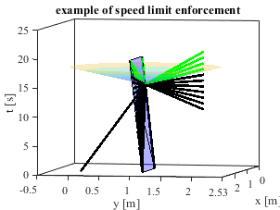
The rainbow contour cone is a visual representation of a speed limit of 0.4 m/s

Slide 40
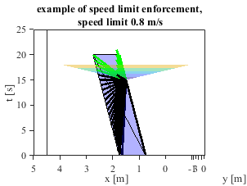
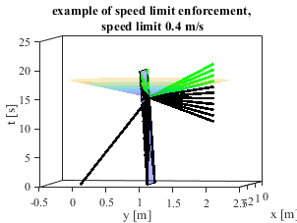
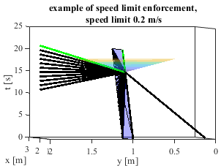
The rainbow contour cone can be shown for various speed limits. Notice how there are fewer green (valid) rays for lower speed limits.
Decreasing speed limit

Slide 41
A* can then search the valid edges for a path through time space based on a cost metric of our choosing.
time

Slide 42
Outline
Introduction to 3D planning
Literature on 3D planning
Process for 3D planning
Examples of 3D planning

Slide 43
We can apply A* to find a path around our simple 2-point moving wall example.

Slide 44
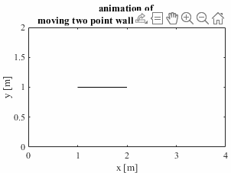
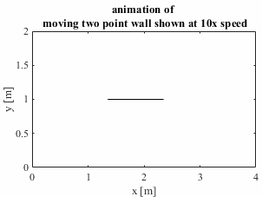
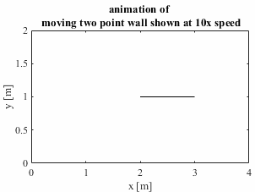
Gif frames from previous slide

Slide 45
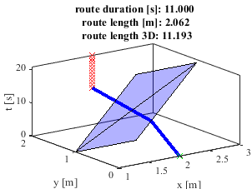
Weighting the cost of time and distance equally leads to a path that goes in front of the moving wall without a significant spatial detour, in a timely manner.

Slide 46
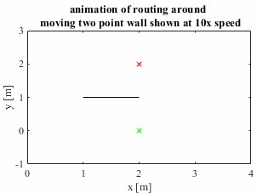
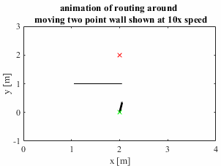
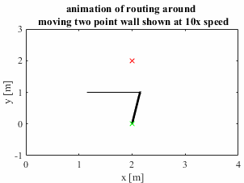
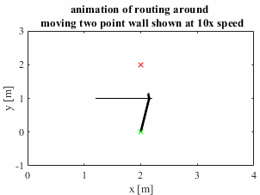
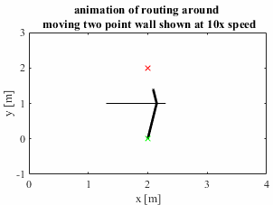
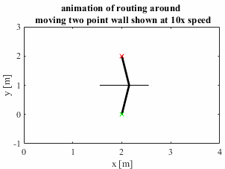
Gif frames from previous slide

Slide 47
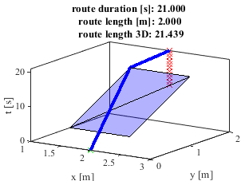
Penalizing only spatial distance leads to the planner selecting a path with more variance in speed to reduce traveled distance from ~2.1 to 2.0. Notice the route length in 3-space has approximately doubled and the duration has gone from 11s to 21s. This is equivalent to waiting for the wall to get out of the planner’s way.

Slide 48

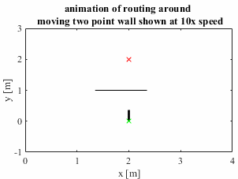
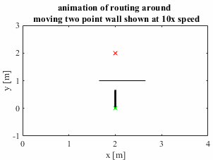
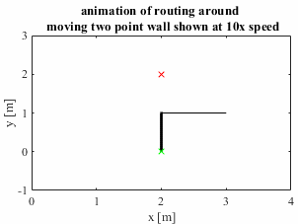
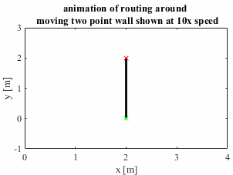
Gif frames from previous slide

Slide 49
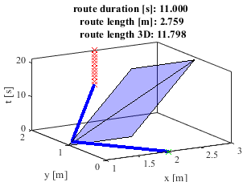
Conversely, penalizing only time leads to a path longer in spatial distance and 3-space, as the planner now “rushes” to go out of its way, behind the wall at the wall’s initial position.

Slide 50
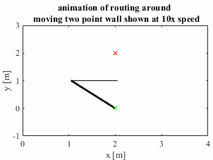
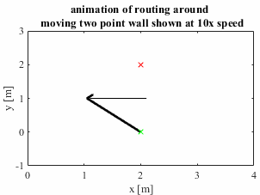

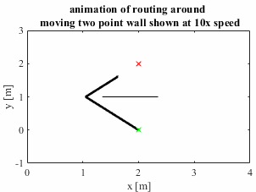
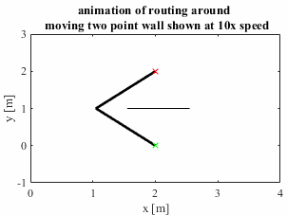
Gif frames from previous slide

Slide 51
In summary, we see that the cost function choice yields different behavioral modes without explicitly defining these.
Time & distance cost
Distance cost
Time cost

Slide 52
The same algorithms can be used to plan around a polytope moving back and forth instead of a 2-point moving wall.

Slide 53
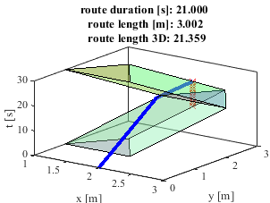
This distance minimizing cost routes through the cusp in the timespace obstacle, equivalent to waiting for the polytope to move out of the way.

Slide 54
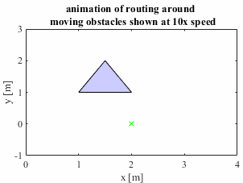
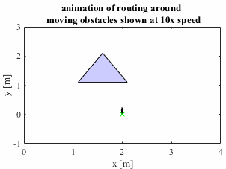
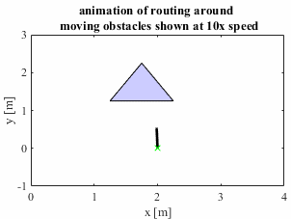
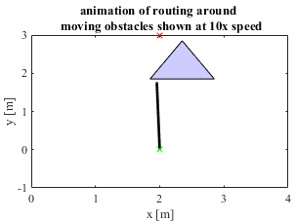
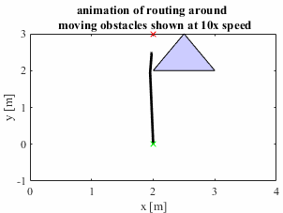
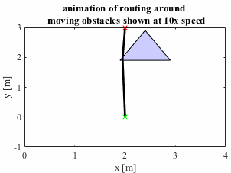
Gif frames from previous slide

Slide 55
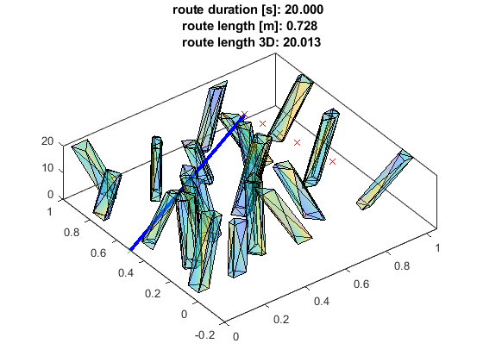
Finally, this method can be used to route around a field of moving polytopes with random velocities, to intercept a moving goal.

Slide 56
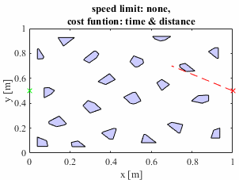
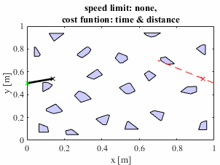
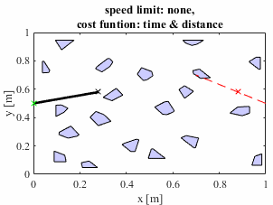
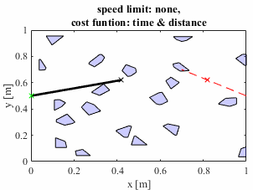
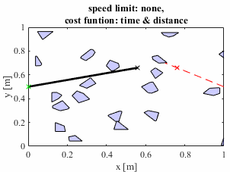
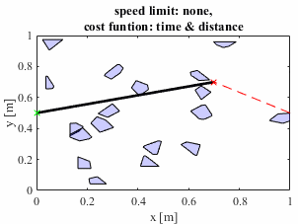
Gif frames from previous slide

Slide 57


As before, different cost functions can be used.
Time cost
Distance cost

Slide 58






Gif frames from previous slide
Time cost
Distance cost

Slide 59


Dijkstra’s can also be used to find a path subject to distance cost, and will slightly reduce cost as it explores more nodes.
Switch from A* to Dijkstra’s

Slide 60



Gif frames from previous slide
Switch from A* to Dijkstra’s

Slide 61


Time cost paths are significantly impacted by imposition of a speed limit. Below are two examples of Dijkstra’s algorithm with different speed limits.
Speed limit removed, route duration halves

Slide 62



Gif frames from previous slide
Speed limit removed, route duration halves

Slide 63
Advanced Cost Functions

Slide 64

$$R=V^{1}∨V^{2}∨…∨V^{n}$$
A visibility matrix, V, raised to a power, k, yields the reachability matrix describing which nodes can be reached in k-steps. Thus, for a network with n nodes, the union of R₁ through R_{n} gives the total reachability, R.
$$R_{k}=V^{k}$$
Gersting, Judith L. Mathematical structures for computer science. Macmillan, 2007.
Example visibility matrix:
Note:
The V and R matrices are Boolean
The union operator is the elementwise Boolean union
To pt. 2
From pt. 1
V_{example} = $\left[\begin{matrix}V11 & V12 \\ V21 & V22\end{matrix}\right]$

Slide 65
$$F=S(V^{1}∨V^{2}∨…∨V^{n})$$
Additionally, if a Boolean vector of starts, S, is employed, a Boolean vector of possible finish points, F, is yielded.
$$F_{k}=S(V^{k})$$
Gersting, Judith L. Mathematical structures for computer science. Macmillan, 2007.
Example visibility matrix:
Note:
The V and R matrices are Boolean
The F and S vectors are Boolean
The union operator is the elementwise Boolean union
To pt. 2
From pt. 1
V_{example} = $\left[\begin{matrix}V11 & V12 \\ V21 & V22\end{matrix}\right]$

Slide 66
Imagine a simple graph where 3 can be reached from 2 which can be reached from 1.
2
1
3

Slide 67

If 3 is the goal and 1 is the start, it is clear there is no edge connecting these.
2
1
3
To pt. 3
From pt. 1
V = $\left[\begin{matrix}1 & 1 & 0 \\ 0 & 1 & 1 \\ 0 & 0 & 1\end{matrix}\right]$

Slide 68

Checking the 2nd order reachability shows it is possible to get from 1 to 3 in 2 steps.
2
1
3
To pt. 3
From pt. 1
V = $\left[\begin{matrix}1 & 1 & 0 \\ 0 & 1 & 1 \\ 0 & 0 & 1\end{matrix}\right]$
R₂ =V² = $\left[\begin{matrix}1 & 2 & 1 \\ 0 & 1 & 1 \\ 0 & 0 & 1\end{matrix}\right]$

Slide 69
Further, checking the absence of 0’s in the first row of the 2nd order reachability shows the whole graph is reachable from node 1 in 2 steps.
2
1
3
V = $\left[\begin{matrix}1 & 1 & 0 \\ 0 & 1 & 1 \\ 0 & 0 & 1\end{matrix}\right]$
R₂ =V² = $\left[\begin{matrix}1 & 2 & 1 \\ 0 & 1 & 1 \\ 0 & 0 & 1\end{matrix}\right]$

Slide 70


Prior to planning a path, using the reachability matrices the minimum number of steps to complete a mission and whether or not mission completion is necessary can be determined.
Speed limit 1 m/s
n = 58, mission possible in 2 steps (k_{min}=2)
Lower speed limit to 0.01 m/s:
n = 58, mission not possible
(goal and start are 2m apart, max arrival time is 21s => ~0.1 m/s is minimum speed)

Slide 71
Other applications of the reachability graph:
When the minimum number of steps is found, this could be combined with an expected cost per step (per vgraph edge) to get a rough order of magnitude of estimated path cost
The minimum time-value of all reachable goals can be easily found to yield the best possible arrival time. This can be plotted as a function of speed limit.
Time efficiency: a 1000x1000 matrix can be raised to the 1000th power in approximately 0.26. This means all 1000 possible step counts can be explored in approximately 4.5 minutes.

Slide 72
How would allowing for an “or” trajectory be accommodated by timespace? I.e. if an obstacle has two possible future states but cannot arrive at both, how does the planner react?

Slide 73
A mutually exclusive polytope trajectory could lead to completely different paths from start to goal.
Obs B. state 1
Obs B.
Obs B. state 2
If state 1 is true, green path is used
If state 2 is true, yellow path is used
Obs. A

Slide 74
The problem with this is if the planner is simply run twice, once for each case, and two paths are provided to the path follower, the paths may diverge before the case is known.
Obs B. state 1
Obs B.
Obs B.
Obs B. state 2
Obs. A
Obs. A
These paths diverge right at the start so cannot both be followed until such as time as the state of obs. B is known.

Slide 75
Thus, it may be advantageous to prioritize keeping paths as similar as possible, as long as possible.
Obs B. state 1
Obs B.
Obs B. state 2
If state 1 is true, green path is used
If state 2 is true, yellow path is used
Obs. A

Slide 76


One approach to this is reducing the cost of visiting visibility graph nodes with more edges leaving them.
Enable visibility priority

Slide 77
One approach to this is reducing the cost of visiting visibility graph nodes with more edges leaving them.
Notice how the route pulls towards open space.
Enable visibility priority

Slide 78
We can analyze the affect of this change by looking at the total number of visible nodes at node in the path.
Route | Nodes visible from waypoints
Legacy | 166
Visibility incentive enabled | 212
Notes:
First route
route =
0 0.5000 0 937.0000
0.1521 0.3125 3.0000 616.0000
1.0000 0.3200 12.0000 942.0000
Second route
route =
0 0.5000 0 937.0000
0.0715 0.7564 3.0000 764.0000
1.0000 0.3200 12.0000 942.0000

Slide 79
The counter-intuitive finding here is that more visibility does not imply more multistep reachability. Thus a reachability incentive could better serve this end.
Route | Nodes visible from waypoints | Nodes reachable from waypoints
Legacy | 166 | 500
Visibility incentive enabled | 212 | 489
Notes:
First route
route =
0 0.5000 0 937.0000
0.1521 0.3125 3.0000 616.0000
1.0000 0.3200 12.0000 942.0000
Second route
route =
0 0.5000 0 937.0000
0.0715 0.7564 3.0000 764.0000
1.0000 0.3200 12.0000 942.0000

Slide 80
The reachability priority, in this case, returns the original path without visibility or reachability priority enabled.
Change visibility priority to reachability priority

Slide 81

Recall the visibility matrix, $V$, and the reachability matrix, $R$. At each possible waypoint in the route, $P$, we look at the cardinality of the set of reachable destinations, ${\overset{̿}{D}}_{R}$. We can also look at the cardinality of visible destinations, ${\overset{̿}{D}}_{V}$.
$$R=V^{1}∨V^{2}∨…∨V^{n}$$
Reachability definition:
Gersting, Judith L. Mathematical structures for computer science. Macmillan, 2007.
Reachability destinations:
$$D_{R}=P(V^{1}∨V^{2}∨…∨V^{n})$$
$${\overset{̿}{D}}_{R}=card(D_{R})$$
$$D_{V}=P∙V^{1}$$
Visible destinations:
$${\overset{̿}{D}}_{V}=card(D_{V})$$

Slide 82
Imagine a bottleneck, such as a canyon, that is relatively unobstructed, with forest on either side.

Slide 83
Increasing the weighting on the visibility and reachability terms of the cost function incentivize the planner to route outside the bottleneck.
Increasing weight on visibility/reachability term

Slide 84
Nodes visible from route waypoints can be highlighted to show the domain of the visible set.

Slide 85
If nodes visible from the start and goal (which are common to both paths) are removed, this difference is more pronounced.

Slide 86
Performance and Discussion

Slide 87
Nodes expanded: this refers to candidate nodes the planner “arrived at” and actually “went to” Nodes explored: this refers to candidate nodes the planner “looked at” and considered going to NOTE: optimizations have not yet been performed; this is proof-of-concept MATLAB code and various time savings could be implemented
Time analysis shows relatively few nodes have to be explored and a wall time of a few seconds for performing the total vgraph creation and route finding, when plotting is off.
Algorithm | Nodes in Map | Nodes Expanded | Nodes Explored | Total Wall Time | Wall time for planning
A* | 944 | 2 | 276 | 159 s | 0.14 s
Dijkstra’s | 944 | 6 | 864 | 160 s | 0.3 s
Substep | Triangulate Surfaces | Discretize in time | VGraph | A* | Dijkstra’s
Complexity | O(NxM) | O(N) | O[(NxN)xM] | O(b^{d}) worst case | O(NxN)
N is number of nodes
M is number of surfaces
T is time step
b is branching factor (avg. num of visible nodes per node)
d is number of nodes in the shortest path
Precomputed
Computed live (if replanning is necessary)
Notes:
These times are from a 3 polytope field with dt = 1. Multi polytope field shown before was 20 polys with dt = 3 and 900 nodes. That takes ~150s. However, doubling dt gives an 8x reduction in time because of cubic scaling on long pole thus giving 18 s. All of this is before any optimization and is all in Matlab.

Slide 88

Some of the operations are shown on the time complexity chart below to give a sense of how they scale as the input size increases.
Dijkstra’s algorithm
vgraph
Time complexity (number of operations)
Discretize in time
Input size (number of nodes)
https://adrianmejia.com/how-to-find-time-complexity-of-an-algorithm-code-big-o-notation/

Slide 89

The flame graph for A* shows that visibility is the most expensive part, due to intersection checking. This has been known for some time.

Slide 90

The flame graph for Dijkstra’s, logically, is similar as it also requires the same vgraph creation step.

Slide 91
At approximately 1000x1000 pt graphs, memory issues are reached.
Vgraph code is vectorized for timeliness. Currently all pairs of nodes are found to form all possible edges, then all edges are paired with all surfels in a table of all edge-surfel pairs that need checking.
So memory is NxNxM
Loops could be employed to save memory at the expense of time
Only one ray could be held in memory at a time, then all surfels could be looped through

Slide 92
Potential issues: node placement is a degree of freedom that will require tuning. Too sparse and planner resolution is not fine enough. Too dense and facet checking will be extremely slow. This problem is not new and presents in our 2D planner as well.
time
time

Slide 93

Looking down at the x-y plane, the spacing of nodes in the time dimension has to be such that a blocked path does not appear open. This sample rate, T, can conservatively be found by taking the smallest obstacle radius, R_{min}, assuming it could move at the fastest obstacle velocity, V_{max}, and sampling such that it does not move further than its width in one time step.
Sampling falsely shows gap
Sampling correctly reflects blockage
$$T= \frac{R_{min}}{V_{max}}$$
y
t1
t2
y
t1
t2
t3
x
x

Slide 94
A* finds the optimal path through a graph. A visibility graph is guaranteed to contain the shortest path through a 2D field. However, this guarantee is not true for 3D. While A* will find the optimal path in the graph, the graph may not contain the optimal path through continuous space. (Bygi, 2007)
time

Slide 95
Some notes on allowable object representations:
If velocity is not constant, 3D shapes may be non-convex.
This representation assumes object trajectories are known.
Obstacles could be allowed to grow or shrink over time to represent changing geometry or uncertainty.

Slide 96
Some notes on not allowable object representations:
While velocities are allowed to change over time, if changed continuously instead of at a cusp/corner, the plane segments representing the side walls will have curved sides and thus resolution will be lost when triangulating these surfaces.
If objects can rotate, side walls may be non-planar. Non-planar side walls, when triangulated for collision checking, will experience a loss of resolution. For this reason, it may be convenient to bound rotating obstacles by a circle, thus producing a cylinder in timespace.

Slide 97
Note on the 3D visibility graph: Bygi et al. claim rather than point to point visibility joined by a line segment, because lines cannot form half spaces in 3D, a better analogy is point to edge visibility, joined by plane segments.
Point A is visible to point B in 2D as they are joined by a line segment that has no collision with object sides
Point C is visible to edge AB as they are joined by a plane segment that has no collision with object facets
B
A
C
B
A

Slide 98
Similarly to how a path of line segments can be found in 2D space a path of plane segments could be found in 3D space.
2D
3D

Slide 99
As there are infinitely many line segments that could occupy a plane segment, a path of line segments still has to be planned. Plane segments will either meet at one vertex or two.
1 common vertex
2 common vertices

Slide 100
If the line segments through the plane segments are restricted to starting and ending at vertices, the number of common vertices indicates the shortest path.
1 common vertex
2 common vertices

Slide 101
Because of this, the plane segment visibility graph would yield the same path as the line segment visibility graph.
1 common vertex,
Graphs formed by planes
2 common vertices,
Graph formed by planes
1 common vertex,
Graph formed by lines
2 common vertices,
Graph formed by lines

Slide 102


A moving goal can be implemented by giving the goal point a trajectory. This leads to the planner intercepting the goal.

Slide 103
Solving this problem requires a slight modification as highlighted in the excerpt of the standard A* algorithm below:
...
1 While unvisited list is not empty
2 pop node with least cost
3 get list of its successors
4 for each successor
5 sort successors in cost order
6 check if successor is the goal
...
A* picks nodes to expand based on lowest cost. However, the successor nodes are not explored in cost order. Modifying A* to explore successors in cost-order fixes this.

Slide 104
This change can be seen with a moving goal in the distance cost example.
Dist. cost = 1.5232 m
With successor sort
Dist. cost = 1.4577 m

Slide 105
extras

Slide 106


Bug fix: numerical issues leading to inconsistent collision detection on edges of facets has been resolved.
Before bug fix: edges sometimes have collision
After bug fix: edges do not have collision, mid-facet rays do

Slide 107

If the cone of possible space is intersected by a face, a nice formula for the appropriate conic section can be found representing reachable points on the face.

Slide 108




However, if several faces partially intersect the cone, the set of reachable points becomes difficult to describe.

Slide 109
2D polytopes defined as vertices,
Max translation distance
fcn_make_timespace_polyhedra_from_polygons
3D polytopes defined as vertices
fcn_make_facets_from_verts
fcn_interpolate_polytopes_in_time
3D polytopes defined as vertices, with fields for facets
3D polytopes defined as dense vertices
3D polytopes defined as dense vertices
fcn_make_triangular_surfels_from_facets
3D polytopes defined as triangular surface elements
fcn_visibility_graph_3d_global
fcn_algorithm_generate_cost_graph
Visibilty graph
Cost graph, heuristic cost
fcn_algorithm_Astar3d
route

