Slide 1

Map Gen Class Library
Descriptions of the “MapGen” class of functions

Slide 2
The MapGen class library hosts tools to build maps useful for studying path planning, autonomy, etc.
The result of these operations is some data representation of the expected environment.

Slide 3
Definitions of terms are important so that we don’t get confused later
Polytope
Polytopes

Slide 4
For many examples below, MATLAB code will be given. It is usually highlighted as shown here: yellow for scripts, grey for console outputs.
%% Example 1: simple three points
fig_num = 1;
x = [-4; -2; 1];
y = [0; -4; -1];
apex_points = [x y];
fcn_FastestTraversal_calculateObstacleDirectionAtApexPoints(...
apex_points, fig_num);
>> script_test_fcn_geometry_selfCrossProduct
cross_products =
0
err =
1

Slide 5
Each function uses a class-specific argument check function
function fcn_MapGen_checkInputsToFunctions(...
variable,variable_type_string,varargin)
% fcn_MapGen_checkInputsToFunctions
% Checks the variable types commonly used in the MapGen codes to
% ensure they are correctly formed.
%
% This function is typically called at the top of most functions. The input
% is a variable and a string defining the "type" of the variable. This
% function checks to see that they are compatible. For example, say there
% 'column_vector' type of variables used in the function that is always a N
% x 1 array; if someone had a variable called "test_example", they could
% check that this fit the 'column_vector' type by calling
% fcn_MapGen_checkInputsToFunctions(test_example,'column_vector').
% This function would then check that the array was N x 1, and if it was
% not, it would send out an error warning.
%
% FORMAT:
%
% fcn_MapGen_checkInputsToFunctions(...
% variable,variable_type_string,(optional_arguments))
%
% INPUTS:
%
% variable: the variable to check
See: script_test_fcn_MapGen_checkInputsToFunctions.m for example usages

Slide 6
A demonstration script exists that shows most of the functionality in this document: script_demo_MapGenLibrary
%% Show how inputs are checked
Twocolumn_of_numbers_test = [4 1; 3 0; 2 5];
fcn_MapGen_checkInputsToFunctions(Twocolumn_of_numbers_test, '2column_of_numbers');
%% Generate a set of polytopes from various pseudo-random sources
% Generate a set of polytopes from the Sobol set
fig_num = 11;
Sobol_range = [1 1000]; % range of Sobol points to use to generate the tiling
tiled_polytopes = fcn_MapGen_sobolVoronoiTiling(Sobol_range,[1 1],fig_num);
% Generate a set of polytopes from the Halton set
fig_num = 12;
Halton_range = [1 1000]; % range of Halton points to use to generate the tiling
tiled_polytopes = fcn_MapGen_haltonVoronoiTiling(Halton_range,[1 1],fig_num);

Slide 7
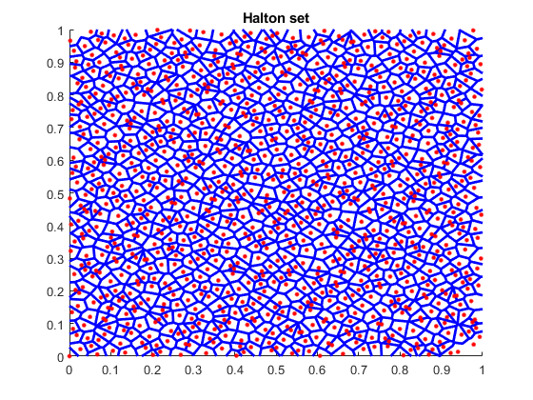
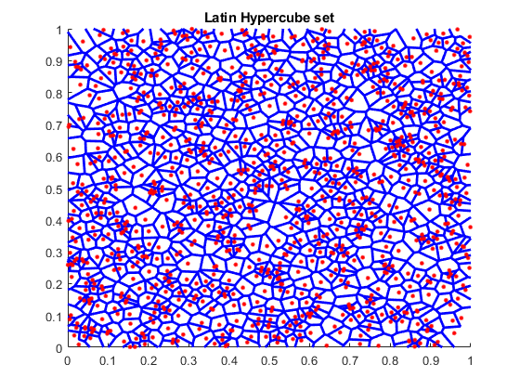
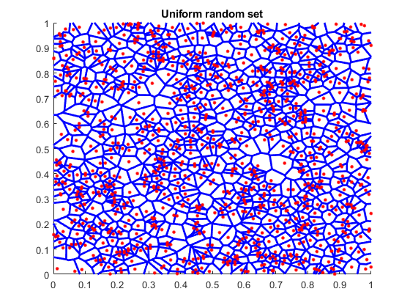
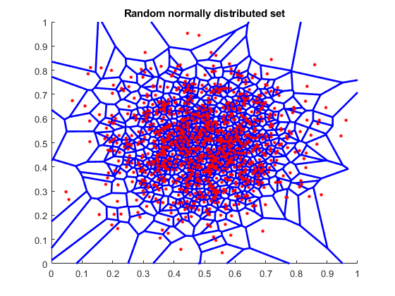
There are a number of pseudo-random number generators that can be used to create tilings within a map, and the results of each are very different.

Slide 8
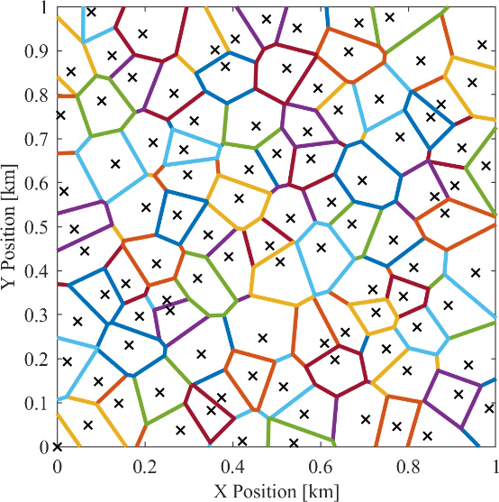
The Halton set is the one we use most often and in nearly all the codes
It gives fairly uniform, non-repeating tilings without clumping

Slide 9
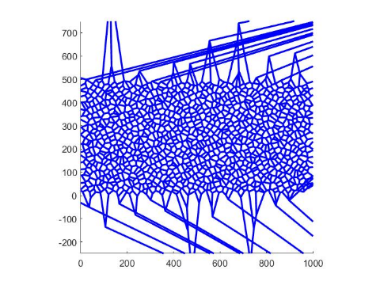
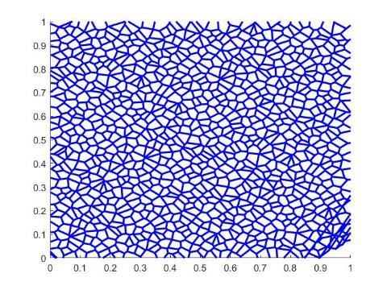
The sets are generated by selecting random numbers in 2 dimensions between 0 and 1, then performing a Voronoi segmentation based on the seed points
The images shown are cropped views, so the outlier boundaries are not seen

Slide 10
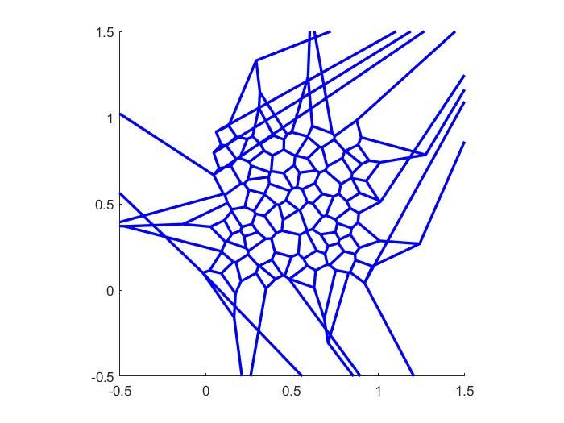
When generating polytopes, the number of results is equal to or less than (usually slightly) than the number of seed points
Some polytopes along edges extend out of the region and are deleted, resulting in fewer polytopes than seeds

Slide 11
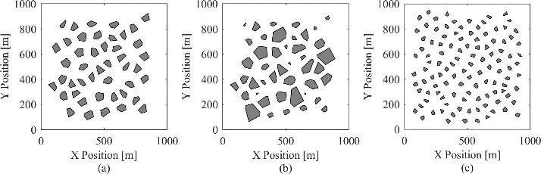
There are defining properties of each map with respect to obstacles
The maps generated in this function are constrained by three main factors:
point density,
average obstacle radius, and
standard deviation in obstacle radius.
The image below shows three maps with variations in these three parameters
Maps (a) and (b) have point densities of 75 points per square kilometer, and map (c) has a point density of 150 points per square kilometer. Maps (a) and (b) have average obstacle radii of 50 meters, and map (c) has an average obstacle radius of 30 meters. Maps (a) and (c) have standard deviations in obstacle radius of 0, and map (b) has a standard deviation in obstacle radius of 20 meters.

Slide 12
The point density is defined as the number of obstacles (or points) per unit area
This describes how close the obstacles are to one another.

Slide 13
Obstacle radius is defined as the distance from an obstacle's centroid to its furthest vertex.
The average obstacle radius is the average of all obstacles being considered.

Slide 14
The standard deviation in obstacle radius is the standard deviation of those obstacle radius values.

Slide 15
The process of generating tiled obstacle polytopes uses 3 steps: initial tiling, trimming edges, and then shrinking the poloytopes down
%% Show how the maps can be trimmed, shrunk, etc
% Generate a set of polytopes from the Halton set
fig_num = 21;
Halton_range = [1 200]; % range of Halton points to use to generate the tiling
tiled_polytopes = fcn_MapGen_haltonVoronoiTiling(Halton_range,[1 1],fig_num);
% Plot the polytopes
fig_num = 22;
line_width = 2;
axis_limits = [0 1 0 1];
fcn_MapGen_plotPolytopes(tiled_polytopes,fig_num,'r',line_width,axis_limits);
% remove the edge polytopes that extend past the high and low points
fig_num = 23;
xlow = 0; xhigh = 1; ylow = 0; yhigh = 1;
bounding_box = [xlow ylow; xhigh yhigh];
trimmed_polytopes = ...
fcn_MapGen_polytopeCropEdges(tiled_polytopes,bounding_box,fig_num);
% Shrink to radius
fig_num = 24;
des_rad = 0.03; sigma_radius = 0; min_rad = 0.001;
shrunk_polytopes2=fcn_MapGen_polytopesShrinkToRadius(...
trimmed_polytopes,des_rad,sigma_radius,min_rad,fig_num);
See script_demo_MapGenLibrary.m

Slide 16
Individual polytopes are shrunk with fcn_MapGen_polytopeShrinkToRadius by moving all verticies towards the centroid by some scalar multiplier, derived from the desired final max radius. Max radius is the distance from the centroid to the furthest vertex.
% determine scale factor
scale = new_radius/rad;
…
% find new vertices
new_vert = centroid + scale*(vertices-centroid);

Slide 17
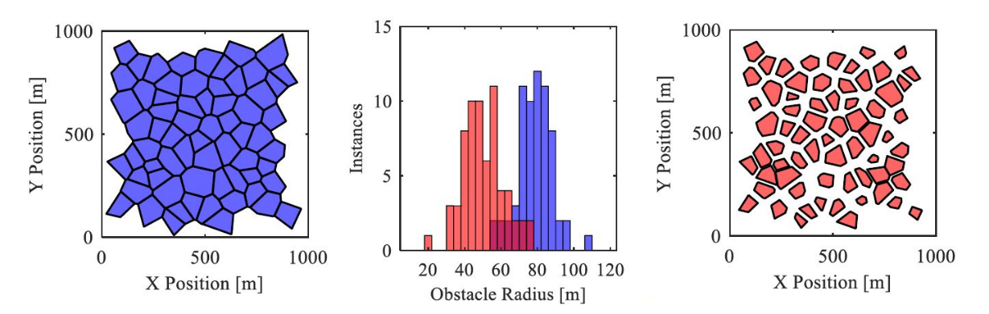
The shrinking process allows introduction of random choice in which polytopes are shrunk, which allows user to set desired mean and standard deviations
See script_demo_MapGenLibrary.m

Slide 18
This is achieved in fcn_MapGen_polytopesShrinkToRadius by first creating a normally distributed set of radii with the desired mean and standard deviation. Then, using a user-defined minimum radius as the minimum value and the current max radius of the polytope as a maximum value, values in the distribution falling out of bounds are reset to the max or min as appropriate.
% determine desired distribution
new_r_dist = normrnd(des_radius,sigma_radius,[Nradii,1]);
…
new_r_dist(new_r_dist>max_r_dist) = max_r_dist(new_r_dist>max_r_dist); % truncate any values that are too large
new_r_dist(new_r_dist<min_r_dist) = min_r_dist; % truncate any values that are too small

Slide 19
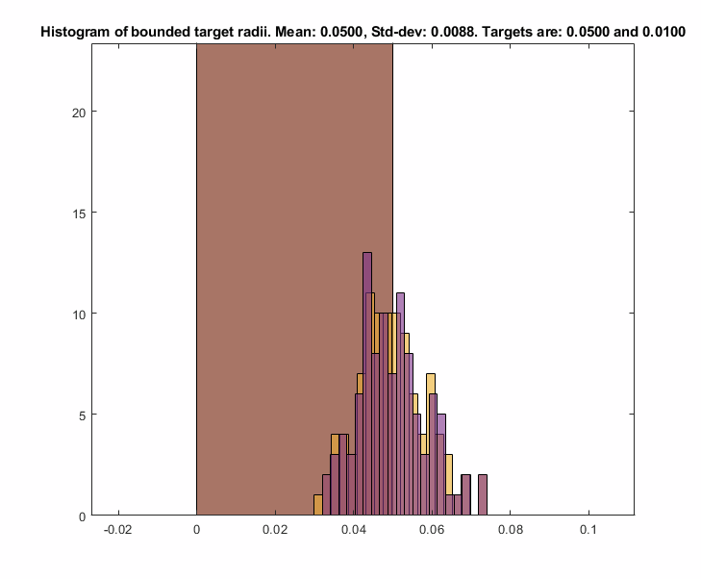
As this truncating operation may shift the mean, the values of the distribution are shifted by the delta between the current mean and the desired mean until the desired mean is reached.
while abs(mean(new_r_dist) - des_radius) > 1e-10
new_r_dist = new_r_dist + (des_radius-mean(new_r_dist));
...
end

Slide 20
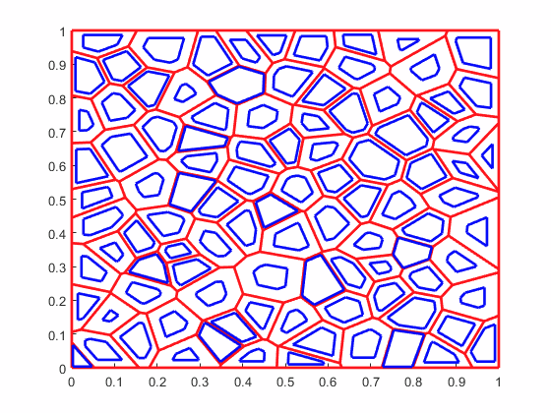
Radii changes and current polytopes are then sorted by size so the largest changes can be applied to the largest polytopes, ensuring all polytopes have enough area to be scaled down. Polytopes are then looped through and scaled with the previously described function fcn_MapGen_polytopeShrinkToRadius
[new_radii_sorted,ob_index] = sort(new_r_dist);
% Check that the old polytopes are large enough to shrink and
% achieve the new radius distribution. Want all the changes to be smaller
% than -2 times the minimum radius, to ensure we do not get singular % I
% have no idea why we do this
% polytopes.
change_in_radii = sort(old_max_radii)'-sort(new_r_dist);
Num_goal_polys_smaller_than_start = sum(change_in_radii>=-2*min_rad);
if Num_goal_polys_smaller_than_start < Nradii
error('distribution is unachievable with generated map')
end
% Initialize the shrunk polytopes structure array, and tolerance for
% distance between vertices, below which vertices are merged into one.
shrunk_polytopes = polytopes;
tolerance = 1e-5; % Units are (implied) kilometers
% Loop through each polytope, shrinking it to the reference size
for ith_radii = 1:length(new_radii_sorted)
shrinker = polytopes(ob_index(ith_radii)); % obstacle to be shrunk
des_rad = new_radii_sorted(ith_radii);
% assign to shrunk_polytopes
shrunk_polytopes(ob_index(ith_radii)) = ...
fcn_MapGen_polytopeShrinkToRadius(...
shrinker,des_rad,tolerance);
end

Slide 21
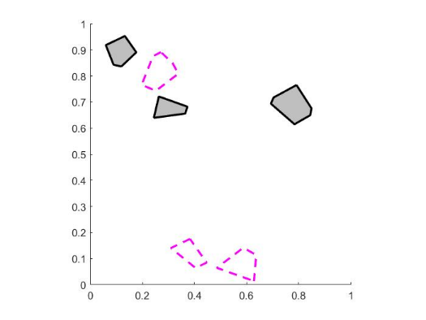
Several functions exist to plot maps. The one for polytopes is: fcn_MapGen_plotPolytopes
% Plot the polytopes
fig_num = 22;
line_width = 2;
axis_limits = [0 1 0 1];
fcn_MapGen_plotPolytopes(tiled_polytopes,fig_num,'r',line_width,axis_limits);

Slide 22
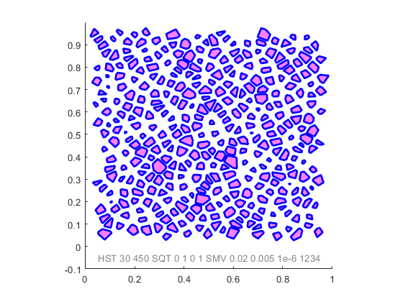
We often want to generate maps by a fully repeatable “name”
The idea is that a string can be produced, and even plotted on the figure, that when entered into the function generates EXACTLY the same map again. This is exceptionally useful for debugging.
%% Generate a map from a name
map_name = "HST 30 450 SQT 0 1 0 1 SMV 0.02 0.005 1e-6 1234";
plot_flag = 1; disp_name = [1, 0.05 -0.05, 0.5 0.5 0.5, 10];
line_style = '-'; line_width = 2; color = [0 0 1];
axis_limits = [0 1 -0.1 1]; axis_style = 'square';
fill_info = [1 1 0 1 0.5];
fig_num = 7;
[polytopes,fig]=fcn_MapGen_nameToMap(...
map_name,...
plot_flag,...
disp_name,...
fig_num,...
line_style,...
line_width,....
color,...
axis_limits,...
axis_style,...
fill_info);

