Slide 1
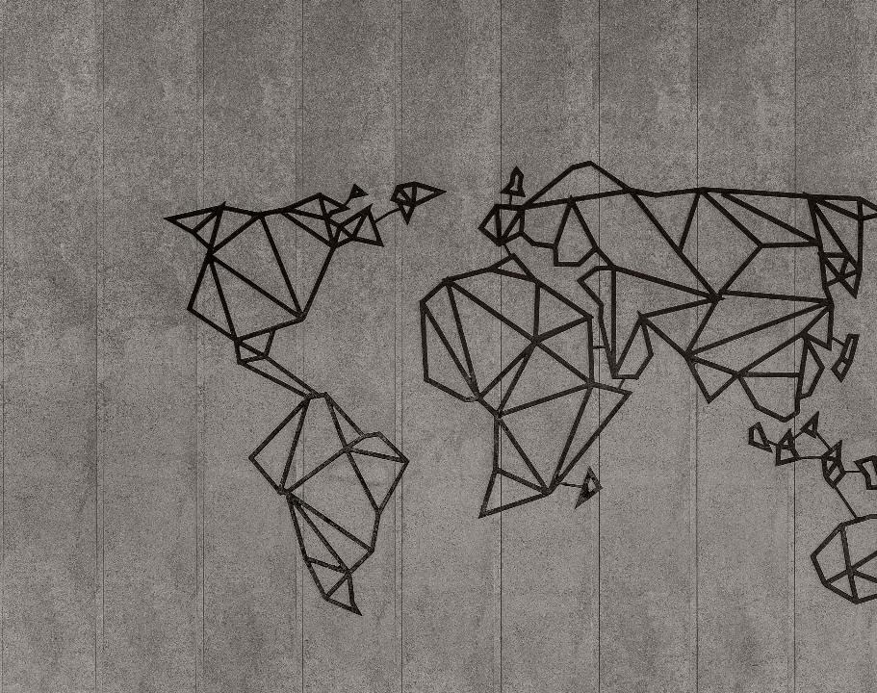
Map Gen Class Library
Descriptions of the “MapGen” class of functions

Slide 2
The MapGen class library hosts tools to build maps useful for studying path planning, autonomy, etc.
The result of these operations is some data representation of the expected environment.

Slide 3
Definitions of terms are important so that we don’t get confused later
Polytope
Polytopes

Slide 4
For many examples below, MATLAB code will be given. It is usually highlighted as shown here: yellow for scripts, grey for console outputs.
%% Example 1: simple three points
fig_num = 1;
x = [-4; -2; 1];
y = [0; -4; -1];
apex_points = [x y];
fcn_FastestTraversal_calculateObstacleDirectionAtApexPoints(...
apex_points, fig_num);
>> script_test_fcn_geometry_selfCrossProduct
cross_products =
0
err =
1

Slide 5
Each function uses a class-specific argument check function
function fcn_MapGen_checkInputsToFunctions(...
variable,variable_type_string,varargin)
% fcn_MapGen_checkInputsToFunctions
% Checks the variable types commonly used in the MapGen codes to
% ensure they are correctly formed.
%
% This function is typically called at the top of most functions. The input
% is a variable and a string defining the "type" of the variable. This
% function checks to see that they are compatible. For example, say there
% 'column_vector' type of variables used in the function that is always a N
% x 1 array; if someone had a variable called "test_example", they could
% check that this fit the 'column_vector' type by calling
% fcn_MapGen_checkInputsToFunctions(test_example,'column_vector').
% This function would then check that the array was N x 1, and if it was
% not, it would send out an error warning.
%
% FORMAT:
%
% fcn_MapGen_checkInputsToFunctions(...
% variable,variable_type_string,(optional_arguments))
%
% INPUTS:
%
% variable: the variable to check
See: script_test_fcn_MapGen_checkInputsToFunctions.m for example usages

Slide 6
A demonstration script exists that shows most of the functionality in this document: script_demo_MapGenLibrary
%% Show how inputs are checked
Twocolumn_of_numbers_test = [4 1; 3 0; 2 5];
fcn_MapGen_checkInputsToFunctions(Twocolumn_of_numbers_test, '2column_of_numbers');
%% Generate a set of polytopes from various pseudo-random sources
% Generate a set of polytopes from the Sobol set
fig_num = 11;
Sobol_range = [1 1000]; % range of Sobol points to use to generate the tiling
tiled_polytopes = fcn_MapGen_sobolVoronoiTiling(Sobol_range,[1 1],fig_num);
% Generate a set of polytopes from the Halton set
fig_num = 12;
Halton_range = [1 1000]; % range of Halton points to use to generate the tiling
tiled_polytopes = fcn_MapGen_haltonVoronoiTiling(Halton_range,[1 1],fig_num);

Slide 7
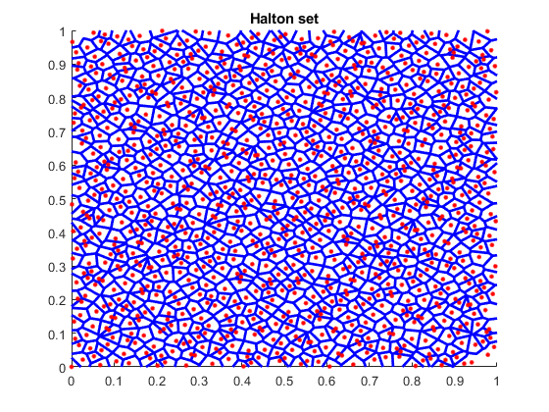
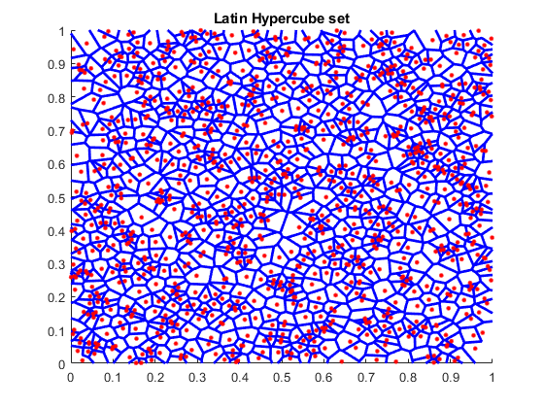
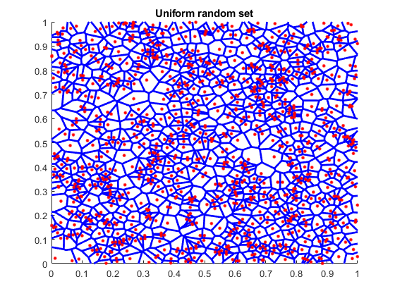
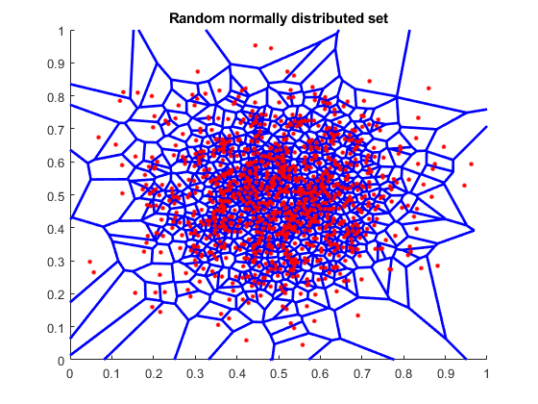
There are a number of pseudo-random number generators that can be used to create tilings within a map, and the results of each are very different.

Slide 8
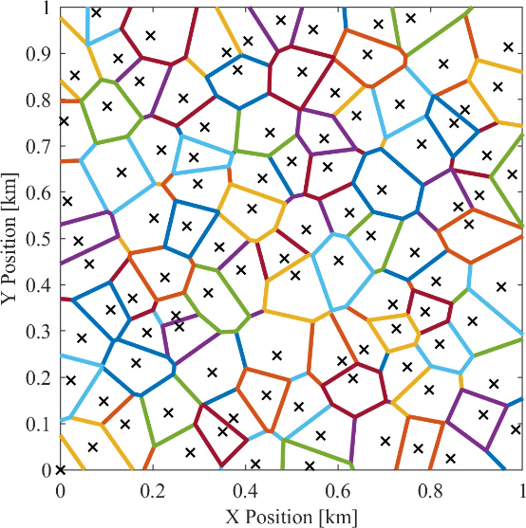
The Halton set is the one we use most often and in nearly all the codes
It gives fairly uniform, non-repeating tilings without clumping

Slide 9
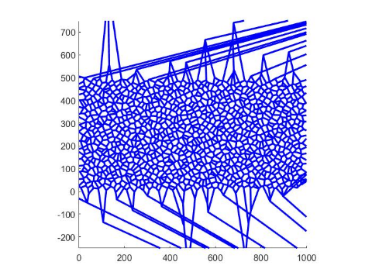
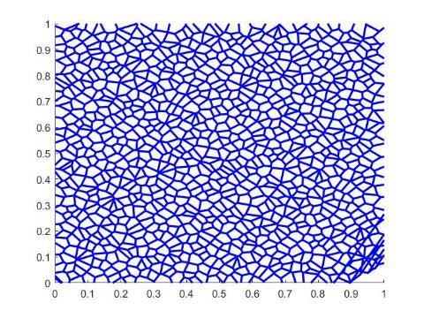
The sets are generated by selecting random numbers in 2 dimensions between 0 and 1, then performing a Voronoi segmentation based on the seed points
The images shown are cropped views, so the outlier boundaries are not seen

Slide 10
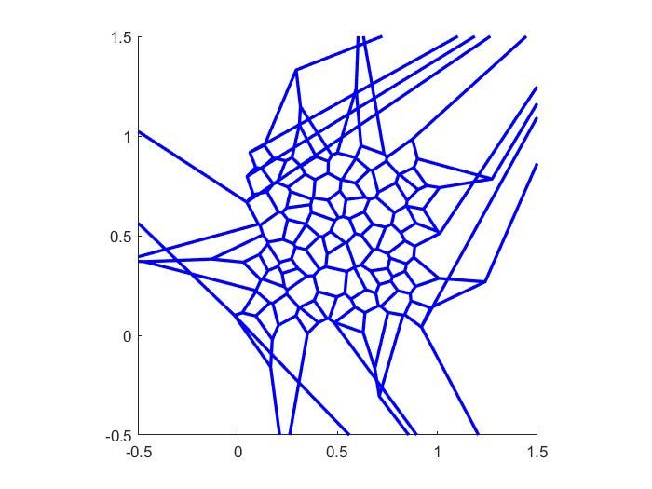
When generating polytopes, the number of results is equal to or less than (usually slightly) than the number of seed points
Some polytopes along edges extend out of the region and are deleted, resulting in fewer polytopes than seeds

Slide 11
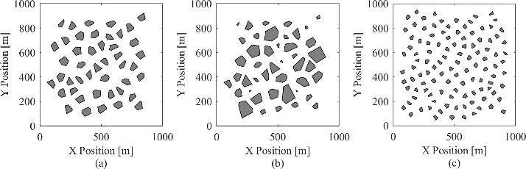
There are defining properties of each map with respect to obstacles
The maps generated in this function are constrained by three main factors:
point density,
average obstacle radius, and
standard deviation in obstacle radius.
The image below shows three maps with variations in these three parameters
Maps (a) and (b) have point densities of 75 points per square kilometer, and map (c) has a point density of 150 points per square kilometer. Maps (a) and (b) have average obstacle radii of 50 meters, and map (c) has an average obstacle radius of 30 meters. Maps (a) and (c) have standard deviations in obstacle radius of 0, and map (b) has a standard deviation in obstacle radius of 20 meters.

Slide 12
The point density is defined as the number of obstacles (or points) per unit area
This describes how close the obstacles are to one another.

Slide 13
Obstacle radius is defined as the distance from an obstacle's centroid to its furthest vertex.
The average obstacle radius is the average of all obstacles being considered.

Slide 14
The standard deviation in obstacle radius is the standard deviation of those obstacle radius values.

Slide 15
The process of generating tiled obstacle polytopes uses 3 steps: initial tiling, trimming edges, and then shrinking the poloytopes down
%% Show how the maps can be trimmed, shrunk, etc
% Generate a set of polytopes from the Halton set
fig_num = 21;
Halton_range = [1 200]; % range of Halton points to use to generate the tiling
tiled_polytopes = fcn_MapGen_haltonVoronoiTiling(Halton_range,[1 1],fig_num);
% Plot the polytopes
fig_num = 22;
line_width = 2;
axis_limits = [0 1 0 1];
fcn_MapGen_plotPolytopes(tiled_polytopes,fig_num,'r',line_width,axis_limits);
% remove the edge polytopes that extend past the high and low points
fig_num = 23;
xlow = 0; xhigh = 1; ylow = 0; yhigh = 1;
bounding_box = [xlow ylow; xhigh yhigh];
trimmed_polytopes = ...
fcn_MapGen_polytopeCropEdges(tiled_polytopes,bounding_box,fig_num);
% Shrink to radius
fig_num = 24;
des_rad = 0.03; sigma_radius = 0; min_rad = 0.001;
shrunk_polytopes2=fcn_MapGen_polytopesShrinkToRadius(...
trimmed_polytopes,des_rad,sigma_radius,min_rad,fig_num);
See script_demo_MapGenLibrary.m

Slide 16
Individual polytopes are shrunk with fcn_MapGen_polytopeShrinkToRadius by moving all verticies towards the centroid by some scalar multiplier, derived from the desired final max radius. Max radius is the distance from the centroid to the furthest vertex.
% determine scale factor
scale = new_radius/rad;
…
% find new vertices
new_vert = centroid + scale*(vertices-centroid);

Slide 17
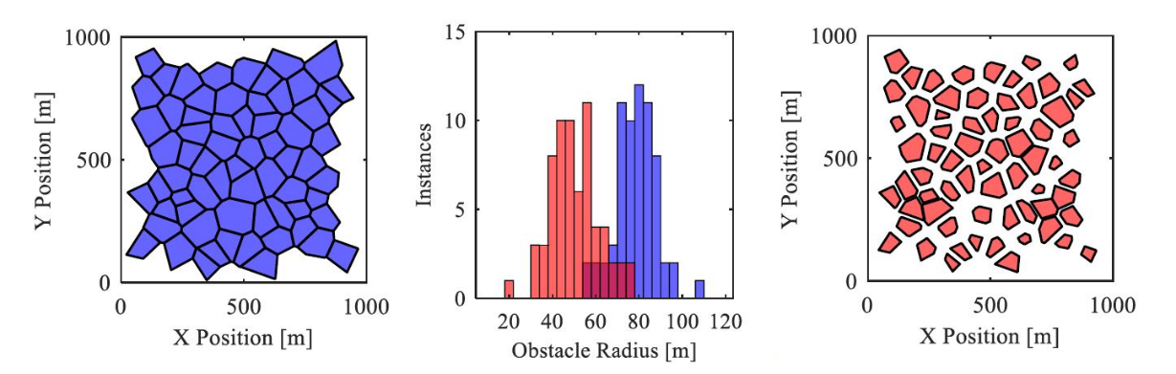
The shrinking process allows introduction of random choice in which polytopes are shrunk, which allows user to set desired mean and standard deviations
See script_demo_MapGenLibrary.m

Slide 18
This is achieved in fcn_MapGen_polytopesShrinkToRadius by first creating a normally distributed set of radii with the desired mean and standard deviation. Then, using a user-defined minimum radius as the minimum value and the current max radius of the polytope as a maximum value, values in the distribution falling out of bounds are reset to the max or min as appropriate.
% determine desired distribution
new_r_dist = normrnd(des_radius,sigma_radius,[Nradii,1]);
…
new_r_dist(new_r_dist>max_r_dist) = max_r_dist(new_r_dist>max_r_dist); % truncate any values that are too large
new_r_dist(new_r_dist<min_r_dist) = min_r_dist; % truncate any values that are too small

Slide 19
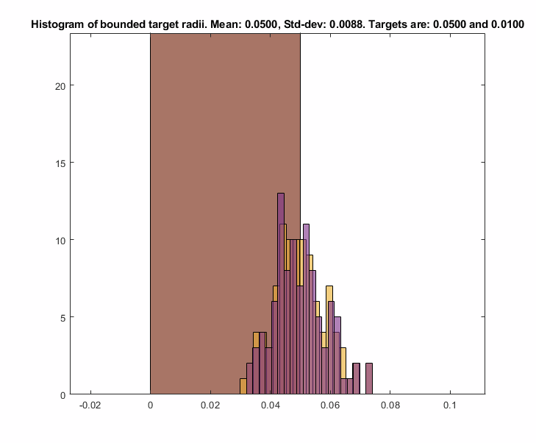
As this truncating operation may shift the mean, the values of the distribution are shifted by the delta between the current mean and the desired mean until the desired mean is reached.
while abs(mean(new_r_dist) - des_radius) > 1e-10
new_r_dist = new_r_dist + (des_radius-mean(new_r_dist));
...
end

Slide 20
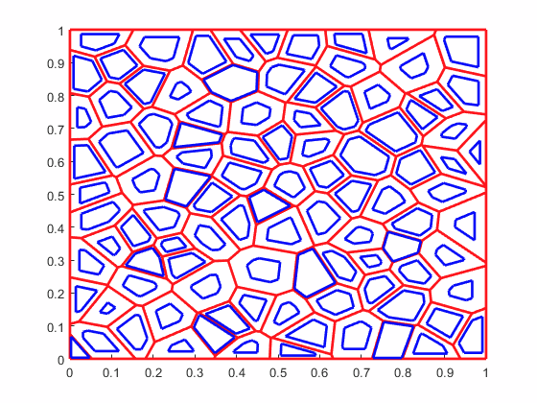
Radii changes and current polytopes are then sorted by size so the largest changes can be applied to the largest polytopes, ensuring all polytopes have enough area to be scaled down. Polytopes are then looped through and scaled with the previously described function fcn_MapGen_polytopeShrinkToRadius
[new_radii_sorted,ob_index] = sort(new_r_dist);
% Check that the old polytopes are large enough to shrink and
% achieve the new radius distribution. Want all the changes to be smaller
% than -2 times the minimum radius, to ensure we do not get singular % I
% have no idea why we do this
% polytopes.
change_in_radii = sort(old_max_radii)'-sort(new_r_dist);
Num_goal_polys_smaller_than_start = sum(change_in_radii>=-2*min_rad);
if Num_goal_polys_smaller_than_start < Nradii
error('distribution is unachievable with generated map')
end
% Initialize the shrunk polytopes structure array, and tolerance for
% distance between vertices, below which vertices are merged into one.
shrunk_polytopes = polytopes;
tolerance = 1e-5; % Units are (implied) kilometers
% Loop through each polytope, shrinking it to the reference size
for ith_radii = 1:length(new_radii_sorted)
shrinker = polytopes(ob_index(ith_radii)); % obstacle to be shrunk
des_rad = new_radii_sorted(ith_radii);
% assign to shrunk_polytopes
shrunk_polytopes(ob_index(ith_radii)) = ...
fcn_MapGen_polytopeShrinkToRadius(...
shrinker,des_rad,tolerance);
end

Slide 21
Shrink from Edges Functionality
Updated 2022-02-17 by S. Brennan

Slide 22
Individual polytopes can be shrunk by edges, and the first step is to find the Vertex Skeleton via: fcn_MapGen_polytopeFindVertexSkeleton This function defines how the vertices “move” as edges are trimmed inward by the same amount.
fig_num = 675;
vertices = [0 0; 2 0; 1 2; 0 1; 0 0]*5;
fcn_MapGen_polytopeFindVertexSkeleton(vertices,fig_num);

Slide 23
The skeleton is calculated by iterating inward from the given vertices
As long as there are more than 2 vertices, it:
Calculates the vectors pointing inward, and angles they make relative to next segment (“half angles”)
Using the angles and vectors, calculates where the vectors intersect
Finds the minimum distance of intersection
Merges vertices that come together
Repeats

Slide 24
Step 1: To calculate the vectors inward, the function calls an internal function to obtain unit vectors inward, the half angles, the distances from vertex-to-vertex, and unit vectors from vertex to vertex.
[vector_direction_of_unit_cut, ...
half_angles,...
distances_vertex_to_vertex,...
unit_vectors_vertex_to_vertex] = ...
INTERNAL_fcn_findUnitDirectionVectors(working_vertices,333);

Slide 25

















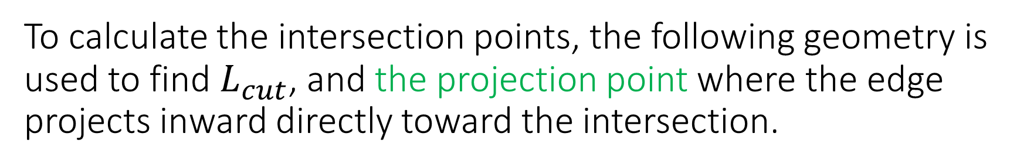


To calculate the intersection points, the following geometry is used to find $L_{cut}$, and the projection point where the edge projects inward directly toward the intersection.
$$L_{1}⋅\tan{θ_{1}}=L_{2}⋅\tan{θ_{2}}$$
$$L_{1}=L_{2}⋅\frac{\tan{θ_{2}}}{\tan{θ_{1}}}$$
$$L_{2}=D−L_{1}$$
$$θ_{1}$$
$$H_{1}$$
$$L_{1}=\left(D−L_{1}\right)⋅\frac{\tan{θ_{2}}}{\tan{θ_{1}}}$$
$$1$$
$$θ_{1}$$
$$L_{cut}$$
$$L_{1}$$
$$Let A=\frac{\tan{θ_{2}}}{\tan{θ_{1}}}$$
$$H_{2}$$
$$L_{1}=\frac{A}{A+1}⋅D$$
$$L_{cut}=L_{1}⋅\tan{θ_{1}}⁡$$
D
$$L_{2}$$
$$θ_{2}$$
$$θ_{2}$$
$$L_{cut}=\frac{\tan{θ_{1}}⋅\tan{θ_{2}}}{\tan{θ_{1}}+\tan{θ_{2}}}⋅D⁡$$
$$2$$

Slide 26
Using the half-angles to define the theta1 and theta2 values, one can find the projection points from each edge
These projection points are where the orthogonal from each edge would intersect the vertices, as vertices shrink inward and touch each other.

Slide 27
We next rotate the unit vectors from one corner to another by 90 degrees, and starting from the projection points, move inward by Lcut. This predicts the intersection points of the vertices.

Slide 28
The minimum cut distance defines how far we can cut inward before vertices merge. The indices that merge have to have the same cut distance and follow one after the other.
Once we know which vertex is the closest, we need to move all vertices inward by ONLY the shortest cut distance.

Slide 29
Before starting on the next step, in case there are only 2 points left, we calculate the vector direction of the unit cuts for the new vertices just created.
These are just the average of the adjacent vectors that were merged. This is repeated until all the points converge, or only 2 points are left

Slide 30
The final result is the skeleton plot
The outputs give:
new_vertices: a cell array of dimension M, where each index 1:M stores a N x 2 array of the coordinates of the nested shape inside, with M = 1 being the starting shape (and with dimension K+1, where K is number of vertices given), and N being smaller and smaller for each M value.
new_projection_vectors: a cell array of M, where each index 1:M stores a L x 2 array of the unit vectors (with L = N-1) that point away from the vertices of the nested shape inside, with M = 1 being the starting unit vectors (and with dimension K, where K is number of vertices given), and L being smaller and smaller for each M value.
cut_distance: a cell array of M, ranging from 0 (for M=1) to the maximum cut distance that can be used

Slide 31
To use this, we index the template corresponding to our cut depth, and cut more if needed
fig_num = 675;
vertices = [0 0; 2 0; 1 2; 0 1; 0 0]*5;
[new_vertices, new_projection_vectors, cut_distance] = fcn_MapGen_polytopeFindVertexSkeleton(vertices,fig_num);
figure(4747);
grid on
grid minor
hold on
axis equal
for cut = 0:0.5:cut_distance(end)
% Find the shape that is less than or equal to the cut
shape_index = find(cut_distance<=cut,1,'last');
% Grab vertices to start from, cut to start from
starting_vertices = new_vertices{shape_index};
starting_cut = cut_distance(shape_index);
% Calculate projection distance
projection_distance = cut - starting_cut;
% Determine final vertices
final_vertices = starting_vertices + new_projection_vectors{shape_index}*projection_distance;
% Plot results
plot(final_vertices(:,1),final_vertices(:,2),'r.-','Linewidth',2,'Markersize',20);
end

Slide 32
Here’s other examples:
Goofy Polytope:
Square:
Wide Rectangle:
Tall Rectangle:
Random Polytope:
See: script_test_fcn_MapGen_polytopeFindVertexSkeleton
For more examples

Slide 33
The function fcn_MapGen_polytopeShrinkFromEdges implements the skeleton calculations to perform the shrinkage
This is implemented in three steps:
1. Calculate the polytope skeleton, or use the skeleton if the user
provides this as inputs.
2. Using the cut distance, find the template that is less than or equal
to the cut distance. If less, then calculate the additional cut and
project the verticies to their new points based on residual cut.
3. Convert the resulting verticies into the standard polytope form.

Slide 34
The code that performs the cutting is relatively simple. It uses the largest template that corresponds to a cut smaller or equal to the requested cut.
%% STEP 2. Using the cut distance, find the template
% We want to use the one that is less than or equal to the cut distance. If
% less, then calculate the additional cut and project the verticies to
% their new points based on residual cut.
% Find the shape that is less than or equal to the cut
shape_index = find(cut_distance<=edge_cut,1,'last');
% Grab vertices to start from, cut to start from
template_vertices = new_vertices{shape_index};
template_start_cut = cut_distance(shape_index);
% Calculate projection distance
additional_cut_distance = edge_cut - template_start_cut;
% Determine final vertices
final_vertices = template_vertices + new_projection_vectors{shape_index}*additional_cut_distance;

Slide 35
The results are as expected
Square:
Right Triangle:
Right Triangle Cut too Deeply
Repeated cuts:
See: script_test_fcn_MapGen_polytopeFindVertexSkeleton
For more examples

Slide 36
When using edge cutting, particularly if repeatedly using this, significant computation time is saved if one avoids repeated calculation of the skeleton.
If one precomputes, this and reuses it, it can save roughly 10 times the computation. If one avoids polytope calculations and just needs the vertices, it saves roughly 100 times the calculations

Slide 37
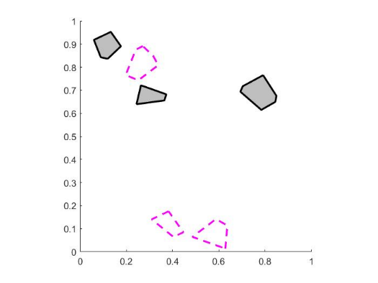
Several functions exist to plot maps. The one for polytopes is: fcn_MapGen_plotPolytopes
% Plot the polytopes
fig_num = 22;
line_width = 2;
axis_limits = [0 1 0 1];
fcn_MapGen_plotPolytopes(tiled_polytopes,fig_num,'r',line_width,axis_limits);

Slide 38
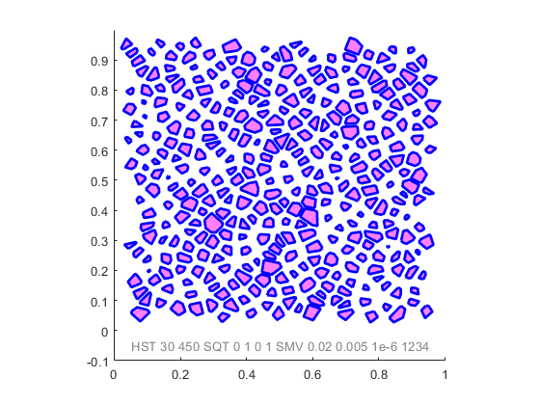
We often want to generate maps by a fully repeatable “name”
The idea is that a string can be produced, and even plotted on the figure, that when entered into the function generates EXACTLY the same map again. This is exceptionally useful for debugging.
%% Generate a map from a name
map_name = "HST 30 450 SQT 0 1 0 1 SMV 0.02 0.005 1e-6 1234";
plot_flag = 1; disp_name = [1, 0.05 -0.05, 0.5 0.5 0.5, 10];
line_style = '-'; line_width = 2; color = [0 0 1];
axis_limits = [0 1 -0.1 1]; axis_style = 'square';
fill_info = [1 1 0 1 0.5];
fig_num = 7;
[polytopes,fig]=fcn_MapGen_nameToMap(...
map_name,...
plot_flag,...
disp_name,...
fig_num,...
line_style,...
line_width,....
color,...
axis_limits,...
axis_style,...
fill_info);

Slide 39
Slide for real calculation (area based)

Slide 40
Slide explaining measured occupancy ratio calculation

Slide 41
Plot of area calc

Slide 42

The most basic estimate can be found from dimensionless analysis (see formula 4.24 in Seth Tau’s thesis).

Slide 43
Plot with 2 series

Slide 44

The perimeter estimation method associates all unoccupied area with side length perimeters so does not account for the area at vertices. Also breaks when edges are removed

Slide 45


This can be modified to include an equilateral triangle with a side length equal to gap size as a crude estimate for including this unaccounted for space.

Slide 46
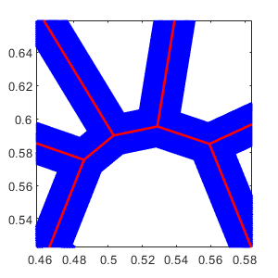
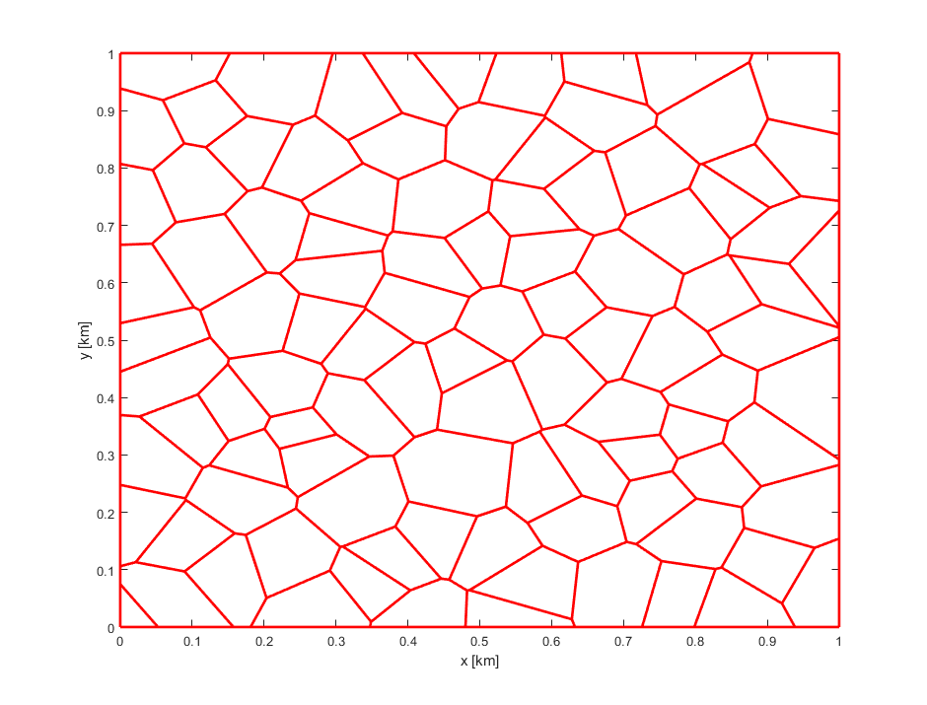
Triangles are not a bad approximate for small gaps because all Voronoi diagram intersections are 3-way intersections. Complex intersections in the Voronoi diagram can be decomposed into 3-way intersections.

Slide 47
Triangles are not a bad approximate for small gaps because all Voronoi diagram intersections are 3-way intersections. Complex intersections in the Voronoi diagram can be decomposed into 3-way intersections.

Slide 48
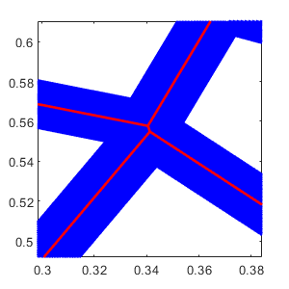
However, this is not necessarily true after shrinking when sides are removed.

Slide 49
This means some non-perimeter areas are quadrilaterals, not triangles. Therefore we need to know not just vertex angles, but which vertices are associated with each other.

Slide 50
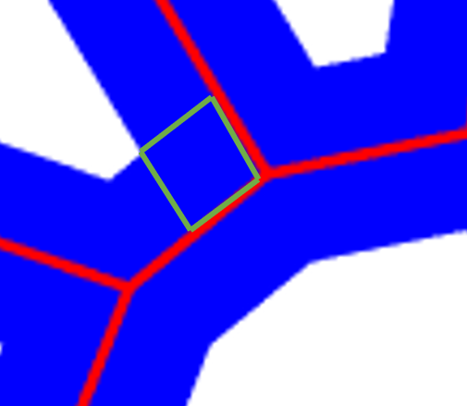
Instead of using one shape to represent each gap between perimeter rectangles, we could use multiple parallelograms to represent each gap between rectangles.
G/2
ᶿvertex
=
=

Slide 51

This gives the following formula, where the original perimeter based estimate is modified by adding a sum of parallelogram areas.
G/2
ᶿvertex
=
=

Slide 52
This can also be modified to include repeated average sized parallelograms based on average interior vertex angle.
G/2
ᶿvertex
=
=

Slide 53
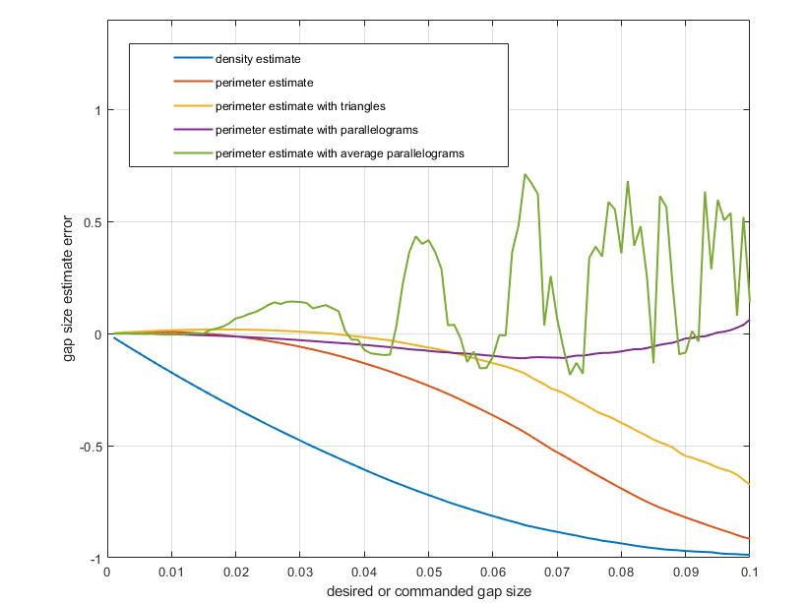
Comparing the errors for these different estimation methods shows that the average parallelogram method is the most accurate. However, we expect the parallelogram method to be perfectly accurate.

Slide 54
The inaccuracy likely occurs because when interior vertex angles are obtuse, the parallelogram formed by this vertex double-counts area already included in the perimeter estimate.

Slide 55
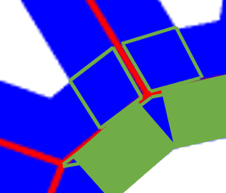
We can modify the code to form a quadrilateral (kite) with the following parameters for every obtuse vertex, in place of a parallelogram.
=
=
G/2
¹⁸⁰⁻ᶿvertex
=
ᶿvertex

Slide 56
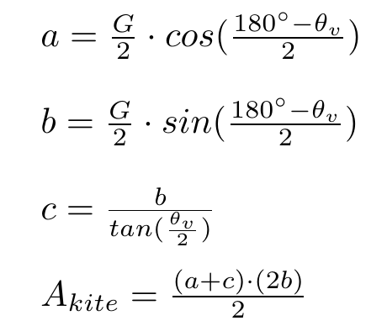
We can find the area of the kite as follows:
ᶿvertex
c
b
a
G/2
¹⁸⁰⁻ᶿvertex

Slide 57
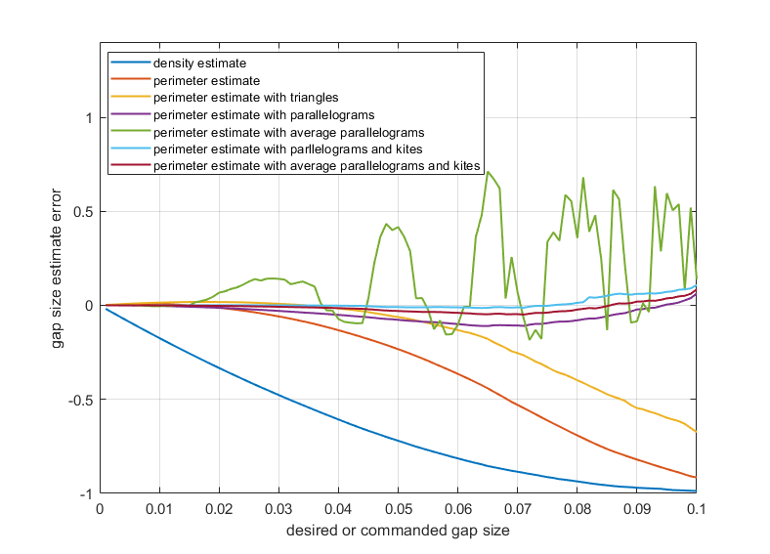
Using kites instead of parallelograms for all obtuse angles improves the estimate over the parallelogram-only approach.

