Slide 1
For many examples below, MATLAB code will be given. It is usually highlighted as shown here: yellow for scripts, grey for console outputs.
%% Example 1: simple three points
fig_num = 1;
x = [-4; -2; 1];
y = [0; -4; -1];
apex_points = [x y];
fcn_FastestTraversal_calculateObstacleDirectionAtApexPoints(...
apex_points, fig_num);
>> script_test_fcn_geometry_selfCrossProduct
cross_products =
0
err =
1

Slide 2
Each function uses a class-specific argument check function
function fcn_MapGen_checkInputsToFunctions(...
variable,variable_type_string,varargin)
% fcn_MapGen_checkInputsToFunctions
% Checks the variable types commonly used in the MapGen codes to
% ensure they are correctly formed.
%
% This function is typically called at the top of most functions. The input
% is a variable and a string defining the "type" of the variable. This
% function checks to see that they are compatible. For example, say there
% 'column_vector' type of variables used in the function that is always a N
% x 1 array; if someone had a variable called "test_example", they could
% check that this fit the 'column_vector' type by calling
% fcn_MapGen_checkInputsToFunctions(test_example,'column_vector').
% This function would then check that the array was N x 1, and if it was
% not, it would send out an error warning.
%
% FORMAT:
%
% fcn_MapGen_checkInputsToFunctions(...
% variable,variable_type_string,(optional_arguments))
%
% INPUTS:
%
% variable: the variable to check
See: script_test_fcn_MapGen_checkInputsToFunctions.m for example usages

Slide 3
A demonstration script exists that shows most of the functionality in this document: script_demo_MapGenLibrary
%% Show how inputs are checked
Twocolumn_of_numbers_test = [4 1; 3 0; 2 5];
fcn_MapGen_checkInputsToFunctions(Twocolumn_of_numbers_test, '2column_of_numbers');
%% Generate a set of polytopes from various pseudo-random sources
% Generate a set of polytopes from the Sobol set
fig_num = 11;
Sobol_range = [1 1000]; % range of Sobol points to use to generate the tiling
tiled_polytopes = fcn_MapGen_sobolVoronoiTiling(Sobol_range,[1 1],fig_num);
% Generate a set of polytopes from the Halton set
fig_num = 12;
Halton_range = [1 1000]; % range of Halton points to use to generate the tiling
tiled_polytopes = fcn_MapGen_haltonVoronoiTiling(Halton_range,[1 1],fig_num);

Slide 4
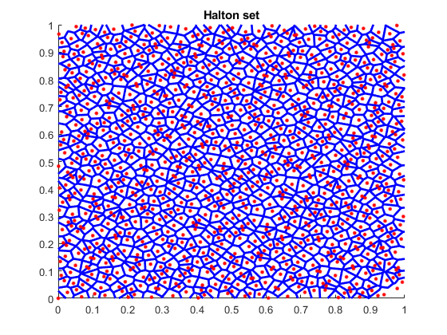
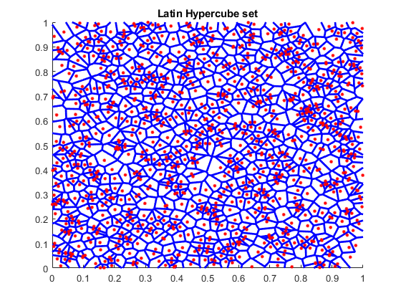
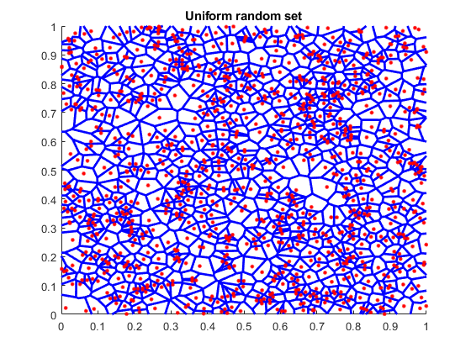
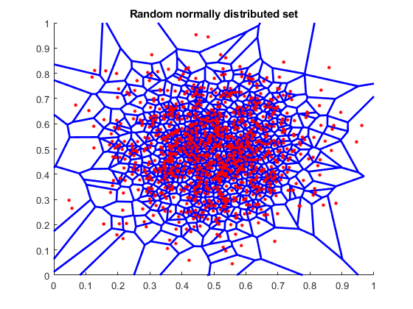
There are a number of pseudo-random number generators that can be used to create tilings within a map, and the results of each are very different.

Slide 5
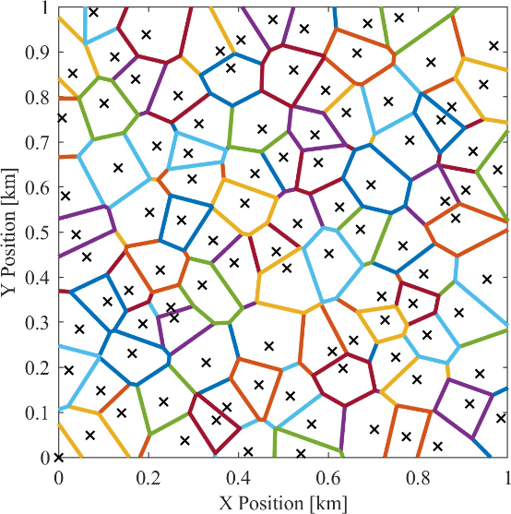
The Halton set is the one we use most often and in nearly all the codes
It gives fairly uniform, non-repeating tilings without clumping

Slide 6
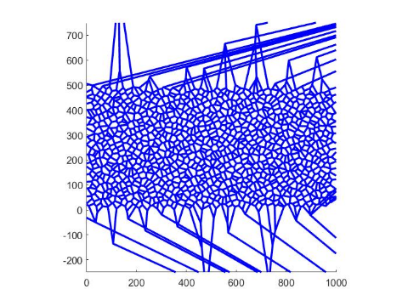
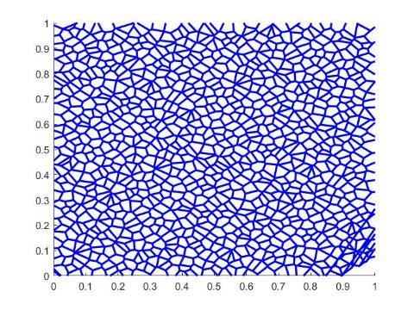
The sets are generated by selecting random numbers in 2 dimensions between 0 and 1, then performing a Voronoi segmentation based on the seed points
The images shown are cropped views, so the outlier boundaries are not seen

Slide 7
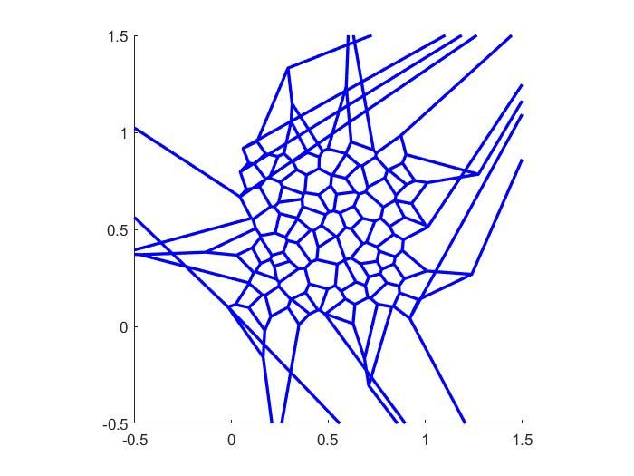
When generating polytopes, the number of results is equal to or less than (usually slightly) than the number of seed points
Some polytopes along edges extend out of the region and are deleted, resulting in fewer polytopes than seeds

Slide 8
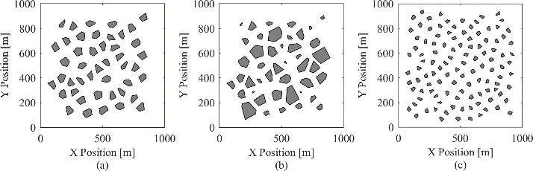
There are defining properties of each map with respect to obstacles
The maps generated in this function are constrained by three main factors:
point density,
average obstacle radius, and
standard deviation in obstacle radius.
The image below shows three maps with variations in these three parameters
Maps (a) and (b) have point densities of 75 points per square kilometer, and map (c) has a point density of 150 points per square kilometer. Maps (a) and (b) have average obstacle radii of 50 meters, and map (c) has an average obstacle radius of 30 meters. Maps (a) and (c) have standard deviations in obstacle radius of 0, and map (b) has a standard deviation in obstacle radius of 20 meters.

Slide 9
The point density is defined as the number of obstacles (or points) per unit area
This describes how close the obstacles are to one another.

Slide 10
Obstacle radius is defined as the distance from an obstacle's centroid to its furthest vertex.
The average obstacle radius is the average of all obstacles being considered.

Slide 11
The standard deviation in obstacle radius is the standard deviation of those obstacle radius values.

Slide 12
The process of generating tiled obstacle polytopes uses 3 steps: initial tiling, trimming edges, and then shrinking the poloytopes down
%% Show how the maps can be trimmed, shrunk, etc
% Generate a set of polytopes from the Halton set
fig_num = 21;
Halton_range = [1 200]; % range of Halton points to use to generate the tiling
tiled_polytopes = fcn_MapGen_haltonVoronoiTiling(Halton_range,[1 1],fig_num);
% Plot the polytopes
fig_num = 22;
line_width = 2;
axis_limits = [0 1 0 1];
fcn_MapGen_plotPolytopes(tiled_polytopes,fig_num,'r',line_width,axis_limits);
% remove the edge polytopes that extend past the high and low points
fig_num = 23;
xlow = 0; xhigh = 1; ylow = 0; yhigh = 1;
bounding_box = [xlow ylow; xhigh yhigh];
trimmed_polytopes = ...
fcn_MapGen_polytopeCropEdges(tiled_polytopes,bounding_box,fig_num);
% Shrink to radius
fig_num = 24;
des_rad = 0.03; sigma_radius = 0; min_rad = 0.001;
shrunk_polytopes2=fcn_MapGen_polytopesShrinkToRadius(...
trimmed_polytopes,des_rad,sigma_radius,min_rad,fig_num);
See script_demo_MapGenLibrary.m

Slide 13
Individual polytopes are shrunk with fcn_MapGen_polytopeShrinkToRadius by moving all verticies towards the centroid by some scalar multiplier, derived from the desired final max radius. Max radius is the distance from the centroid to the furthest vertex.
% determine scale factor
scale = new_radius/rad;
…
% find new vertices
new_vert = centroid + scale*(vertices-centroid);

Slide 14
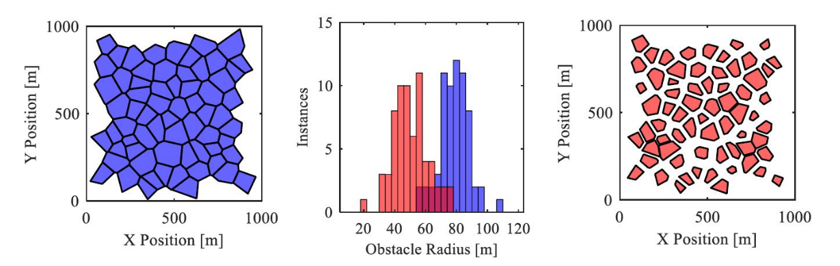
The shrinking process allows introduction of random choice in which polytopes are shrunk, which allows user to set desired mean and standard deviations
See script_demo_MapGenLibrary.m

Slide 15
This is achieved in fcn_MapGen_polytopesShrinkToRadius by first creating a normally distributed set of radii with the desired mean and standard deviation. Then, using a user-defined minimum radius as the minimum value and the current max radius of the polytope as a maximum value, values in the distribution falling out of bounds are reset to the max or min as appropriate.
% determine desired distribution
new_r_dist = normrnd(des_radius,sigma_radius,[Nradii,1]);
…
new_r_dist(new_r_dist>max_r_dist) = max_r_dist(new_r_dist>max_r_dist); % truncate any values that are too large
new_r_dist(new_r_dist<min_r_dist) = min_r_dist; % truncate any values that are too small

Slide 16
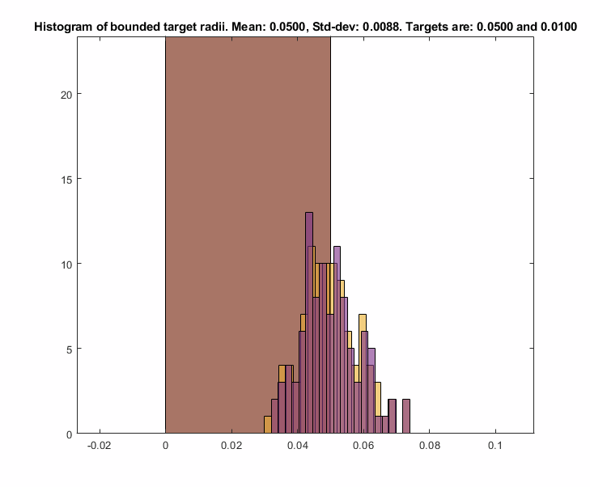
As this truncating operation may shift the mean, the values of the distribution are shifted by the delta between the current mean and the desired mean until the desired mean is reached.
while abs(mean(new_r_dist) - des_radius) > 1e-10
new_r_dist = new_r_dist + (des_radius-mean(new_r_dist));
...
end

Slide 17
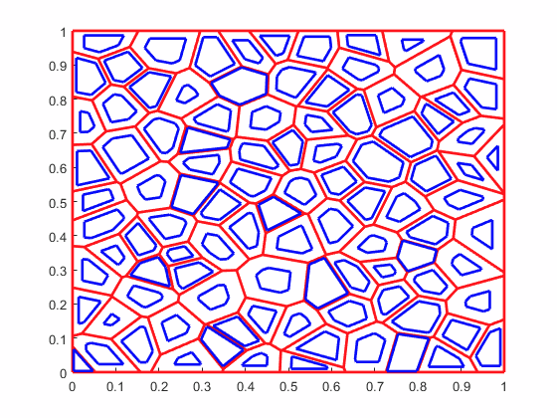
Radii changes and current polytopes are then sorted by size so the largest changes can be applied to the largest polytopes, ensuring all polytopes have enough area to be scaled down. Polytopes are then looped through and scaled with the previously described function fcn_MapGen_polytopeShrinkToRadius
[new_radii_sorted,ob_index] = sort(new_r_dist);
% Check that the old polytopes are large enough to shrink and
% achieve the new radius distribution. Want all the changes to be smaller
% than -2 times the minimum radius, to ensure we do not get singular % I
% have no idea why we do this
% polytopes.
change_in_radii = sort(old_max_radii)'-sort(new_r_dist);
Num_goal_polys_smaller_than_start = sum(change_in_radii>=-2*min_rad);
if Num_goal_polys_smaller_than_start < Nradii
error('distribution is unachievable with generated map')
end
% Initialize the shrunk polytopes structure array, and tolerance for
% distance between vertices, below which vertices are merged into one.
shrunk_polytopes = polytopes;
tolerance = 1e-5; % Units are (implied) kilometers
% Loop through each polytope, shrinking it to the reference size
for ith_radii = 1:length(new_radii_sorted)
shrinker = polytopes(ob_index(ith_radii)); % obstacle to be shrunk
des_rad = new_radii_sorted(ith_radii);
% assign to shrunk_polytopes
shrunk_polytopes(ob_index(ith_radii)) = ...
fcn_MapGen_polytopeShrinkToRadius(...
shrinker,des_rad,tolerance);
end

Slide 18
Shrink from Edges Functionality
Updated 2022-02-17 by S. Brennan

Slide 19
Individual polytopes can be shrunk by edges, and the first step is to find the Vertex Skeleton via: fcn_MapGen_polytopeFindVertexSkeleton This function defines how the vertices “move” as edges are trimmed inward by the same amount.
fig_num = 675;
vertices = [0 0; 2 0; 1 2; 0 1; 0 0]*5;
fcn_MapGen_polytopeFindVertexSkeleton(vertices,fig_num);

Slide 20
The skeleton is calculated by iterating inward from the given vertices
As long as there are more than 2 vertices, it:
Calculates the vectors pointing inward, and angles they make relative to next segment (“half angles”)
Using the angles and vectors, calculates where the vectors intersect
Finds the minimum distance of intersection
Merges vertices that come together
Repeats

Slide 21
Step 1: To calculate the vectors inward, the function calls an internal function to obtain unit vectors inward, the half angles, the distances from vertex-to-vertex, and unit vectors from vertex to vertex.
[vector_direction_of_unit_cut, ...
half_angles,...
distances_vertex_to_vertex,...
unit_vectors_vertex_to_vertex] = ...
INTERNAL_fcn_findUnitDirectionVectors(working_vertices,333);

Slide 22

















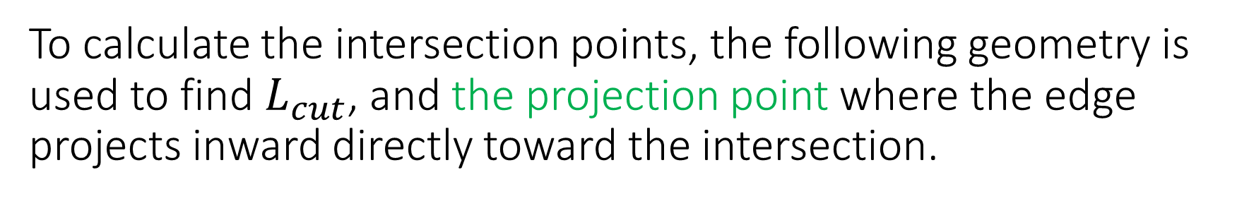


To calculate the intersection points, the following geometry is used to find $L_{cut}$, and the projection point where the edge projects inward directly toward the intersection.
$$L_{1}⋅\tan{θ_{1}}=L_{2}⋅\tan{θ_{2}}$$
$$L_{1}=L_{2}⋅\frac{\tan{θ_{2}}}{\tan{θ_{1}}}$$
$$L_{2}=D−L_{1}$$
$$θ_{1}$$
$$H_{1}$$
$$L_{1}=\left(D−L_{1}\right)⋅\frac{\tan{θ_{2}}}{\tan{θ_{1}}}$$
$$1$$
$$θ_{1}$$
$$L_{cut}$$
$$L_{1}$$
$$Let A=\frac{\tan{θ_{2}}}{\tan{θ_{1}}}$$
$$H_{2}$$
$$L_{1}=\frac{A}{A+1}⋅D$$
$$L_{cut}=L_{1}⋅\tan{θ_{1}}⁡$$
D
$$L_{2}$$
$$θ_{2}$$
$$θ_{2}$$
$$L_{cut}=\frac{\tan{θ_{1}}⋅\tan{θ_{2}}}{\tan{θ_{1}}+\tan{θ_{2}}}⋅D⁡$$
$$2$$

Slide 23
Using the half-angles to define the theta1 and theta2 values, one can find the projection points from each edge
These projection points are where the orthogonal from each edge would intersect the vertices, as vertices shrink inward and touch each other.

Slide 24
We next rotate the unit vectors from one corner to another by 90 degrees, and starting from the projection points, move inward by Lcut. This predicts the intersection points of the vertices.

Slide 25
The minimum cut distance defines how far we can cut inward before vertices merge. The indices that merge have to have the same cut distance and follow one after the other.
Once we know which vertex is the closest, we need to move all vertices inward by ONLY the shortest cut distance.

Slide 26
Before starting on the next step, in case there are only 2 points left, we calculate the vector direction of the unit cuts for the new vertices just created.
These are just the average of the adjacent vectors that were merged. This is repeated until all the points converge, or only 2 points are left

Slide 27
The final result is the skeleton plot
The outputs give:
new_vertices: a cell array of dimension M, where each index 1:M stores a N x 2 array of the coordinates of the nested shape inside, with M = 1 being the starting shape (and with dimension K+1, where K is number of vertices given), and N being smaller and smaller for each M value.
new_projection_vectors: a cell array of M, where each index 1:M stores a L x 2 array of the unit vectors (with L = N-1) that point away from the vertices of the nested shape inside, with M = 1 being the starting unit vectors (and with dimension K, where K is number of vertices given), and L being smaller and smaller for each M value.
cut_distance: a cell array of M, ranging from 0 (for M=1) to the maximum cut distance that can be used

Slide 28
To use this, we index the template corresponding to our cut depth, and cut more if needed
fig_num = 675;
vertices = [0 0; 2 0; 1 2; 0 1; 0 0]*5;
[new_vertices, new_projection_vectors, cut_distance] = fcn_MapGen_polytopeFindVertexSkeleton(vertices,fig_num);
figure(4747);
grid on
grid minor
hold on
axis equal
for cut = 0:0.5:cut_distance(end)
% Find the shape that is less than or equal to the cut
shape_index = find(cut_distance<=cut,1,'last');
% Grab vertices to start from, cut to start from
starting_vertices = new_vertices{shape_index};
starting_cut = cut_distance(shape_index);
% Calculate projection distance
projection_distance = cut - starting_cut;
% Determine final vertices
final_vertices = starting_vertices + new_projection_vectors{shape_index}*projection_distance;
% Plot results
plot(final_vertices(:,1),final_vertices(:,2),'r.-','Linewidth',2,'Markersize',20);
end

Slide 29
Here’s other examples:
Goofy Polytope:
Square:
Wide Rectangle:
Tall Rectangle:
Random Polytope:
See: script_test_fcn_MapGen_polytopeFindVertexSkeleton
For more examples

Slide 30
The function fcn_MapGen_polytopeShrinkFromEdges implements the skeleton calculations to perform the shrinkage
This is implemented in three steps:
1. Calculate the polytope skeleton, or use the skeleton if the user
provides this as inputs.
2. Using the cut distance, find the template that is less than or equal
to the cut distance. If less, then calculate the additional cut and
project the verticies to their new points based on residual cut.
3. Convert the resulting verticies into the standard polytope form.

Slide 31
The code that performs the cutting is relatively simple. It uses the largest template that corresponds to a cut smaller or equal to the requested cut.
%% STEP 2. Using the cut distance, find the template
% We want to use the one that is less than or equal to the cut distance. If
% less, then calculate the additional cut and project the verticies to
% their new points based on residual cut.
% Find the shape that is less than or equal to the cut
shape_index = find(cut_distance<=edge_cut,1,'last');
% Grab vertices to start from, cut to start from
template_vertices = new_vertices{shape_index};
template_start_cut = cut_distance(shape_index);
% Calculate projection distance
additional_cut_distance = edge_cut - template_start_cut;
% Determine final vertices
final_vertices = template_vertices + new_projection_vectors{shape_index}*additional_cut_distance;

Slide 32
The results are as expected
Square:
Right Triangle:
Right Triangle Cut too Deeply
Repeated cuts:
See: script_test_fcn_MapGen_polytopeFindVertexSkeleton
For more examples

Slide 33
When using edge cutting, particularly if repeatedly using this, significant computation time is saved if one avoids repeated calculation of the skeleton.
If one precomputes, this and reuses it, it can save roughly 10 times the computation. If one avoids polytope calculations and just needs the vertices, it saves roughly 100 times the calculations

Slide 34
How to Shrink from Edges with Non-Convex Polytopes
Updated 2025-04-19 by S. Brennan

Slide 35
For non-convex polytopes, the previous methods will not work.

Slide 36
For non-convex polytopes, the previous method requires modification.
Namely, in step 2, the intersections may include other sides
Calculates the vectors pointing inward, and angles they make relative to next segment (“half angles”)
Using the angles and vectors, calculates where the vectors intersect
Finds the minimum distance of intersection
Merges vertices that come together
Repeats

Slide 37
Step 1: Remains largely the same, to calculate key vectors and angles.
These include:
Distances from vertex-to-vertex,
Unit vectors from vertex to vertex,
Unit normal for segment ahead of each vertex
Unit vectors inward at each vertex
[vector_direction_of_unit_cut, ...
half_angles,...
distances_vertex_to_vertex,...
unit_vectors_vertex_to_vertex] = ...
INTERNAL_fcn_findUnitDirectionVectors(working_vertices,333);

Slide 38

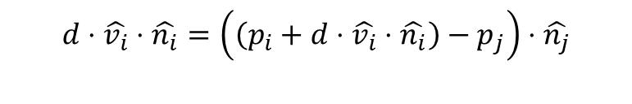




Step 2: This step uses a function to calculate the smallest radius that is circumscribed at a given vertex
Given a unit vertex projection, v_i, this vertex will always be on the centerline of any circle center that is tangent to both n_i and n_i-1. So a projection from another edge must intersect v_j such that the orthogonal distance between both are equal. Note that this method works for any dimension (2D, 3D, 4D, etc.)
$$\hat{n_{j}}$$
$$p_{j}$$
$$\hat{v_{i}}$$
$$d⋅\hat{v_{i}}⋅\hat{n_{i}}=\left(\left(p_{i}+d⋅\hat{v_{i}}⋅\hat{n_{i}}\right)−p_{j}\right)⋅\hat{n_{j}}$$
$$p_{i}$$
$$\hat{n_{i}}$$

Slide 39
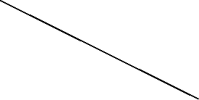

Not all edges participate in this calculation
The center of the resulting circle must be “within” the shrink envelope of the test edge. For example, the circle shown here is “inscribed” by 3 edges, but the top-left edge would not actually project enough to contact the circle at this radius.
$$\hat{v_{i}}$$

Slide 40

How does one find which edges participate in the vertex expansion?
Each candidate plane has vertex projections that define its boundaries. From the known radius, one can project the edge outward along these vertex projections. The circle center must lie within the envelope of points created by projecting by these vertices
$$\hat{v_{i}}$$

Slide 41

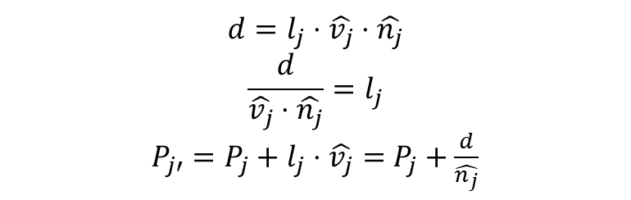



How to find if the center is “enclosed” by the projected plane?
Knowing the projection distance, d, we can calculate the projection distance of each unit vector vertex using:
Each point of the vertex, defined by the point Pj projected outward to Pj’, creates an encirclement criterion
$$\hat{v_{j}}$$
$$l_{j}$$
$$d$$
$$d=l_{j}⋅\hat{v_{j}}⋅\hat{n_{j}}$$
$$\frac{d}{\hat{v_{j}}⋅\hat{n_{j}}}=l_{j}$$
$P_{j′}=P_{j}+l_{j}⋅\hat{v_{j}}=$ $P_{j}+\frac{d}{\hat{n_{j}}}$
$$\hat{n_{j}}$$

Slide 42
https://www.mdpi.com/2220-9964/9/5/304
https://stackoverflow.com/questions/69237154/how-do-you-get-the-medial-axis-of-a-multipolygon-using-cgal
https://groups.csail.mit.edu/graphics/classes/6.838/S98/meetings/m25/m25.html

Slide 43

To calculate the intersection points, the following geometry is used to find $L_{cut}$, and the projection point where the edge projects inward directly toward the intersection.
$$L_{1}⋅\tan{θ_{1}}=L_{2}⋅\tan{θ_{2}}$$
$$L_{1}=L_{2}⋅\frac{\tan{θ_{2}}}{\tan{θ_{1}}}$$
$$L_{2}=D−L_{1}$$
$$θ_{1}$$
$$H_{1}$$
$$L_{1}=\left(D−L_{1}\right)⋅\frac{\tan{θ_{2}}}{\tan{θ_{1}}}$$
$$1$$
$$θ_{1}$$
$$L_{cut}$$
$$L_{1}$$
$$Let A=\frac{\tan{θ_{2}}}{\tan{θ_{1}}}$$
$$H_{2}$$
$$L_{1}=\frac{A}{A+1}⋅D$$
$$L_{cut}=L_{1}⋅\tan{θ_{1}}⁡$$
D
$$L_{2}$$
$$θ_{2}$$
$$θ_{2}$$
$$L_{cut}=\frac{\tan{θ_{1}}⋅\tan{θ_{2}}}{\tan{θ_{1}}+\tan{θ_{2}}}⋅D⁡$$
$$2$$

Slide 44
Using the half-angles to define the theta1 and theta2 values, one can find the projection points from each edge
These projection points are where the orthogonal from each edge would intersect the vertices, as vertices shrink inward and touch each other.

Slide 45
We next rotate the unit vectors from one corner to another by 90 degrees, and starting from the projection points, move inward by Lcut. This predicts the intersection points of the vertices.

Slide 46
The minimum cut distance defines how far we can cut inward before vertices merge. The indices that merge have to have the same cut distance and follow one after the other.
Once we know which vertex is the closest, we need to move all vertices inward by ONLY the shortest cut distance.

Slide 47
Before starting on the next step, in case there are only 2 points left, we calculate the vector direction of the unit cuts for the new vertices just created.
These are just the average of the adjacent vectors that were merged. This is repeated until all the points converge, or only 2 points are left

Slide 48
The final result is the skeleton plot
The outputs give:
new_vertices: a cell array of dimension M, where each index 1:M stores a N x 2 array of the coordinates of the nested shape inside, with M = 1 being the starting shape (and with dimension K+1, where K is number of vertices given), and N being smaller and smaller for each M value.
new_projection_vectors: a cell array of M, where each index 1:M stores a L x 2 array of the unit vectors (with L = N-1) that point away from the vertices of the nested shape inside, with M = 1 being the starting unit vectors (and with dimension K, where K is number of vertices given), and L being smaller and smaller for each M value.
cut_distance: a cell array of M, ranging from 0 (for M=1) to the maximum cut distance that can be used

Slide 49
To use this, we index the template corresponding to our cut depth, and cut more if needed
fig_num = 675;
vertices = [0 0; 2 0; 1 2; 0 1; 0 0]*5;
[new_vertices, new_projection_vectors, cut_distance] = fcn_MapGen_polytopeFindVertexSkeleton(vertices,fig_num);
figure(4747);
grid on
grid minor
hold on
axis equal
for cut = 0:0.5:cut_distance(end)
% Find the shape that is less than or equal to the cut
shape_index = find(cut_distance<=cut,1,'last');
% Grab vertices to start from, cut to start from
starting_vertices = new_vertices{shape_index};
starting_cut = cut_distance(shape_index);
% Calculate projection distance
projection_distance = cut - starting_cut;
% Determine final vertices
final_vertices = starting_vertices + new_projection_vectors{shape_index}*projection_distance;
% Plot results
plot(final_vertices(:,1),final_vertices(:,2),'r.-','Linewidth',2,'Markersize',20);
end

Slide 50
Here’s other examples:
Goofy Polytope:
Square:
Wide Rectangle:
Tall Rectangle:
Random Polytope:
See: script_test_fcn_MapGen_polytopeFindVertexSkeleton
For more examples

Slide 51
The function fcn_MapGen_polytopeShrinkFromEdges implements the skeleton calculations to perform the shrinkage
This is implemented in three steps:
1. Calculate the polytope skeleton, or use the skeleton if the user
provides this as inputs.
2. Using the cut distance, find the template that is less than or equal
to the cut distance. If less, then calculate the additional cut and
project the verticies to their new points based on residual cut.
3. Convert the resulting verticies into the standard polytope form.

Slide 52
The code that performs the cutting is relatively simple. It uses the largest template that corresponds to a cut smaller or equal to the requested cut.
%% STEP 2. Using the cut distance, find the template
% We want to use the one that is less than or equal to the cut distance. If
% less, then calculate the additional cut and project the verticies to
% their new points based on residual cut.
% Find the shape that is less than or equal to the cut
shape_index = find(cut_distance<=edge_cut,1,'last');
% Grab vertices to start from, cut to start from
template_vertices = new_vertices{shape_index};
template_start_cut = cut_distance(shape_index);
% Calculate projection distance
additional_cut_distance = edge_cut - template_start_cut;
% Determine final vertices
final_vertices = template_vertices + new_projection_vectors{shape_index}*additional_cut_distance;

Slide 53
The results are as expected
Square:
Right Triangle:
Right Triangle Cut too Deeply
Repeated cuts:
See: script_test_fcn_MapGen_polytopeFindVertexSkeleton
For more examples

Slide 54
When using edge cutting, particularly if repeatedly using this, significant computation time is saved if one avoids repeated calculation of the skeleton.
If one precomputes, this and reuses it, it can save roughly 10 times the computation. If one avoids polytope calculations and just needs the vertices, it saves roughly 100 times the calculations

Slide 55
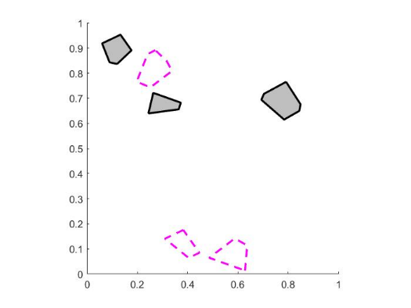
Several functions exist to plot maps. The one for polytopes is: fcn_MapGen_plotPolytopes
% Plot the polytopes
fig_num = 22;
line_width = 2;
axis_limits = [0 1 0 1];
fcn_MapGen_plotPolytopes(tiled_polytopes,fig_num,'r',line_width,axis_limits);

Slide 56
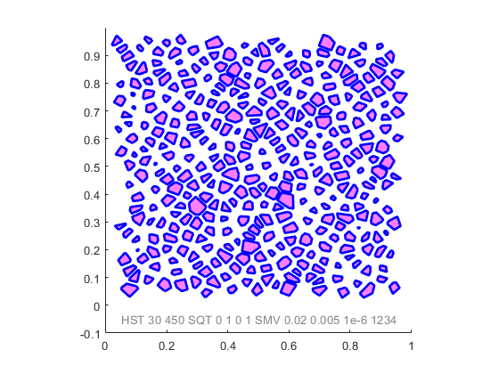
We often want to generate maps by a fully repeatable “name”
The idea is that a string can be produced, and even plotted on the figure, that when entered into the function generates EXACTLY the same map again. This is exceptionally useful for debugging.
%% Generate a map from a name
map_name = "HST 30 450 SQT 0 1 0 1 SMV 0.02 0.005 1e-6 1234";
plot_flag = 1; disp_name = [1, 0.05 -0.05, 0.5 0.5 0.5, 10];
line_style = '-'; line_width = 2; color = [0 0 1];
axis_limits = [0 1 -0.1 1]; axis_style = 'square';
fill_info = [1 1 0 1 0.5];
fig_num = 7;
[polytopes,fig]=fcn_MapGen_nameToMap(...
map_name,...
plot_flag,...
disp_name,...
fig_num,...
line_style,...
line_width,....
color,...
axis_limits,...
axis_style,...
fill_info);

