Slide 1
Unit Testing and Test-Driven Development (TDD)
Steve Harnett

Slide 2

Unit test: the most atomic type of test. It usually tests one small function or few lines of code. The test scope is something that can be logically isolated (generally no dependencies on other libraries, files, or functions).

Slide 3
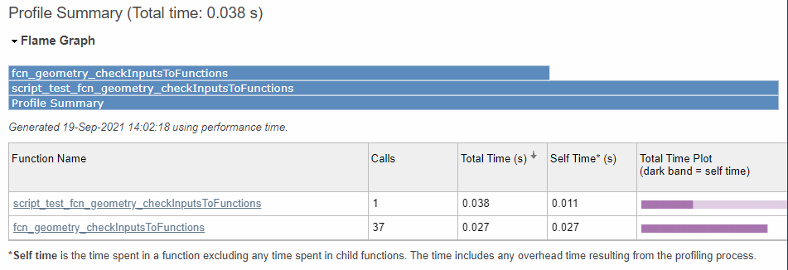
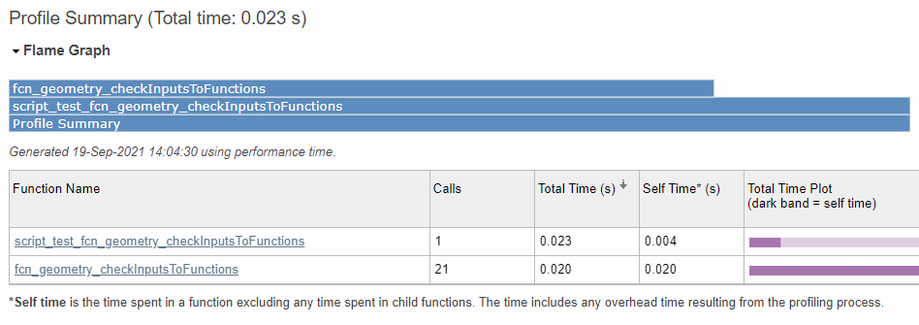
Advantages: small scope allows for quick testing and straightforward debugging. And the overhead to the script is usually minor.
Instrumented with 19 assertion tests:
The same function calls without instrumentation:

Slide 4


Disadvantages: unit tests do not protect from integration or performance regressions.
For example, if the arguments to a function change, the integration may be in error even if the function itself still works. Or if a modified function takes 10,000 times longer to run than previously, the performance will regress sometimes to the point of causing other things to fail.

Slide 5
Current implementation is based on binary assertions. This is typical for simplicity. Assertions run as tests will not break operation. Assertions that fail outside of tests will break operation and are a great way to throw an exception (with an informative failure message) when a critical failure is detected.
%% BASIC example 1
fig_num = 1;
points = [0 0; 1 4; 0.5 -1];
[centers,radii] = fcn_geometry_circleCenterFrom3Points(points,fig_num);
...
assert(isequal(round(centers,4), [3.6667,1.2083]))
assert(isequal(round(radii,4), 3.8606))

Slide 6
To assert that an error was not thrown, a true assertion can be placed after the point where execution would stop if an error was thrown.
% Maximum length is 3
Twocolumn_of_numbers_test = [4 1; 3 9; 2 7];
fcn_geometry_checkInputsToFunctions(Twocolumn_of_numbers_test, '2column_of_numbers',[3 3]);
assert(true); % pass the test defined by this section if no errors were thrown

Slide 7
To assert that an error is thrown, the error can be caught and verified to avoid breaking execution. The try-catch functionality works well for this.
%% Maximum length is 2
TwoOrThreeColumn_of_numbers_test = [4 1; 3 9; 2 7];
try
fcn_geometry_checkInputsToFunctions(TwoOrThreeColumn_of_numbers_test, '2or3column_of_numbers',[2 2]);
catch ME
assert(strcmp(ME.message,'The TwoOrThreeColumn_of_numbers_test input must be a 2or3column_of_numbers, namely (N x 2) or (N x 3) with N = 2'));
end

Slide 8
Test suites can be made in several ways. One of the simplest ways, is to make a test suite from every assertion test in a given file.
suite_geometry_circleCenterFrom3Points = testsuite('script_test_fcn_geometry_circleCenterFrom3Points');
This avoids the wordiness of having to explicitly define test cases and explicitly add them to a test suite, which is useful for larger scope tests requiring fixtures.
geometry_circleCenterFrom3Points_case1 = matlab.unittest.TestCase.forInteractiveUse;

Slide 9
The run method on the runner object can be created and used to call the suite and report the output.
results = run('script_test_fcn_geometry_findIntersectionOfSegments/SimpleTest1_ASimpleIntersection')
Simple intersection result:
.
Done script_test_fcn_geometry_findIntersectionOfSegments
__________
results =
TestResult with properties:
Name: 'script_test_fcn_geometry_findIntersectionOfSegments/SimpleTest1_ASimpleIntersection'
Passed: 1
Failed: 0
Incomplete: 0
Duration: 0.5964
Details: [1×1 struct]
Totals:
1 Passed, 0 Failed, 0 Incomplete.
0.59645 seconds testing time.

Slide 10
Failure summaries indicate failed function and test case. Test case names are generated programmatically from the name of the section in which the assertions occur.
Simple intersection result:
================================================================================
Error occurred in script_test_fcn_geometry_findIntersectionOfSegments/SimpleTest1_ASimpleIntersection and it did not run to completion.
---------
Error ID:
---------
'MATLAB:assertion:failed'
--------------
Error Details:
--------------
Error using script_test_fcn_geometry_findIntersectionOfSegments (line 27)
Assertion failed.
================================================================================
.
Done script_test_fcn_geometry_findIntersectionOfSegments
__________
Failure Summary:
Name Failed Incomplete Reason(s)
====================================================================================================================
script_test_fcn_geometry_findIntersectionOfSegments/SimpleTest1_ASimpleIntersection X X Errored.
results =
TestResult with properties:
Name: 'script_test_fcn_geometry_findIntersectionOfSegments/SimpleTest1_ASimpleIntersection'
Passed: 0
Failed: 1
Incomplete: 1
Duration: 0.5584
Details: [1×1 struct]
Totals:
0 Passed, 1 Failed (rerun), 1 Incomplete.
0.55841 seconds testing time.

Slide 11
Wrappers can be used to create test cases from assertions, test suites from files of assertions, and trigger all created test suites in a given repository, while logging the outputs.
% This is a wrapper script to run all the test scripts in the geometry
% class library for the purpose of evaluating every assertion test in these
% files
clear all; close all; clc;
all_scripts = dir('script_test_fcn_*');
suites = [];
diary ‘script_test_fcn_geometry_all_stdout.txt’; % this is git ignored
for i_script = 1:length(all_scripts)
file_name_extended = all_scripts(i_script).name;
file_name = erase(file_name_extended,'.m');
if ~strcmp(mfilename,file_name) && ~strcmp(file_name(end-3:end),'.asv')
file_name_trunc = erase(file_name,'script_');
suite = testsuite(file_name);
suites(end+1) = suite;
results = run(suites);
end
end

Slide 12

One practice for making unit tests is Test Driven Development (TDD). In TDD, requirements are defined as tests and features are only added to turn a test from failing to passing (commonly called red-light, green-lighting).

Slide 13
This ensures only the functionality to meet the requirement is added.
% test cases
assert(sum(0) == 0)
% a function sums inputs
def sum(a):
return a

Slide 14
This ensures only the functionality to meet the requirement is added.
% test cases
assert(sum(0) == 0)
assert(sum(0,1) == 1)
% a function sums inputs
def sum(a):
return a
def sum(a,b):
return a + b

Slide 15
This ensures only the functionality to meet the requirement is added.
% test cases
assert(sum(0) == 0)
assert(sum(0,1) == 1)
assert(sum(0,1,2)) = 3
% a function sums inputs
def sum(a):
return a
def sum(a,b):
return a + b
def sum(*args):
ans = 0
for arg in args:
ans = ans + arg
return ans

Slide 16
This can be a time-consuming way to develop, but it helps ensure that every part of a function has test coverage and serves some use case.

Slide 17
Environment variables can be used to flag large types of execution on or off (e.g. input sanitation, plotting, testing). This is done the same in Matlab regardless of OS so our code can be platform agnostic.
var = getenv('variable_name')

Slide 18
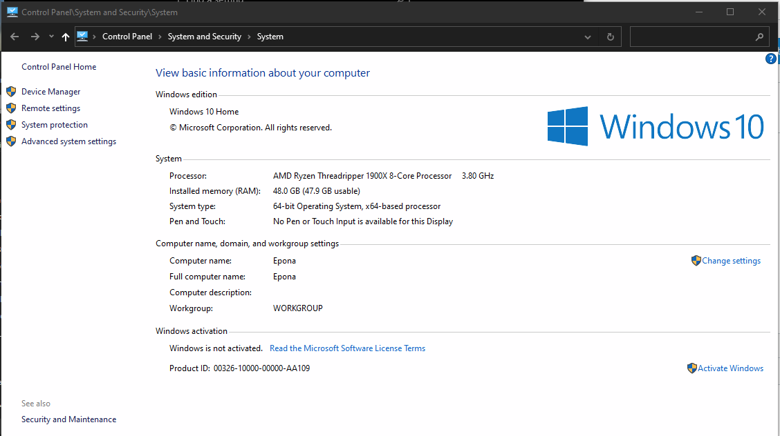
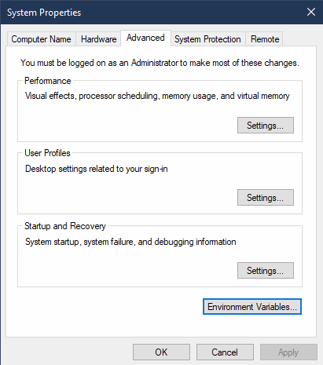
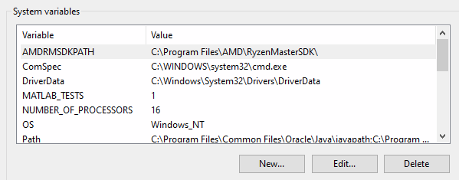
Environment variables in Windows (called "system variables" by Windows) can be set from the "Advanced system settings" pane in the System Control Panel.
1
2
4
3

Slide 19
Environment variables can be set in ~/.bashrc in Linux by adding a line to set the variable at each new terminal session.
export VAR_NAME=variable_value

Slide 20
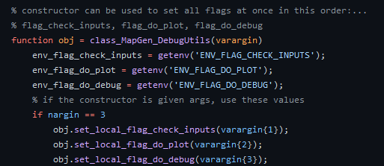
This is useful for setting flags, which allow users to optionally run blocks of code. This is a more sustainable practice than commenting code on and off as it can have default behavior and associated warnings.
/* //
% #

Slide 21
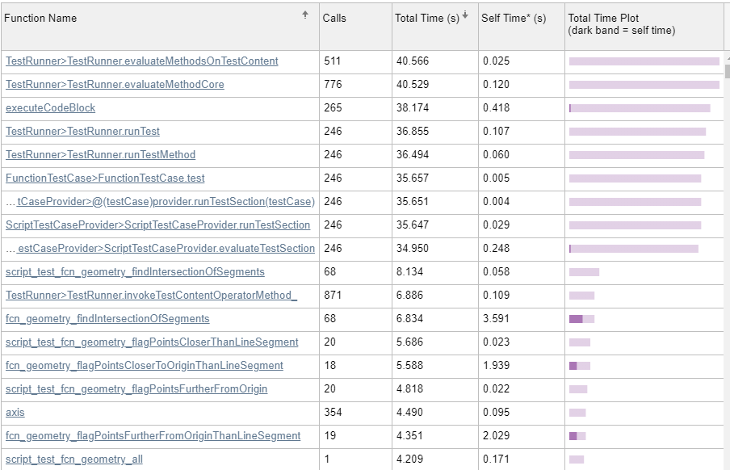
Performance profiling of the Geometry library.

Slide 22
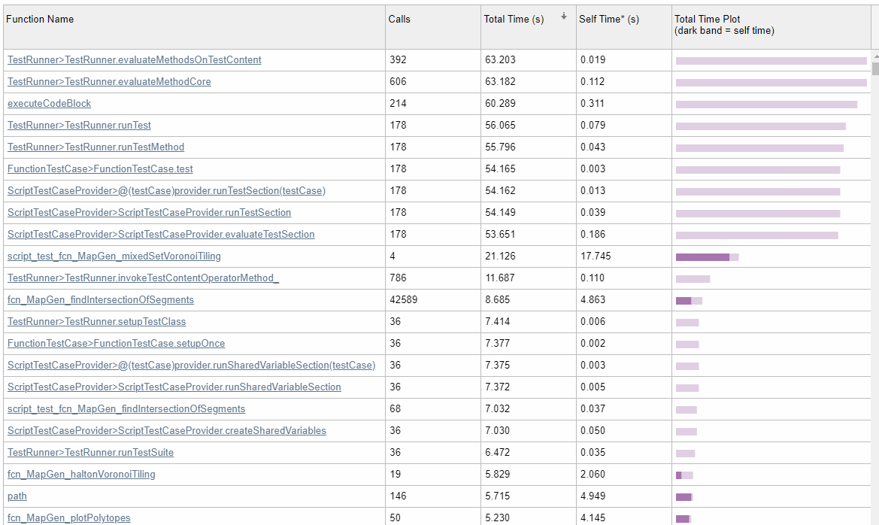
Performance profiling of the MapGen library.

