Slide 1
Vehicle Dynamics Library
Sri Venkata Satya Prasad Maddipatla
Intelligent Vehicles and Systems Group
Department of Mechanical Engineering

Slide 2
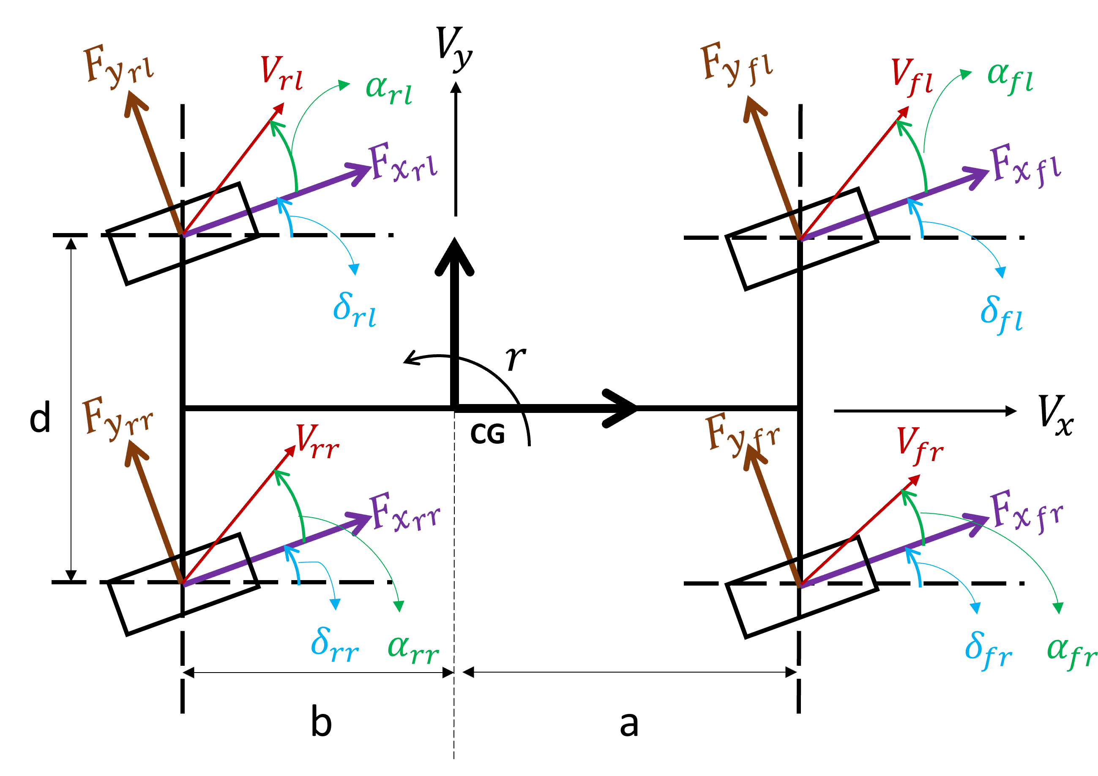
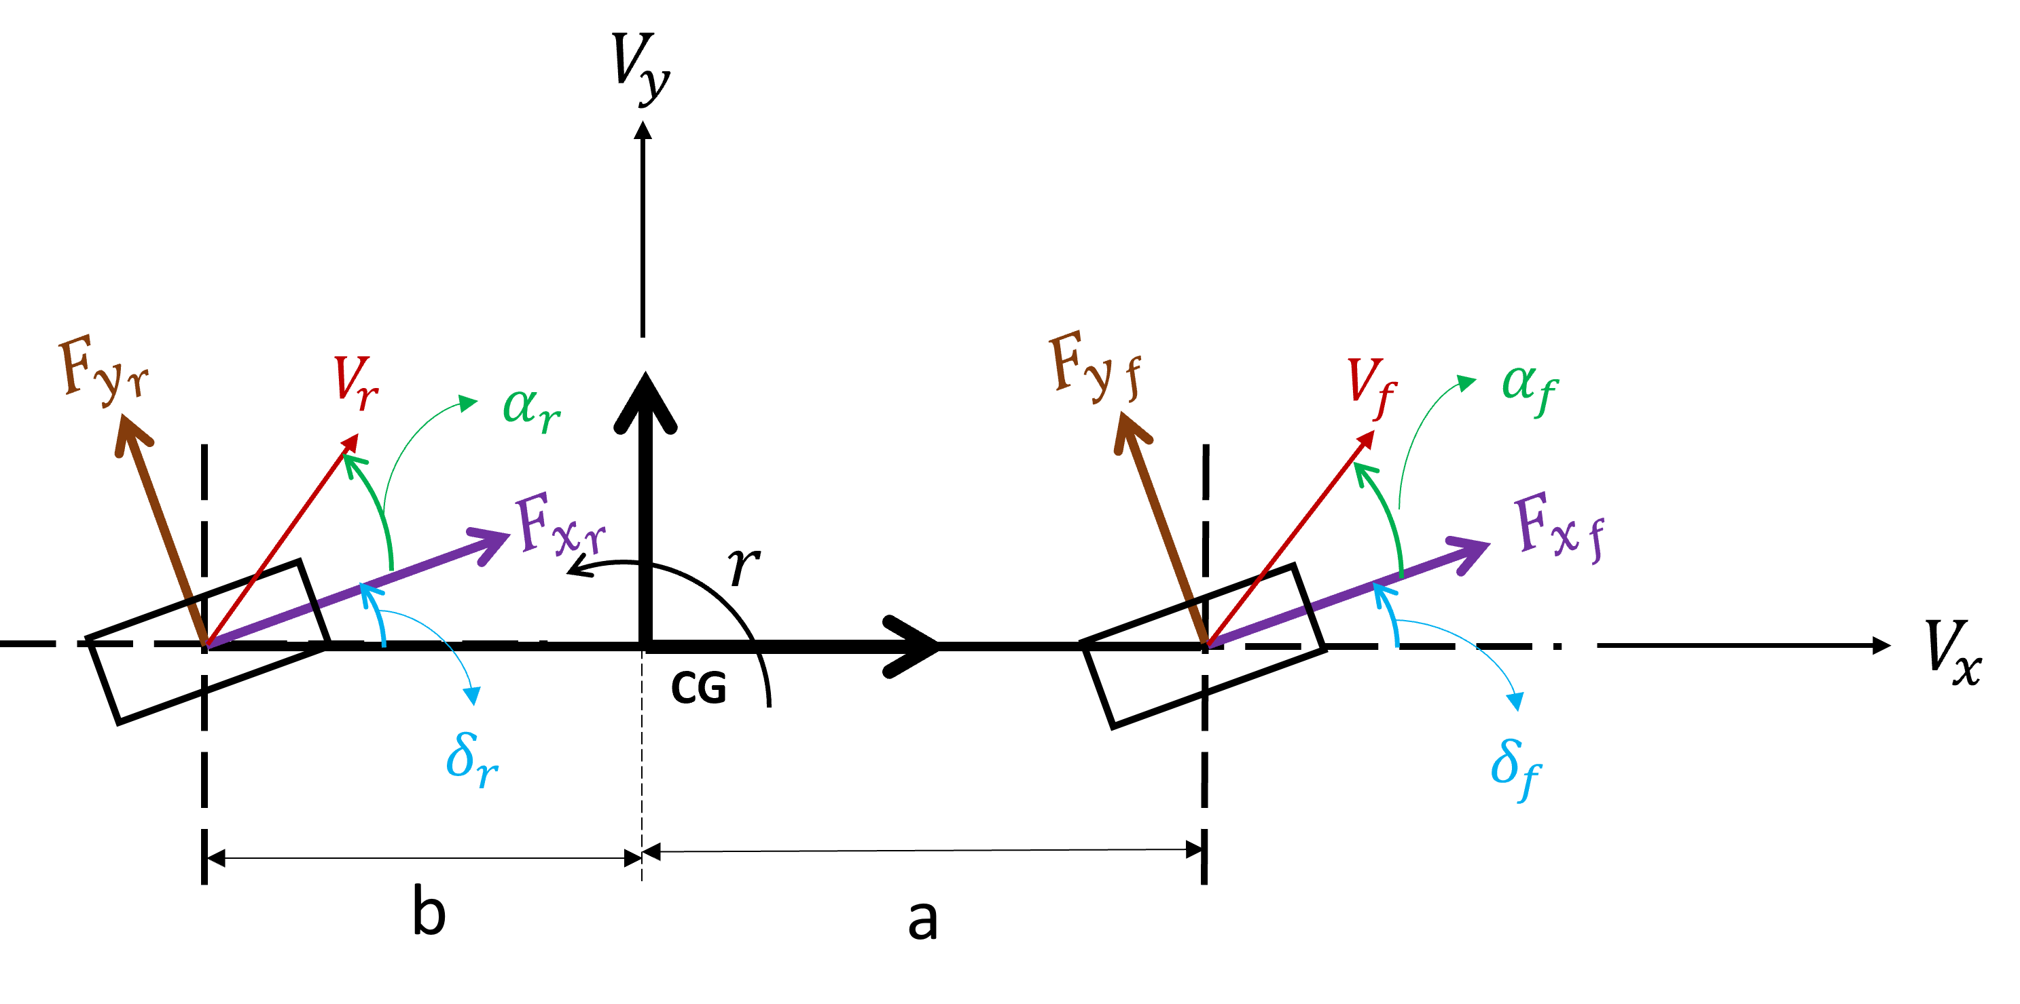
It is believed that vehicle behavior can be better predicted by modeling the vehicle like a bicycle or dual track.
Dual Track
Bicycle

Slide 3
Bicycle model
$$V_{y}$$
$$F_{y_{r}}$$
$$F_{y_{f}}$$
$$V_{r}$$
$$α_{r}$$
$$V_{f}$$
$$α_{f}$$
$$F_{x_{r}}$$
$$F_{x_{f}}$$
$$r$$
$$V_{x}$$
CG
$$δ_{r}$$
$$δ_{f}$$
b
a

Slide 4
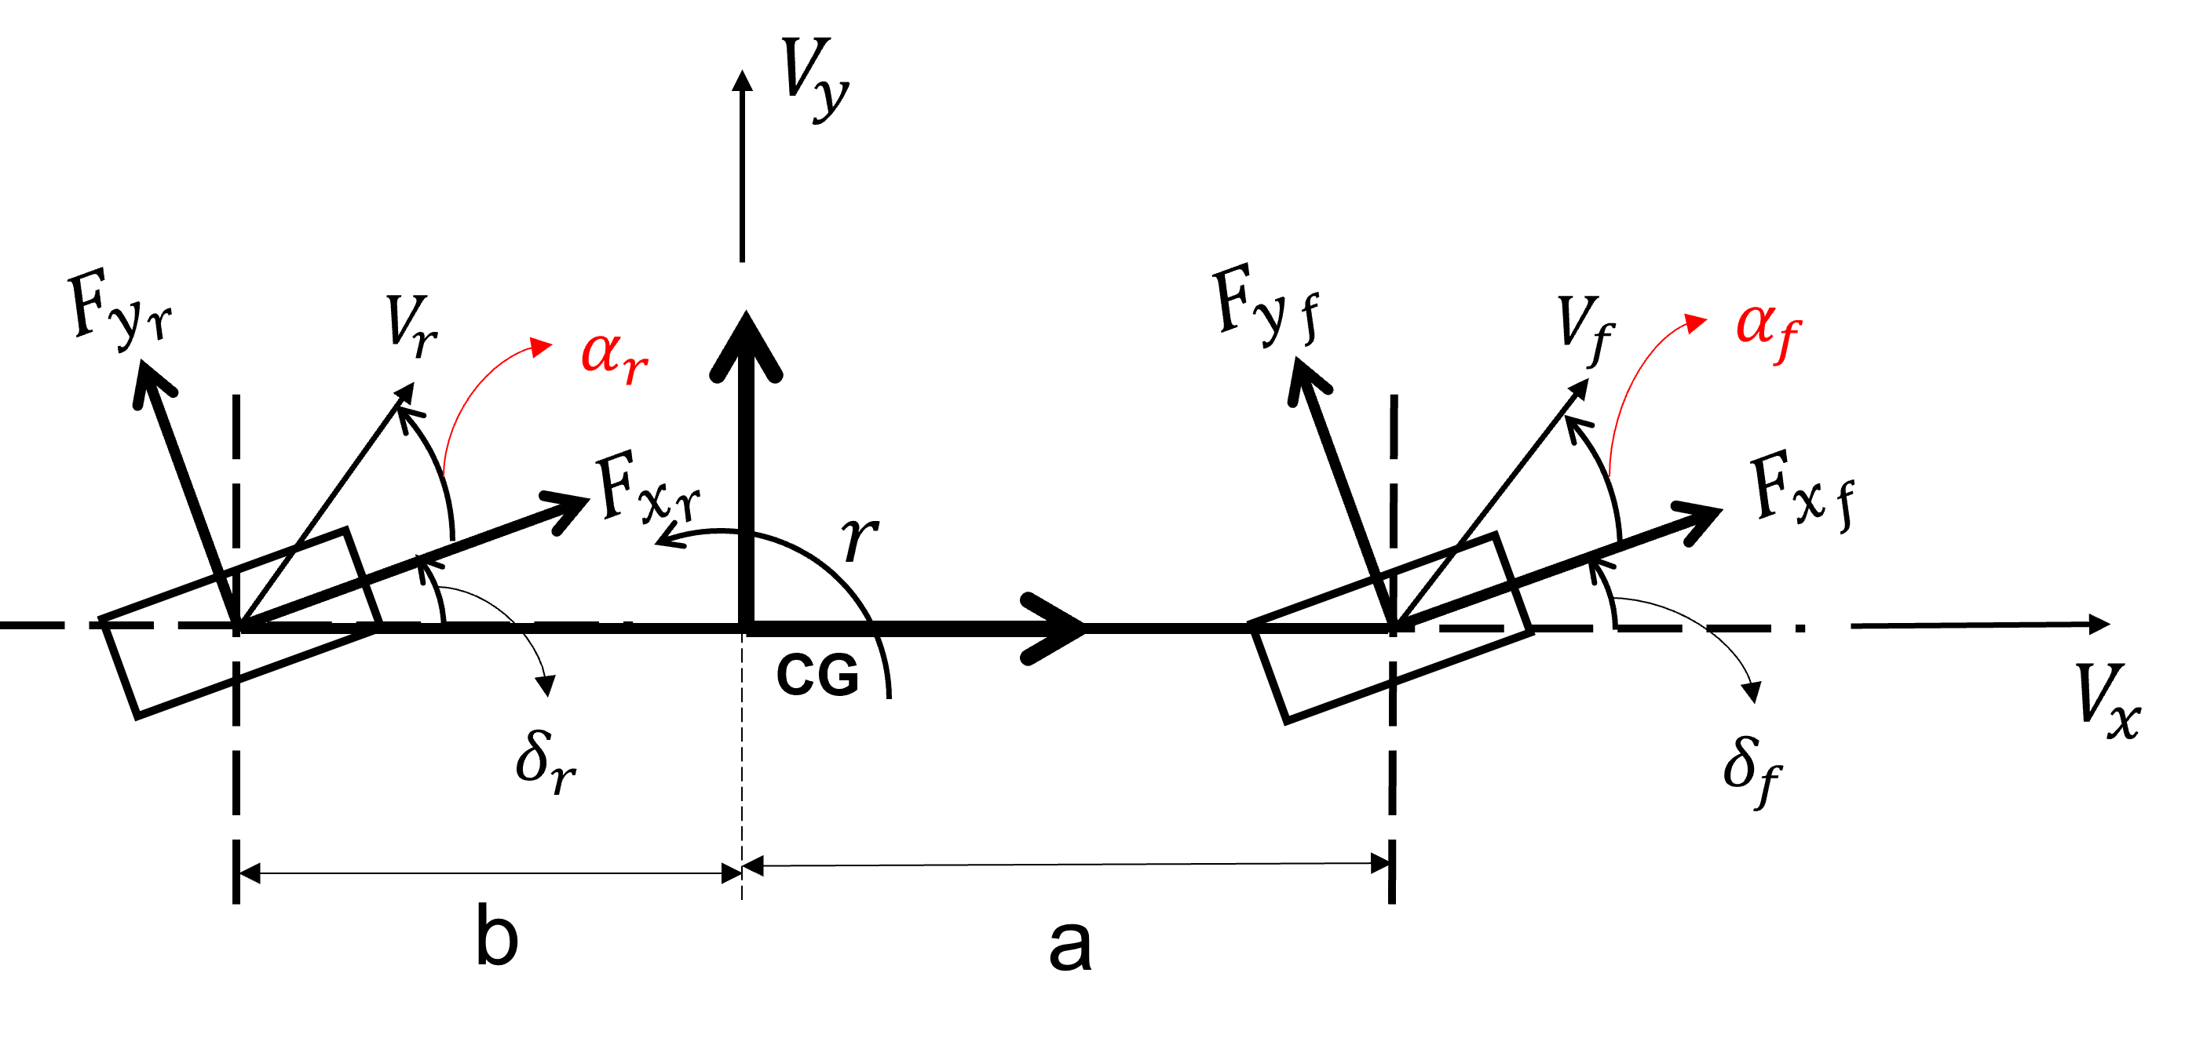
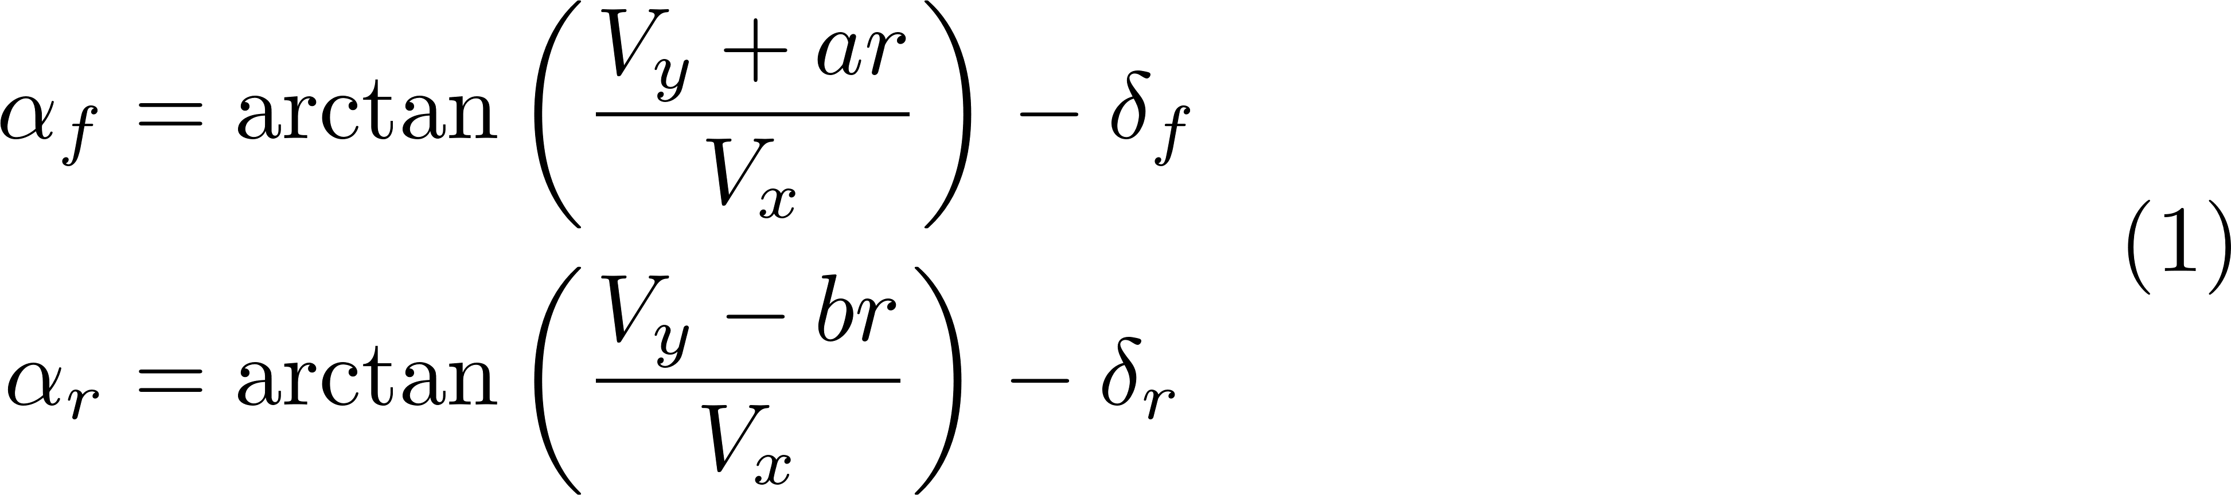
Slip angles at each tire of a vehicle represented by the bicycle (single-track) model are given by
function slip_angles = fcn_VD_stSlipAngle(U, V, r, steering_angle, vehicle)
%% fcn_VD_stSlipAngle
% This function computes slip-angles for front and rear wheels. It
% uses a single-track/bicycle model.
%
%% Calculate Slip-Angles
%%%%%%%%%%%%%%%%%%%%%%%%%%%%%%%%%%%%%%%%%%%%%%%%%%%%%%%%%%%%%%%%%%%
% __ __ _
% | \/ | (_)
% | \ / | __ _ _ _ __
% | |\/| |/ _` | | '_ \
% | | | | (_| | | | | |
% |_| |_|\__,_|_|_| |_|
%
%%%%%%%%%%%%%%%%%%%%%%%%%%%%%%%%%%%%%%%%%%%%%%%%%%%%%%%%%%%%%%%%%%%%
wheel_velocity = fcn_VD_stWheelVelocity(U,V,r,vehicle); % calculate wheel velocities
slip_angles = atan(wheel_velocity(:,2)./wheel_velocity(:,1))-steering_angle; % Slip angle
end

Slide 5
`fcn_VD_stSlipAngle’ estimates slip angle
%% script_test_fcn_VD_stSlipAngle.m
% This script tests MATLAB function 'fcn_VD_stSlipAngle'
%
% Author: Satya Prasad on 2021/08/13
% Questions or comments? szm888@psu.edu
%% Prepare the workspace
close all; % close all the plots
clear all %#ok<CLALL>
clc
%% Add path
addpath('../VD_Utilities')
addpath('../VD_Utilities/Bicycle')
%% Inputs
%%%%%%%%%%%%%%%%%%%%%%%%%%%%%%%%%%%%%%%%%%%%%%%%%%
% _____ _
% |_ _| | |
% | | _ __ _ __ _ _| |_ ___
% | | | '_ \| '_ \| | | | __/ __|
% _| |_| | | | |_) | |_| | |_\__ \
% |_____|_| |_| .__/ \__,_|\__|___/
% | |
% |_|
% See: http://patorjk.com/software/taag/#p=display&f=Big&t=Inputs
%%%%%%%%%%%%%%%%%%%%%%%%%%%%%%%%%%%%%%%%%%%%%%%%%%
%% Define vehicle properties
% Define a MATLAB structure that specifies the physical values for a vehicle.
% For convenience, we ask that you call this stucture 'vehicle'.
vehicle.m = 1600; % mass (kg)
vehicle.Izz = 2500; % mass moment of inertia (kg m^2)
vehicle.Iw = 1.2; % mass moment of inertia of a wheel (kg m^2)
vehicle.Re = 0.32; % effective radius of a wheel (m)
vehicle.a = 1.3; % length from front axle to CG (m)
vehicle.L = 2.6; % wheelbase (m)
vehicle.b = 1.3; % length from rear axle to CG (m)
vehicle.d = 1.5; % track width (m)
vehicle.h_cg = 0.42; % height of the cg (m)
vehicle.Ca = [95000; 110000]; % wheel cornering stiffnesses
vehicle.Cx = [65000; 65000]; % longitudinal stiffnesses
%% Define inputs to the vehicle model
U = 24.59; % longitudinal velocity [m/s]
V = 0.0; % lateral velocity [m/s]
r = 0.5; % yaw rate [rad/s]
steering_amplitude = 2*pi/180; % front steering angle [rad]
Period = 3; % Units are seconds. A typical lane change is about 3 to 4 seconds based on experimental highway measurements
% Define items used to determine how long to run sim
TotalTime = 5; % This is how long the simulation will run.
deltaT = 0.01;
N_timeSteps = floor(TotalTime/deltaT)+1; % This is the number of time steps we should have
%% Main code
%%%%%%%%%%%%%%%%%%%%%%%%%%%%%%%%%%%%%%%%%%%%%%%%%%%%%%%%%%%%%%%%%%%
% __ __ _
% | \/ | (_)
% | \ / | __ _ _ _ __
% | |\/| |/ _` | | '_ \
% | | | | (_| | | | | |
% |_| |_|\__,_|_|_| |_|
%
%%%%%%%%%%%%%%%%%%%%%%%%%%%%%%%%%%%%%%%%%%%%%%%%%%%%%%%%%%%%%%%%%%%%
%% Run the simulation in MATLAB
% variables to store outputs of Matlab simulation
matlab_alpha = nan(N_timeSteps,2);
matlab_time = nan(N_timeSteps,1);
counter = 1;
for t = 0:deltaT:TotalTime
matlab_time(counter) = t;
%% Inputs
delta_f = (1-1*(0<t-Period))*steering_amplitude*sin((2*pi/Period)*t); % front steering angle
steering_angle = [delta_f; 0];
Vx = abs(U*sin((0.5*pi/Period)*t + pi/2));
Vy = V*sin((pi/Period)*t);
yaw_rate = r*sin((2*pi/Period)*t);
%% Slips
% Slip Angle/Lateral Slip
slip_angle = fcn_VD_stSlipAngle(Vx,Vy,yaw_rate,steering_angle,vehicle);
matlab_alpha(counter,:) = slip_angle';
counter = counter+1;
end
%% Plot results
%%%%%%%%%%%%%%%%%%%%%%%%%%%%%%%%%%%%%%%%%%%%%%%%%%%%%%%%%%%%%%%%%%%%
% _____ _ _ _ _
% | __ \| | | | | | (_)
% | |__) | | ___ | |_| |_ _ _ __ __ _
% | ___/| |/ _ \| __| __| | '_ \ / _` |
% | | | | (_) | |_| |_| | | | | (_| |
% |_| |_|\___/ \__|\__|_|_| |_|\__, |
% __/ |
% |___/
%%%%%%%%%%%%%%%%%%%%%%%%%%%%%%%%%%%%%%%%%%%%%%%%%%%%%%%%%%%%%%%%%%%%
fcn_VD_plotTimeSlipAngle(matlab_time,matlab_alpha);

Slide 6
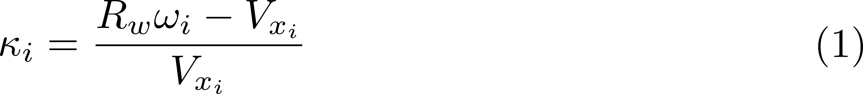
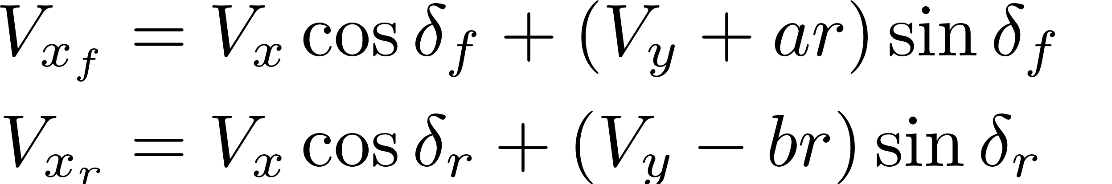
Wheel slips at each tire of a vehicle represented by the bicycle model are given by
function wheel_slip = fcn_VD_stWheelSlip(U,V,r,wheel_angular_velocity,...
steering_angle,vehicle)
%% fcn_VD_stWheelSlip
% This function computes Wheel Slip/Longitudinal Slip for front and rear wheels.
% It uses single-track/bicycle vehicle model.
%
%% Calculate Longitudinal Slip
%%%%%%%%%%%%%%%%%%%%%%%%%%%%%%%%%%%%%%%%%%%%%%%%%%%%%%%%%%%%%%%%%%%
% __ __ _
% | \/ | (_)
% | \ / | __ _ _ _ __
% | |\/| |/ _` | | '_ \
% | | | | (_| | | | | |
% |_| |_|\__,_|_|_| |_|
%
%%%%%%%%%%%%%%%%%%%%%%%%%%%%%%%%%%%%%%%%%%%%%%%%%%%%%%%%%%%%%%%%%%%%
wheel_slip = nan(2,1); % Initialize a variable
wheel_velocity = fcn_VD_stWheelVelocity(U,V,r,vehicle); % calculate wheel velocities
wheel_longitudinal_velocity = wheel_velocity(:,1).*cos(steering_angle)+...
wheel_velocity(:,2).*sin(steering_angle); % velocity of wheel along the wheel direction
wheel_longitudinal_velocity(0==wheel_longitudinal_velocity) = eps;
% Wheel-Slip calculation
wheel_slip(0>wheel_longitudinal_velocity) = 0;
% wheel slip is calculated only when the tire is moving in the direction it
% is pointed
target_indices = 0<=wheel_longitudinal_velocity;
wheel_slip(target_indices) = (vehicle.Re.*wheel_angular_velocity(target_indices)-...
wheel_longitudinal_velocity(target_indices))./...
wheel_longitudinal_velocity(target_indices);
% Saturation
wheel_slip(1<wheel_slip) = 1; % maximum wheel slip
wheel_slip(-1>wheel_slip) = -1; % minimum wheel slip
end
where $i=f, r$

Slide 7
`fcn_VD_stWheelSlip’ estimates wheel slip
%% script_testfcn_VD_stWheelSlip.m
% This script tests MATLAB function 'fcn_VD_stWheelSlip'
%
% Author: Satya Prasad on 2021/08/13
% Questions or comments? szm888@psu.edu
%% Prepare the workspace
close all; % close all the plots
clear all %#ok<CLALL>
clc
%% Add path
addpath('../VD_Utilities')
addpath('../VD_Utilities/Bicycle')
%% Inputs
%%%%%%%%%%%%%%%%%%%%%%%%%%%%%%%%%%%%%%%%%%%%%%%%%%
% _____ _
% |_ _| | |
% | | _ __ _ __ _ _| |_ ___
% | | | '_ \| '_ \| | | | __/ __|
% _| |_| | | | |_) | |_| | |_\__ \
% |_____|_| |_| .__/ \__,_|\__|___/
% | |
% |_|
% See: http://patorjk.com/software/taag/#p=display&f=Big&t=Inputs
%%%%%%%%%%%%%%%%%%%%%%%%%%%%%%%%%%%%%%%%%%%%%%%%%%
%% Define vehicle properties
% Define a MATLAB structure that specifies the physical values for a vehicle.
% For convenience, we ask that you call this stucture 'vehicle'.
vehicle.m = 1600; % mass (kg)
vehicle.Izz = 2500; % mass moment of inertia (kg m^2)
vehicle.Iw = 1.2; % mass moment of inertia of a wheel (kg m^2)
vehicle.Re = 0.32; % effective radius of a wheel (m)
vehicle.a = 1.3; % length from front axle to CG (m)
vehicle.L = 2.6; % wheelbase (m)
vehicle.b = 1.3; % length from rear axle to CG (m)
vehicle.d = 1.5; % track width (m)
vehicle.h_cg = 0.42; % height of the cg (m)
vehicle.Ca = [95000; 110000]; % wheel cornering stiffnesses
vehicle.Cx = [65000; 65000]; % longitudinal stiffnesses
%% Define inputs to the vehicle model
U = 24.59; % longitudinal velocity [m/s]
V = 0.0; % lateral velocity [m/s]
r = 0.5; % yaw rate [rad/s]
omega = 0.98*U/vehicle.Re*ones(2,1); % angular velocity of wheel [rad/s]
steering_amplitude = 2*pi/180; % front steering angle [rad]
Period = 3; % Units are seconds. A typical lane change is about 3 to 4 seconds based on experimental highway measurements
% Define items used to determine how long to run sim
TotalTime = 5; % This is how long the simulation will run.
deltaT = 0.01;
N_timeSteps = floor(TotalTime/deltaT)+1; % This is the number of time steps we should have
%% Main code
%%%%%%%%%%%%%%%%%%%%%%%%%%%%%%%%%%%%%%%%%%%%%%%%%%%%%%%%%%%%%%%%%%%
% __ __ _
% | \/ | (_)
% | \ / | __ _ _ _ __
% | |\/| |/ _` | | '_ \
% | | | | (_| | | | | |
% |_| |_|\__,_|_|_| |_|
%
%%%%%%%%%%%%%%%%%%%%%%%%%%%%%%%%%%%%%%%%%%%%%%%%%%%%%%%%%%%%%%%%%%%%
%% Run the simulation in MATLAB
% variables to store outputs of Matlab simulation
matlab_kappa = nan(N_timeSteps,2);
matlab_time = nan(N_timeSteps,1);
counter = 1;
for t = 0:deltaT:TotalTime
matlab_time(counter) = t;
%% Inputs
delta_f = (1-1*(0<t-Period))*steering_amplitude*sin((2*pi/Period)*t); % front steering angle
steering_angle = [delta_f; 0];
Vx = abs(U*sin((0.5*pi/Period)*t + pi/2));
Vy = V*sin((pi/Period)*t);
yaw_rate = r*sin((2*pi/Period)*t);
%% Slips
% Wheel Slip/Longitudinal Slip
wheel_slip = fcn_VD_stWheelSlip(Vx,Vy,yaw_rate,omega,steering_angle,vehicle);
matlab_kappa(counter,:) = wheel_slip';
counter = counter+1;
end
%% Plot results
%%%%%%%%%%%%%%%%%%%%%%%%%%%%%%%%%%%%%%%%%%%%%%%%%%%%%%%%%%%%%%%%%%%%
% _____ _ _ _ _
% | __ \| | | | | | (_)
% | |__) | | ___ | |_| |_ _ _ __ __ _
% | ___/| |/ _ \| __| __| | '_ \ / _` |
% | | | | (_) | |_| |_| | | | | (_| |
% |_| |_|\___/ \__|\__|_|_| |_|\__, |
% __/ |
% |___/
%%%%%%%%%%%%%%%%%%%%%%%%%%%%%%%%%%%%%%%%%%%%%%%%%%%%%%%%%%%%%%%%%%%%
fcn_VD_plotTimeWheelSlip(matlab_time,matlab_kappa);

Slide 8
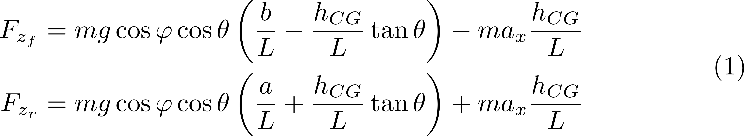
Normal forces at each tire of a vehicle represented by the bicycle model are given by
function normal_force = fcn_VD_stNormalForce(acceleration,vehicle,...
road_properties,type_of_transfer)
%% fcn_VD_stNormalForce
% This function calculates normal force on both wheels.
% It uses single-track/bicycle vehicle model.
%
%% Calculate Normal Forces
%%%%%%%%%%%%%%%%%%%%%%%%%%%%%%%%%%%%%%%%%%%%%%%%%%%%%%%%%%%%%%%%%%%
% __ __ _
% | \/ | (_)
% | \ / | __ _ _ _ __
% | |\/| |/ _` | | '_ \
% | | | | (_| | | | | |
% |_| |_|\__,_|_|_| |_|
%
%%%%%%%%%%%%%%%%%%%%%%%%%%%%%%%%%%%%%%%%%%%%%%%%%%%%%%%%%%%%%%%%%%%%
g = 9.81; % [m/s^2]
Fz_front = vehicle.m*g*cos(road_properties.bank_angle)*cos(road_properties.grade)*...
(vehicle.b-vehicle.h_cg*tan(road_properties.grade))/vehicle.L;
Fz_rear = vehicle.m*g*cos(road_properties.bank_angle)*cos(road_properties.grade)*...
(vehicle.a+vehicle.h_cg*tan(road_properties.grade))/vehicle.L;
normal_force = [Fz_front; Fz_rear]; % load transfer due to grade and bank
if strcmpi(type_of_transfer,'longitudinal') % Only Longitudinal Transfer
Fz_longitudinal = vehicle.m*acceleration(1)*(vehicle.h_cg/vehicle.L)*[-1; 1];
normal_force = normal_force + Fz_longitudinal;
end
end

Slide 9
`fcn_VD_stNormalForce’ estimates normal force
%% script_test_fcn_VD_stNormalForce.m
% This script tests MATLAB function 'fcn_VD_stNormalForce'
%
% Author: Satya Prasad on 2021/08/13
% Questions or comments? szm888@psu.edu
%% Prepare the workspace
close all; % close all the plots
clear all %#ok<CLALL>
clc
%% Add path
addpath('../VD_Utilities')
addpath('../VD_Utilities/Bicycle')
%% Inputs
%%%%%%%%%%%%%%%%%%%%%%%%%%%%%%%%%%%%%%%%%%%%%%%%%%
% _____ _
% |_ _| | |
% | | _ __ _ __ _ _| |_ ___
% | | | '_ \| '_ \| | | | __/ __|
% _| |_| | | | |_) | |_| | |_\__ \
% |_____|_| |_| .__/ \__,_|\__|___/
% | |
% |_|
% See: http://patorjk.com/software/taag/#p=display&f=Big&t=Inputs
%%%%%%%%%%%%%%%%%%%%%%%%%%%%%%%%%%%%%%%%%%%%%%%%%%
%% Define vehicle properties
% Define a MATLAB structure that specifies the physical values for a vehicle.
% For convenience, we ask that you call this stucture 'vehicle'.
vehicle.m = 1600; % mass (kg)
vehicle.Izz = 2500; % mass moment of inertia (kg m^2)
vehicle.Iw = 1.2; % mass moment of inertia of a wheel (kg m^2)
vehicle.Re = 0.32; % effective radius of a wheel (m)
vehicle.a = 1.3; % length from front axle to CG (m)
vehicle.L = 2.6; % wheelbase (m)
vehicle.b = 1.3; % length from rear axle to CG (m)
vehicle.d = 1.5; % track width (m)
vehicle.h_cg = 0.42; % height of the cg (m)
vehicle.Ca = [95000; 110000]; % wheel cornering stiffnesses
vehicle.Cx = [65000; 65000]; % longitudinal stiffnesses
%% Define load transfer conditions
type_of_transfer = 'longitudinal';
% type_of_transfer = 'default';
%% Define inputs to the vehicle model
road_properties.grade = 0; road_properties.bank_angle = 0; % road properties
acceleration = [2, 0.5]; % acceleration
Period = 3; % Units are seconds. A typical lane change is about 3 to 4 seconds based on experimental highway measurements
% Define items used to determine how long to run sim
TotalTime = 5; % This is how long the simulation will run.
deltaT = 0.01;
N_timeSteps = floor(TotalTime/deltaT)+1; % This is the number of time steps we should have
%% Main code
%%%%%%%%%%%%%%%%%%%%%%%%%%%%%%%%%%%%%%%%%%%%%%%%%%%%%%%%%%%%%%%%%%%
% __ __ _
% | \/ | (_)
% | \ / | __ _ _ _ __
% | |\/| |/ _` | | '_ \
% | | | | (_| | | | | |
% |_| |_|\__,_|_|_| |_|
%
%%%%%%%%%%%%%%%%%%%%%%%%%%%%%%%%%%%%%%%%%%%%%%%%%%%%%%%%%%%%%%%%%%%%
%% Run the simulation in MATLAB
% variables to store outputs of Matlab simulation
matlab_Fz = nan(N_timeSteps,2);
matlab_time = nan(N_timeSteps,1);
counter = 1;
for t = 0:deltaT:TotalTime
matlab_time(counter) = t;
%% Inputs
ax = acceleration(1)*sin(pi/Period*t);
ay = acceleration(2)*sin(pi/Period*t);
%% Normal Forces
normal_force = fcn_VD_stNormalForce([ax;ay],vehicle,road_properties,...
type_of_transfer);
matlab_Fz(counter,:) = normal_force';
counter = counter+1;
end
%% Plot results
%%%%%%%%%%%%%%%%%%%%%%%%%%%%%%%%%%%%%%%%%%%%%%%%%%%%%%%%%%%%%%%%%%%%
% _____ _ _ _ _
% | __ \| | | | | | (_)
% | |__) | | ___ | |_| |_ _ _ __ __ _
% | ___/| |/ _ \| __| __| | '_ \ / _` |
% | | | | (_) | |_| |_| | | | | (_| |
% |_| |_|\___/ \__|\__|_|_| |_|\__, |
% __/ |
% |___/
%%%%%%%%%%%%%%%%%%%%%%%%%%%%%%%%%%%%%%%%%%%%%%%%%%%%%%%%%%%%%%%%%%%%
fcn_VD_plotTimeNormalForce(matlab_time,matlab_Fz);

Slide 10
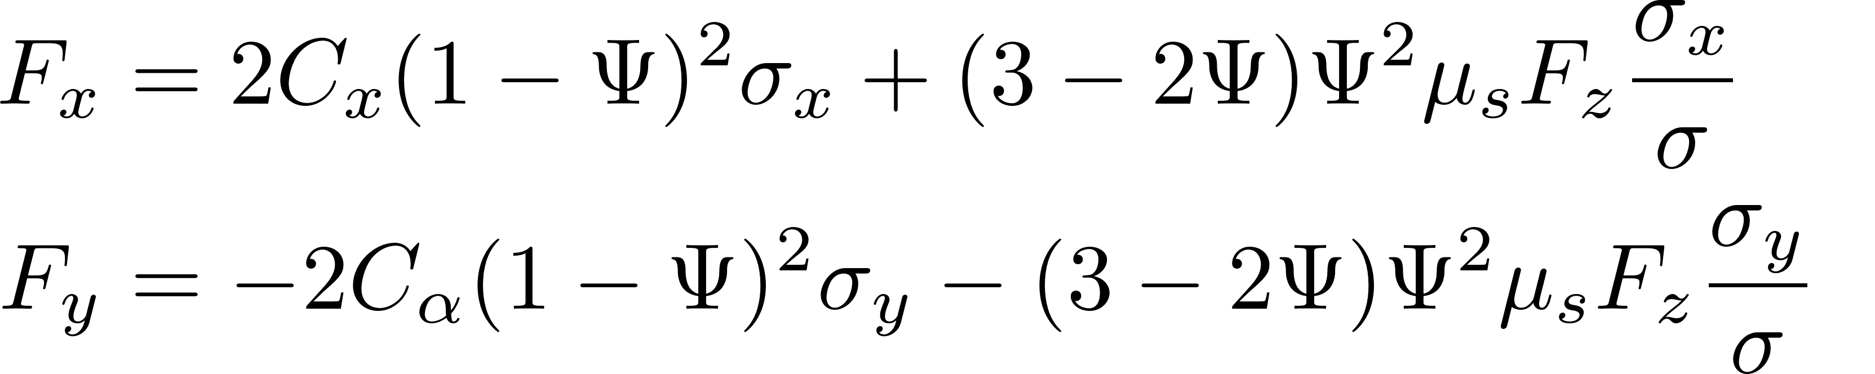
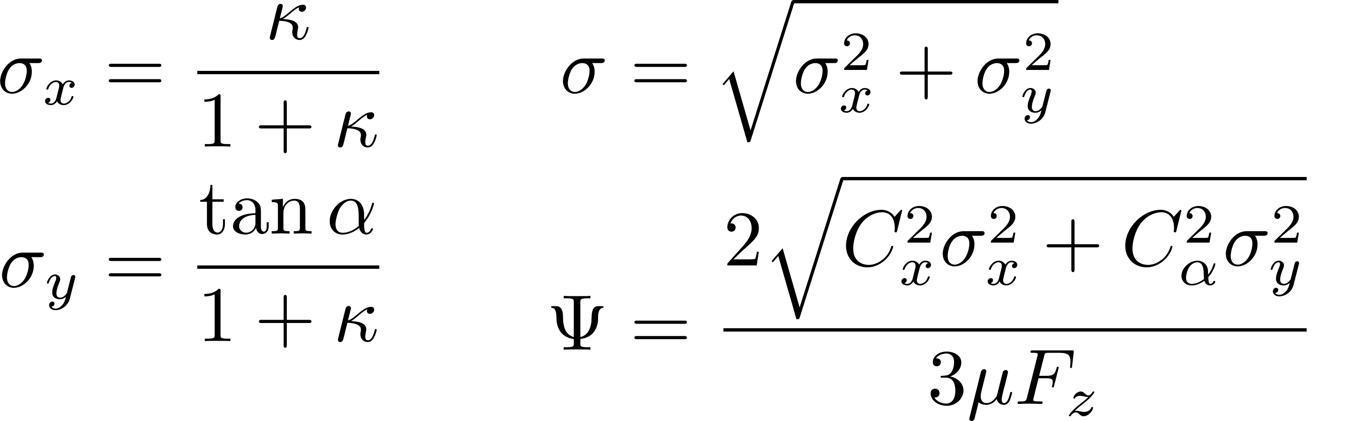
Tire forces at each tire of a vehicle given by the brush model are
function tire_force = fcn_VD_stTireForceBrush(slip_angle,wheel_slip,...
normal_force,friction_coefficient,vehicle)
%% fcn_VD_stTireForceBrush
% This function computes tire forces using Combined-Slip Brush Model.
% Ref: Tire Modeling and Friction Estimation by Jacob Svendenius
% It uses single-track/bicycle vehicle model and brush tire model.
%
%% Calculate Tire Forces using Brush Model
%%%%%%%%%%%%%%%%%%%%%%%%%%%%%%%%%%%%%%%%%%%%%%%%%%%%%%%%%%%%%%%%%%%
% __ __ _
% | \/ | (_)
% | \ / | __ _ _ _ __
% | |\/| |/ _` | | '_ \
% | | | | (_| | | | | |
% |_| |_|\__,_|_|_| |_|
%
%%%%%%%%%%%%%%%%%%%%%%%%%%%%%%%%%%%%%%%%%%%%%%%%%%%%%%%%%%%%%%%%%%%%
combined_slip = fcn_VD_stCombinedSlip(slip_angle,wheel_slip); % calculate combined slip
sigma_x = combined_slip(:,1);
sigma_y = combined_slip(:,2);
sigma = sqrt(sigma_x.^2 + sigma_y.^2);
sigma(0==sigma) = eps; % To avoid division by zero
% eq 4.10, 4.13 on pg 44
Psi = sqrt((vehicle.Cx.*sigma_x).^2 + (vehicle.Ca.*sigma_y).^2)./...
abs(3*friction_coefficient.*normal_force); % use peak-friction here
Psi(1<=Psi) = 1; % account for pure slip
% Adhesion forces:
% eq 4.14 on pg 44
Fax = vehicle.Cx.*sigma_x.*((1-Psi).^2);
Fay = -vehicle.Ca.*sigma_y.*((1-Psi).^2);
% Slide forces:
% eq 4.17 on pg 46
Fsz = normal_force.*(Psi.^2).*(3-2*Psi);
% eq 4.18 on pg 46
Fsx = (sigma_x./sigma).*friction_coefficient.*Fsz; % use sliding-friction here
Fsy = -(sigma_y./sigma).*friction_coefficient.*Fsz; % use sliding-friction here
tire_force = [Fax+Fsx, Fay+Fsy];
end

Slide 11
`fcn_VD_stTireForceBrush’ estimates tire forces
%% script_test_fcn_VD_stTireForceBrush.m
% This script tests MATLAB function 'fcn_VD_stTireForceBrush'
%
% Author: Satya Prasad on 2021/08/13
% Questions or comments? szm888@psu.edu
%% Prepare the workspace
close all; % close all the plots
clear all %#ok<CLALL>
clc
%% Add path
addpath('../VD_Utilities')
addpath('../VD_Utilities/Bicycle')
%% Inputs
%%%%%%%%%%%%%%%%%%%%%%%%%%%%%%%%%%%%%%%%%%%%%%%%%%
% _____ _
% |_ _| | |
% | | _ __ _ __ _ _| |_ ___
% | | | '_ \| '_ \| | | | __/ __|
% _| |_| | | | |_) | |_| | |_\__ \
% |_____|_| |_| .__/ \__,_|\__|___/
% | |
% |_|
% See: http://patorjk.com/software/taag/#p=display&f=Big&t=Inputs
%%%%%%%%%%%%%%%%%%%%%%%%%%%%%%%%%%%%%%%%%%%%%%%%%%
%% Define vehicle properties
% Define a MATLAB structure that specifies the physical values for a vehicle.
% For convenience, we ask that you call this stucture 'vehicle'.
vehicle.m = 1600; % mass (kg)
vehicle.Izz = 2500; % mass moment of inertia (kg m^2)
vehicle.Iw = 1.2; % mass moment of inertia of a wheel (kg m^2)
vehicle.Re = 0.32; % effective radius of a wheel (m)
vehicle.a = 1.3; % length from front axle to CG (m)
vehicle.L = 2.6; % wheelbase (m)
vehicle.b = 1.3; % length from rear axle to CG (m)
vehicle.d = 1.5; % track width (m)
vehicle.h_cg = 0.42; % height of the cg (m)
vehicle.Ca = [95000; 110000]; % wheel cornering stiffnesses
vehicle.Cx = [65000; 65000]; % longitudinal stiffnesses
%% Define load transfer conditions
type_of_transfer = 'longitudinal';
% type_of_transfer = 'default';
%% Define inputs to the vehicle model
U = 24.59; % longitudinal velocity [m/s]
V = 0; % lateral velocity [m/s]
r = 0.5; % yaw rate [rad/s]
omega = 0.98*U/vehicle.Re*ones(2,1); % angular velocity of wheel [rad/s]
steering_amplitude = 2*pi/180; % front steering angle [rad]
road_properties.grade = 0; road_properties.bank_angle = 0; % road properties
acceleration = [2, 0.5]; % acceleration
friction_coefficient = [0.9; 0.9];
Period = 3; % Units are seconds. A typical lane change is about 3 to 4 seconds based on experimental highway measurements
% Define items used to determine how long to run sim
TotalTime = 5; % This is how long the simulation will run.
deltaT = 0.01;
N_timeSteps = floor(TotalTime/deltaT)+1; % This is the number of time steps we should have
%% Main code
%%%%%%%%%%%%%%%%%%%%%%%%%%%%%%%%%%%%%%%%%%%%%%%%%%%%%%%%%%%%%%%%%%%
% __ __ _
% | \/ | (_)
% | \ / | __ _ _ _ __
% | |\/| |/ _` | | '_ \
% | | | | (_| | | | | |
% |_| |_|\__,_|_|_| |_|
%
%%%%%%%%%%%%%%%%%%%%%%%%%%%%%%%%%%%%%%%%%%%%%%%%%%%%%%%%%%%%%%%%%%%%
%% Run the simulation in MATLAB
% variables to store outputs of Matlab simulation
matlab_Fx = nan(N_timeSteps,2); matlab_Fy = nan(N_timeSteps,2);
matlab_time = nan(N_timeSteps,1);
counter = 1;
for t = 0:deltaT:TotalTime
matlab_time(counter) = t;
%% Inputs
delta_f = (1-1*(0<t-Period))*steering_amplitude*sin((2*pi/Period)*t); % front steering angle
steering_angle = [delta_f; 0];
Vx = abs(U*sin((0.5*pi/Period)*t + pi/2));
Vy = V*sin((pi/Period)*t);
yaw_rate = r*sin((2*pi/Period)*t);
ax = acceleration(1)*sin(pi/Period*t);
ay = acceleration(2)*sin(pi/Period*t);
%% Slips
% Slip Angle/Lateral Slip
slip_angle = fcn_VD_stSlipAngle(Vx,Vy,yaw_rate,steering_angle,vehicle);
% Wheel Slip/Longitudinal Slip
wheel_slip = fcn_VD_stWheelSlip(Vx,Vy,yaw_rate,omega,steering_angle,vehicle);
%% Normal Forces
normal_force = fcn_VD_stNormalForce([ax;ay],vehicle,road_properties,...
type_of_transfer);
%% Tire Forces
tire_force = fcn_VD_stTireForceBrush(slip_angle,wheel_slip,normal_force,...
friction_coefficient,vehicle);
matlab_Fx(counter,:) = tire_force(:,1)';
matlab_Fy(counter,:) = tire_force(:,2)';
counter = counter+1;
end
%% Plot results
%%%%%%%%%%%%%%%%%%%%%%%%%%%%%%%%%%%%%%%%%%%%%%%%%%%%%%%%%%%%%%%%%%%%
% _____ _ _ _ _
% | __ \| | | | | | (_)
% | |__) | | ___ | |_| |_ _ _ __ __ _
% | ___/| |/ _ \| __| __| | '_ \ / _` |
% | | | | (_) | |_| |_| | | | | (_| |
% |_| |_|\___/ \__|\__|_|_| |_|\__, |
% __/ |
% |___/
%%%%%%%%%%%%%%%%%%%%%%%%%%%%%%%%%%%%%%%%%%%%%%%%%%%%%%%%%%%%%%%%%%%%
fcn_VD_plotTimeLongitudinalTireForce(matlab_time,matlab_Fx);
fcn_VD_plotTimeLateralTireForce(matlab_time,matlab_Fy);

Slide 12
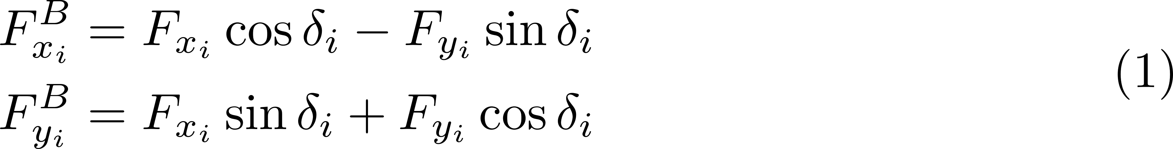
Body forces are derived from tire forces as below.
function body_variable = fcn_VD_stWheel2BodyCoordinates(wheel_variable,...
steering_angle)
%% fcn_VD_stWheel2BodyCoordinates
% This function transforms variables from wheel to body coordinates
% It uses single-track\bicycle vehicle model.
%
%% Convert from Wheel to Body Coordinates
%%%%%%%%%%%%%%%%%%%%%%%%%%%%%%%%%%%%%%%%%%%%%%%%%%%%%%%%%%%%%%%%%%%
% __ __ _
% | \/ | (_)
% | \ / | __ _ _ _ __
% | |\/| |/ _` | | '_ \
% | | | | (_| | | | | |
% |_| |_|\__,_|_|_| |_|
%
%%%%%%%%%%%%%%%%%%%%%%%%%%%%%%%%%%%%%%%%%%%%%%%%%%%%%%%%%%%%%%%%%%%%
body_variable = nan(2,2);
body_variable(:,1) = wheel_variable(:,1).*cos(steering_angle)-...
wheel_variable(:,2).*sin(steering_angle);
body_variable(:,2) = wheel_variable(:,1).*sin(steering_angle)+...
wheel_variable(:,2).*cos(steering_angle);
end

Slide 13
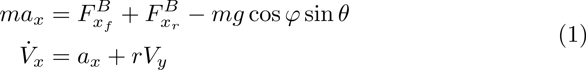
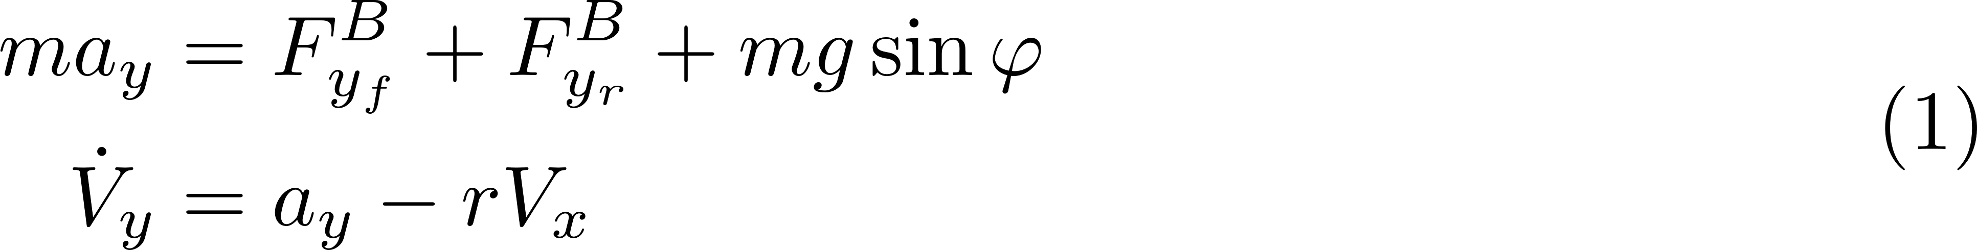
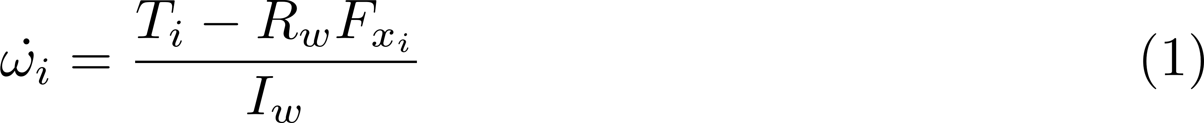
State equations of the vehicle represented by bicycle model are
function acceleration = fcn_VD_st5dofForceEquation(wheel_force,wheel_torque,...
steering_angle,vehicle,road_properties)
%% fcn_VD_st5dofForceEquation
% This function calculates accelerations.
%
%% Calculate accelerations
%%%%%%%%%%%%%%%%%%%%%%%%%%%%%%%%%%%%%%%%%%%%%%%%%%%%%%%%%%%%%%%%%%%
% __ __ _
% | \/ | (_)
% | \ / | __ _ _ _ __
% | |\/| |/ _` | | '_ \
% | | | | (_| | | | | |
% |_| |_|\__,_|_|_| |_|
%
%%%%%%%%%%%%%%%%%%%%%%%%%%%%%%%%%%%%%%%%%%%%%%%%%%%%%%%%%%%%%%%%%%%%
g = 9.81; % [m/s^2]
body_force = fcn_VD_stWheel2BodyCoordinates(wheel_force,steering_angle); % find body forces
% Force and torque balance on the vehicle body
ax = sum(body_force(:,1))/vehicle.m-g*cos(road_properties.bank_angle)*sin(road_properties.grade); % longitudinal acceleration
ay = sum(body_force(:,2))/vehicle.m+g*sin(road_properties.bank_angle); % lateral acceleration
drdt = ((vehicle.a*body_force(1,2))-(vehicle.b*body_force(2,2)))/vehicle.Izz; % yaw acceleration
% Torque balance on vehicle's wheels
domegadt = (wheel_torque-vehicle.Re.*wheel_force(:,1))./vehicle.Iw; % angular acceleration of wheel
acceleration = [ax; ay; drdt; domegadt];
end

Slide 14
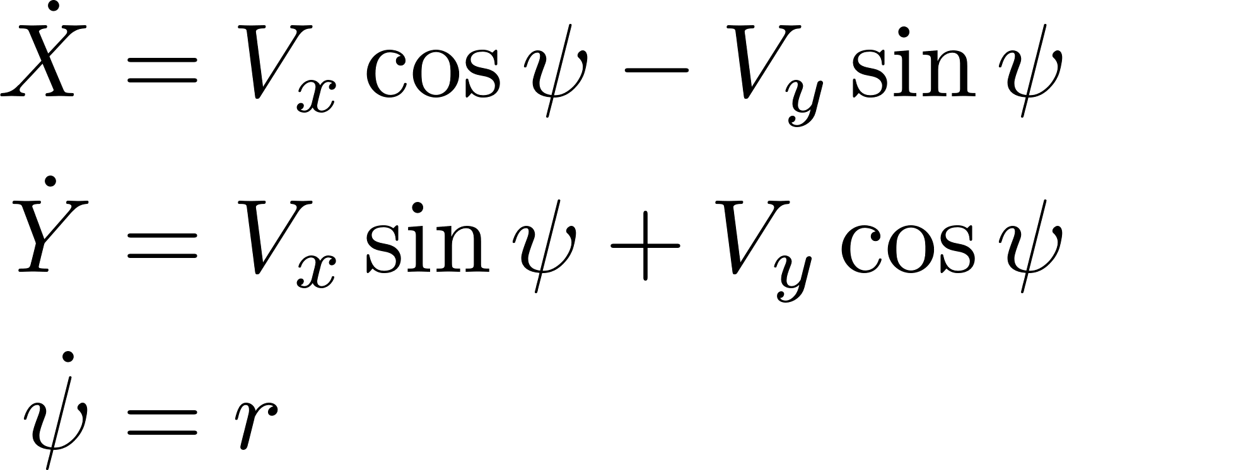
Vehicle motion is represented in global coordinates is related to the motion in local coordinates as
function dydt = fcn_VD_Body2GlobalCoordinates(~, y, U, V, r)
%% fcn_VD_Body2GlobalCoordinates
% This function calculates velocites in global coordinates.
%
%% Calculate velocities in Global coordinates
%%%%%%%%%%%%%%%%%%%%%%%%%%%%%%%%%%%%%%%%%%%%%%%%%%%%%%%%%%%%%%%%%%%
% __ __ _
% | \/ | (_)
% | \ / | __ _ _ _ __
% | |\/| |/ _` | | '_ \
% | | | | (_| | | | | |
% |_| |_|\__,_|_|_| |_|
%
%%%%%%%%%%%%%%%%%%%%%%%%%%%%%%%%%%%%%%%%%%%%%%%%%%%%%%%%%%%%%%%%%%%%
psi = y(3);
dXdt = U*cos(psi)-V*sin(psi);
dYdt = U*sin(psi)+V*cos(psi);
dPhidt = r;
dydt = [dXdt; dYdt; dPhidt];
end

Slide 15
MATLAB implementation of the 5-dof vehicle model is
function dydt = fcn_VD_st5dofModel(t,y,...
steering_amplitude,Period,wheel_torque,...
vehicle,road_properties,friction_coefficient,type_of_transfer)
%% fcn_VD_st5dofModel
% This function sets-up a 5-DoF Single-Track vehicle model using Brush
% tire model. This works without controller but with time dependent inputs.
%
global flag_update global_acceleration % change the variable name based on the matlab script
persistent delayed_acceleration % variable to store acceleration in the previous time-step
%% Implement 5-DoF Vehicle Model
%%%%%%%%%%%%%%%%%%%%%%%%%%%%%%%%%%%%%%%%%%%%%%%%%%%%%%%%%%%%%%%%%%%
% __ __ _
% | \/ | (_)
% | \ / | __ _ _ _ __
% | |\/| |/ _` | | '_ \
% | | | | (_| | | | | |
% |_| |_|\__,_|_|_| |_|
%
%%%%%%%%%%%%%%%%%%%%%%%%%%%%%%%%%%%%%%%%%%%%%%%%%%%%%%%%%%%%%%%%%%%%
U = y(1); % longitudinal velocity [m/s]
V = y(2); % lateral velocity [m/s]
r = y(3); % yaw rate [rad/s]
omega = y(4:5); % angular velocity of wheels [rad/s]
pose = y(6:8); % position and orientation of the vehicle
%% Steering Input
delta_f = (1-1*(0<t-Period))*steering_amplitude*sin((2*pi/Period)*t); % front steering angle [rad]
steering_angle = [delta_f; 0];
%% Slips
% Slip Angle/Lateral Slip
slip_angle = fcn_VD_stSlipAngle(U,V,r,steering_angle,vehicle);
% Wheel Slip/Longitudinal Slip
wheel_slip = fcn_VD_stWheelSlip(U,V,r,omega,steering_angle,vehicle);
%% Normal Forces
if flag_update
% load transfer is calculated based on the acceleration in the previous
% time-step 't-deltaT'
delayed_acceleration = global_acceleration;
end
normal_force = fcn_VD_stNormalForce(delayed_acceleration(1:2),vehicle,...
road_properties,type_of_transfer);
%% Tire Forces
tire_force = fcn_VD_stTireForceBrush(slip_angle,wheel_slip,normal_force,...
friction_coefficient,vehicle);
%% Newtonian Dynamics
acceleration = fcn_VD_st5dofForceEquation(tire_force,wheel_torque,...
steering_angle,vehicle,road_properties);
DvelDt = fcn_VD_5dofStateEquation(t,y(1:5),acceleration);
if flag_update
% 'global_acceleration' will be updated only in the first call to the
% function in RK4 method i.e., while computing k1 in 'fcn_VD_RungeKutta'
global_acceleration = acceleration;
flag_update = false;
end
%% Body2Global coordinates
DposeDt = fcn_VD_Body2GlobalCoordinates(t,pose,U,V,r);
%% Write to output
dydt = [DvelDt; DposeDt];
end

Slide 16
Simulink implementation of the 5-dof vehicle model is
function dydt = fcn_VD_st5dofModel(t,y,...
steering_amplitude,Period,wheel_torque,...
vehicle,road_properties,friction_coefficient,type_of_transfer)
%% fcn_VD_st5dofModel
% This function sets-up a 5-DoF Single-Track vehicle model using Brush
% tire model. This works without controller but with time dependent inputs.
%
global flag_update global_acceleration % change the variable name based on the matlab script
persistent delayed_acceleration % variable to store acceleration in the previous time-step
%% Implement 5-DoF Vehicle Model
%%%%%%%%%%%%%%%%%%%%%%%%%%%%%%%%%%%%%%%%%%%%%%%%%%%%%%%%%%%%%%%%%%%
% __ __ _
% | \/ | (_)
% | \ / | __ _ _ _ __
% | |\/| |/ _` | | '_ \
% | | | | (_| | | | | |
% |_| |_|\__,_|_|_| |_|
%
%%%%%%%%%%%%%%%%%%%%%%%%%%%%%%%%%%%%%%%%%%%%%%%%%%%%%%%%%%%%%%%%%%%%
U = y(1); % longitudinal velocity [m/s]
V = y(2); % lateral velocity [m/s]
r = y(3); % yaw rate [rad/s]
omega = y(4:5); % angular velocity of wheels [rad/s]
pose = y(6:8); % position and orientation of the vehicle
%% Steering Input
delta_f = (1-1*(0<t-Period))*steering_amplitude*sin((2*pi/Period)*t); % front steering angle [rad]
steering_angle = [delta_f; 0];
%% Slips
% Slip Angle/Lateral Slip
slip_angle = fcn_VD_stSlipAngle(U,V,r,steering_angle,vehicle);
% Wheel Slip/Longitudinal Slip
wheel_slip = fcn_VD_stWheelSlip(U,V,r,omega,steering_angle,vehicle);
%% Normal Forces
if flag_update
% load transfer is calculated based on the acceleration in the previous
% time-step 't-deltaT'
delayed_acceleration = global_acceleration;
end
normal_force = fcn_VD_stNormalForce(delayed_acceleration(1:2),vehicle,...
road_properties,type_of_transfer);
%% Tire Forces
tire_force = fcn_VD_stTireForceBrush(slip_angle,wheel_slip,normal_force,...
friction_coefficient,vehicle);
%% Newtonian Dynamics
acceleration = fcn_VD_st5dofForceEquation(tire_force,wheel_torque,...
steering_angle,vehicle,road_properties);
DvelDt = fcn_VD_5dofStateEquation(t,y(1:5),acceleration);
if flag_update
% 'global_acceleration' will be updated only in the first call to the
% function in RK4 method i.e., while computing k1 in 'fcn_VD_RungeKutta'
global_acceleration = acceleration;
flag_update = false;
end
%% Body2Global coordinates
DposeDt = fcn_VD_Body2GlobalCoordinates(t,pose,U,V,r);
%% Write to output
dydt = [DvelDt; DposeDt];
end

Slide 17
Dual Track Model of a vehicle represents left wheel separate from the right unlike bicycle model
$$F_{y_{rl}}$$
$$V_{y}$$
$$F_{y_{fl}}$$
$$V_{rl}$$
$$α_{rl}$$
$$V_{fl}$$
$$α_{fl}$$
$$F_{x_{rl}}$$
$$F_{x_{fl}}$$
$$δ_{rl}$$
$$δ_{fl}$$
$$r$$
d
$$F_{y_{rr}}$$
$$F_{y_{fr}}$$
$$V_{x}$$
$$V_{rr}$$
CG
$$V_{fr}$$
$$F_{x_{rr}}$$
$$F_{x_{fr}}$$
$$δ_{rr}$$
$$α_{rr}$$
$$δ_{fr}$$
$$α_{fr}$$
b
a

Slide 18
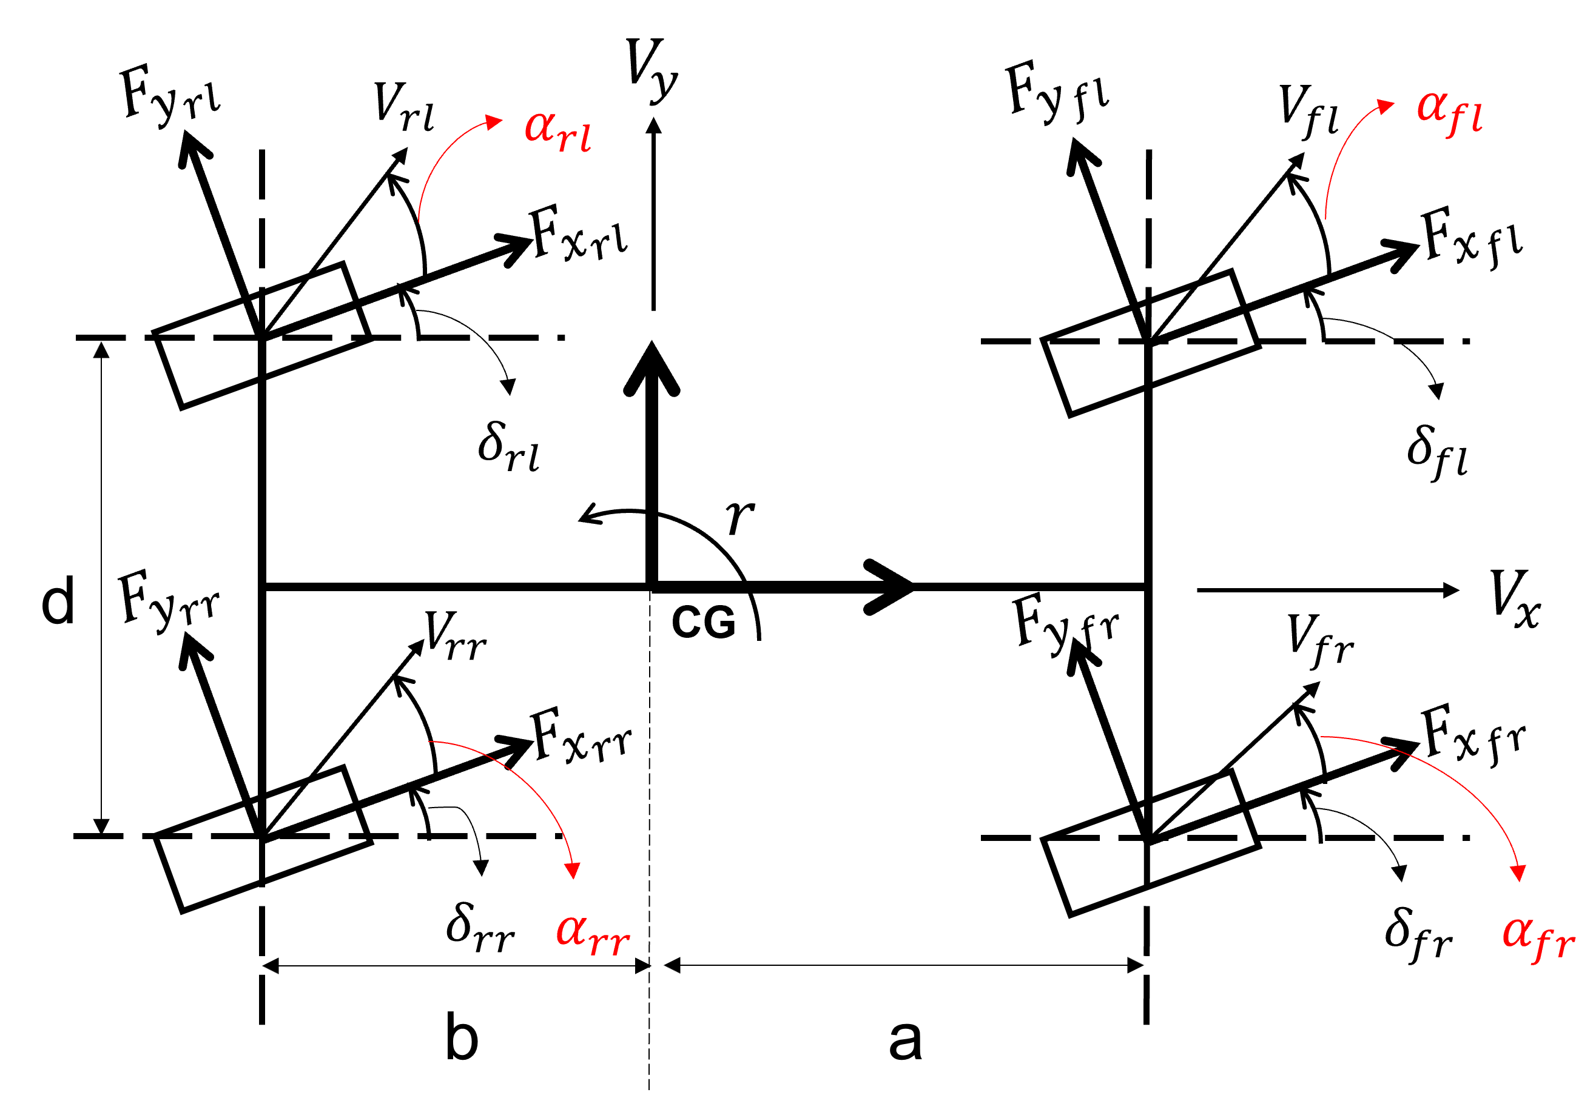
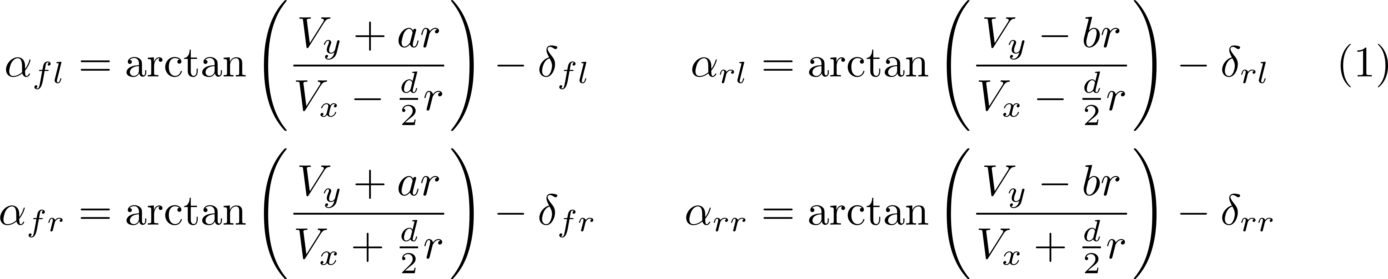
Slip angles/lateral slip at each tire of a vehicle represented by the dual-track model are given by

Slide 19
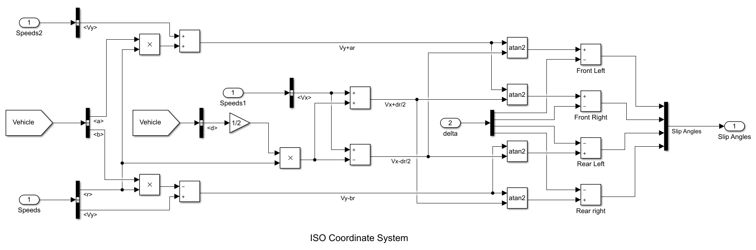
`mdl_dtSlipAngle’ is the Simulink model to estimate slip angles.

Slide 20
`fcn_VD_dtWheelVelocity’ is the Matlab function to estimate wheel velocities.
function wheel_velocity = fcn_VD_dtWheelVelocity(U,V,r,vehicle)
%% fcn_VD_dtWheelVelocity
% This function computes velocities for front left, front right,
% rear left and rear right wheels.
% It uses double-track vehicle model.
%
%% Calculate Wheel Velocities in body coordinates
%%%%%%%%%%%%%%%%%%%%%%%%%%%%%%%%%%%%%%%%%%%%%%%%%%%%%%%%%%%%%%%%%%%
% __ __ _
% | \/ | (_)
% | \ / | __ _ _ _ __
% | |\/| |/ _` | | '_ \
% | | | | (_| | | | | |
% |_| |_|\__,_|_|_| |_|
%
%%%%%%%%%%%%%%%%%%%%%%%%%%%%%%%%%%%%%%%%%%%%%%%%%%%%%%%%%%%%%%%%%%%%
wheel_velocity = nan(4,2); % Initialize a variable
% Velocity of wheel along vehicle body (X-Direction)
wheel_velocity([1,3],1) = U-0.5*vehicle.d*r; % Left tires
wheel_velocity([2,4],1) = U+0.5*vehicle.d*r; % Right tires
% Velocity of wheel perpendicular to vehicle body (Y-Direction)
wheel_velocity([1,2],2) = V+vehicle.a*r; % Front tires
wheel_velocity([3,4],2) = V-vehicle.b*r; % Rear tires
end

Slide 21
`fcn_VD_dtSlipAngle’ is the Matlab function to estimate slip angles.
function slip_angle = fcn_VD_dtSlipAngle(U,V,r,steering_angle,vehicle)
%% fcn_VD_dtSlipAngle
% This function computes Slip Angles/Lateral Slip for front left,
% front right, rear left and rear right wheels.
% It uses double-track vehicle model.
%
%% Calculate Slip-Angles
%%%%%%%%%%%%%%%%%%%%%%%%%%%%%%%%%%%%%%%%%%%%%%%%%%%%%%%%%%%%%%%%%%%
% __ __ _
% | \/ | (_)
% | \ / | __ _ _ _ __
% | |\/| |/ _` | | '_ \
% | | | | (_| | | | | |
% |_| |_|\__,_|_|_| |_|
%
%%%%%%%%%%%%%%%%%%%%%%%%%%%%%%%%%%%%%%%%%%%%%%%%%%%%%%%%%%%%%%%%%%%%
wheel_velocity = fcn_VD_dtWheelVelocity(U,V,r,vehicle); % calculate wheel velocities
slip_angle = atan(wheel_velocity(:,2)./wheel_velocity(:,1))-steering_angle; % calculate slip angles
end

Slide 22
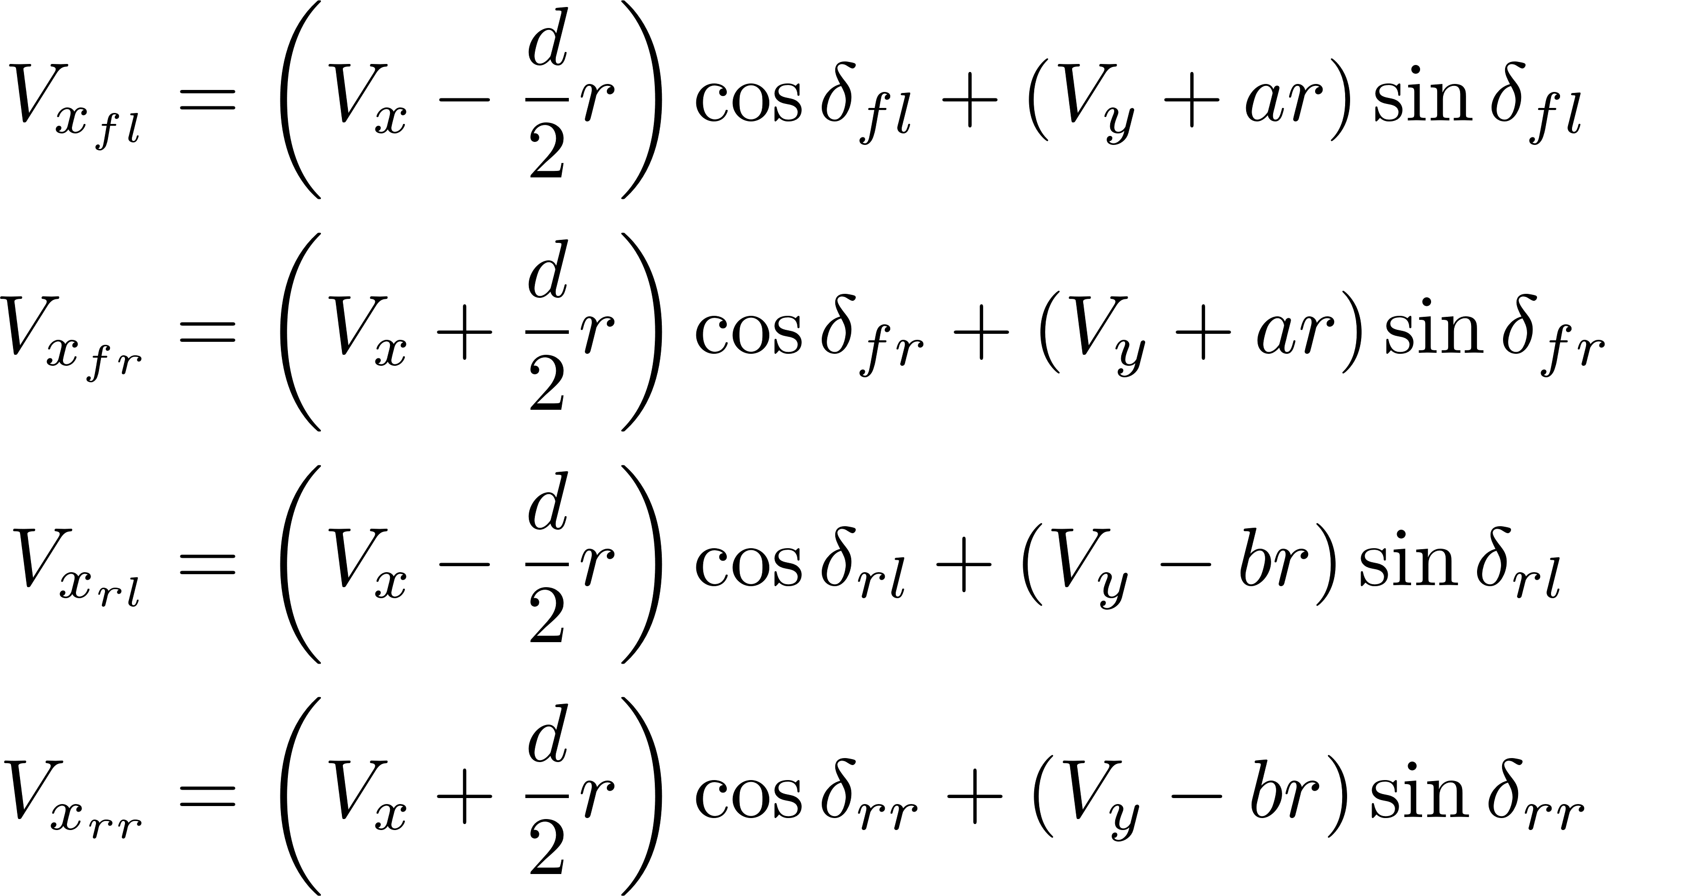
Wheel/longitudinal slips at each tire of a vehicle represented by the dual-track model are given by
where $i=fl, fr, rl, rr$

Slide 23
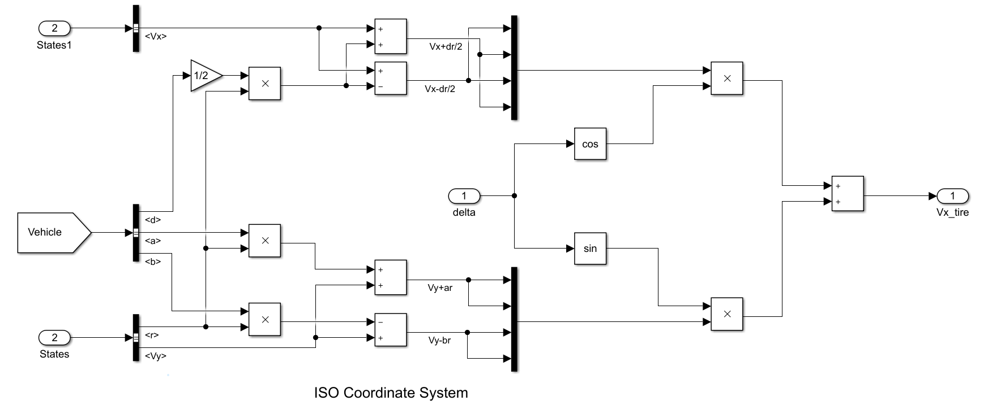
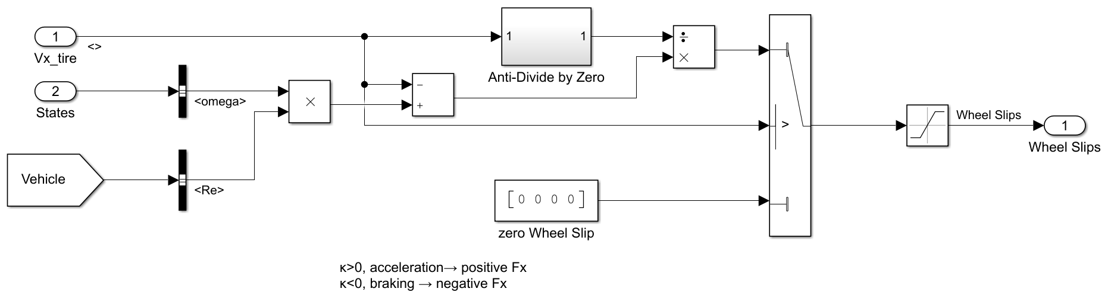
`mdl_dtWheelSlip’ is the Simulink model to estimate wheel slip.
Wheel slip
Tire longitudinal velocity

Slide 24
`fcn_VD_dtWheelSlip’ is the Matlab function to estimate wheel slip.
function wheel_slip = fcn_VD_dtWheelSlip(U,V,r,wheel_angular_velocity,...
steering_angle,vehicle)
%% fcn_VD_longitudinalSlipDualTrack
% This function computes Wheel Slip/Longitudinal Slip for front left,
% front right, rear left and rear right wheels.
% It uses double-track vehicle model.
%
%% Calculate Longitudinal Slip
%%%%%%%%%%%%%%%%%%%%%%%%%%%%%%%%%%%%%%%%%%%%%%%%%%%%%%%%%%%%%%%%%%%
% __ __ _
% | \/ | (_)
% | \ / | __ _ _ _ __
% | |\/| |/ _` | | '_ \
% | | | | (_| | | | | |
% |_| |_|\__,_|_|_| |_|
%
%%%%%%%%%%%%%%%%%%%%%%%%%%%%%%%%%%%%%%%%%%%%%%%%%%%%%%%%%%%%%%%%%%%%
wheel_slip = nan(4,1); % Initialize a variable
wheel_velocity = fcn_VD_dtWheelVelocity(U,V,r,vehicle); % calculate wheel velocities
wheel_longitudinal_velocity = wheel_velocity(:,1).*cos(steering_angle)+...
wheel_velocity(:,2).*sin(steering_angle); % velocity of wheel along the wheel direction
wheel_longitudinal_velocity(0==wheel_longitudinal_velocity) = eps;
% Wheel-Slip calculation
wheel_slip(0>=wheel_longitudinal_velocity) = 0;
% wheel slip is calculated only when the tire is moving in the direction it
% is pointed
target_indices = 0<wheel_longitudinal_velocity;
wheel_slip(target_indices) = (vehicle.Re.*wheel_angular_velocity(target_indices)-...
wheel_longitudinal_velocity(target_indices))./...
wheel_longitudinal_velocity(target_indices);
% Saturation
wheel_slip(1<wheel_slip) = 1; % maximum wheel slip
wheel_slip(-1>wheel_slip) = -1; % minimum wheel slip
end

Slide 25
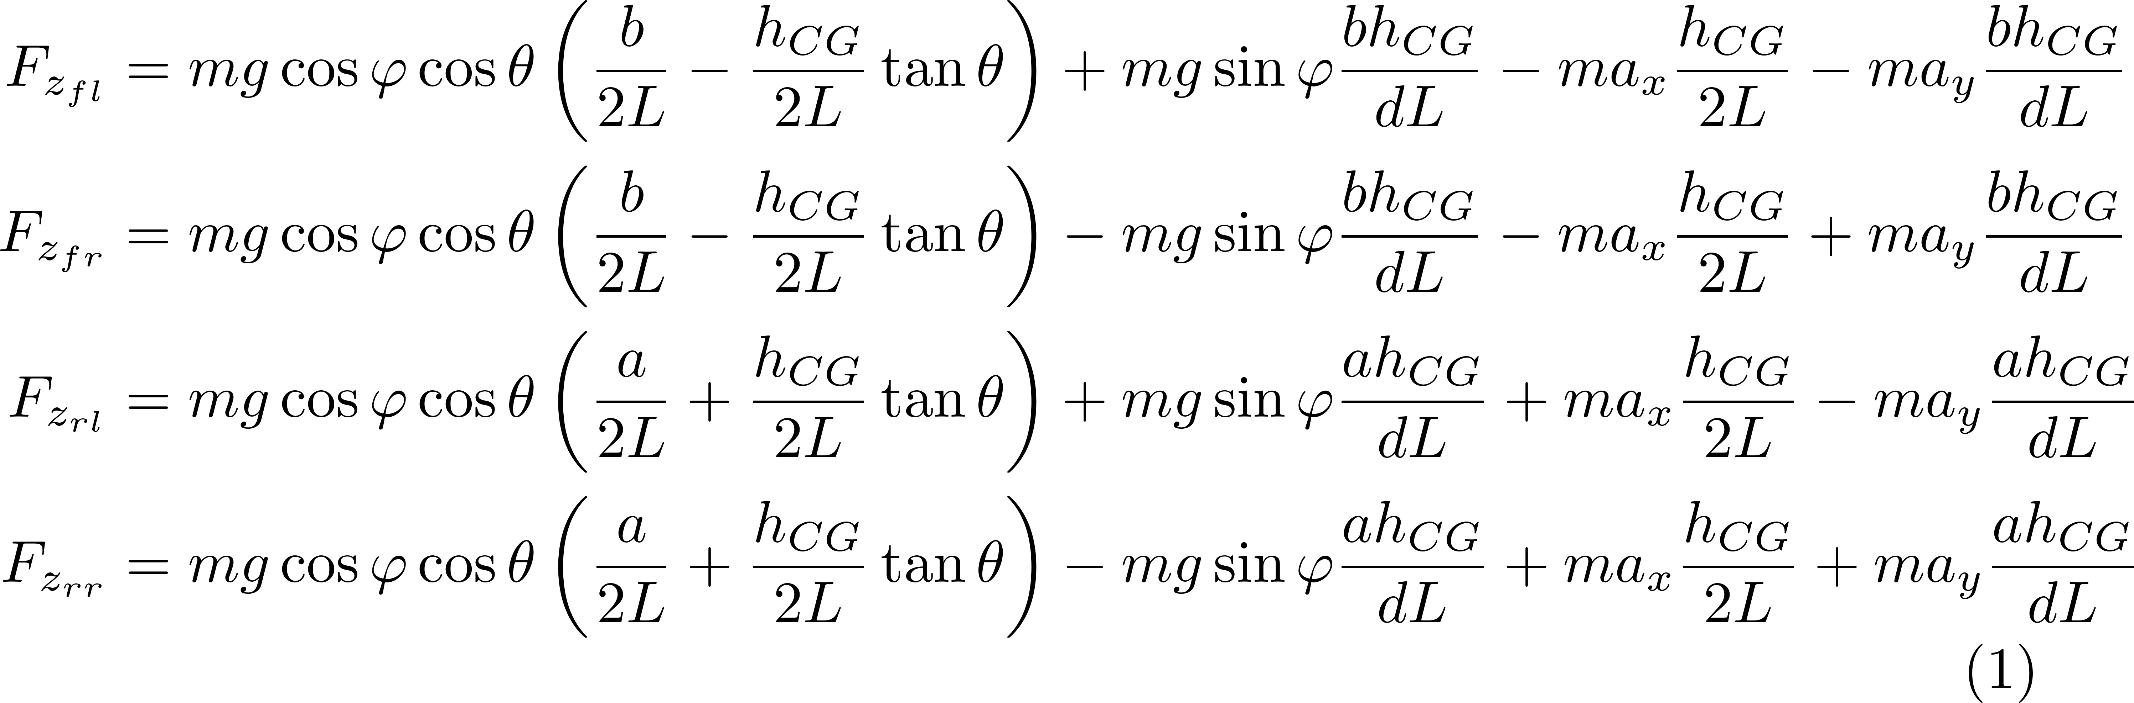
Normal forces at each tire of a vehicle represented by the dual-track model are given by

Slide 26
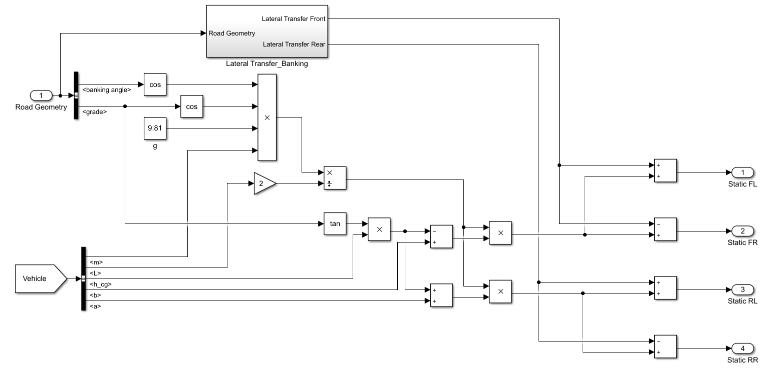
`mdl_dtNormalForce’ is the Simulink model to estimate normal forces.
Static load

Slide 27
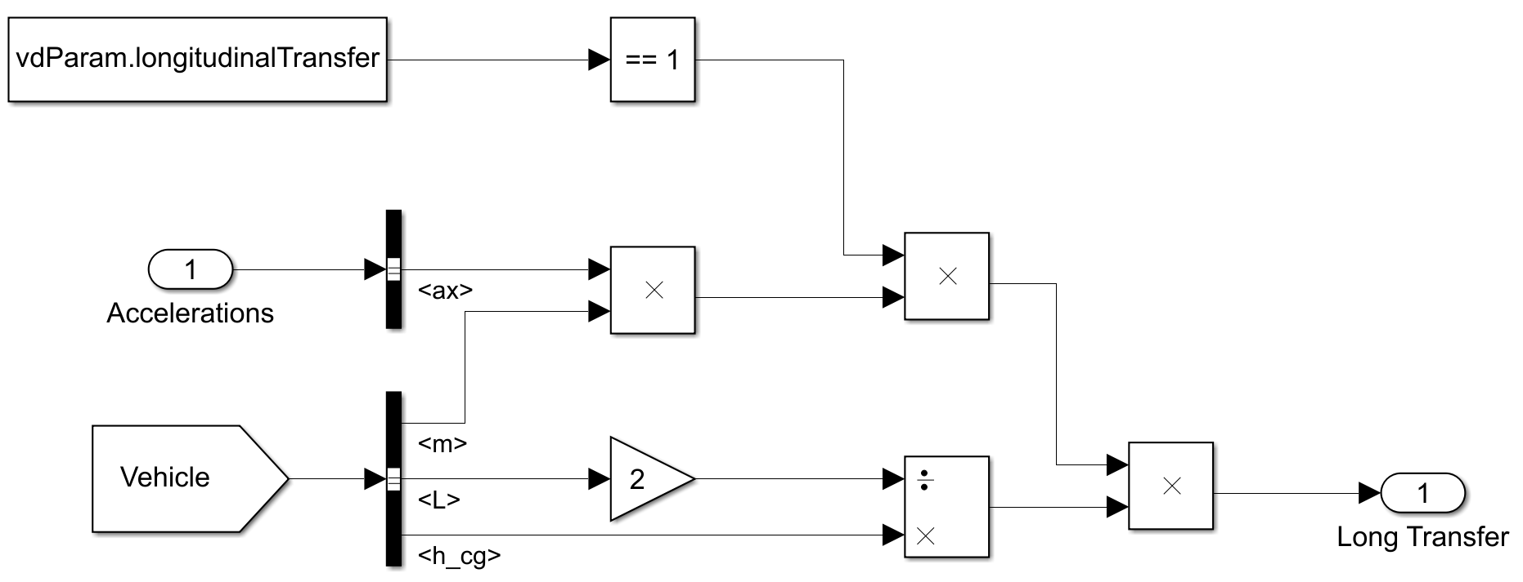
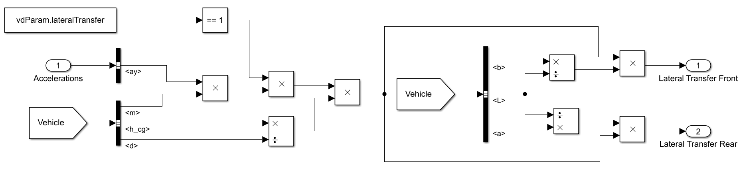
`mdl_dtNormalForce’ is the Simulink model to estimate normal forces.
Longitudinal transfer
Lateral transfer

Slide 28
`fcn_VD_dtNormalForce’ is the Matlab function to estimate normal forces.
function normal_force = fcn_VD_dtNormalForce(acceleration,vehicle,...
road_properties,type_of_transfer)
%% fcn_VD_dtNormalForce
% This function calculates normal force on all the four wheels.
% It uses double-track vehicle model.
%
%% Calculate Normal Forces
%%%%%%%%%%%%%%%%%%%%%%%%%%%%%%%%%%%%%%%%%%%%%%%%%%%%%%%%%%%%%%%%%%%
% __ __ _
% | \/ | (_)
% | \ / | __ _ _ _ __
% | |\/| |/ _` | | '_ \
% | | | | (_| | | | | |
% |_| |_|\__,_|_|_| |_|
%
%%%%%%%%%%%%%%%%%%%%%%%%%%%%%%%%%%%%%%%%%%%%%%%%%%%%%%%%%%%%%%%%%%%%
g = 9.81; % [m/s^2]
Fz_front = 0.5*vehicle.m*g*cos(road_properties.bank_angle)*cos(road_properties.grade)*...
(vehicle.b-vehicle.h_cg*tan(road_properties.grade))/vehicle.L;
Fz_rear = 0.5*vehicle.m*g*cos(road_properties.bank_angle)*cos(road_properties.grade)*...
(vehicle.a+vehicle.h_cg*tan(road_properties.grade))/vehicle.L;
Fz_lateral_static = vehicle.m*g*sin(road_properties.bank_angle)*(vehicle.h_cg/vehicle.d)*...
([vehicle.b; -vehicle.b; vehicle.a; -vehicle.a]/vehicle.L);
normal_force = [Fz_front; Fz_front; Fz_rear; Fz_rear]+Fz_lateral_static; % load transfer due to grade and bank
if strcmpi(type_of_transfer,'both') % Both Longitudinal and Lateral Transfer
Fz_longitudinal = vehicle.m*acceleration(1)*(vehicle.h_cg/vehicle.L)*[-0.5; -0.5; 0.5; 0.5];
Fz_lateral = vehicle.m*acceleration(2)*(vehicle.h_cg/vehicle.d)*([-vehicle.b; vehicle.b; -vehicle.a; vehicle.a]/vehicle.L);
normal_force = normal_force + Fz_longitudinal + Fz_lateral;
elseif strcmpi(type_of_transfer,'longitudinal') % Only Longitudinal Transfer
Fz_longitudinal = vehicle.m*acceleration(1)*(vehicle.h_cg/vehicle.L)*[-0.5; -0.5; 0.5; 0.5];
normal_force = normal_force + Fz_longitudinal;
end
end

Slide 29
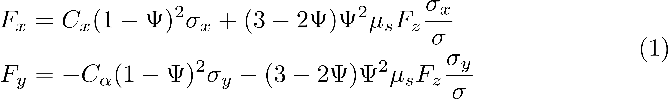
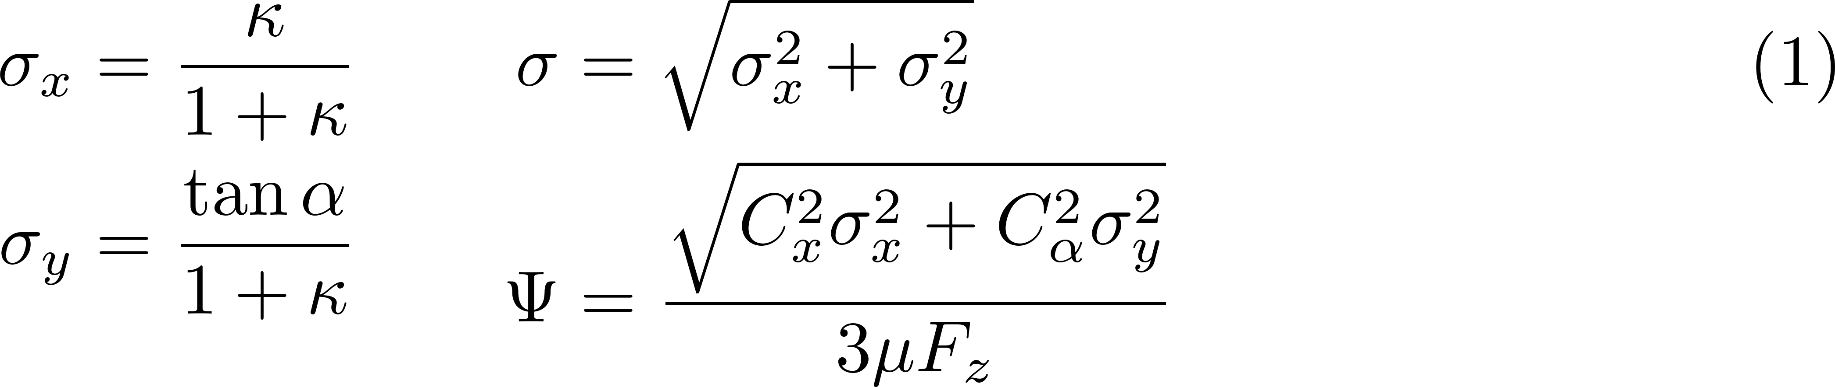
Tire forces at each tire of a vehicle represented by the dual-track model are given by

Slide 30
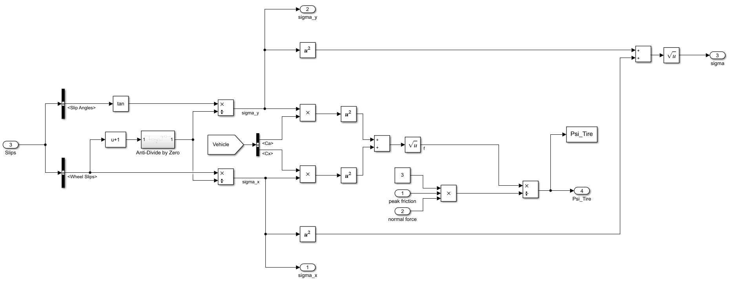
`mdl_dtTireForceBrush’ is the Simulink model to estimate tire forces using the brush tire model.
Combined slip

Slide 31
`fcn_VD_dtCombinedSlip’ is the Matlab function to estimate combined slips.
function combined_slip = fcn_VD_dtCombinedSlip(slip_angle,wheel_slip)
%% fcn_VD_dtCombinedSlip
% This function computes Combined Slip for front left, front right,
% rear left and rear right wheels.
% It uses double-track vehicle model.
%
%% Calculate Combined Slip
%%%%%%%%%%%%%%%%%%%%%%%%%%%%%%%%%%%%%%%%%%%%%%%%%%%%%%%%%%%%%%%%%%%
% __ __ _
% | \/ | (_)
% | \ / | __ _ _ _ __
% | |\/| |/ _` | | '_ \
% | | | | (_| | | | | |
% |_| |_|\__,_|_|_| |_|
%
%%%%%%%%%%%%%%%%%%%%%%%%%%%%%%%%%%%%%%%%%%%%%%%%%%%%%%%%%%%%%%%%%%%%
combined_slip = nan(4,2); % Initialize a variable
denominator = wheel_slip+1; % denominator that's used in calculating combined slip
denominator(0==denominator) = eps; % to avoid division by zero
combined_slip(:,1) = wheel_slip./denominator; % sigma-x
combined_slip(:,2) = tan(slip_angle)./denominator; % sigma-y
end

Slide 32
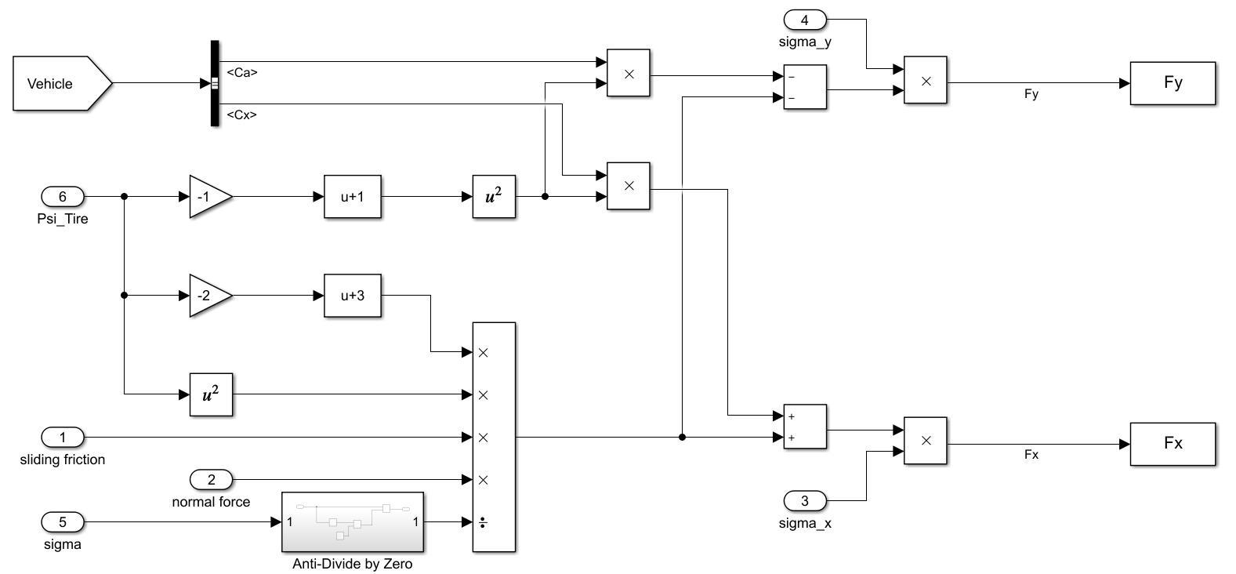
`mdl_dtTireForceBrush’ is the Simulink model to estimate tire forces using the brush tire model.
Tire forces

Slide 33
`fcn_VD_dtTireForceBrush’ is the Matlab function to estimate tire forces using the brush tire model.
function tire_force = fcn_VD_dtTireForceBrush(slip_angle,wheel_slip,...
normal_force,friction_coefficient,vehicle)
%% fcn_VD_dtTireForceBrush
% This function computes tire forces using Combined-Slip Brush Model.
% Ref: Tire Modeling and Friction Estimation by Jacob Svendenius
% It uses double-track vehicle model and brush tire model.
%
%%%%%%%%%%%%%%%%%%%%%%%%%%%%%%%%%%%%%%%%%%%%%%%%%%%%%%%%%%%%%%%%%%%
% __ __ _
% | \/ | (_)
% | \ / | __ _ _ _ __
% | |\/| |/ _` | | '_ \
% | | | | (_| | | | | |
% |_| |_|\__,_|_|_| |_|
%
%%%%%%%%%%%%%%%%%%%%%%%%%%%%%%%%%%%%%%%%%%%%%%%%%%%%%%%%%%%%%%%%%%%%
combined_slip = fcn_VD_dtCombinedSlip(slip_angle,wheel_slip); % calculate combined slip
sigma_x = combined_slip(:,1);
sigma_y = combined_slip(:,2);
sigma = sqrt(sigma_x.^2 + sigma_y.^2);
sigma(0==sigma) = eps; % To avoid division by zero
% eq 4.10, 4.13 on pg 44
Psi = sqrt((vehicle.Cx.*sigma_x).^2 + (vehicle.Ca.*sigma_y).^2)./...
abs(3*friction_coefficient.*normal_force); % use peak-friction here
Psi(1<=Psi) = 1; % account for pure slip
% Adhesion forces:
% eq 4.14 on pg 44
Fax = vehicle.Cx.*sigma_x.*((1-Psi).^2);
Fay = -vehicle.Ca.*sigma_y.*((1-Psi).^2);
% Slide forces:
% eq 4.17 on pg 46
Fsz = normal_force.*(Psi.^2).*(3-2*Psi);
% eq 4.18 on pg 46
Fsx = (sigma_x./sigma).*friction_coefficient.*Fsz; % use sliding-friction here
Fsy = -(sigma_y./sigma).*friction_coefficient.*Fsz; % use sliding-friction here
tire_force = [Fax+Fsx, Fay+Fsy];
end

Slide 34
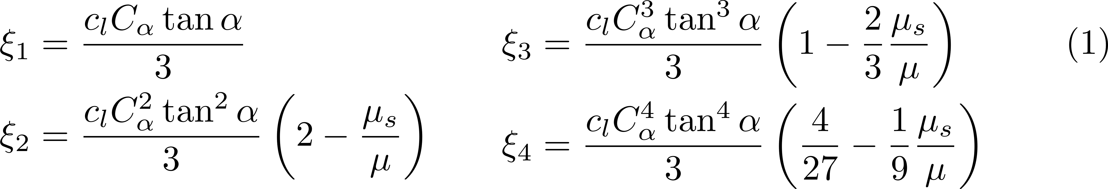
Aligning moment at each tire of a vehicle represented by the dual-track model is given by

Slide 35
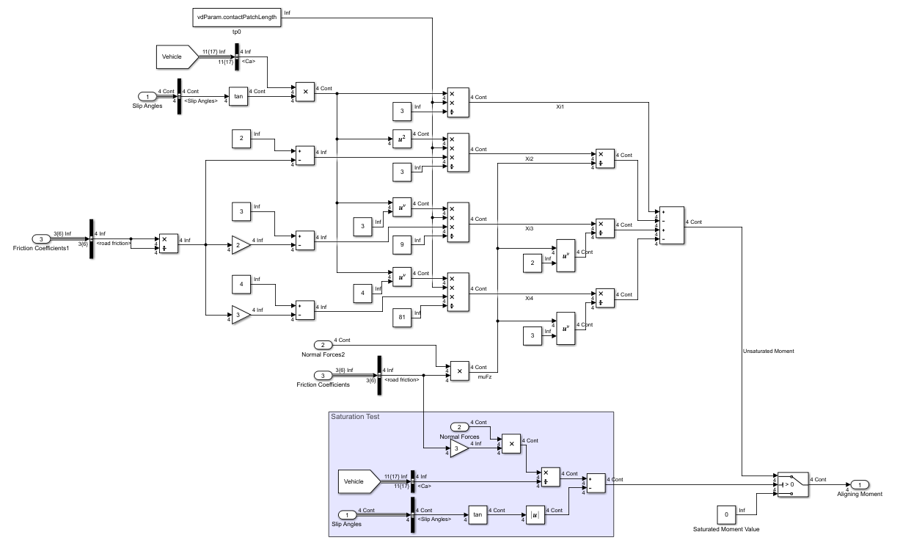
`mdl_dtAligningMomentBrush’ is the Simulink model to estimate aligning moment using the brush tire model.
Aligning moment

Slide 36
`fcn_VD_dtAligningMomentBrush’ is the Matlab function to estimate aligning moment using the brush tire model.
function aligning_moment = fcn_VD_dtAligningMomentBrush(slip_angle,...
normal_force,friction_coefficient,vehicle)
%% fcn_VD_dtAligningMomentBrush
% This function calculates aligning moment on all the four wheels.
% Reference: https://www.tandfonline.com/doi/full/10.1080/00423114.2019.1580377
% It uses double-track vehicle model and brush tire model.
%
%% Calculate Aligning Moment
%%%%%%%%%%%%%%%%%%%%%%%%%%%%%%%%%%%%%%%%%%%%%%%%%%%%%%%%%%%%%%%%%%%
% __ __ _
% | \/ | (_)
% | \ / | __ _ _ _ __
% | |\/| |/ _` | | '_ \
% | | | | (_| | | | | |
% |_| |_|\__,_|_|_| |_|
%
%%%%%%%%%%%%%%%%%%%%%%%%%%%%%%%%%%%%%%%%%%%%%%%%%%%%%%%%%%%%%%%%%%%%
% equation 13a, 13b on pg 9
Xi1 = (vehicle.contact_patch_length*vehicle.Ca.*tan(slip_angle))/3;
Xi2 = ((2-vehicle.friction_ratio)*vehicle.contact_patch_length*(vehicle.Ca.^2).*(tan(slip_angle).^2))/3;
Xi3 = ((1-2*vehicle.friction_ratio/3)*vehicle.contact_patch_length*(vehicle.Ca.^3).*(tan(slip_angle).^3))/3;
Xi4 = ((4/27-vehicle.friction_ratio/9)*vehicle.contact_patch_length*(vehicle.Ca.^4).*(tan(slip_angle).^4))/3;
% equation 12 on pg 9
aligning_moment = Xi1-...
Xi2./(friction_coefficient.*normal_force)+...
Xi3./((friction_coefficient.*normal_force).^2)-...
Xi4./((friction_coefficient.*normal_force).^3);
% check for saturation
saturation_test = (3*friction_coefficient.*normal_force)./vehicle.Ca-abs(tan(slip_angle));
aligning_moment(0>=saturation_test) = 0;
end

Slide 37
Tire forces along the longitudinal and lateral direction of the vehicle are given by

Slide 38
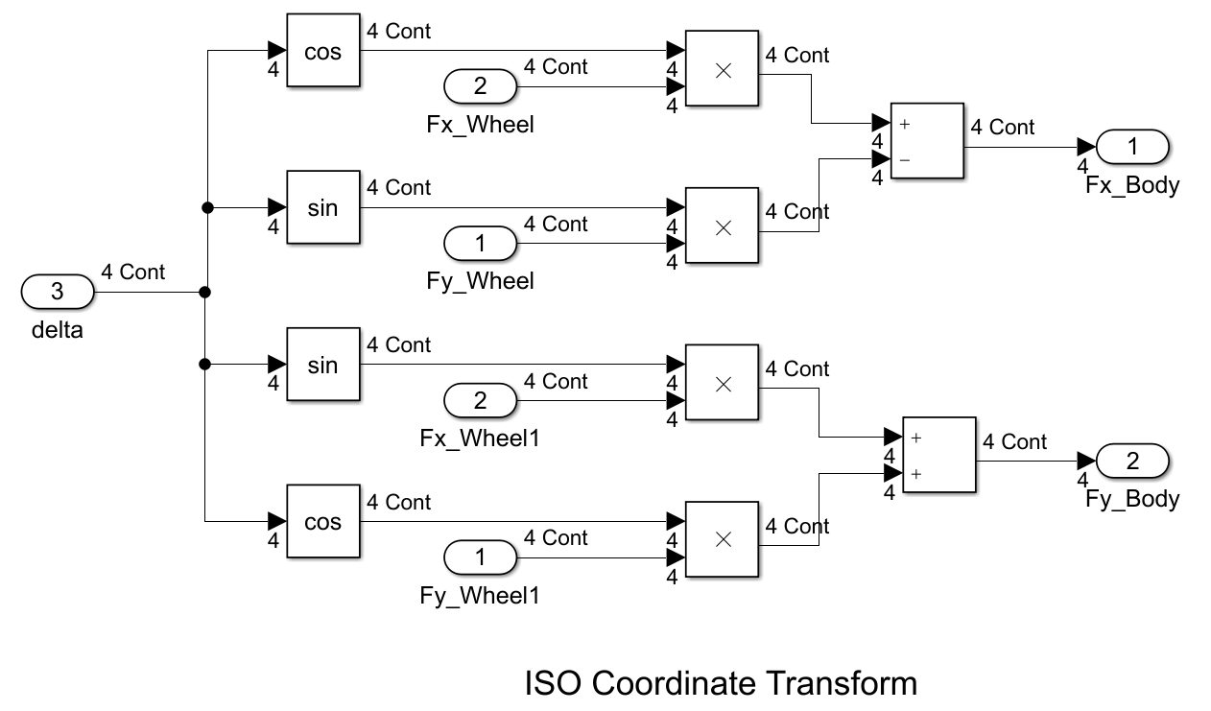
Simulink model to estimate tire forces along the longitudinal and lateral direction.

Slide 39
`fcn_VD_dtWheel2BodyCoordinates’ is the Matlab function to estimate tire forces along the longitudinal and lateral direction.
function body_variable = fcn_VD_dtWheel2BodyCoordinates(wheel_variable,...
steering_angle)
%% fcn_VD_dtWheel2BodyCoordinates
% This function transforms variables from wheel to body coordinates
% It uses double-track vehicle model.
%
%% Convert from Wheel to Body Coordinates
%%%%%%%%%%%%%%%%%%%%%%%%%%%%%%%%%%%%%%%%%%%%%%%%%%%%%%%%%%%%%%%%%%%
% __ __ _
% | \/ | (_)
% | \ / | __ _ _ _ __
% | |\/| |/ _` | | '_ \
% | | | | (_| | | | | |
% |_| |_|\__,_|_|_| |_|
%
%%%%%%%%%%%%%%%%%%%%%%%%%%%%%%%%%%%%%%%%%%%%%%%%%%%%%%%%%%%%%%%%%%%%
body_variable = nan(4,2);
body_variable(:,1) = wheel_variable(:,1).*cos(steering_angle)-...
wheel_variable(:,2).*sin(steering_angle);
body_variable(:,2) = wheel_variable(:,1).*sin(steering_angle)+...
wheel_variable(:,2).*cos(steering_angle);
end

Slide 40
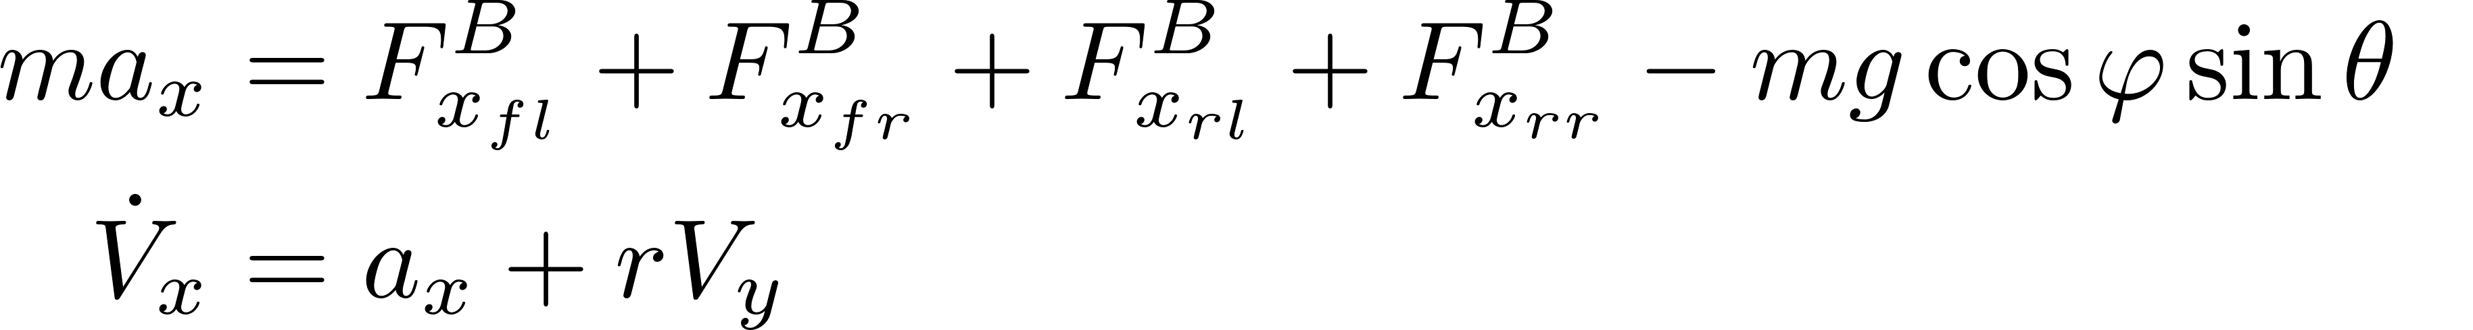
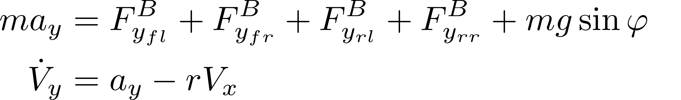
State equations of the 7DOF vehicle model are

Slide 41
`fcn_VD_7dofForceEquation’ is the Matlab function for force equations of a 7DOF vehicle model.
function acceleration = fcn_VD_dt7dofForceEquation(wheel_force,wheel_torque,...
steering_angle,vehicle,road_properties)
%% fcn_VD_dt7dofForceEquation
% This function calculates accelerations.
%
%% Calculate accelerations
%%%%%%%%%%%%%%%%%%%%%%%%%%%%%%%%%%%%%%%%%%%%%%%%%%%%%%%%%%%%%%%%%%%
% __ __ _
% | \/ | (_)
% | \ / | __ _ _ _ __
% | |\/| |/ _` | | '_ \
% | | | | (_| | | | | |
% |_| |_|\__,_|_|_| |_|
%
%%%%%%%%%%%%%%%%%%%%%%%%%%%%%%%%%%%%%%%%%%%%%%%%%%%%%%%%%%%%%%%%%%%%
g = 9.81; % [m/s^2]
body_force = fcn_VD_dtWheel2BodyCoordinates(wheel_force,steering_angle); % find body forces
% Force and torque balance on the vehicle body
ax = sum(body_force(:,1))/vehicle.m-g*cos(road_properties.bank_angle)*sin(road_properties.grade); % longitudinal acceleration
ay = sum(body_force(:,2))/vehicle.m+g*sin(road_properties.bank_angle); % lateral acceleration
drdt = (((vehicle.d/2)*(-body_force(1,1)+body_force(2,1)-body_force(3,1)+body_force(4,1)))+...
(vehicle.a*sum(body_force([1,2],2)))-(vehicle.b*sum(body_force([3,4],2))))/vehicle.Izz; % yaw acceleration
% Torque balance on vehicle's wheels
domegadt = (wheel_torque-vehicle.Re.*wheel_force(:,1))./vehicle.Iw; % angular acceleration of wheel
acceleration = [ax; ay; drdt; domegadt];
end

Slide 42
`fcn_VD_7dofStateEquation’ is the Matlab function for state equations of a 7DOF vehicle model.
function dydt = fcn_VD_7dofStateEquation(~,y,acceleration)
%% fcn_VD_7dofStateEquation
% This function is a differential equation for longitudinal velocity,
% lateral velocity, yaw rate, and angular velocities of wheels.
%
%% Differential equation for 7-DOF model
%%%%%%%%%%%%%%%%%%%%%%%%%%%%%%%%%%%%%%%%%%%%%%%%%%%%%%%%%%%%%%%%%%%
% __ __ _
% | \/ | (_)
% | \ / | __ _ _ _ __
% | |\/| |/ _` | | '_ \
% | | | | (_| | | | | |
% |_| |_|\__,_|_|_| |_|
%
%%%%%%%%%%%%%%%%%%%%%%%%%%%%%%%%%%%%%%%%%%%%%%%%%%%%%%%%%%%%%%%%%%%%
dUdt = acceleration(1)+y(3)*y(2); % Vxdot
dVdt = acceleration(2)-y(3)*y(1); % Vydot
drdt = acceleration(3); % yaw acceleration
domegadt = acceleration(4:7); % angular acceleration of wheel
dydt = [dUdt; dVdt; drdt; domegadt];
end

Slide 43
Vehicle position in the global coordinates is given by

Slide 44
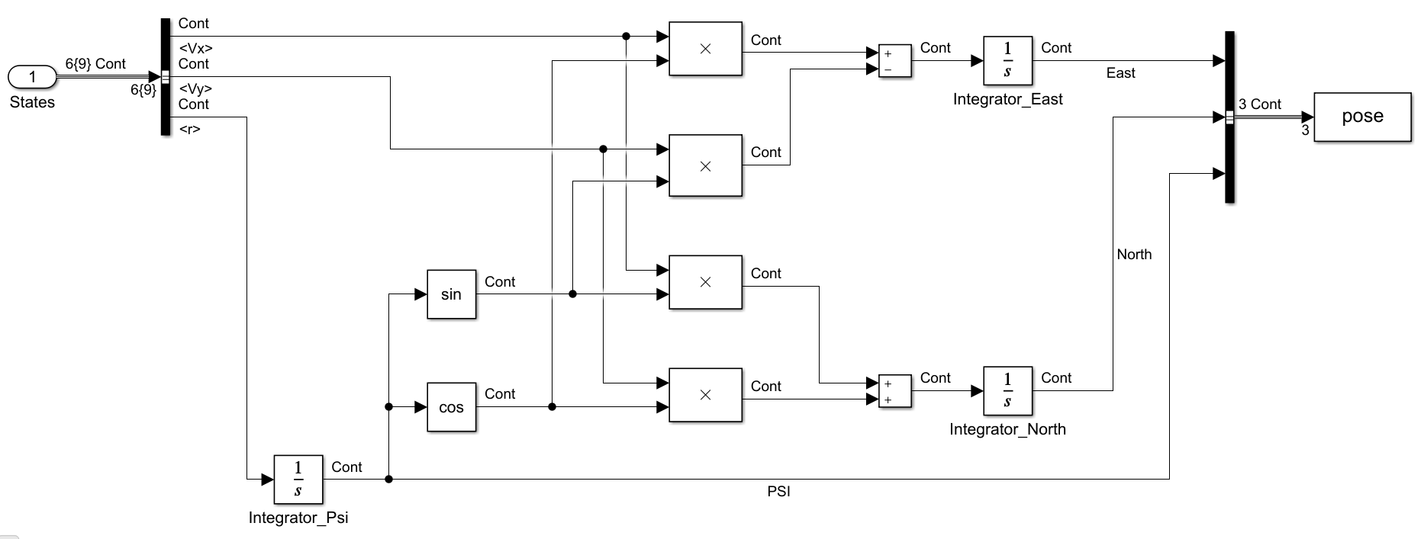
Simulink model to estimate vehicle position in the global coordinates.

Slide 45
`fcn_VD_dtBody2GlobalCoordinates’ is the Matlab function to estimate vehicle position in the global coordinates.
function dydt = fcn_VD_Body2GlobalCoordinates(~, y, U, V, r)
%% fcn_VD_Body2GlobalCoordinates
% This function calculates velocites in global coordinates.
%
%% Calculate velocities in Global coordinates
%%%%%%%%%%%%%%%%%%%%%%%%%%%%%%%%%%%%%%%%%%%%%%%%%%%%%%%%%%%%%%%%%%%
% __ __ _
% | \/ | (_)
% | \ / | __ _ _ _ __
% | |\/| |/ _` | | '_ \
% | | | | (_| | | | | |
% |_| |_|\__,_|_|_| |_|
%
%%%%%%%%%%%%%%%%%%%%%%%%%%%%%%%%%%%%%%%%%%%%%%%%%%%%%%%%%%%%%%%%%%%%
psi = y(3);
dXdt = U*cos(psi)-V*sin(psi);
dYdt = U*sin(psi)+V*cos(psi);
dPhidt = r;
dydt = [dXdt; dYdt; dPhidt];
end

Slide 46
Vehicle position in the global coordinates is given by

Slide 47
Simulink model to estimate vehicle position in the global coordinates.

Slide 48
`fcn_VD_dtBody2GlobalCoordinates’ is the Matlab function to estimate vehicle position in the global coordinates.

Slide 49
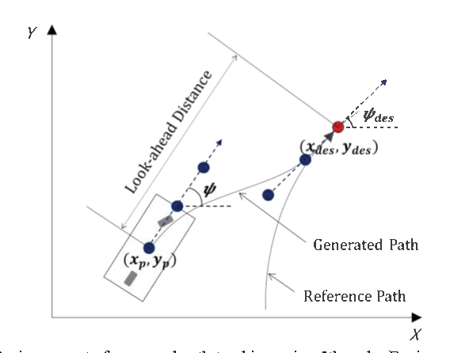
Pure Pursuit driver model
Lateral Offset Error, e

Slide 50
Macadam driver model
$$minimize J=\int_{t}^{t+T}{{\left[y\left(η\right)−f\left(η\right)\right]}^{2}}dη$$
Optimal control, $u^{o}\left(t\right)$
Time delay, D
Final steering control, $u\left(t\right)=u^{o}\left(t−D\right)$

Slide 51
Single-Point Macadam driver model
Previewed
Path
Input
Previewed
Lateral
Displacement
Previewed
Error
Driver
Lag
Vehicle
Dynamics
Driver
Prediction
f$\left(t+T^{∗}\right)$
$$e\left(t+T^{∗}\right)$$
$$\frac{1}{a^{∗}}$$
$$u^{0}\left(t\right)$$
$$H=e^{−sτ}$$
u$\left(t\right)$
G
$$x\left(t\right)$$
$$b^{∗}$$
$$y_{0}\left(t+T^{∗}\right)$$
$$y\left(t+T^{∗}\right)$$
$$+$$
$$+$$
$$+$$
$$−$$
$$+$$
$$+$$
Driver Gain
Compensation
$$a^{∗}$$
$$y_{u}\left(t+T^{∗}\right)$$
Driver
Prediction

Slide 52
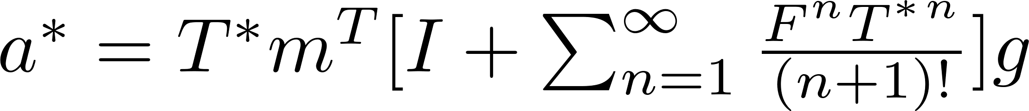
Driver’s ability to predict that component of the future response of the vehicle deriving only from the current steering control input

Slide 53
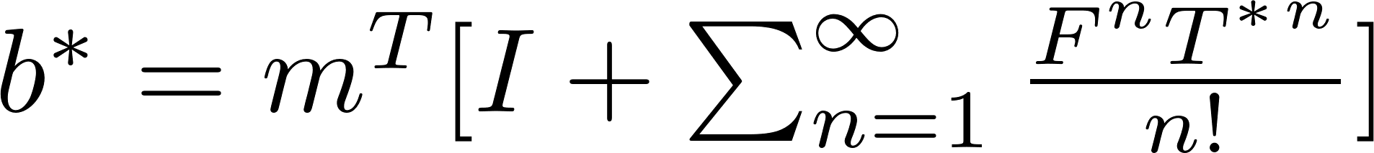
Driver’s ability to predict that component of the future response of the vehicle deriving only from the present state of the vehicle

Slide 54
$$F_{y_{rl}}$$
$$V_{y}$$
$$F_{y_{fl}}$$
$$V_{rl}$$
$$α_{rl}$$
$$V_{fl}$$
$$α_{fl}$$
$$F_{x_{rl}}$$
$$F_{x_{fl}}$$
$$δ_{rl}$$
$$δ_{fl}$$
$$r$$
d
$$F_{y_{rr}}$$
$$F_{y_{fr}}$$
$$V_{x}$$
$$V_{rr}$$
CG
$$V_{fr}$$
$$F_{x_{rr}}$$
$$F_{x_{fr}}$$
$$δ_{rr}$$
$$α_{rr}$$
$$δ_{fr}$$
$$α_{fr}$$
b
a

