Slide 1
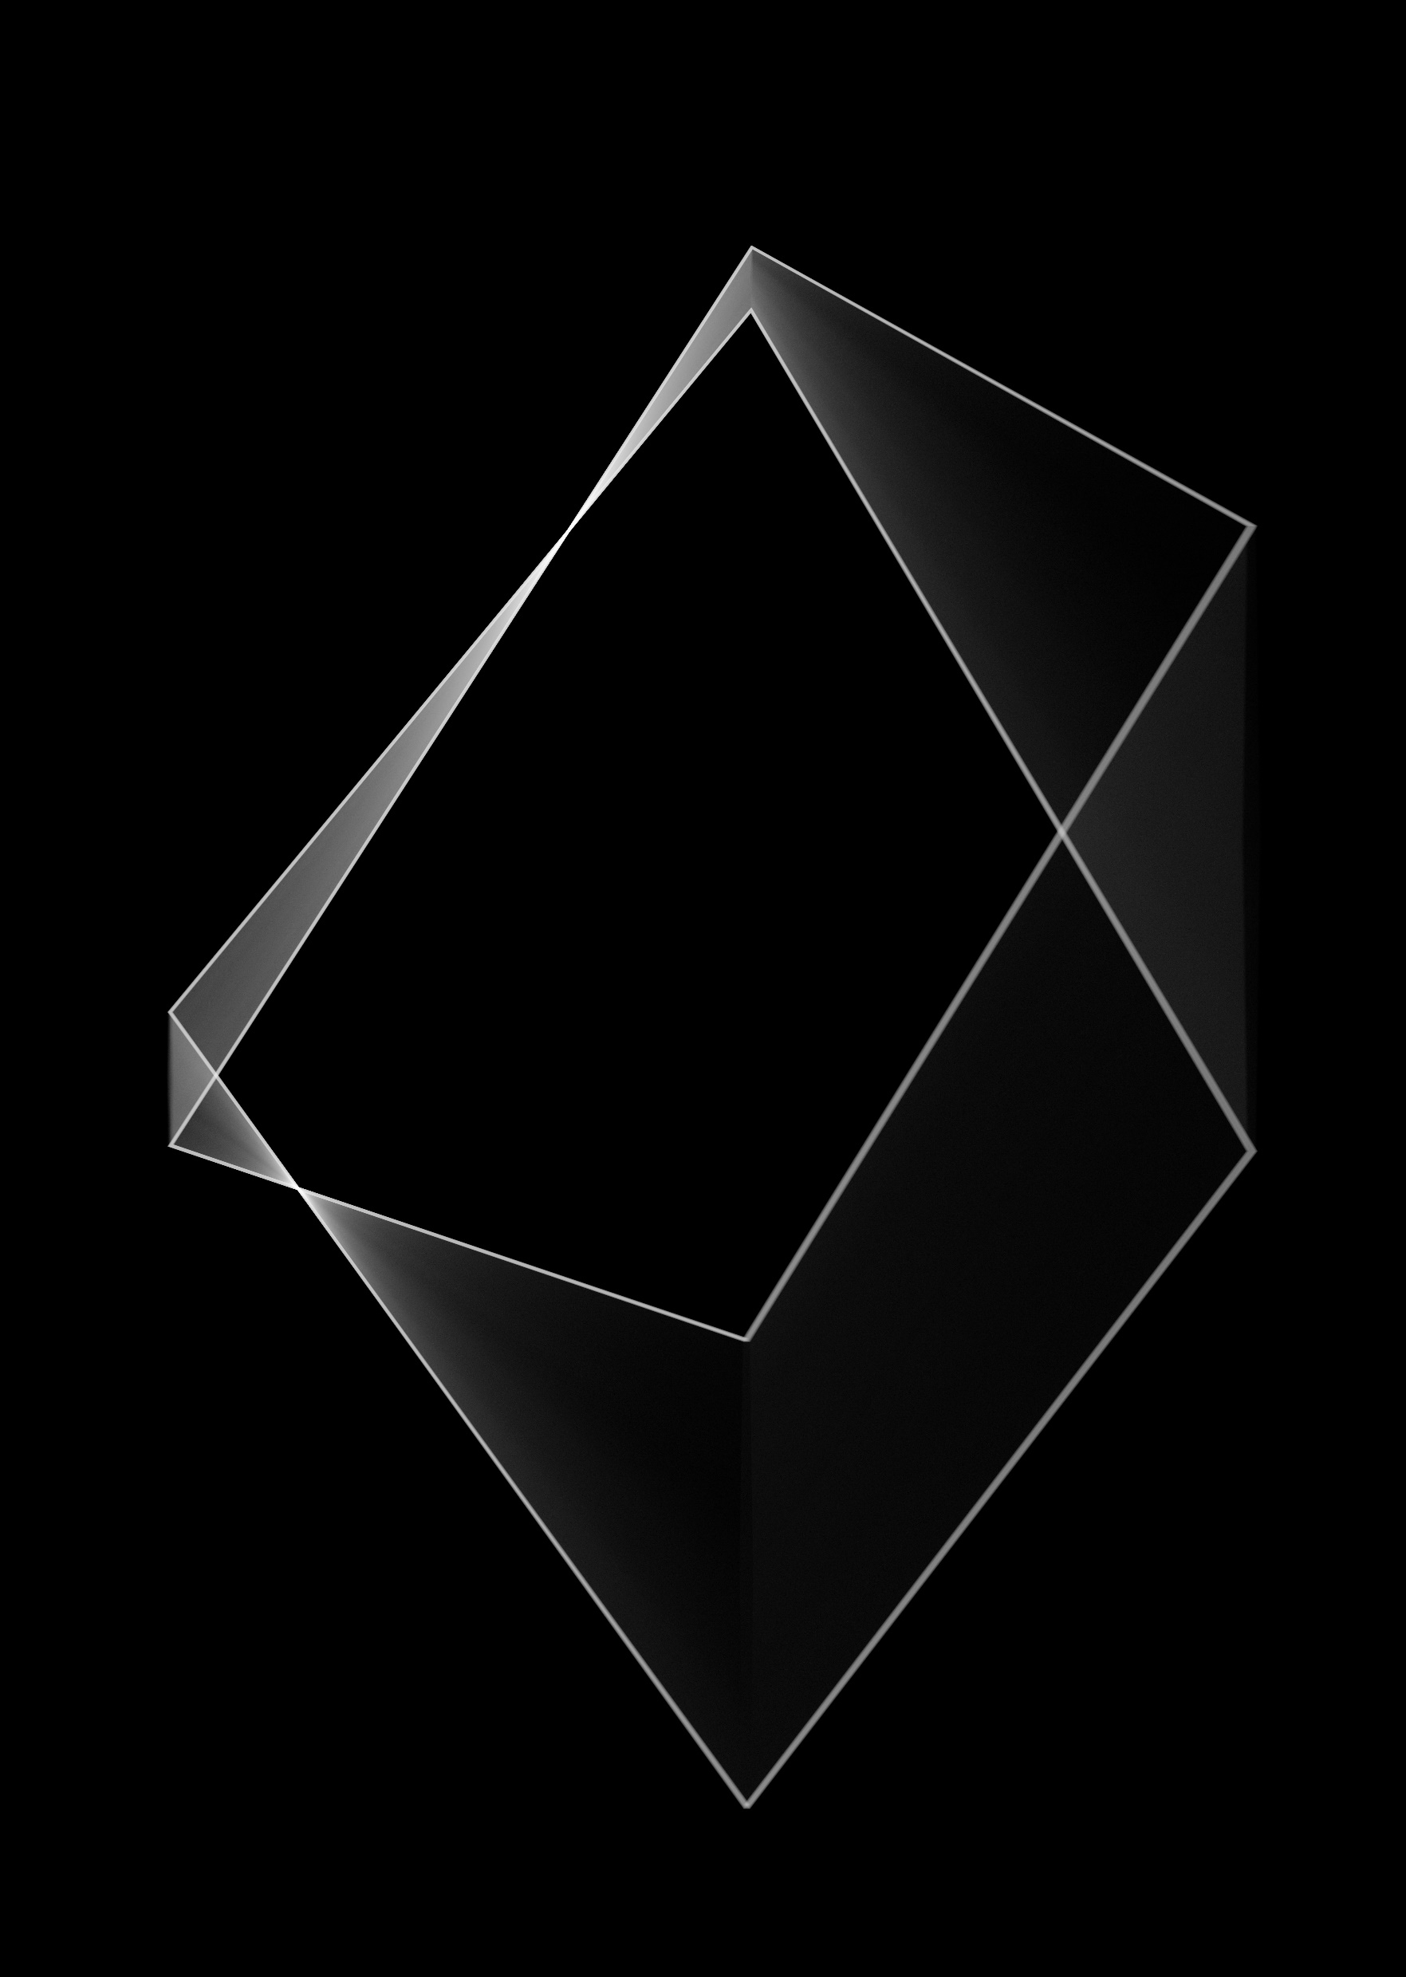
Introduction to the Vertex Skeleton “Vskel” Library
Methods to shrink 2D and higher polytopes, and to approximate medial axes
Photo by <a href="https://unsplash.com/@fakurian?utm_content=creditCopyText&utm_medium=referral&utm_source=unsplash">Milad Fakurian</a> on <a href="https://unsplash.com/photos/a-black-and-white-photo-of-a-diamond-0uUzrqDeBNY?utm_content=creditCopyText&utm_medium=referral&utm_source=unsplash">Unsplash</a>

Slide 2
For many examples below, MATLAB code will be given. It is usually highlighted as shown here: yellow for scripts, grey for console outputs.
%% Example 1: simple three points
fig_num = 1;
x = [-4; -2; 1];
y = [0; -4; -1];
apex_points = [x y];
fcn_FastestTraversal_calculateObstacleDirectionAtApexPoints(...
apex_points, fig_num);
>> script_test_fcn_geometry_selfCrossProduct
cross_products =
0
err =
1

Slide 3
Each function uses a class-specific argument check function
function fcn_MapGen_checkInputsToFunctions(...
variable,variable_type_string,varargin)
% fcn_MapGen_checkInputsToFunctions
% Checks the variable types commonly used in the MapGen codes to
% ensure they are correctly formed.
%
% This function is typically called at the top of most functions. The input
% is a variable and a string defining the "type" of the variable. This
% function checks to see that they are compatible. For example, say there
% 'column_vector' type of variables used in the function that is always a N
% x 1 array; if someone had a variable called "test_example", they could
% check that this fit the 'column_vector' type by calling
% fcn_MapGen_checkInputsToFunctions(test_example,'column_vector').
% This function would then check that the array was N x 1, and if it was
% not, it would send out an error warning.
%
% FORMAT:
%
% fcn_MapGen_checkInputsToFunctions(...
% variable,variable_type_string,(optional_arguments))
%
% INPUTS:
%
% variable: the variable to check
See: script_test_fcn_MapGen_checkInputsToFunctions.m for example usages

Slide 4
A demonstration script exists that shows most of the functionality in this document: script_demo_MapGenLibrary
%% Show how inputs are checked
Twocolumn_of_numbers_test = [4 1; 3 0; 2 5];
fcn_MapGen_checkInputsToFunctions(Twocolumn_of_numbers_test, '2column_of_numbers');
%% Generate a set of polytopes from various pseudo-random sources
% Generate a set of polytopes from the Sobol set
fig_num = 11;
Sobol_range = [1 1000]; % range of Sobol points to use to generate the tiling
tiled_polytopes = fcn_MapGen_sobolVoronoiTiling(Sobol_range,[1 1],fig_num);
% Generate a set of polytopes from the Halton set
fig_num = 12;
Halton_range = [1 1000]; % range of Halton points to use to generate the tiling
tiled_polytopes = fcn_MapGen_haltonVoronoiTiling(Halton_range,[1 1],fig_num);

Slide 5
Shrink from Edges Functionality
Updated 2025-04-29 by S. Brennan

Slide 6
Individual polytopes can be shrunk by edges, and the first step is to find the Vertex Skeleton via: fcn_MapGen_polytopeFindVertexSkeleton This function defines how the vertices “move” as edges are trimmed inward by the same amount.
fig_num = 675;
vertices = [0 0; 2 0; 1 2; 0 1; 0 0]*5;
fcn_MapGen_polytopeFindVertexSkeleton(vertices,fig_num);

Slide 7
The skeleton is calculated by iterating inward from the given vertices
As long as there are more than 2 vertices, it:
Calculates the vectors pointing inward, and angles they make relative to next segment (“half angles”)
Using the angles and vectors, calculates where the vectors intersect
Finds the minimum distance of intersection
Merges vertices that come together
Repeats

Slide 8
Step 1: To calculate the vectors inward, the function calls an internal function to obtain unit vectors inward, the half angles, the distances from vertex-to-vertex, and unit vectors from vertex to vertex.
[vector_direction_of_unit_cut, ...
half_angles,...
distances_vertex_to_vertex,...
unit_vectors_vertex_to_vertex] = ...
INTERNAL_fcn_findUnitDirectionVectors(working_vertices,333);

Slide 9




















To calculate the intersection points, the following geometry is used to find $L_{cut}$, and the projection point where the edge projects inward directly toward the intersection.
$$L_{1}⋅\tan{θ_{1}}=L_{2}⋅\tan{θ_{2}}$$
$$L_{1}=L_{2}⋅\frac{\tan{θ_{2}}}{\tan{θ_{1}}}$$
$$L_{2}=D−L_{1}$$
$$θ_{1}$$
$$H_{1}$$
$$L_{1}=\left(D−L_{1}\right)⋅\frac{\tan{θ_{2}}}{\tan{θ_{1}}}$$
$$1$$
$$θ_{1}$$
$$L_{cut}$$
$$L_{1}$$
$$Let A=\frac{\tan{θ_{2}}}{\tan{θ_{1}}}$$
$$H_{2}$$
$$L_{1}=\frac{A}{A+1}⋅D$$
$$L_{cut}=L_{1}⋅\tan{θ_{1}}⁡$$
D
$$L_{2}$$
$$θ_{2}$$
$$θ_{2}$$
$$L_{cut}=\frac{\tan{θ_{1}}⋅\tan{θ_{2}}}{\tan{θ_{1}}+\tan{θ_{2}}}⋅D⁡$$
$$2$$

Slide 10
Using the half-angles to define the theta1 and theta2 values, one can find the projection points from each edge
These projection points are where the orthogonal from each edge would intersect the vertices, as vertices shrink inward and touch each other.

Slide 11
We next rotate the unit vectors from one corner to another by 90 degrees, and starting from the projection points, move inward by Lcut. This predicts the intersection points of the vertices.

Slide 12
The minimum cut distance defines how far we can cut inward before vertices merge. The indices that merge have to have the same cut distance and follow one after the other.
Once we know which vertex is the closest, we need to move all vertices inward by ONLY the shortest cut distance.

Slide 13
Before starting on the next step, in case there are only 2 points left, we calculate the vector direction of the unit cuts for the new vertices just created.
These are just the average of the adjacent vectors that were merged. This is repeated until all the points converge, or only 2 points are left

Slide 14
The final result is the skeleton plot
The outputs give:
new_vertices: a cell array of dimension M, where each index 1:M stores a N x 2 array of the coordinates of the nested shape inside, with M = 1 being the starting shape (and with dimension K+1, where K is number of vertices given), and N being smaller and smaller for each M value.
new_projection_vectors: a cell array of M, where each index 1:M stores a L x 2 array of the unit vectors (with L = N-1) that point away from the vertices of the nested shape inside, with M = 1 being the starting unit vectors (and with dimension K, where K is number of vertices given), and L being smaller and smaller for each M value.
cut_distance: a cell array of M, ranging from 0 (for M=1) to the maximum cut distance that can be used

Slide 15
To use this, we index the template corresponding to our cut depth, and cut more if needed
fig_num = 675;
vertices = [0 0; 2 0; 1 2; 0 1; 0 0]*5;
[new_vertices, new_projection_vectors, cut_distance] = fcn_MapGen_polytopeFindVertexSkeleton(vertices,fig_num);
figure(4747);
grid on
grid minor
hold on
axis equal
for cut = 0:0.5:cut_distance(end)
% Find the shape that is less than or equal to the cut
shape_index = find(cut_distance<=cut,1,'last');
% Grab vertices to start from, cut to start from
starting_vertices = new_vertices{shape_index};
starting_cut = cut_distance(shape_index);
% Calculate projection distance
projection_distance = cut - starting_cut;
% Determine final vertices
final_vertices = starting_vertices + new_projection_vectors{shape_index}*projection_distance;
% Plot results
plot(final_vertices(:,1),final_vertices(:,2),'r.-','Linewidth',2,'Markersize',20);
end

Slide 16
Here’s other examples:
Goofy Polytope:
Square:
Wide Rectangle:
Tall Rectangle:
Random Polytope:
See: script_test_fcn_MapGen_polytopeFindVertexSkeleton
For more examples

Slide 17
The function fcn_MapGen_polytopeShrinkFromEdges implements the skeleton calculations to perform the shrinkage
This is implemented in three steps:
1. Calculate the polytope skeleton, or use the skeleton if the user
provides this as inputs.
2. Using the cut distance, find the template that is less than or equal
to the cut distance. If less, then calculate the additional cut and
project the verticies to their new points based on residual cut.
3. Convert the resulting verticies into the standard polytope form.

Slide 18
The code that performs the cutting is relatively simple. It uses the largest template that corresponds to a cut smaller or equal to the requested cut.
%% STEP 2. Using the cut distance, find the template
% We want to use the one that is less than or equal to the cut distance. If
% less, then calculate the additional cut and project the verticies to
% their new points based on residual cut.
% Find the shape that is less than or equal to the cut
shape_index = find(cut_distance<=edge_cut,1,'last');
% Grab vertices to start from, cut to start from
template_vertices = new_vertices{shape_index};
template_start_cut = cut_distance(shape_index);
% Calculate projection distance
additional_cut_distance = edge_cut - template_start_cut;
% Determine final vertices
final_vertices = template_vertices + new_projection_vectors{shape_index}*additional_cut_distance;

Slide 19
The results are as expected
Square:
Right Triangle:
Right Triangle Cut too Deeply
Repeated cuts:
See: script_test_fcn_MapGen_polytopeFindVertexSkeleton
For more examples

Slide 20
When using edge cutting, particularly if repeatedly using this, significant computation time is saved if one avoids repeated calculation of the skeleton.
If one precomputes, this and reuses it, it can save roughly 10 times the computation. If one avoids polytope calculations and just needs the vertices, it saves roughly 100 times the calculations

Slide 21
How to Shrink from Edges with Non-Convex Polytopes
Updated 2025-04-19 by S. Brennan

Slide 22
For non-convex polytopes, the previous methods will not work.

Slide 23
For non-convex polytopes, the previous method requires modification.
Namely, for non-convex polytopes, vertex intersections may include non-adjacent sides
Calculates the vectors pointing inward, vectors normal, vector projections from each vertex per unit cut, and maximum cut distances for each edge
Using the angles and vectors, calculates where the vectors intersect
Finds the minimum distance of intersection
Merges vertices that come together
Repeats

Slide 24
Step 1: Remains largely the same, to calculate key vectors and angles.
These include:
Unit normal for segment ahead of each vertex
Unit vectors inward at each vertex
Magnitude and direction vector defining vertex motion for a unit cut
Inside the function, the following are also calculated
Distances from vertex-to-vertex,
Unit vectors from vertex to vertex,
[unit_normal_vectors, vertex_projection_vectors] =... fcn_VSkel_fcn_polytopeFindUnitDirectionVectors(vertices,fig_num);

Slide 25




The magnitude of vertex motion for a unit cut can be found via the following
Given:
Unit normal for segment ahead of each vertex
Unit vectors inward at each vertex
For a unit travel in direction n_i:
And projection vector for unit cut is given by:
$$\hat{v_{i}}$$
$$p_{i}$$
$$\hat{n_{i}}$$
$$d⋅\hat{v_{i}}⋅\hat{n_{i}}=1$$
$$d=1/(\hat{v_{i}}⋅\hat{n_{i}})$$
$$v_{i}=d⋅\hat{v_{i}}$$
[unit_normal_vectors, unit_vertex_projection_vectors, vector_direction_of_unit_cut] = ...
fcn_VSkel_fcn_polytopeFindUnitDirectionVectors(vertices,fig_num);

Slide 26
Some example results from Step 1

Slide 27







This can be generalized into higher dimensions by noting that the vector projection is a process of solving linear equations
The ith vertex projection from vi to the center, P, has length given by:
For a unit radius:
In vector form, this is not solvable unless there are N questions, where N is the dimension.
$$r=\overset{⃑}{P}⋅\hat{n_{i}}$$
$$(Cx, Cy)$$
$$r$$
$$1=\overset{⃑}{P}⋅\hat{n_{i}}$$
$$v_{i}$$
$$\hat{n_{i}}$$
$$\hat{n_{i−1}}$$
$$\left[\begin{matrix}\hat{n_{i}} \\ \hat{n_{j}} \\ \hat{n_{k}}\end{matrix}\right]⋅\overset{⃑}{P}=\left[\begin{matrix}1 \\ 1 \\ 1\end{matrix}\right]$$
$$v_{i−1}$$

Slide 28
For each edge, the vertex projections at each end can limit the allowable cut distances
Most vertices will have a finite cut distance. For polytopes that are convex, all vertices have finite cut distances.
fig_num = 0001;
figure(fig_num);
clf;
% this polytope has two nonconvex vertices facing each other
vertices = [5 4; 6 0; 10 0; 10 7; 8 8; 10 9; 10 10; 0 10; 0 0; 4 0; 5 4];
[unit_normal_vectors, unit_vertex_projection_vectors, ~, ~] = ...
fcn_VSkel_polytopeFindUnitDirectionVectors(vertices,-1);
max_edge_cuts = fcn_VSkel_polytopeFindMaxEdgeCut(vertices, unit_normal_vectors, unit_vertex_projection_vectors, (fig_num));

Slide 29

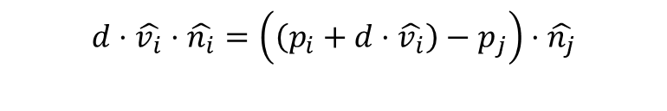



Step 2: This step uses a function to calculate the smallest radius that is circumscribed at a given vertex
For vertex to edge intersections, given a unit vertex projection, v_i, this vertex will always be on the centerline of any circle center that is tangent to edges to the right and left, e_i and e_i-1. So a projection from another edge must intersect v_j such that the orthogonal distance between both are equal. Note that this method works for any dimension (2D, 3D, and maybe 4+ D)
$$\hat{n_{j}}$$
$$p_{j}$$
$$\hat{v_{i}}$$
$$d⋅\hat{v_{i}}⋅\hat{n_{i}}=\left(\left(p_{i}+d⋅\hat{v_{i}}\right)−p_{j}\right)⋅\hat{n_{j}}$$
$$p_{i}$$
$$\hat{n_{i}}$$

Slide 30

This can be solved to determine the projection distance, d, and radius from vertex i to edge j.
$$d⋅\hat{v_{i}}⋅\hat{n_{i}}=\left(\left(p_{i}+d⋅\hat{v_{i}}\right)−p_{j}\right)⋅\hat{n_{j}}$$
$$d⋅\hat{v_{i}}⋅\hat{n_{i}}=\left(\left(d⋅\hat{v_{i}}\right)+\left({p_{i}−p}_{j}\right) \right)⋅\hat{n_{j}}$$
$$d⋅\hat{v_{i}}⋅\hat{n_{i}}−\left(d⋅\hat{v_{i}}⋅\hat{n_{j}}\right)=\left({p_{i}−p}_{j}\right)⋅\hat{n_{j}}$$
$$d⋅\left(\hat{v_{i}}⋅\hat{n_{i}}−\hat{v_{i}}⋅\hat{n_{j}}\right)=\left({p_{i}−p}_{j}\right)⋅\hat{n_{j}}$$
$$d⋅\hat{v_{i}}⋅\left(\hat{n_{i}}−\hat{n_{j}}\right)=\left({p_{i}−p}_{j}\right)⋅\hat{n_{j}}$$
$$d=\frac{\left({p_{i}−p}_{j}\right)⋅\hat{n_{j}}}{\hat{v_{i}}⋅\left(\hat{n_{i}}−\hat{n_{j}}\right)}$$
The projection distance, d:
The radius:
$$r_{ij}=d⋅\hat{v_{i}}⋅\hat{n_{i}}$$

Slide 31


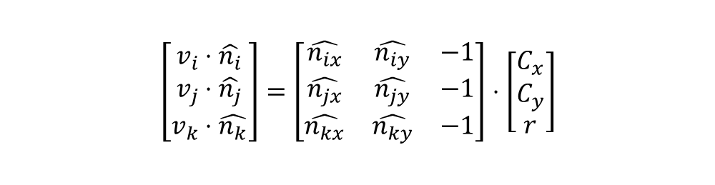

This can be generalized into higher dimensions by noting that this is a process of solving linear equations
The ith vertex is constrained by:
For 3 edges in 2D, one can solve for the center and radius via:
$$r=\left(C−v_{i}\right)⋅\hat{n_{i}}$$
$$r=C⋅\hat{n_{i}}−v_{i}⋅\hat{n_{i}}$$
$$v_{i}⋅\hat{n_{i}}=C⋅\hat{n_{i}}−r$$
$$v_{i}⋅\hat{n_{i}}=C_{x}⋅\hat{n_{ix}}+C_{y}⋅\hat{n_{iy}}−r$$
$$(Cx, Cy)$$
$$\hat{n_{j}}$$
$$r$$
$$v_{j}$$
$$v_{i}$$
$$\hat{n_{i}}$$
$$\hat{n_{i−1}}$$
$$\left[\begin{matrix}v_{i}⋅\hat{n_{i}} \\ v_{j}⋅\hat{n_{j}} \\ v_{k}⋅\hat{n_{k}}\end{matrix}\right]=\left[\begin{matrix}\hat{n_{ix}} & \hat{n_{iy}} & −1 \\ \hat{n_{jx}} & \hat{n_{jy}} & −1 \\ \hat{n_{kx}} & \hat{n_{ky}} & −1\end{matrix}\right]⋅\left[\begin{matrix}C_{x} \\ C_{y} \\ r\end{matrix}\right]$$
$$v_{i−1}$$

Slide 32
Of note, the edge that is tangent may shrink or grow, so we must find tangents not only to the current edge segment, but as well to any extensions

Slide 33

How does one find which edges participate in the vertex expansion?
The circle center, after it is found, can be projected in the opposite direction of the edge’s unit normal vector, by a radius distance. This projection must either be on the edge for the point to be valid intersection with the segment.
$$\hat{v_{i}}$$
isOnEdge = fcn_INTERNAL_isPointOnEdge(new_edgePointStart,new_edgePointEnd,sphereCenter, flag_do_debug, debug_fig_num);

Slide 34
Some results from Step 2

Slide 35
Non-convex case

Slide 36
There may be situations where polytopes are nested INSIDE other polytopes
In this case, the main change is to allow searching of edges that are both on and within the current polytope

Slide 37
Step 3: Find the smallest feasible cut. This is implemented by simply finding the smallest radius among all fitted spheres
Given a unit vertex projection, v_i, this vertex will always be on the centerline of any circle center that is tangent to edges to the right and left, e_i and e_i-1. So a projection from another edge must intersect v_j such that the orthogonal distance between both are equal. Note that this method works for any dimension (2D, 3D, and maybe 4+ D)
fig_num = 1006; figure(fig_num); clf;
% this polytope has a vertical wall
vertices = [0 0; 3/5 0; 1 1; 7/5 0; 2 0; 1 2; 0 1; 0 0]*5;
[unit_normal_vectors, unit_vertex_projection_vectors, vector_direction_of_unit_cut, flag_vertexIsNonConvex] = fcn_VSkel_polytopeFindUnitDirectionVectors(vertices,-1);
max_edge_cuts = fcn_VSkel_polytopeFindMaxEdgeCut(vertices, unit_normal_vectors, unit_vertex_projection_vectors, (-1));
[sphereRadii, definingEdges] = fcn_VSkel_polytopeFindEnclosedSpheres(vertices, unit_normal_vectors, unit_vertex_projection_vectors, vector_direction_of_unit_cut, flag_vertexIsNonConvex, max_edge_cuts, (-1));
[min_cut, ...
indices_repeated, intersection_points] = ...
fcn_VSkel_polytopeFindMinimumEnclosedSphere(vertices, ...
sphereRadii, definingEdges, unit_normal_vectors, unit_vertex_projection_vectors, ...
vector_direction_of_unit_cut, (fig_num));

Slide 38
Step 4: Merge all the vertices that come together
Given a unit vertex projection, v_i, this vertex will always be on the centerline of any circle center that is tangent to edges to the right and left, e_i and e_i-1. So a projection from another edge must intersect v_j such that the orthogonal distance between both are equal. Note that this method works for any dimension (2D, 3D, and maybe 4+ D)
fig_num = 1006; figure(fig_num); clf;
% this polytope has a vertical wall
vertices = [0 0; 3/5 0; 1 1; 7/5 0; 2 0; 1 2; 0 1; 0 0]*5;
[unit_normal_vectors, unit_vertex_projection_vectors, vector_direction_of_unit_cut, flag_vertexIsNonConvex] = fcn_VSkel_polytopeFindUnitDirectionVectors(vertices,-1);
max_edge_cuts = fcn_VSkel_polytopeFindMaxEdgeCut(vertices, unit_normal_vectors, unit_vertex_projection_vectors, (-1));
[sphereRadii, definingEdges] = fcn_VSkel_polytopeFindEnclosedSpheres(vertices, unit_normal_vectors, unit_vertex_projection_vectors, vector_direction_of_unit_cut, flag_vertexIsNonConvex, max_edge_cuts, (-1));
[min_cut, ...
indices_repeated, intersection_points] = ...
fcn_VSkel_polytopeFindMinimumEnclosedSphere(vertices, ...
sphereRadii, definingEdges, unit_normal_vectors, unit_vertex_projection_vectors, ...
vector_direction_of_unit_cut, (fig_num));

Slide 39
How do we represent a vertex merger?
10
9
When a vertex encounters a boundary, it creates a break in that boundary. The break can be represented by a vertex insertion into a vertex sequence defining the boundary. For example, the vertex 3 intersecting segment 8 (which connects 8 to 9), can be represented as “3” added into the sequence:
7, 8, 3, 9 10
3
2
8
7
4

Slide 40
However, the vertex merging, in this case, creates two “reconnections”
10
9
The first produces the sequence:
1, 2, 3, 9, 10 …
The second produces the sequence:
7, 8, 3, 4, …
These can be represented by inserting negative vertex numbers for the out-of-sequence insertion:
1, 2, 3, 4, 5, 6, 7, 8, -3, 9, 10 …
3
2
8
7
4

Slide 41

Note: for a particular cut depth, more than one vertex can intersect at the same time but into different points. This can create multiple polytopes.
In this case, the original sequence is:
1; 2; 3; 4; 5; 6; 7; 8; 9; 10; 11; 1
The sequence after insertions is:
1; 2; 3; -7; 4; 5; 6; 7; 8; 9; -2; 10; 11; 1
3
1
4
11
7
5
2
9
10
6
8

Slide 42
To convert from the inserted sequence to new polytopes, we use the following rules:
Starting from the first nonConvex vertex, proceed along upward in positive values until returning back to start, jumping at any negative values to the corresponding positive value, until reaching either positive or negative valued version of the starting point. Then repeat this for the negative valued version of the vertex ID.
1; 2; 3; -7; 4; 5; 6; 7; 8; 9; -2; 10; 11; 1
Vertex 2: (start at 2 in forward direction, -2 in negative direction)
(forward) [2; 3; -7; 8; 9; -2] --> [2; 3; 7; 8; 9; 2]
(reverse) [-2; 10; 11; 1; 2]; --> [1; 2; 10; 11; 1]
Vertex 7:
(start at 7 in forward direction, -7 in negative direction)
(forward) [7; 8; 9; -2; 3; -7] --> [2; 3; 7; 8; 9; 2]
(reverse) [-7; 4; 5; 6; 7] --> [4; 5; 6; 7; 4]

Slide 43
The conversion of polytope sequences uses the lowest vertex number to re-order vertices to produce a unique, repeatable vertex ordering
For example, given the vertex ordering:
[7; 8; 9; 2; 3; 7]
This is the same as:
[3; 7; 8; 9; 2; 3]
Or:
[9; 2; 3; 7; 8; 9]
The vertex ordering that starts with the lowest-indexed vertex is always used. Hence:
[7; 8; 9; 2; 3; 7] --> [2; 3; 7; 8; 9; 2]

Slide 44
https://www.mdpi.com/2220-9964/9/5/304
https://stackoverflow.com/questions/69237154/how-do-you-get-the-medial-axis-of-a-multipolygon-using-cgal
https://groups.csail.mit.edu/graphics/classes/6.838/S98/meetings/m25/m25.html

