Slide 1
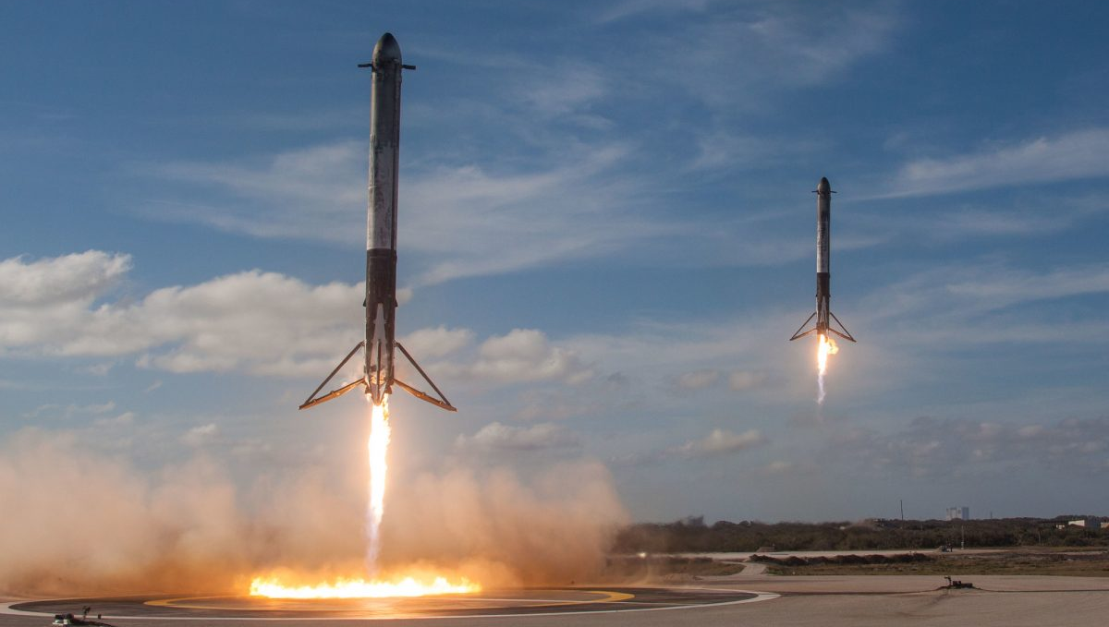






Data Science
Capstone Project
IVAN STARKOV
Dec 05, 2022

Slide 2



OUTLINE
Executive Summary
Introduction
Methodology
Results
Visualization – Charts
Dashboard
Conclusion
Appendix

Slide 3

EXECUTIVE SUMMARY
Methodology
Data Collection
Data Wrangling
Exploratory Data Analysis with Data Visualization
Exploratory Data Analysis with SQL
Interactive Visual Analytics with Folium
Interactive Dashboard with Plotly Dash
Predictive Analysis
Results
Exploratory Data Analysis
Interactive Dashboard
Predictive Analysis

Slide 4

INTRODUCTION
Project background and context
The commercial space age is here, companies are making space travel affordable for everyone. Perhaps the most successful is SpaceX.
One reason SpaceX can do this is the rocket launches are relatively inexpensive. SpaceX advertises Falcon 9 rocket launches with a cost of 62 million dollars; other providers cost upwards of 165 million dollars each, much of the savings is because SpaceX can reuse the first stage.
We will train a machine learning model and use public information to predict if SpaceX will reuse the first stage.
Problems to find answers
Sometimes the first stage does not land. Sometimes it will crash. Other times, Space X will sacrifice the first stage due to the mission parameters like payload, orbit, and customer
Based on the available data, we build a model to predict the successful landing of the first stage.

Slide 5
METHODOLOGY
Data Collection
SpaceX REST API
Web Scrapping with Beautiful Soup
Data Wrangling
Data Cleaning
Data normalization
Data conversion
Exploratory Data Analysis
SQL
Scatterplot
Interactive Visual Analytics
Interactive Maps with Folium
Dashboard with Ploty Dash
Predictive Analysis
Logical Regression
Support Vector Machine
Decision tree classifier
k Nearest Neighbors

Slide 6

DATA COLLECTION - SpaceX REST API
SpaceX REST API will give us data about launches, including information about the rocket used, payload delivered, launch specifications, landing specifications, and landing outcome.

Slide 7
DATA COLLECTION – Web Scrapping
Another popular data source for obtaining Falcon 9 Launch data is web scraping related Wiki pages. We will be using the Python Beautiful Soup package to web scrape some HTML tables that contain valuable Falcon 9 launch records.

Slide 8


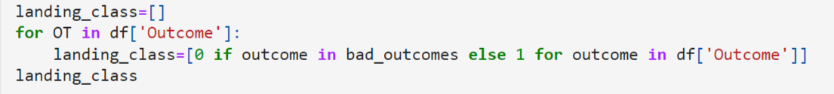
DATA WRANGING
After collecting the data we check the missing data and data.
Some of the attributes are: Flight Number, Date, Booster version, Payload mass Orbit, Launch Site, Outcome: this is the status of the first stage Flights, Grid Fins: these help with landing Reused, Legs: used in landing pad, Block, Reused count, Serial, Longitude and latitude of launch
We would like landing outcomes to be converted to Classes.

Slide 9
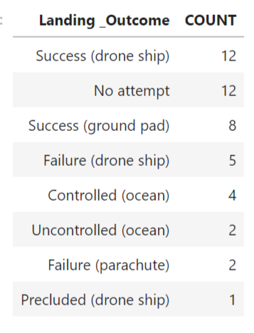
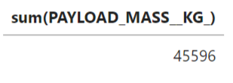
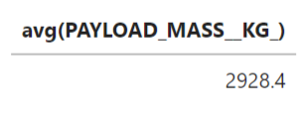
EXPLORATORY DATA ANALYSIS - SQL
Load the dataset into the table in a Db2 database. Execute SQL queries to answer questions

Slide 10
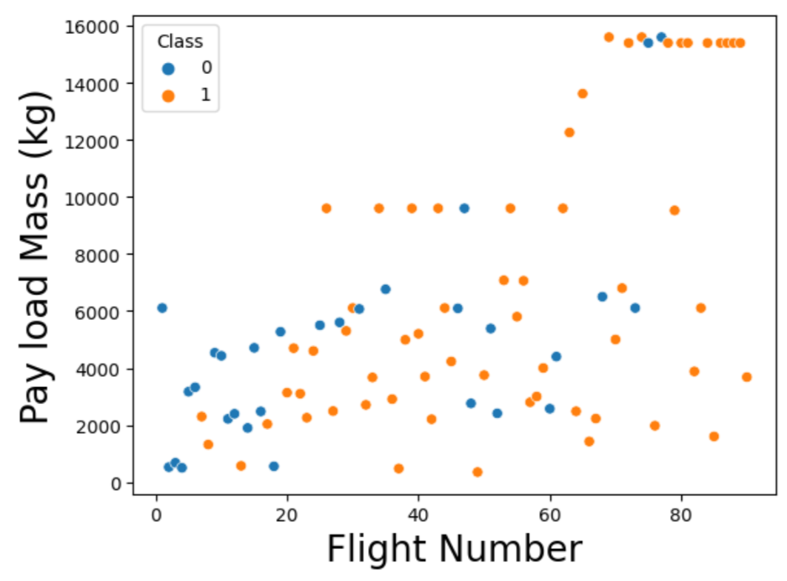
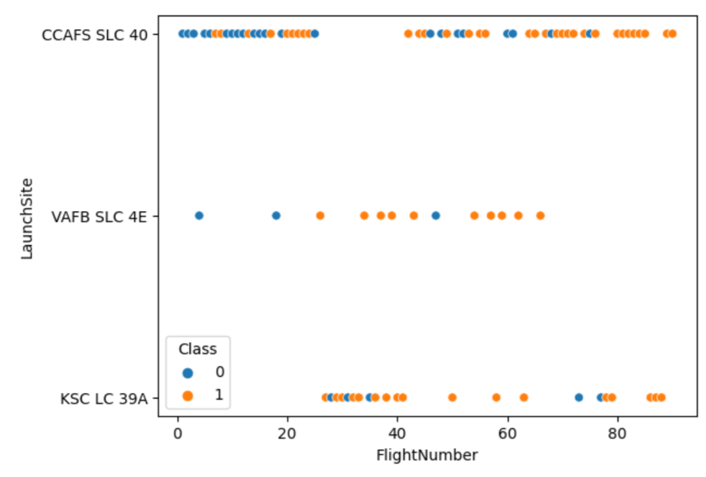
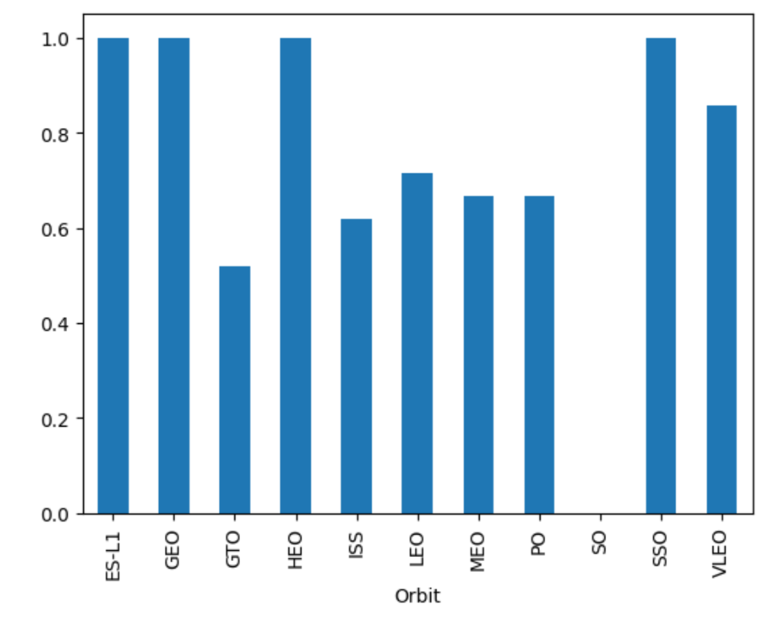
EXPLORATORY DATA ANALYSIS - Visualization
Perform exploratory Data Analysis and Feature Engineering using Pandas and Matplotlib

Slide 11
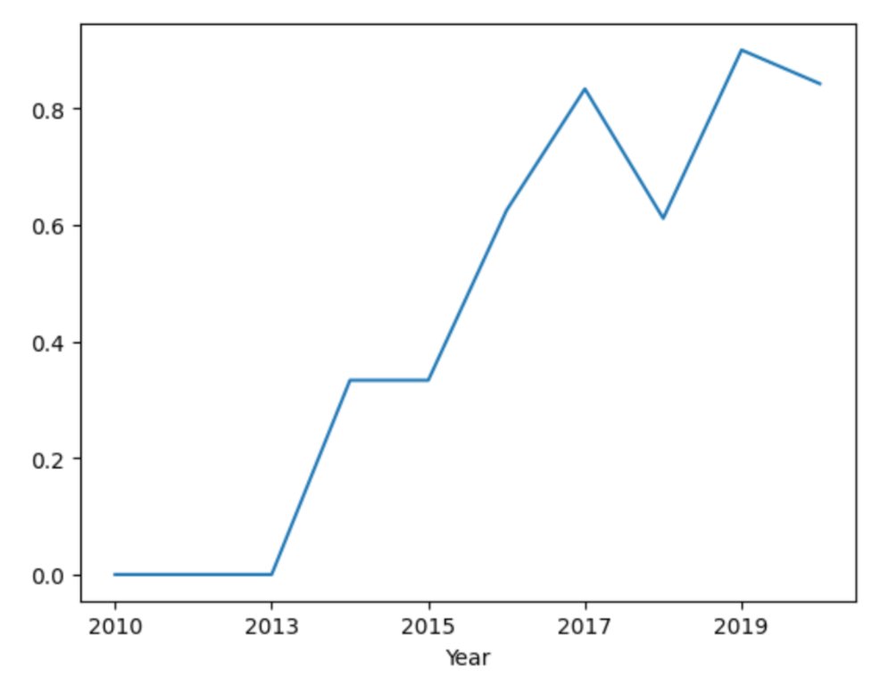
EXPLORATORY DATA ANALYSIS - Visualization
Year to the average success rate plot. Success rate kept increasing since 2013 to 2020.

Slide 12
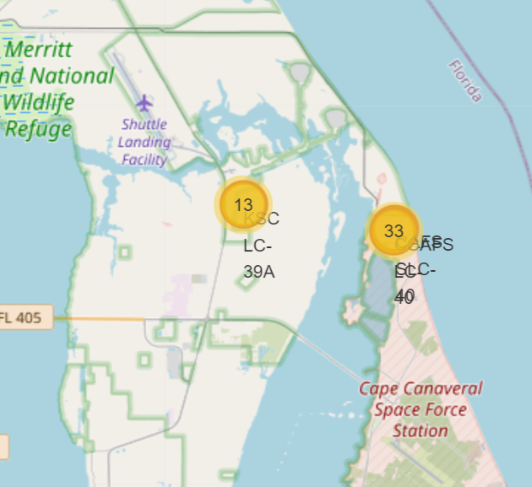
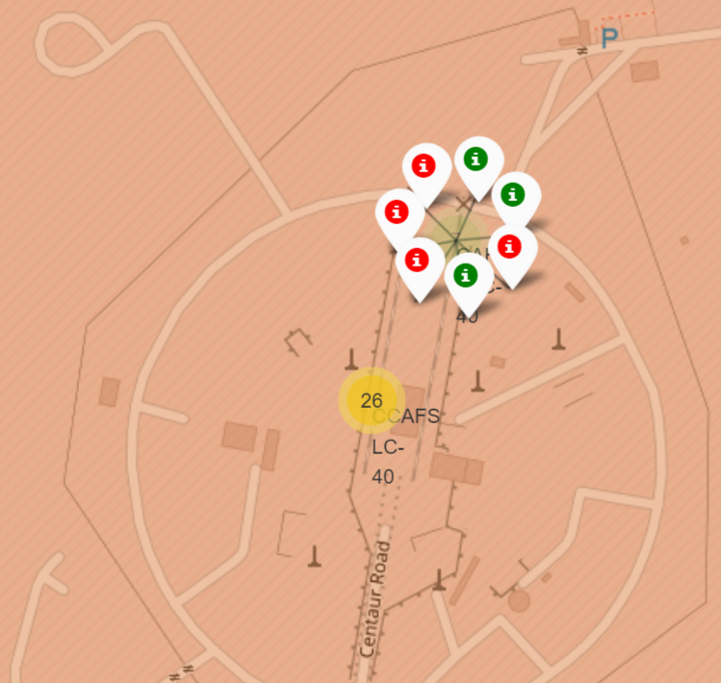
Interactive Visual Analytics - Folium
Interactive visual analytics enables users to explore and manipulate data in an interactive and real-time way. With interactive visual analytics, users could find visual patterns faster and more effectively.

Slide 13
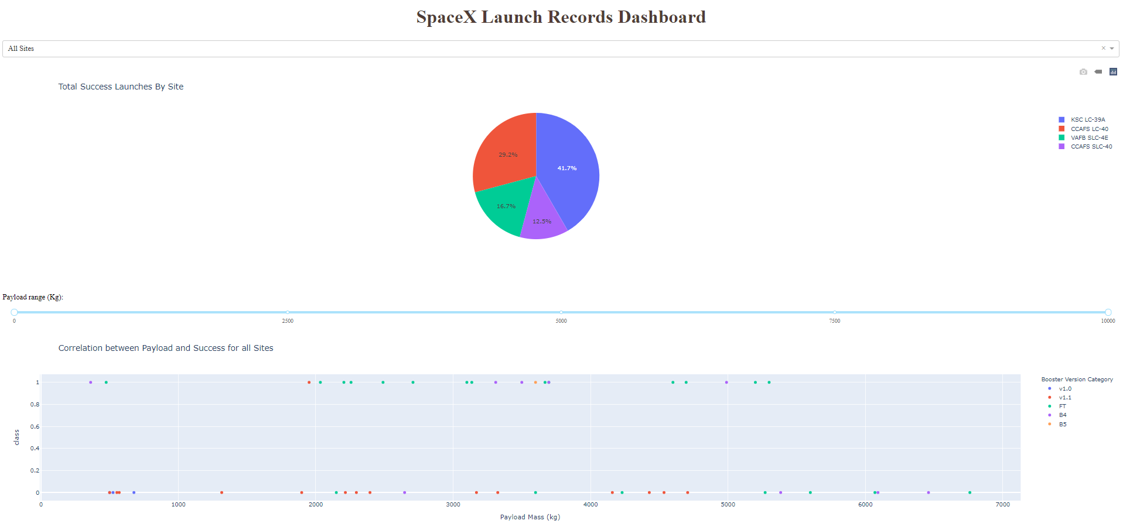
Interactive Visual Analytics – Plotty Dash
Plotly Dash application for users to perform interactive visual analytics on SpaceX launch data in real-time. Dashboard application contains input components such as a dropdown list and a range slider to interact with a pie chart and a scatter point chart.

Slide 14
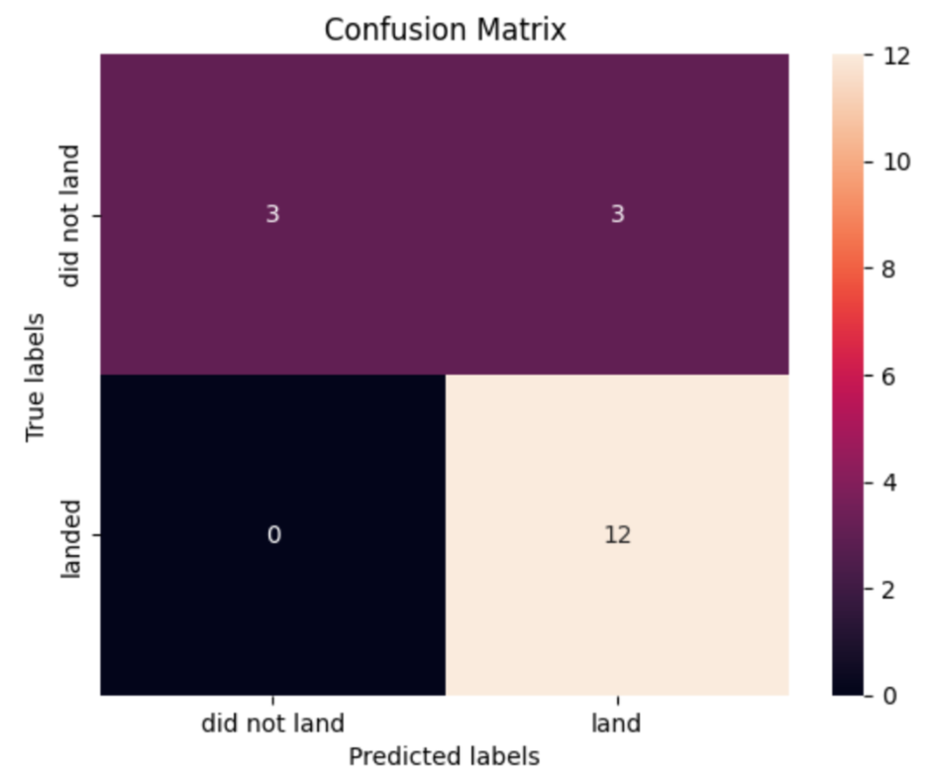
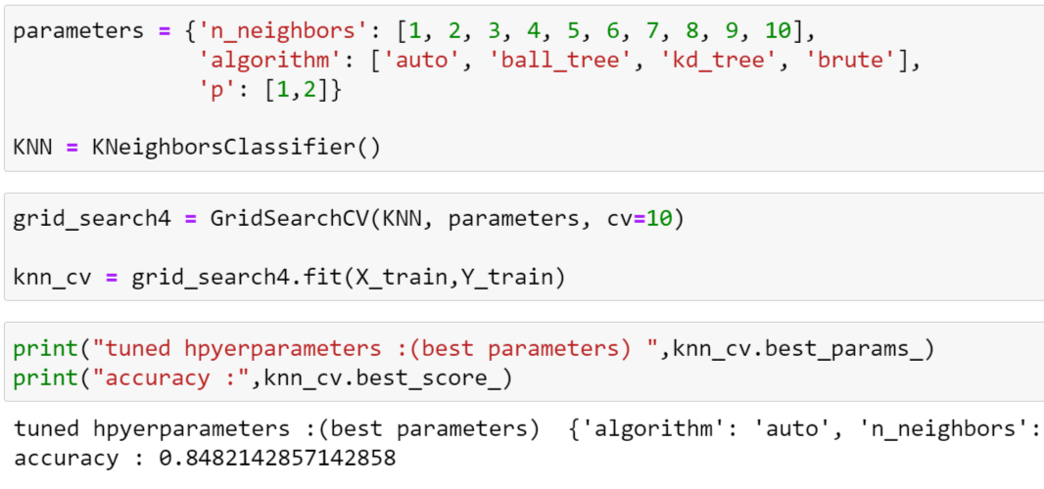
PREDICTIVE ANALYSIS – Logical Regression
Perform exploratory Data Analysis and determine Training Labels, find best Hyperparameters.

Slide 15
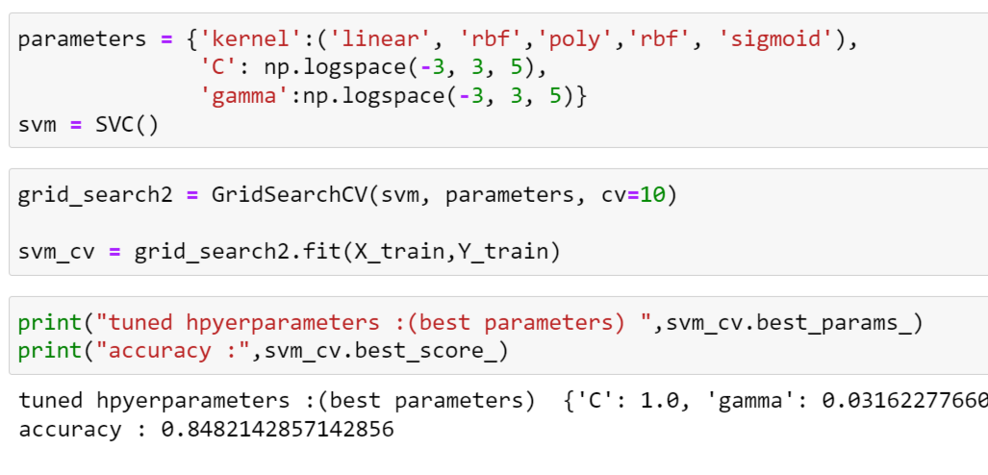
PREDICTIVE ANALYSIS – SVM
Perform exploratory Data Analysis and determine Training Labels, find best Hyperparameters.

Slide 16
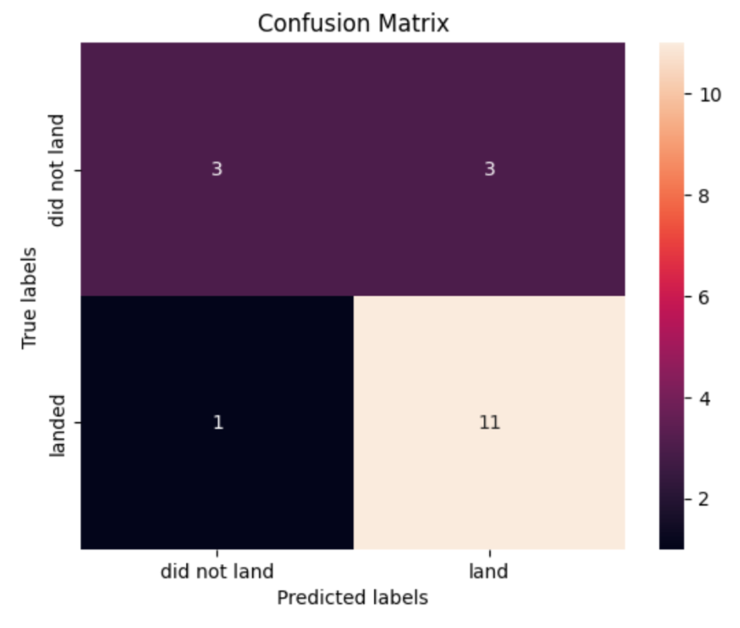
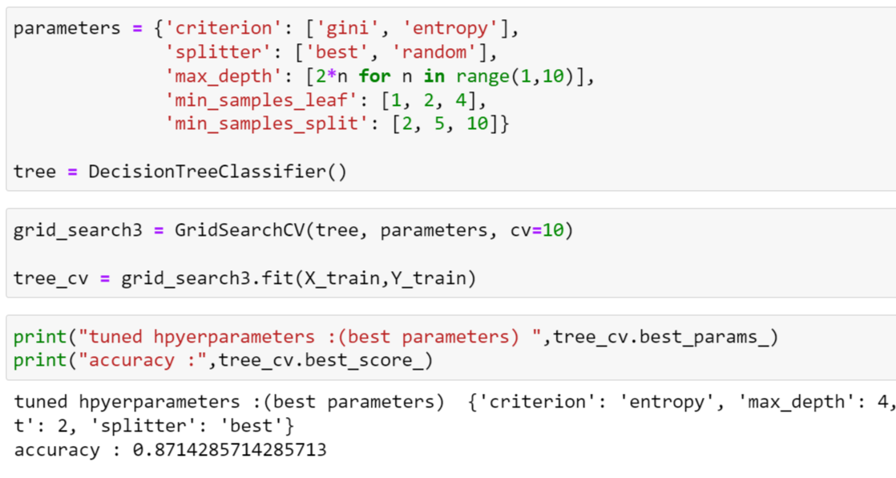
PREDICTIVE ANALYSIS – Decision Tree
Perform exploratory Data Analysis and determine Training Labels, find best Hyperparameters.

Slide 17
PREDICTIVE ANALYSIS – k Nearest Neighbors
Perform exploratory Data Analysis and determine Training Labels, find best Hyperparameters.

Slide 18
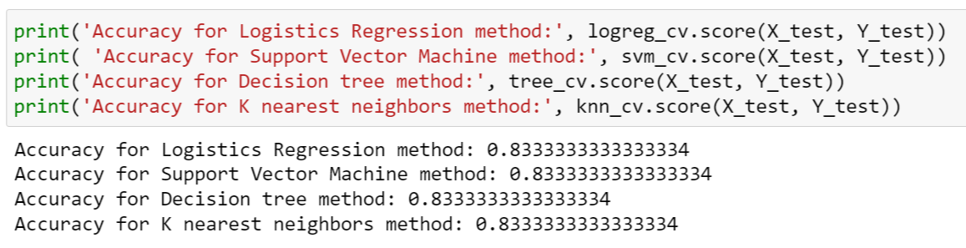
PREDICTIVE ANALYSIS – Comparison
Due to relatively small size of Logistic Regression, Support Vector Machine, Decision Tree Classifier and k-Nearest Neighbor algorithms showed the same accuracy on the test sample.

Slide 19

CONCLUSION – SpaceX Data
The success rate of landing the first stage has a clear upward trend.
Most launches were from Kennedy Space center. It’s close to SpaceX production factory.
Lower payloads have a higher first stage return success rate than higher payloads.
VLEO orbit began to dominate recently when SpaceX began deploying the StarLink network.

Slide 20
CONCLUSION – Machine Learning
All four machine learning algorithms give us predictions with about 83% accuracy, although the actual success rate is about 70%. This means that machine learnings models provide 10-15% more accuracy than assuming that all first stages land successfully.
All four machine learning algorithms provides the same accuracy rate on test set, this was expected as all of these algorithms suits binary classification task.
All four models give the same 3 false positive predictions. This fact can be explained by the lack of data to create more accurate models.

Slide 21
APPENDIX
Link to the GitHub repository:
https://github.com/ivstarkov/IBM-Capstone-Project.git
Link to the SpaceX Wikipedia web page:
https://en.wikipedia.org/wiki/List_of_Falcon_9_and_Falcon_Heavy_launches
Link to the SpaceX REST API:
api.spacexdata.com/v4/launches/past
Link to the IBM Data Science Course:
https://www.coursera.org/professional-certificates/ibm-data-science

