Slide 1




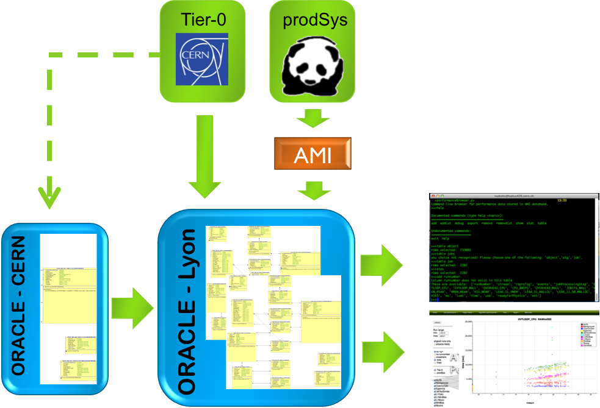

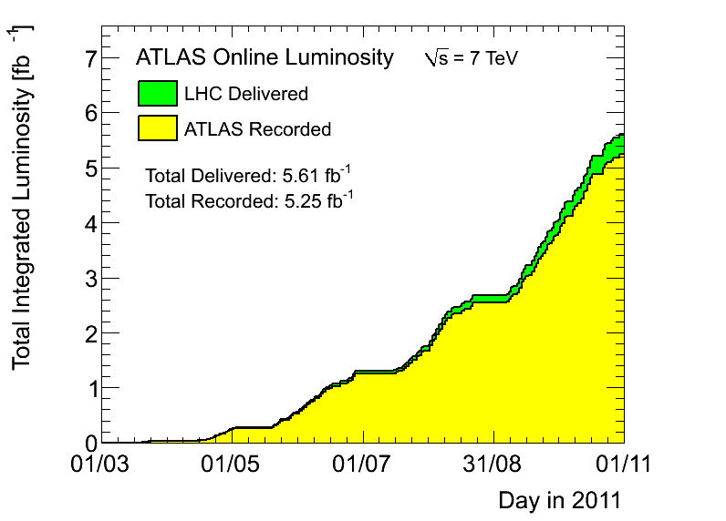
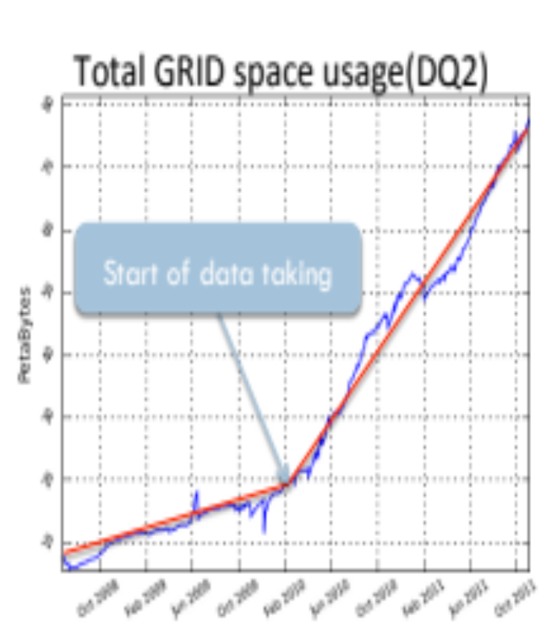
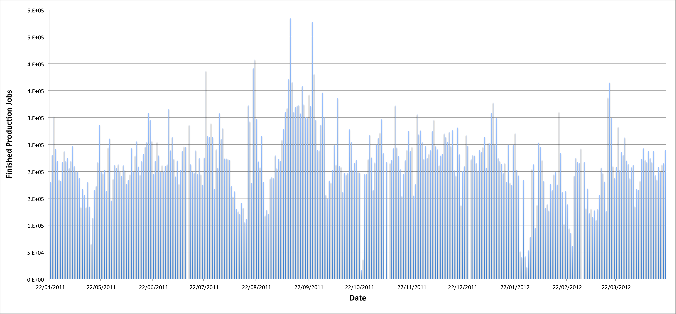
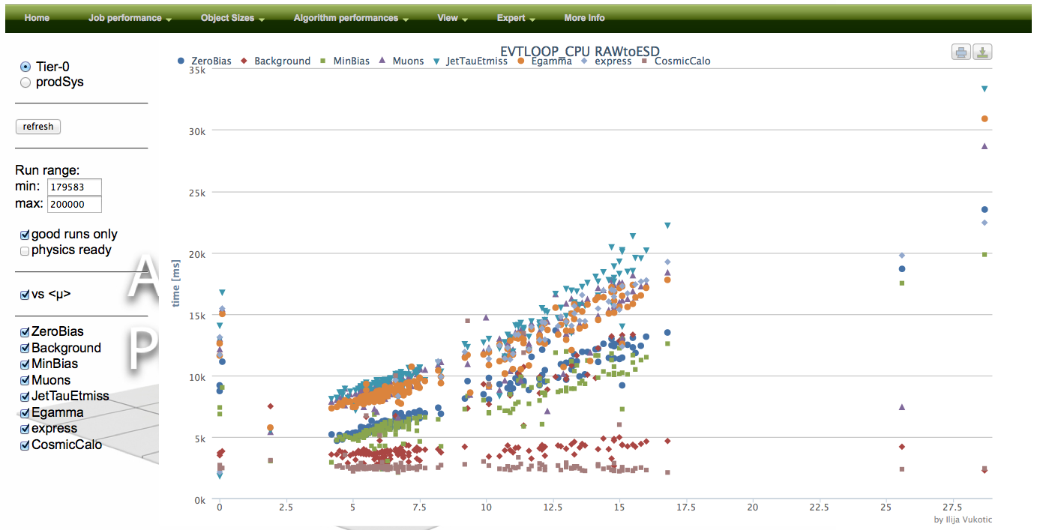
Monitoring of computing resource utilization of the ATLAS experiment
Ilija Vukotic, David Rousseau, Gancho Dimitrov, Osman Aidel, RD Schaffer, Solveig Albrand
Ilija Vukotic Laboratoire de l'Accelerateur Lineaire, Bat 200, BP 34, 91898 Orsay, France
E-mail: ivukotic@cern.ch
Introduction
Altering The Column Layout
Importing Tables & Graphs
Due to the good performance of the LHC accelerator, the ATLAS experiment has seen higher than anticipated levels for both the event rate and the average number of interactions per bunch crossing.
The current and future usage of CPU, memory and disk resources has to be monitored, understood and acted upon.
This requires data collection at a fairly fine level of granularity: the performance of each object written and each algorithm run, as well as a dozen per-job variables, are gathered for the different processing steps of Monte Carlo generation and simulation and the reconstruction of both data and Monte Carlo. We present a system to collect and visualize the data from both the online Tier-0 system and distributed grid production jobs.
Production
System DB
Job
ATLAS DDM
Server
Logger
Job
Jobs
Pull
File catalog
Pilots
Pilots
Pilots
Pilot wrappers
Scheduler
User
Sites
Worker nodes
Figure 5
Requirements
Fast feedback is essential if we want to reduce unnecessary resource usage due to misconfiguration of a sub-detector, trigger, job or even algorithm
Reliable, full information is needed as important changes can happen in the middle of the run. on our resource usage
  Disk size
  CPU/real time usage
  Memory usage
System must be robust, easy to support
It must be easy to extract the info at each granularity level.
System must be transparent in a sense that no job should ever fail due to problem in monitoring. The monitoring can introduce only very small overhead.
Way to throttle percentage of jobs monitored. This is specially important for MC jobs where there we need just to collect statistically significant sample
ALL the officially produced data
  both T0 and prodSys(grid)
  each reprocessing
  ALL the streams
  ALL the formats
  ALL the runs
  Most of the events
  Down to collection/algorithm level
Results
http://ivukotic.web.cern.ch/ivukotic/performance/index.asp
Task size
Tier-0 O (hundreds tasks/day)
prodSys ~ O (200k jobs/ day)
Size information is ~30 kB/produced output file
Algo information is ~100-200 kB/subjob
Memory/total job timings < 1kB/subjob
That is ~40GB/day to collect
Information to store is 10³-10⁴ times less
Obtaining all the information
Conclusion

