Slide 1
FAX tutorial for end-users
for the FAX team
Ilija Vukotic, University of Chicago

Slide 2
You will learn
What is FAX
Why you might find it useful
Requirements
Interactive use
Tier3 use

Slide 3
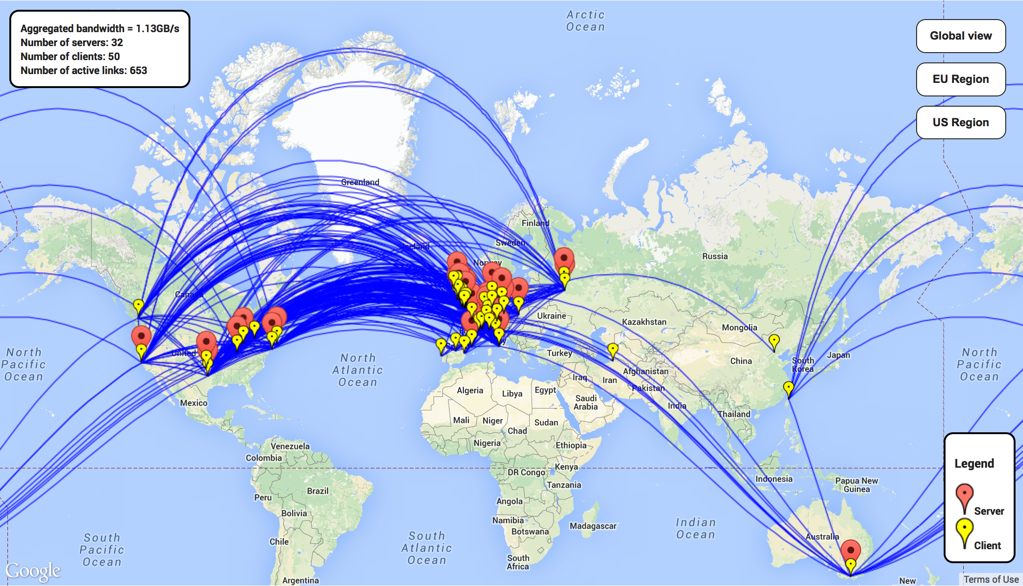
What is FAX?
FAX (Federated ATLAS Xrootd) is a way to directly access most of the ATLAS data from anywhere.
Read only
It relies on a gLFN globalLogicalFileName
Currently 64 sites are part of FAX
all of the US, DE, UK, FR, IT, ES, CERN…
> 96% of all disk
> 98% of all data

Slide 4
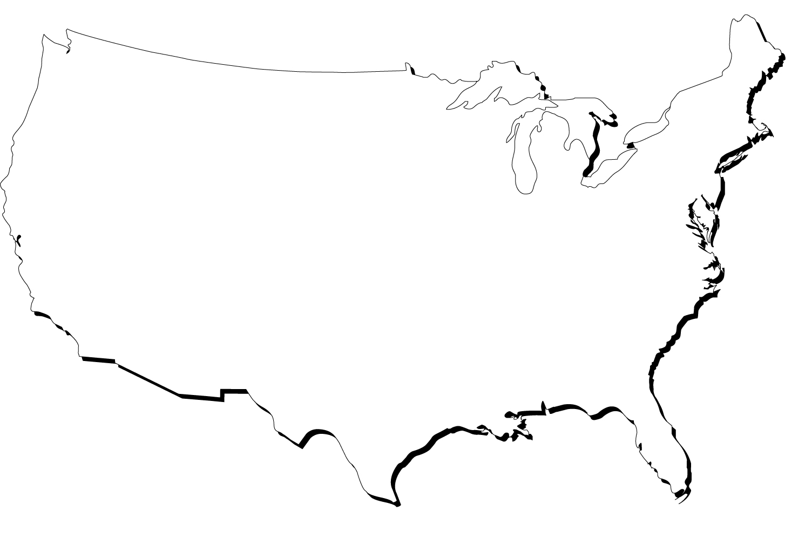


FAX topology
bnl
ATLAS-XRD-ASIA
ATLAS-XRD-US
ATLAS-XRD-EU
Data can be asked for from any endpoint and redirector
Data are transferred directly from server to user
Searching for the file is fast, delivering is more important
Ideally one should use the one with best connection
Usually that’s the closest one
XRD-CENTRAL
NET2
MWT2
AGLT2
SLAC
BNL
OCHEP
SWT2

Slide 5
How fax helps analysis
If you have access to CPUs but not enough local disk space
If you have Tier3 without or not enough storage
If you have Proof cluster without or not enough storage
Your desktop/laptop (ProofLite) is sufficient but need more space
Increase redundancy
If a file is inaccessible and another copy exists elsewhere, your job should still run
Use the same file names independently where you run
Quickly inspect your files, do quick debugging
Do merging without moving all the input data to the same place
Do event picking
Do remote skimming slimming

Slide 6
Requirements
A valid grid proxy
Files registered in DQ2
Datasets exist in FAX enabled site
Have files listed in gLFN format
Your code uses TTreeCache

Slide 7
Tutorial outline
Get grid proxy
Check if your dataset is in FAX
Prepare gLFNs
Make sure your code is using TTreeCache properly
Use FAX interactively
Read data directly from FAX
Read/write example
Multi-site FAX examples – Slim Skim
Quick start: Type these two commands and you’ll get everything set up for you:
wget https://twiki.cern.ch/twiki/pub/AtlasComputing/UsingFAXforEndUsersTutorial/Tutorial.tar
tar -xvf Tutorial.tar

Slide 8
Setup FAX
source setup.sh
From CVMFS
Sets dq2, grid environment
To simultaneously set a default ROOT version do
Your proxy is a file like this
By default it is valid for 12 hours
You can put it anywhere as long as you do this
export ATLAS_LOCAL_ROOT_BASE=/cvmfs/atlas.cern.ch/repo/ATLASLocalRootBase
source ${ATLAS_LOCAL_ROOT_BASE}/user/atlasLocalSetup.sh –quiet
localSetupFAX
voms-proxy-init -voms atlas
localSetupFAX --rootVersion=current-SL6
/tmp/x509up_u20037
export X509_USER_PROXY=/path/to/my/proxy/x509up_u20037

Slide 9
datasets in FAX?
./whereIsTheDS.sh
This script will tell if and how many copies of your dataset exist in FAX
You may do the same using a fax-ls command.
isDSinFAX data12_8TeV.periodH2.physics_Muons.PhysCont.NTUP_SMWZ.grp13_v01_p1067/
data12_8TeV.00212809.physics_Muons.merge.NTUP_SMWZ.f481_m1233_p1067_p1141_tid01012924_00 complete replicas: 6 incomplete: 0
data12_8TeV.00212858.physics_Muons.merge.NTUP_SMWZ.f481_m1233_p1067_p1141_tid01014068_00 complete replicas: 5 incomplete: 0
data12_8TeV.00212815.physics_Muons.merge.NTUP_SMWZ.f481_m1233_p1067_p1141_tid01012923_00 complete replicas: 7 incomplete: 0
This step won’t be needed when all the sites join FAX

Slide 10
Getting the DATASET
This command will fetch dataset from FAX
Multiple streams
Retries
Skipping non-root files
Timeouts
fax-get -v -s 4 user.ivukotic:user.ilijav.HCtest.1

Slide 11
Anatomy of the
gLFN
A gLFN looks like this:
Redirector address
Full Path always starts with //atlas
root://fax.mwt2.org:1094//atlas/rucio/user.ivukotic:group.test.hc.NTUP_SMWZ.root
root://fax.mwt2.org:1094
//atlas/rucio/user.ivukotic:group.test.hc.NTUP_SMWZ.root

Slide 12
Getting
./createFileList.sh
gLFNs
Best guess redirector address is automatically determined by localSetupFAX.
Result is in $STORAGEPREFIX
You can always re-run it
Get list by providing a DataSet or DataContainer name
fax-get-best-redirector
fax-get-gLFNs user.ivukotic:user.ilijav.HCtest.1 > myFileList.txt
If you have a reason to use a different endpoint select a green endpoint or a redirector from here:
https://twiki.cern.ch/twiki/bin/view/AtlasComputing/FaxRedirectors

Slide 13
Performance in WAN
This is important to do independently if you use FAX or not
Make sure you use TTreeCache (http://root.cern.ch/root/html/TTreeCache.html)
Simple
For full optimization in addition
With latest ROOT versions you may use AsyncPrefetch
t->SetCacheSize(30*1024*1024);
t->SetBranchStatus("ele_trig_l1match*",0);
TIter iter(t->GetListOfBranches());
while(TBranch *sub = (TBranch *)iter.Next())
if( t->GetBranchStatus(sub->GetName()) )
t->AddBranchToCache(sub->GetName(),kTRUE);
t->StopCacheLearningPhase();
~> cat .rootrc
TFile.AsyncPrefetching: 1
This will become default with ROOT 6.0

Slide 14
Use fax interactively
Tutorial/GettingFile
Copy file locally
Setup ROOT any way you like, open file and list its content
In a TChain do not create a TFile and add it to TChain
Do
~> xrdcp root://fax.mwt2.org:1094//atlas/rucio/user.ivukotic:group.test.hc.NTUP_SMWZ.root group.test.hc.NTUP_SMWZ.root
[xrootd] Total 760.22 MB |====================| 100.00 % [53.1 MB/s]
Tutorial/InspectingFile
~ >root -l
root [0] TFile *f = TFile::Open("root://fax.mwt2.org:1094//atlas/rucio/user.ivukotic:group.test.hc.NTUP_SMWZ.root");
root [2] f->ls()
TXNetFile** root://fax.mwt2.org//atlas/rucio/user/ivukotic:group.test.hc.NTUP_SMWZ.root StreamNTUP_SMWZ
TXNetFile* root://fax.mwt2.org//atlas/rucio/user/ivukotic:group.test.hc.NTUP_SMWZ.root StreamNTUP_SMWZ
KEY: AttributeListLayout Schema;1
KEY: TDirectoryFile physicsMeta;1 physicsMeta
KEY: TDirectoryFile Lumi;1 Lumi
KEY: TTree CollectionTree;1 CollectionTree
KEY: TTree physics;1 physics
ch.AddFile("filename",TChain::kBigNumber,"physics");
Tutorial/UsingTChain
Notes:
say source Tutorial/getROOT.sh

Slide 15
Direct access reading from fax
Tutorial/ReadingWritingFile
Compile. Execute. Play with parameters
This code prints all the important information
CPU/Wall time
number of reads/writes
memory usage
Use its functions to investigate issues with your own programs
~> ./readDirect
usage: read <filename> <treename> <percentage of events to read> <TTreeCache size> [file containing branches to be read]
~> ./readDirect $STORAGEPREFIX/atlas/rucio/user.ivukotic:group.test.hc.NTUP_SMWZ.root physics 10 30

Slide 16
Read/write example
Tutorial/ReadingWritingFile
Compile. Execute. Play with parameters
./readWrite
usage: read <infilename> <outfilename> <treename> <percentage of events to read> <TTreeCache size> [file containing branches to be read]
./readWrite \
$STORAGEPREFIX/atlas/rucio/user.ivukotic:group.test.hc.NTUP_SMWZ.root \
/tmp/out_$RANDOM.root \
physics 10 30

Slide 17
Using fax from A Tier3 cluster
Tutorial/SkimSlimT3/SkimSlimT3.sh
Most Tier 3 sites use HTCondor
Requires a submit script like this:
Basic commands:
######### job.sub #########
executable = SkimSlim.sh
output = SkimSlim.out
error = SkimSlim.error
log = SkimSlim.log
transfer_input_files = filter-and-merge-d3pd.py,/tmp/x509up_u20074, inputFileList,branchesList,cutCode
universe = vanilla
queue 1
condor_submit job.submit # that‘s how you submit job
condor_q yourUsername # check status of your jobs
condor_ssh_to_job jobID # logging at a node where your jobs is executed

Slide 18
FOR REFERENCE
Short users instructions https://twiki.cern.ch/twiki/bin/viewauth/AtlasComputing/UsingFAXforEndUsersTutorial
Example codes and scripts https://twiki.cern.ch/twiki/pub/AtlasComputing/UsingFAXforEndUsersTutorial/Tutorial.tar
Questions, problems, ideas https://its.cern.ch/jira/browse/FAX or mail toatlas-adc-fax-operations@cern.ch

Slide 19
Reserve

Slide 20
Tips and tricks
Making proxy valid for 96 hours and not ask for password
When a file can not be found in FAX, that’s reported as a
Too many redirections for request kXR_open.
Some xrootd errors should be neglected:
Xrd: XrdClientMessage::ReadRaw: Failed to read header
Always check the return code of the file open and GetEntry operations.
voms-proxy-init -voms atlas -valid 96:0 -pwstdin < $HOME/.myPassword

Slide 21
FAX topology
bnl
ATLAS-XRD-ASIA
ATLAS-XRD-US
ATLAS-XRD-EU
Asking a far away site for the file can lead to suboptimal access in case multiple replicas of DS exist
XRD-CENTRAL
NET2
MWT2
AGLT2
SLAC
BNL
OCHEP
SWT2

Slide 22
Ttreecache longer story
TTreeCache tries to guess which TBranches you want and read only these and in large chunks.
During first 100 events it learns which variables you read
Learning phase can still be expensive.
If you know what branches you’ll need, enable them only and turn it off.
If you do tree->GetEvent() it learns that you want to read all branches.

Slide 23
Setting up root only
Tutorial/getROOT.sh
#!/bin/bash
echo "Setting up gcc"
source /cvmfs/atlas.cern.ch/repo/ATLASLocalRootBase/x86_64/Gcc/current/setup.sh
echo "Setting up ROOT"
source /cvmfs/atlas.cern.ch/repo/ATLASLocalRootBase/x86_64/root/5.34.07-x86_64-slc5-gcc4.3/bin/thisroot.sh
echo "Setting up xRootD"
source /cvmfs/atlas.cern.ch/repo/ATLASLocalRootBase/x86_64/root/5.34.07-x86_64-slc5-gcc4.3/bin/setxrd.sh /cvmfs/atlas.cern.ch/repo/ATLASLocalRootBase/x86_64/xrootd/3.2.4-x86_64-slc5/v3.2.4/ 2>&1 > /dev/null
export LD_LIBRARY_PATH=$LD_LIBRARY_PATH:/cvmfs/atlas.cern.ch/repo/ATLASLocalRootBase/x86_64/xrootd/3.2.4-x86_64-slc5/v3.2.4/lib

Slide 24
Skim slim example
Tutorial/SkimSlim
Official skim slim code: filter-and-merge-d3pd.py
Just setup Athena environment and you have it
Don’t write your own.
This one has a lot of options.
python filter-and-merge-d3pd.py
--in=inputFileList
--out=SkimmedSlimmed.root
--tree=physics
--var=branchesList
--selection=file:cutCode

Slide 25
