Slide 1
FAX tutorial for end-users
Rob Gardner
Ilija Vukotic
Lincoln Bryant
David Champion
University of Chicago

Slide 2
You will learn
What is FAX
Why you might find it useful
Requirements
Interactive use
Tier3 use

Slide 3
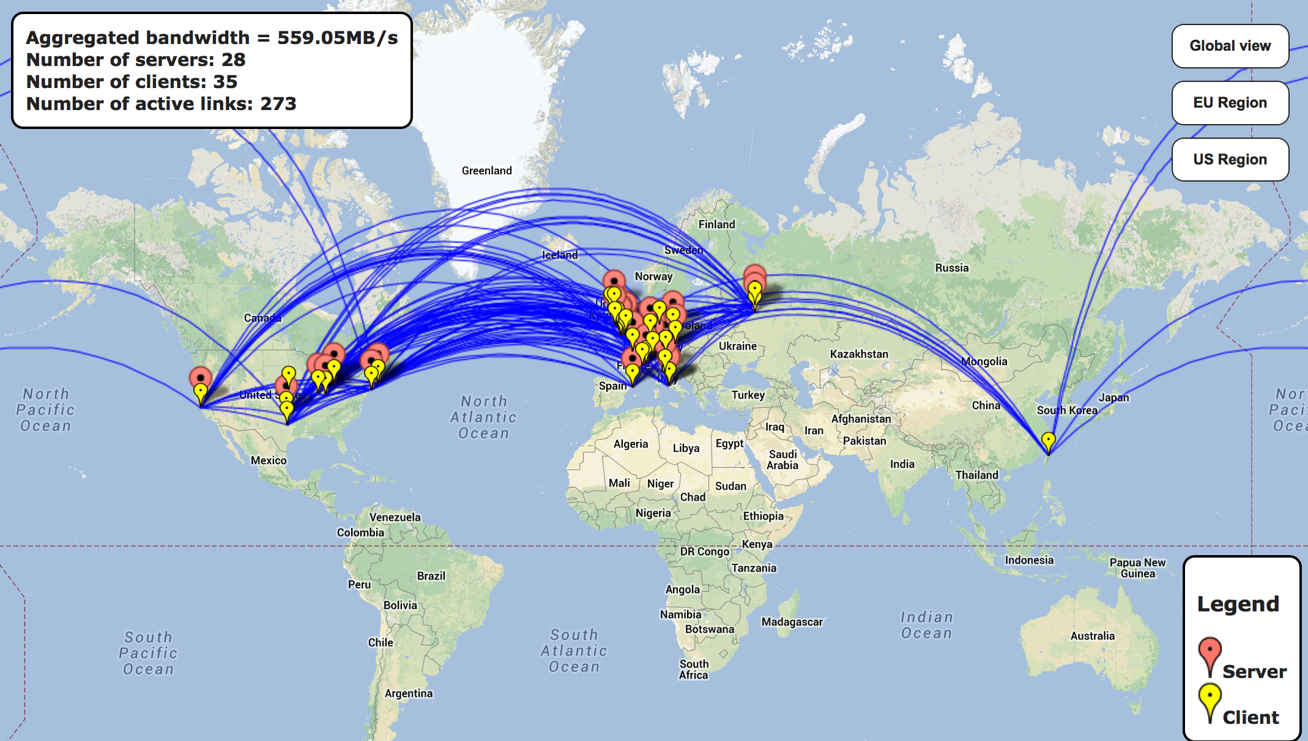
What is FAX?
FAX (Federated ATLAS Xrootd) is a way to directly access most of the ATLAS data from anywhere.
Read only
It relies on a gLFN (globalLogicalFileName)
Currently 44 sites are part of FAX (all the US, DE, UK, CERN…)
> 98% of all data

Slide 4
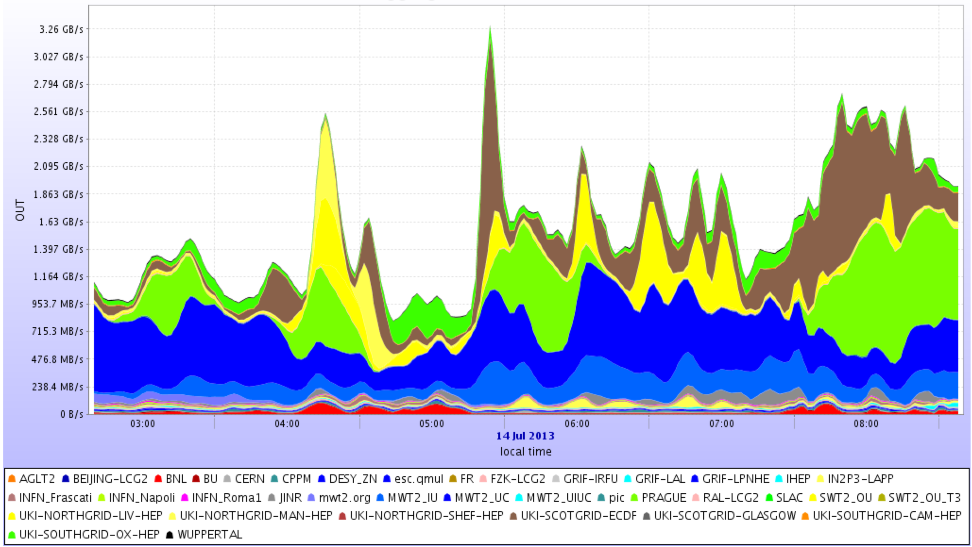
Aggregate fax bandwidth

Slide 5
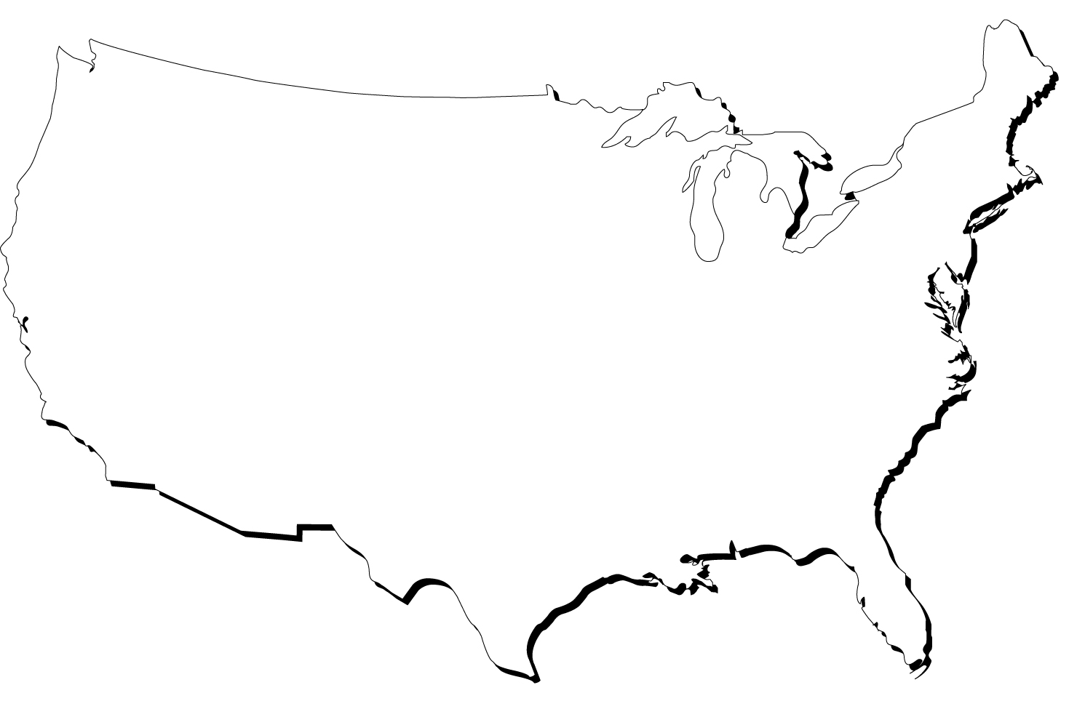


FAX topology
bnl
ATLAS-XRD-ASIA
GLRD
ATLAS-XRD-EU
Data can be asked for from any endpoint and redirector
Data are transferred directly from server to user
Searching for the file is fast, delivering is more important
Ideally one should use the one with best connection
Usually that’s the closest one
XRD-CENTRAL
NET2
MWT2
AGLT2
SLAC
BNL
OCHEP
SWT2

Slide 6
FAX topology
bnl
ATLAS-XRD-ASIA
GLRD
ATLAS-XRD-EU
Asking a far away site for the file can lead to suboptimal access in case multiple replicas of DS exist
There is a separate global redirector for Tier3 sites
XRD-CENTRAL
NET2
MWT2
AGLT2
SLAC
BNL
OCHEP
SWT2

Slide 7
How fax helps analysis
If you have access to CPUs but not enough local disk space
If you have Tier3 without/not enough storage
If you have Proof cluster without/not enough storage
Your desktop/laptop (ProofLite) is sufficient but need more space
Increase redundancy
If a file is inaccessible and another copy exists elsewhere, your job should still run
Use the same file names independently where you run
Quickly inspect your files, do quick debugging
Do merging without moving all the input data to the same place
Do event picking
Do remote skimming slimming

Slide 8
Requirements
A valid grid proxy
Files registered in DQ2
Datasets exist in FAX’d storage element
Have files listed in gLFN format
Your code uses TTreeCache

Slide 9
Tutorial outline
Get grid proxy
Check if your dataset is in FAX
Choose the best FAX starting point (redirector)
Prepare gLFNs
Make sure code is using TTreeCache properly
Use FAX interactively
Read data directly from FAX
Read/write example
Multi-site FAX examples – Slim Skim
Quick start: Type these two commands and you’ll get everything set up for you:
curl http://ivukotic.web.cern.ch/ivukotic/dropbox/Tutorial.tar > Tutorial.tar
tar -xvf Tutorial.tar
or
curl -L -O https://github.com/ivukotic/Tutorial/archive/master.zip
unzip master.zip

Slide 10
Getting proxy
Tutorial/getProxy.sh
The same proxy that you use for all ATLAS grid related tasks
From CVMFS
Your proxy is file like this
By default it is valid for 23 hours
You can put it anywhere as long as you do this
######### getProxy.sh ################
export ATLAS_LOCAL_ROOT_BASE=/cvmfs/atlas.cern.ch/repo/ATLASLocalRootBase
source ${ATLAS_LOCAL_ROOT_BASE}/user/atlasLocalSetup.sh
localSetupEmi
voms-proxy-init -voms atlas
/tmp/x509up_u20037
export X509_USER_PROXY=/path/to/my/proxy/x509up_u20037

Slide 11
datasets in FAX?
Tutorial/WhereIsTheDS
Setup DQ2
Need isDSinFAX.py script
This script will tell if and how many copies of your dataset exist in FAX
############### getDQ2.sh #################
export ATLAS_LOCAL_ROOT_BASE=/cvmfs/atlas.cern.ch/repo/ATLASLocalRootBase
source ${ATLAS_LOCAL_ROOT_BASE}/user/atlasLocalSetup.sh
localSetupDQ2Client
https://twiki.cern.ch/twiki/pub/Atlas/UsingFAXforEndUsers/isDSinFAX.py.txt
or
curl –O http://ivukotic.web.cern.ch/ivukotic/dropbox/isDSinFAX.py
python isDSinFAX.py data12_8TeV.periodH2.physics_Muons.PhysCont.NTUP_SMWZ.grp13_v01_p1067/
data12_8TeV.00212809.physics_Muons.merge.NTUP_SMWZ.f481_m1233_p1067_p1141_tid01012924_00 complete replicas: 6 incomplete: 0
data12_8TeV.00212858.physics_Muons.merge.NTUP_SMWZ.f481_m1233_p1067_p1141_tid01014068_00 complete replicas: 5 incomplete: 0
data12_8TeV.00212815.physics_Muons.merge.NTUP_SMWZ.f481_m1233_p1067_p1141_tid01012923_00 complete replicas: 7 incomplete: 0
This step won’t be needed when all the sites join FAX

Slide 12
Anatomy of the
gLFN
A gLFN looks like this:
Redirector address
Full Path always starts with //atlas
So – we need to determine the “best” FAX redirector
root://fax.mwt2.org:1094//atlas/dq2/data12_8TeV/NTUP_SMWZ/grp13_v01_p1067//data12_8TeV.periodH2.physics_Muons.PhysCont.NTUP_SMWZ.grp13_v01_p1067//NTUP_SMWZ.01014068._000103.root.1
root://fax.mwt2.org:1094
//atlas/dq2/data12_8TeV/NTUP_SMWZ/grp13_v01_p1067//data12_8TeV.periodH2.physics_Muons.PhysCont.NTUP_SMWZ.grp13_v01_p1067//NTUP_SMWZ.01014068._000103.root.1

Slide 13
Getting
Tutorial/CreateFileList
gLFNs
Select a green endpoint or a redirector closest to you from list here: https://twiki.cern.ch/twiki/bin/view/Atlas/FaxRedirectors
Ideally choose the nearest Tier 2 or Tier 1
If not sure, you can use
root://glrd.usatlas.org:1094 to get started
Then:
US ATLAS FAX endpoints
AGLT2 | manage.aglt2.org
MWT2 | fax.mwt2.org
NET2 | atlas-cm4.bu.edu
OU_OCHEP | tier2-03.ochep.ou.edu
SWT2 | gk06.atlas-swt2.org
WT2 | atl-prod09.slac.stanford.edu
BNL Tier1 | dcdoor11.usatlas.bnl.gov
export STORAGEPREFIX=root://fax.mwt2.org:1094/
dq2-list-files -p user.ilijav.HCtest.1 > myFileList.txt

Slide 14
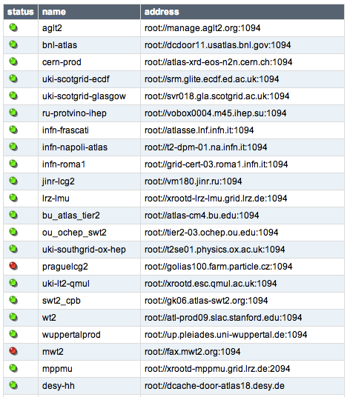
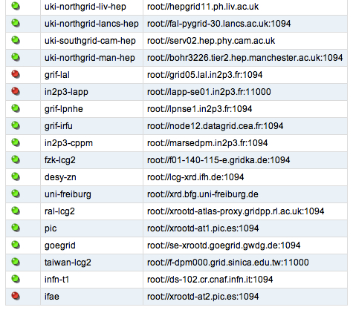
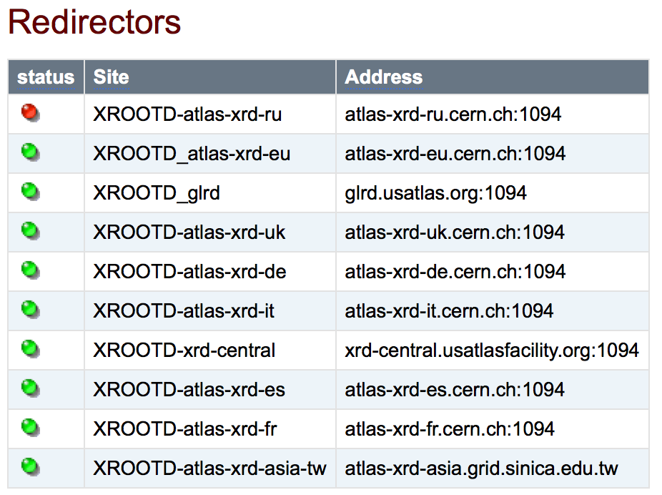
Full fax endpoint list

Slide 15
Performance in WAN
This is important to do independently if you use FAX or not
Make sure you use TTreeCache (http://root.cern.ch/root/html/TTreeCache.html)
Simple
For full optimization in addition
With latest ROOT versions you may use AsyncPrefetch
t->SetCacheSize(30*1024*1024);
t->SetBranchStatus("ele_trig_l1match*",0);
TIter iter(t->GetListOfBranches());
while(TBranch *sub = (TBranch *)iter.Next())
if( t->GetBranchStatus(sub->GetName()) )
t->AddBranchToCache(sub->GetName(),kTRUE);
t->StopCacheLearningPhase();
~> cat .rootrc
TFile.AsyncPrefetching: 1
This should become default with ROOT 6.0

Slide 16
Use fax interactively
Copy file locally
Setup ROOT any way you like, open file and list its content
Event picking
Tutorial/GettingFile
~> xrdcp root://fax.mwt2.org//atlas/dq2/user/ilijav/HCtest/user.ilijav.HCtest.1/group.test.hc.NTUP_SMWZ.root .
[xrootd] Total 760.22 MB |====================| 100.00 % [53.1 MB/s]
Tutorial/InspectingFile
~ >root -l
root [0] TFile *f = TFile::Open("root://fax.mwt2.org//atlas/dq2/user/ilijav/HCtest/user.ilijav.HCtest.1/group.test.hc.NTUP_SMWZ.root")
root [1] f->ls()
TXNetFile** root://fax.mwt2.org//atlas/dq2/user/ilijav/HCtest/user.ilijav.HCtest.1/group.test.hc.NTUP_SMWZ.root StreamNTUP_SMWZ
TXNetFile* root://fax.mwt2.org//atlas/dq2/user/ilijav/HCtest/user.ilijav.HCtest.1/group.test.hc.NTUP_SMWZ.root StreamNTUP_SMWZ
KEY: AttributeListLayout Schema;1
KEY: TDirectoryFile physicsMeta;1 physicsMeta
KEY: TDirectoryFile Lumi;1 Lumi
KEY: TTree CollectionTree;1 CollectionTree
KEY: TTree physics;1 physics
Tutorial/InspectingFiles
Notes:
say source Tutorial/getROOT.sh

Slide 17
Direct access reading from fax
Tutorial/ReadingWritingFile
Compile. Execute. Play with parameters
This code prints all the important information
CPU/Wall time
number of reads/writes
memory usage
Use its functions to investigate issues with your own programs
~> ./readDirect
usage: read <filename> <treename> <percentage of events to read> <TTreeCache size> [file containing branches to be read]
~> ./readDirect root://fax.mwt2.org:1094//atlas/dq2/user/ilijav/HCtest/user.ilijav.HCtest.1/group.test.hc.NTUP_SMWZ.root physics 10 30

Slide 18
Read/write example
Tutorial/ReadingWritingFile
Compile. Execute. Play with parameters
A new service - facilitates FAX and flocked Tier 3 jobs at Tier 2 Centers
100GB /user currently. Request it at http://faxbox.mwt2.org/
No backup. Think of it as a scratch space accessible from anywhere
More features to come.
./readWrite
usage: read <infilename> <outfilename> <treename> <percentage of events to read> <TTreeCache size> [file containing branches to be read]
./readWrite \
root://fax.mwt2.org:1094//atlas/dq2/user/ilijav/HCtest/user.ilijav.HCtest.1/group.test.hc.NTUP_SMWZ.root \
root://faxbox.mwt2.org:1094//user/ilijav/out.root \
Physics 10 30
ROOT://FAXBOX.MWT2.ORG

Slide 19
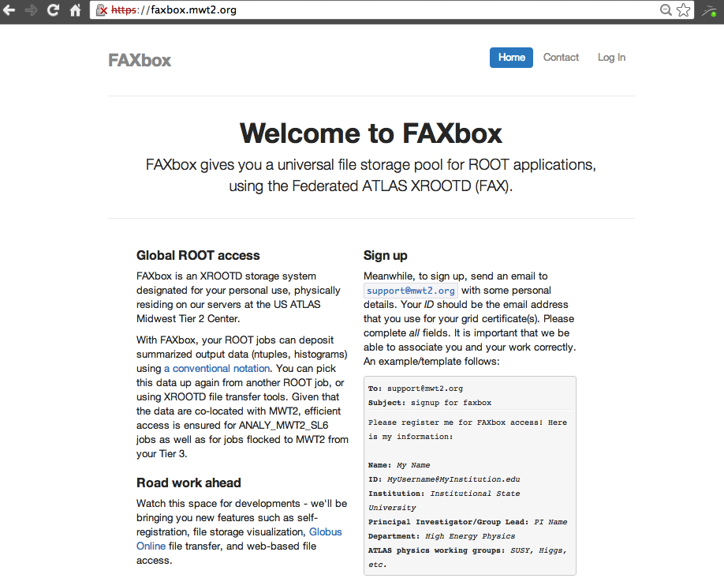

Slide 20
Skim slim example
Tutorial/SkimSlim
Official skim slim code: filter-and-merge-d3pd.py
Don’t write your own.
This one has a lot of options.
python filter-and-merge-d3pd.py
--in=inputFileList
--out=SkimmedSlimmed.root
--tree=physics
--var=branchesList
--selection=file:cutCode

Slide 21
Using fax from Tier3
Tutorial/SkimSlimT3/skimSlimT3.sh
Most Tier 3 sites use HTCondor
Requires a submit script like this:
Basic commands:
######### job.sub #########
executable = SkimSlim.sh
output = SkimSlim.out
error = SkimSlim.error
log = SkimSlim.log
transfer_input_files = filter-and-merge-d3pd.py,/tmp/x509up_u20074, inputFileList,branchesList,cutCode
universe = vanilla
queue 1
condor_submit job.submit # that‘s how you submit job
condor_q yourUsername # check status of your jobs
condor_ssh_to_job jobID # logging at a node where your jobs is executed

Slide 22
MULTI-SITE FAX ACCESS FROM TIER3
Tutorial/SkimSlimT3/skimSlimT3Large.sh
Skims Slims 100 files spread over 3 different sites
Outputs files of optimal size (>1GB)
########## job.sub ########
Jobs = 10
getenv = False
executable = SkimSlimLarge.sh
output = SkimSlimLarge.out.$(Process)
error = SkimSlimLarge.error.$(Process)
log = SkimSlimLarge.log.$(Process)
arguments = $(Process) $(Jobs)
transfer_input_files = filter-and-merge-d3pd.py,/tmp/x509up_u20074, inputFileListLarge,branchesList,cutCode
universe = vanilla
queue $(Jobs)
Notes:
----- Meeting Notes (7/11/13 15:50) -----
point that Requirements line is our T3 specific just explain that code requires cvmfs mounted.

Slide 23
MULTI-SITE FAX, CONT.
Tutorial/SkimSlimT3/skimSlimT3Large.sh
Splitting up the task.
Output files are automatically transferred back to your submission directory
############ SkimSlimT3Large.sh #############
#!/bin/zsh
export ATLAS_LOCAL_ROOT_BASE=/cvmfs/atlas.cern.ch/repo/ATLASLocalRootBase
source ${ATLAS_LOCAL_ROOT_BASE}/user/atlasLocalSetup.sh
source $AtlasSetup/scripts/asetup.sh 17.6.0,noTest
export X509_USER_PROXY=x509up_u20074
echo 'job:' $1, 'from:' $2
files=$(wc -l <inputFileListLarge)
echo 'input files:' $files
awk -v jo=$1 -v totjobs=$2 -v len=$files 'BEGIN {slice = len/totjobs; start = jo*slice; end = (jo+1)*slice;} NR > start && NR <= end {print}' inputFileListLarge > inputFileList
cat inputFileList
python filter-and-merge-d3pd.py --in=inputFileList --out=SkimmedSlimmed_$1.root --tree=physics --var=branchesList --selection=file:cutCode

Slide 24
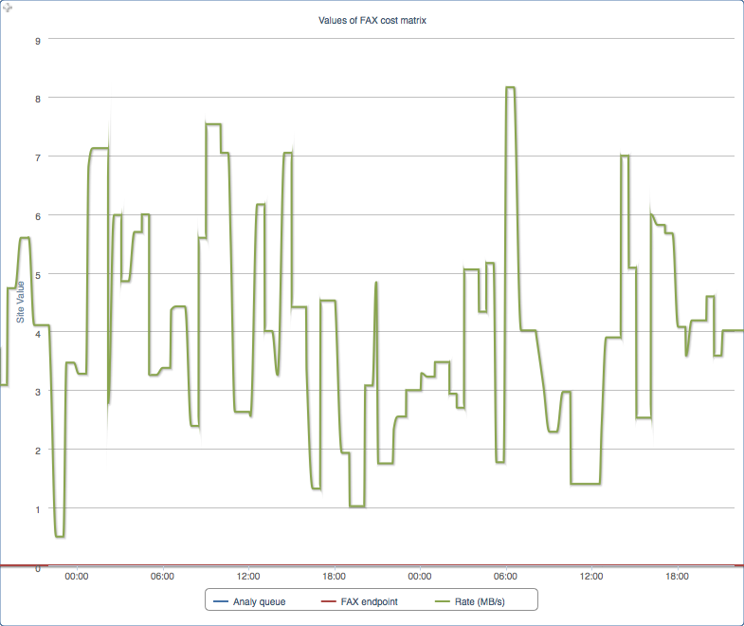
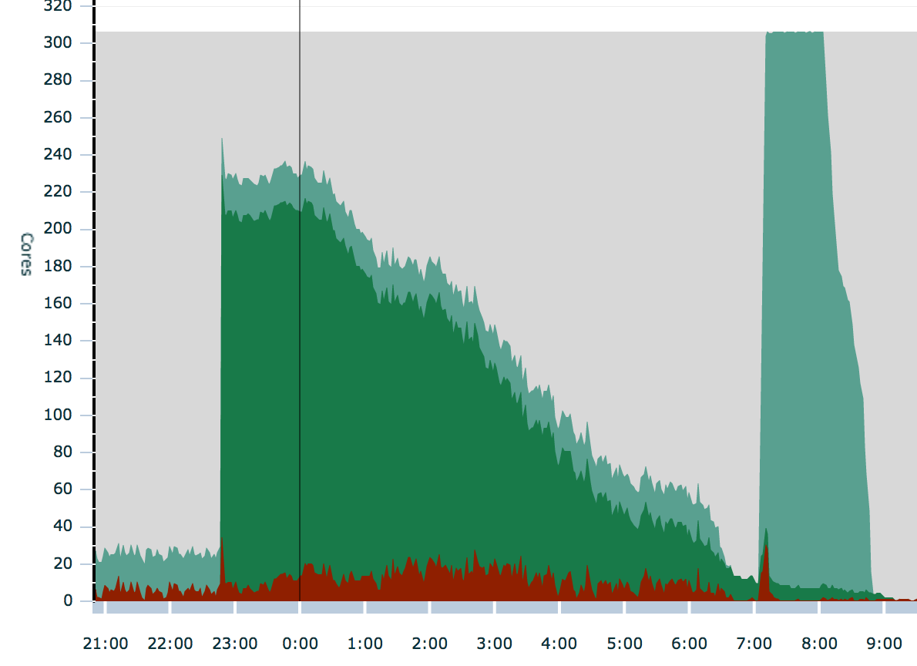
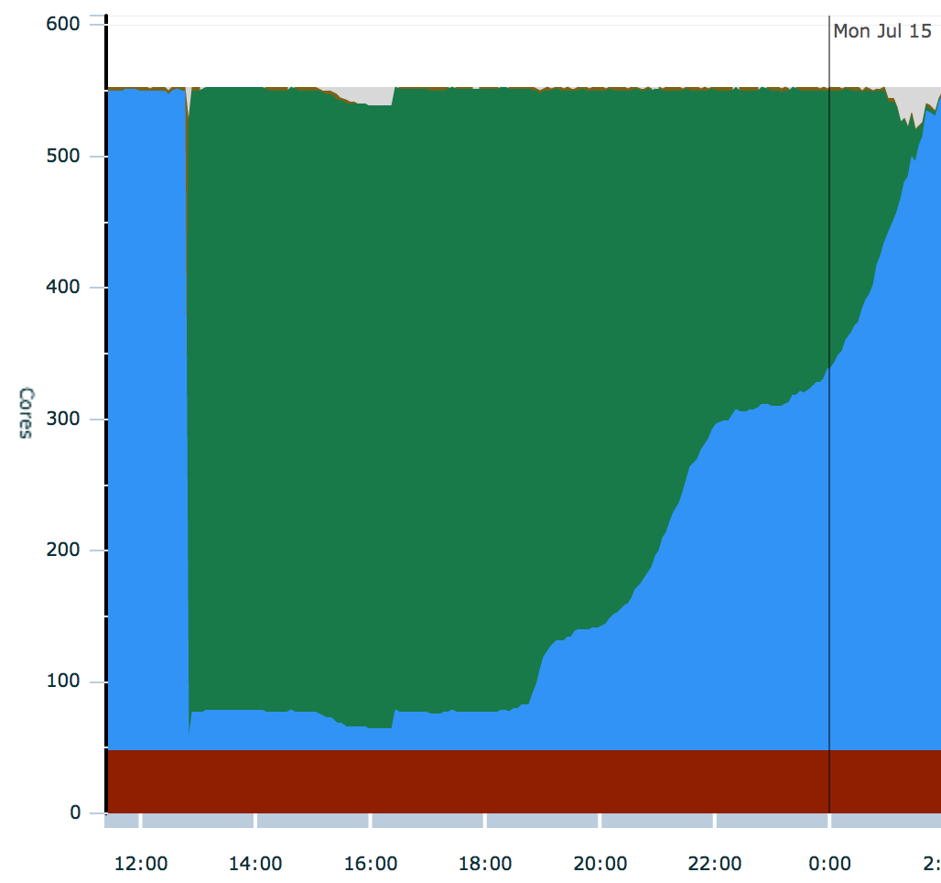
Performance example – skim SLIM
200 SMWZ SkimSlim jobs from UC Tier3
Data were at MWT2
MB/s
BNL to CERN
500 jobs at UC3 data at AGLT2
Performance will vary with available bandwidth between sites.

Slide 25
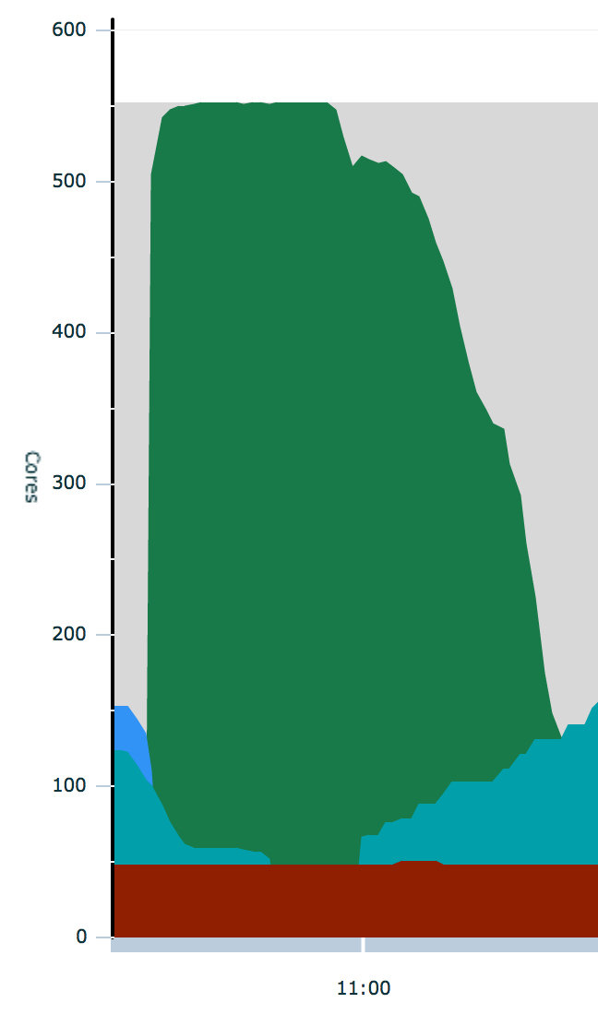
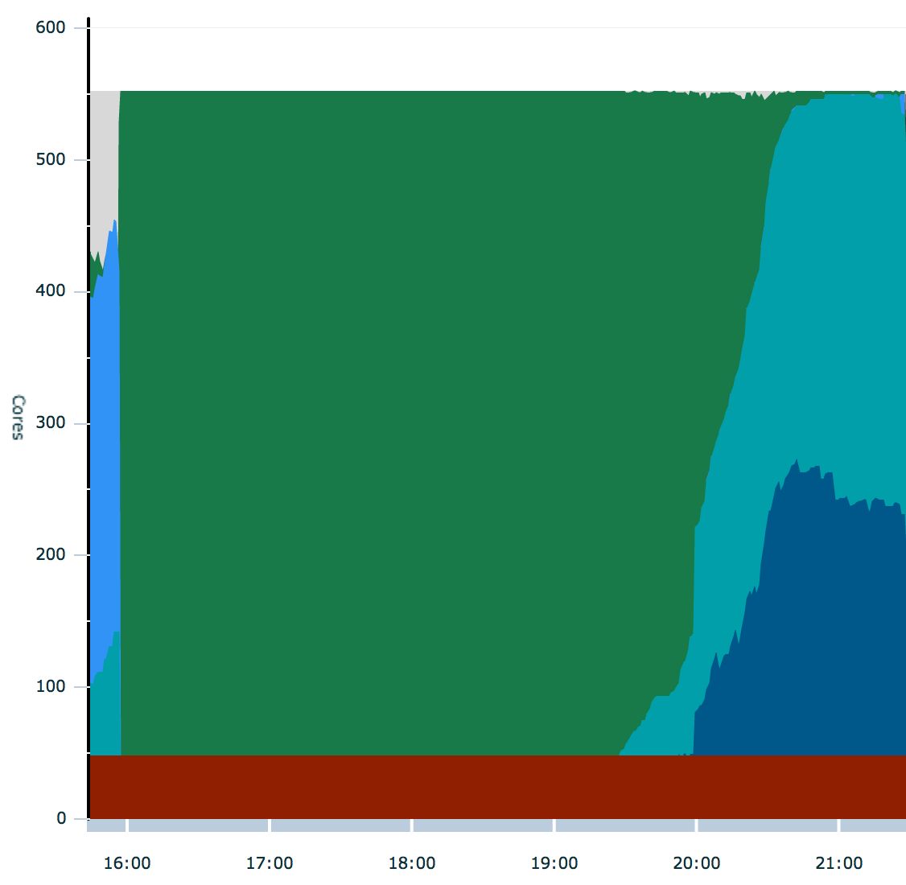
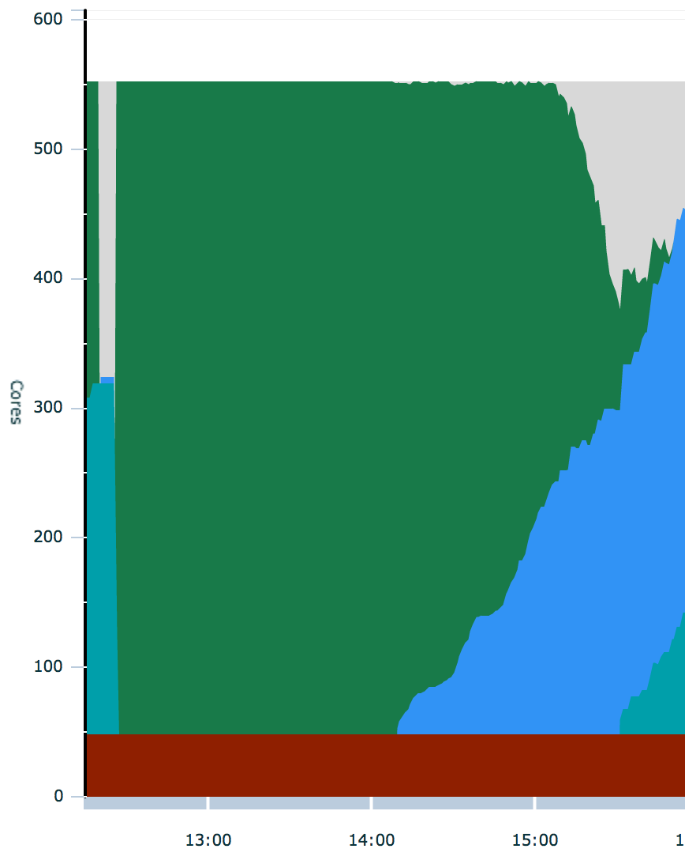
Performance example
From MWT2
500 cores at UC3
Reading 2.6TB
1.5 GB/s
3MB/s/core
From WT2
500 cores at UC3
Reading 2.6TB
190 MB/s
0.38 MB/s/core
Each test writing to FAXbox
From AGLT2
500 cores at UC3
Reading 2.6TB
300 MB/s
0.6MB/s/core

Slide 26
FOR REFERENCE
Short users instructions https://twiki.cern.ch/twiki/bin/view/Atlas/UsingFAXforEndUsers
Example codes and scripts http://ivukotic.web.cern.ch/ivukotic/dropbox/Tutorial.tar
Questions, problems, ideas https://its.cern.ch/jira/browse/FAX or mail toatlas-adc-fax-operations@cern.ch

Slide 27
Reserve

Slide 28
Setting proxy from AFS
Making proxy valid for 96 hours and not ask for password
Setting dq2 from AFS
source /afs/cern.ch/project/gd/LCG-share/current_3.2/etc/profile.d/grid_env.sh
voms-proxy-init -voms atlas
voms-proxy-init -voms atlas -valid 96:0 -pwstdin < $HOME/.myPassword
source /afs/cern.ch/atlas/offline/external/GRID/ddm/DQ2Clients/setup.zsh

Slide 29
Ttreecache longer story
TTreeCache tries to guess which TBranches you want and read only these and in large chunks.
During first 100 events it learns which variables you read
Learning phase can still be expensive.
If you know what branches you’ll need, enable them only and turn it off.
If you do tree->GetEvent() it learns that you want to read all branches.

Slide 30
Setting up root only
Tutorial/getROOT.sh
#!/bin/bash
echo "Setting up gcc"
source /cvmfs/atlas.cern.ch/repo/ATLASLocalRootBase/x86_64/Gcc/current/setup.sh
echo "Setting up ROOT"
source /cvmfs/atlas.cern.ch/repo/ATLASLocalRootBase/x86_64/root/5.34.07-x86_64-slc5-gcc4.3/bin/thisroot.sh
echo "Setting up xRootD"
source /cvmfs/atlas.cern.ch/repo/ATLASLocalRootBase/x86_64/root/5.34.07-x86_64-slc5-gcc4.3/bin/setxrd.sh /cvmfs/atlas.cern.ch/repo/ATLASLocalRootBase/x86_64/xrootd/3.2.4-x86_64-slc5/v3.2.4/ 2>&1 > /dev/null
export LD_LIBRARY_PATH=$LD_LIBRARY_PATH:/cvmfs/atlas.cern.ch/repo/ATLASLocalRootBase/x86_64/xrootd/3.2.4-x86_64-slc5/v3.2.4/lib

