Slide 1
Question Answering Project
1700012993 李婧如 1700012977 姚惠涵
1700012746 郭子瑜 1600018514 余钟扬

Slide 2
Data Processing
Data format: classification VS question-answering
SQuAD(Stanford Question Answering Dataset) format: context, question, answer

Slide 3
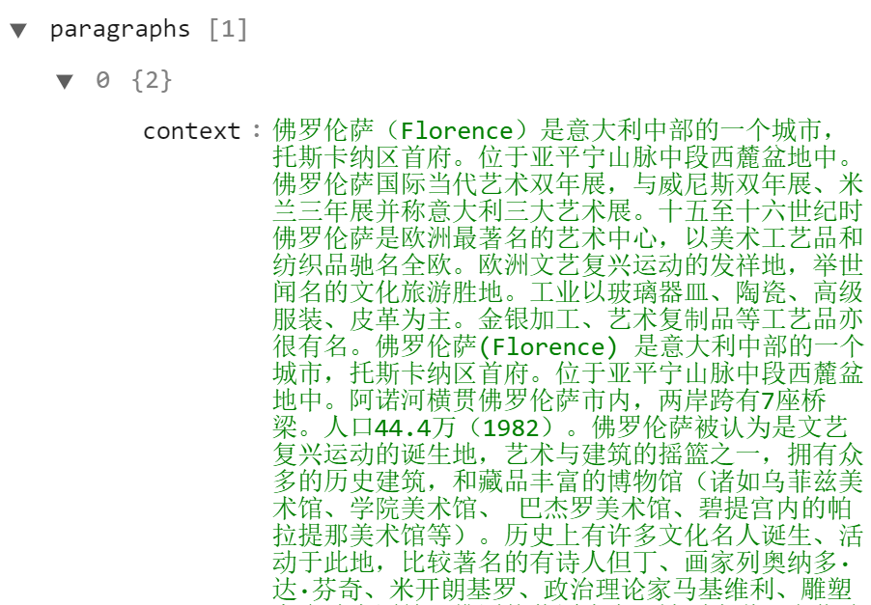
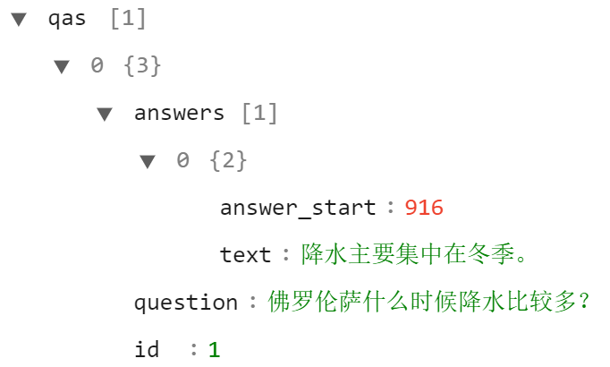
Data Processing
Concatenate sentences into context:

Slide 4
Model Structure
Use BERT as pre-trained model.
For classification task:
  Input question and answer
  Concatenate 2 sentences with [SEG]
  Input the string into BERT, obtain representation
  Dense layer
  Output 0/1

Slide 5
Model Structure
For question-answering task:
  Input context and question
  Concatenate 2 strings with [SEG]
  Input the string into BERT, obtain representation
  Dense layer
  Output start pos and end pos of answer in context

Slide 6
Prediction
For classification: trivial
For question-answering:
  Count the similarity of answer segment and sub-sentences.

Slide 7
BERT Result
Performance on validation set:
metric | classification
macro-F1 | 0.8970
micro-F1 | 0.9815
macro-P | 0.9303
micro-P | 0.9815
macro-R | 0.8691
micro-R | 0.9815
MAP | 0.8581
MPR | 0.8599
QA
0.7723
0.9435
0.9154
0.9435
0.7101
0.9435
0.8492
0.8541

Slide 8
Result Analysis
Classification:
  too many zeros
  Could deal with many answers
Question-answering:
  Fail to label more than one answer

Slide 9
Addition
XLNet:
Data processing :
“A”这句话中是否包含对问题“Q”的解答 Label
Special text classification task
Model:
  Chinese Pre-Trained XLNet
  Dense layer
  Batch normalization layer
  Dense layer : Output 0/1

