Slide 1
Chicago Crime Analysis Using MongoDB
IPD 451
Final Project
Yue Li (Ivy)

Slide 2
Research interests:
top crime types
top time of day for crimes to happen
Data Source – three datafiles:
City of Chicago – Crimes - 2001 to present
API: https://data.cityofchicago.org/resource/crimes.json
Chicago Police Department - Illinois Uniform Crime Reporting (IUCR) Code
API: https://data.cityofchicago.org/resource/c7ck-438e.json
FBI - National Incident-Based Reporting System (NIBRS)
https://crime-data-explorer.fr.cloud.gov/downloads-and-docs

Slide 3
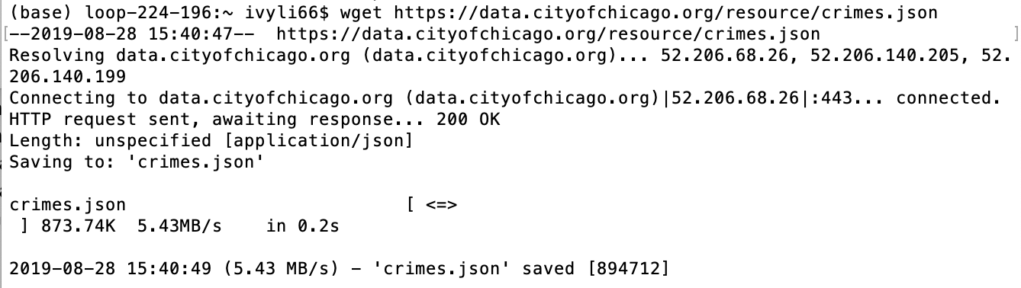
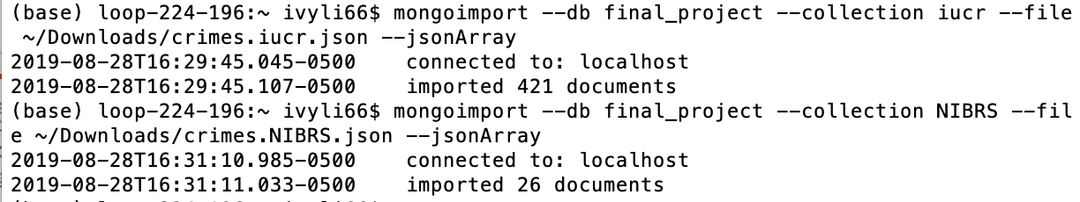
Importing Crime data into MongoDB
Importing IUCR and NIBRS data into MongoDB

Slide 4
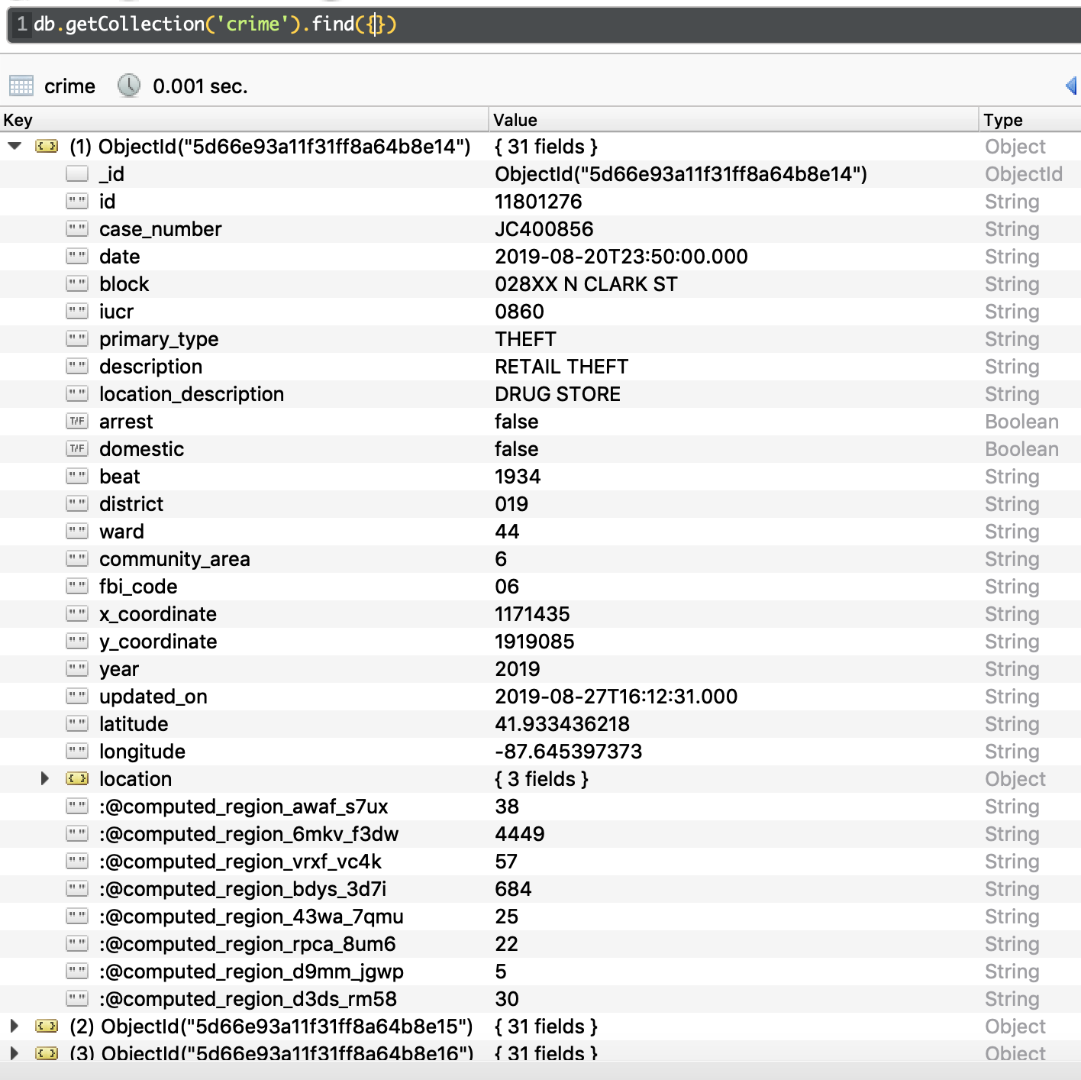
Crime Collection
1000 crimes / documents in total
for two days: 08/19/2019 & 08/20/2019
Date field is string type – conversion needed
CrimeID indexing

Slide 5
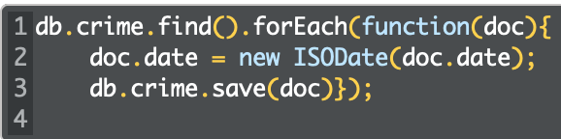
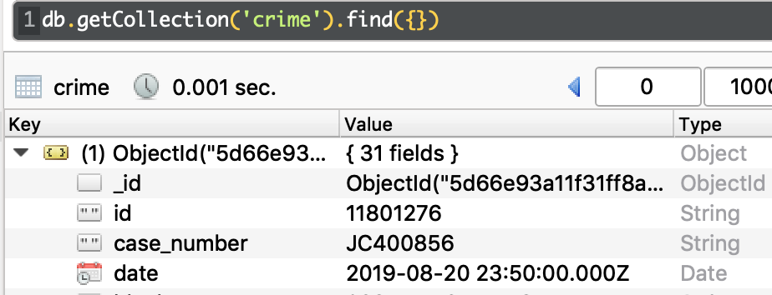
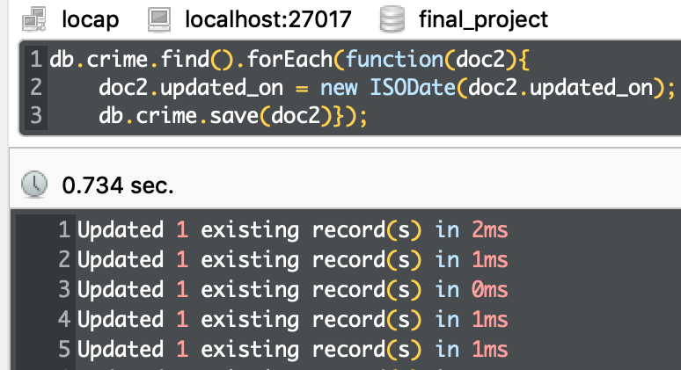
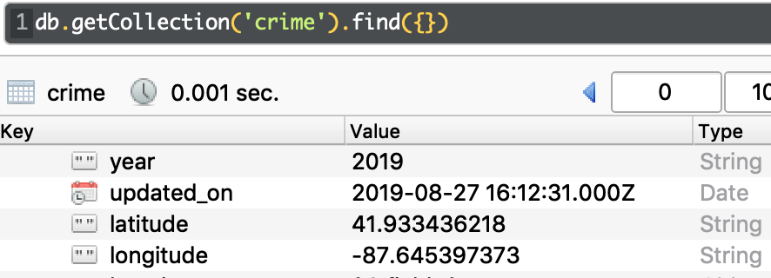
Crime Collection Date fields Conversion
Use the new ISODate helper, convert ”date” field
from String type to Date type for querying

Slide 6
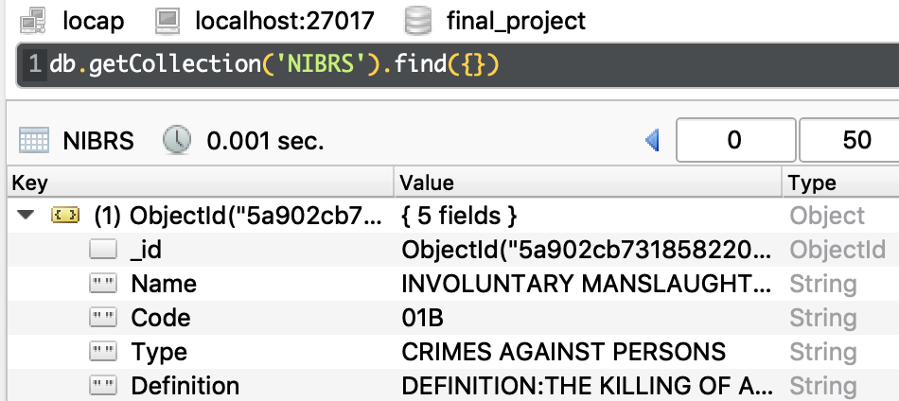
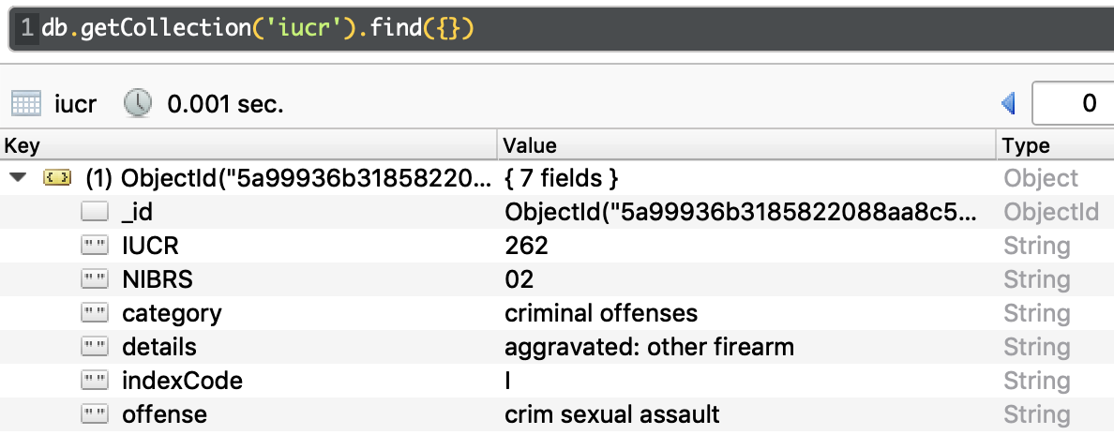
IUCR & NIBRS Collections
IUCR collection: 421 documents
IUCR field is String type, conversion needed for grouping with other collection
NIBRS collection: 26 documents
Mostly string type

Slide 7
Data Denormalization
$lookup on common fields, embed in - three collections result in one
IUCR filed in both crime and IUCR collection
FBI code on both IUCR and NIBRS collection
Data type conversion:
Originally iucr field in crime collection was string type, converted to Int32
Also converted iucr in Crime collection

Slide 8
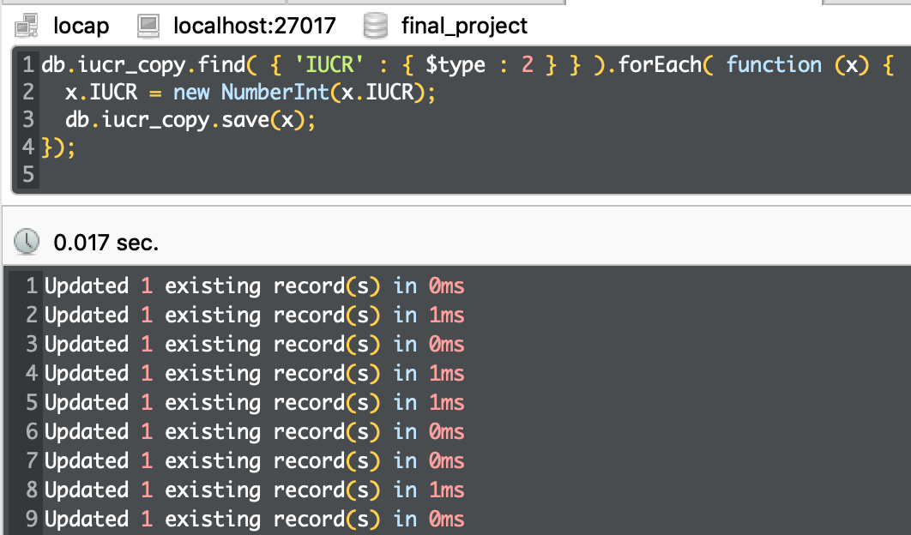
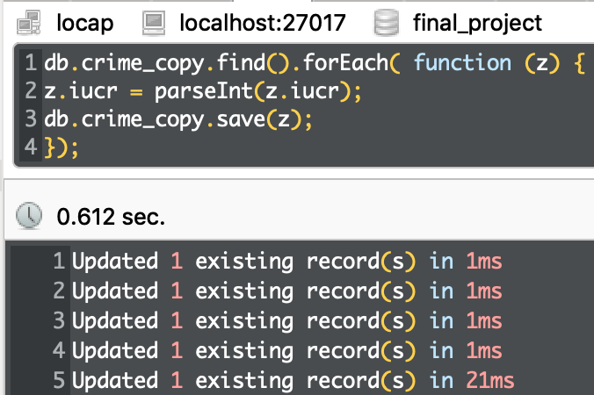
Data type conversion IUCR & Crime collection – Queries: iucr field

Slide 9
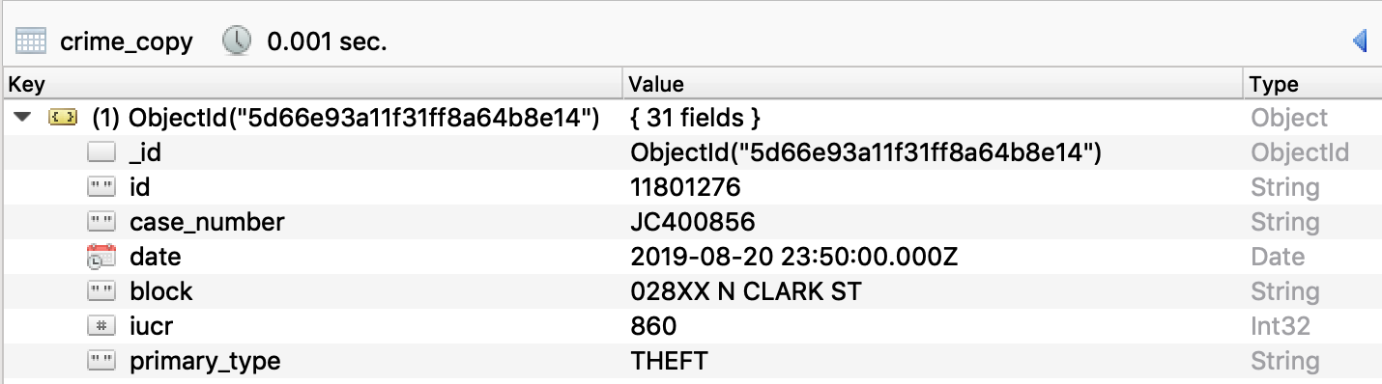
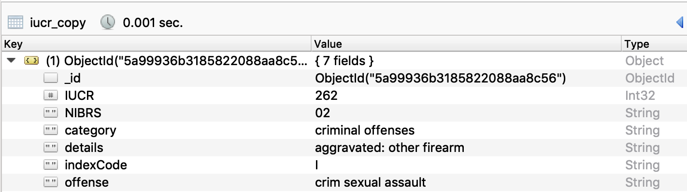
Data type conversion IUCR & Crime collection – Results: iucr field

Slide 10
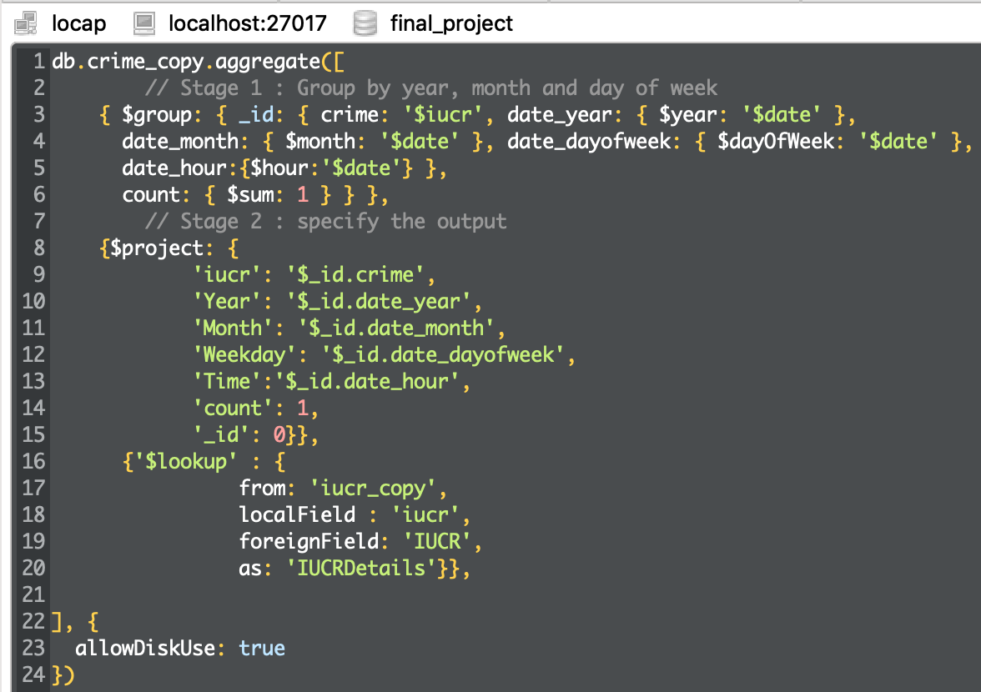
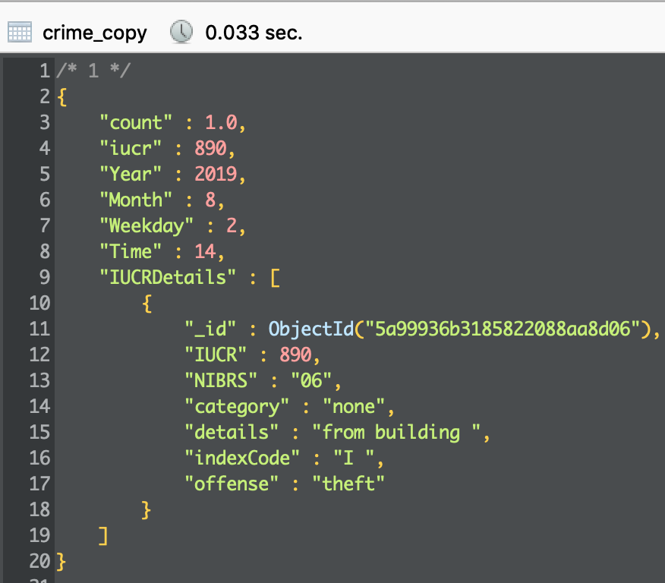
Steps: group, project, lookup, reduce
- Group by year, month, day of week
- Embed IUCR collection in
Query
Output view

Slide 11
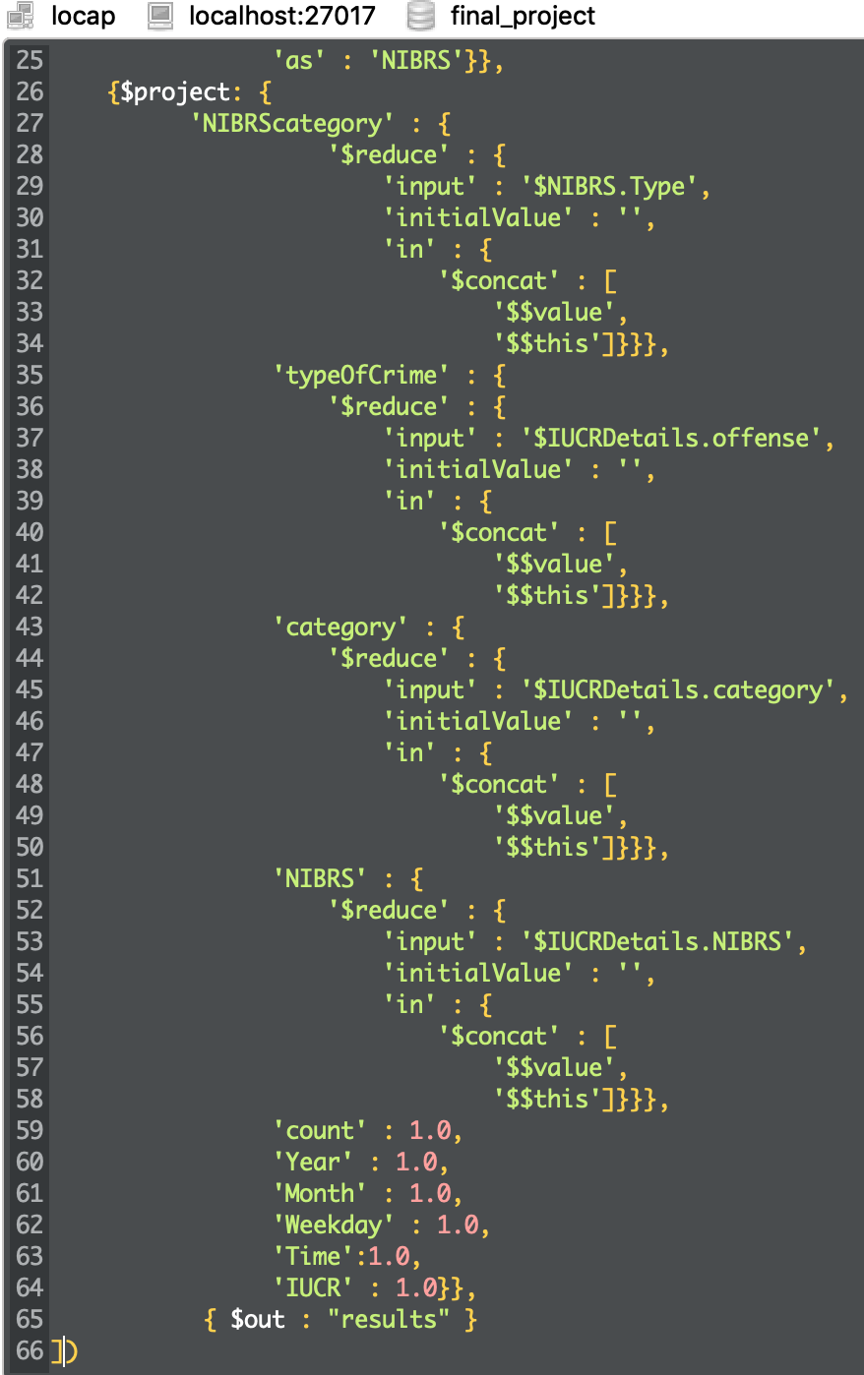
Steps: reduce, out to new collection
- Embed NIBRS in embedded IUCR in crime
collection
Reduce the fields to project only wanted ones
Output the final grouped + reduced crime collection to a new clean collection called results

Slide 12
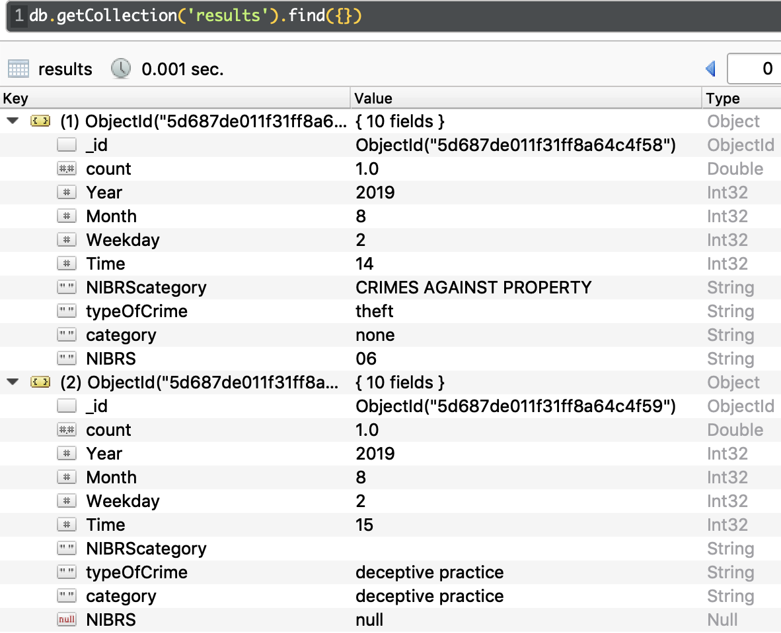
Result collection – only include relevant fields
New collection is more readable – ready for final analytical queries using :
Time field
typeOfCrime field

Slide 13
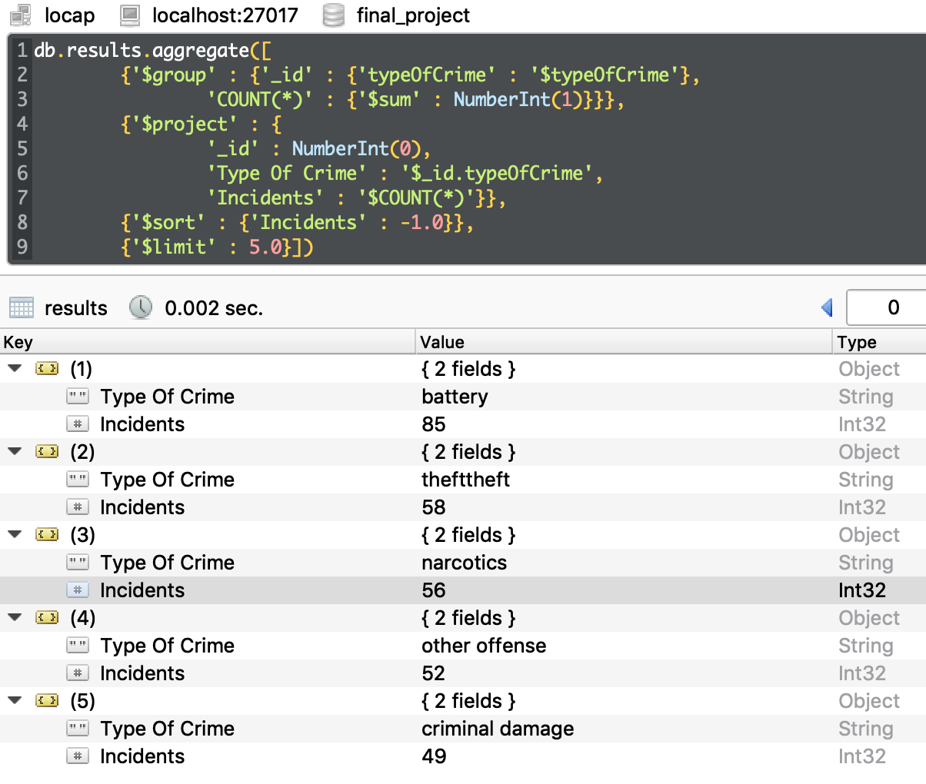
Query top 5 crime types in Chicago ( two days in August, 2019)
Battery
Theft
Narcotics
Other offense
Criminal charge

Slide 14
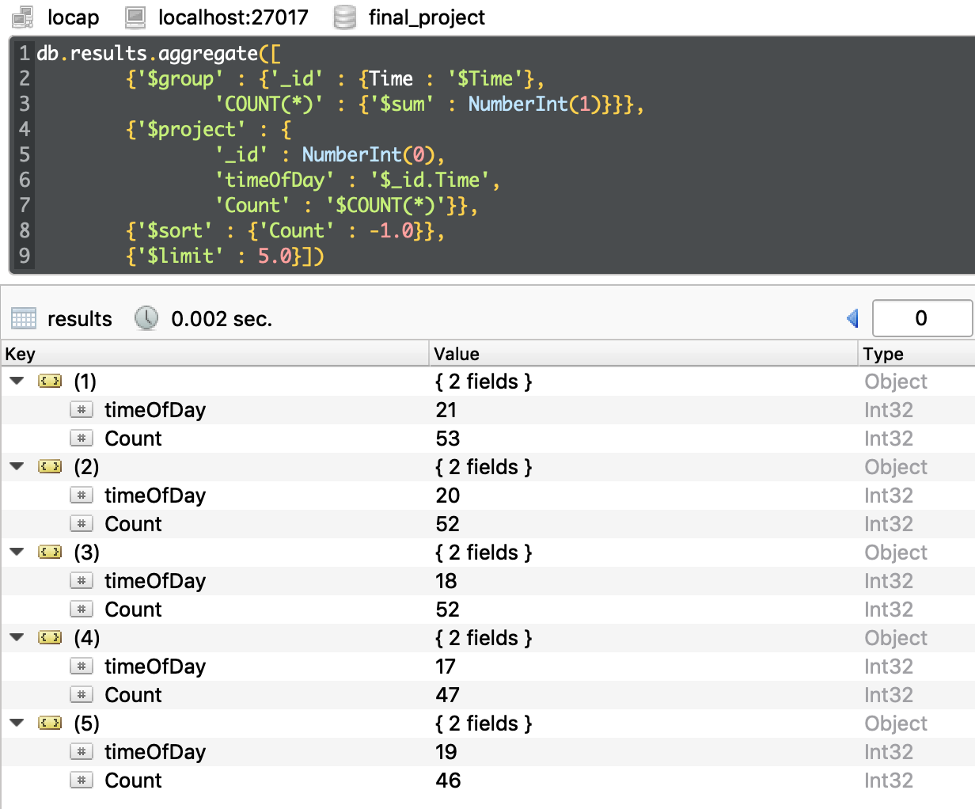
Query top 5 time of the day for Chicago Crime Scene
21:00
20:00
18:00
17:00
19:00

Slide 15
Conclusion:
The findings in the crime data analysis suggest that the Chicago Police department should distribute the police force accordingly:
more police surveillance after 17:00, especially at 21:00, for the locations that top crime types take place, like battery and theft

