Slide 1
Introduction to
Reinforcement Learning

Slide 2



Requirements
You must know python!
You must enjoy coding and solving problem.
You must know a little bit about Git and Github.

Slide 3
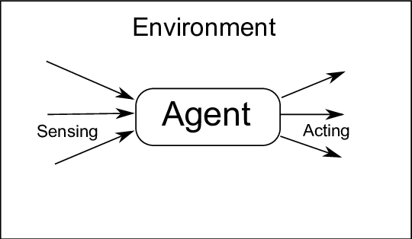
Autonomous Agent
An autonomous agent is an entity that can perceive its environment and take actions to achieve a specific goal. In other words, it is a software program or a robot that can act on its own without human intervention.

Slide 4
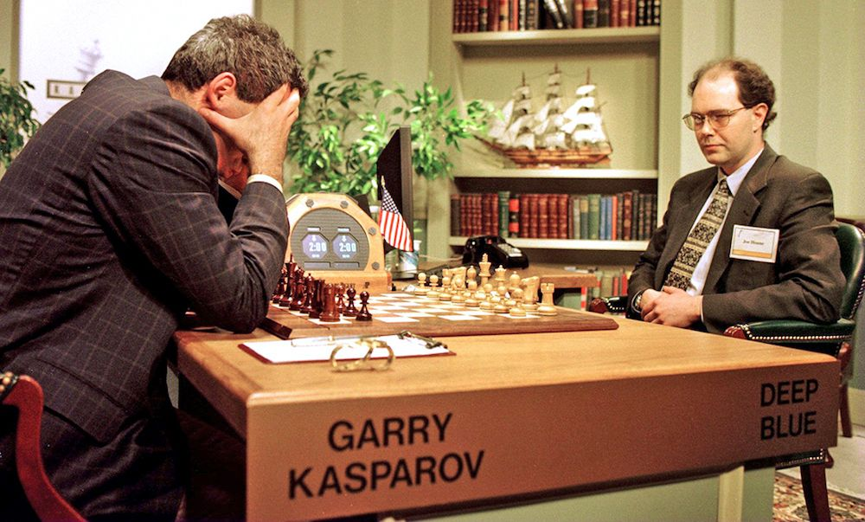
IBM Deep Blue vs. Kasparov (1997)
environment: chess board
task: play and win a chess game
actions: move chess pieces
implementation: Min-Max algorithm

Slide 5
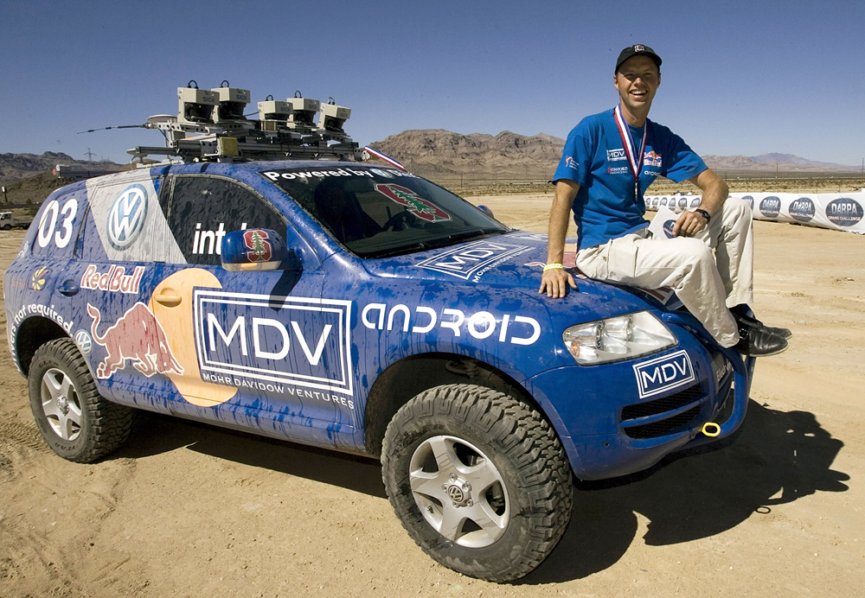
Autonomous car
environment: a road in a desert
task: drive through a desert and get to a specific point
actions: speed up, brake, turn left, turn right
implementation: a very complex implementation with different sensors and actuators.

Slide 6
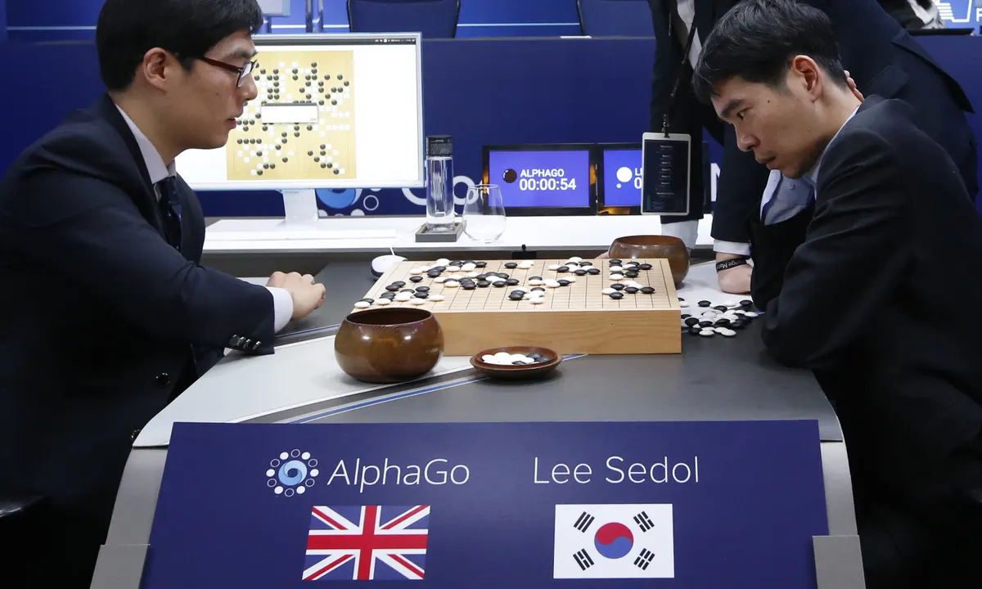
AlphaGO
playing GO (2016)
environment: GO board
task: Play Go game and win
actions: move pieces
implementation: reinforcement learning

Slide 7
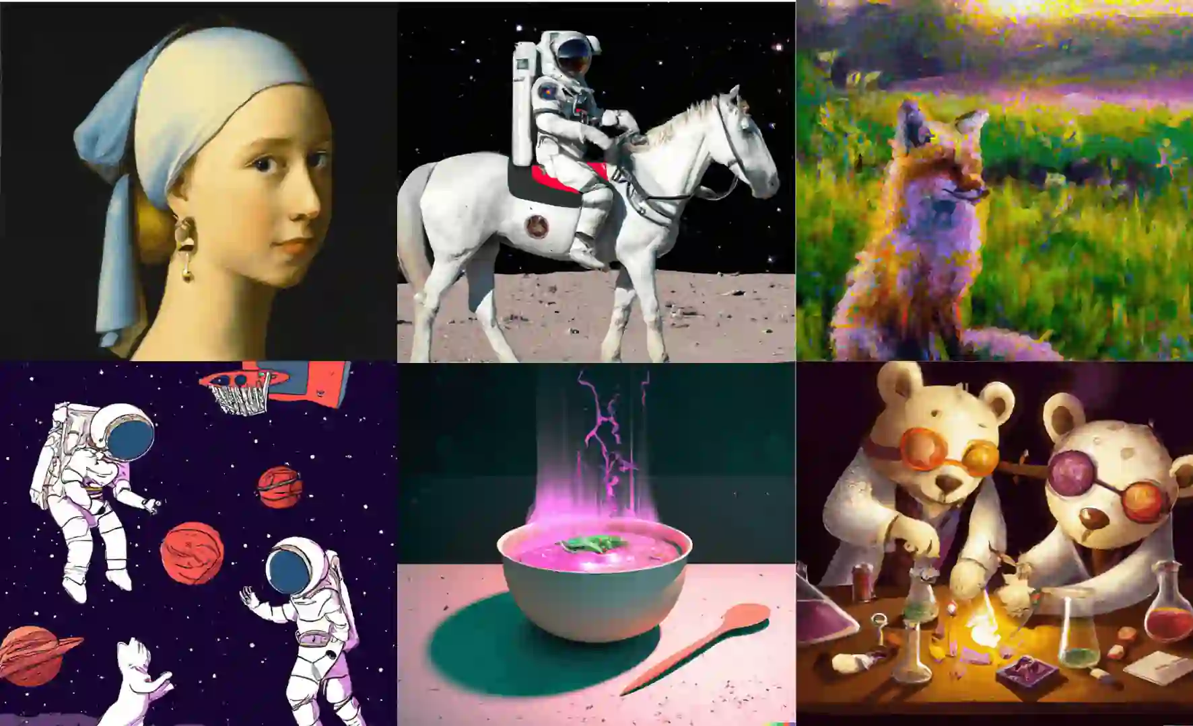
Generative models DALL-E - chatGPT
environment: a form where the user can input a text
task: generate images that are related to the text informed
actions: generate images
implementation: a Deep Neural Network

Slide 8
Reinforcement Learning
definition and key concepts

Slide 9
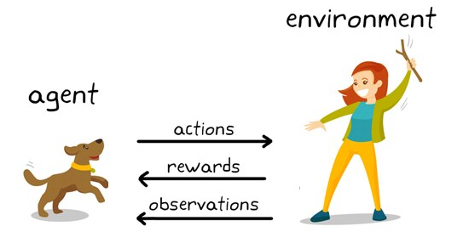
Reinforcement Learning (RL)
RL is a popular approach to AI where an agent learns to take sequential actions in an environment through trial and error.
Each action changes the environment and has a reward (positive, negative or neutral).
An Agent learns a policy that maximizes the reward.

Slide 10
Reinforcement Learning
Examples

Slide 11
Playing Atari with Deep Reinforcement Learning, 2013.
Human-Level control through deep reinforcement learning, 2015.
A General reinforcement learning algorithm that masters chess, shogi, and Go through self-play, 2018.
Self-driving cars: there are some components in self-driving cars that are optimized through RL.
Industry automation: Google Data Centers are using RL to reduce energy spending.
Trading and finance: there are a lot of companies saying that they are using RL to create robots for trading.
Natural Language Processing (NLP): chatGTP is using RL to improve its training.
Recommendation: RL in recommendation systems.

Slide 12
Differences between other machine learning and AI techniques

Slide 13
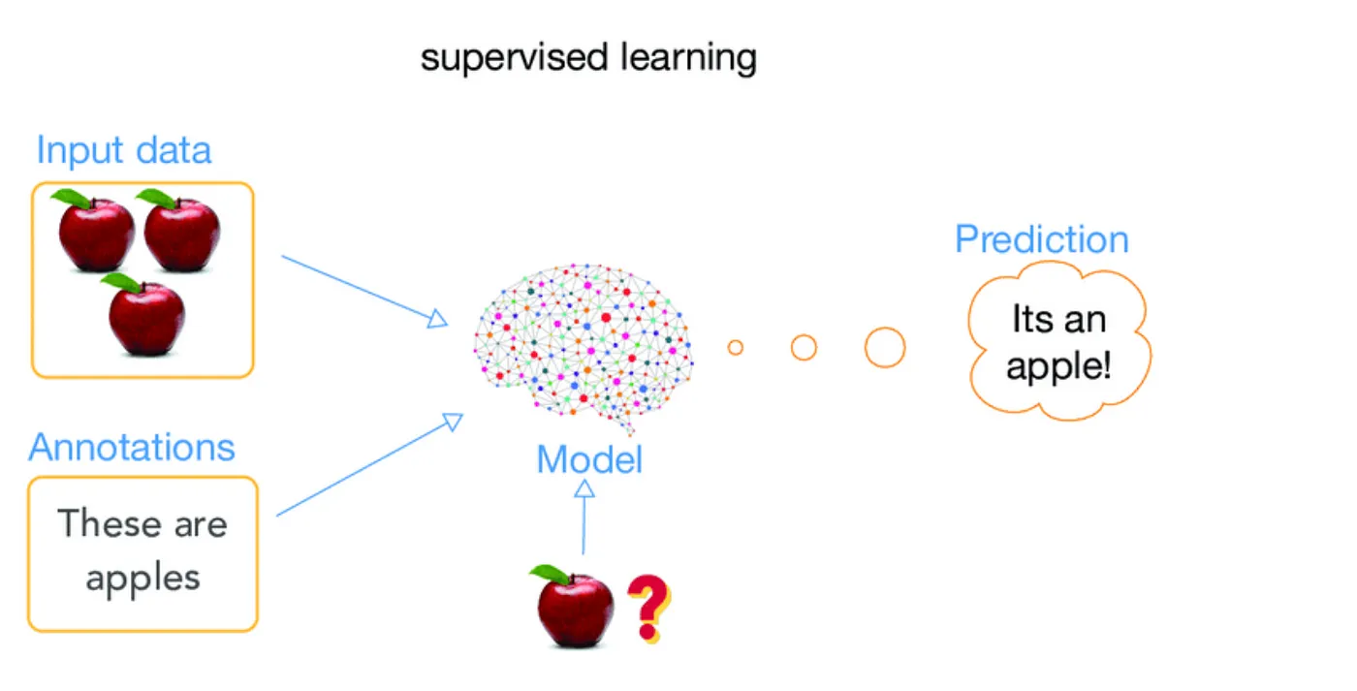
Supervised learning:
the main goal of supervised learning is to create a predicted model.
All the model construction is based on training and test datasets and both datasets must have a label attribute.
All the training process is in batch mode.

Slide 14
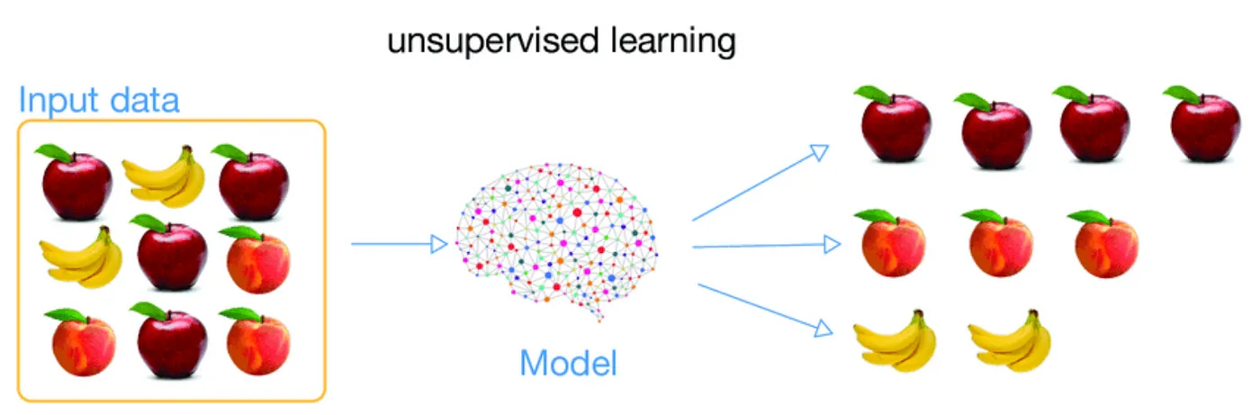
Unsupervised learning:
the main goal of unsupervised learning is to summarize data. Usually, through clustering or rule models.
All the model construction is based on training datasets without a label attribute.

Slide 15
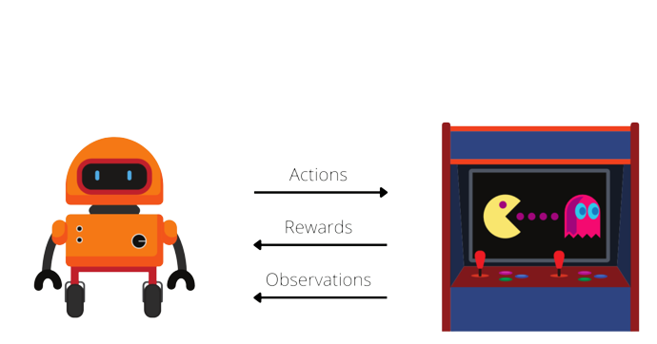
Reinforcement Learning:
All the learning process is interactive.
There is no training data. However, there is an environment.

