Slide 1
Problem-solving searching review

Slide 2
Key Questions
What is the definition of agent and environment?
Which are the main environment dimensions?
What is a state?
What is an action space?
What is a policy?

Slide 3
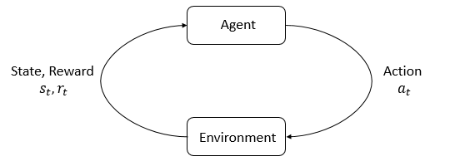
Agent and Environment
An agent is an entity that perceives and acts within an environment.
The environment includes everything outside of the agent, including any objects or agents it may interact with.

Slide 4
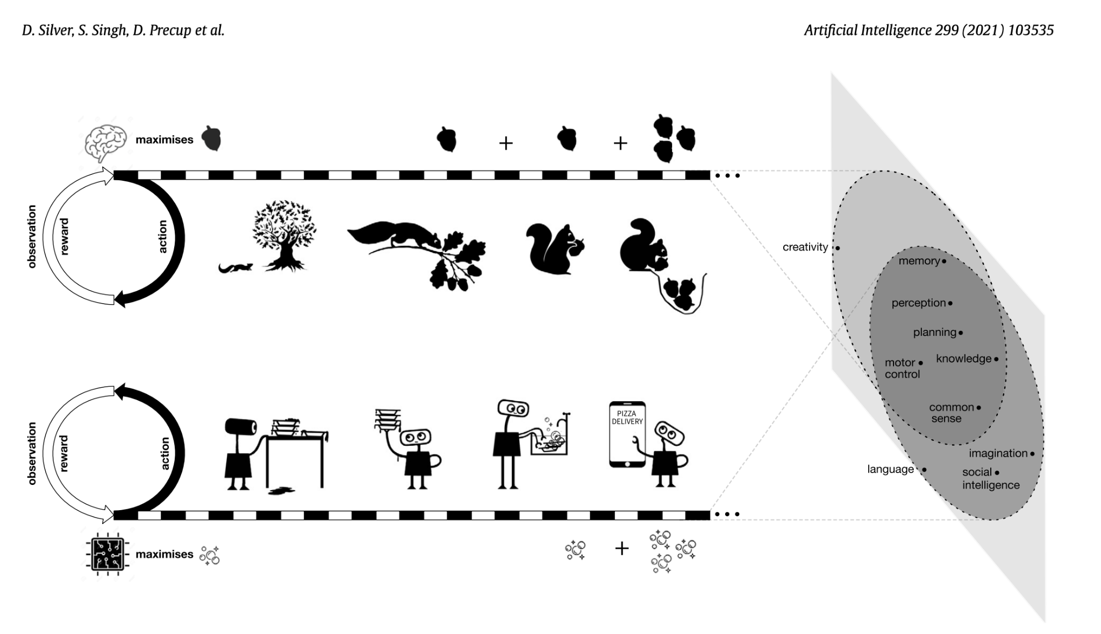
Reward is enough
David Silver, Satinder Singh, Doina Precup, Richard S. Sutton
Agent and Environment
In "Reward is enough" the authors define an agent as a decision-making system that chooses actions based on sensory inputs.
They define an environment as the set of all possible states in which an agent might find itself, along with the rules governing transitions between those states.

Slide 5
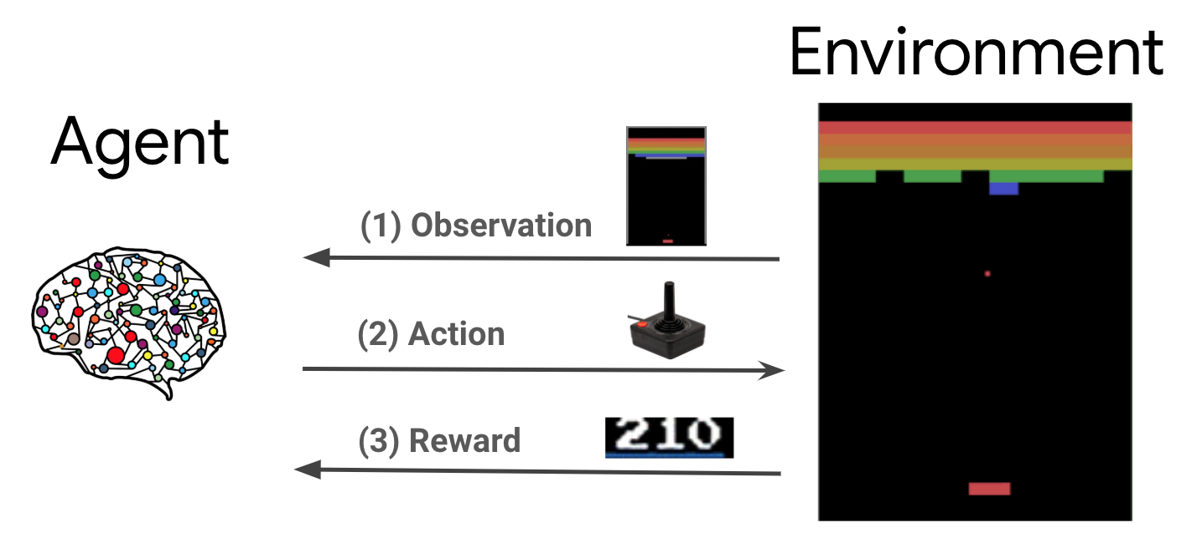
Main environment dimensions
The main dimensions of an environment are
Observations: what the agent can see
Actions: what the agent can do
Rewards: what the agent gets for its actions

Slide 6
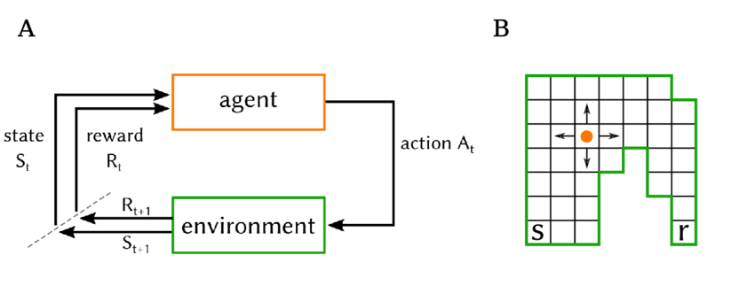
State
A state is a description of everything relevant to the agent at a particular point in time, including the current state of the environment and the agent's own internal state.

Slide 7
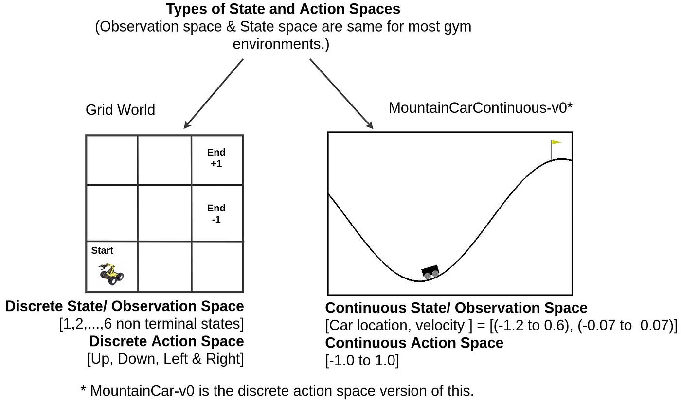
Action Space
An action space is the set of all possible actions that an agent can take in a given environment.

Slide 8
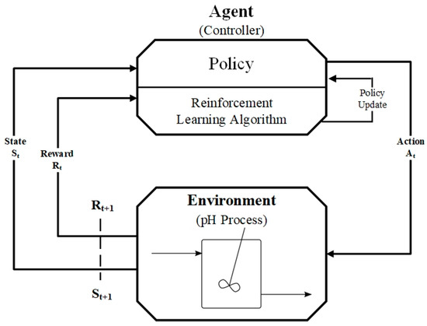
Policy
A policy is a function that maps each state to a probability distribution over possible actions. In other words, it tells the agent what action to take in each state.

Slide 9
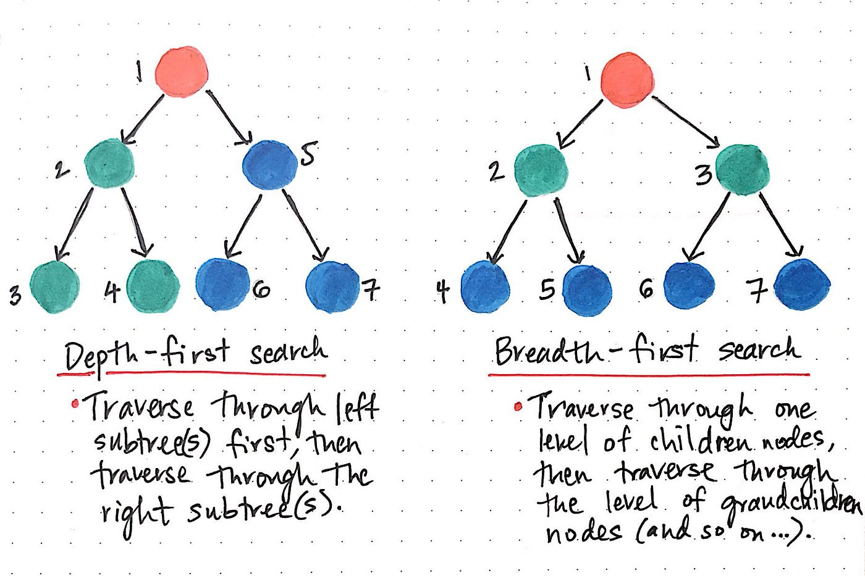
Problem-solving searching review
Uninformed Search Algorithms:
Breadth-First Search (BFS)
Depth-First Search (DFS)
Depth-Limited Search
Informed Search Algorithms:
A* Search
Greedy Search
Local Search Algorithms:
Hill Climbing
Simulated Annealing
Genetic Algorithms

Slide 10
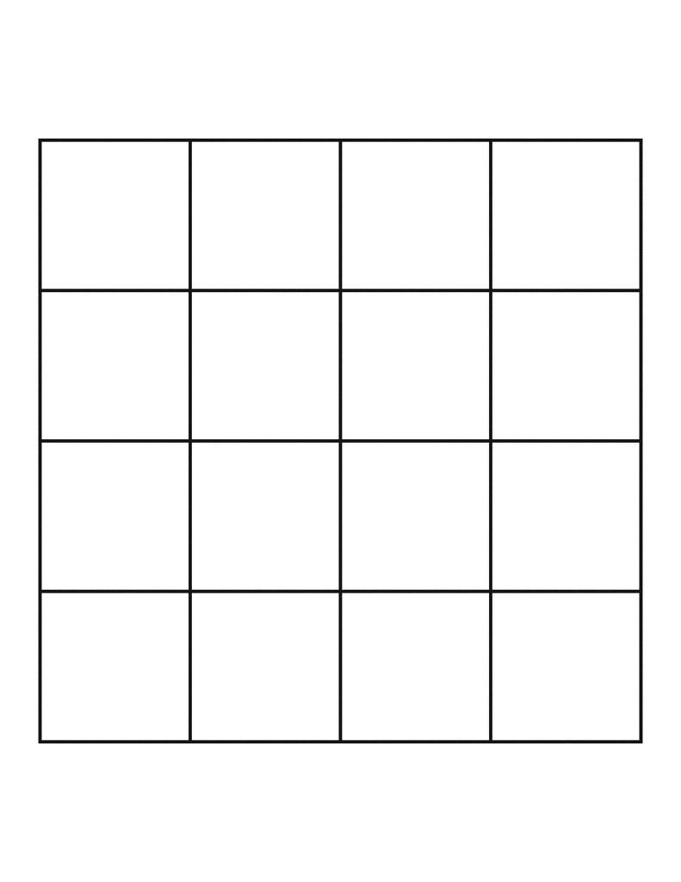




Taxi Driver
3
Grid Board/World
Car
Barrier
Passenger
Target
2
1
0
Y
X
0
1
2
3

Slide 11
Taxi Driver
3
Grid Board/World
Car
Barrier
Passenger
Target
2
1
0
Y
X
0
1
2
3

