Slide 1
Adversarial search and games review

Slide 2
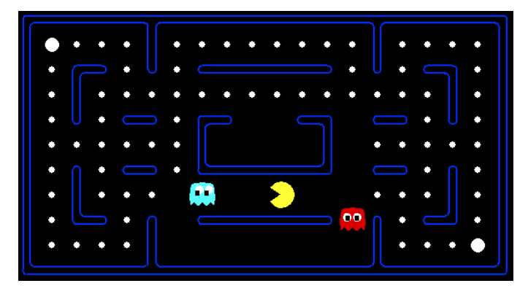

Slide 3
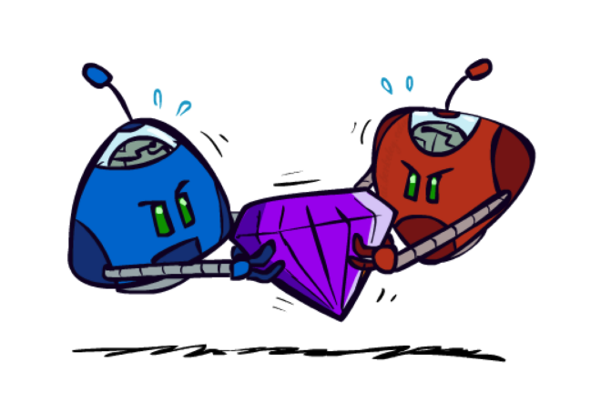
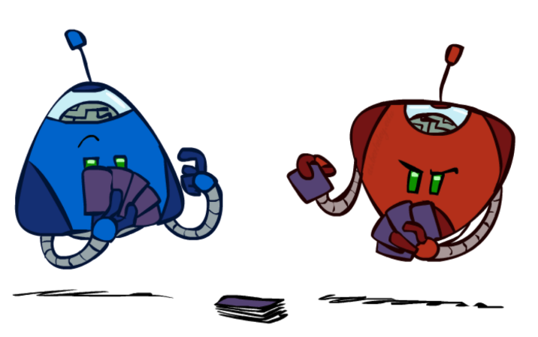
Adversarial Games
Types of Games
Deterministic or stochastic?
One, two, or more players?
Zero sum?
Perfect information (can you see the state)?
Want algorithms for calculating a strategy (policy) which recommends a move from each state

Slide 4
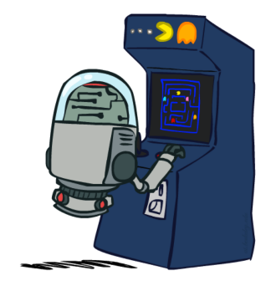
Deterministic Games
States: S (start at s0)
Players: P={1...N} (usually take turns)
Actions: A (may depend on player / state)
Transition Function: SxA → S
Terminal Test: S → {true, false}
Terminal Utilities: SxP → R
Solution for a player is a policy: S → A

Slide 5
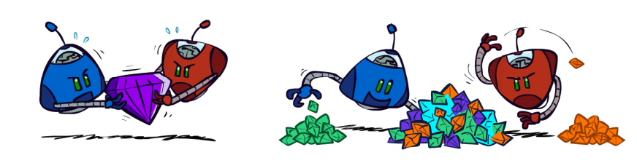
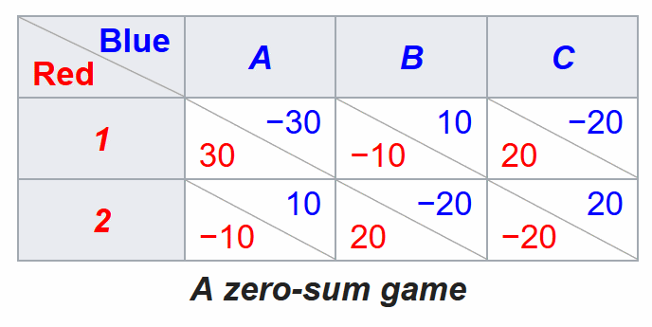
Zero-Sum Games
Zero-Sum Games
Agents have opposite utilities (values on outcomes)
Lets us think of a single value that one maximizes and the other minimizes
Adversarial, pure competition
General Games
Agents have independent utilities (values on outcomes)
Cooperation, indifference, competition, and more are all possible
Zero-Sum Example Game
A situation that involves two sides, where the result is an advantage for one side and an equivalent loss for the other

Slide 6
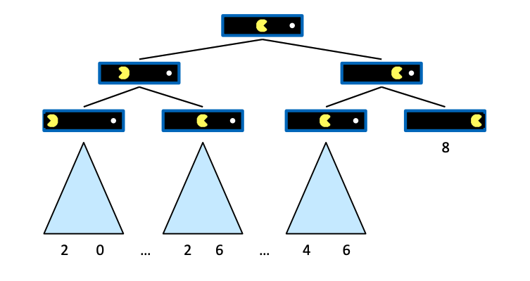
Single-Agent Trees

Slide 7
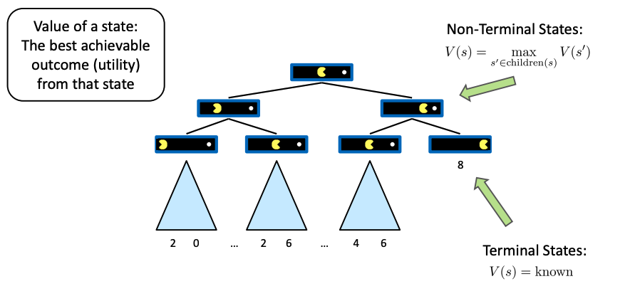
Value of a State

Slide 8
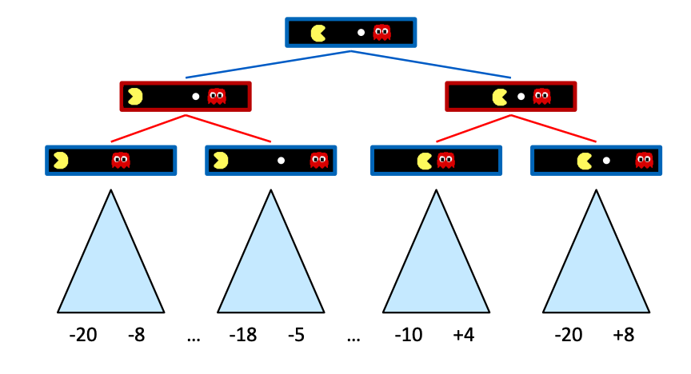
Adversarial Game Trees

Slide 9
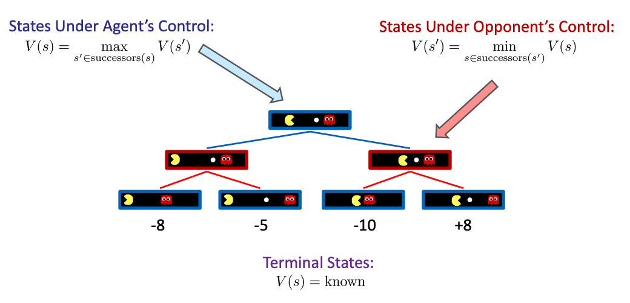
Minimax Values

Slide 10
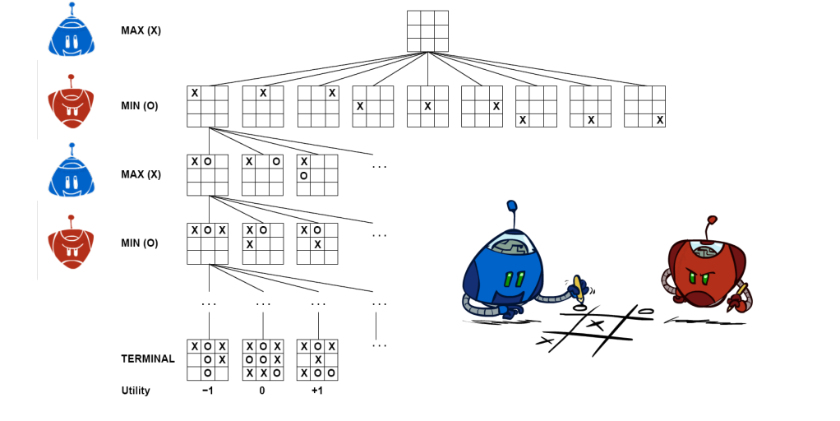
Tic-Tac-Toe Game Tree

Slide 11
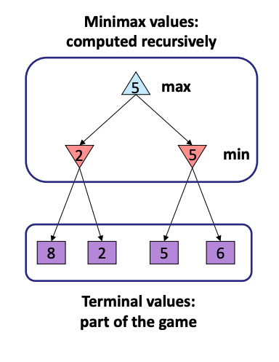
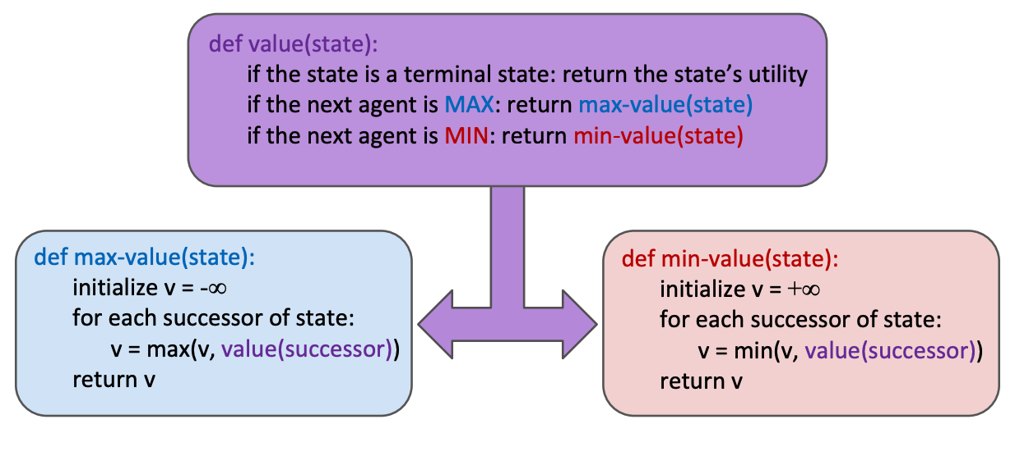
Adversarial Search (Minimax) and Implementation

Slide 12
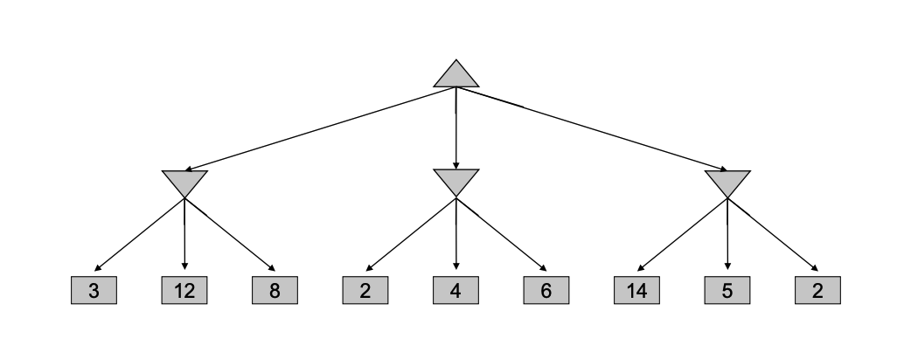
Minimax Example
Max
Min
Min
Min
Max

Slide 13
Minimax Example
Max
Min
3
Min
Min
Max

Slide 14
Minimax Example
Max
Min
3
Min
2
Min
Max

Slide 15
Minimax Example
Max
Min
3
Min
2
Min
2
Max

Slide 16
Minimax Example
Max
3
Min
3
Min
2
Min
2
Max

