Slide 1
Markov Decision Process (MDP)

Slide 2
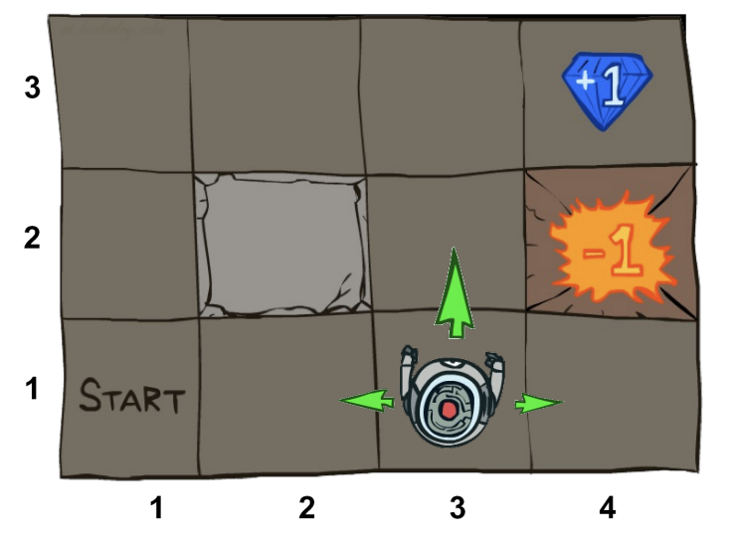
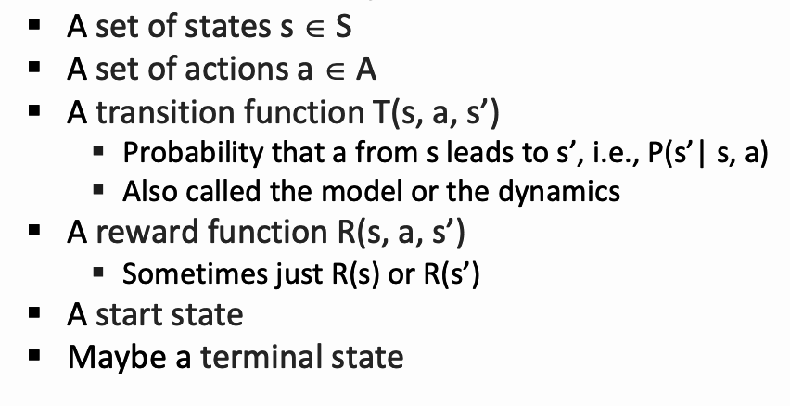





Markov Decision Process (MDP)
An MDP is defined by:
If you can frame your task in an MDP, congratulations! You’ve defined your environment.
Now you have a space where the agent can take actions, get rewards, and learn
State Space
Action Space
Transition Function
Reward Function

Slide 3
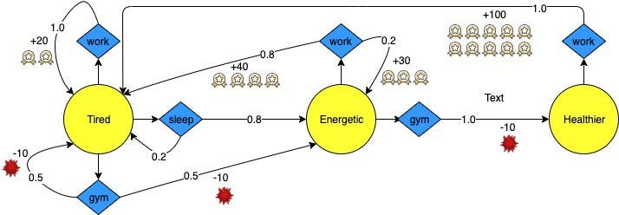
An example of the Markov decision process

Slide 4
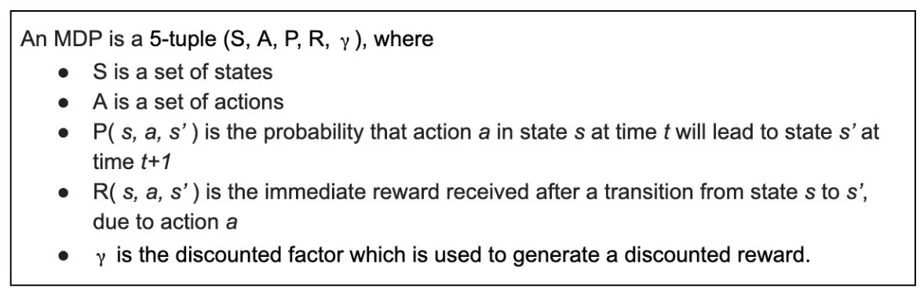
Formulated definition of MDP

Slide 5
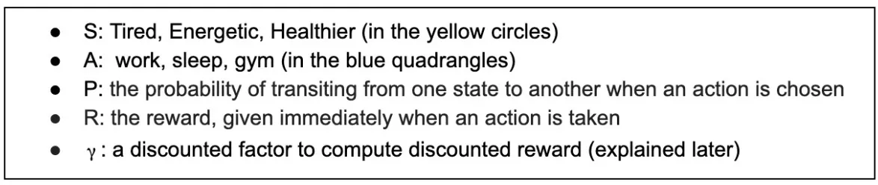

Slide 6
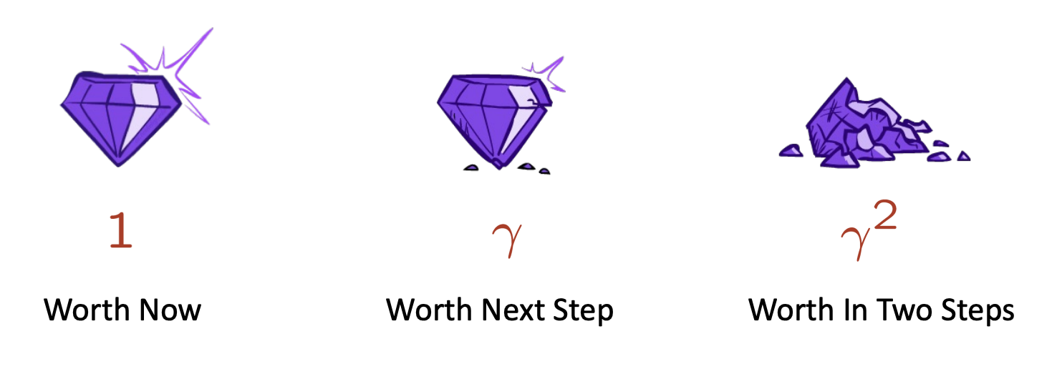
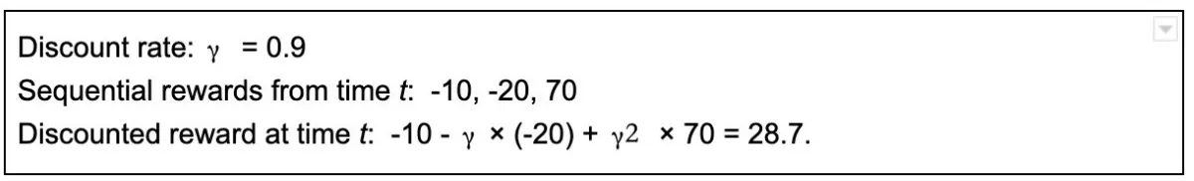
Discounted Reward

Slide 7
Deterministic vs Stochastic

Slide 8
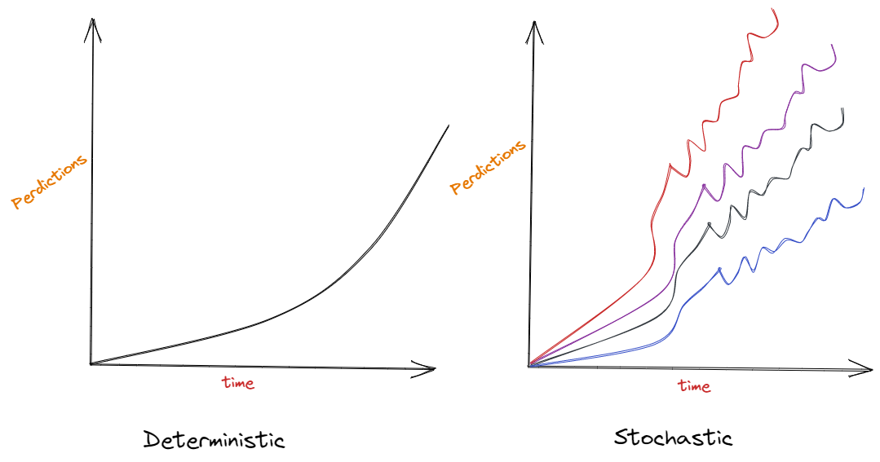
Deterministic and Stochastic in Machine Learning

Slide 9
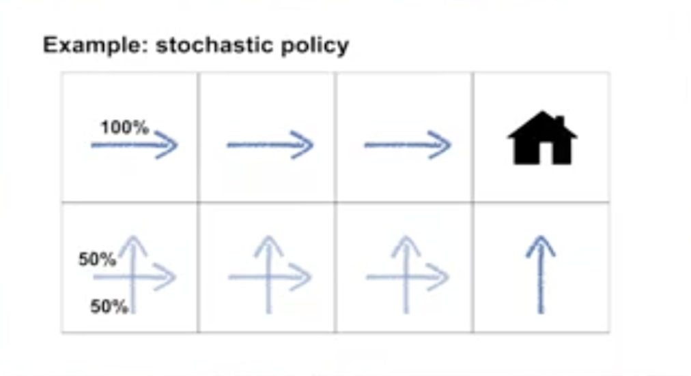
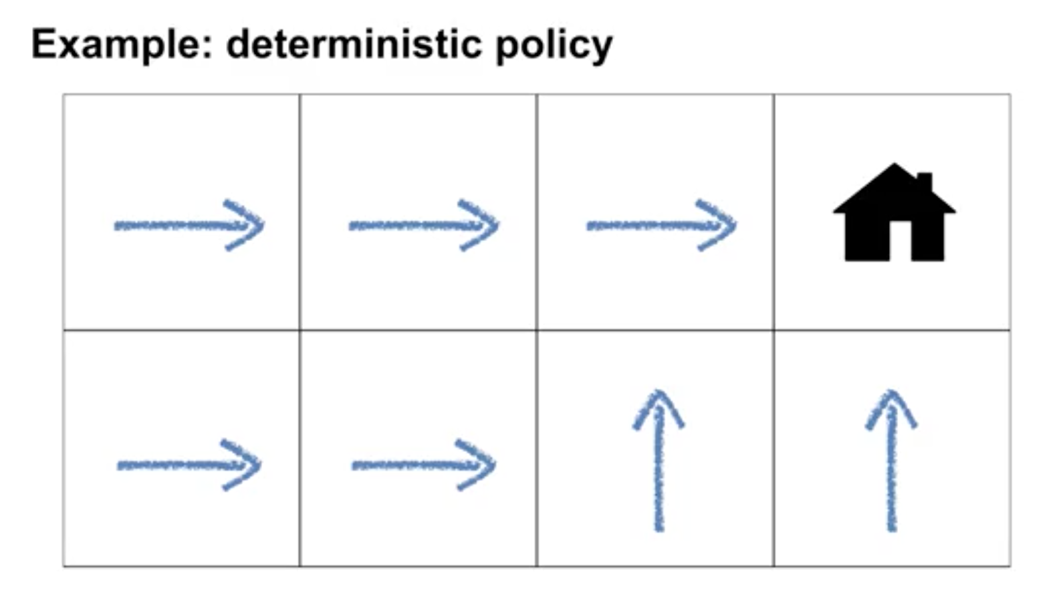
Example of Deterministic and Stochastic policy
Deterministic policies: a policy assigns probabilities to each action in each state.
Stochastic policy: a policy where multiple actions may be selected with non-zero probability.

Slide 10
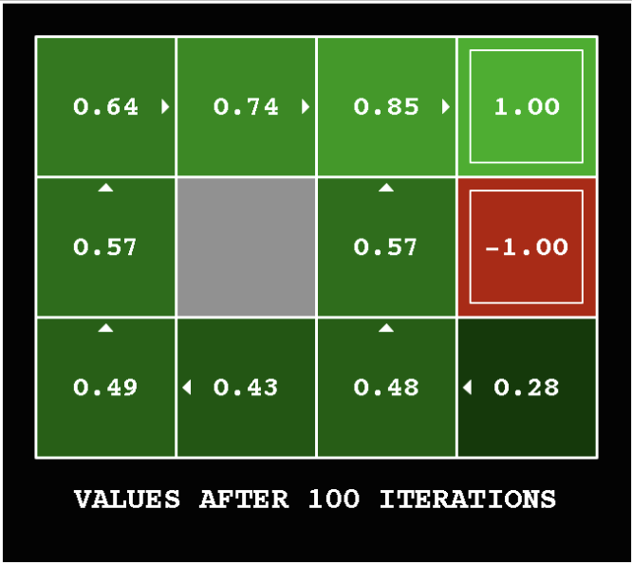
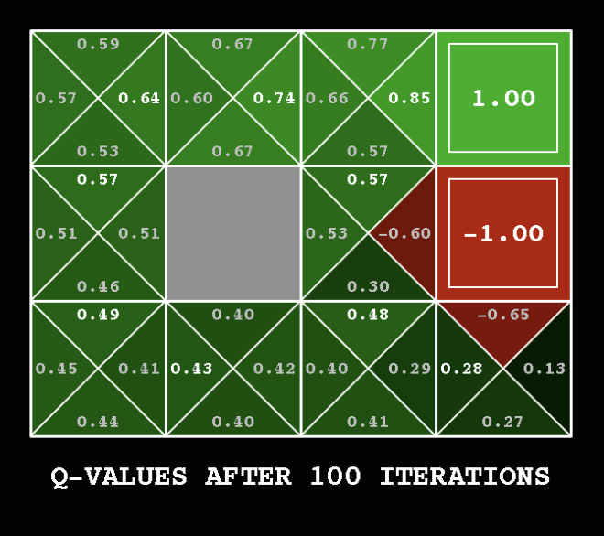
Optimal Policy vs Value Function

