Slide 1
Kinds of RL Algorithms

Slide 2
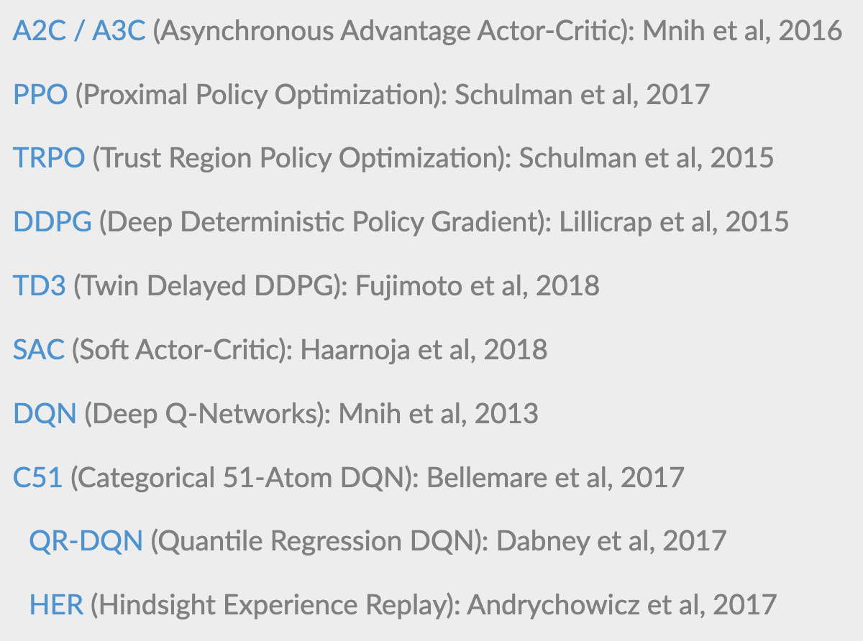
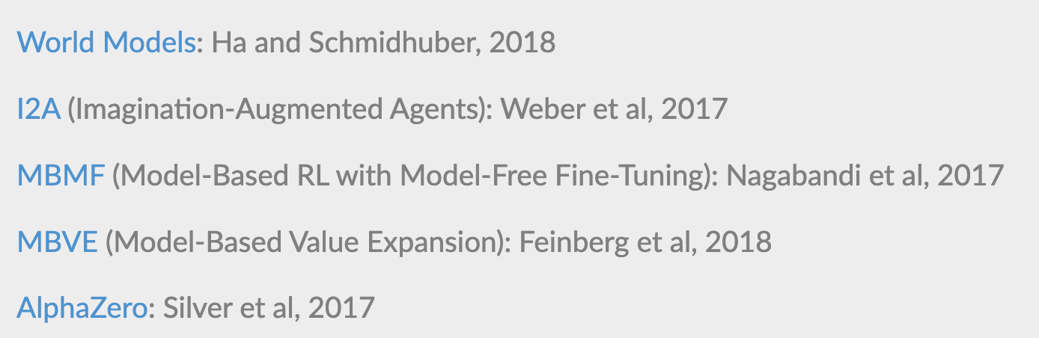
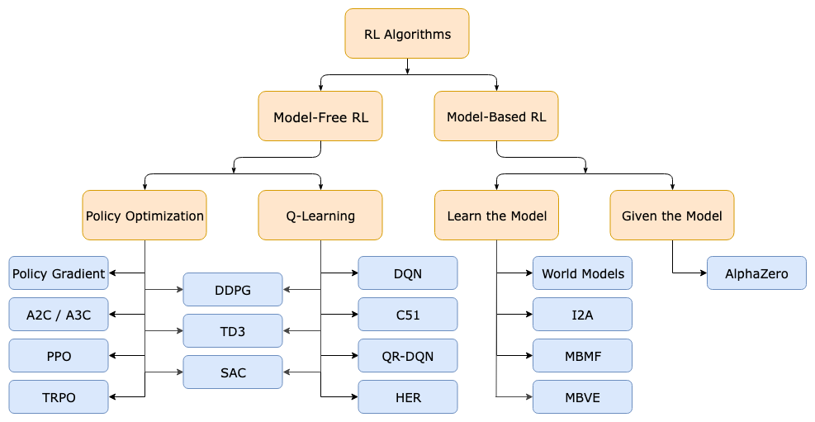
A Taxonomy of
RL Algorithms
A non-exhaustive, but useful taxonomy of algorithms in modern RL.

Slide 3
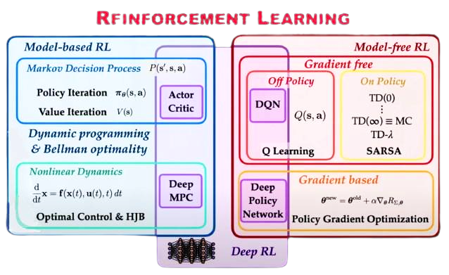
Reinforcement Learning

Slide 4
Inputs
(Distribution of Random Variables)
Model-based
(Generate the transition probability and transition reward matrices)
Model-free
(Simulator/ Real system)
Dynamic Programming Algorithm
(Policy Iteration/ Value
Iteration or LP)
RL. Algorithm
(Q-Learning/ SARSA)
Optimal Solution
Approximate - Near
Optimal Solution

Slide 5
Common Approaches

Slide 6
Dynamic Programming
Policy Evaluation
Policy Improvement
Policy Iteration
Monte-Carlo Methods
Temporal-Difference Learning
Bootstrapping
Value Estimation
SARSA: On-Policy TD control
Q-Learning: Off-policy TD control
Deep Q-Network
Combining TD and MC Learning
Policy Gradient
Policy Gradient Theorem
REINFORCE
Actor-Critic
A3C
Evolution Strategies

Slide 7
Model-based
Dynamic Programming
When the model is fully known, following Bellman equations, we can use Dynamic Programming (DP) to iteratively evaluate value functions and improve policy.
In Policy Iteration algorithms, you start with a random policy, then find the value function of that policy (policy evaluation step), then find an new (improved) policy based on the previous value function, and so on. In this process, each policy is guaranteed to be a strict improvement over the previous one (unless it is already optimal).
In Value Iteration, you start with a random value function and then find a new (improved) value function in a iterative process, until reaching the optimal value function. Notice that you can derive easily the optimal policy from the optimal value function.
Policy iteration is generally faster than value iteration as policy converges more quickly than value function.

Slide 8
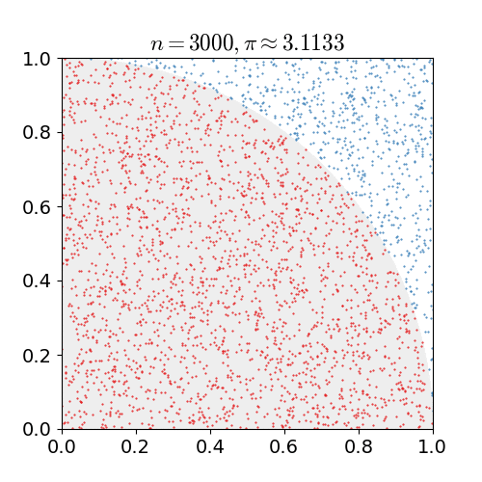

Monte Carlo: Learn from experiences
N is the number of times a dot was put inside the circle
Any method which solves a problem by generating suitable random numbers, and observing that fraction of numbers obeying some property or properties, can be classified as a Monte Carlo method.

Slide 9
Monte Carlo off-policy vs. on-policy
The story of Monte Carlo learning does not end here. There is another set of algorithms under this which are called off policy Monte Carlo methods. Off policy methods try to learn an optimal policy using returns generated from another policy.
The on policy methods is basically like learning while doing the job. Whereas off policy methods are like learning while watching other people doing the job.
The Monte Carlo method for reinforcement learning learns directly from episodes of experience without any prior knowledge of MDP transitions.

